Slide 1

Prioritizing with the Kano Model
Instructor:
Dr. Sushil Kumar
Assistant Professor
Entrepreneurship , IIM Visakhapatnam

Slide 2

What is the Kano Model?
The Kano Model was created by the Japanese professor Noriako Kano in 1980 while studying what affects customer satisfaction and loyalty.
The Kano model shows that even if more features add to your products, it doesn’t mean that customer satisfaction will also increase accordingly.
No matter how good the features are, some do not create positive customer satisfaction.

Slide 3
How does Kano Model work?
According to the Kano model, there are five different customer expectations when adding a new feature.
The expectations can range from dissatisfaction to features that delight the customer.
You can illustrate the relationship between customer satisfaction and the features using a graph in which customer satisfaction is on the Y-axis, and the investment for the feature implementation is on the x-axis.
Therefore you can view the Kano model as an approach that defines the customer satisfaction vs. feature investment model.

Slide 4
Customer expectation categories
These five categories again can be divided into two types features you should avoid and features you need to include.
Features to avoid -customers are indifferent or dissatisfied with these features.
Features to implement - features that have basic, desired, and delightful qualities.

Slide 5
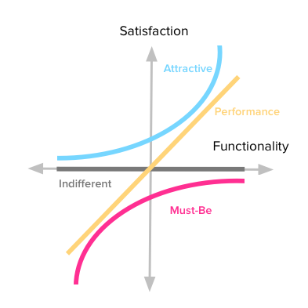

Slide 6
.
Basic expectations or mandatory features
Basic expectations are the features that must be present in the product, but they never increase customer satisfaction since they expect them to be in the product.
However, if the features are not present, it will highly satisfy the customer.
Desired features or satisfiers
Desired features which are also known as performance features.
These are features that either increase or decrease customer satisfaction.
These are the features customer usually want to see in a product. If there are more features, the more it will satisfy the customers. Take a phone battery as an example. The more battery capacity the phone has, the happier the customers will be.
Dissatisfaction Features
These are the features that tend to upset or dissatisfy the customer. For example, let's say you have search functionality and need your customers to include the search term in only capital letters to search for something. While few customers might not mind this requirement, it will dissatisfy most customers because they need to switch to capital mode whenever they need to search for something

Slide 7
Delightful features or delighters
Features in this third category are the features that customers usually do not expect, but they will delight the customer when present. In other words, if these features are not there, it does not cause customer dissatisfaction. For example, if you are running a restaurant, serving something free with a meal will greatly satisfy the customer. Another example is that the more discounts the user get, the happier customers are. The most notable thing about these features is they are easy to implement at a small cost. However, their presence can have a higher degree of satisfaction that can grow exponentially.
Features with indifferent quality
These are some features you need to refrain from introducing these features to your product because they do not provide customer satisfaction or dissatisfaction. In short, customers will be indifferent to such features. For example, say you are in a call center, and the operators speak like native English speakers in a non-English country. It is unnecessary to sound like you speak native English, and customers may not appreciate it.

Slide 8
How can product teams use the Kano Model for feature Prioritization?
You can implement this model in three simple steps.
These 3 questions will be present for each feature you have as a consideration for your product:
How do you feel if this feature is present in our product?
What is your reaction if you do not have this feature?
How important is this feature for you?
Provide answers using a scale:
I like it that way
I expect it to be that way
I am neutral
I can live with it that way
I dislike it that way

