Slide 1
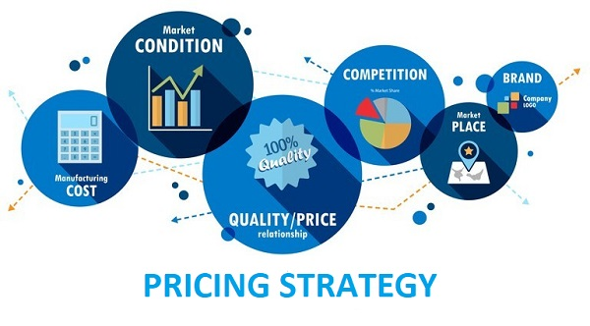
Pricing and pricing strategies
Mdp: 22-11-2020
Notes:
A very Good evening all!!
Lets begin with our session

Slide 2
Key takeaways
How should a price be set on a product or service for the first time?
How should the price be adapted to meet varying circumstances and opportunities?
When should the company initiate a price change, and how should it respond to a competitor’s price change?

Slide 3


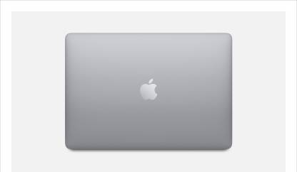
CUSTOMER-BASED BRAND EQUITY
Customer Centric Approach to this concept of finding the worth of a branded product vis-a-vis a generic un-branded product
It is the differential consumer response to the different brand
INR 30000
INR 75000
Notes:
Now let’s consider the second classification of brand equity which is customer-based brand equity
Customer Based Brand Equity or CBBE takes a Customer Centric Approach of finding the worth of a branded product vis-a-vis a generic un-branded product. Brand equity is the differential consumer response to the different brand. For instance, you won’t respond Lenovo laptops and Apple Macbook in the same manner. Note here that customers’ responses includes willingness to pay, purchase intention, attitude, perception and association etc.
Here the catch is, differences in the responses. So if the customers respond better to the marketing of a brand name say the Apple Macbook; than just a generic laptop, then Apple has positive CBBE.
So if we consider consumers’ willingness to pay as an response, then if adding logo of the brand apple to a generic laptop leads to substantial change in their willingness to pay let’s say from 30000 to 75000 then we can conclude that Brand apple enjoys differential effect and have high CBBE.
Note that this is not the actual price but wiliness to pay , which is acts as a consumers’ response. Actual price difference will account for FBBE.
Another important implication of CBBE is when Brand or organisation is considering Brand extension through offering extended product line. In such scenario users are more willing to adjust to price increases, if at all parent Brand enjoys high brand equity.

Slide 4
Hitachi vs. General Electric (GE)
Jointly owned a factory in England
Hitachi was able to sell televisions at a price premium of $75 over the GE televisions
Hitachi sold twice as many TV sets
Notes:
Lets discuss now a very interesting story of Hitachi vs. General Electric (GE).
At one time, Hitachi and General Electric (GE) jointly owned a factory in England which apparently manufactured identical televisions for the two companies. The only difference was the brand name on the television.
As a result of brand name, Hitachi was able to sell televisions at a price premium of $75 over the GE televisions. Moreover, Hitachi sold twice as many TV sets as GE despite its higher price
A well-designed and marketed product can command a price premium and reap big profits.

Slide 5
Backdrop pricing
Not just a number on the tag
Only element of the marketing mix that produces revenue; the other elements produce costs
Pricing decisions are complex and difficult
Influenced by many factors in making pricing decisions—the company, the customers, the competition, the marketing environment, firm’s marketing strategy and its target markets and brand positionings.
Standardisation or “Strictly one-price policy,” new idea toward organised retailing and integrated communication
Notes:
Price is the one element of the marketing mix that produces revenue; the other elements produce costs. Price also communicates to the market the company’s intended value positioning of its product or brand.
Pricing decisions are clearly complex and difficult, and many marketers neglect their pricing strategies. Holistic marketers must take into account many factors in making pricing decisions—the company, the customers, the competition, and the marketing environment. Pricing decisions must be consistent with the firm’s marketing strategy and its target markets and brand positionings.
What do you see as tipping point in setting price

Slide 6
Steps in Setting a Pricing Policy
Pricing decision is formed at several junctures
  At the time of introduction of new product
  At the time of introduction of new distribution channel or geographical area
  At the time of reintroduction of the product
Single firm can have different price points
For instance, Marriott’s hotel brands : Marriott Vacation Club—Vacation Villas (highest price), Marriott Marquis (high price), Marriott (high-medium price), Renaissance (medium-high price), Courtyard (medium price), TownePlace Suites (medium-low price), and Fairfield Inn (low price).

Slide 7
Steps in Setting a Pricing Policy
1. Selecting the Pricing Objective
2. Determining Demand
3. Estimating Costs
4. Analyzing Competitors’ Costs, Prices, and Offers
5. Selecting a Pricing Method
6. Selecting the Final Price

Slide 8
Step 1: Selecting the pricing objective
Survival
Maximize current profits
Maximize their market share
Maximum market skimming
Overcapacity, intense competition, or changing consumer wants
As long as prices cover variable costs and some fixed costs, the company stays in business
Estimate the demand and costs associated with alternative prices
Maximum current profit, cash flow, or rate of return investment
Competitive markets firm can maximize their market share
Used when market is highly price sensitive
Market-penetration pricing
Assertion that higher sales volume will lead to lower unit costs and higher long-run profit
Notes:
What can guide pricing decision

Slide 9
pricing objective
Maximum market skimming
Product-quality leadership
Setting high prices to maximize market skimming.
“Skim” the maximum amount of revenue from the various segments
For instance, Sony and Apple
Fatal in case competitor fixes low price. E.g., Philips videodisc vs Japanese competitors
High price communicates the image of a superior product
Products or services characterized by high levels of perceived quality, taste, and status with a price
Starbucks, Aveda, BMW, and Viking

Slide 10
Discussion question
Many companies engage in “market skimming,” offering new products at whatever price the market will bear, then over time decreasing the price in order to gain the maximum profit from each market segment. Can you think of any products that wouldn’t fit this pricing model? Why not?

Slide 11
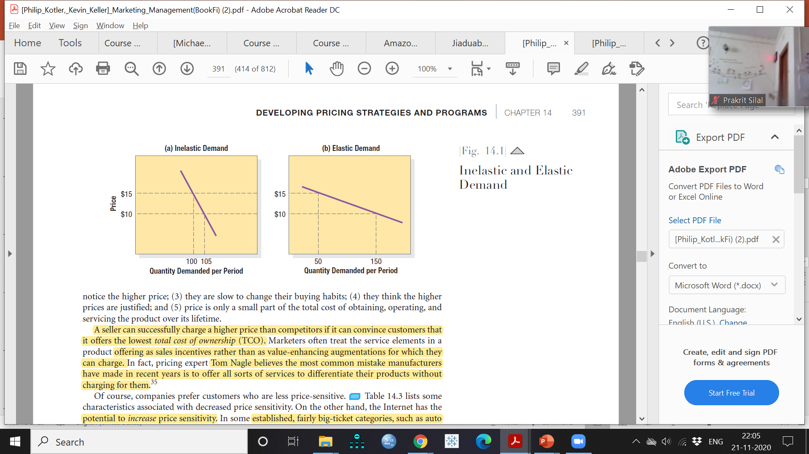
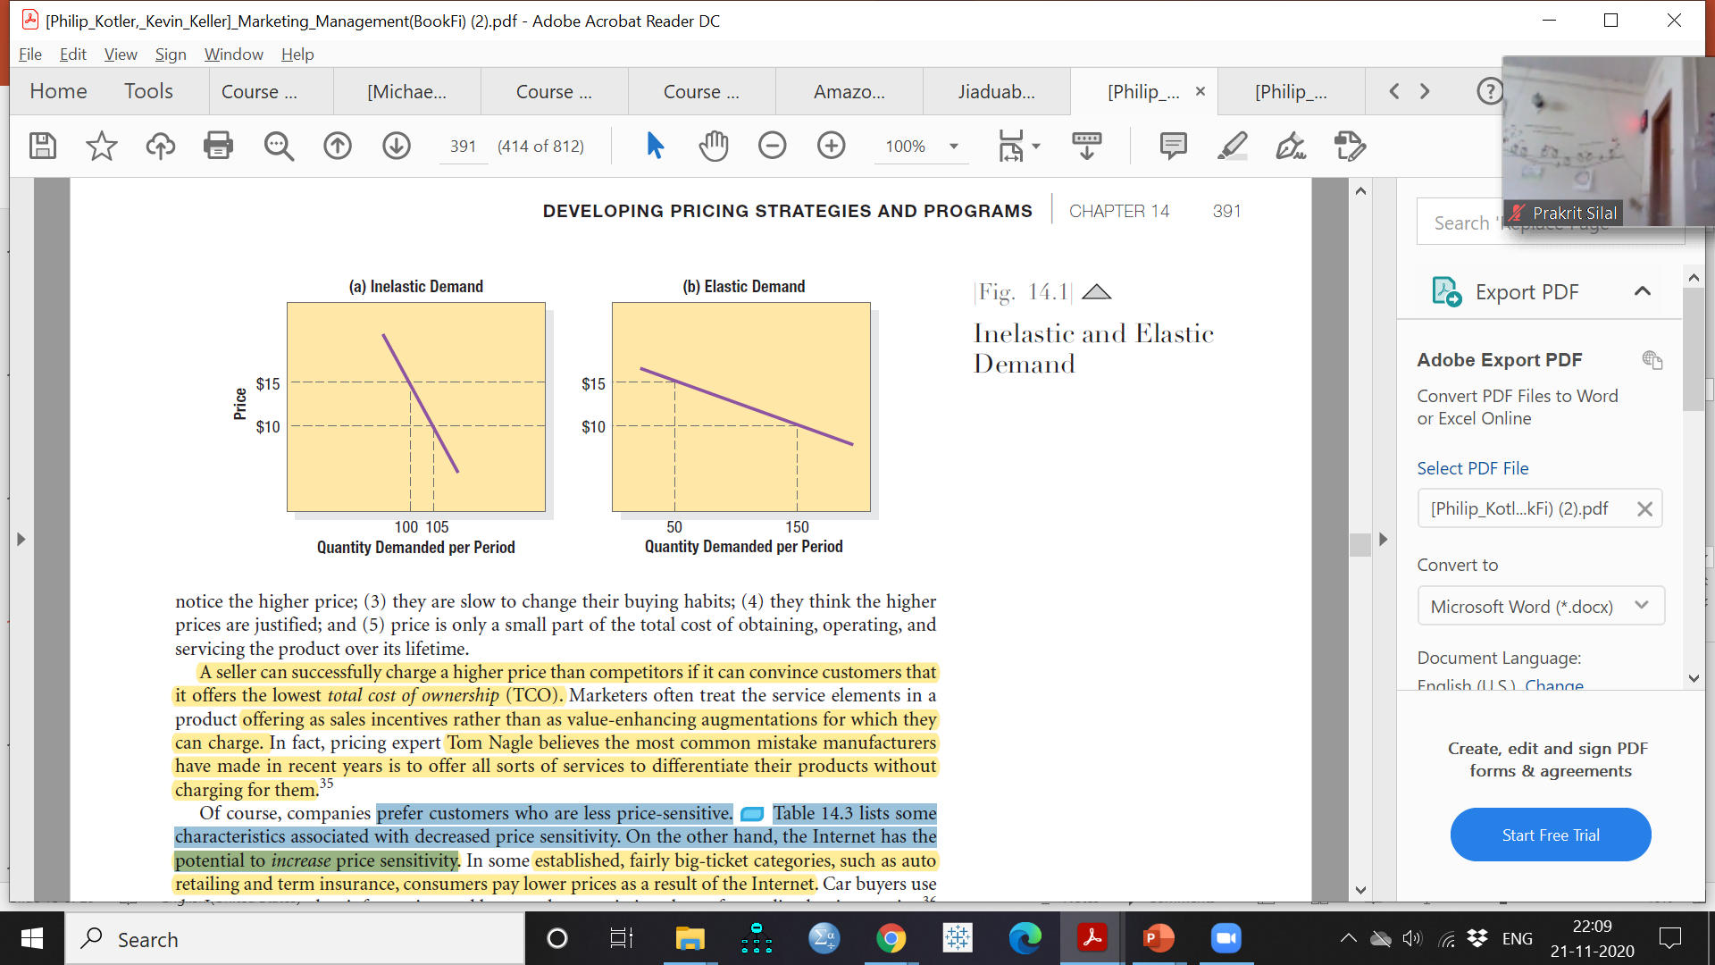
Step 2: Determining Demand
Price sensitivity And Demand elasticity
  Each price will lead to a different level of demand depicted by demand curve.
  Demand curve is downward sloping based on the law of demand suggest higher the price lower the demand (Figure 2)
  For prestige goods,the demand curve sometimes slopes upward e.g., luxury goods.
  How responsive, or elastic, demand is to a change in price is known as elasticity of demand. (Figure 2.(b).)
  Companies prefer customers who are less price-sensitive and more loyal to the brand (Tom Nagle )
    The product is more distinctive.
    Buyers are less aware of substitutes.
    Buyers cannot easily compare the quality of substitutes.
    The expenditure is a smaller part of the buyer’s total income.
    The product is assumed to have more quality, prestige, or exclusiveness.

Slide 12
Step 2: Determining Demand: Total Cost of Ownership (TCO)
Total Cost of Ownership (TCO)
  Convince customers that product offers the lowest total cost of ownership
  Offer all sorts of services to differentiate their products while charging for them.
  Treat the service elements as value-enhancing augmentations (Can be charged for) rather than sales incentives.

Slide 13
Step 3: Estimating Cost
Demand sets a ceiling on the price. Costs set the floor
Price that covers its cost of producing, distributing, and selling the product, including a fair return for effort and risk
Types of Cost and Levels of Production
  Fixed costs (overhead)
  Variable cost
  Total cost= Fixed costs (overhead) + Variable cost
  Average cost is the cost per unit at that level of production; it equals total costs divided by production.
  Two ways of reducing cost: with production scale and experience.

Slide 14
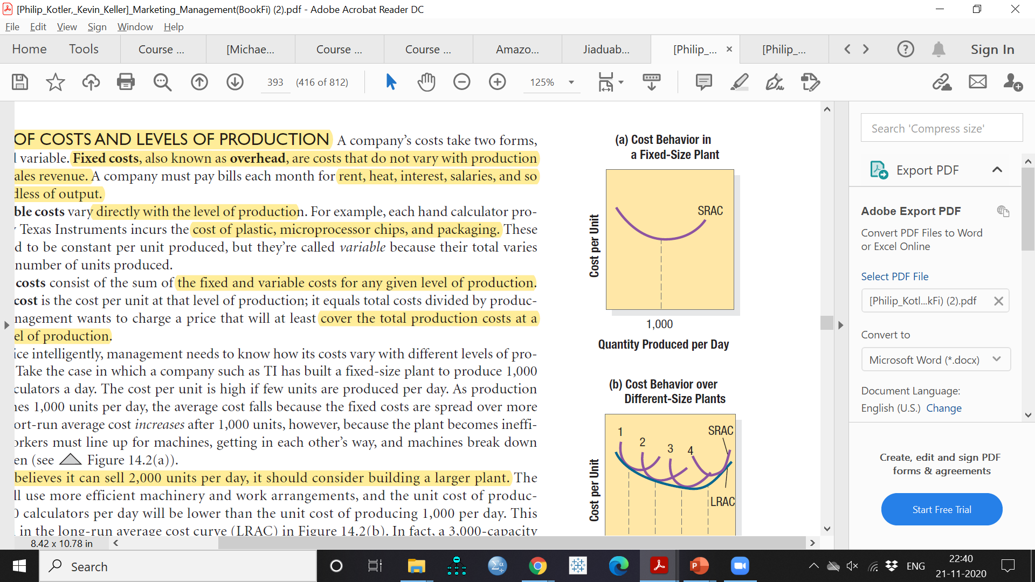
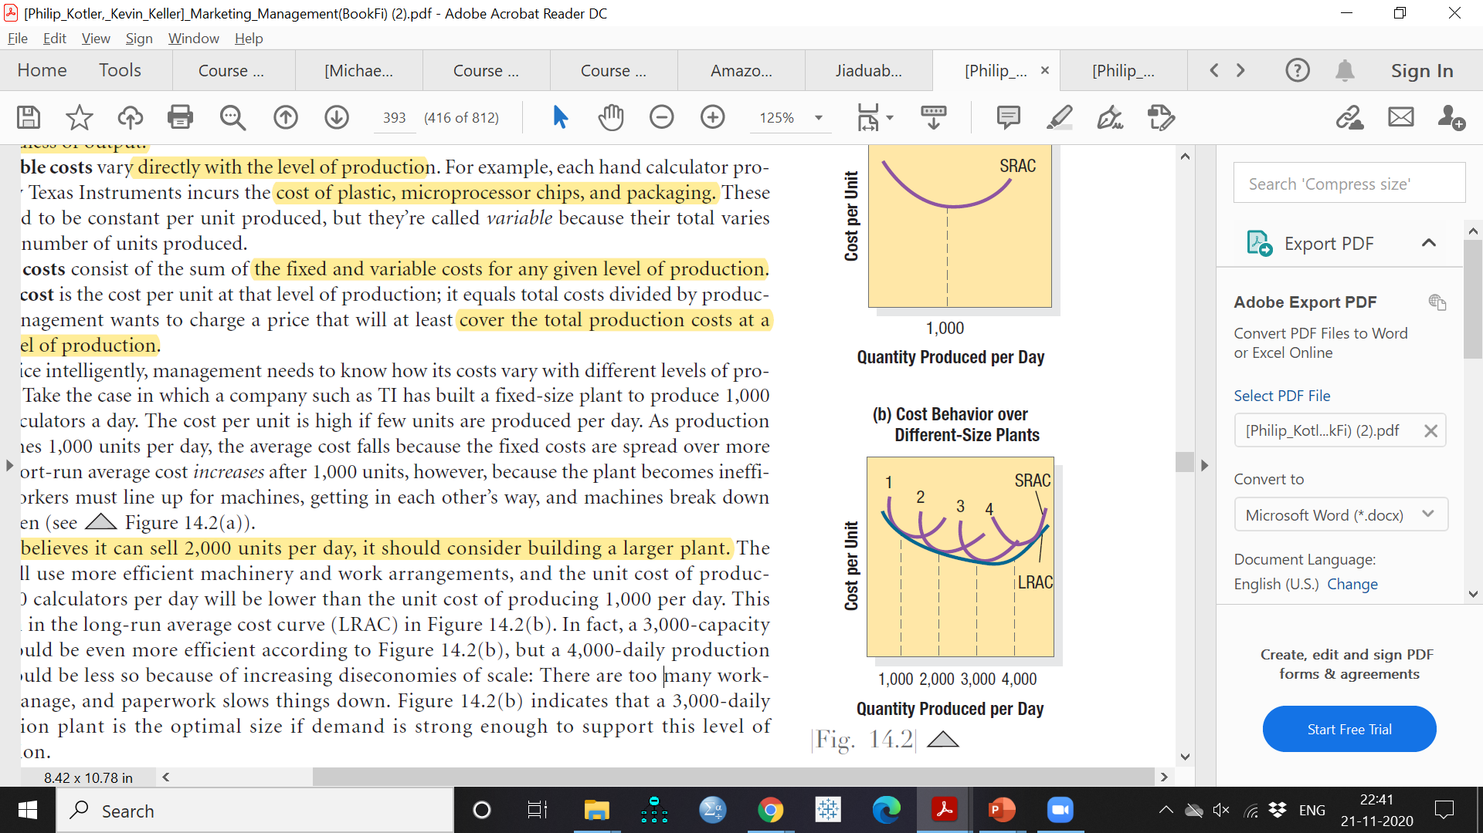
Management needs to know how its costs vary with different levels of production.
Let’s say company TI has a fixed-size plant to produce 1,000 hand calculators a day (Figure 3.a).
Cost per unit is high if few units are produced per day.
As production approaches 1,000 units per day, the average cost falls because the fixed costs are spread over more units.
Figure 3 (b) If TI believes it can sell 2,000 units per day, it should consider building a larger plant 2
Long-run average cost curve (LRAC) curve is the envelope of the short run average total cost
Increasing diseconomies of scale after SRAC 3
Figure 3: Cost curves (Source: Kotler and Keller, Marketing management, 14e)

Slide 15
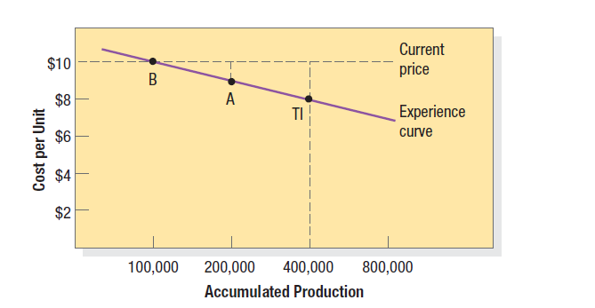
Accumulated Production: The
Experience Curve
With production of more hand calculators, methods improve, Workers learn shortcuts, materials flow more smoothly, and procurement costs fall.
Average cost falls with accumulated production experience (Figure 4)
This decline in average cost with accumulated production experience is called the experience curve or learning curve.
Figure 4: Cost per Unit as a Function of Accumulated Production: The Experience Curve (Source: Kotler and Keller, Marketing management, 14e)

Slide 16
Target costing
Cost can also change as a result of a concentrated effort by designers, engineers, and purchasing agents.
Target is the price less desired profit margin leaves the target cost the marketer must achieve.
Examine each cost element—design, engineering, manufacturing to bring down costs i.e, Target costing

Slide 17
Aldi retail stores
Aldi stocks only about 1,000 (vs. 20000 SKU competitors) of the most popular everyday grocery and household items.
  All the products carry Aldi’s own exclusive label.
  Strong control over quality and price and simplify shipping and handling, leading to high margins
  With more than 8,200 stores worldwide currently, Aldi brings in almost $60 billion in annual sales

Slide 18
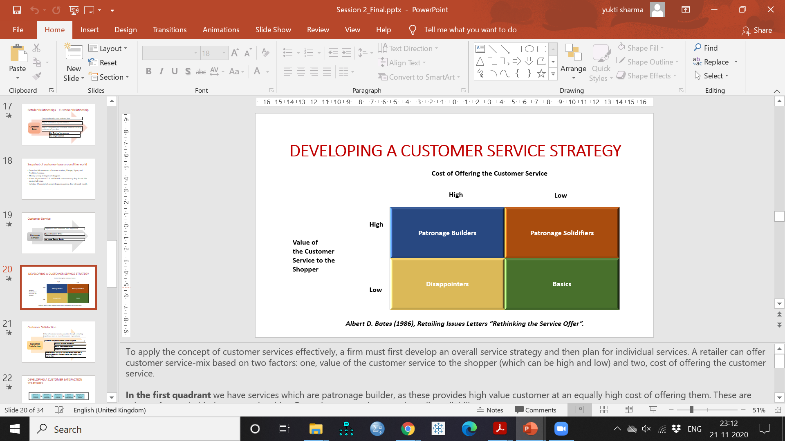
Step 4: Analyzing Competitors’ Costs, Prices, and Offers
Firm must take competitors’ costs, prices, and possible price reactions into account.
Features not offered by the nearest competitor, should evaluated for its worth to the customer and add that value to the competitor’s price. Vis-a-versa.
Competitors are most likely to react when the number of firms is few, the product is homogeneous, and buyers are highly informed
Notes:
Positioning map

Slide 19
Step 5: Selecting a Pricing Method
Given the customers’ demand schedule, the cost function, and competitors’ prices, the company is select a price
Three major considerations in price setting
  Costs set a floor to the price
  Competitors’ prices and the price of substitutes
  Customers’ assessment of unique features

Slide 20
Selecting a Pricing Method
Pricing Method
Mark-up pricing
Target-Return Pricing
Value Pricing
Going-Rate Pricing

Slide 21
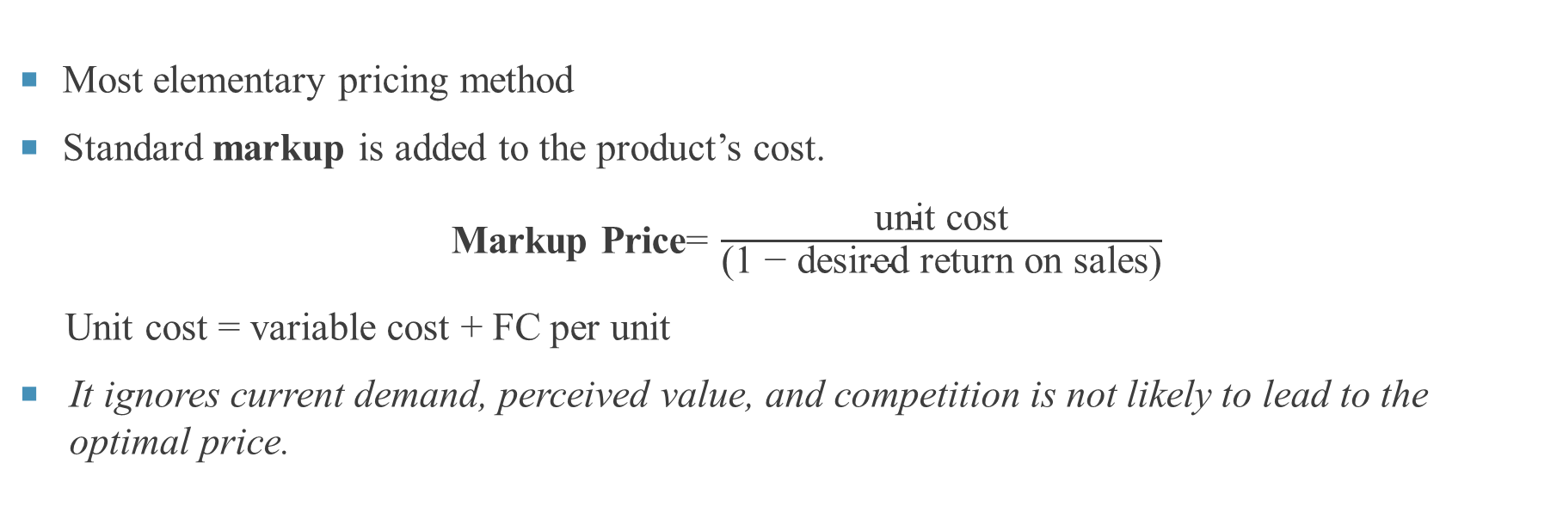
A. Markup Pricing
Most elementary pricing method
Standard markup is added to the product’s cost.
  Markup Price= $\frac{\text{unit} \text{cost}}{\text{(1 − }\text{desired} \text{return} \text{on} \text{sales}\text{)}}$
  Unit cost = variable cost + FC per unit
  It ignores current demand, perceived value, and competition is not likely to lead to the optimal price.

Slide 22
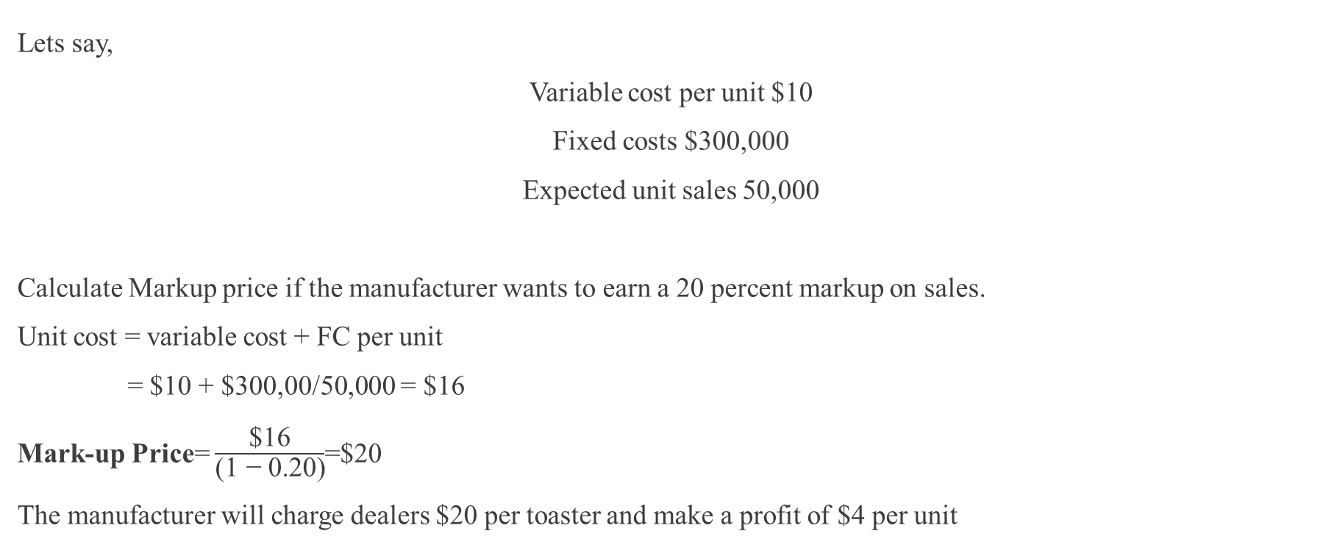
Illustration
Lets say,
Variable cost per unit $10
Fixed costs $300,000
Expected unit sales 50,000
Calculate Markup price if the manufacturer wants to earn a 20 percent markup on sales.
Unit cost = variable cost + FC per unit
= $10 + $300,00/50,000 = $16
Mark-up Price= $\frac{\text{\$16}}{\text{(1 − }\text{0.20}\text{)}}$=$20
The manufacturer will charge dealers $20 per toaster and make a profit of $4 per unit

Slide 23
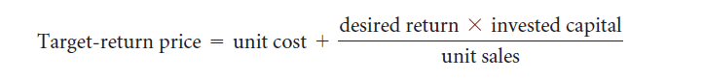

B. TARGET-RETURN PRICING
Firm determines the price that yields its target rate of return on investment.
In previous example Suppose the manufacturer has invested $1 million in the business and wants to set a
price to earn a 20 percent ROI, specifically $200,000. The target-return price is given by the following:

Slide 24
C. PERCEIVED-VALUE PRICING
Based on the customer’s perceived value.
Perceived value comprises of buyer’s image of the product performance, the channel deliverables, the warranty quality, customer support, and softer attributes such as the supplier’s reputation, trustworthiness, and esteem.
Firms use the marketing program elements, such as advertising, sales force, and the Internet, to communicate and enhance perceived value in buyers’ minds

Slide 25
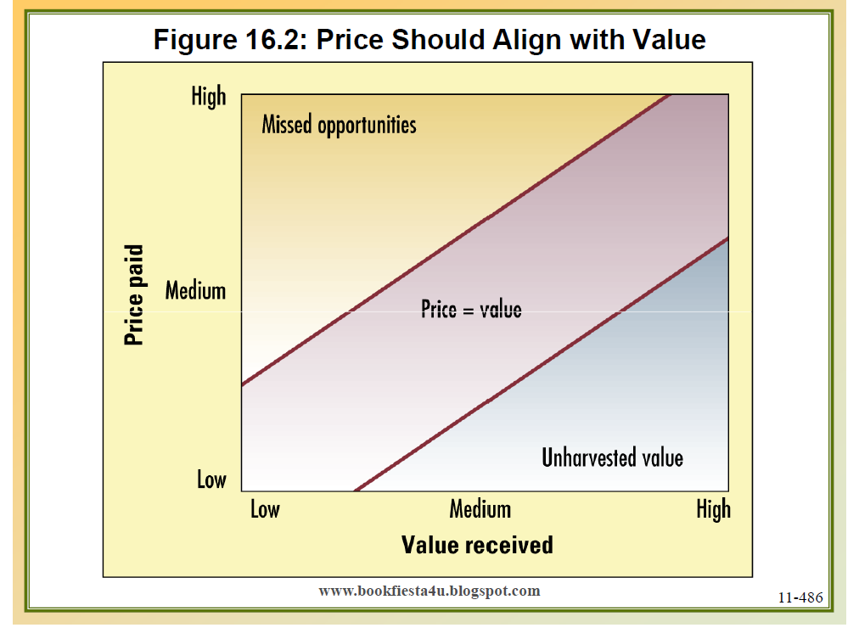
Price Should Align with Value
Figure 6: Price-value dynamics (Kotler and Keller, Marketing management, 14e)

Slide 26
Caterpillar
Caterpillar uses perceived value to set prices on its construction equipment.
Price its tractor at $100,000, although a similar competitor’s tractor might be priced at $90,000.
$90,000 is the tractor’s price if it is only equivalent to the competitor’s tractor
$7,000 is the price premium for Caterpillar’s superior durability
$6,000 is the price premium for Caterpillar’s superior reliability
$5,000 is the price premium for Caterpillar’s superior service
$2,000 is the price premium for Caterpillar’s longer warranty on parts
$110,000 is the normal price to cover Caterpillar’s superior value
– $10,000 discount
$100,000 final price

Slide 27
value-based pricing
Right product at a right price—to better meet consumer needs
Customer-focused pricing approach
Setting prices primarily based on a consumer's perceived value of a product
Value pricing is thus not a setting lower prices
Reengineering the company’s operations to become a low-cost producer without sacrificing quality
Notes:
In the terms of layman, value-based pricing means selling the right product at the right price—to better meet consumer needs. Thus, it involves setting prices primarily based on a consumer's perceived value of a product. Value pricing is customer-focused approach of pricing requiring firms to base their pricing on how much the customer believes a product is worth.
<Can you think of a brand employing value-based pricing approach>

Slide 28
Value –pricing approach
Product design and delivery
Product Costs
Product price
Value-added Products
New and Improved products
Reducing product cost without sacrificing quality
What is the price-premium customer willing to pay over product costs.
Notes:
The objective of value pricing is to uncover the right blend of product design and delivery , product costs, and product prices that fully satisfies the needs and wants of consumers and also generates sufficient profit targets of the firm.
We look at each of these three elements below. First, To use value-pricing product must have value-added features and its price premiums must be backed by proper investments. Secondly, to charge value-based pricing, product cost must be optimized by reducing extra-cost or overhead not appreciated by customers, and Thirdly, product price must be determined by What is the price-premium customer willing to pay over product costs.
Lets discuss these one by one.

Slide 29
Everyday low pricing (EDLP)
This method was noted in 1994 by Walmart retail chain in the united states
Pricing strategy promising consumers a low price without the need to wait for sales-offer and seasons
Benefits
Less advertising for promotional prices
Simpler inventory management systems
More predictable consumer
Fewer supply-chain problems.
Higher brand loyalty
Notes:
Everyday low pricing (also abbreviated as EDLP) is a popular method for determining price discounts and promotions.
Everyday low pricE is a pricing strategy promising consumers a low price without the need to wait for sales-offer and seasons.
EDLP involves maintaining consistently low prices on major items every day. This method was noted in 1994 by Walmart retail chain in the United States. It buys "feature advertisements“(communicating product on discount) in newspapers on a monthly basis, while its competitors would advertise weekly. Other examples of EDLP are Procter & Gamble.
It results in less advertising for promotional prices, simpler inventory management systems and more predictable consumer demand, fewer stocking and supply-chain problems. It also helps in building brand loyalty

Slide 30
D. Going-Rate Pricing
The firm bases its price largely on competitors’ prices.
In oligopolistic industries that sell a commodity such as steel, paper, or fertilizer, all firms normally charge the same price
Smaller firms “follow the leader,” changing their prices when the market leader’s prices change

Slide 31
Step 6: Selecting the Final Price
IMPACT OF OTHER MARKETING ACTIVITIES
  Brand’s quality and advertising relative to the competition
  Charge premium prices
COMPANY PRICING POLICIES
  Price must be consistent with company pricing policies
GAIN-AND-RISK-SHARING PRICING
  Seller has the option to absorb part or all the risk if it does not deliver the full promised value
IMPACT OF PRICE ON OTHER PARTIES
  How will distributors and dealers feel about the contemplated price
  Will the sales force be willing to sell at that price?
  How will competitors react?
  Will suppliers raise their prices when they see the company’s price?
  Will the government intervene and prevent this price from being charged?

Slide 32
Adapting the Price
Companies usually do not set a single price but rather develop a pricing structure that reflects variations on account of several factors
Several price-adaptation strategies: geographical pricing, promotional pricing, and differentiated pricing.

Slide 33
a. Geographical Pricing (Cash, Countertrade, Barter)
How to price its products to different customers in different locations and countries
Should the company charge higher prices to distant customers to cover the higher shipping costs, or a lower price to win additional business??
How to get paid?
  Many buyers want to offer other items in payment, a practice known as countertrade (15-20% of the entire world trade). Can take following forms
  Barter: The buyer and seller directly exchange goods, with no money and no third party involved.
  Compensation deal: The seller receives some percentage of the payment in cash and the rest in products.
  Buyback arrangement: The seller sells a plant, equipment, or technology to another country and agrees to accept as partial payment products manufactured with the supplied equipment.

Slide 34
b. Promotional Pricing (To stimulate early purchase)
Loss-leader pricing
Special event pricing
Special customer pricing
Cash rebates
Followed by Supermarkets and department stores
Drop the price on well-known brands to stimulate additional store traffic
Special prices in certain seasons
Special prices exclusively to certain customers
Encourage intermediary to purchase of the manufacturers’ products within a specified time period

Slide 35
b. Promotional Pricing (To stimulate early purchase)
Longer payment terms
Warranties and service contracts
Psychological discounting.
Low-interest financing
Automakers have used no-interest financing to try to attract more customers.
Stretch loans over longer periods and lower the monthly payments.
free or low-cost warranty or service contract.
For example, “Was $359, now $299.”

Slide 36
c. Differentiated Pricing
Adjust basic price to accommodate differences in customers, products, locations.
Price discrimination occurs when a company sells a product or service at two or more prices
In first-degree price discrimination, the seller charges a separate price to each customer depending on the intensity of his or her demand.
In second-degree price discrimination, the seller charges less to buyers of larger volumes
In third-degree price discrimination, the seller charges different amounts to different classes of buyers. For instance, seniors, adults, and children.

Slide 37
third-degree price discrimination
Customer-segment pricing
Different customer groups pay different prices for the same product or service.
Product-form pricing
Different versions of the product are priced differently
Image pricing
Some companies price the same product at two different levels based on image differences.
Channel pricing
Coca-Cola carries a different price depending on whether the consumer purchases it in a fine restaurant, a fast-food restaurant, or a vending machine.
Location pricing
Priced differently at different locations even though the cost of offering it at each location is the same
Time pricing
Prices are varied by season, day, or hour

Slide 38
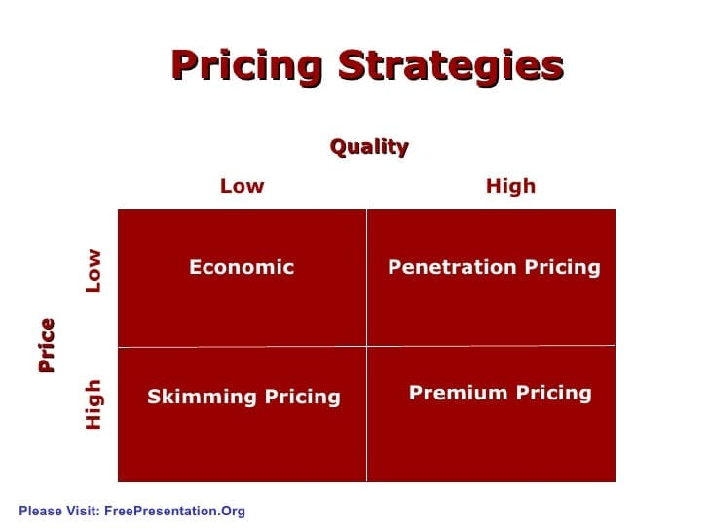
SUMMARISE

