Slide 1
Pricing and Revenue Management
Milan Kumar
IIM Visakhapatnam

Slide 2
Introduction
Implicit assumption so far has been that demand cannot be influenced
In reality, this is not true
Demand level changes can be made through:
  Advertising, displays, and promotional tools
  Pricing

Slide 3
Dell’s Pricing Strategy
Product price different based on type of customer
Product price varies over time
Prices of options offered also vary over time

Slide 4
Other Examples
IBM is investigating software that will allow it to adjust prices according to demand
Nikon Coolpix Digital Camera sold for about $600
  Manufacturer provides a rebate of $100 independently of where the camera is purchased
Boise Cascade Office Products sells many products on-line
  Prices for the 12,000 items ordered most frequently on-line might change as often as daily

Slide 5
Questions Related to Pricing
What are these companies doing?
Why does Dell charge a different price for different consumers? At different times?
If Dell can do it, can it work for other companies?
What is the impact of the mail-in rebate?
Should not Nikon and Sharp just reduce the wholesale price paid by the retailers instead of asking the consumer to mail in the coupon?
What is wrong with a traditional fixed-price policy?

Slide 6
Revenue Management Principles
All companies trying to boost profit by using what are know as smart pricing or revenue management techniques
Techniques first pioneered by the airline, hotel, and rental car industries
Airline industry…
  Revenue management has increased revenue significantly
  American Airlines’ estimates of annual incremental revenue of $1 billion through revenue management

Slide 7
Price and Demand
Demand for a product will typically go up as the product’s price goes down
Certain products more or less sensitive to price changes
To find the best price, a manager needs to be able to characterize the relationship between pricing and demand for each product

Slide 8
Markdowns
Assumption in example: demand is deterministic based on price
Realistic picture
  Demand is random
  At the end of a selling season, there may be remaining inventory
      Firms frequently employ a markdown or sale to dispose excess inventory
Think about demand from the customer’s perspective:
  Each customer has a maximum price that he or she is willing to pay for the product
      Reservation price

Slide 9
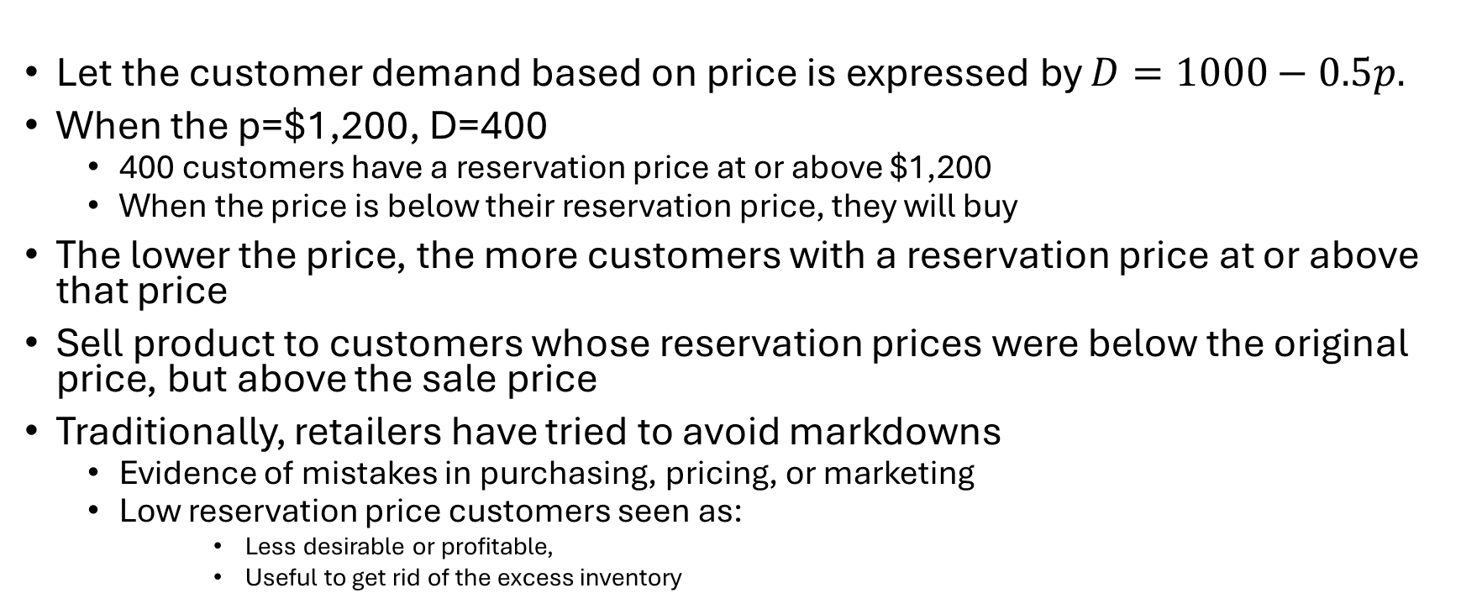
Markdown Concept
Let the customer demand based on price is expressed by $D=1000−0.5p.$
When the p=$1,200, D=400
  400 customers have a reservation price at or above $1,200
  When the price is below their reservation price, they will buy
The lower the price, the more customers with a reservation price at or above that price
Sell product to customers whose reservation prices were below the original price, but above the sale price
Traditionally, retailers have tried to avoid markdowns
  Evidence of mistakes in purchasing, pricing, or marketing
  Low reservation price customers seen as:
      Less desirable or profitable,
      Useful to get rid of the excess inventory

Slide 10
Price Differentiation
Customers who were willing to buy at the sales price were different from the customers who were willing to buy at the original price
In fashion, some customers are very fashion-conscious
  Eager to buy at the start of the selling season
  Willing to pay more to have fashionable items first
Other customers are value-conscious
  Willing to wait until the end of the sales season
  Unwilling to pay the same high prices as the fashionable customers
Different customers charged different prices can result in higher revenue
  Known as price differentiation

Slide 11
Price Differentiation Example
According to the demand–price curve, the retailer charges many customers who are willing to pay a higher price only $1000
About 200 customers willing to pay $1,600
About 100 willing to pay $1,800
By charging a single price, management is leaving a large amount of money on the table

Slide 12
Multi-tiered Pricing Strategy
Money left on the table = (2,000 - 1,000) • 500/2 = 250,000
Consider a differential or customized pricing strategy that tailors pricing to different market segments
Consider a two-price strategy in which the firm introduces two prices, $1,600 and $1,000
  At p=$1,600, there is demand for 200 items
  At p= $1,000, there is demand for 500 items
  Total revenue in this case is 1,600 • 200 + 1,000 • (500 - 200) = 620,000
      $120,000 more than in the single-tier strategy
A three-tier pricing strategy can do even better
  At p=$1,800, D=100; p=$1,600, D=200; p=$1,000, D=500
  Total revenue equals 1,800 • 100 + 1,600 • (200 - 100) + 1,000 • (500 - 200) = 640,000
      $20,000 more than in two-tier strategy

Slide 13
Revenue Management
Selling the right inventory unit to the right type of customer, at the right time, and for the right price
  Integrates pricing and inventory strategies to influence market demand
  Provides controls for companies to improve the bottom line
Revenue management techniques have been traditionally applied in the airline, hotel, and rental car industries
Common characteristics of such industries:
  Existence of perishable products
  Fluctuating demand
  Fixed capacity of the system
  Segmentation of the market based on sensitivity to price or service time
  Products sold in advance

Slide 14
History of Revenue Management
Pioneered by American Airlines in the 1980s
As a counter to new airlines like PeopleExpress
Techniques employed differentiated pricing
Widely successful
  PeopleExpress went out of business
  Other airlines started adopting
  Hotels and rental companies adopted later

Slide 15
Customer Segments in Airline Industry
Leisure travelers
  Highly sensitive to price
  Not generally sensitive to the duration of the trip
  Willing to book non-refundable tickets far ahead of time
Business travelers
  Not particularly price-sensitive
  Highly sensitive to trip duration
  Need high flexibility to adjust their travel plans as needed

Slide 16
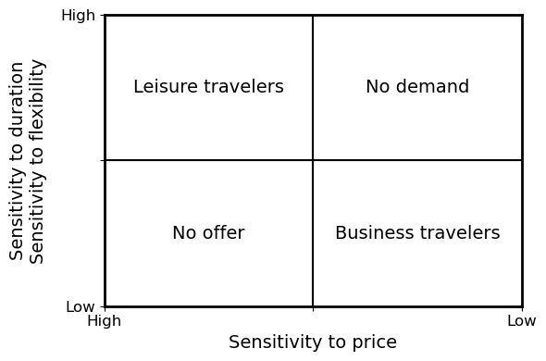
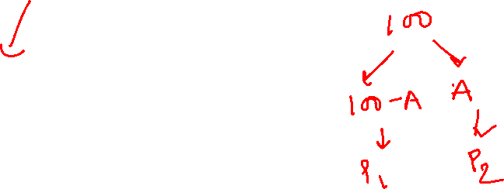
Customer Differentiation in the airline industry

Slide 17
Differential Pricing
“Build fences” to prevent business travelers from moving from the top-left box to the bottom-right box
  Require weekend stays and early booking
The more fare classes, the more fences required
Other factors:
  How many of each type of ticket to offer
  How much to price for each ticket

Slide 18
Revenue Management Systems
Market segmentation
  For a specific time and flight (origin to destination)
  Different products designed and priced to target different market segments
  Products feature different restrictions
      Non-refundable
      Available up to 21 days before the flight
Booking control
  Allocates available seats to fare classes
  Setting limits on the number of seats that can be allocated to lower fare classes
Requires:
  Sophisticated algorithms
  Basic criterion: Equal marginal revenues in each class

Slide 19
Optimal Allocation of Flights
Leisure fare is $100 per ticket
Business fare is $250 per ticket
80 seats on the plane
Company can sell as many seats as they make available at the leisure fare
Business fare is random

Slide 20
Marginal Revenues
Determine expected revenue for each number of allocated seats
Determine expected marginal revenue of business class
  revenue associated with allocating one additional seat can also be calculated
  this decreases as the number of allocated seats increases
Marginal revenue associated with leisure class seats
  unlimited demand for seats implies marginal revenue is constant
Marginal revenue of the two is equal at 18 seats
  18 seats should be allocated to business class

Slide 21
Complexities of the Real Systems
Variety of flight classes
Different hierarchies of classes
More complex demand information
Network management
  A flight can be part of many ultimate origin-destination pairs
  System needs to account for this by allocating seats to particular flights
Prices change over time
  Flight may be expensive on some days and times
  If a plane is not filling up, the airline might increase the allocation of lower price fares to that flight over time

Slide 22
Matching Supply to Demand When Supply Is Fixed
Examples of fixed supply:
  Travel industries (fixed number of seats, rooms, cars, etcetera).
  Advertising time (limited number of time slots).
  Telecommunications bandwidth.
  Size of the M B A program.
  Doctor’s availability for appointments.
Revenue management is a solution:
    If adjusting supply is impossible – adjust the demand!
    Segment customers into high willingness to pay and low willingness to pay.
    Limit the number of tickets sold at a low price, that is, control the average price by changing the mix of customers.
Notes:
Introduction

Slide 23
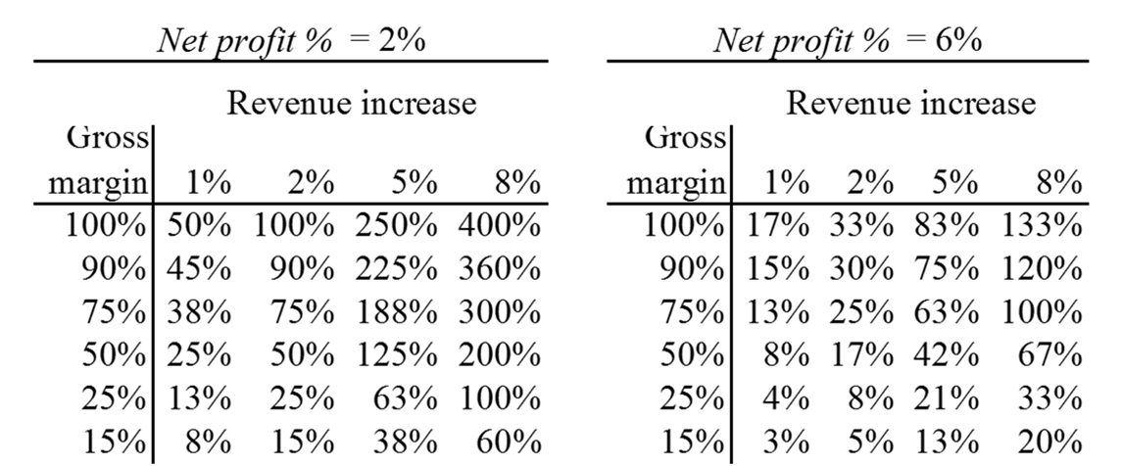
Revenue Management and Margin Arithmetic
Small changes in revenue can have a big impact on profit, especially for high gross margin and low net profit % industries:
Percentage change in profit for different gross margins, revenue increases and net profits as a percentage of revenue.
Access the text alternative for this image.
Notes:
18.1 Revenue Management and Margin Arithmetic
Table 18.1 in text.

Slide 24
Environments Suitable for Revenue Management
The same unit of capacity (for example: airline seat) can be used to deliver services to different customer segments (for example: business and leisure customers) at different prices.
High gross margins (so that the variable cost of additional sales is low).
Perishable capacity (it cannot be stored) and limited capacity (all possible customers cannot always be served).
Capacity is sold in advance of demand.
There is an opportunity to segment customers (so that different prices can be charged) and different segments are willing to pay different prices.
It is not illegal or morally irresponsible to discriminate among customers.
Notes:
18.1 Revenue Management and Margin Arithmetic

Slide 25
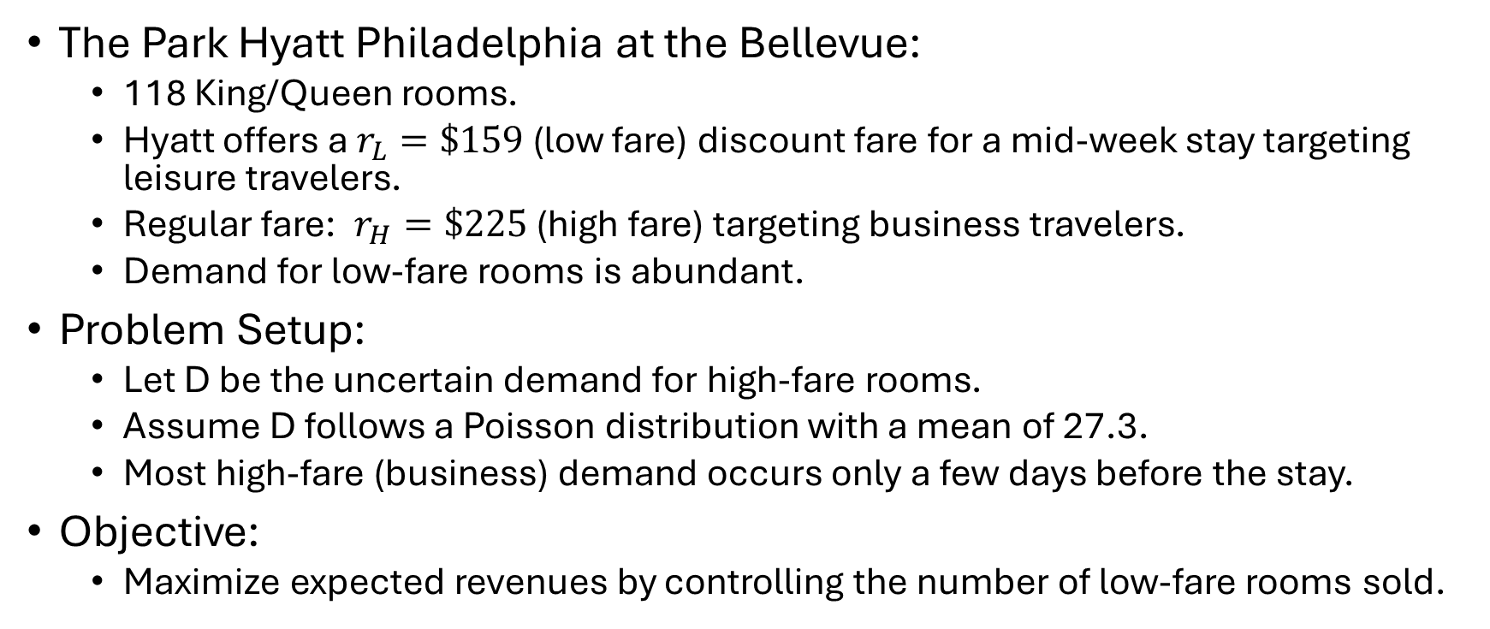
Practical Problem
The Park Hyatt Philadelphia at the Bellevue:
  118 King/Queen rooms.
  Hyatt offers a $r_{L}=\$159$ (low fare) discount fare for a mid-week stay targeting leisure travelers.
  Regular fare: $r_{H}=\$225$ (high fare) targeting business travelers.
  Demand for low-fare rooms is abundant.
Problem Setup:
  Let D be the uncertain demand for high-fare rooms.
  Assume D follows a Poisson distribution with a mean of 27.3.
  Most high-fare (business) demand occurs only a few days before the stay.
Objective:
  Maximize expected revenues by controlling the number of low-fare rooms sold.

Slide 26
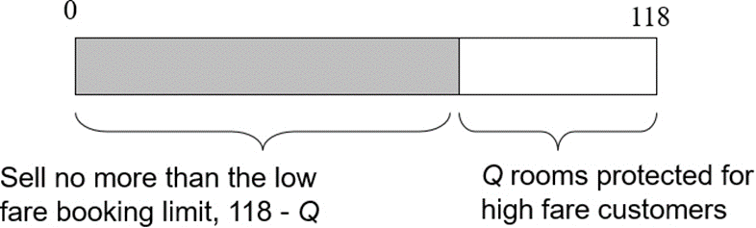
Yield Management Decisions
The booking limit is the number of rooms you are willing to sell in a fare class or lower.
The protection level is the number of rooms you reserve for a fare class or higher.
Let Q be the protection level for the high-fare class.
Q is in effect while you sell low-fare tickets.
Since there are only two fare classes, the booking limit on the low fare class is 118−𝑄.
You will sell no more than low-fare rooms because you are protecting (or reserving) Q rooms for high-fare passengers.
Access the text alternative for this image.
Notes:
18.2 Protection Levels and Booking Limits

Slide 27
The Connection to the Newsvendor
A single decision is made before uncertain demand is realized.
There is an overage cost:
    If D < Q, then you protected too many rooms (you over-protected) . . .
    . . . so some rooms are empty, which could have been sold to a low-fare traveler.
There is an underage cost:
    If D > Q, then you protected too few rooms (you under-protected) . . .
    . . . so some rooms could have been sold at the high fare instead of the low fare.
  Choose Q to balance the overage and underage costs.
Notes:
Choose Q to balance the overage and underage costs.

Slide 28
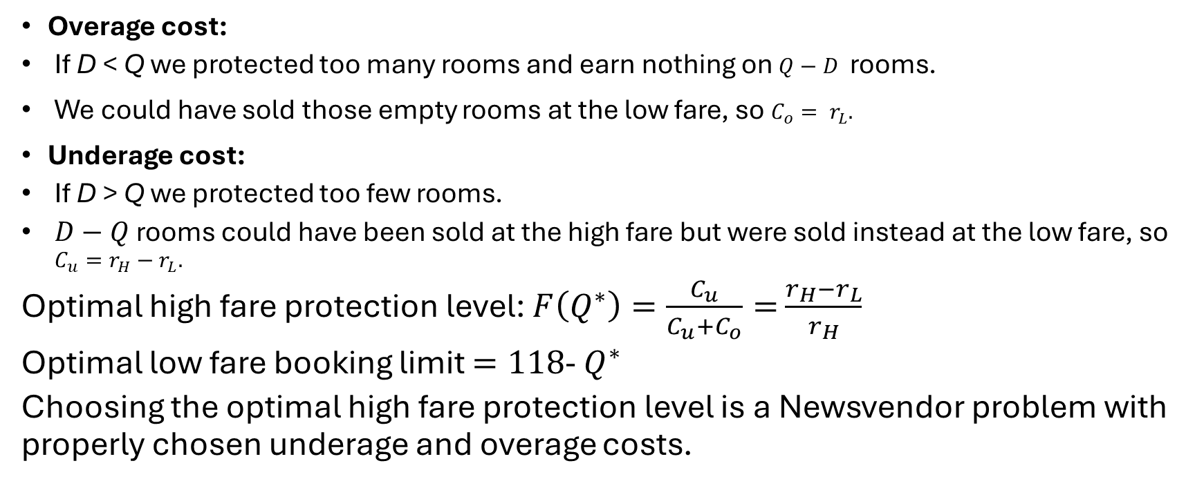
Optimal Protect Level
Overage cost:
  If D < Q we protected too many rooms and earn nothing on $Q−D$ rooms.
We could have sold those empty rooms at the low fare, so $C_{o}= r_{L}.$
Underage cost:
  If D > Q we protected too few rooms.
  $D−Q$ rooms could have been sold at the high fare but were sold instead at the low fare, so $C_{u}=r_{H}−r_{L}.$
  Optimal high fare protection level: $F\left(Q^{∗}\right)=\frac{C_{u}}{C_{u}+C_{o}}=$ $\frac{r_{H}−r_{L}}{r_{H}}$
  Optimal low fare booking limit $=118$- $Q^{∗}$
  Choosing the optimal high fare protection level is a Newsvendor problem with properly chosen underage and overage costs.
Notes:
18.2 Protection Levels and Booking Limits

Slide 29
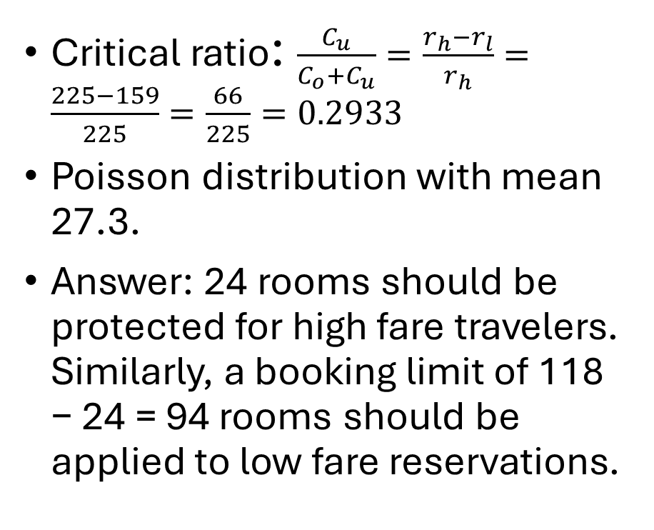
Hyatt Example
Critical ratio: $\frac{C_{u}}{C_{o}+C_{u}}=\frac{r_{h}−r_{l}}{r_{h}}=\frac{225−159}{225}=\frac{66}{225}=0.2933$
Poisson distribution with mean 27.3.
Answer: 24 rooms should be protected for high fare travelers. Similarly, a booking limit of 118 − 24 = 94 rooms should be applied to low fare reservations.
Q | F(Q)
10 | 0.0001
11 | 0.0004
12 | 0.0009
13 | 0.0019
14 | 0.0039
15 | 0.0077
16 | 0.0140
17 | 0.0242
18 | 0.0396
19 | 0.0618
Q | F(Q)
20 | 0.0920
21 | 0.1314
22 | 0.1802
23 | 0.2381
24 | 0.3040
25 | 0.3760
26 | 0.4516
27 | 0.5280
28 | 0.6025
29 | 0.6726
Q | F(Q)
30 | 0.7365
31 | 0.7927
32 | 0.8406
33 | 0.8803
34 | 0.9121
35 | 0.9370
36 | 0.9558
37 | 0.9697
38 | 0.9797
39 | 0.9867
Notes:
18.2 Protection Levels and Booking Limits

Slide 30
Related Calculations
How many high-fare travelers will be refused a reservation?
    Expected lost sales = 4.10.
    (Look this up in a Poisson Loss function table with mean 27.3).
How many high-fare travelers will be accommodated?
    Expected sales = Expected demand − Lost sales = 27.3 − 4.1 = 23.2.
How many rooms will remain empty?
    Expected left over inventory = Q − Expected sales = 24 − 23.2 = 0.8.
What is the expected revenue?
    $225×Exp. sales + $159×Booking limit = $20,166.
  Note: without yield management the worst-case scenario (all rooms are sold at the discounted price) generates revenue $159×118 = $18,762.
Notes:
18.2 Protection Levels and Booking Limits

Slide 31
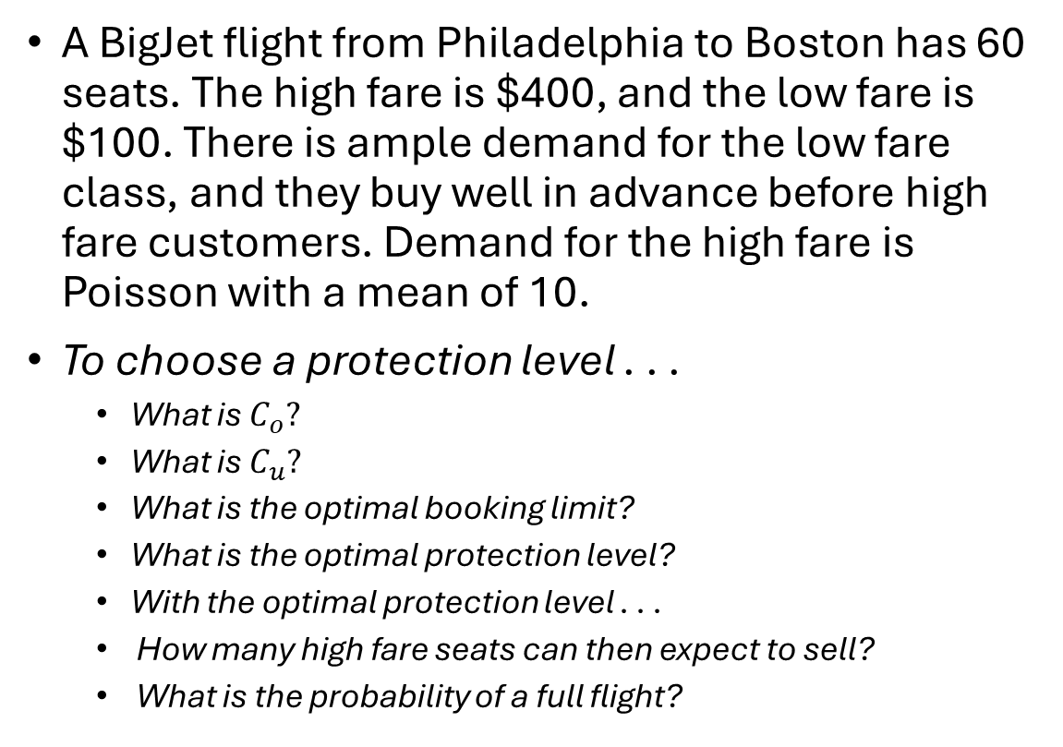
Example
q | f(q) | F(q) | L(q)
0 | 0.000 | 0.000 | 10.0
1 | 0.000 | 0.000 | 9.0
2 | 0.002 | 0.003 | 8.0
3 | 0.008 | 0.010 | 7.0
4 | 0.019 | 0.029 | 6.0
5 | 0.038 | 0.067 | 5.0
6 | 0.063 | 0.130 | 4.1
7 | 0.090 | 0.220 | 3.2
8 | 0.113 | 0.333 | 2.5
9 | 0.125 | 0.458 | 1.8
10 | 0.125 | 0.583 | 1.3
11 | 0.114 | 0.697 | 0.8
12 | 0.095 | 0.792 | 0.5
13 | 0.073 | 0.864 | 0.3
14 | 0.052 | 0.917 | 0.2
15 | 0.035 | 0.951 | 0.1
A BigJet flight from Philadelphia to Boston has 60 seats. The high fare is $400, and the low fare is $100. There is ample demand for the low fare class, and they buy well in advance before high fare customers. Demand for the high fare is Poisson with a mean of 10.
To choose a protection level . . .
  What is $C_{o}?$
  What is $C_{u}?$
  What is the optimal booking limit?
  What is the optimal protection level?
  With the optimal protection level . . .
  How many high fare seats can then expect to sell?
  What is the probability of a full flight?
Data for a Poisson with mean 10.
Notes:
18.2 Protection Levels and Booking Limits

Slide 32
Revenue Management Challenges
Demand forecasting.
    Wealth of information from reservation systems but there is seasonality, special events, changing fares and truncation of demand data.
Dynamic decisions.
Variable capacity:
    Different aircrafts, ability to move rental cars around.
Group reservations.
How to construct good “fences” to differentiate among customers?
    Non-refundability.
    One-way vs round-trip tickets.
    Non-stop versus. connecting flights.
    Saturday-night stay requirement.
Multi-leg passengers/multi-day reservations for cars and hotels:
    Not all customers using a given piece of capacity (a seat on a flight leg, a room for one night) are equally valuable.
Notes:
18.4 Implementation of Revenue Management

Slide 33
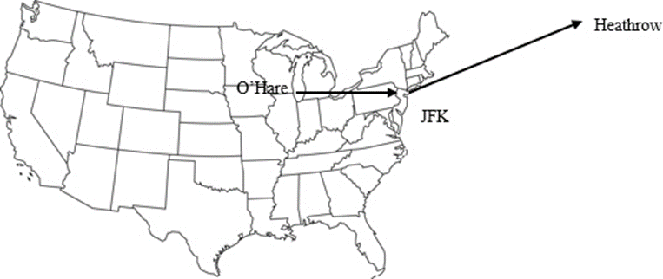
A Solution to the Multi Leg Customer: Buckets
Fare class | O’Hare to JFK | O’Hare to Heathrow
Y | $724 | $1,610
M | $475 | $829
Q | $275 | $525
Bucket | Itinerary | Fare class
0 | O’Hare to Heathrow | Y
1 | O’Hare to Heathrow | M
 | O’Hare to JFK | Y
2 | O’Hare to Heathrow | Q
 | O’Hare to JFK | M
3 | O’Hare to JFK | Q
With segment control there are only three booking limits for the O’Hare-J F K leg, one for each fare class.
But an O’Hare-Heathrow customer may be more valuable, so you could have six booking limits, one for each fare-itinerary combination.
But that leads to many booking limits, so group similar fare-itineraries into buckets:
Notes:
18.4 Implementation of Revenue Management

Slide 34
Another Solution to Multi Legs: Bid Prices
Fare class | O’Hare to JFK | O’Hare to Heathrow
Y | $724 | $1,610
M | $475 | $829
Q | $275 | $525
Assign a bid price to each segment:
A fare is accepted if it exceeds the sum of the bid prices on the segments it uses:
  For example, an O’Hare-J F K fare is accepted if it exceeds $290.
  A O’Hare-Heathrow fare is accepted if it exceeds $290 + $170 = $460.
  The trick is to choose good bid-prices.
 | O’Hare to JFK | JFK Heathrow
Bid price | $290 | $170
Notes:
18.4 Implementation of Revenue Management

Slide 35
Ugly Reality: Cancellations and No-Shows
Approximately 50% of reservations get cancelled at some point in time.
  In many cases (car rentals, hotels, full fare airline passengers) there is no penalty for cancellations (which almost invites “no-shows”).
Problem: The company may fail to fill its capacity (for example, seat, room or car) if the passenger cancels at the very last minute or does not show up.
Solution: Accept/sell more reservations than capacity.
Danger: Some customers may have to be denied service even though they have a confirmed reservation.
Notes:
18.3 Overbooking

Slide 36
Hyatt’s Problem
The forecast for the number of customers that do not show up ( X ) is Poisson with a mean of 8.5.
The net cost of denying a room to the customer with a confirmed reservation is $350 in ill-will and penalties.
How many rooms ( Y ) should be overbooked (sold in excess of capacity)?
Newsvendor setup:
  Single decision when the number of no-shows in uncertain.
  Underage cost if X > Y (insufficient number of rooms overbooked).
  Overage cost if X < Y (too many rooms overbooked).
Notes:
18.3 Overbooking

Slide 37
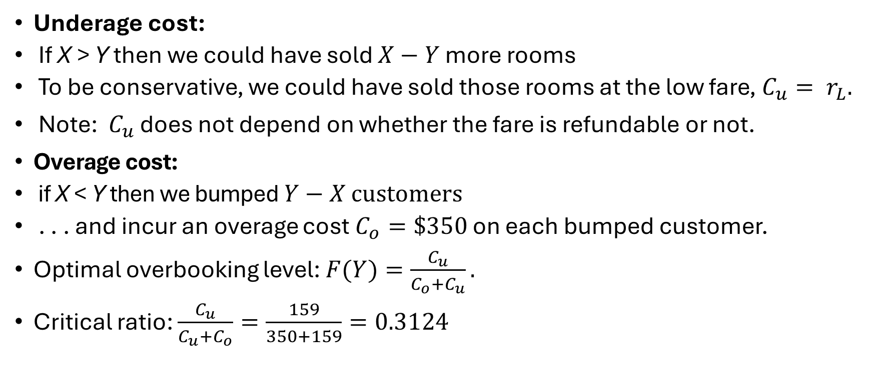
Overbooking Solution
Underage cost:
  If X > Y then we could have sold $X−Y$ more rooms
  To be conservative, we could have sold those rooms at the low fare, $C_{u}= r_{L}.$
Note: $C_{u}$ does not depend on whether the fare is refundable or not.
Overage cost:
  if X < Y then we bumped $Y−X \text{customers}$
  . . . and incur an overage cost $C_{o}=\$350$ on each bumped customer.
Optimal overbooking level: $F(Y)=\frac{C_{u}}{C_{o}+C_{u}}.$
Critical ratio: $\frac{C_{u}}{C_{u}+C_{o}}=\frac{159}{350+159}=0.3124$

Slide 38
Optimal Overbooking Level
Poisson distribution with mean 8.5.
Optimal number of overbooked rooms is Y = 7.
Hyatt should allow up to 118 + 7 reservations.
Suppose 125 reservations are made.
Then, there is about a F(6) = 25.62% chance that the Hyatt will find itself turning down travelers with reservations.
Q | F(Q)
0 | 0.0002
1 | 0.0019
2 | 0.0093
3 | 0.0301
4 | 0.0744
5 | 0.1496
6 | 0.2562
7 | 0.3856
8 | 0.5231
9 | 0.6530
Q | F(Q)
10 | 0.7634
11 | 0.8487
12 | 0.9091
13 | 0.9486
14 | 0.9726
15 | 0.9862
16 | 0.9934
17 | 0.9970
18 | 0.9987
19 | 0.9995
Notes:
18.3 Overbooking

Slide 39
Smart Pricing
American Airlines’ success prompted other industries to adopt similar practices regarding pricing
Specific techniques and tools of airline revenue management don’t necessarily apply to very different industries
Many of the underlying principles and concepts of revenue management do

Slide 40
Fundamental Approaches to Smart Pricing
Differential Pricing
  Charging different prices to different customers
Dynamic pricing
  Charging different prices over time

Slide 41
Differential Pricing
Charge different customers different prices according to their price sensitivity
Dell does this by distinguishing between private consumers, small or large businesses, government agencies, and health care providers
Difficult to do in many cases

Slide 42
Differential Pricing Strategies
Group pricing
Channel pricing
Regional pricing
Time-based differentiation
Product version
Coupons and rebates

Slide 43
Group, Channel, and Regional Pricing
Group pricing
  Discounts to specific groups of customers very common in many industries
  Senior citizen discounts at diners, software discounts to universities, student discounts at movie theaters, “ladies night” at bars
  Works only when there is a correlation between group members and price sensitivity
Channel pricing
  Charging different prices for the same product sold through different channels
  Different prices on web sites vs. retail stores
  Works only if customers who use different channels have different price sensitivities
Regional pricing
  Exploiting different price sensitivities at different locations
  Beer is much more expensive in a typical stadium than in a bar

Slide 44
Time-Based Differentiation and Product Versioning
Time-based Differentiation
  Similar products differentiated based on time
  Amazon.com charges different rates for different delivery times
      A technique for segmenting price sensitive customers and those who are more delivery time sensitive
      Dell charges different prices for repair contracts that complete repairs in different amounts of time
Product Versioning
  Offer slightly different products in order to differentiate price sensitivities
  May take the form of branding
      Store brand vs Generic brand
  Additional features added to products at the higher end of the line
        High end buyers are inclined to buy the higher end products in the line
        Pay significantly more than the lower end products
        Cost very little more to manufacture

Slide 45
Coupons and Rebates
Distinguish between customers that place a high value on time or flexibility
Those who are willing to spend the time to get a lower price by using a coupon or submitting a rebate form
Mail-in rebates at the point of sale
  Adds a significant hurdle to the buying process
  Customers willing to pay the higher price will not necessarily send the coupon
  Do not incorporate fences
  Require a more detailed analysis

Slide 46
Rebates
No rebate
  Each retailer decides on the price and the amount to order from the manufacturer to maximize its profit
  Retailer needs to find a price and an order quantity so as to maximize its expected profit
  Manufacturer would like the retailer to order as much as possible at the wholesale price
Mail-in-rebates
  manufacturer influences customer demand
  provides an upside incentive to the retailer to increase its order quantity
  Retailer’s profit increases
  Increase in demand forces the retailer to order more from the manufacturer
  Optimal order quantity compensates for the rebate
  Implies an increase in the manufacturer’s expected profit

Slide 47
Why Not Discount the Wholesale Price?
Rebate strategy implies not every consumer will mail the coupon to the manufacturer
If the manufacturer merely reduces the wholesale price, the retailer may keep the discount and not transfer it to the customers
Even if the retailer uses the discounted wholesale price to optimize its pricing and ordering decisions, and even if every consumer mails back the rebate, the mail-in rebate strategy is a better strategy for the manufacturer

Slide 48
Mail-in Rebate Strategy Better
Assume retailer orders the same amount in both strategies
Order quantity < realized demand
  The two strategies provide the manufacturer with exactly the same profit
Order quantity > realized demand
  Manufacturer’s profit with rebate is larger than its profit under discounted wholesale price

Slide 49
Dynamic Pricing
Retailers change price at the end of the season to get rid of excess inventory
Manufacturers change price during the season to distinguish between low and high reservation price customers
Use pricing to affect demand
Dynamic pricing may increase profit by 2-6%
  Significant in industries with low margins
      Retail industry
      Computers industry

Slide 50
Conditions under which Dynamic Pricing Is Superior
Available capacity
  Smaller the production capacity relative to average demand, the larger the benefit from dynamic pricing
Demand variability
  Benefit of dynamic pricing increases as the degree of demand uncertainty increases
Seasonality in demand pattern
  Benefit of dynamic pricing increases as the level of demand seasonality increases
Length of the planning horizon
  Longer the planning horizon, the smaller the benefit from dynamic pricing

Slide 51
Impact of Strategic Consumer Behavior
Strategic consumer behavior refers to consumers willing to delay purchase in anticipation of price discounts
The firm’s profit may drop if customers delay purchasing decisions until they receive a discount
However, discount may raise sales so net effect is not clear
  What matters is the fraction of strategic customers
Two strategies…
  Wait time and prices: The firm can build fences by delaying the discount time and optimizing price so that this combination of delay and lower discount curb strategic consumer behavior
  Inventory: By focusing on product scarcity, the firm motivates consumers to purchase early rather than wait for a discount

Slide 52
Impact of the Internet
Many approaches of smart pricing made more practical by internet and e-commerce
Menu cost
  cost that retailers incur when changing the posted price
  Much lower on the Internet than in the off-line world
  Updating of prices possible on a daily basis
Lower buyer search price
  cost that buyers incur when looking for a product
  forces competition between sellers
  leads to a focus on smart pricing strategies

Slide 53
Impact of the Internet
Visibility
  to the back-end of the supply chain
  makes it possible to coordinate pricing, inventory, and production
  information has facilitated growth of smart pricing
Customer segmentation
  using buyers’ historical data is possible on the Internet
  very difficult in conventional stores
Testing capability
  Internet can be used to test pricing strategies in real time
  On-line seller may test a higher price on a small group of the site visitors
  Use those data to determine a pricing strategy

Slide 54
Caveats
Must avoid the appearance of unfair treatment of customers
  Amazon.com’s failed experimented with a pricing strategy in which customers were paying different amounts for the same DVD based on demographics or the browser used
  Coke’s development of a soda machine that would measure the outside temperature, and increase prices as the temperature increased
On-line sites Priceline and Hotwire.com provide:
  An outlet for last-minute, unsold seats and hotel rooms
  Opaque fares
  “Protects” the published fares promoted by the airlines and hotels themselves
  When many published fares are about as good as the opaque fares, it is harder to attract customers to the Priceline and Hotwire sites

Slide 55
Rue La La
Rue La La is an example of how a retailer can use its wealth of data to optimize pricing decisions daily.
They are in the online fashion sample sales industry
One of Rue La La’s main challenges is pricing and predicting demand for items that it has never sold before
A large percentage of first exposure items sell out before the sales period is over
Building a demand prediction model for first exposure styles and a price optimization model
Tests showed that raising prices only negatively impacts demand for very-priced items

Slide 56
Learning Objectives
How is the new trend of digitization, analytics, and automation changing companies like Rue La La?
How can Rue La La benefit from machine learning when making pricing decisions?
How and why some companies apply customized pricing that try to differentiate between different customers?
What lessons can firms draw from the success of airline revenue management?
How can dynamic pricing help improve business performance?
What are the risks associated with these types of customized and dynamic pricing?
How can take advantage of the fact that different customers are willing to pay different amounts for the same product?
What are manufacturers trying to achieve by offering rebates? If all of the rebates are redeemed, is it still worthwhile to manufacturers to offer them? To retailers?

Slide 57
Manager’s Issue
What is the optimal price at which revenue is maximized?
Need to characterize the relationship between pricing and demand for each product
Utilize this characterization to determine the optimal price for each product
May involve many complexities
  Vast quantities of data may need to be analyzed
  Competitors’ behavior may need to be captured
Many firms do manage to at least approximate this relationship

Slide 58
New Frontier in Price Optimization
Retailers face significant pressure to improve revenue, margins, and market share by applying price optimization models
These are mathematical models that calculate how demand varies at different price levels, then combine that with information on costs and inventory to recommend prices that will improve revenue and profits
Three important changes from the past…
  Data: availability of internal and external real-time data, such as traffic to a website, consumers making buy/no-buy decisions, and competitor pricing strategies
  Analytics: advances in machine learning and ease of access have enabled the development of systems that learn on the fly about consumer behavior and preferences and generate effective estimates of demand–price relationships
  Automation: increase in computing speed enables real-time optimization of prices of hundreds of competing products

Slide 59
The Challenge and the Approach
Never have retailers been in such a complex and competitive environment
  Brick-and-mortar stores and online selling, rising, and changing customer expectations, short selling seasons, and many products competing
Price optimization can be extremely complex
It requires understanding consumer valuations, and it demands analyzing vast quantities of data as well as understanding competitors’ behavior
Price optimization can also be very risky
For many online sellers, frequently changing or experimenting with price is not appropriate because of the negative customer reaction or fear of confusing the market
What to do?

Slide 60
Three Techniques
Forecasting is about generating an initial demand–price relationship for a product that was never sold before by projecting from historical sales of other products
Learning is about observing customers making buy/no-buy decisions and using that information to update the demand–price curve
Price optimization is about the simultaneous selection of price for all competing products offered by the retailer, thus considering the impact of cannibalization on the firm revenue
Not every company needs or can apply, the three techniques

Slide 61
Forecast and Price Optimization at Rue La La
One of Rue La La’s main challenges is pricing and predicting demand for items that it has never sold before
Because Rue La La is not interested in changing the price during the first exposure event, learning from customer online behavior was not an option
First approach was developing a demand prediction model for first exposure styles
  Used as an input to a price optimization model
Two biggest challenges…
  Estimating lost sales due to stock outs
  Predicting demand for styles that had no historical sales data

Slide 62
Forecast and Price Optimization at Rue La La Cont..
Split historical sales data into two groups:
  All item-event combinations that did not stock out while
  Those item-event combination that did stock out
Use sales data from items that did not sell out to estimate lost sales for items that did sell out
Calculated the percent of sales that occur in every hour of the event
Aggregated all these demand curves in group one into just a few distinct and interpretable curves based on start time
For every event-item combination that stock-out, identify which curve is appropriate based on start time
Once the clustering technique are applied and generate estimated demand for items that stock out, ready to predict future demand

Slide 64
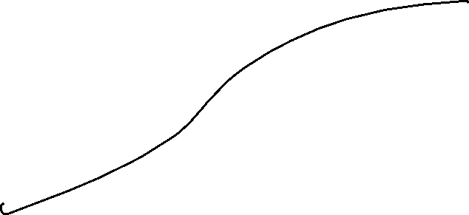
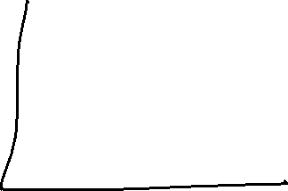

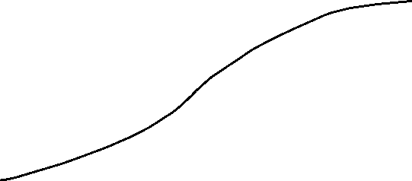
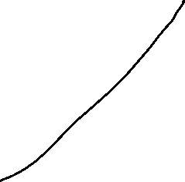

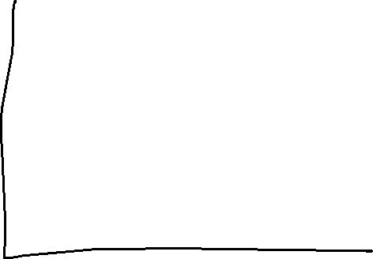
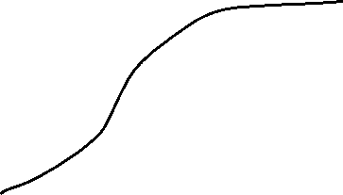



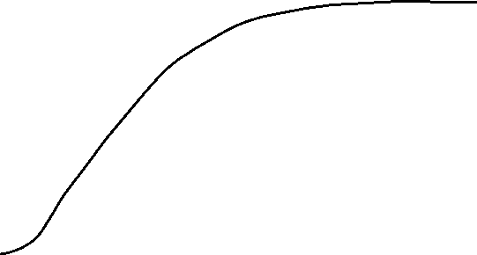

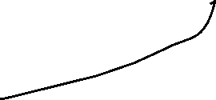



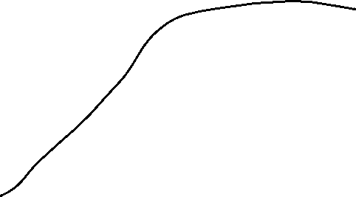



Slide 65
Forecast and Price Optimization at Rue La La Cont..
Regression trees have proven to be the best predictors of demand
  These are a collection of rules that when followed, will end up with a prediction
There are two reasons for the effectiveness of regression trees…
  It can successfully partition all items sold in the past and only use the relevant one to predict demand for the current item
  It allows for a nonmonotonic price–demand relationship, a characteristic not shared by traditional linear regression techniques
Formulate a price optimization model to maximize revenue from first exposure styles, using demand predictions from the regression trees as input
The price optimization was implemented at Rue La La
  The overall financial impact was approximately 10 percent increase in revenue

Slide 66
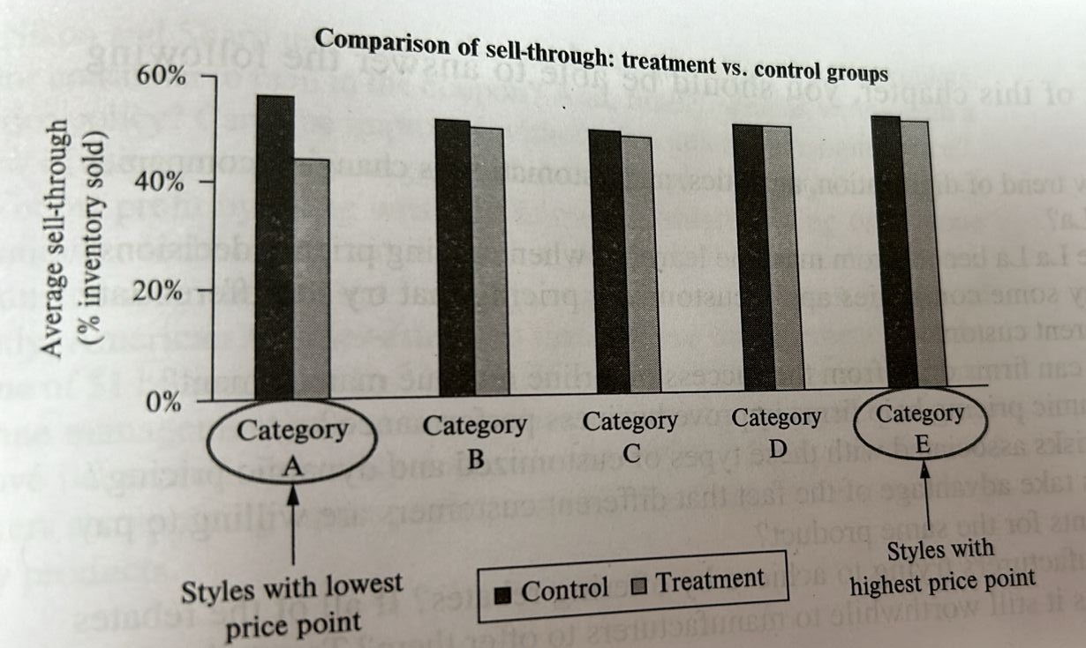

Slide 67
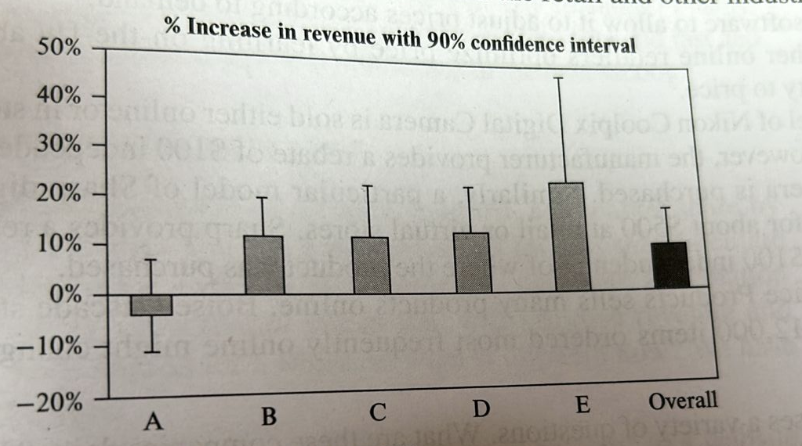

Slide 68
Learning and Price Optimization at Groupon
Groupon offers subscribed customers discount deals from local merchants
By the second quarter of 2015, Groupon served more than 500 cities worldwide, had nearly 49 million active customers
The company launches thousands of new deals every day, and these deals have a short lifecycle
The combination of the huge product portfolio and short lifecycle implies that demand prediction is quite challenging
Generate multiple forecasts at the time a product is launched on the company website
The idea behind this approach is to generate multiple demand functions, such that the true demand–price relationship is approximated well by one of these demand functions

Slide 69
Learning and Price Optimization at Groupon Contd..
Applied a two-step process: learning and optimization
Split the product lifecycle, the time the product is sold on the website, into two parts, the first portion is learning and the second is the price optimization
When the product is introduced on Groupon’s website, initially apply a learning price and observe customers making buy/no-buy decisions
At the end of the learning period, know how much was sold and therefore we can identify the demand function that has the closest demand prediction to this level of sales
If we learn for a long time, then we will have a good understanding of the true demand function but there is little time remaining for the optimization
If we learn just for a short period of time, we will have an approximate understanding on customer demand but we can use the final, optimized price, for a long period of time

Slide 70
Learning and Price Optimization at Groupon contd..
When implementing this approach for the first time, initially generated for every new deal around 10 demand functions
Very quickly realized that this is not enough and in the final implementation, we generated for every new deal around 100 demand functions
In the final implementation, Groupon imposed a few business constraints
  the learning price is negotiated between Groupon and the local merchant and cannot be determined by the algorithm
  Groupon only allowed a price decrease at the end of the learning period in the range of 5 to 30 percent
  The local merchant receives a fixed share

Slide 71
Groupon Results
The field experiment included 1,295 deals that spanned five product categories: beauty, food & drink, activities, services, and shopping
Focused on two performance measurements…
  The total amount of money paid by customers to Groupon
  The portion of money that Groupon keeps after paying local merchants
Among the five categories, beauty, food & drink, and shopping have significant revenue increase
Services category has almost no revenue change but significant bookings increase
Activities has a decrease in revenue
Overall, bookings increased by 116 percent, and revenue increased by 21.7 percent

Slide 72
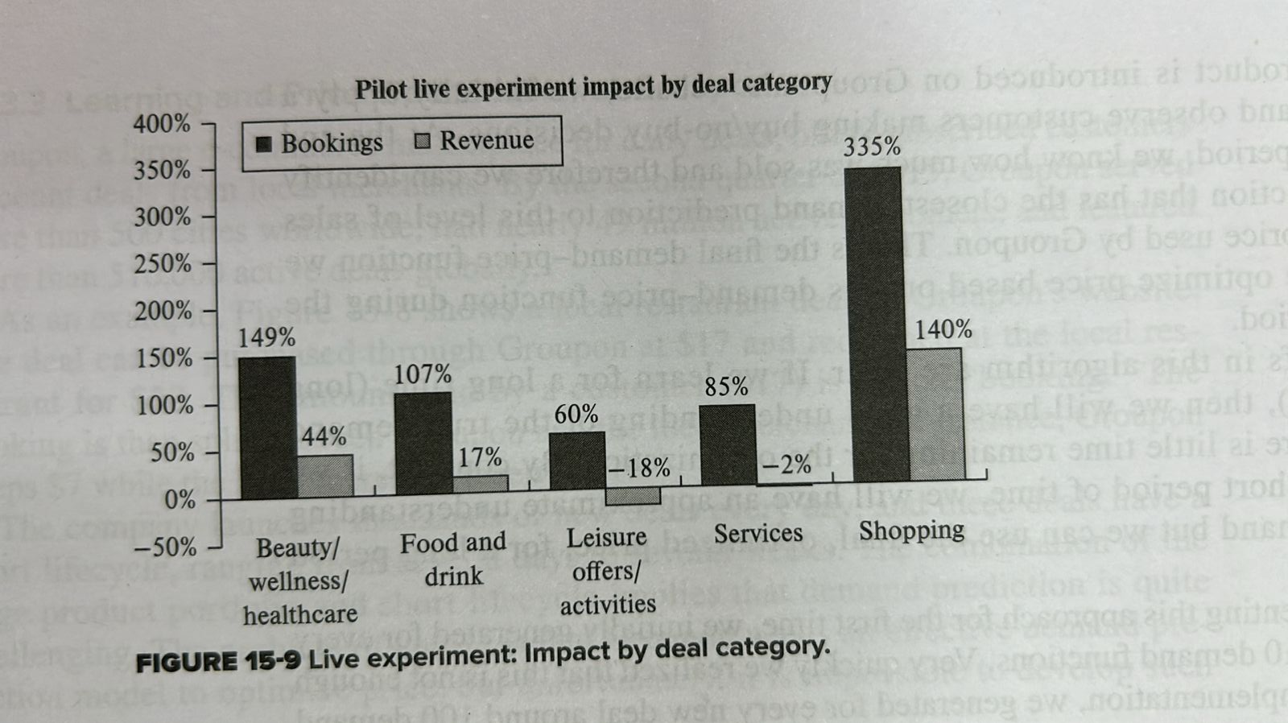
Groupon Results contd.

Slide 73
References:
Cachon, G., & Terwiesch, C. (2023). Revenue management with capacity controls (Ch. 18). In Matching supply with demand: An introduction to operations management (4th ed). McGraw Hill.
Simchi-Levi, D., Kaminsky, P., Simchi-Levi, E., & Shankar, R. (2022). Smart pricing (Ch. 15). In Designing and managing the supply chain: Concepts, strategies, and case studies (4th ed.). McGraw Hill.

