Slide 1
Quick View on
Recent Corporate Scams
presented by star participants of Entreprenuership program – IIM Rohtak

Slide 2

Groups and Topics
7 out of 8 topics received.
Thank you!
Anish Mukherjee | Nirav Modi Case
Anshuman Bhatia
Nitin Gorav
Santosh Yadav
Akanksha Bhardwaj
Anurag Ahlawat
Vikram Singh Yadav
Nikki Chadha | Bhushan Steel Case
Parwinder Singh
Shalinee Chuadhry
Phanikumar P
Pranjal Kumar
Hitesh Sharma
Rahul Kumar Gupta | INX Media Case
Samarjith Baskaran
Sarath Shyamson
Sobha Trishla Pathak
Yakanshu Kakkar
Someshwaran Mohankumar
Srinivas S K
Devender Kumar | Ranbaxy Daiichi Case
Dinesh Dorairaj
Dr santosh Saklecha
Dr. Rohit Sharma
Geeta Singh
Vivek Agarwal
Rohit Kumar | PMC Bank Scam
Prashanth Adiyodi
Puneet Sethi
Rahul Sharma
Rahul Bansal
Rama Krishna Kasilanka
Apaar Sharma | Vijay Mallya Case
Vinay T A
Atharva Ulangwar
Barinder kumar
Baskar Natarajan
Bharat Nadvani
D poonam | Rotomac Scam
Manish Pathari
Mukul Gupta
Mukul Pasricha Someshwaran
navin Kishore
Dev Rawar
Om Ranjeet Prakash | DHFL Scam
Rishikesh Kotian
Sahil Rana
Saikat Sahoo
Sam Nicholas
M Jehirul Islam

Slide 3
3 minutes per topic
DHFL – Sam Nicholas
INX Media – Someshwaran M
Rotomac – Mukul Gupta
Nirav Modi – Akanksha Bhardwaj
PMC Bank – Puneet Sethi
Ranbaxy Daiichi – Vivek Agarwal
Bhushan Steel - Pranjal
Other members of the group are welcome to chip in

Slide 4
DHFL Scam – What’s that fraudulent act
The primary promoters of DHFL siphoned off more than ₹31,000 cr. of public money through secured and unsecured loans and advances to shell companies, round tripping, tax avoidance and insider trading.
“Money has also been routed through these dubious companies and parked outside India, to acquire assets
Used their proxies and associates to buy shares/equity and other private assets in India and abroad
“By lending to shell/pass-through companies without due diligence, DHFL has ensured that the recovery of such dubious loans is impossible since the companies or their directors themselves do not own any assets.
“This way the private assets acquired by the Wadhawans and their associates by using the funds from these dubious loans are completely ring-fenced from any recovery process that may be initiated by authorities under the SARFAESI Act or IBC.
Thus, the only losers in the process would be the public sector banks, such as SBI and Bank of Baroda, with an exposure of over ₹11,000 Cr. and ₹4,000 Cr, respectively, foreign banks and shareholders from among the public or investors of DHFL,”
DHFL’s primary stakeholders, Kapil Wadhawan, Aruna Wadhawan and Dheeraj Wadhawan are the main culprits

Slide 5
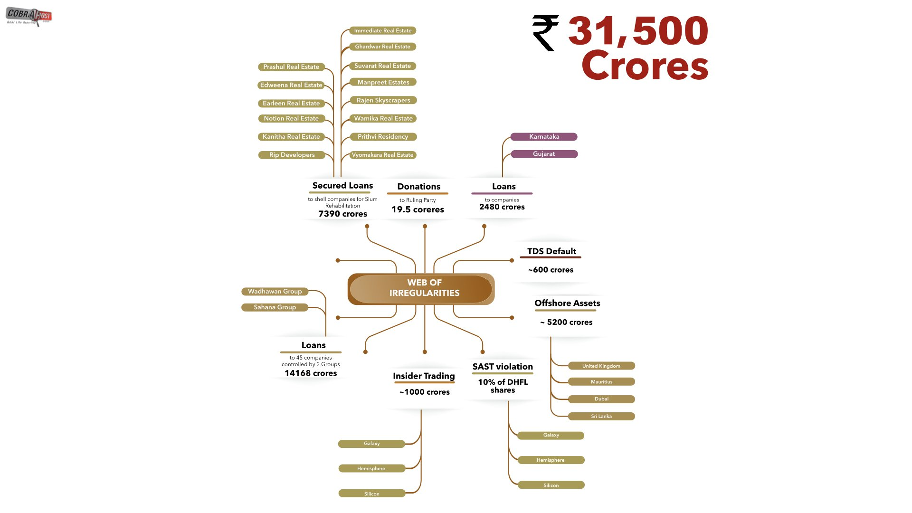

Slide 6
Current status of DHFL Scam
The Enforcement Directorate (ED) Thursday arrested Dewan Housing Finance Corporation Ltd (DHFL) promoters, Kapil and Dheeraj Wadhawan, in the alleged fraud caused to Yes Bank Ltd
The Wadhawan brothers - Kapil and Dheeraj - and their non-banking financial company DHFL are the co-accused in a cheating and money laundering case registered against Kapoor
While CBI is probing the alleged criminal conspiracy and fraud caused to the private lender, officials of the ED are probing them for alleged money laundering
The National Company Law Tribunal has ordered the commencement of a corporate insolvency resolution process of DHFL on December 3, 2019

Slide 7
INX Media Case
People Involved
Govt. Dept’s Involved
P Chidambaram(Former Fin. Minister)
Peter Mukerjea(Co-founder of INX)
Indrani Mukerjea(Co-founder of INX)
Karti Chidambaram(Middle man / Director of shell companies)
5 IAS Officers of FIPB
CA Bhasakararaman
FIPB
Investigation wing of Income Tax
CBI
New Delhi Police Department
INR 305 Crore Scam
Cases Filed
Section 120-B of Indian Police Code (IPC) r/w 420 of IPC.
Section 8 , 13(2) r/w 13(1) of Prevention of Corruption Act, 1988.
Chapter XII code of criminal procedure for P Chidambaram (Before verdict)
Final Hearing
Justice R Banumathi of SC reserved judgement for INX Media Case

Slide 8
Timeline
2017
2018
Jan 2008
15 May - The CBI ﬁles FIR alleging irregularities in FIPB’s clearance to INX Media to receive overseas funds of 305 crore in 2007 when Karti's father P Chidambaram was ﬁnance minister
16 Jun - The Foreigners Regional Registration Oﬃcer and Bureau of Immigration, under Union Home Ministry, issues Look Out Circular (LOC) against Karti Chidambaram.
14 Aug - Supreme Court (SC) overturns Madras HC order that the stay on LOC against Karti Chidambaram.
11 Sep - CBI furnish the details of 25 offshore properties of Karti.
16 Feb - Karti's CA S Bhaskararaman was arrested
28 Feb - Karti was arrested for investigation against INX case and it was issued by Delhi High court and then bailed out after 23 days.
2007
Jan 2008
Indrani Mukerjea and husband Peter Mukerjea, co-found INX Media
Financial Intelligence Unit of the Finance
Ministry ﬁnds anomaly in money ﬂow from three Mauritius-based ﬁrms into INX media
2019
31 May, 2007
11 Jul - Indrani Mukerjea turns approver for clemency.
21 Aug - Chidambaram was taken to CBI HQ for investigation
28 Nov - Chidambaram was arrested for the case
FIPB allows INX Media to receive foreign investment of INR 4.62 crore. However, INX Media receives foreign investment of INR 305.36 crore in violation of FIPB rules. INX Media pumps downstream investments of 26% in INX News without FIPB approval.
2010
ED registers a case against INX Media
for alleged Foreign exchange Management Act violation

Slide 9
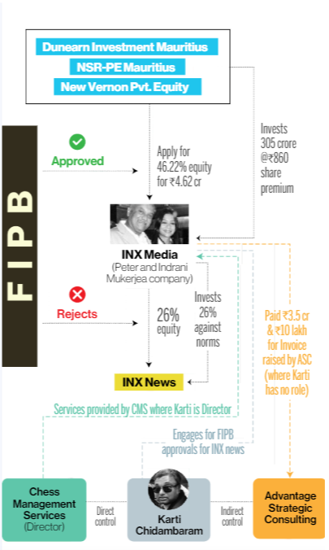
Case Flow
To conclude the case, it was a classic money laundering case and the people involved where big shots and responsible government employees. But when they come in sight of justice, the truth prevailed and their criminal cases where revealed.
From the Supreme Court Statement:
“Simply because he is a Member of Parliament would not justify grant of pre-arrest bail to him. The magnitude of the offence dissuades this court to grant bail to the petitioner.”
This above statement made the constitution is more stronger than any government personnels and made sure that they would put behind bars when involving in any criminal code of procedures.
Source: Indiatoday

Slide 10
Rotomac Scam
Total
Rs. 3695 Cr.
Business Type
98% Wholesale Trading
2% Plastic and Rubber Product Manufacturing
Primary Charges
Round Tripping of money, which amounts to misappropriation of funds.
Criminal breach of trust and violation of FEMA regulations

Slide 11
Main Culprits
Vikram Kothari, Directory of Rotomac Global
Rahul Kothari, Son of Vikram Kothari
Chronology:
Rotomac Global Pvt Ltd, engaged in intermediary trade and manufacturing pens, routinely approached seven banks, seeking credit ranging from Rs 15 crore to Rs 200 crore from 2008 to 2013, mostly for exports and imports.
Instead of using the money to pay buyers/suppliers, the money was round-tripped to accounts of Rotomac and its sister companies.
Kothari indulged in trade for which incomplete documents were produced, or the company submitted photocopies of bills of loading and other documents of transactions on the pretext that original papers were sent to the importer. Most of the papers, the CBI claimed, originated in overseas centers.
When BoB officials visited Rotomac's suppliers and buyers abroad, they found that the import/export business was allegedly running through shell companies.

Slide 12
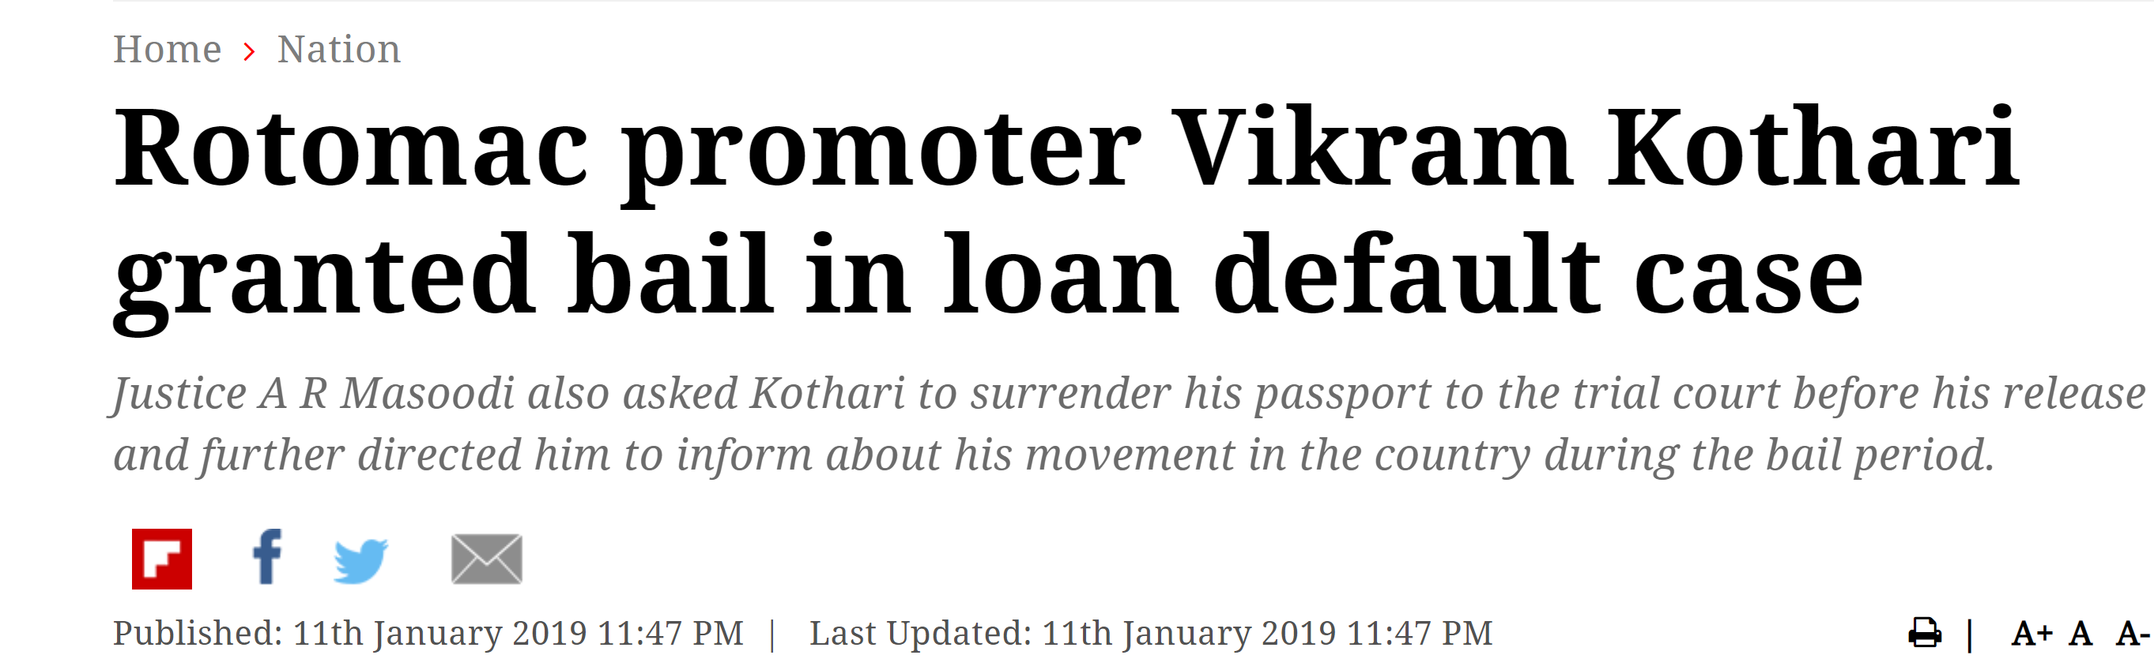
Current State
CBI Investigation is on.
Rotomac promoter Vikram Kothari granted bail in loan default case.
Kothari to surrender his passport to the trial court before his release and further directed him to inform about his movement in the country during the bail period.

Slide 13
Nirav MODI
Intro
Fraud of total 11356.84 Cr organised by Nirav Modi and PNB Authority, where Punjab National Bank (Brady House Branch, Mumbai) issues number of LOU in order to provide buyer`s credit to Nirav Modi to purchase diamond from other country.
What is Buyer`s Credit?
  It is a short term loan taken from a foreign bank in order to pay to the supplier(s) against the imported supply.
  To take buyer`s credit from any local bank, one should submit security of the same amount to make the secured transaction b/w bank and supplier (through nato account)

Slide 14
Twist in the story
Brandy House Branch, PNB bank issued LoU(letter of undertaking) to the foreign bank without taking any security amount from Nirav Modi.
Apart from this, bank is liable to pay to foreign bank including interest against the payment of supply.
Nirav Modi didn`t pay principle amount + interest to bank and still got 11000 Cr diamond for free of cost.

Slide 15
FRAUD, CULPRIT AND CURRENT STATUS
Nirav Modi, a diamond jewellery businessmen, did 11356 Cr fraud with the collaboration with top authority of Brandy House Branch, PNB bank.
Apart from Nirav Modi, top management of Brandy House Branch,PNB Bank is also major culprit, as without their approval, a huge amount of credit wouldn’t have been released.
Now, A Diamond merchant , Nirav Modi, fighting against Indian government`s action against money laundry case and he need to present on a regular bases of hearing which takes place at Westminster Magistrates` Court in London

Slide 16
PMC Bank Scam

Slide 17
Ranbaxy Daiichi

Slide 18
Bhushan Steel

