Slide 1
What is Stakeholder Management?
Stakeholder management is the processes required to identify the people, groups, or organizations that could impact or be impacted by the project.
Analyze stakeholder expectations and their impact on the project.
Develop appropriate management strategies for effectively engaging stakeholders in the project decision and execution Identify Stakeholders
This is the first process in this knowledge area coming under the initiation process group to Identify all the people or organizations impacted by the project: e.g., Customers, Sponsors, Team Members, Suppliers (Internal & External), and Labor unions etc.
Identify Stakeholders:
Inputs:
1. Project Charter (provides information about internal & external involved parties
2. Procurement Documents (to find out parties involved in procurement and other details)
3. Enterprise Environmental Factors(e.g., organizational culture, industry standards,… etc)
4. Organizational Process Assets (stakeholders register templates, lessons learned, old project documents, … etc)

Slide 2
Who Is a Stakeholder?
Anyone with a Vested Interest in the Project
To get started, here is a brief list of potential project stakeholders:
External: The client, including the main client team, their managers, and their division director. In an agency environment, there are typically one or two stakeholders identified as a liaison from the client project team. On a company project, there will be a small number of critical leaders who are considered the key stakeholders.
Internal: The project team, including contractors and vendors, as well as top management, resourcing directors, accounting department members, and others who want to see the project run efficiently and profitably.
‘Expanded’ Stakeholders: These may include the industry evangelists, customers, employees, manufacturers, vendors, environmental and other community activists, and more. Maintaining strong, consistent communications with all types of stakeholders ensures a smooth project with much more buy-in and better public relations.

Slide 3
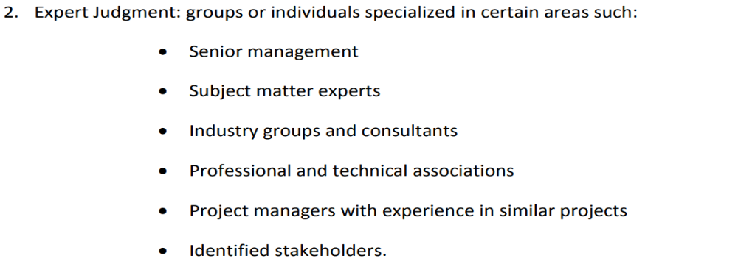
Identify Stakeholders:
Tools & Techniques
Stakeholder Analysis: gathering & analyzing information to determine stakeholder in 3 steps:
Identify all potential stakeholders & relevant information (roles, departments, interests, knowledge levels, expectations & influence levels).
Identify potential impact or support each stakeholder could generate (power interest)
• Assess how key stakeholders are likely to react or respond to various situations.

Slide 4
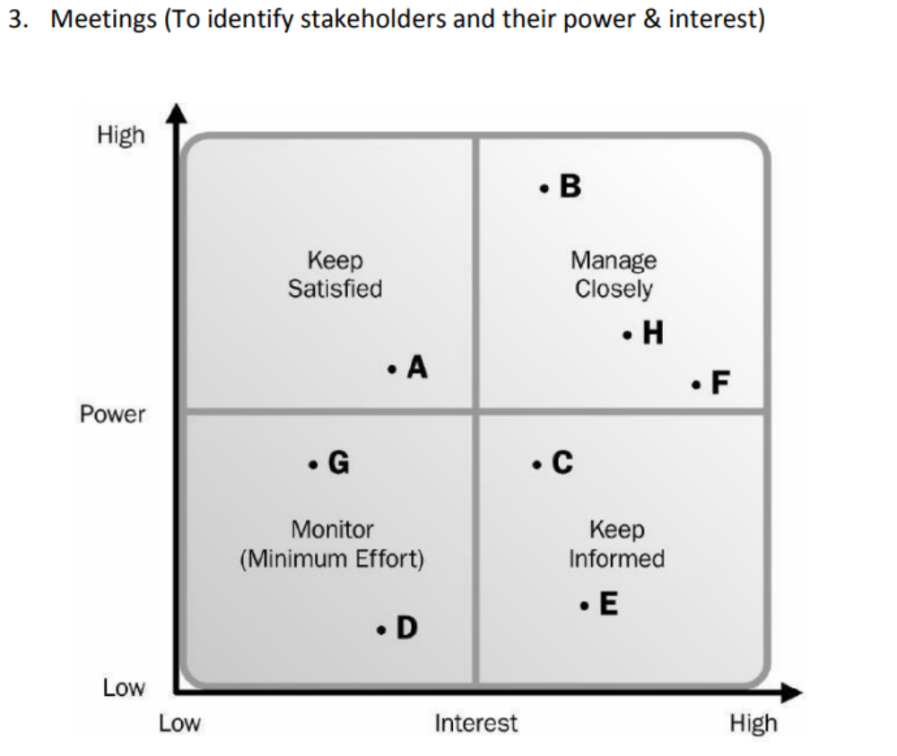

Slide 5
Identify Stakeholders:
Outputs
Stakeholder Register: it contains
Identification Information: name, organizational position, location, role in project, etc.
Assessment Information: major requirements, expectation, potential influence in project … etc.
Stakeholder Classification: Internal/External, supporter, neutral, resistor, etc.

Slide 6
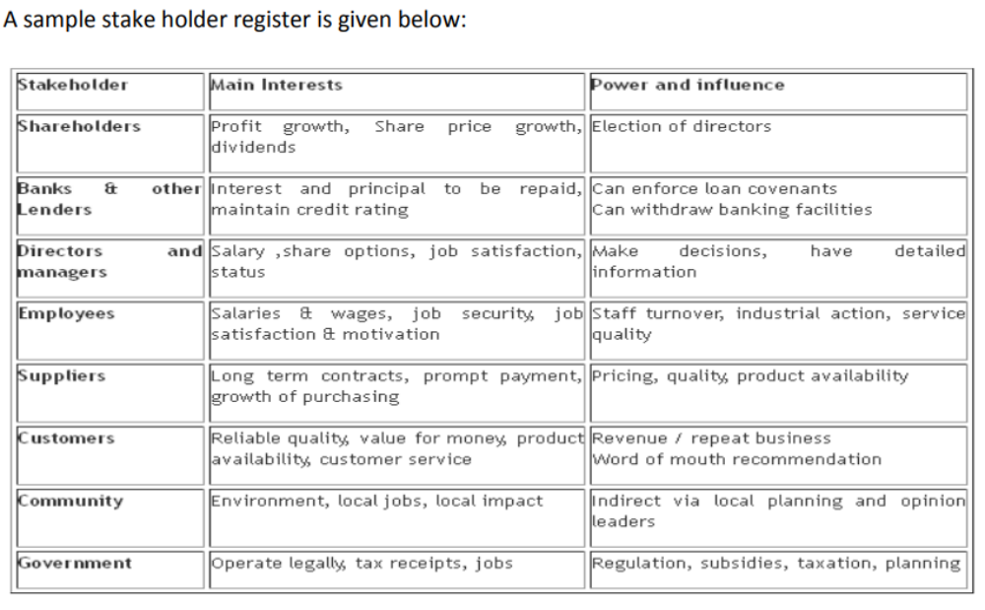

Slide 7
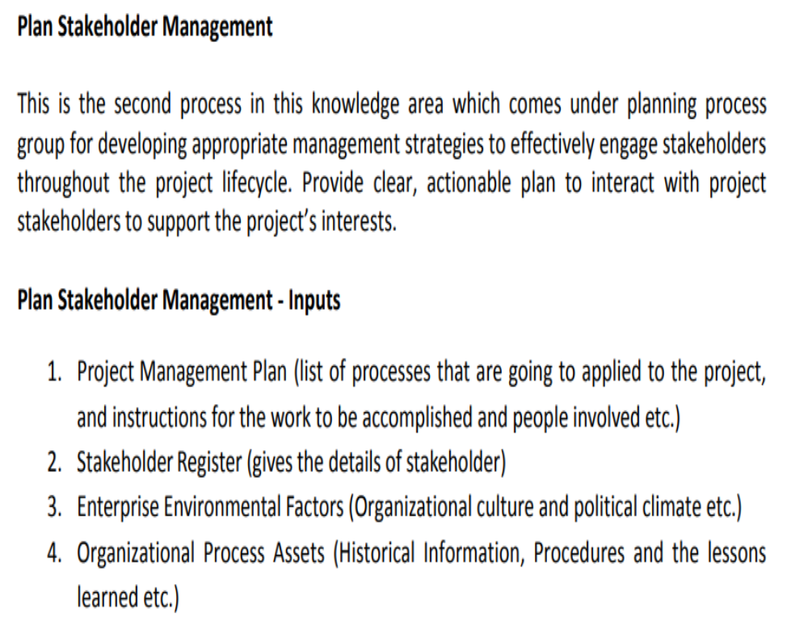

Slide 8
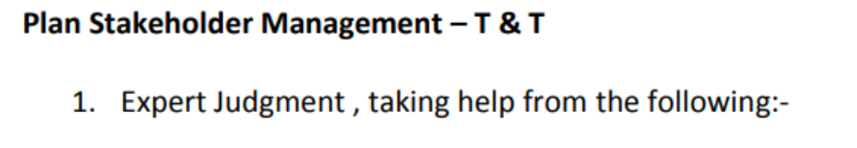
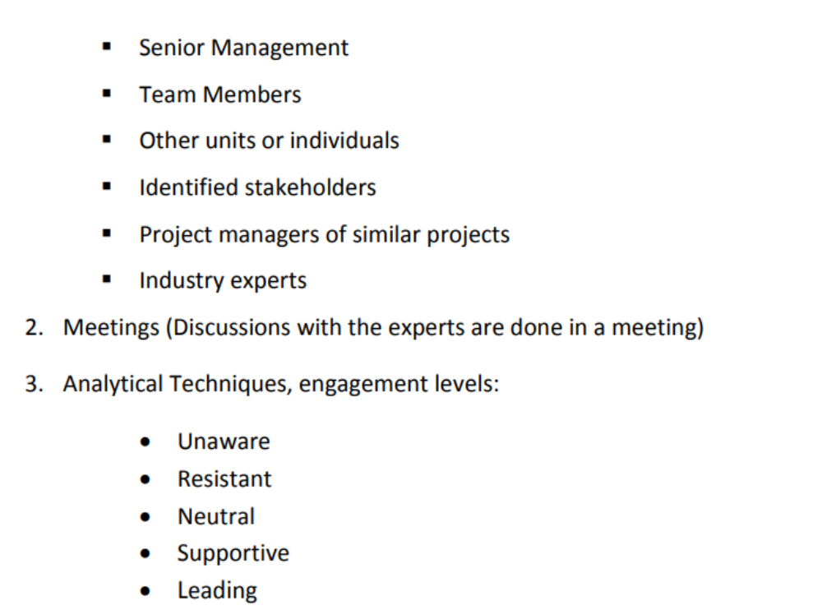

Slide 9
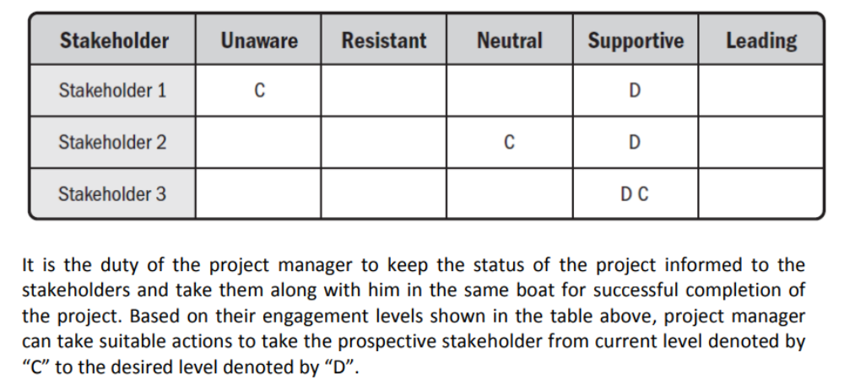

Slide 10
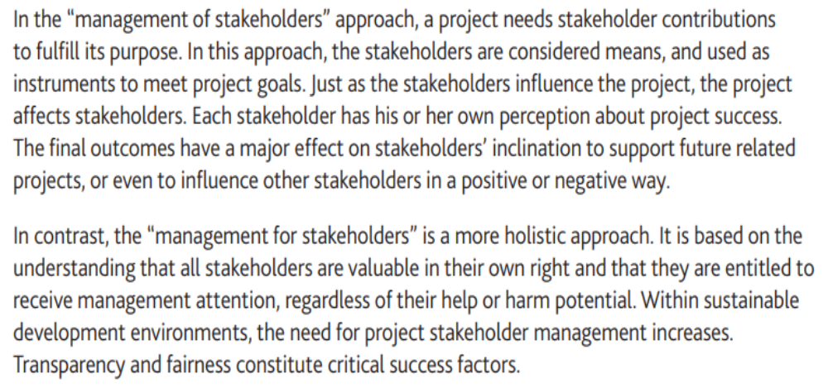

Slide 11
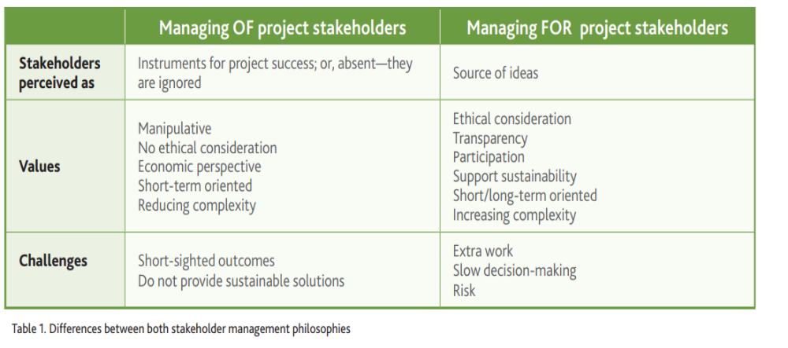

Slide 12
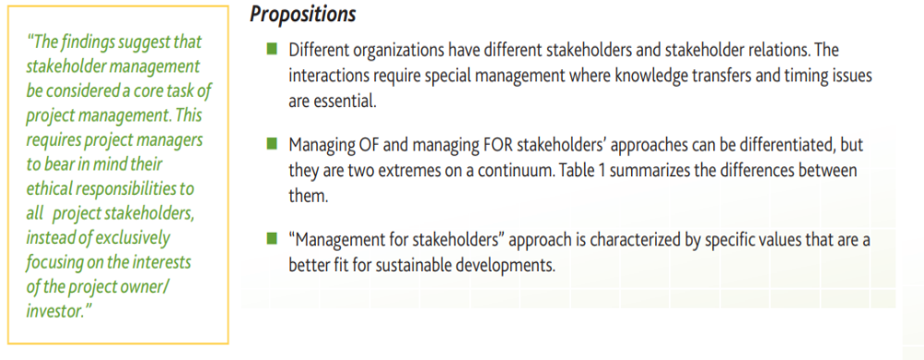

Slide 13
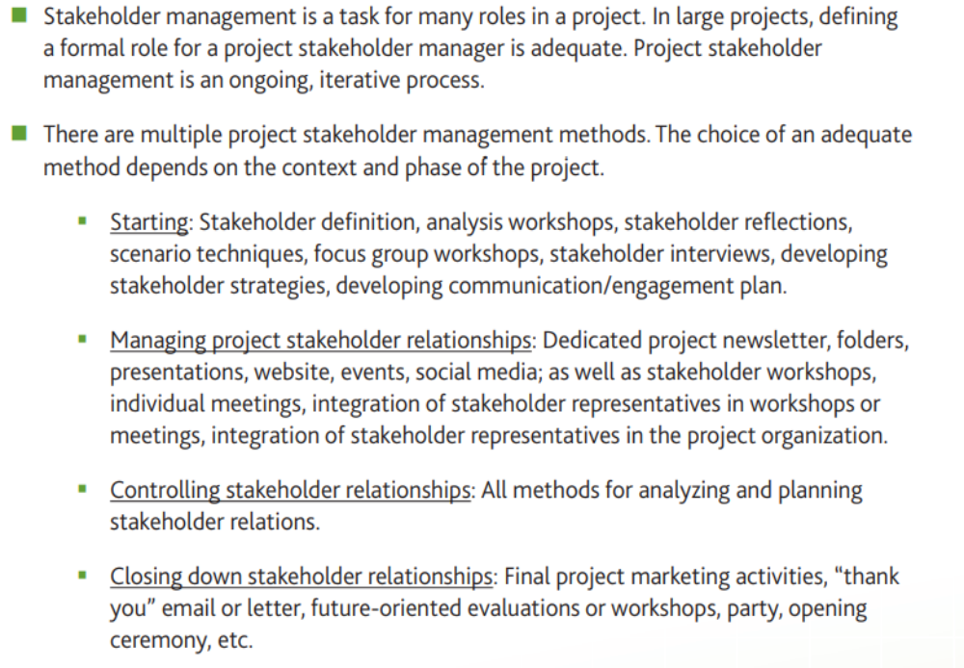

Slide 14
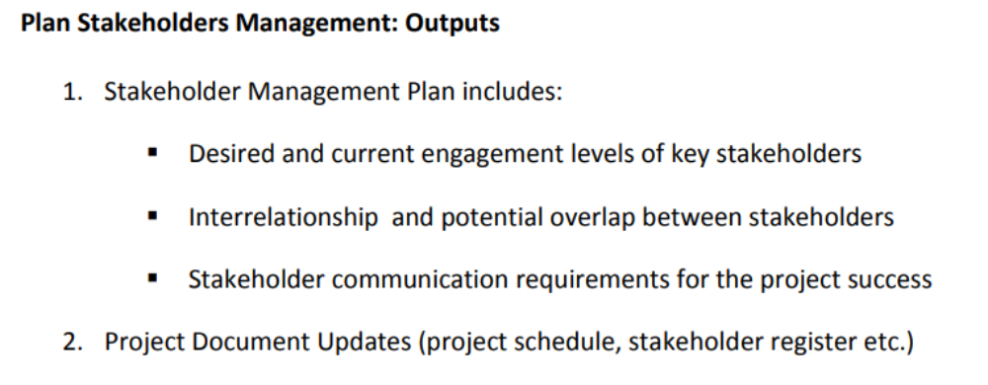

Slide 15
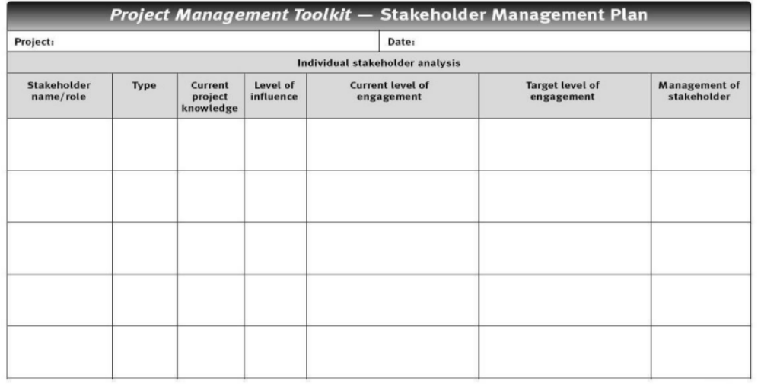

Slide 16
Manage Stakeholder Engagement
This is the third process in this knowledge area comes under executing process group.
In this process project manager communicating and working with stakeholders to meet their needs/expectations, address issues as they occur, and foster appropriate stakeholder engagement in project activities throughout the project lifecycle.
The key benefit of this process is to allow the project manager to increase support and minimize resistance from stakeholders.

Slide 17
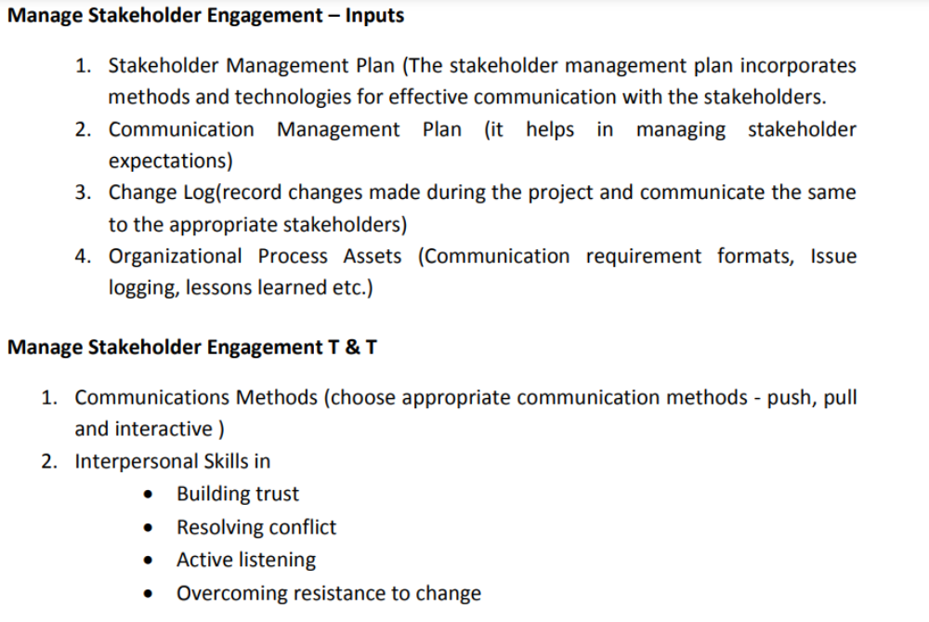

Slide 18
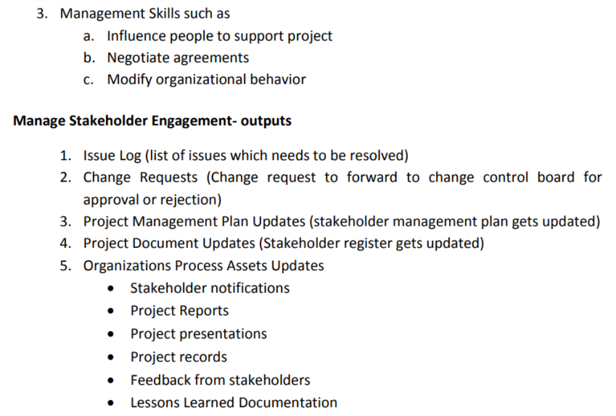

Slide 19
Control Stakeholder Engagement
This is the fourth and final process in this knowledge area comes under the monitoring and control process group.
The purpose of this process is for monitoring overall stakeholder relationships and adjusting strategies and plans for engaging stakeholders.
The key benefit is to maintain or increase the efficiency and effectiveness of stakeholder engagement activities towards the project success.

Slide 20
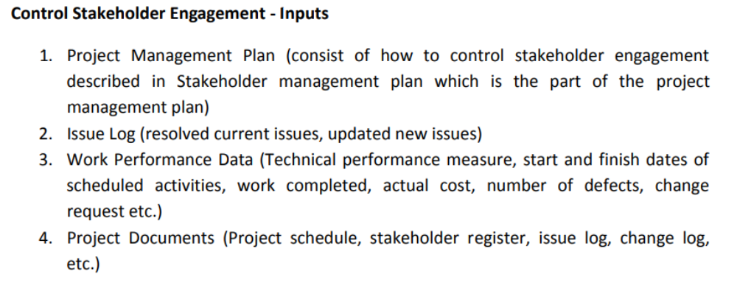

Slide 21
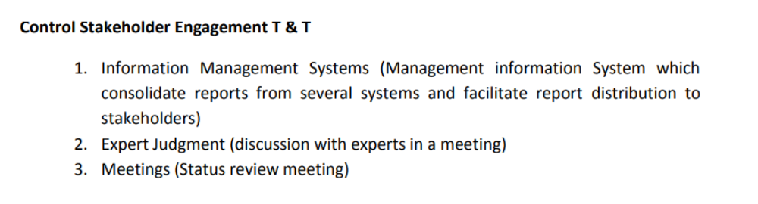

Slide 22
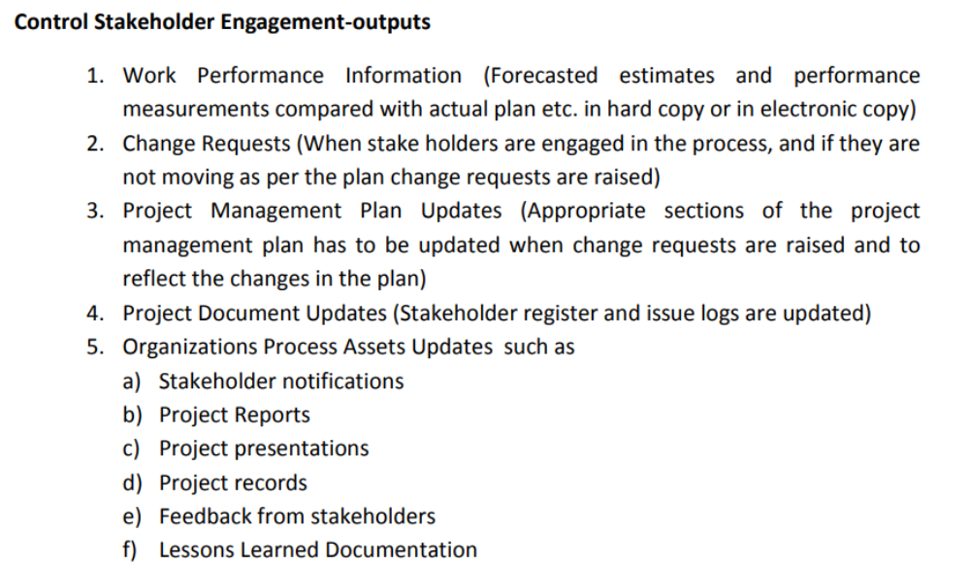

Slide 23
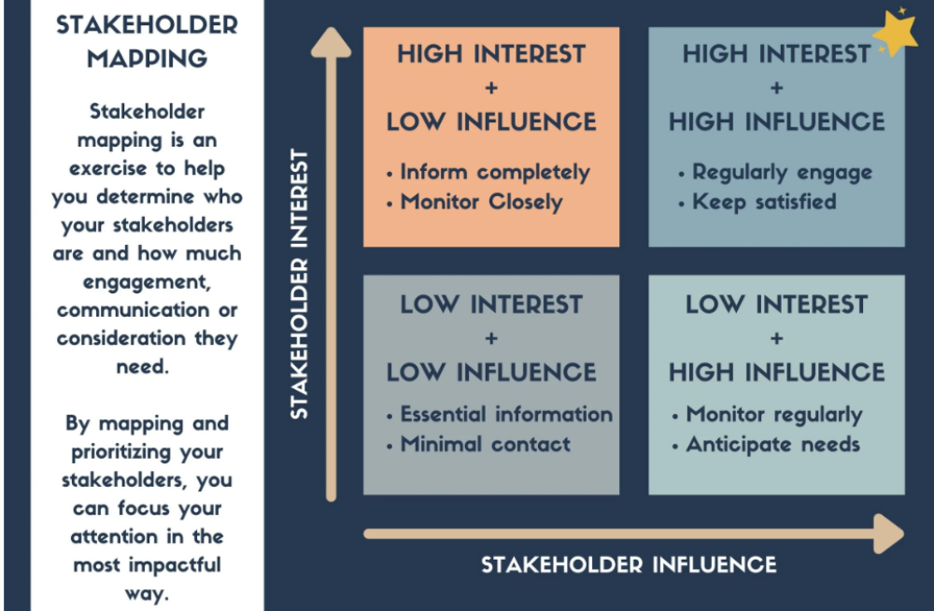

Slide 24
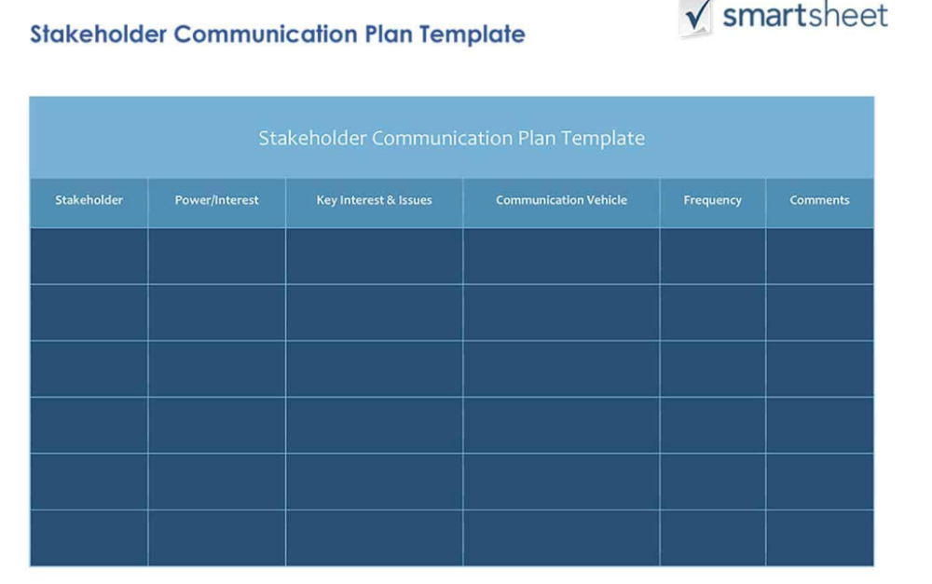

Slide 25
Factors to Consider in a Stakeholder Management Plan
Once you have identified all the types of stakeholders related to your project, you can begin to plan how to manage them over the lifecycle of your project. It’s time to ask key questions, and remember to be honest when assessing your stakeholders and their needs.

Slide 26
Important Factors to Consider
Who are the stakeholders who have the most influence on your project? Typically, these people tend to be mostly on the client side and include their project team, the project sponsor, and the executive sponsor.
Which stakeholders will be most affected by your project? While this group can also include those on the client side, it may also include outside people. With a construction project, for example, those in the neighborhood, environmental activists, and potential residents of the final building could be in this group.
How should you handle important people who actually won’t be considered stakeholders? Keep these people minimally involved since they could have the power to raise concerns or create roadblocks. These people can often be key leaders in their department, and who may need to be kept in the loop on certain things.
Who controls the resources? These stakeholders will likely be on the client side as well as on your agency’s side. You would go to these people if you need to request a scope or budget change or require more allocated resources from a certain discipline.
What are the top motivations and interests of your stakeholders? When deciding the driving force of stakeholders consider:
Who has a financial stake/interest?
Who has an emotional interest (don’t underestimate this; if this project was someone’s “baby,” keeping them happy and in the loop is critical)?
What are the top motivations for each stakeholder?
Who are the biggest supporters of the project?
Who are the biggest non-supporters or naysayers?

Slide 27
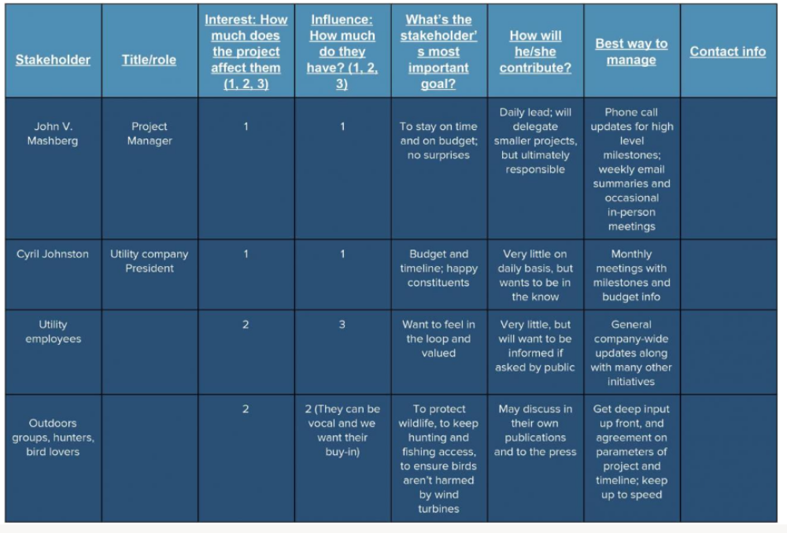

Slide 28
Benefits of Creating a Stakeholder Management Plan
When you use the opinions and influence of your most powerful stakeholders to help shape the project, you and the project will be better equipped for success. Best of all, you won’t waste precious time and resources communicating with those who simply don’t require the information.
In addition, your key stakeholders with the most weight and influence can help you gain resources, prioritize competing demands for resources or timelines, and clear potential roadblocks. So, keeping them happy and feeling positive about the project and its progress is critical.

Slide 29
Vivian Kloosterman, Managing Director at VK Consulting Environmental Engineers Ltd. in New Zealand, and founder of the online business school Continuing Professional Development, which offers courses on stakeholder management, says, “It’s critical to allow for evolution of your project - and the stakeholders. Some stakeholders may be deeply involved early on, and then ‘drop off’ in later stages, while others may join the project long after it’s underway.”
For instance, Kloosterman adds, a building project may involve architects and city planners heavily at first, and much less so later on, while community environmental groups - who are also stakeholders under stakeholder theory - may come into play much later, as the building is erected and begins to function.

Slide 30
Stakeholder Communications: Who Needs to Know What and When?
As you identify the stakeholders and how to manage them most efficiently, you will also start to have the beginnings of your communications plan. Begin with a simple grid filled out with the stakeholders you’ve ranked, and jot down what kinds of communications they would expect and need.
When you are creating this plan, be mindful that while high-level executives want to be kept in the loop on high-profile projects, their time is also quite valuable. A good project manager knows how to balance communications that keep someone important feeling informed, but not bogged down with granular details. Likewise, “extended” stakeholders don’t need to have access to everything about the project, as long as they feel they are being heard and have input. Here is a sample plan:

Slide 31
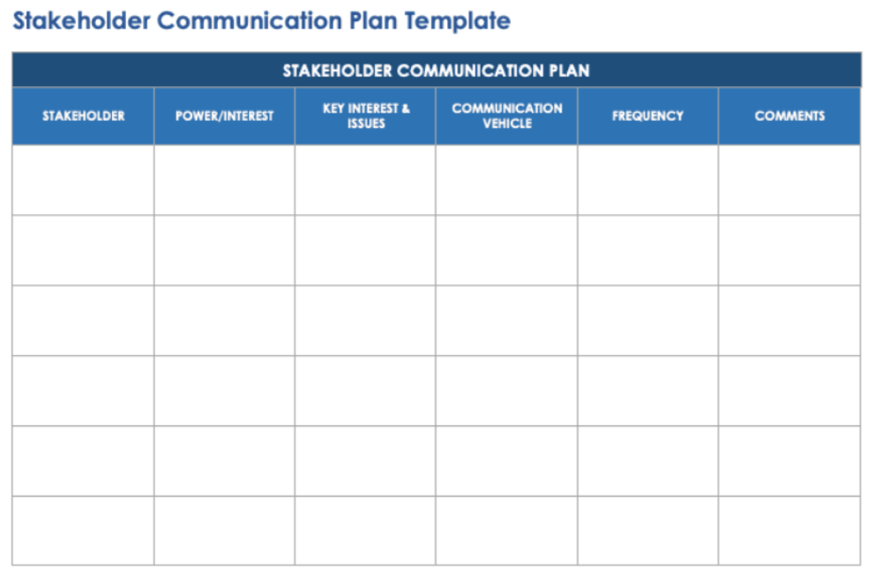

Slide 32
The grid could include rounds of copy and design review as well as daily, weekly, or monthly updates on progress, budget, and upcoming tasks.
You can share the plan with your clients by saving the grid to a shared drive, and use an automated tool to send email updates to the right people at the right frequency.
You might do a weekly high-level report for the clients via a personal email from the project manager.
Internal stakeholders likely will also want to see a burn report - hours forecasted vs. hours spent, and time likely to be spent in the near future.
Some stakeholders (like the executive leads) may need a more formal, less frequent type of communication. Perhaps these stakeholders would prefer a monthly PowerPoint presentation that reports on the status, the features and updates that have been published, the input and feedback that’s been received to date, and so on.

Slide 33
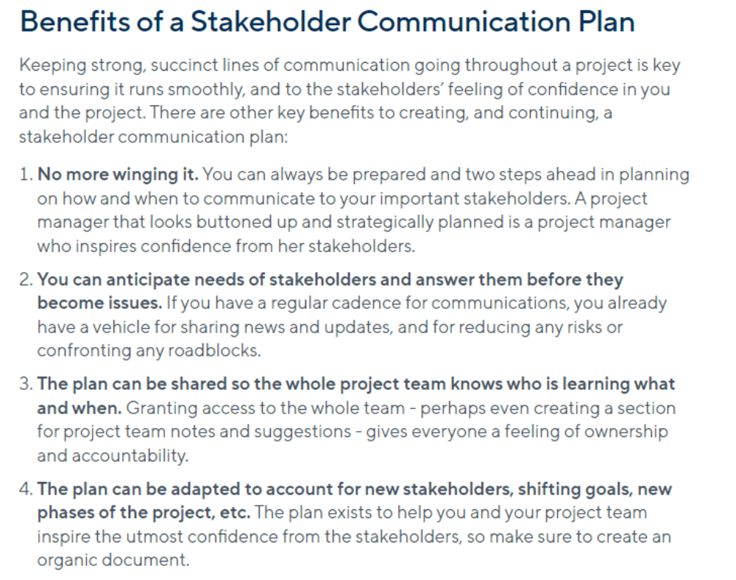

Slide 34
