Slide 1


Strategies and Business Models for
Virtual World
Dr. Neeraj Singh
Marketing & Strategy Area
IIM Rohtak
neeraj.singh@iimrohtak.ac.in

Slide 2
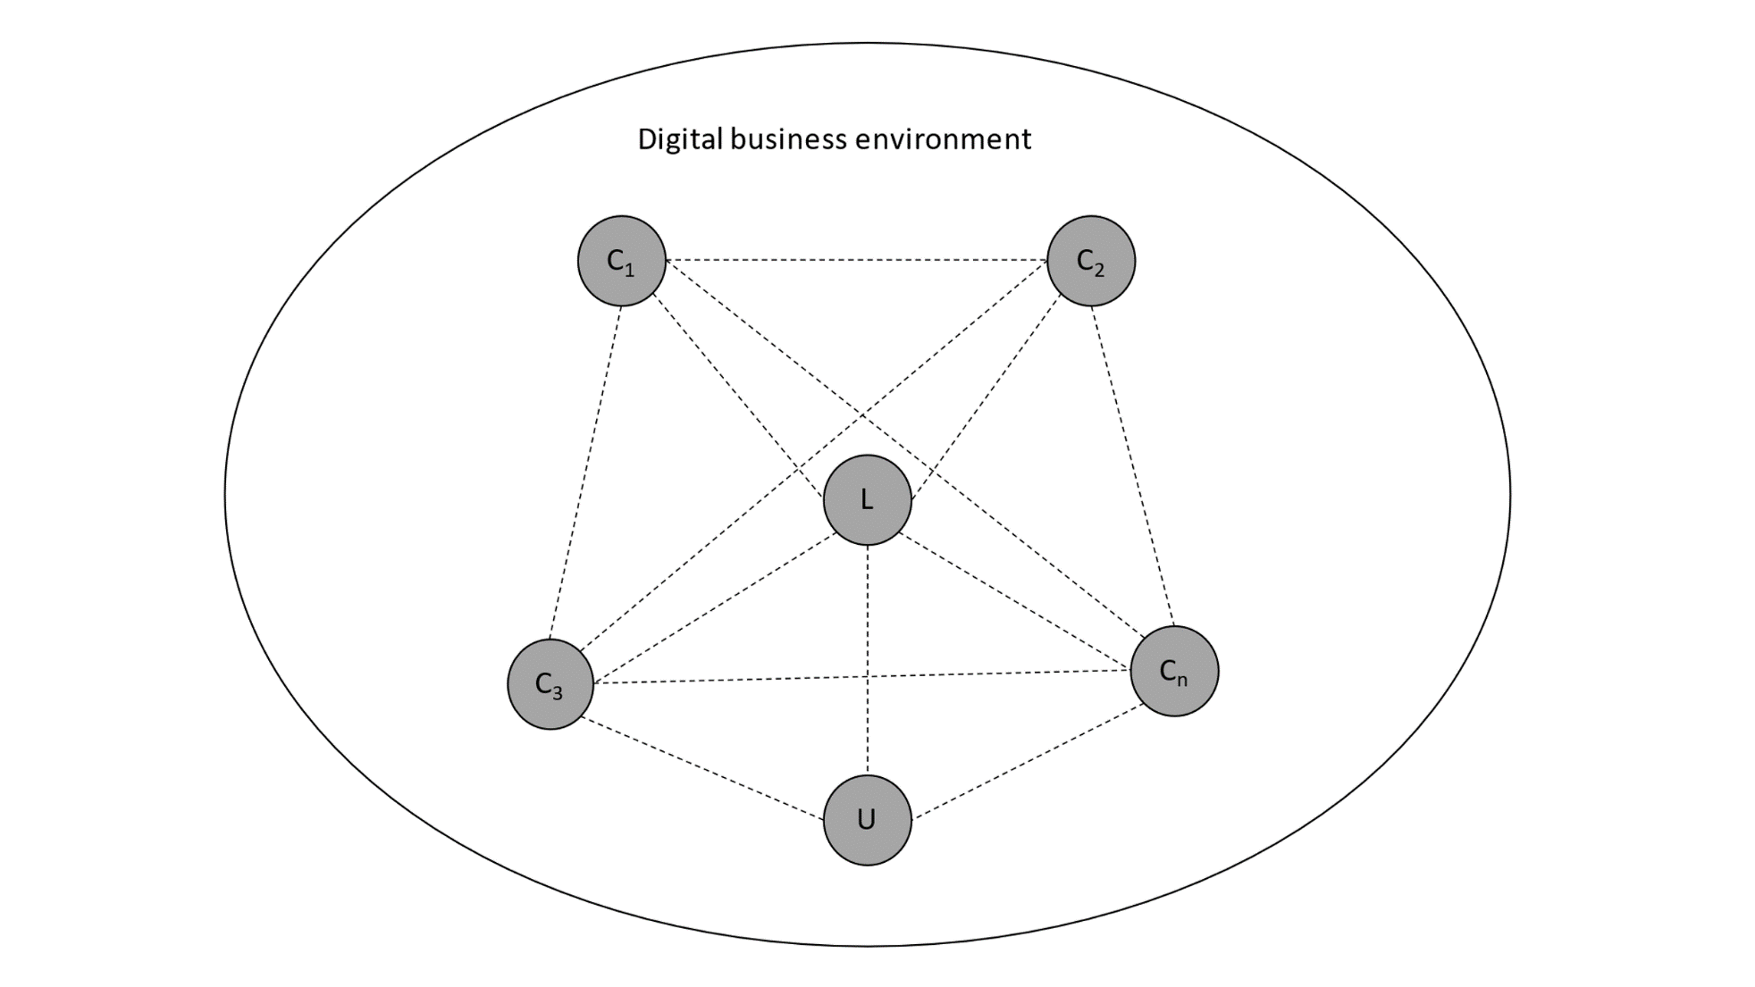
The conceptual schematics of digital platforms
The digital platforms are sociotechnical systems consisting of technical elements, organizational standards, processes, lead firms and a dynamic network of complementors.^{1,2,3}
Complementors on the food delivery platforms (for instance) include: ^{2,3}
  Physical restaurants
  Hyper-local logistic partners
  Technology developers
  Social media modules
  Banks and payment partners (including mobile wallets)
  Real estate entities (For Dark kitchens and cloud kitchens)
Dynamic interactions
Source: Authors’ conceptualization based on literature review.
C₁, C₂, C₃…C_{n} are complementors
L is the lead firm
U is the end users of the platform
De Reuver, M., Sørensen, C., & Basole, R. C. (2018). The digital platform: a research agenda. Journal of information technology, 33(2), 124-135.
Cenamor, J. (2021). Complementor competitive advantage: A framework for strategic decisions. Journal of Business Research, 122, 335-343.
Cusumano, M., Yoffie, D., & Gawer, A. (2020). The future of platforms. MIT Sloan Management Review, 46-54.

Slide 3





Platforms and electronic markets
Point solutions
Aggregation
Platform Integration
Self-organisation
(local-entrepreneurs)
Discuss

Slide 4
Taobao Platform in China: Map the actors
Actor Type | Name of the actor | Role
Complementors | C1 | Role on the platform
 | C2 | Role on the platform
 | C3 | Role on the platform
Lead Firm(s) | L1 | Role on the platform
 | L2 | Role on the platform
Users | U1 | Role on the platform
 | U2 | Role on the platform

Slide 5
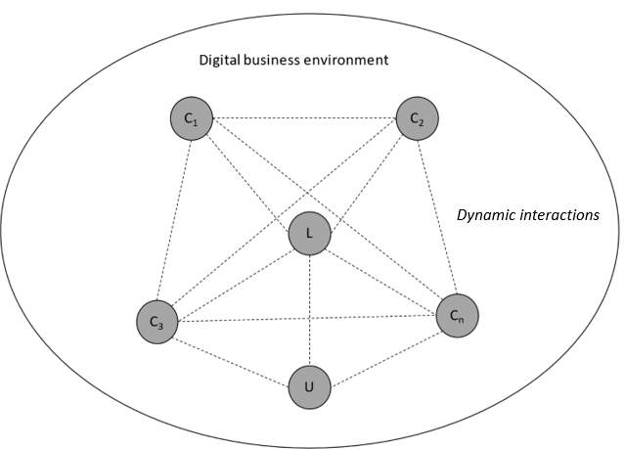
Taobao Platform in China: Map the actors
Taobao is a Chinese online shopping platform. It is headquartered in Hangzhou and is owned by Alibaba. According to Alexa rank, it is the eighth most-visited website globally in 2021. Taobao.com was registered on April 21, 2003 by Alibaba Cloud Computing (Beijing) Co., Ltd. Taobao Marketplace facilitates consumer-to-consumer retail by providing a platform for small businesses and individual entrepreneurs to open online stores that mainly cater to consumers in Chinese-speaking regions (Mainland China, Hong Kong, Macau and Taiwan) and abroad, which is made payable by online accounts. Its stores usually offer an express delivery service. Sellers are able to post goods for sale either through a fixed price or an auction. Auctions make up a small percentage of transactions, whereas the majority of the products are new merchandise sold at fixed prices. Taobao users usually read feedback and compare items from multiple shops. Taobao's popular payment platform is Alibaba's Alipay With over 1 billion product listings as of 2016, the combined transaction volume of Taobao Marketplace and Tmall.com reached 3 trillion yuan in 2017. eBay acquired Eachnet, China's online auction leader at the time, for US$180 million. It became a major contender in the Chinese consumer e-commerce market. To counter eBay's expansion, Taobao offered free listings to sellers. It introduced instant messaging for facilitating buyer-seller communication and an escrow-based payment tool: Alipay. Taobao became mainland China's market leader within two years. Its market share grew from 8% to 59% between 2003 and 2005, while eBay China dropped from 79% to 36%. eBay shut down its Chinese site in 2006.
In October 2010, Taobao beta-launched eTao as an independent search engine for online shopping to provide and merchant information from a number of major consumer e-commerce websites in China. Online shoppers would be able to use the site to compare prices across sellers. According to the Alibaba Group web site, eTao offers products from Amazon China, Dangdang, Gome, Yihaodian, Nike China and Vancl, as well as Taobao and Tmall. In June 2011, Jack Ma, executive chairman and former chief executive officer of Alibaba Group, announced that Taobao would split into three different companies: Taobao Marketplace (a consumer-to-consumer platform), Tmall.com (a business-to consumer platform, then called Taobao Mall), and eTao (a search engine for online shopping). The move was said to be necessary for Taobao to “meet competitive threats that emerged in the past two years during which the Internet and e-commerce landscape has changed dramatically.” In 2012 Taobao began to accept international Visa and MasterCard credit and debit cards. On 29 April 2013, Alibaba announced an investment of US$586 million in Sina Weibo. According to Reuters, the deal “should drive more web traffic to Alibaba's Taobao Marketplace”. On August 1, 2013, Alibaba launched Weibo for Taobao, which allows users to link Sina Weibo accounts with Taobao accounts.

Slide 6
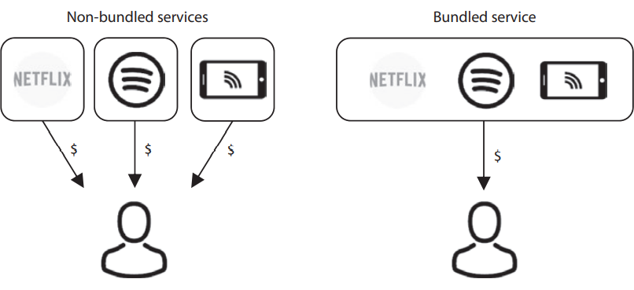
E-Bundling
Product or service bundling means that several products or services are combined and offered for sale as a single package.
Pure bundling means that consumers can only buy the bundled package without the opportunity to buy the single products or services in the package
Mixed bundling means that a consumer has the option to buy the package as well as the single products or services constituting the package. In general, the price of the bundle is lower than the sum of the price of the individual services constituting the package.

Slide 7
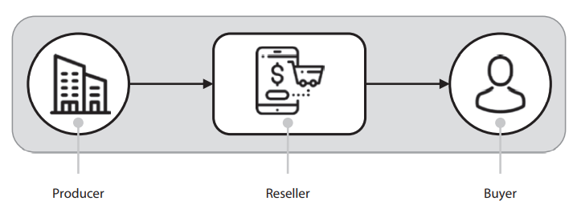
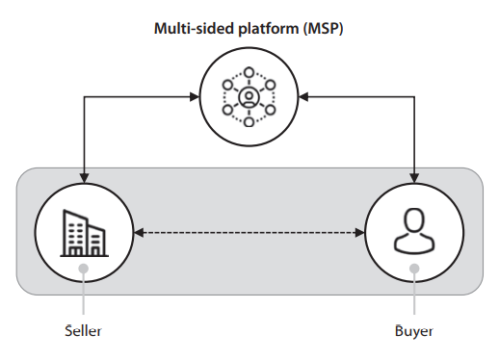
Trade Process on Platforms
The MSP is one of several ways to organize a company.
Figure illustrates a trade process for an MSP. The MSP mediates contact between the seller and the buyer. Observe the similarities between the MSP and the value network.
The trade—including the few of goods, services, and payment—is done directly between the seller and the buyer and facilitated by the MSP.
The MSP is not directly involved in the exchange of goods.

Slide 8
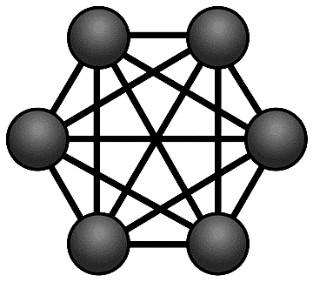
Network effect make platform an attractive alternative for Users and complementors
Network effect: Value attached by a complementor/user planning to join a platform to other participants already onboard
The number and type of complementor groups attract the new users
Restaurant
logistic
I
Direct effect (D): Value attached by a user to the same group of complementors
Indirect effect (I): Value attached by a user to the different group of complementors
USER
Tech
Bank/
Wallet
I
D
Lead firm
_{User}

Slide 9
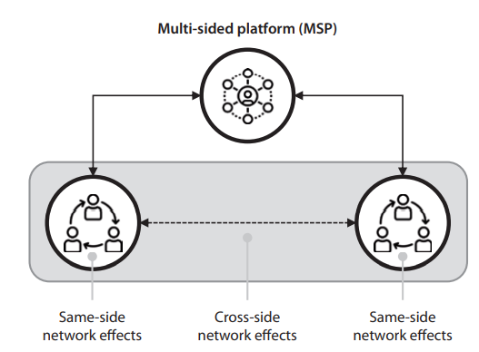
Network Effects on Platforms
The platform mediates between two user groups as well as between users within each user group.
If the network effect involves only one side, it is called a same-side network effect.
If it has an impact on the other side, it is called a cross-side network effect.
It is worthwhile to repeat that network effects are positive feedbacks from the market and that the mere nature of positive feedback is such that the market cannot be in equilibrium unless the market is saturated (there are no more potential customers). Therefore, equilibrium theory is not applicable to markets where network effects are present

Slide 10

Value created by a Social Network:
Case of the hypothetical platform ‘IIMR econnect’
Metcalfe’s Law
Metcalfe’s Law is frequently brought up when discussing the phenomenon, as it states that the value of a network grows in proportion to the square of the number of users within the network. Value= financial value or impact
IIMR econnect
IIMR econnect
IIMR econnect
Year 2016
Year 2019
Year 2022
N=88
N=188
N=1088
Find Value₂₀₁₆: Value ₂₀₁₉: Value₂₀₂₂

Slide 11
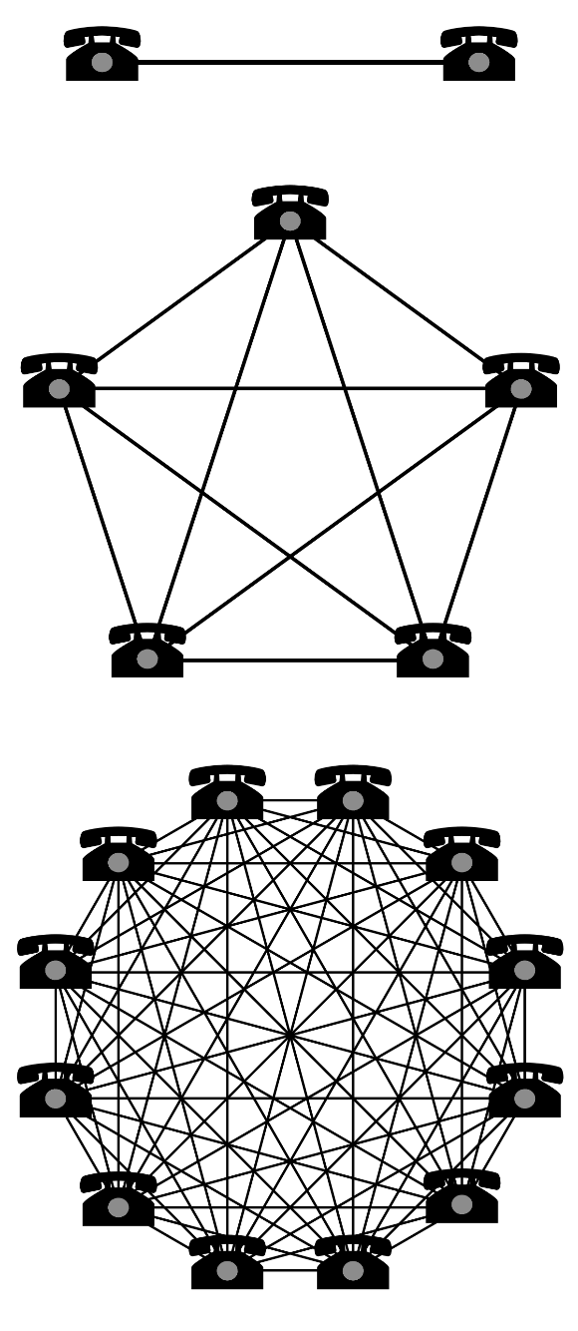
Discuss:
Which type of network effect is at play ?
Is there a tipping point ?

Slide 12
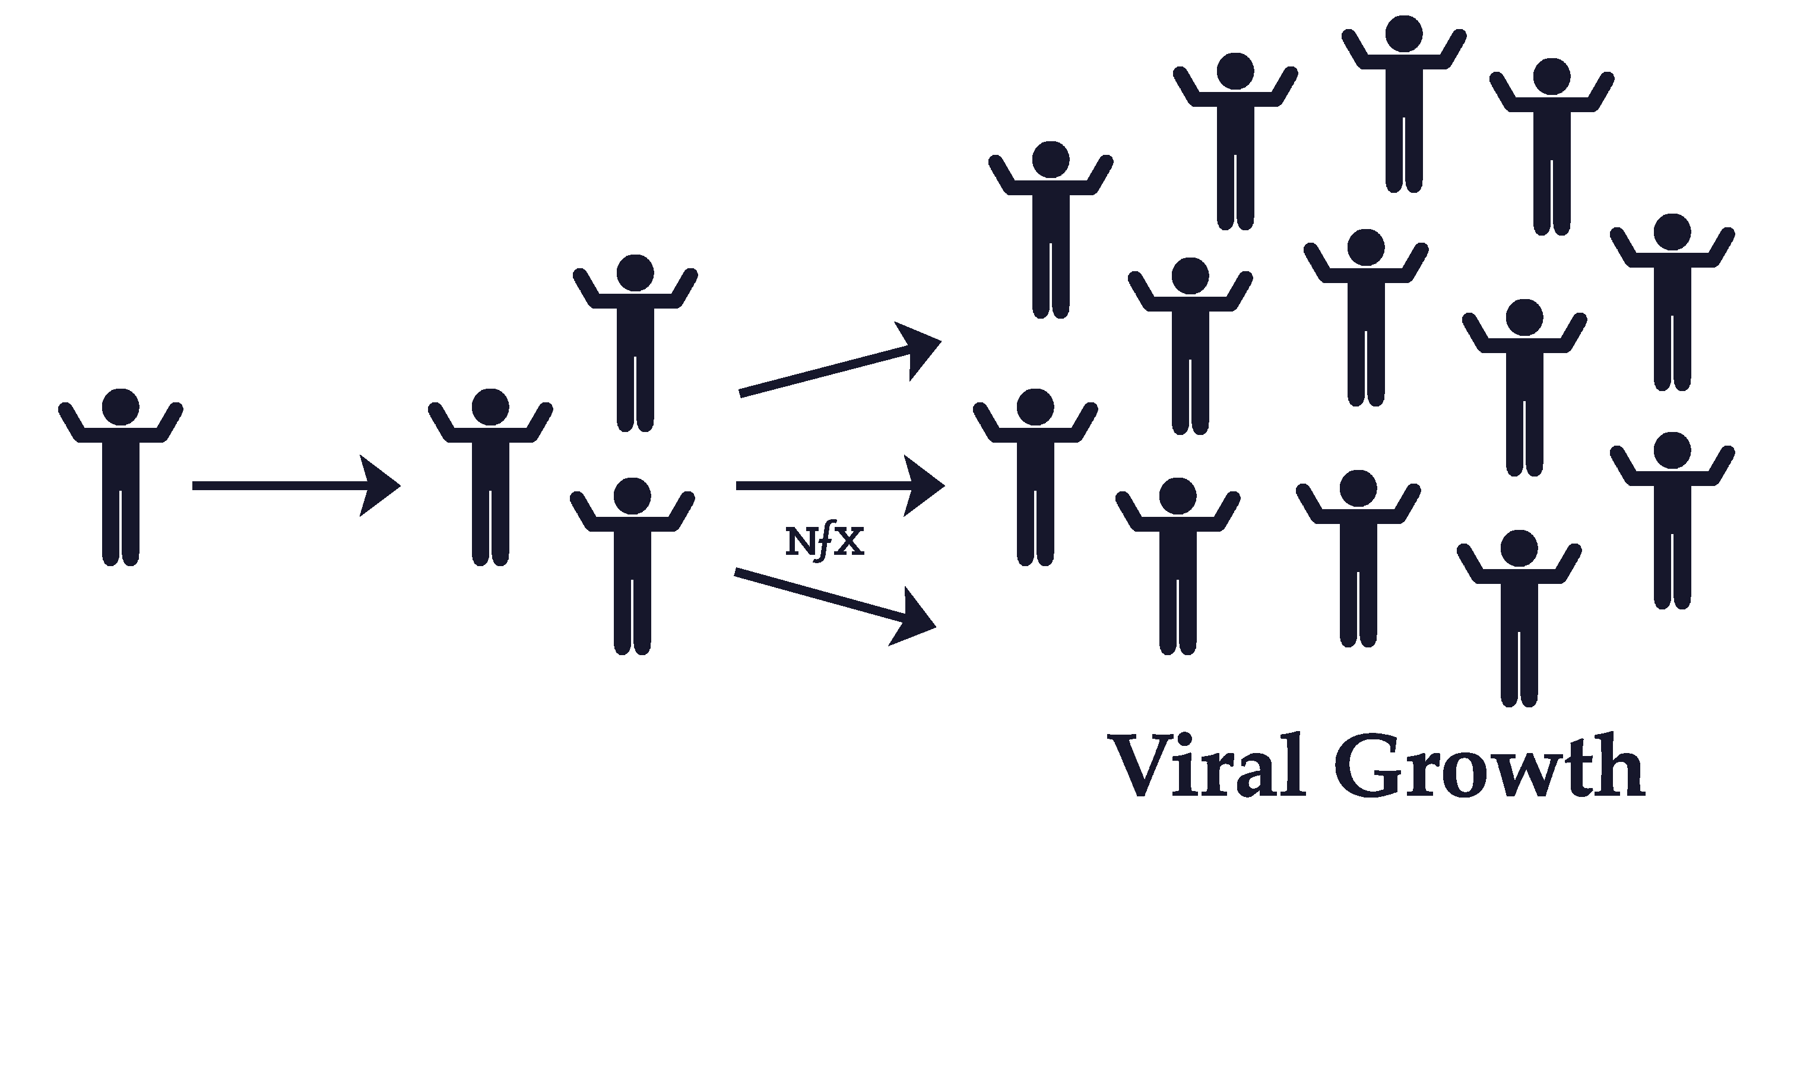
Network effect is not Viral Effect
A ‘Youtube Shorts’ video got viral among young users.
Initially, it was viewed by 1500 Gen Z Users at t=0. The count doubles every half an hour.
Find the size of the user population after 2 hours.
Source: https://www.nfx.com/post/viral-effects-vs-network-effects

Slide 13
Some of the major characteristics of MSPs are associated with network effects, pricing, competition, business ecosystem, and market regulation (Ardolino et al., 2020).
Characteristics of MSPs
Network Effect
Pricing
Competition
Business Ecosystem
Market Regulation
The network effects may sometimes lead to winner-take-all markets where one platform supplier after some time becomes a de facto monopoly.
An MSP often benefits from a reduced price of the goods or services mediated between the sellers and the buyers.
Competition: The platform may compete directly with other platforms offering the same services or compete with entirely different platforms for certain types of customers or competition between the customers of the same type.
Because of the complex interactions among the various types of customers, the use of standard business modeling tools may not capture all strategic issues related to MSPs.
Intricate competition and complex ecosystem make it even harder to regulate MSP businesses.

Slide 14
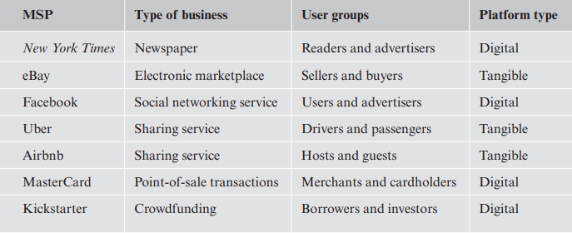
Characteristics of Multisided Platforms
MSPs offer several benefits to the users, including:
They offer uniform, simple, and secure login procedures and ease of use.
They offer simple and transparent ways of connecting customers with matching interests through built-in matchmaking mechanisms
They offer efficient transaction management, thereby simplifying search, reducing management costs, and streamlining administrative and payment processes.
They may also assist in trust-building between users within the same group or between users in different groups
There are two main types of MSPs: digital MSPs and tangible MSPs.
Digital MSPs mediate the exchange of digital goods and services
Tangible MSPs mediate the exchange of physical goods and non-digital services.

Slide 15
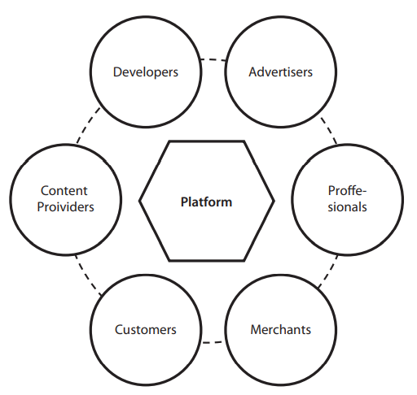
Platforms are not always Digital
Physical Platforms (Newspaper)
One generic model for MSPs consists of six types of stakeholders in addition to the platform itself: content providers, advertisers, developers, professionals, merchants, and consumers (Gautier & Lemesch, 2020).

Slide 16
Digital Goods and Services

Slide 17
A digital good is a networked zero marginal cost virtual object having value for some individuals or organizations.
A digital service is a networked zero marginal cost service that has value for individuals or organizations.
A digital good has, in addition, the following properties (Fournier, 2014):
The virtual object is intangible but can be stored as data on a digital medium,
The virtual object can be replicated without any incurred cost; that is, the marginal production cost of the object is zero
The virtual object is networked.
The virtual object must have financial, psychological, or other value for the consumer (individuals or organizations).
Services are intangible by nature. Digital services include posting news on social media, electronic banking, Internet access, multiplayer online gaming, web browsing, and composing and sending e-mails
Network access and transmission of data over fixed and mobile networks, as well as data storage and data processing, are also digital services and these are called enabling or fundamental technologies.
Offering enabling services as a commercial product has become a new business arena referred to as Anything as a Service (XaaS), also known as cloud computing.

Slide 18
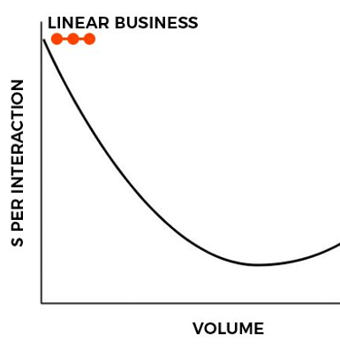
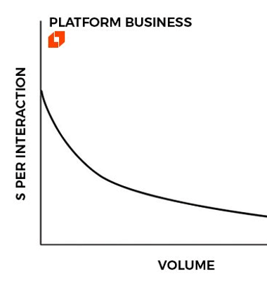
Marginal Cost (Unit cost of replication and delivering to the consumers/ users)

Slide 19
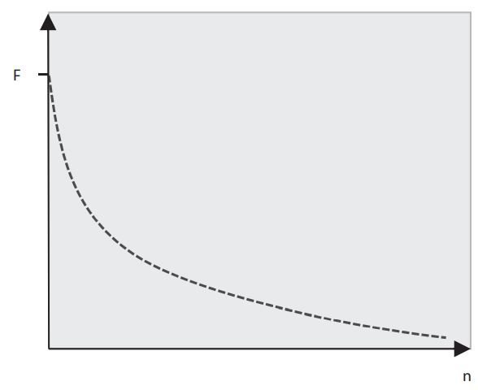
Zero Marginal Cost
Marginal cost is the cost of producing one additional unit of a good or service. Digital goods and services have zero marginal cost.
Digital goods may have high fixed costs since some of them are expensive to develop, build, and operate.
The relative gap between fixed and marginal costs is descriptive for digital goods. For example, the average cost of a copy of the digital good equals:
$$AC=\frac{F}{n}+MC=\frac{F}{n}$$
where AC is the average cost, F is the fixed costs, n is the number of copies of the good produced during its lifetime, and MC is the marginal cost.
The average cost as a function of the number of units produced.

Slide 20
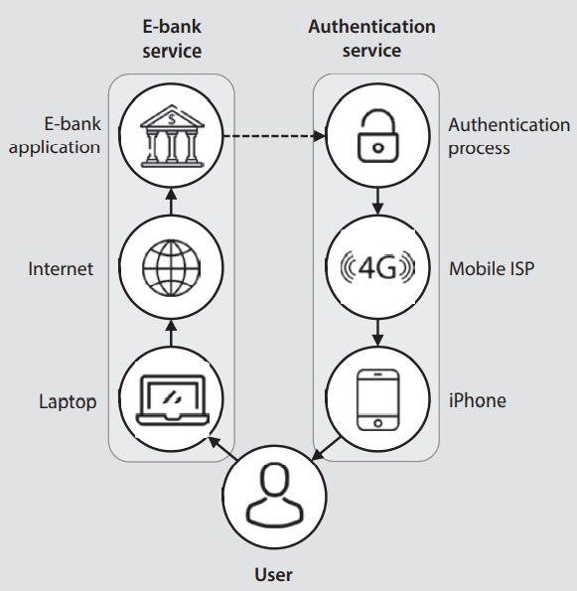
Digital goods and services are different from physical products (or tangible goods). Physical products have presence in the physical domain, while digital goods are built up by sequences of bits and exist only as pieces of software or data stored on computers or other storage devices.
Digital goods and services may be combined to form larger and more complex digital goods and services before being offered to consumers
One simple example is the use of the secure digital payment solution offered by Google Play where the same platform is used to support the app software, to pay the developer for use of the and to collect payments from the user.
A similar but more complex example is to use smartphones as authentication tokens for secure access to bank accounts

Slide 21
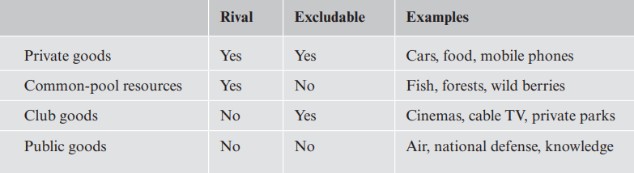
Classification of Digital Goods
A good is classified as rival if it is reduced in quantity after consumption or if the usage of the good prevents others from using it.
A non-rival good is the opposite of a rival good; it is neither reduced by consumption nor does the usage of the good prevent others from using it.
An excludable good is such that it is possible to prevent consumers from accessing or using the good.
A non-excludable good is such that consumers cannot be prevented from accessing or using the good.

Slide 22
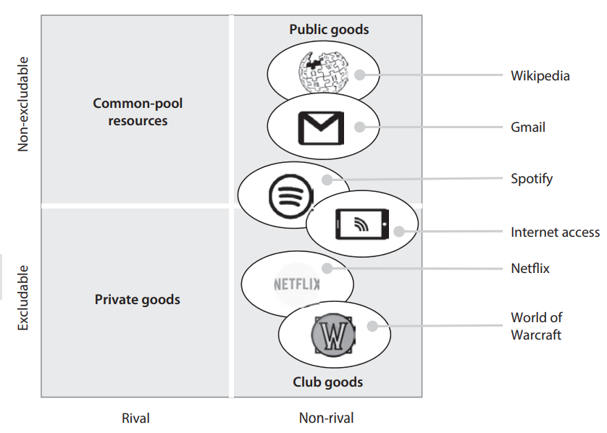
Digital goods and services are non-rival by nature. Digital goods and services can be either excludable or non-excludable.
If a digital good is both non-rival and non-excludable, it is classified as a public good.
Public goods are frequently susceptible to market failure. One of the reasons for market failure is the free rider problem.
A common-pool resource is prone to the tragedy of the commons, in which common resources get overused and depleted.

Slide 23
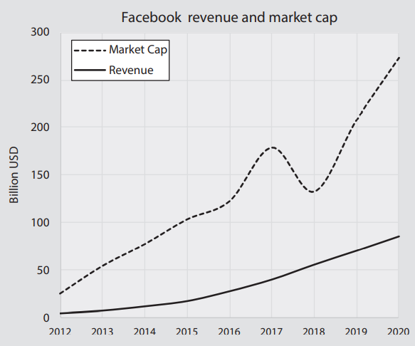
Zero Average Revenue per User
Average revenue per user (ARPU) states how much revenue an average user is generating over a specific period of time.
In the digital economy, several companies operate with zero average return per user (ARPU = 0), in which case the company does not receive any revenue from the consumers at all. For example- Facebook.
ARPU = 0 is not a universal rule applicable to all digital services. Netflix, for example, has an ARPU >0 because consumers pay to access the service
Facebook revenue and market cap 2012–2020

Slide 24
Digital Commodities
Transaction Costs
Commoditization is the process by which digital goods (or any good or service in general) end up being indistinguishable from a consumer’s point of view.
Digital goods that have been commoditized compete only on price.
The zero-marginal cost attribute of digital goods causes fierce competition among businesses that provide them to drive down prices to zero and this drives majority of them to go out of business as sales fall and expenses increase.
In order to avoid price war companies either make their product unique or apply creative business models→ Differentiation
The transaction cost is the cost associated with the process of selling and buying. Transaction costs can be divided into three categories:
Search and information costs are the costs of searching for a particular good and determining its price and properties.
Bargaining costs are the collective costs for the consumer and the provider to agree on the terms of the contract. This includes the price and delivery conditions of the good.
Policing and enforcement costs are the costs of sticking to the agreement and taking appropriate action if the agreement is not upheld by either party.

Slide 25
Digital Value Chains
The value chain can, in its simplest form, be represented as a linear chain consisting of three elements: logistics in (retrieval of raw material, components, or services), the production of goods, and logistics out (delivering goods to the market). In addition, there is a need for common activities such as management, buildings, inventory, storage facilities, and research
The classical and perhaps most influential paper concerning the strategy of industrial companies was written by Michal Porter in 1979 (Porter, 1985).
Porter’s model was developed for analyzing the industrial company’s conversion of raw material into final tangible products sold to consumers. These companies are categorized as value chains
In 1998, Stabell and Fjeldstad published a paper proposing two additional types of companies using completely different ways to produce their product: value shops and value networks
Most companies in the digital economy are value networks. The value network is closely related to multisided platforms (MSPs)

Slide 26
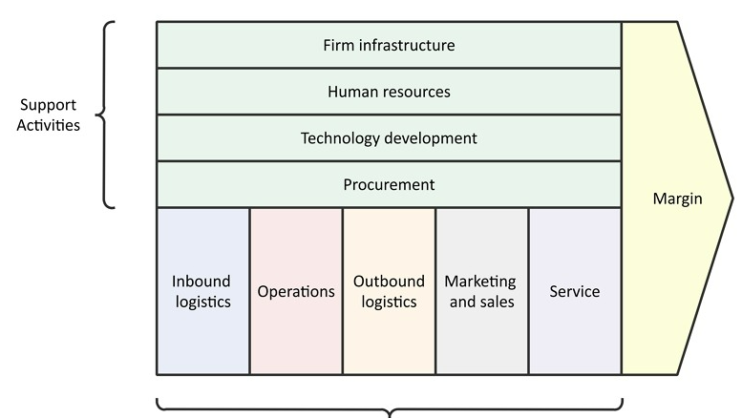
Value Chain

Slide 27
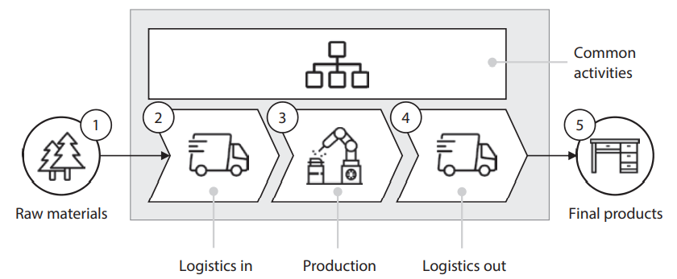

The logic behind the value chain is that the cost of a single item of a good can be computed as-
(m) : cost of raw materials needed for each item
: the cost of producing a single item
: the cost of shipping the item to the market
: the cost of the common activities
(n) : no of item
C= m + p + s + $\frac{A}{n}$
The major strategy of the chain is to reduce the cost per item. The marginal cost (or incremental cost) as n → ∞ is then
MC = m + p + s > 0
This is the lowest achievable cost per item.

Slide 28
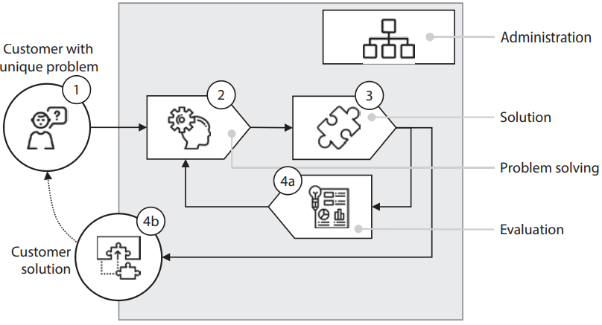
The value shop is a problem-solving organization such as consultants, health services, engineering companies, and architects.
Value shops earn more money the better and faster they can solve a problem. Their most important competitive market force is their reputation.
Value shops depend on customers or clients who have problems they cannot solve themselves. There are several mechanisms allowing a value shop to solve problems better or faster than the client himself, including:
  The shop knows more about the problem than the client.
  The shop possesses specialized methods to deal with the problem.
  The employees are expert professionals in the relevant field.
  The shop can form flexible project teams and is able to reorganize quickly to solve new problems.
The value shop

Slide 29
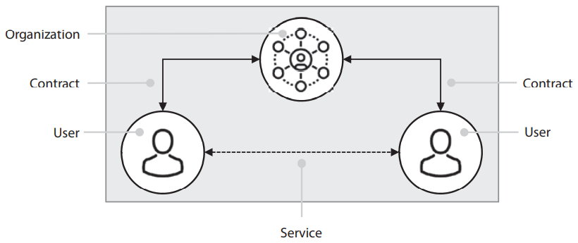
A value network is a business mediating between members of a market.
The mediation relationships in the value network can be represented as links between interacting stakeholders. These links form a network called a value network
Value networks consist of four components:
  An organization that provides the services
  Customers or users in the network
  Services enabling interaction between the customers or users
  Contracts that permit customers or users access to the services
The value network is not a physical network but an abstract network of relationships between stakeholder

Slide 30
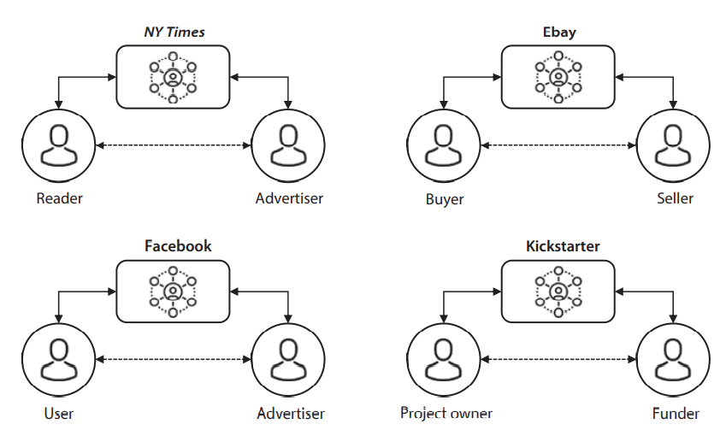
Examples of value networks
The competitive strength of several value networks depends not only on the quality of the product they deliver but also on the number of users they have been able to capture and, in particular, how these users stimulate other people to become members of the network
NY Times, which mediates between the readers of the newspaper and the merchants advertising merchandise and services;
eBay, which mediates between the sellers and buyers of goods; Facebook, which mediates between the users of the social media and the advertisers
Kickstarter, which mediates between the project owners and the funders.

Slide 31

The cost of one item of a service in a value network can be expressed as follows:
$$C=m+\frac{A}{n}$$
Direct cost / Marginal cost (m): In many cases, the direct cost per item is zero. For example-The cost of producing and sending one more bit in the telecommunications network is negligible.
Common costs (A): Since the direct costs are often negligible, the dominant costs of the value network are the common (or fixed) costs. These costs are the total cost of running the company and producing and marketing the services.
Number of items (n): What is the volume of production? For a producer of digital books, this is obviously the number of digital books sold. In a communication network, it may be the number of subscriptions.
In several value networks, the cost of producing one item of a good or service is zero.

Slide 32
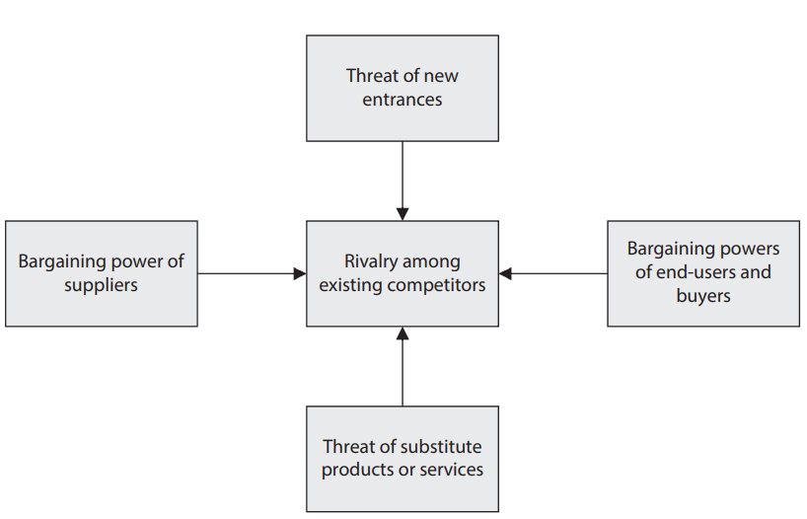
Porter’s Five Forces
One important strategic evaluation of both tangible and digital markets is the five forces model proposed by Porter (Porter, 1979).
The purpose of the model is to identify which external forces that may act on a company and how these forces may influence the market performance of that company
The five forces are:
  Competitive rivalry is the same as standard competition between providers of identical goods.
  Threat that new entrants may enter the market making it less profitable for existing providers of the good
  Bargaining power of end users and buyers is related to network externalities such as user feedback and the influence users may have on the price of goods and the consumption of freemium or free goods.
  Bargaining power of suppliers has to do with the price they may charge for raw materials, semi-products, contents, and services needed in the production of the good. It also includes the availability of raw materials and other inputs the company needs.
  Threat from substitutes is that the good may be replaced by an entirely different product offering the same or better user satisfaction.

Slide 33
Later, a sixth force was added to Porter’s model. Different authors attributed different interpretations of what this force is (Brandenburger & Nalebuff, 1995):
Complementors are companies that produce or sell products for which the demand is positively correlated to the demand of a given product. These products are called complementary products.
Complementarity may be either unilateral or bilateral.
  Unilateral complementarity occurs when the product of one company depends on the product from the other company but not vice versa.
  Bilateral complementarity means that each product cannot exist without the other product
Governments decide rules for competition and oversee that the rules are followed. In the telecommunications market, regulations may include license of operation, maximum and minimum price of services and subscriptions, conditions for lease of network resources, use of the frequency spectrum, conditions for interconnectivity of customers in different networks, and number portability.
Governments may also regulate the business of application service providers, for example, via licensing, taxation, law regulations, and censors
The public is made up of more than just users and buyers.
Society has numerous written and unwritten rules that may influence the market of a company. Some of these rules are ethical; for example, a company may sell products which are made by suppliers who employ child workers, cause pollution, or prohibit workers to form labor organizations. This company may meet strong hostility in the market.

Slide 34
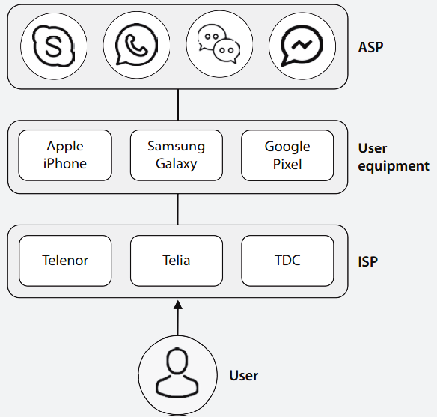
Competition, Cooperation, and Coopetition
Companies compete within the same business layer. The companies may cooperate both within the same business layer (horizontal cooperation) and across business layers (vertical cooperation). Coopetition implies that a company simultaneously competes and cooperates with other companies within the same business layer.
The figure shows how a user of a chat service can choose between various providers at all three business levels independently-
Cooperation between Skype, Telenor, and Apple iPhone is required to provide the chat service to some users, while Telia, Samsung, and WeChat must cooperate to provide chat services to other users. This is vertical cooperation.
For the chat service, a customer using an iPhone may be a subscriber of Telenor, while the server providing the chat service is attached to the network of Telia. This is called horizontal cooperation.
These companies also compete for the same customers. As explained above, this market behavior is called coopetition.

Slide 35
Value proposition of platform
DMTE as a cycle
Discovery
Matching
Transaction
Evaluation
4. The platform provide mechanism for evaluation and feedback of product and services offered
1. Reduce search cost for one entity, transaction may not occur on platform.
2. Reduce search cost for both interested entities, transaction may not occur on platform
3. The transactions are subsumed in the platform
Srinivasan, R. (2021). Platform Business Models. Springer.
Kanoria, Y., & Saban, D. (2021). Facilitating the search for partners on matching platforms. Management Science, 67(10), 5990-6029.
Hänninen, M. (2020). Review of studies on digital transaction platforms in marketing journals. The International Review of Retail, Distribution and Consumer Research, 30(2), 164-192.
Bonina, C., Koskinen, K., Eaton, B., & Gawer, A. (2021). Digital platforms for development: Foundations and research agenda. Information Systems Journal, 31(6), 869-902.
.

Slide 36




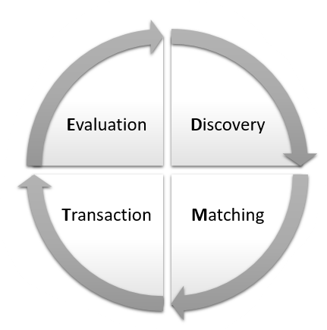





Discussion
Map these platforms based on their value proposition

Slide 37
Business model
Business modeling as a tool for strategic business analysis was developed in the beginning of the twentieth century.
One of the first business models was the “bait-and-hook” business model, in which a basic product is first offered for free or for a very low price, while necessary add-ons are sold for a high price.
For Example- Adobe PDF software suite, in which the software needed to read PDFs is free (bait), while the software needed to generate a PDF is expensive (hook).
A business model describes how an organization (or company) creates, delivers, captures, and keeps value (Ovens, 2015). The model consists of items such as:
  How the organization earns money and controls expenditures
  Economic and organizational aspects of the organization
  Competition and market evolution
  Interrelationships between the organization and its customers, key partners, and other stakeholders

Slide 38
A business model describes how an organization creates, delivers, captures, and keeps value.
Creates
Delivers
Captures
Keeps
The business process consists of the following elements
A digital business model is a business model applied to digital goods or services. Digital business models are facilitated by the widespread use of the Internet, mobile technologies, smartphones, and fast and small computers
New business models based on digital technologies are developed as they advance and are embraced by the general public. For example- the music industry which has been radically changed after the introduction of small and powerful music devices (e.g., the iPod) and online streaming services (e.g., Spotify)

Slide 39
A digital company need not own the goods they are selling as exemplified by the business models of eBay, Airbnb, and Uber. The business model of these companies is to offer a platform for mediation between buyers and sellers of tangible or intangible goods.
The most significant contribution of ICT to business modelling may be the business of connecting users or diverse user groups. This move from business models for value chains to business models for value networks is comparable.

Slide 40
The Business Model Canvas
Alexander Osterwalder proposed the business model ontology as part of his Ph.D. thesis in 2005. Later, this business model ontology was refined to become the business model canvas (BMC).
The BMC is based on describing nine central building blocks of a business and modeling the relationships between these building blocks.
Value proposition is the core building block of the BMC.
Value turnover includes four building blocks: customer segments, channels, customer relationships, and revenue stream. These building blocks describe how the organization disseminates its value proposition to the customers and how the customers generate revenues for the company
BMC
Value proposition
Customer segments
Channels
Customer relationships
Key activities
Key resources
Key partners
Cost structure
Revenue streams

Slide 41
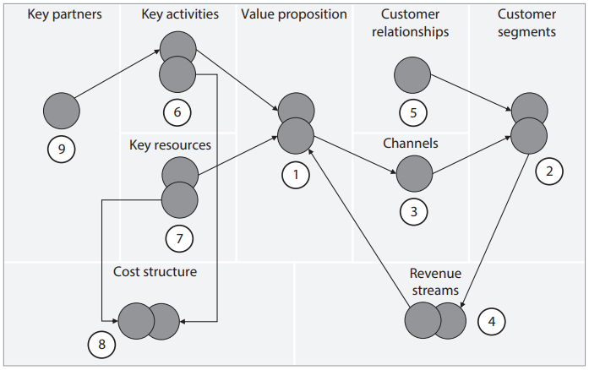
Value generation includes the building blocks of key partners, key activities, key resources, and cost structures. More specifically, it describes what is needed in terms of resources, activities, and partners to create the value proposition and the costs associated with these activities.
The BMC of specific organizations is a thorough description of each of the nine building blocks and the relationships between them. . Figure shows an example of these relationships.

Slide 42
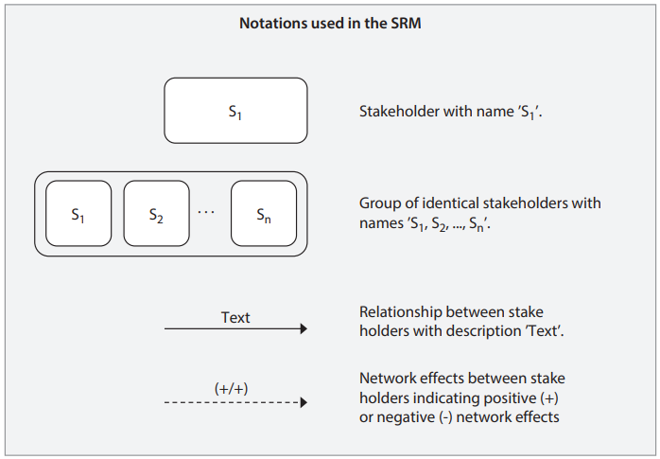
The Stakeholder Relationship Model
The stakeholder relationship model (SRM) identifies key stakeholders engaged in the organization’s business model and the interactions that the organization has with these stakeholders.
Stakeholders in the SRM are the organization itself, customer segments, and key partners. One key relationship between stakeholders is network effects which can either be positive or negative
The SRM models three different kinds of network effects between two stakeholders, A and B: (+/+), (−/−), and (+/−). The (+/+) network effect means that stakeholder A induces a positive network effect on stakeholder B and vice versa.
The purpose of the SRM is illustrating the network effects that may modify the competitive strength of the organization

Slide 43
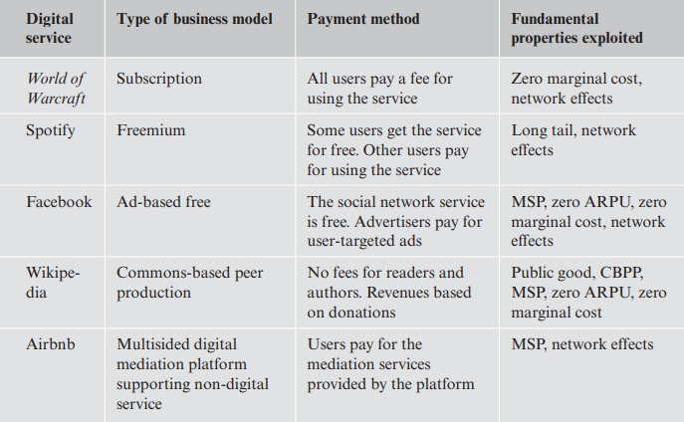
Digital Business Models
In a digital business model, the value proposition is a digital good or service
Case studies present five examples of digital business models that have had a substantial impact on the evolution of the digital economy

Slide 44
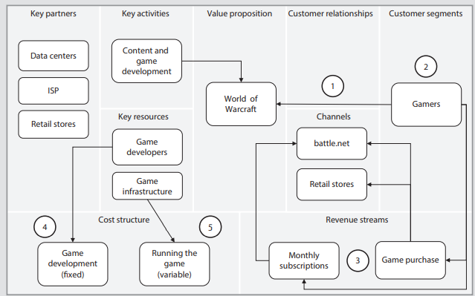
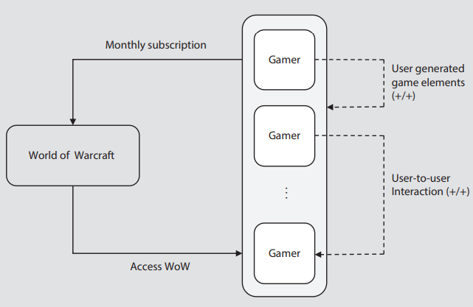
Case Study-I World of Warcraft
Blizzard’s online game, World of Warcraft (WoW), is a digital service based on the subscription business model.
The value proposition of WoW consists of giving gamers access to the game and the persistent world’s content.
1). The only defined customer segment is gamers 2). The gamers pay monthly subscription fees to access the game in addition to purchasing the game itself.
WoW modeled using the SRM
Wow modeled using the BMC

Slide 45
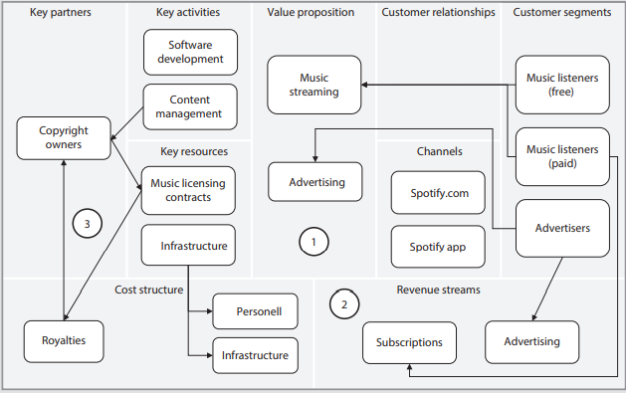
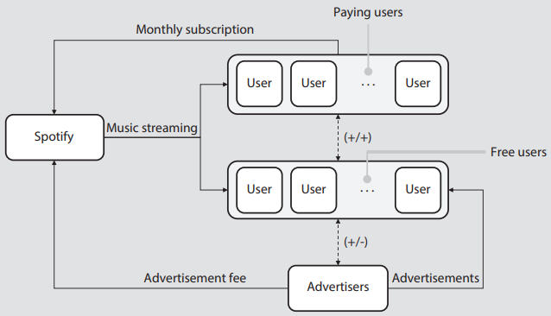
Case Study-II Spotify
Spotify is an example of a digital service that uses the freemium business model. Here, the digital service is offered to two different consumer segments: One gets the service for free and other pays for the service
Spotify has two value propositions
  one for music streaming services and one for advertisements. The subset of listeners paying for the service contributes to the revenue of Spotify
  This corresponds to about 90% of the revenue (2017). The other source of revenue—advertisements— constituted about 10% of the income (2017).
Spotify modeled using the SRM
Spotify modeled using the BMC

Slide 46
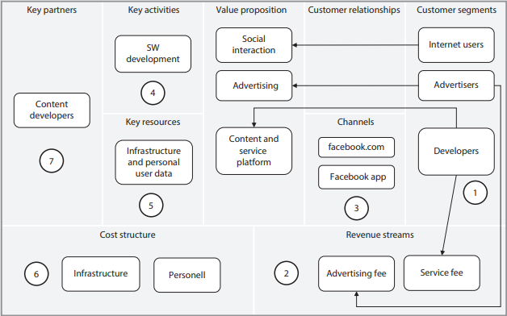
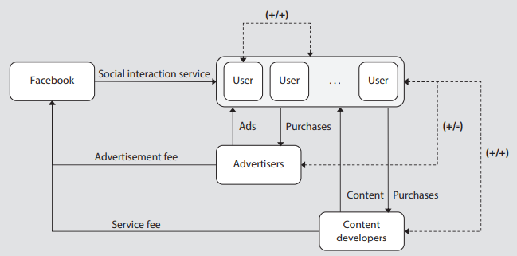
Case Study-III Facebook
Facebook offers a social networking service in which users can interact, socialize, share pictures and videos, play games, and use other professional content. Facebook uses the ad-based free business model.
Facebook offers three value propositions to three different customer segments: users involved in social interactions, advertisers, and third-party.
About 90% of Facebook’s revenue is from advertisements
Facebook modeled using the SRM
Facebook modeled using the BMC

Slide 47
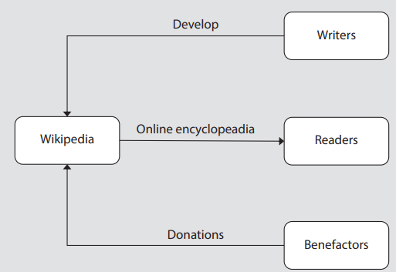
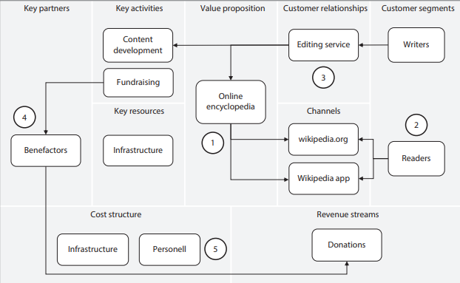
Case Study-IV Wikipedia
Wikipedia is an example of the commons-based peer production (CBPP) business model.
In CCBP, the value proposition is not produced by a firm but by a potentially large number of people who, in a collaborative way, contribute to the development of the service, normally, not receiving any financial reward for their contribution
Wikipedia modeled using the SRM
Wikipedia modeled using the BMC

Slide 48
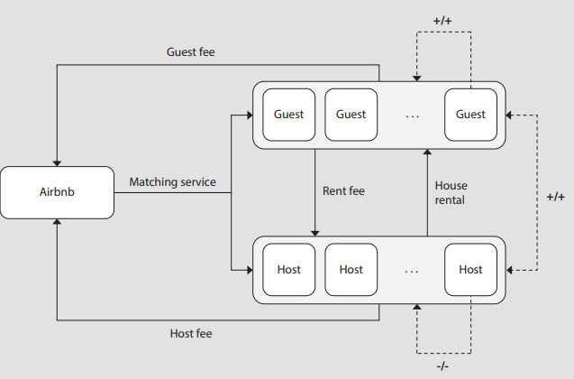
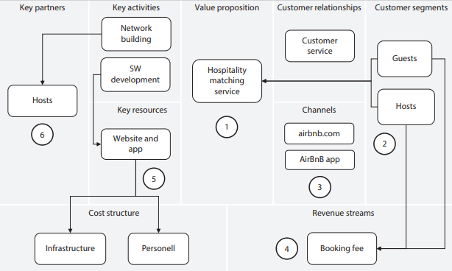
Case Study-V Airbnb
Airbnb is an example of an organization using the multisided platform business model
The main value proposition of Airbnb is to offer a mediation service between the two customer segments hosts and guests . This is done on the website or mobile app
Airbnb modeled using the SRM
Airbnb modeled using the BMC

Slide 49
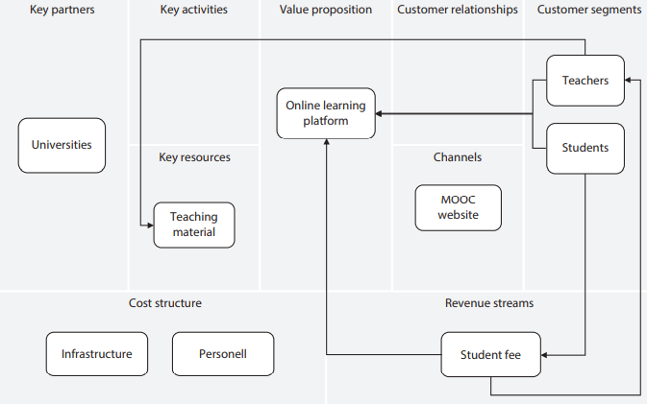
Case study: MOOC
A company offering an MOOC is a value network and an MSP. It connects two user groups: teachers and students.
A key insight in the business model of an MOOC is that the teacher user group is producing the key resource of the MOOC—the teaching material.
MOOC modeled using the BMC

Slide 50
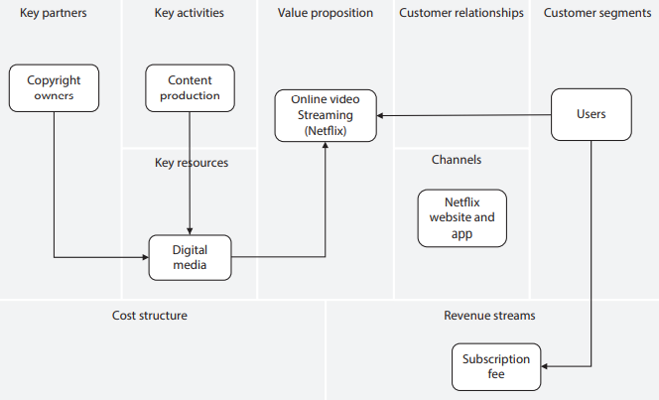
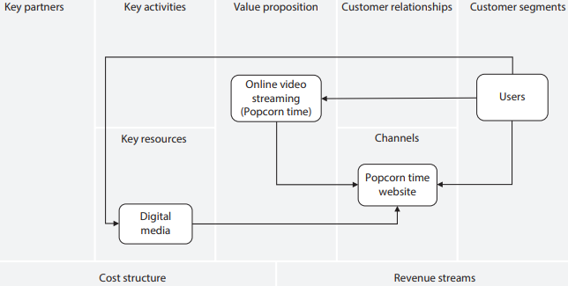
Case study: Popcorn Time and Netflix
Popcorn Time and Netflix are both providers of online streaming media (e.g., video, series, and movies).
The main commercial difference is that Popcorn Time is free and has a disputed legality because users frequently (but not always) upload and distribute content without the owner's consent. However, Netflix is a paid service
that is legitimate due to the fact that it has purchased copyright content in addition to creating its own content.
Popcorn Time modeled using the BMC
Netflix modeled using the BMC

Slide 51
Thank You

