Slide 1
Portfolio Performance Evaluation

Slide 2
Introduction
If markets are to be reasonably efficient, investors must be able to measure asset management performance
Two common ways to measure average portfolio return:
  Time-weighted returns
  Dollar-weighted returns
Returns must be adjusted for risk.

Slide 3
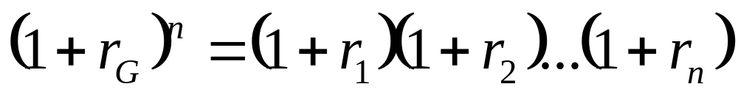
Time - Weighted Return
The geometric average is a time-weighted average.
Each period’s return has equal weight.

Slide 4
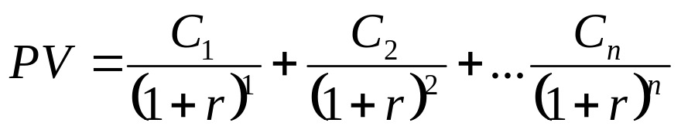
Dollar-weighted Return
Internal rate of return considering the cash flow from or to investment
Returns are weighted by the amount invested in each period:

Slide 5
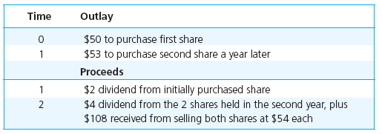
Example of Multiperiod Returns

Slide 6
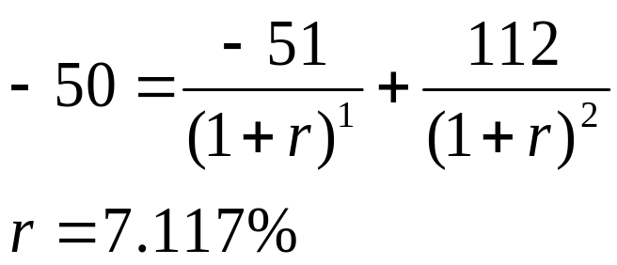
Dollar-weighted Return
Dollar-weighted Return (IRR):
$4+$108
$2
-$50
-$53

Slide 7
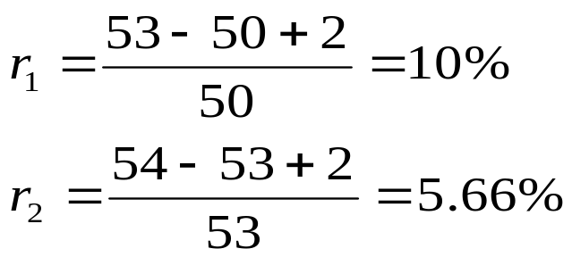
Time-Weighted Return
r_{G} = [ (1.1) (1.0566) ]^{1/2} – 1 = 7.81%
The dollar-weighted average is less than the time-weighted average in this example because more money is invested in year two, when the return was lower

Slide 8
Adjusting Returns for Risk
The simplest and most popular way to adjust returns for risk is to compare the portfolio’s return with the returns on a comparison universe.
The comparison universe is a benchmark composed of a group of funds or portfolios with similar risk characteristics, such as growth stock funds or high-yield bond funds.

Slide 9
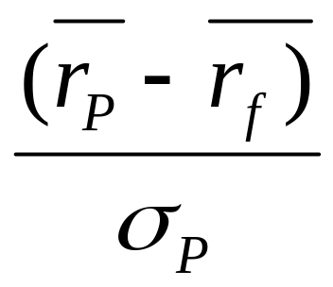
Risk Adjusted Performance: Sharpe
Sharpe Ratio – measures the reward to total volatility trade-off
r_{p} = Average return on the portfolio
r_{f} = Average risk-free rate
σ_{ρ} = Standard deviation of portfolio
return

Slide 10
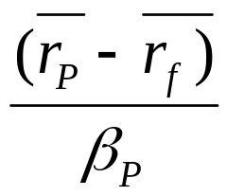
Risk Adjusted Performance: Treynor
Treynor Measure – excess return per unit of systematic risk
r_{p} = Average return on the portfolio
r_{f} = Average risk-free rate
ß_{p} = Weighted average beta for portfolio

Slide 11
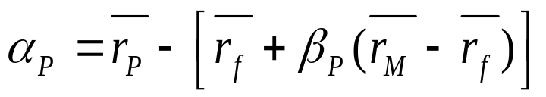
Risk Adjusted Performance: Jensen
Jensen’s Measure – Average return on portfolio over and above predicted by CAPM
α_{ρ} = Alpha for the portfolio
r_{p} = Average return on the portfolio
ß_{p} = Weighted average Beta
r_{f} = Average risk-free rate
r_{m} = Average return on market index portfolio

Slide 12
Information Ratio
Information Ratio = α_{p} / σ(e_{p})
The information ratio divides the alpha of the portfolio by the nonsystematic risk.
Nonsystematic risk could, in theory, be eliminated by diversification.

Slide 13
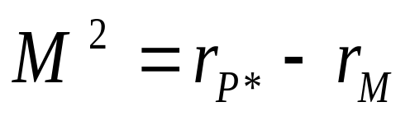
M² Measure
Developed by Modigliani and Modigliani
Create an adjusted portfolio P* that combines P with Treasury Bills
Set P* to have the same standard deviation as the market index
Because the market index and P* have the same standard deviation, their returns are comparable:

Slide 14
M² Measure: Example
Managed Portfolio: return = 35% standard deviation = 42%
Market Portfolio: return = 28% standard deviation = 30%
T-bill return = 6%
P* Portfolio:
30/42 = .714 in P and (1-.714) or .286 in T-bills
The return on P* is (.714) (.35) + (.286) (.06) = 26.7%
Since this return is less than the market, the managed portfolio underperformed.

Slide 15
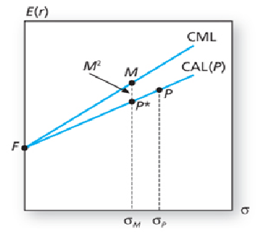
M² of Portfolio P

Slide 16
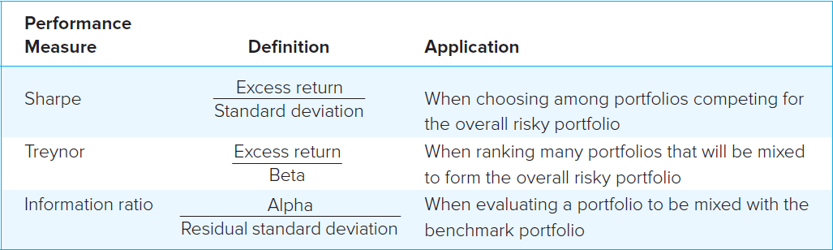
Which Measure is Appropriate?

Slide 17
Performance Measurement with Changing Portfolio Composition
We need a very long observation period to measure performance with any precision, even if the return distribution is stable with a constant mean and variance.
What if the mean and variance are not constant? We need to keep track of portfolio changes.

Slide 18
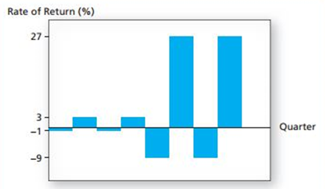
Portfolio Returns
Returns in last four quarters are more variable than in the first four

Slide 19
Changing Portfolio Risk
Sharpe measure of the market index is 0.4
Over the initial period of 52 weeks, the portfolio manager executes a low-risk strategy with an annualized mean excess return of 1% and standard deviation of 2%.
  This makes for a Sharpe ratio of 0.5, which beats the passive strategy.
Over the next 52-week period, the manager finds that a high-risk strategy is optimal, with an annual mean excess return of 9% and standard deviation of 18%.
  Sharpe ratio is 0.5.
Over the eight-quarter sequence the mean and standard deviation are 5% and 13.42%, making for a Sharpe measure of only 0.37, apparently inferior to passive strategy!

Slide 20
Changing Portfolio Risk
The shift of the mean from first four quarters to the next was not recognized as a shift in strategy.
The difference in mean returns in the two years added to the appearance of volatility in portfolio returns.
The active strategy with shifting means appears riskier than it really is and biases the estimate of Sharpe measure downwards.
For actively managed portfolios it is helpful to keep track of portfolio composition and changes in portfolio mean and risk.

Slide 21
Style Analysis
Introduced by William Sharpe
Regress fund returns on indexes representing a range of asset classes
The regression coefficient on each index measures the fund’s implicit allocation to that “style”
R-square measures return variability due to style or asset allocation
The remainder is due either to security selection or to market timing

Slide 22
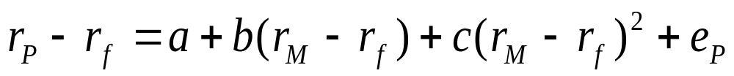
Market Timing
In its pure form, market timing involves shifting funds between a market-index portfolio and a safe asset
Treynor and Mazuy:
Henriksson and Merton:

Slide 23
Performance Attribution
A common attribution system decomposes performance into three components:
Allocation choices across broad asset classes.
Industry or sector choice within each market.
Security choice within each sector.

Slide 24
Attributing Performance to Components
Set up a ‘Benchmark’ or ‘Bogey’ portfolio:
Select a benchmark index portfolio for each asset class.
Choose weights based on market expectations.
Choose a portfolio of securities within each class by security analysis.
Calculate the return on the ‘Bogey’ and on the managed portfolio.
Explain the difference in return based on component weights or selection.
Summarize the performance differences into appropriate categories.

Slide 25
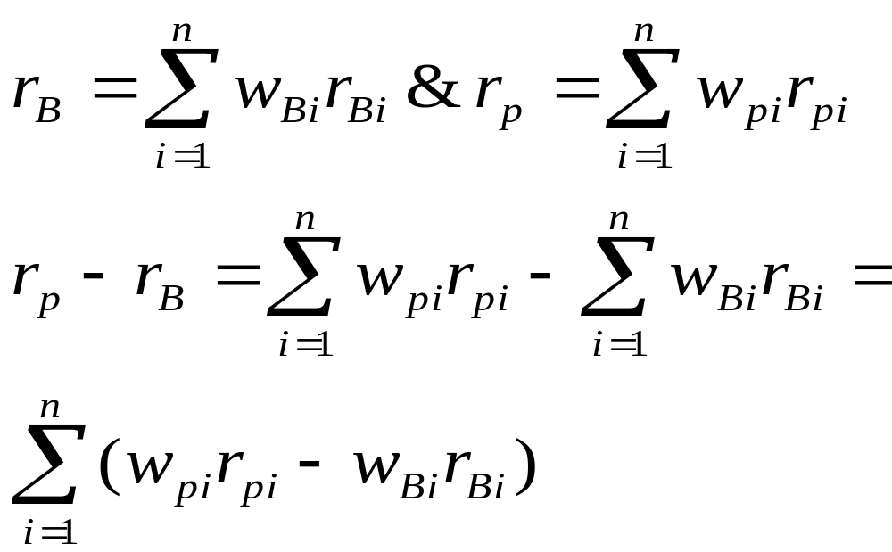
Formulas for Attribution
where B is the bogey portfolio and p is the managed portfolio

Slide 26
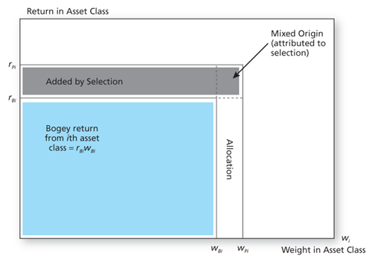
Performance Attribution of ith Asset Class

Slide 27
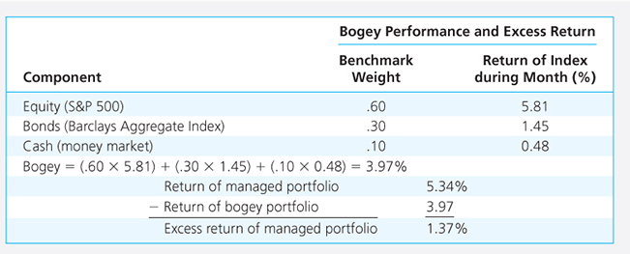
Performance of the managed portfolio

Slide 28
Performance Attribution
Superior performance is achieved by:
  overweighting assets in markets that perform well
  underweighting assets in poorly performing markets

Slide 29
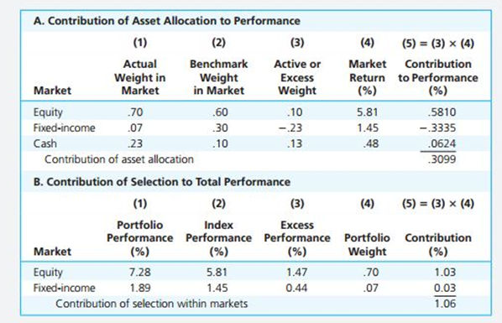
Performance Attribution

Slide 30
Sector and Security Selection
Good performance (a positive contribution) derives from overweighting high-performing sectors
Good performance also derives from underweighting poorly performing sectors.

Slide 31
Example - 1
Consider the two (excess return) index-model regression results for stocks A and B. The risk-free rate over the period was 6%, and the market’s average return was 14%.
Which stock is the best choice under the following circumstances?
i) This is the only risky asset to be held by the investor
ii)This is one of many stocks that the investor is analysing to form an actively managed portfolio
 | Stock A | Stock B
Regression estimates | 1%+ 1.2 (rM -rf) | 2% + 0.8 (rM - rf)
Std deviation of excess returns | 21.60% | 24.90%

Slide 32
Example - 2
An analyst wants to evaluate portfolio X, consisting entirely of US stocks, using both the Treynor and Sharpe measures of portfolio performance. The table provides the average annual rate of return for portfolio X, the market portfolio (as measured by the S&P 500), and US Treasury bills
Calculate the Treynor and Sharpe measures for both portfolio X and S&P 500, and explain whether X is underperformed, equalled, or overperformed the S&P 500 using both measures?
 | Avg Annual Return | Std Dev of Return | Beta
Portfolio X | 10% | 18% | 0.6
S&P 500 | 12% | 13% | 1.0
T-bills | 6% | N/A | N/A

Slide 33
Example 3
A global equity manager is assigned to select stocks from a universe of large stocks throughout the world. The manager will be evaluated by comparing her returns to the return on the MSCI World Market Portfolio, but she is free to hold stocks from various countries in whatever proportions she finds desirable. Results for a given month are given

Slide 34
Example 3
A. Calculate the total value added of all the manager’s decisions this period
B. Calculate the value added (or subtracted) by her country allocation decisions
C. Calculate the value added from her stock selection ability within countries
Country | Weight in MSCI Index | Manager's Weight | Manager's Return in Country | Return of stock index for that Country
UK | 0.15 | 0.3 | 20% | 12%
Japan | 0.30 | 0.1 | 15% | 15%
US | 0.45 | 0.4 | 10% | 14%
Germany | 0.10 | 0.2 | 5% | 12%

