Slide 1
Project
Management
McGraw-Hill/Irwin
Copyright © 2014 by The McGraw-Hill Companies, Inc. All rights reserved.

Slide 2
Learning Objectives
LO4–1: Explain what projects are and how projects are organized.
LO4–2: Analyze projects using network-planning models.
LO4–3: Evaluate projects using earned value management.
LO4–4: Exemplify how these techniques are implemented in commercial software packages.

Slide 3
Project Management
What is a project?
  A series of related jobs, usually directed toward some major output and requiring a significant period of time to perform.
What is project management?
  Planning, directing, and controlling resources (people, equipment, material, etc.) to meet the technical, cost, and time constraints of the project.
Why is project management important?
  At the highest levels of an organization, management often involves juggling a portfolio of projects.

Slide 4
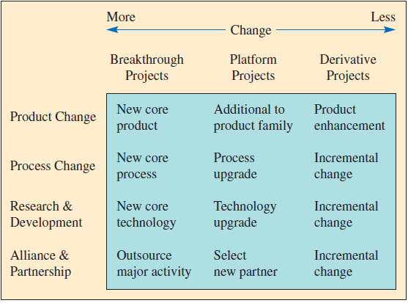
Types of Development Projects
Degree of Change
Type of Project

Slide 5
Project Structure
Pure Project
A self-contained team works full-time on the project.
Responsibility for the project lies within one functional area of the firm. Employees from that area work on the project, usually only part-time.
Functional Project
Matrix Project
A blend of pure and functional project structures – people from different functional areas work on the project, possibly only part-time.

Slide 6
Pure Project Structure
Advantages
The project manager has full authority
Disadvantages
Duplication of resources
Team members report to one boss
Shortened communication lines
Team pride, motivation, and commitment are high
Organizational goals and policies are ignored
Lack of technology transfer
Team members have no functional area "home"

Slide 7
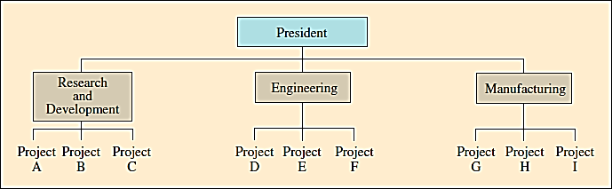
Functional Project Structure
Advantages
A team member can work on several projects
Disadvantages
Aspects of the project that are not directly related to the functional area get short-changed
Technical expertise maintained in functional area
Functional area is “home” after project completed
Critical mass of specialized knowledge
Motivation of team members is often weak
Needs of the client are secondary and are responded to slowly

Slide 8
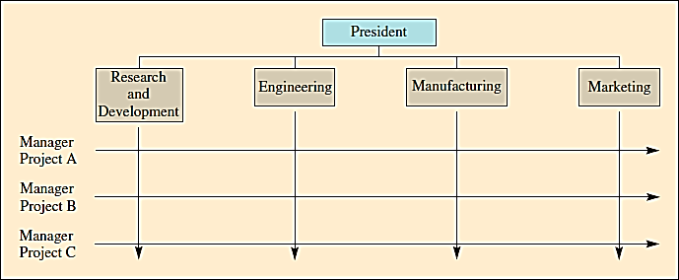
Matrix Project Structure
Advantages
Better communications between functional areas
Disadvantages
Too many bosses
Project manager held responsible for success
Duplication of resources is minimized
Functional “home” for team members
Policies of the parent organization are followed
Depends on project manager’s negotiating skills
Potential for sub-optimization

Slide 9
Defining the Project
Statement of Work
  A written description of the objectives to be achieved
Task
  A further subdivision of a project – usually shorter than several months and performed by a single group or organization
Work Package
  A group of activities combined to be assignable to a single organizational unit

Slide 10
Defining the Project
Continued
Project Milestone
  Specific events in the life of the project
Work Breakdown Structure
  Defines the hierarchy of project tasks, subtasks, and work packages
Activities
  Pieces of work that consume time

Slide 11
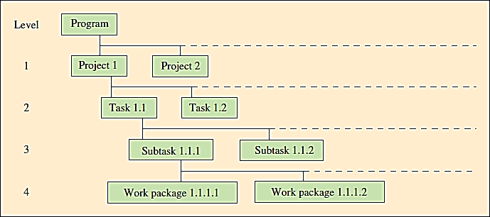
Work Breakdown Structure Example
Overview
Details

Slide 12
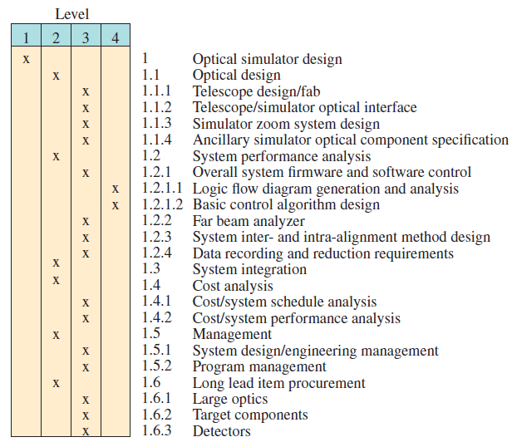
Work Breakdown Structure – Large Optical Scanner Design
Overview
Details

Slide 13
Network-Planning Models
A project is made up of a sequence of activities that form a network representing a project.
The path taking longest time through this network of activities is called the “critical path.”
The critical path provides a wide range of scheduling information useful in managing a project.
Critical path method (CPM) helps to identify the critical path(s) in the project networks.

Slide 14
Critical Path Method (CPM)
Identify each activity to be done and estimate how long it will take.
Determine the required sequence and construct a network diagram.
Determine the critical path.
Determine the early start/finish and late start/finish schedule.

Slide 15
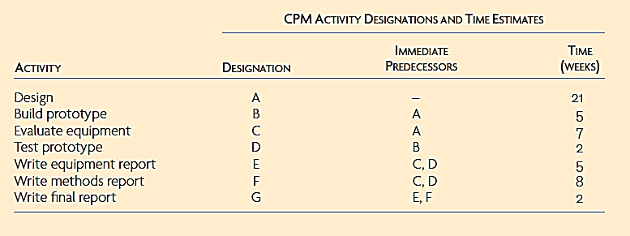
Example 4.1 – Identify Activities and Construct Network
C(7)
F(8)
A(21)
G(2)
B(5)
D(2)
E(5)

Slide 16

Determine Early Start/Early Finish and Late Start/Late Finish Schedule
Critical Path 1: ACFG
21
28
28
36
C(7)
F(8)
21
28
28
36
0
21
36
38
A(21)
G(2)
0
21
36
38
21
26
26
28
28
33
B(5)
D(2)
E(5)
Critical Path 2: ABDFG
21
26
26
28
31
36
Excel: Critical Paths
For the Excel template visit www.mhhe.com/sie-chase14e

Slide 17
CPM with Activity Time Estimates
When activity times vary, a single time estimate may not be reliable.
  Instead, estimate three values
    Minimum
    Maximum
    Most likely
This allows calculation of a probability estimate of completion time.
This is the distinguishing characteristic of the PERT method.

Slide 18




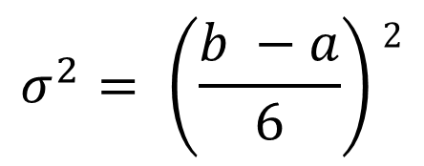

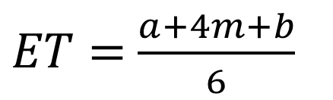
PERT Method Calculations
$$a=minimum$$
$$ET=\frac{a+4m+b}{6}$$
$$b=maximum$$
$$m=most likely$$
$$σ^{2}= \left(\frac{b −a}{6}\right)2$$
$$ET=expected time$$
$$σ^{2}=variance$$
Excel: PERT Calculations
For the Excel template visit www.mhhe.com/sie-chase14e

Slide 19
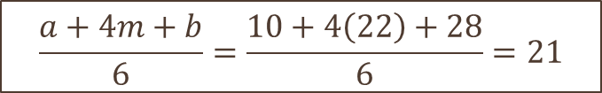
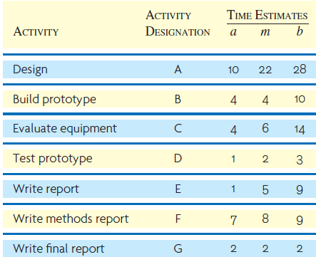
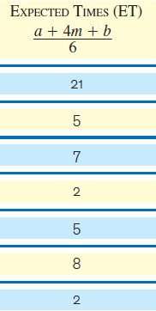
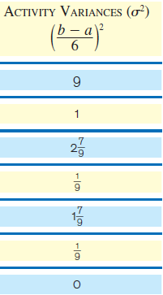

Example 4.2 - Three Time Estimates

Slide 20


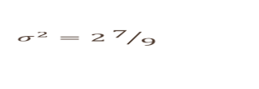
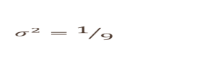








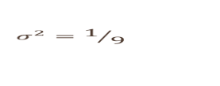
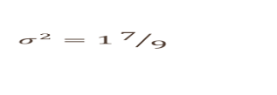
Example 4.2 - Network with Time Estimates
21
28
28
36
C(7)
F(8)
21
28
28
36
0
21
36
38
A(21)
G(2)
0
21
36
38
21
26
26
28
28
33
B(5)
D(2)
E(5)
21
26
26
28
31
36

Slide 21
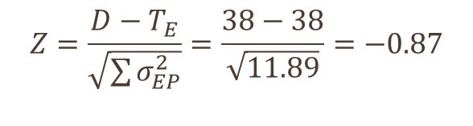
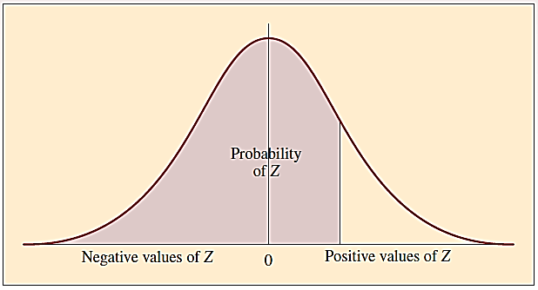
Example 4.2 – Three Time Estimates
Probability of finishing in 35 weeks (or less)

Slide 22
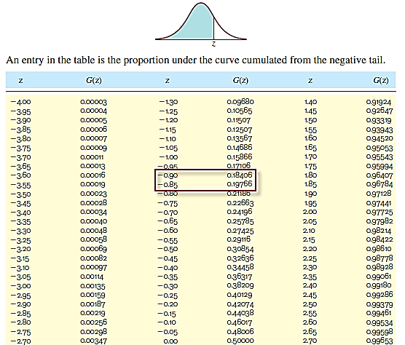
Example 4.2 – Three Time Estimates
Probability of finishing in 35 weeks (or less) is about 19%

Slide 23
Time-Cost Models and Project Crashing
A time-cost model extends the CPM model to consider the trade-off between time required to complete an activity and total project cost.
  Considers direct activity costs, indirect costs of project, and activity completion times
It is often referred to as “crashing” the project to reduce overall duration.

Slide 24
Project Crashing
Prepare a CPM-type network diagram.
Determine the cost per unit of time to expedite each activity.
Compute the critical path.
Shorten the critical path at the point where costs are lowest.
Plot project, indirect, and total cost curves to find the minimum-cost schedule.

Slide 25
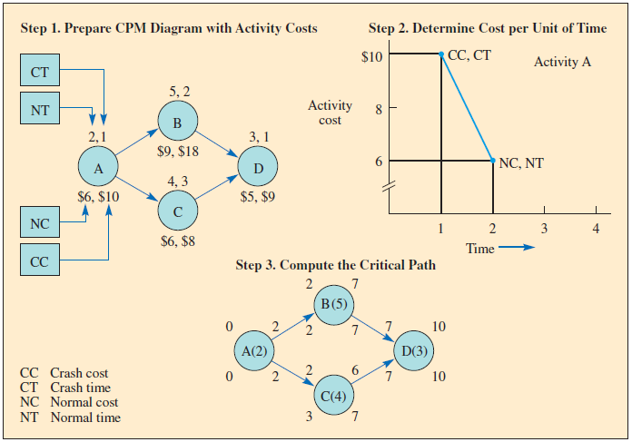
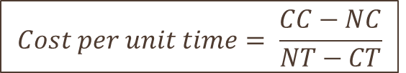
Example 4.3 – Project Crashing
Excel: Project Crashing
For the Excel template visit www.mhhe.com/sie-chase14e

Slide 26
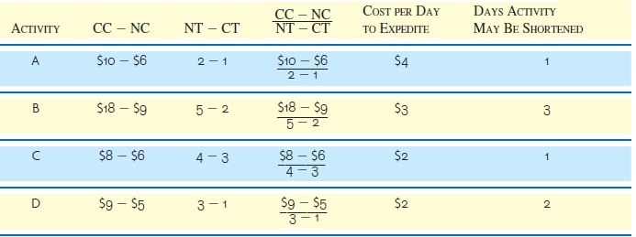
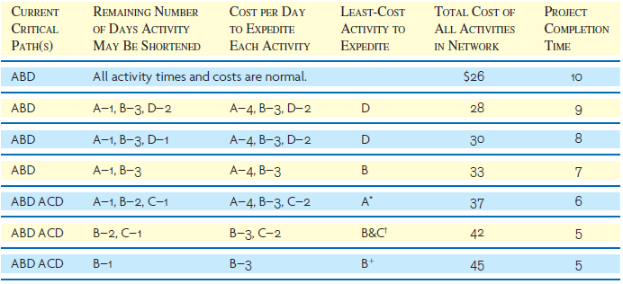
Example 4.3 – Project Crashing
Project has reached minimum duration
Activity D cannot be reduced any further at this point
Activity A cannot be reduced any further at this point

Slide 27
Managing Resources
In addition to scheduling tasks, resources must also be assigned to specific tasks.
Software can be used to spot over-allocation.
  Planned use exceeds available supply
When resources are over-allocated, either more resources are required or rescheduling is necessary.
  Taking advantage of task slack can free resources

Slide 28
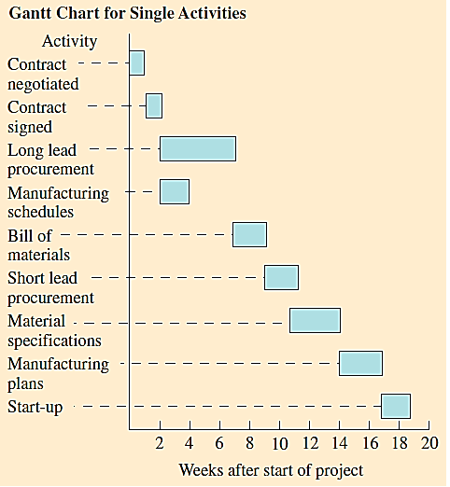
Project Control Charts
Charts provide an easily understood visual presentation.
Software can be used to create the charts.
Gantt charts show, in a graphic manner, the amount of time involved and the sequence of activities. Often referred to as a bar chart.

