Slide 3
Personality Traits of Effective Leaders (1 of 2)
Characteristics associated with leadership are classified into three broad categories:
  Personality Traits
  Motives
  Cognitive Factors
Regardless of classification, characteristics point toward the conclusion that effective leaders are made of the right stuff.

Slide 4
Personality Traits of Effective Leaders (2 of 2)
A leader’s personality traits can be divided into two groups:
  General Personality Traits
    Traits observable both within and outside the context of work – and related to success and satisfaction in both work and personal life.
  Task-Related Traits
    Traits closely associated with task accomplishment.

Slide 5
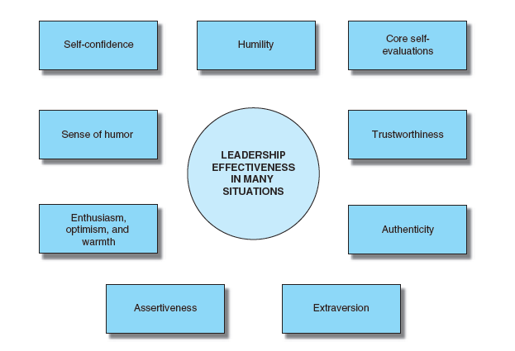
Figure 2-1 General Personality Traits of Effective Leaders

Slide 6
General Personality Traits of Effective Leaders (1 of 4)
Self-confidence
  Self-confidence improves one’s performance in a variety of tasks including leadership.
Humility
  Part of humility is admitting that you do not know everything and cannot do everything, as well as admitting your mistakes to team members and outsiders.

Slide 7
General Personality Traits of Effective Leaders (2 of 4)
Core Self-Evaluations
  A broad personality trait that captures bottom-line self-assessment that is composed of self-esteem, locus of control, generalized self-efficacy, and emotional stability.
Trustworthiness
  Evidence and opinion continue to mount that being trustworthy and/or honest contributes to leadership effectiveness.
  Trust is closely related to transparency, in which organizational leadership is open rather than secretive about activities that affect the welfare of stakeholders.

Slide 8
General Personality Traits of Effective Leaders (3 of 4)
Authenticity
  Being genuine and honest about your personality, values, and beliefs as well as having integrity.
Extraversion
  Recognized for its contribution to leadership effectiveness because it is helpful for leaders to be gregarious, outgoing, and upbeat in most situations.

Slide 9
General Personality Traits of Effective Leaders (4 of 4)
Assertiveness
  Refers to being forthright in expressing demands, opinions, feelings, and attitudes.
Enthusiasm, Optimism, and Warmth
  Enthusiasm often takes the form of optimism, which helps keep the group in an upbeat mood and hopeful about attaining difficult goals.
Sense of Humor
  Humor adds to the approachability and people orientation of a leader.

Slide 10
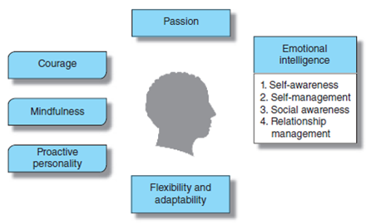
Figure 2-2 Task-Related Personality Traits of Leaders

Slide 11
Task-Related Personality Traits (1 of 3)
Proactive Personality
  Proactive behavior usually stems from a proactive personality and refers to self-initiated anticipatory action.
Mindfulness
  Refers to concentrating on the present moment without making judgments about what is happening.
Passion for the Work and the People
  Passion goes beyond enthusiasm and often expresses itself as an obsession for achieving company goals.

Slide 12
Task-Related Personality Traits (2 of 3)
Emotional Intelligence
  Refers to the ability to do such things as understanding one’s feelings, have empathy for others, and regulate one’s emotions to enhance one’s quality of life.
  Four key domains in emotional intelligence are:
    Self-awareness.
    Self-management.
    Social awareness.
    Relationship management.

Slide 13
Task-Related Personality Traits (3 of 3)
Flexibility and Adaptability
  Flexibility is the ability to adjust to different situations.
  A leader must be flexible enough to cope with such changes as technological advances, downsizings, global outsourcing, a shifting customer base, and a changing work force.
Courage
  Leaders need courage to face the challenges of taking prudent risks and taking initiative in general.

Slide 14
Leadership Motives
Effective leaders have frequently been distinguished by their motives and needs.
Leaders have an intense desire to occupy a position of responsibility for others and to control them.
Effective leaders have a strong need to control resources.

Slide 15
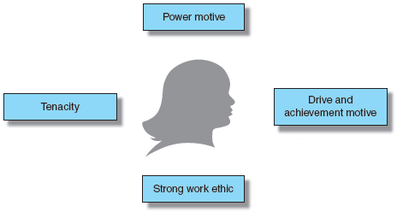
Figure 2-3 Leadership Motives

Slide 16
The POWER Motive (1 of 2)
Effective leaders have a strong need to control resources.
Leaders with high power motives have three dominant characteristics:
  They act with vigor and determination to exert their power.
  They invest much time in thinking about ways to alter the behavior and thinking of others.
  They care about their personal standing with those around them.

Slide 17
The POWER Motive (2 of 2)
Personalized Power Motive
  Seek power to further their own interests.
  Do not worry about everybody liking them.
  Recognize that as you acquire power, you also acquire enemies.
Socialized Power Motive
  Seek power to achieve organizational goals or a vision.
  The term socialized means that the leader uses power primarily to help others.

Slide 18
DRIVE & ACHIEVEMENT Motive
Leaders are known for working hard to achieve their goals.
Drive
  A propensity to put forth high energy towards achieving goals and to be persistent in applying that energy.
  Usually requires a lot of physical energy and fitness.
Achievement Motivation
  Finding joy in accomplishment for its own sake.
Notes:
Describe how leadership influences organizational performance.

Slide 19
TENACITY & RESILIENCE Motive
Leaders are tenacious and resilient.
Tenacity multiplies in importance for organizational leaders.
Grit is synonymous with tenacity.
  Refers to an unswerving focus on long-term goals.
  Is considered to be a success factor in most fields.
Tenacious leaders are resilient when they bounce back from a setback through their continuous efforts.
Notes:
Describe how leadership influences organizational performance.

Slide 20
Cognitive Factors & Leadership
Leaders must have problem-solving and intellectual skills to gather, process, and store essential information effectively.
These skills are referred to as cognitive factors.
Notes:
Pinpoint several important leadership roles.

Slide 21
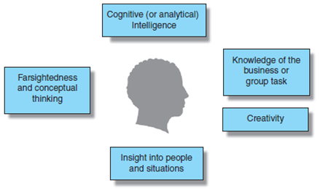
Figure 2-4 Cognitive Factors & Leadership

Slide 22
Cognitive (or Analytical) Intelligence (1 of 2)
Being very good at solving problems is a fundamental characteristic of effective leaders in all fields.
Cognitive intelligence is all the more useful for leadership when it is supplemented by practical intelligence.
Practical intelligence:
  The ability to solve everyday problems by using experience-based knowledge to adapt to and shape the environment.

Slide 23
Cognitive (or Analytical) Intelligence (2 of 2)
An effective leader has to be technically competent in some discipline, particularly when leading a group of specialists.
Knowledge of the business or the group task is particularly important when developing strategy, formulating mission statements, and sizing up the external environment.
Notes:
Explain the meaning of leadership and how it differs from management.

Slide 24
Creativity
Many effective leaders are creative in the sense that they arrive at imaginative and original solutions to complex problems.
Creative ability lies on a continuum:
  Leaders who think of innovative products and services.
  Leaders who explore imaginative—but not breakthrough—solutions to business problems.
  Leaders who inspire group members to push forward with standard solutions to organizational problems.

Slide 25
Insight into People and Situations
Insight is a depth of understanding that requires considerable intuition and common sense.
Intuition is often the mental process used to provide the understanding of a problem.
Notes:
Recognize how leadership skills are developed.

Slide 26
Farsightedness and Conceptual Thinking
Farsightedness is the ability to understand the long-range implications of actions and policies.
Conceptual thinking refers to the ability to see the overall perspective, and it makes farsightedness possible.
A conceptual thinker is also a systems thinker.
They understand how the external environment influences the organization and how different parts of the organization influence each other.

Slide 28
Dimensions of Leadership Behavior
Ohio State studies were conducted in the 1950s.
Researchers surveyed group members regarding their perceptions of their supervisors (leaders).
85% of the leadership behaviors described were focused in two areas/dimensions:
    Consideration
    Initiating Structure

Slide 29
Consideration
Consideration refers to the extent to which the leader creates an environment of emotional support, warmth, friendliness, and trust.
The leader is approachable and focuses on the welfare of the group members.
The leader makes connections with people.
Being soft-spoken, or not dominating the discussions taking place between leader and group members, is another aspect of consideration.

Slide 30
Initiating Structure
Extent to which relationships are organized and defined by assigning tasks, specifying procedures to be followed, scheduling work, clarifying expectations, and establishing realistic goals.
Leaders clearly define their personal role as well as those of each and every group member.

Slide 31
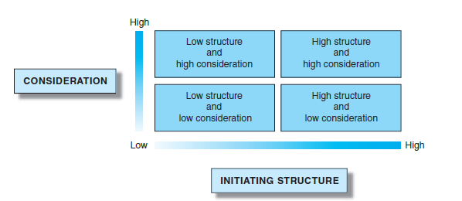
Figure 4-1Four Combinations of Initiating Structure and Consideration

Slide 32
Combining Initiating Structure & Consideration Behaviors
Both dimensions contribute to an understanding of leadership.
  Consideration – influences satisfaction of group members and the leader; worker motivation; leader effectiveness
  Initiating Structure – influences job, group, and organization performance
Unfavorable attitudes occur when employees don’t receive what they feel they need from both dimensions.

Slide 33
Task-Related Attitudes & Behavior (1 of 3)
Task-related attitudes and behaviors that are characteristic of effective leaders:
  Adaptability to the situation
      Adaptability reflects the contingency viewpoint: A tactic is chosen based on the unique circumstances at hand.
  Direction setting
      Direction setting is part of creating a vision and a component of strategy.
  High-performance standards
      People tend to live up to the expectations of their superiors. This is called the Pygmalion effect.

Slide 34
Task-Related Attitudes & Behavior (2 of 3)
  Concentrating on strengths of group members
      Make good use of the strengths of group members rather than concentrating effort on patching up areas for improvement.
  Risk-taking with execution of plans
      The leader must take risks and be willing to implement those risky decisions.
  Hands-on guidance and feedback
      Technical competence and knowledge of the business are important leadership characteristics.

Slide 35
Task-Related Attitudes & Behavior (3 of 3)
  Ability to ask tough questions
      A tough question is one that makes a person or group stop and think about why they are doing or not doing something.
  Organizing for collaboration
      The task focus is that the information sharing takes place, whereas the relationship focus is that group members must work collaboratively with each other.

Slide 36
Relationship-Oriented Attitudes
& Behavior (1 of 3)
Many effective leadership attitudes, behaviors, and practices deal with interpersonal relationships:
  Aligning people
      People pulling in the same direction and collaborating smoothly.
      After being aligned, organizational members can pull together toward a higher purpose.
  Openness to worker opinions
      A major part of relationship-oriented leadership is to engage in management openness, or a set of leader behaviors particularly relevant to subordinates’ motivation to voice their opinion.
  Creating inspiration and visibility
    Inspiring people usually involves appealing to their emotions and values.

Slide 37
Relationship-Oriented Attitudes
& Behavior (2 of 3)
  Satisfying higher-level needs
      Effective leaders motivate them by satisfying higher-level needs, such as needs for achievement, personal growth, a sense of belonging, recognition, self-esteem, and a feeling of control over one’s life.
  Giving emotional support and encouragement
      A supportive leader gives frequent encouragement and praise and displays caring and kindness even about non-work-related matters such as the health of a worker’s ill family member.

Slide 38
Relationship-Oriented Attitudes
& Behavior (3 of 3)
  Promoting principles and values
      Help promote values and principles that contribute to the welfare of individuals and organizations.
      This promotion can be classified as relationship oriented because it deals directly with the emotions and attitudes of people, and indirectly with the task.
  Reducing task ambiguity
      Ambiguity leads to stress for many workers, so stress is reduced when more structure is provided.

Slide 39
Leadership Styles
A leader’s behavior begins to reveal a consistent, regular, predictable pattern of dealing with group members.
This consistency then reveals a pattern of behavior which characterizes the leader’s actions into one of several leadership styles:
  Participative
  Autocratic
  Servant
  Entrepreneurial

Slide 40
Participative Leadership (1 of 2)
Share decision making with group members.
Encompasses the team approach as leaders accept suggestions from group members related to managing the operation.
Leadership style can be time-consuming and results in reducing the power of the leader.

Slide 41
Participative Leadership (2 of 2)
Divided into three subtypes:
  Consultative
    Leaders confer with group members before making a decision, but the leader retains the final authority to make decisions.
  Consensus
    Leaders strive for consensus in discussions and decisions are made reflecting a general agreement the group members’ support.
  Democratic
    Leaders confer final authority to group members.

Slide 42
Autocratic Leadership
Leaders retain authority and make all decisions assuming group members will comply.
Considered task-oriented leaders as their focus is on getting tasks accomplished.
Typical behaviors include telling, asserting, and serving.
Is effective in certain situations.
Does not necessarily imply the leader is impulsive or stubborn.

Slide 43
Servant Leadership (1 of 2)
A servant leader serves constituents by working on their behalf to help them achieve their goals, not the leader’s own goals.
The idea behind servant leadership, as formulated by Robert K. Greenleaf, is that leadership derives naturally from a commitment to service.
A servant leader is therefore a moral leader.
Servant leadership has been accomplished when group members become wiser, healthier, and more autonomous.

Slide 44
Servant Leadership (2 of 2)
The following are key aspects of servant leadership:
  Place service before self-interest
  Listen first to express confidence in others.
  Inspire trust by being trustworthy.
  Focus on what is feasible to accomplish.
  Lend a hand.
  Provide emotional healing.
  Act as a role model for other organizational members to emphasize service.
  Focus on employee growth that leads to need satisfaction.

Slide 45
Entrepreneurial Leadership
An entrepreneur is a person who founds and operates an innovative business.
The entrepreneurial leadership style often incorporates the following behaviors:
  Strong achievement drive and sensible risk taking.
  High degree of enthusiasm and passion.
  Typical pattern of being proactive.
  Tendency to act quickly when opportunity arises.
  Visionary perspective combined with tenacity.
  Dislike of hierarchy and bureaucracy.
  Preference for dealing with external customers.
  Eye on the future.

Slide 46
Selecting the Best Leadership Style
There is no one best or most effective leadership style.
Leaders who get the best results do not rely on one style.
Effective leaders need to focus on BOTH structuring the work (task behaviors) AND supporting and developing good interpersonal relationships with and among group members (relationship behaviors).
Notes:
Pinpoint several important leadership roles.

Slide 48
Situational Influences on Leadership Behavior
Situations can influence the leadership behavior or style a leader emphasizes.
This contingency approach to leadership implies leaders are most effective when they make their behavior contingent on situational forces, including group member characteristics.
Both the internal and external environment have a significant impact on leader effectiveness.
Notes:
Explain the meaning of leadership and how it differs from management.

Slide 49
Role of Situations in Leadership
Research has shown the following regarding the role of situations in leadership effectiveness:
  Organizational effectiveness is affected by situational factors not under leader control.
  Situations shape how leaders behave.
  Situations influence the consequences of of leader behavior.
  The type of organization influences which leadership approach is best.

Slide 50
Path-Goal Theory
Developed by Robert House.
Specifies what a leader must do to achieve high productivity and morale in a given situation.
In general, the theory says a leader who attempts to “clear the path” to a goal for a group member tends to find the group member’s job satisfaction and performance increase.
  A leader should choose a leadership style that takes into account the group member characteristics and the task demands.
The theory is based on the Expectancy Theory of Motivation.

Slide 51
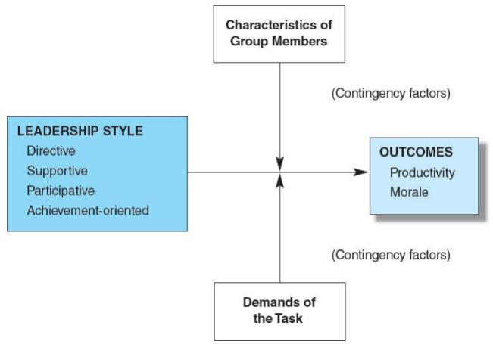
Figure 5-3 The Path-Goal Theory of Leadership

Slide 52
Using Path-Goal Theory to Match Leadership Style to Situations
DIRECTIVE
  Tasks are unclear.
SUPPORTIVE
  Tasks are frustrating and stressful, plus group members are apprehensive.
PARTICIPATIVE
  Tasks are non-repetitive and group members are capable and motivated.
ACHIEVEMENT-ORIENTED
  Tasks are unique or entrepreneurial and group members are competent and committed.

Slide 53
Leader-Member Exchange (LMX)
Another perspective on the contingency approach.
Leaders who adapt their style to different individuals within the group, or have different quality relationships with individual group members, are essentially practicing contingency leadership.

Slide 54
LMX Conclusions (1 of 2)
Leaders tend to give members of their in-group more favorable performance ratings than they give to out-group members, even when objective performance is the same.
Leaders do not always develop entirely different relationships with each group member but may respond the same way to a few members of the group.
Larger groups tend to result in differences with respect to leader-member exchanges.
Managers are more likely to use servant leadership in groups with whom the leader has high-quality exchanges.

Slide 55
LMX Conclusions (2 of 2)
Leaders are more likely to use empowerment with group members with whom they have high-quality exchanges.
LMX quality median influences how leader-member exchanges and differentiation affect team performance.
Moderate differentiation improves coordination within in the team which enhances performance.
The quality of one’s own LMX influences how leaders treating subordinates differently affects organizational commitment and organizational citizenship behavior.

