Slide 1
Project Management

Slide 2
What is Project Management?
What is a project?
  A series of related jobs, usually directed toward some major output and requiring a significant period of time to perform
What is project management?
  Planning, directing, and controlling resources (people, equipment, material) to meet the technical, cost, and time constraints of the project
Why is project management important?
  At the highest levels of an organization, management often involves juggling a portfolio of projects

Slide 3
Types of Project

Slide 4
Types of Projects
Development of New Product
Revision of Old Product
New Marketing Plan
Reducing Cost
Projects for Better Customer Service

Slide 5
Project Categorisation

Slide 6
Project Categorisation based on the
Type of Change
Product Change
Process Change
R& D
Alliance & Partnership

Slide 7
Projects Categorisation based on the
Amount of Change
Derivative Project
(Small changes in Packaging etc )
Platform Project
( Fundamental improvement to existing product)
Breakthrough Projects
( Major Changes that create entirely new Market)

Slide 8
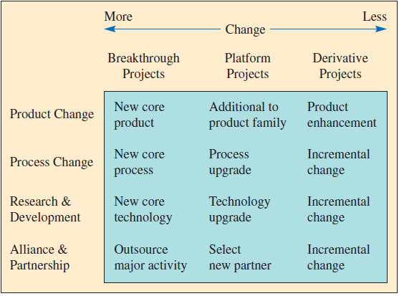
Types of Development Projects

Slide 9
Project Team

Slide 10
Project Structure
Pure Project
A self-contained Team works Full-Time on the project only.
The Team member remains a part of his Functional Department and are not fully allocated to the Project. Thus they are actually doing a part time job on the project apart from the core work in their Functions.
Functional Project
Matrix Project
A blend of pure and functional project structures – people from different functional areas work on the project, possibly only part-time.
Responsibility for the project lies within one functional area of the firm.
A dedicated Project Manager decides what task needs to be performed and when BUT the Functional Manager decides of which resource to be used for which Project.

Slide 11
Pure Project Structure
Defination :A self-contained Team works Full-Time on the project only.
Advantages
The project manager has full authority
Disadvantages
Duplication of resources
Team members report to one boss
Shortened communication lines
Team pride, motivation, and commitment are high
Organizational goals and policies are ignored
Lack of technology transfer
Team members have no functional area "home"

Slide 12
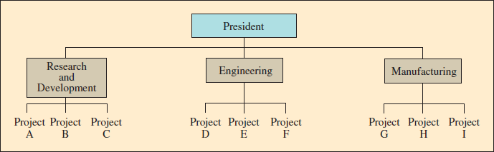
Functional Project Structure
Defination : The Team member remains a part of his Functional Department and are not fully allocated to the Project. Thus they are actually doing a part time job on the project apart from the core work in their Functions
Advantages
A team member can work on several projects
Disadvantages
Aspects of the project that are not directly related to the functional area get short-changed
Technical expertise maintained in functional area
Functional area is “home” after project completed
Critical mass of specialized knowledge
Motivation of team members is often weak
Needs of the client are secondary and are responded to slowly

Slide 13
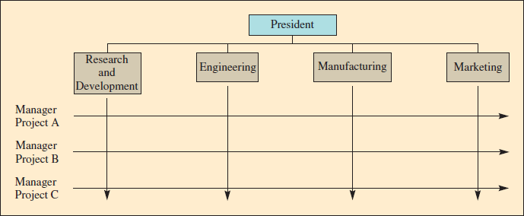
Matrix Project Structure
Defination : A blend of pure and functional project structures . A dedicated Project Manager decides what task needs to be performed and when BUT the Functional Manager decides of which resource to be used for which Project.
Advantages
Better communications between functional areas
Disadvantages
Too many bosses
Project manager held responsible for success
Duplication of resources is minimized
Functional “home” for team members
Policies of the parent organization are followed
Depends on project manager’s negotiating skills
Potential for sub-optimization

Slide 14
Critical Path Method (CPM)

Slide 15
Critical Path Method (CPM)
Identify each activity to be done and estimate how long it will take
Determine the required sequence and construct a network diagram
Determine the critical path
Determine the early start/finish and late start/finish schedule

Slide 16
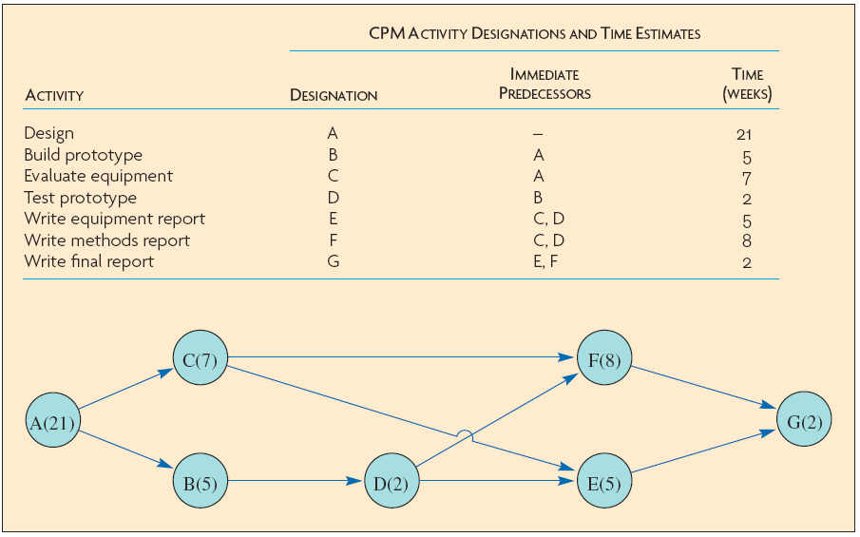
Example : Identify Activities and Construct Network
Key Observations :
1)This network has 4 paths. :
ACFG =38 weeks
ACEG =35 weeks
ABDFG =38 weeks
ABDEG =35 weeks
2) And 2 Critical Paths of 35 weeks and 38 weeks.

Slide 17
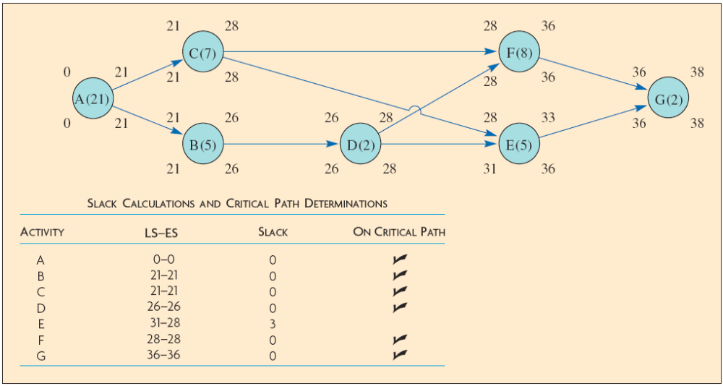
Determine Early Start/Early Finish and Late Start/Late Finish Schedule

Slide 18
Project Life Cycle

Slide 19
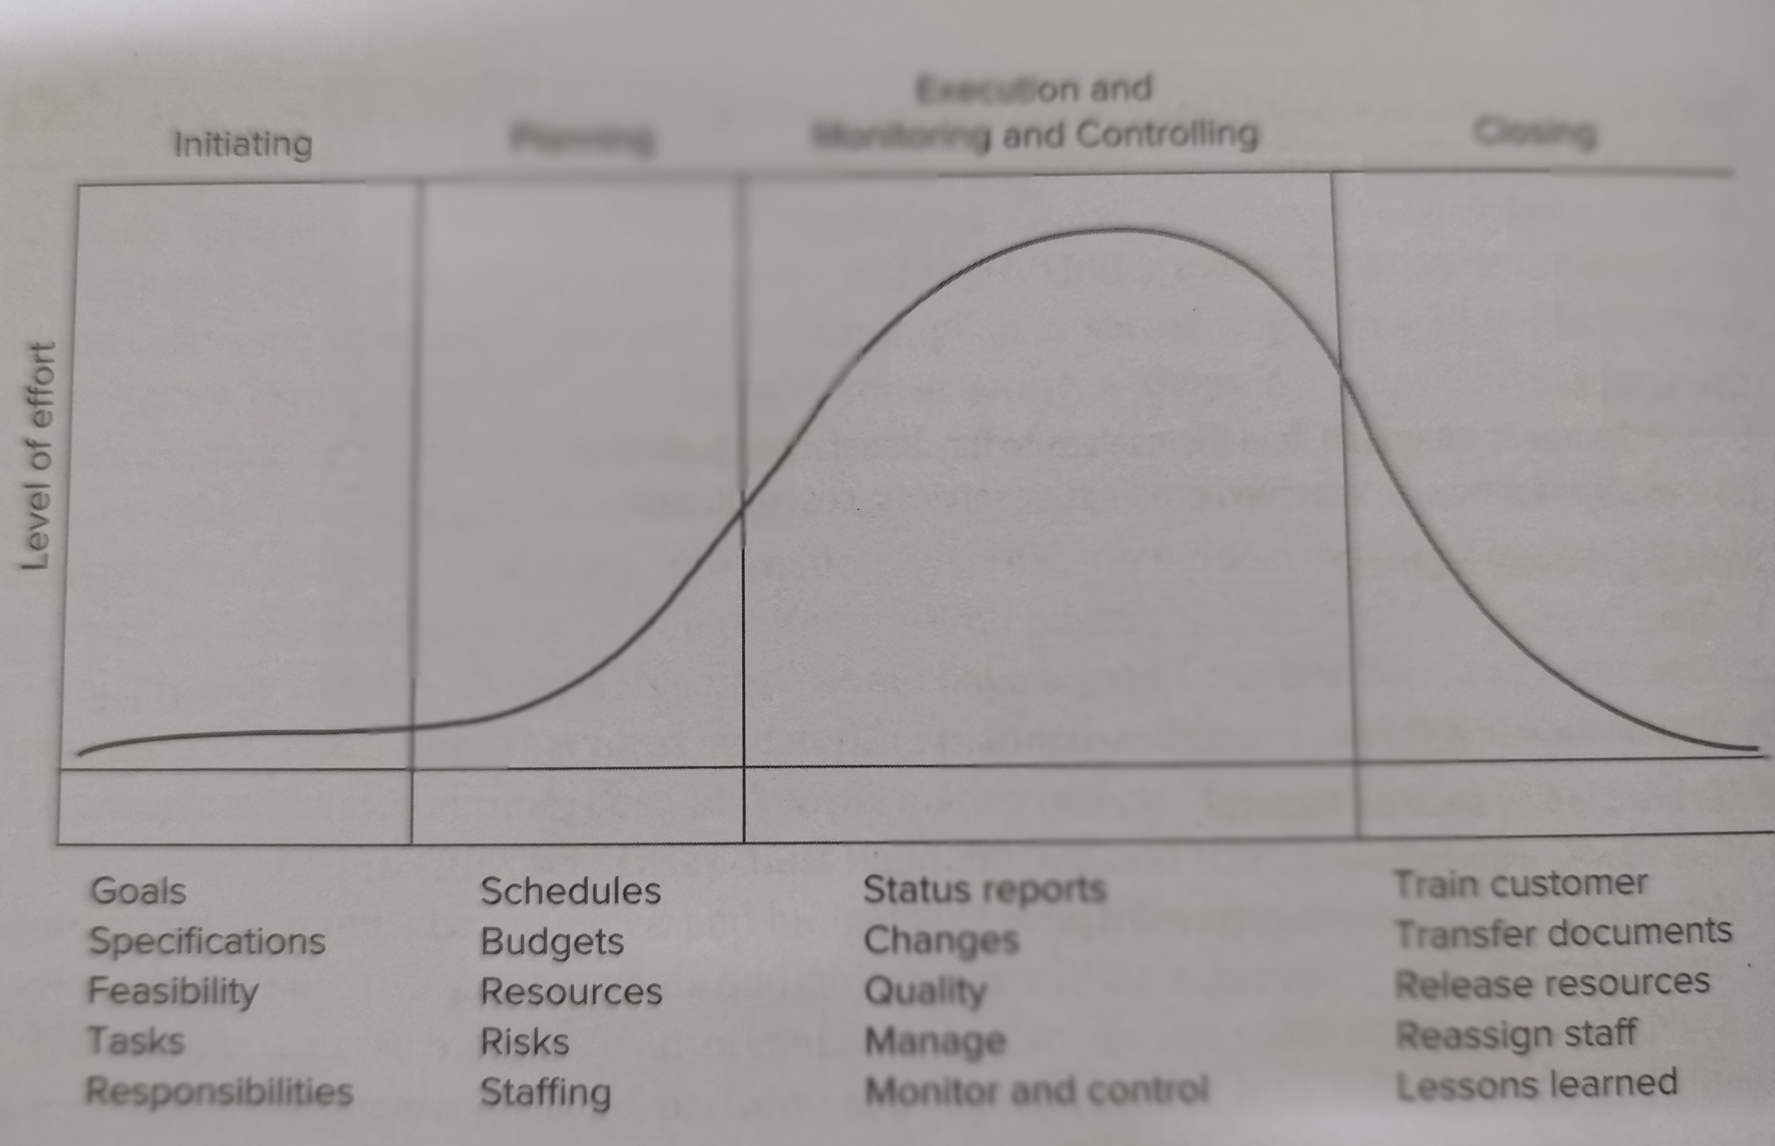
Executing and
Monitoring and Controlling
Initiating
Planning
Closing

Slide 20
Project on :
How to improve the Quality of PVC Trey

Slide 21
Why this Project taken up :
There were regular rejections in PVC Treys.And though currently there is wish to shift to PET but till such time there is
a shift to PET we have to source PVC. Though not in PP is also being used in Treys but its cost is more than PVC. Thus PP
is used in few SKU’s only
Trey is a Primary Packing Material and touches the food product.
Consumer complains were coming about FBC of plastics.
All the 3 parameters ( Cost, Quality & Schedule )of Project Management was put into action to get this Project Operational.
Cost
Quality
Schedule

Slide 22
Specification Sheet
Conformance Specifications
(1)Here Buying Organisation Lays down Clearly and Unambiguouly all Parameters & requirements that must be met. Eg BIL, Nestle, Heinz, VEEBA etc
(2) Here the Specification is of the product, not the application
Performance Specifications
(1) Here the Buyer shares the Performance expected of the supplied material.
(2)It enable suppliers to suggest new or improved ways of meeting the requirement

Slide 23
Ref to the Excel sheet on :
Plant- Vendor –Reason
Reasons for rejection
Vendor Wise Rejection

Slide 24
Ref to the Excel sheet on :
SOB
Here bring out and details multiple variables like :
Needs for all PVC & PP vendors
There price difference, thus different SOB %
Sourcing from different Regions.

Slide 25
Solution-1
Setting up of a New Local Plant close to the Demand point in Uttrakhand

Slide 26
Manufacturing Process

Slide 27
Stages in PVC Trey Making
( In Totality a Assembly Line Process but also has Work Centers )
Stage 2 : Forming ( Work Centre)
Conversion from a Plain Sheet to a Sheet with Multiple PVC Treys in it.
Stage 3 : Cutting ( Work Centre)
Cutting of the Sheet which has Multiple PVC Treys in it . This is done by using Dye Press Machine.
Stage 4 : Cleaning , Stacking & Packing ( Work Centre ) Removal of the unusable plastics from the Edges
Stage 5 :Inspection ( Work Centre)
Satge 6 : Despatch ( Work Centre)
Satge 1 : Raw Material ( Sheet or Roll )
Raw Material arrangement
Vacuum forming
Cutting
Cleaning and QC
Packing
Dispatch
Scrap removal

Slide 28
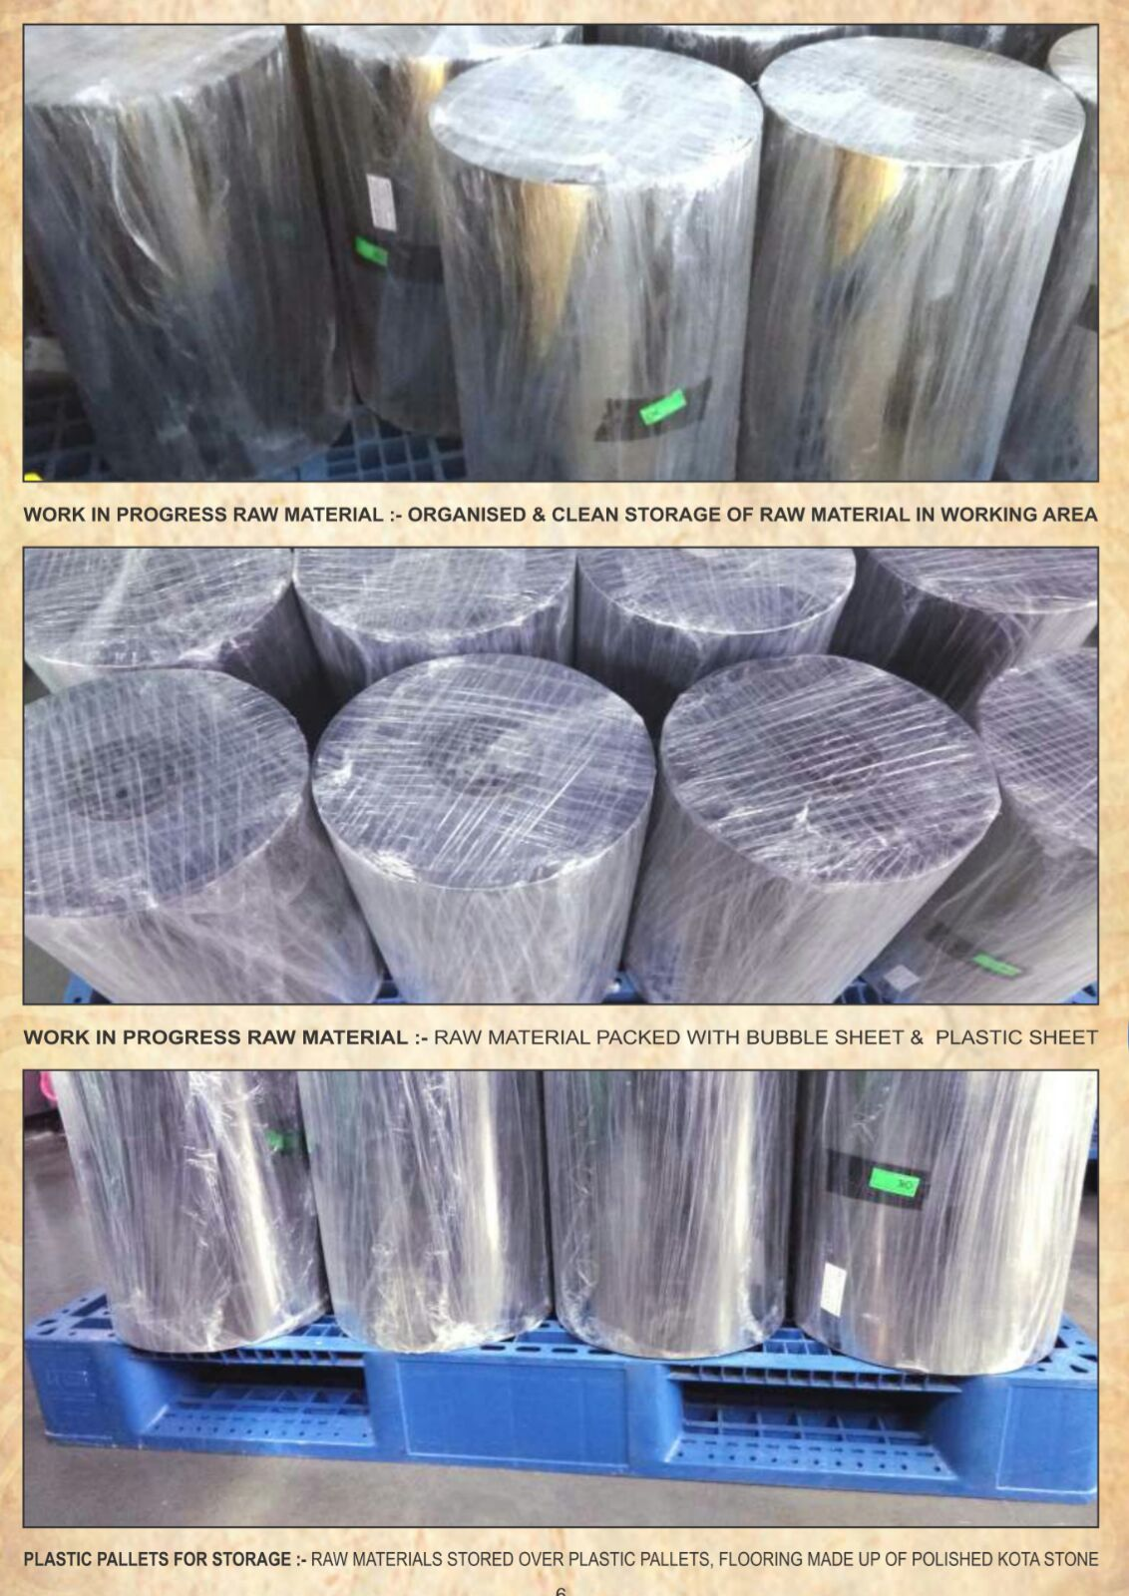
Stage 1 : Raw Material : Sheets & Rolls

Slide 29
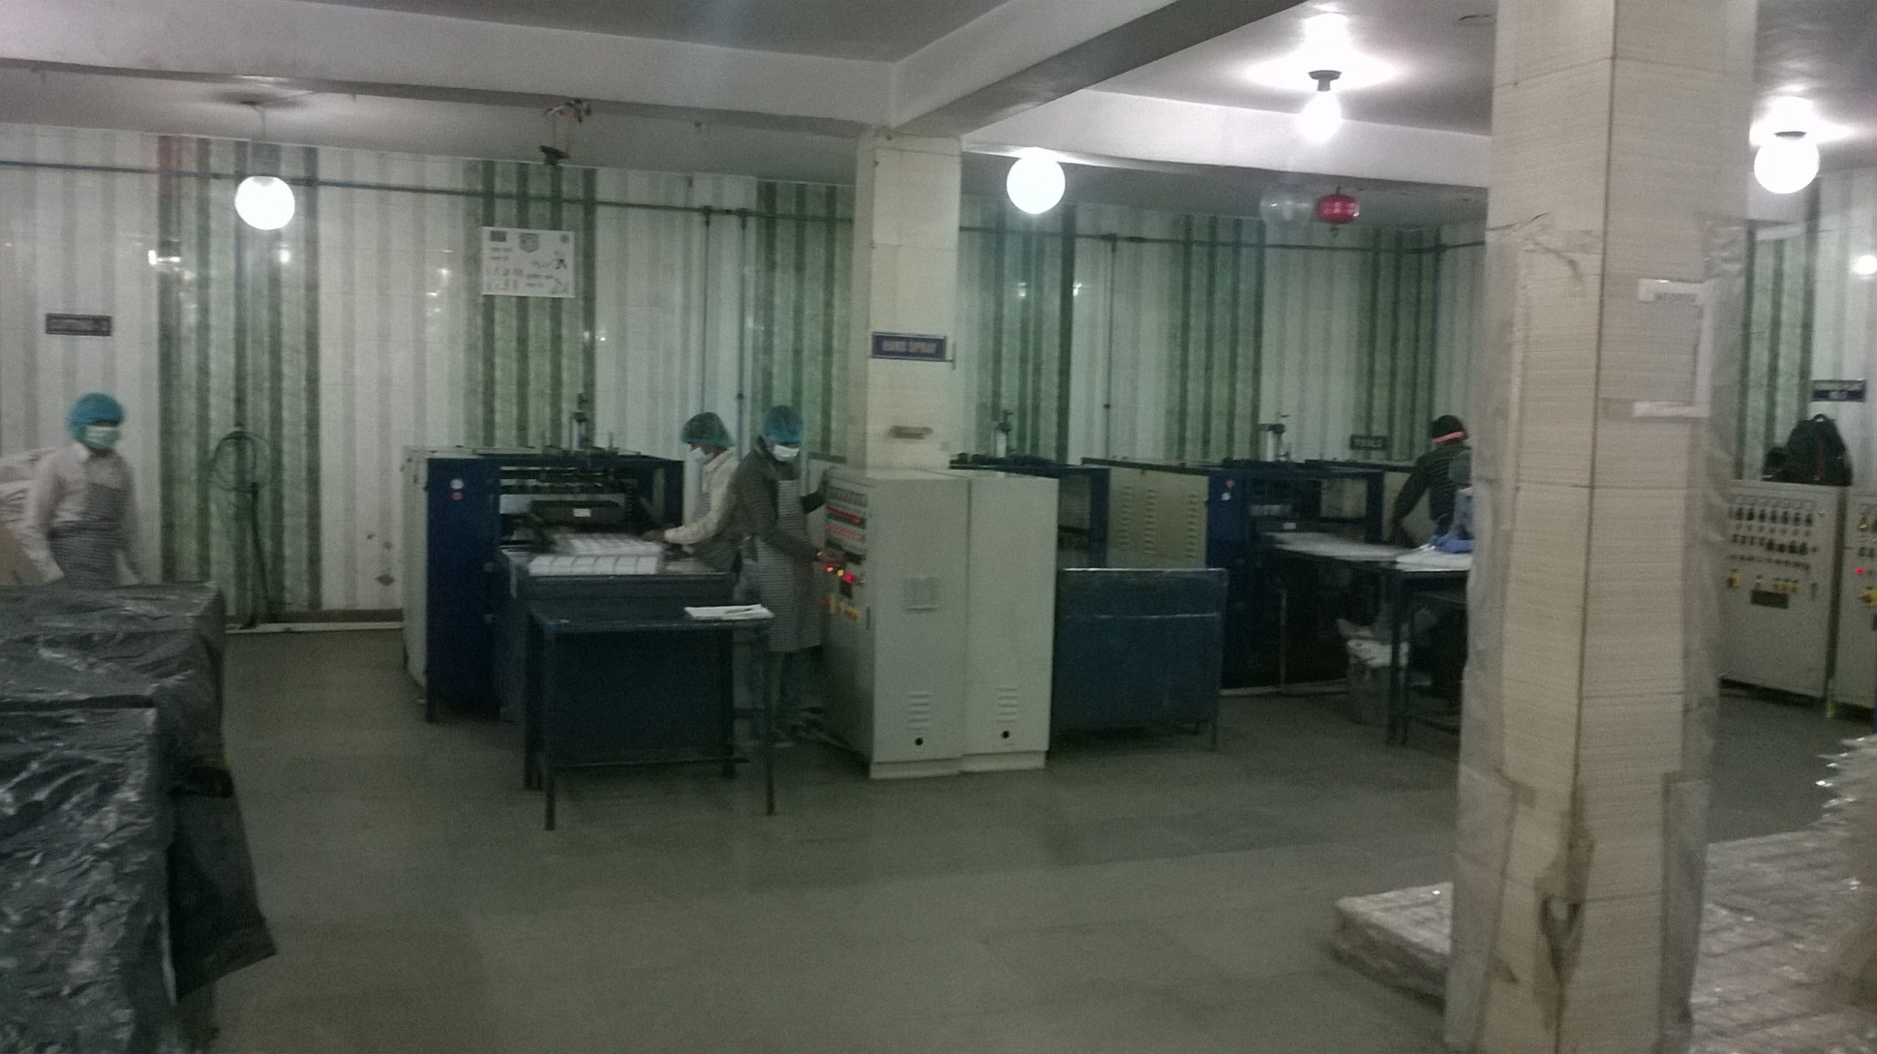
Stage 1 : A Typical PVC Trey Making Unit where Forming & Cutting takes place

Slide 30
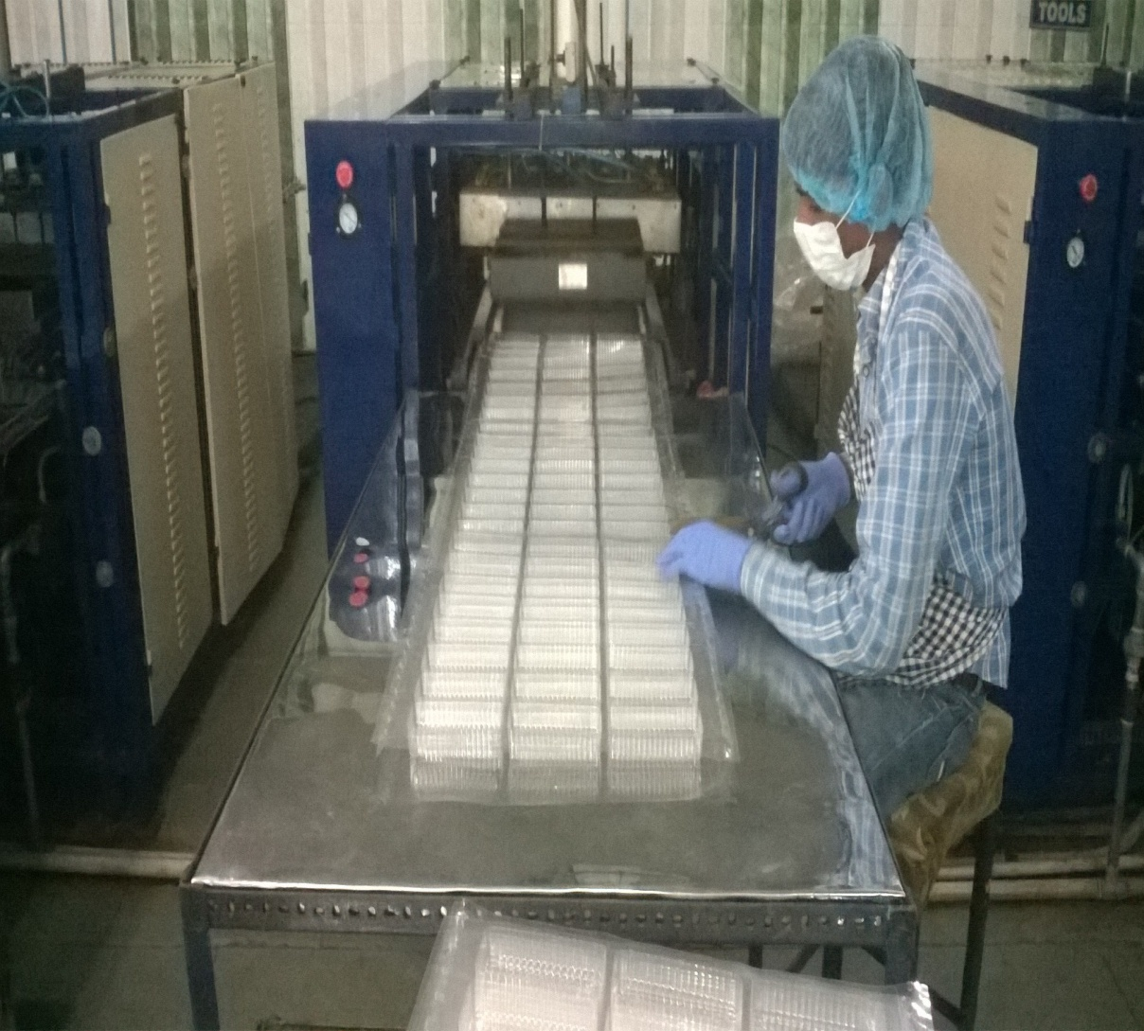
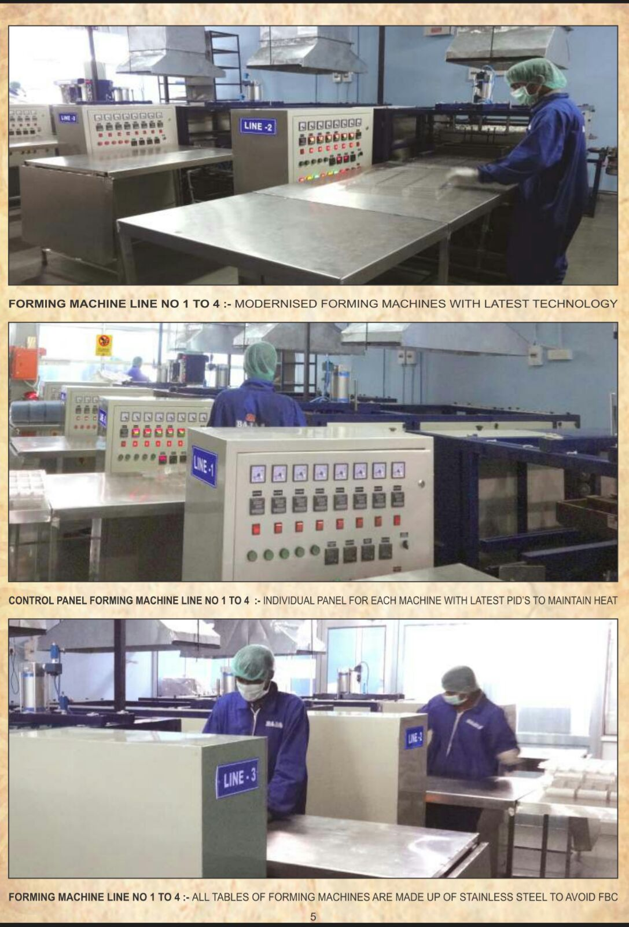
Stage 2 : Forming Stage ( Work Centre) : Plain Sheet to a Sheet with Multiple Treys (

Slide 31
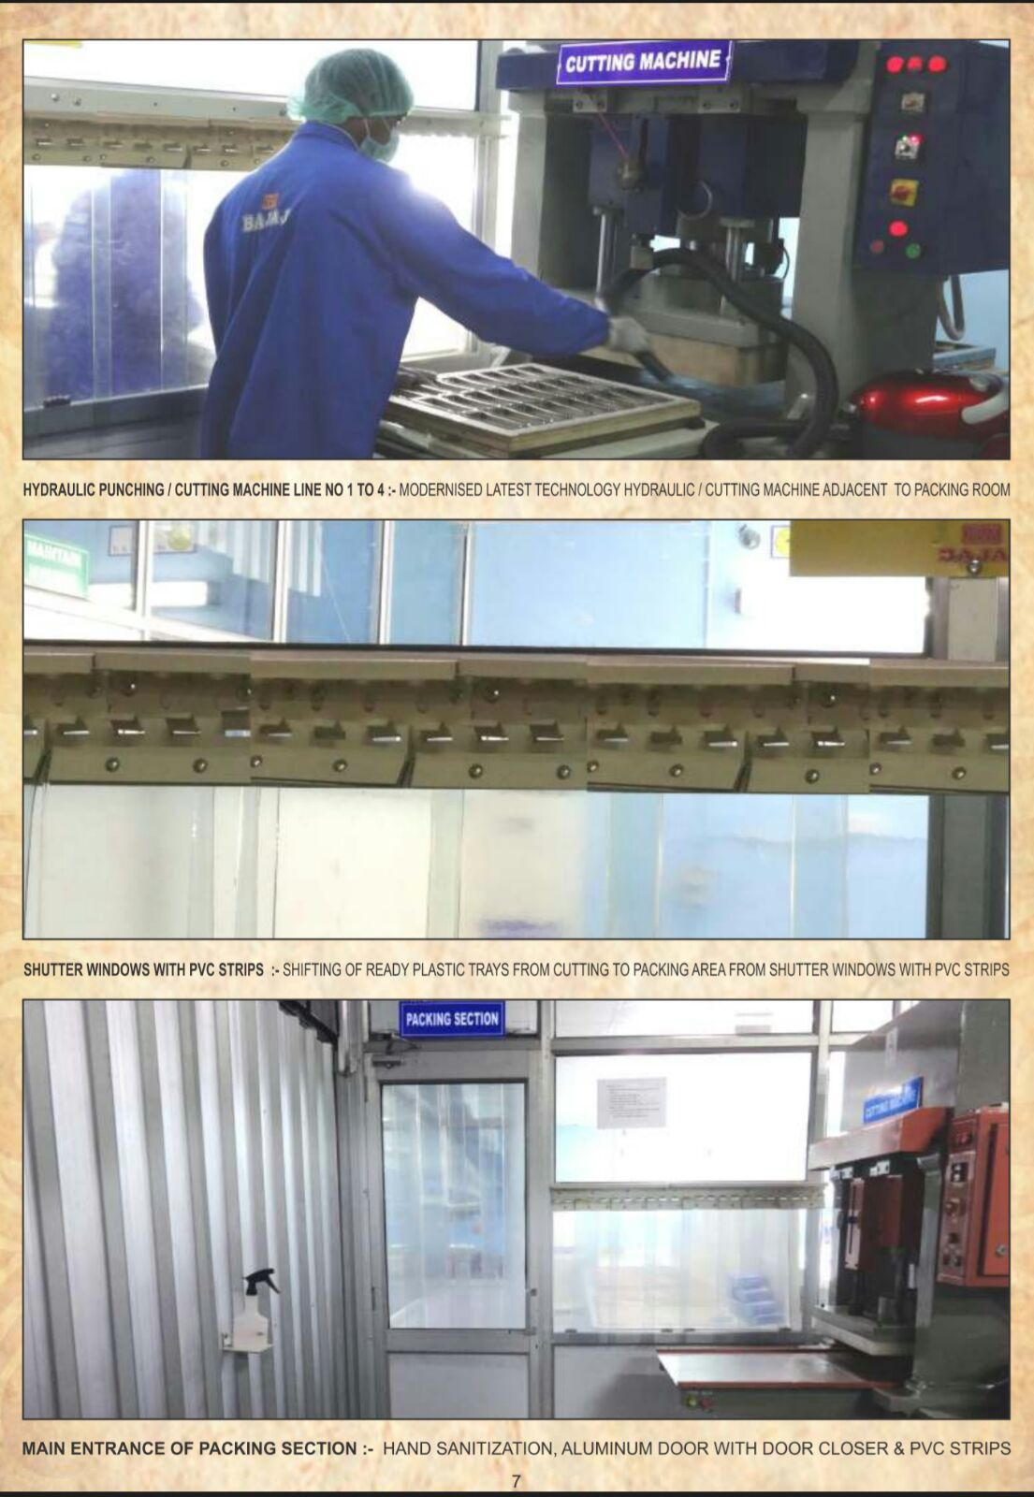
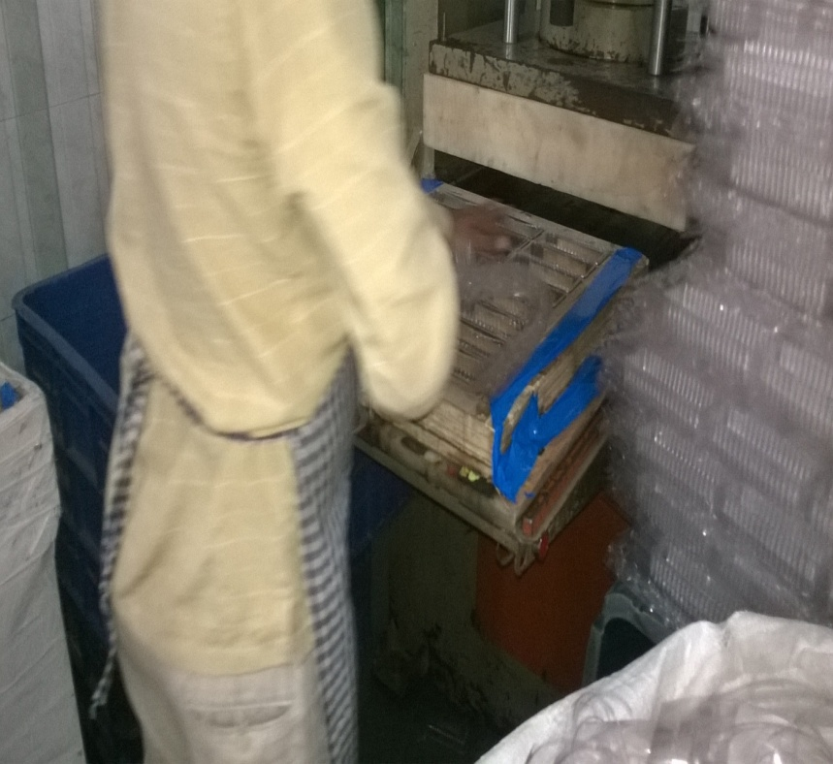
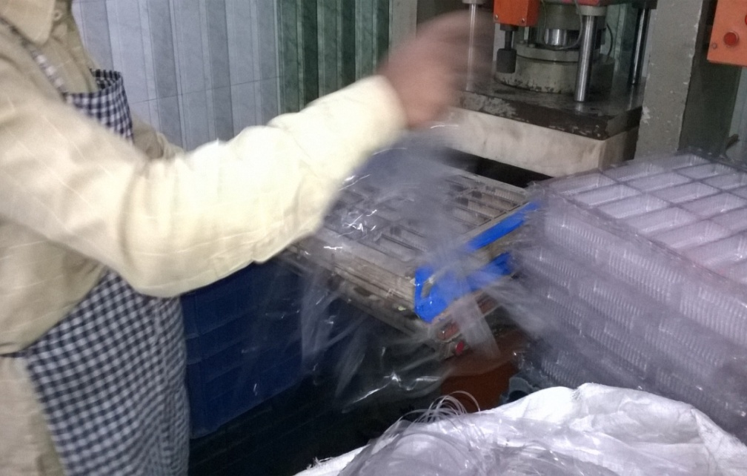
Stage 3 : Cutting Stage ( Work Centre) ( Taking Out the Edges )

Slide 32
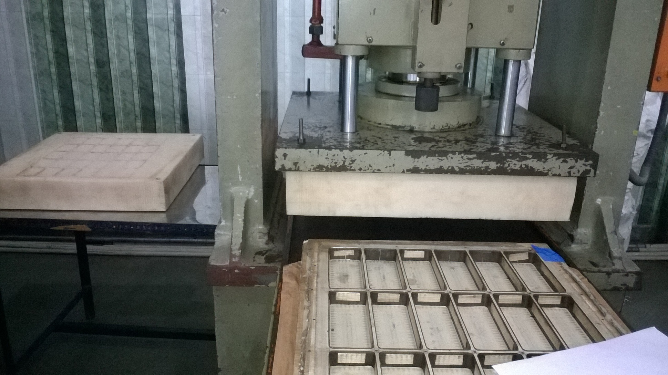
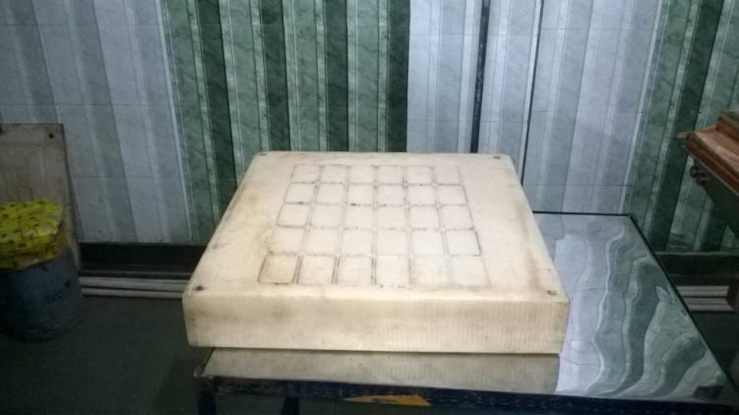
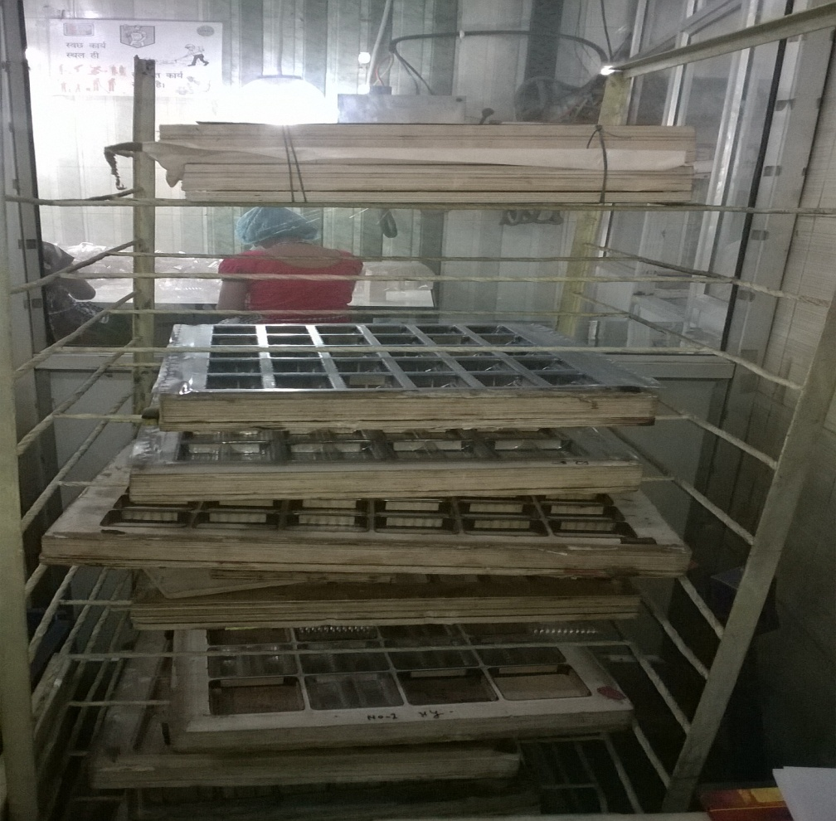
Cont : Cutting Stage ( Work Centre)

Slide 33
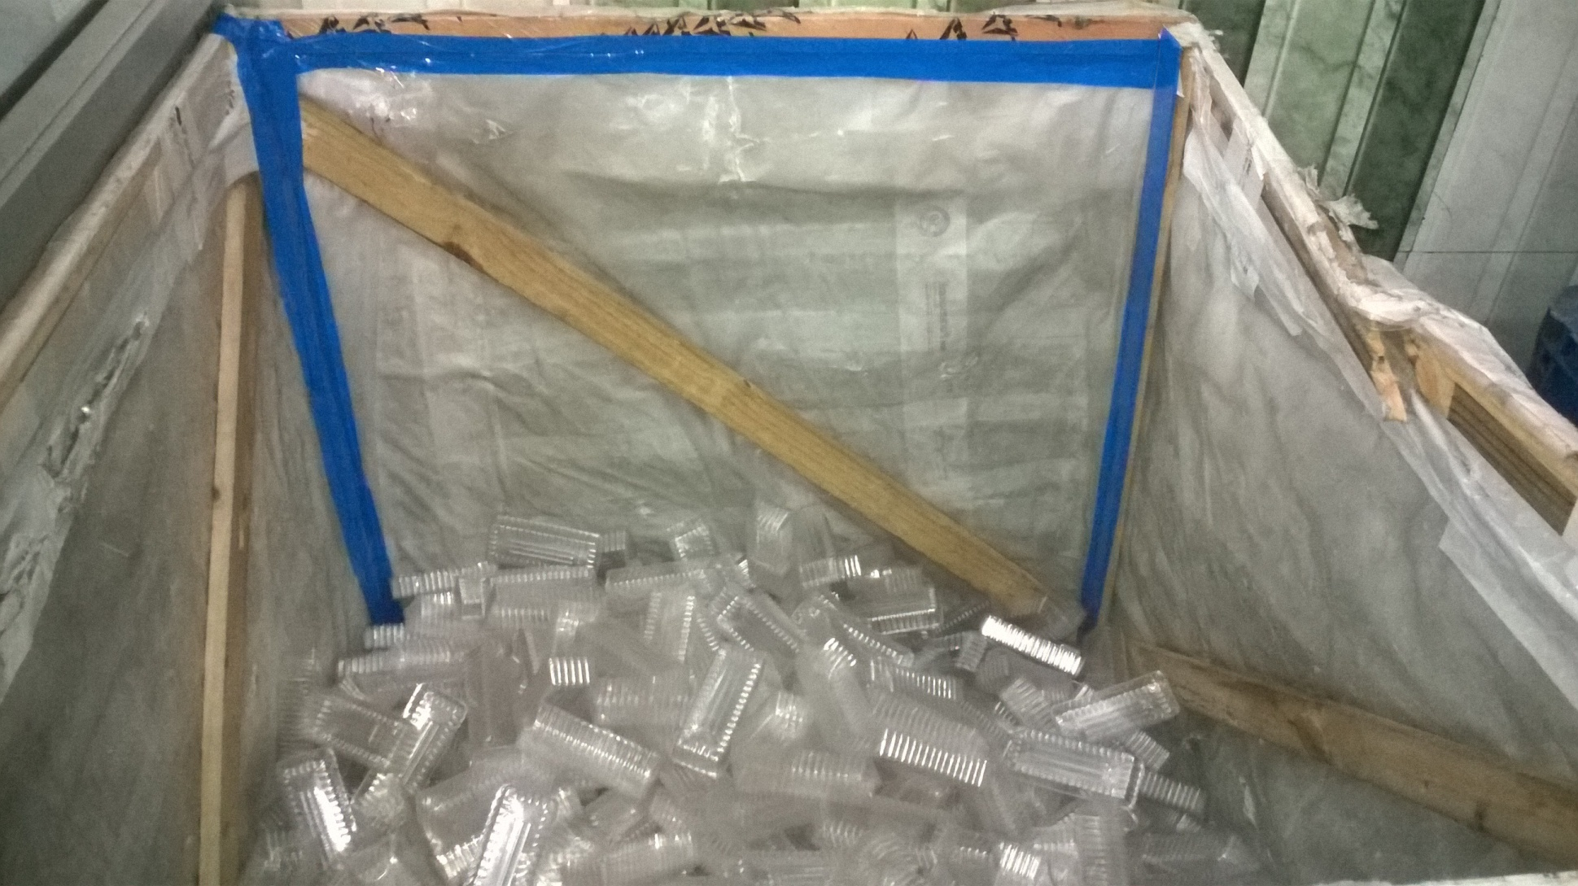
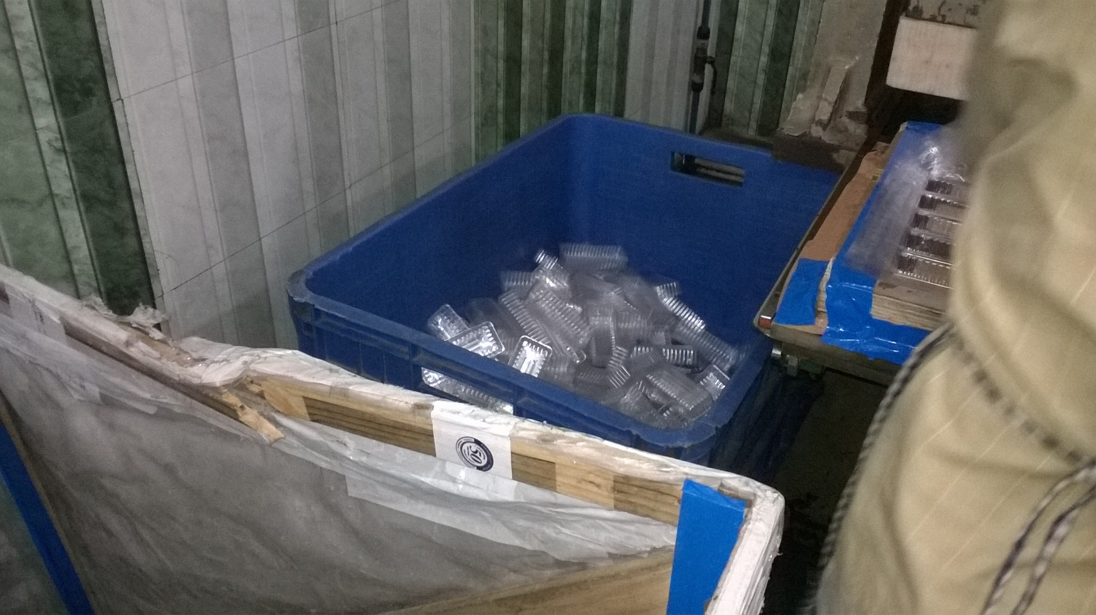
Stage 4 :Post Cutting Stage ( Work Centre) : Collection of individual PVC Treys

Slide 34
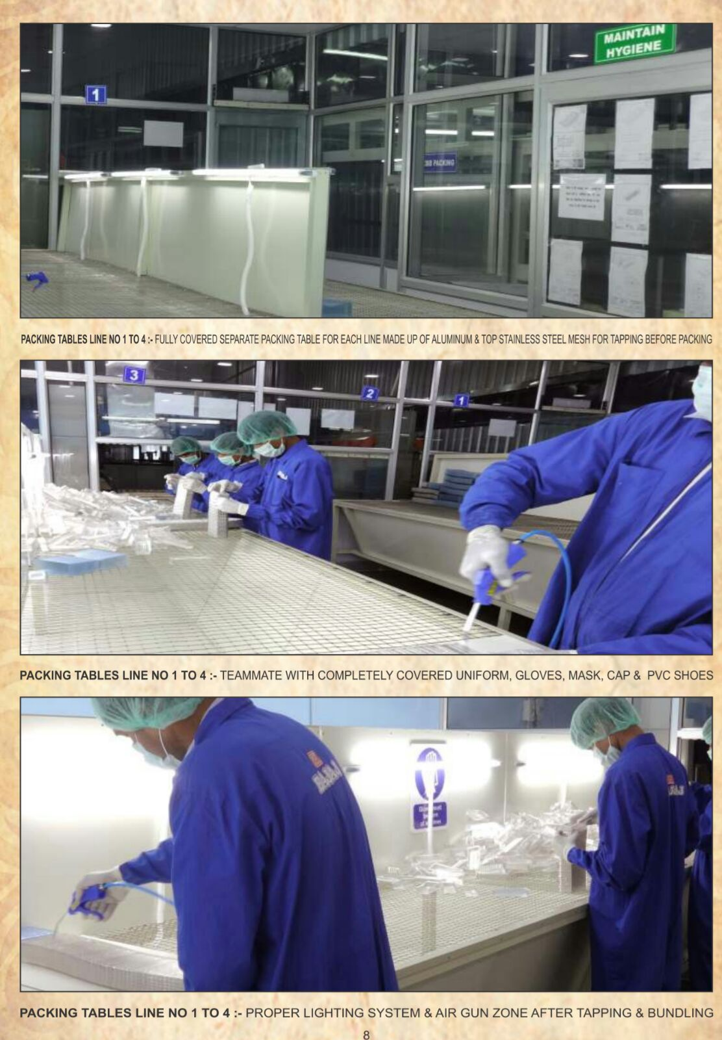
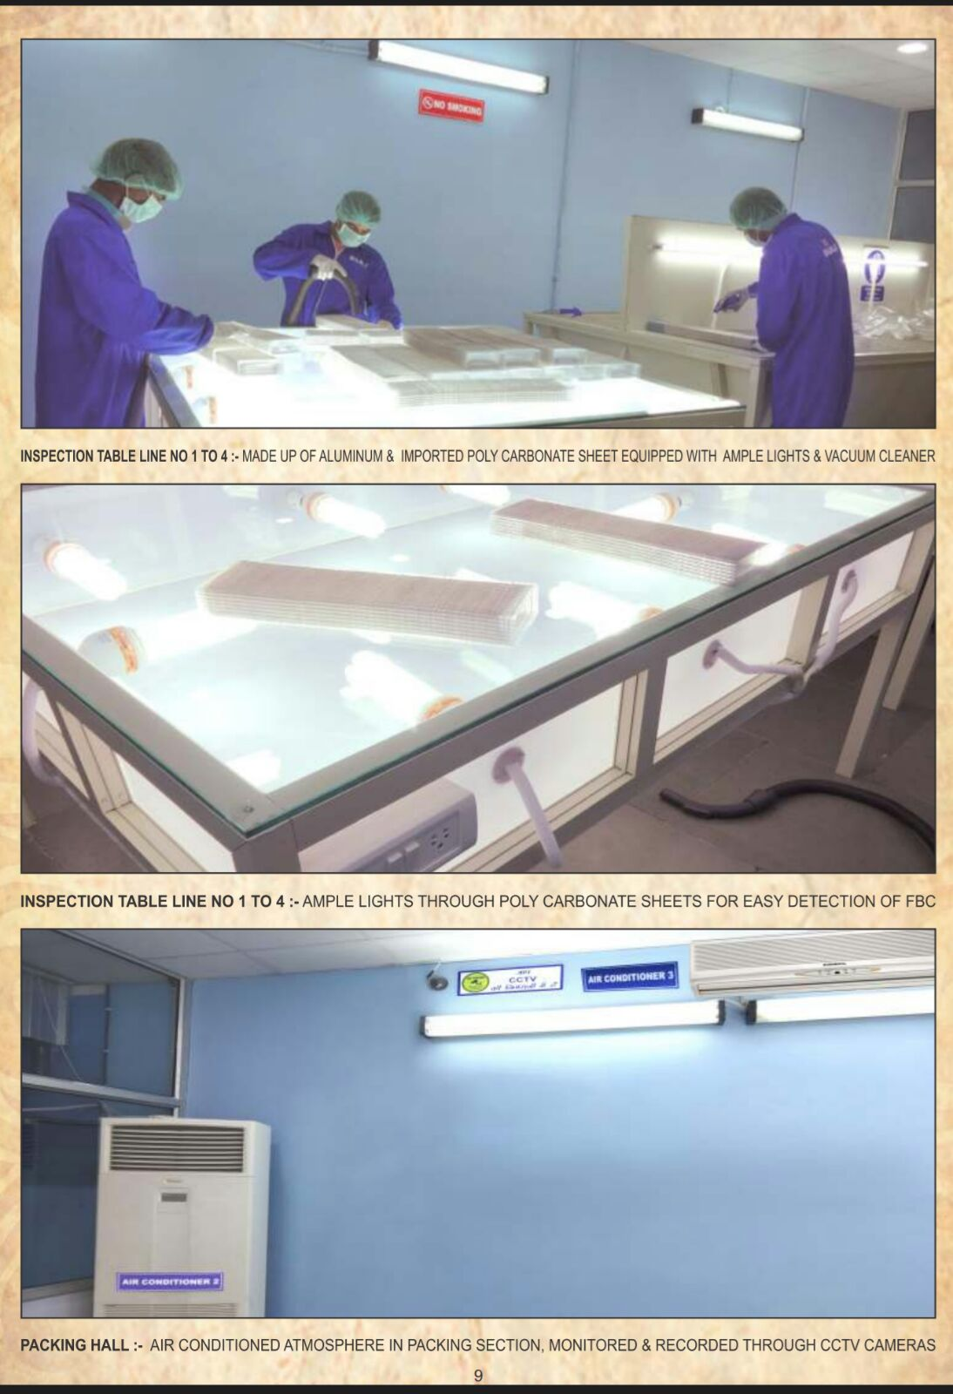
Stage 5 : Stacking,Packing & Inspection ( Work Centre)

Slide 35
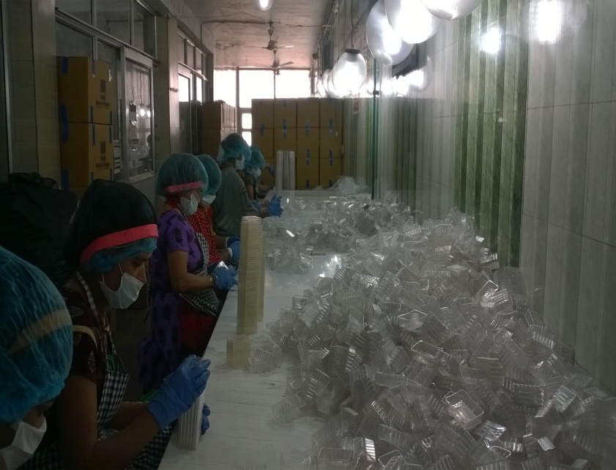
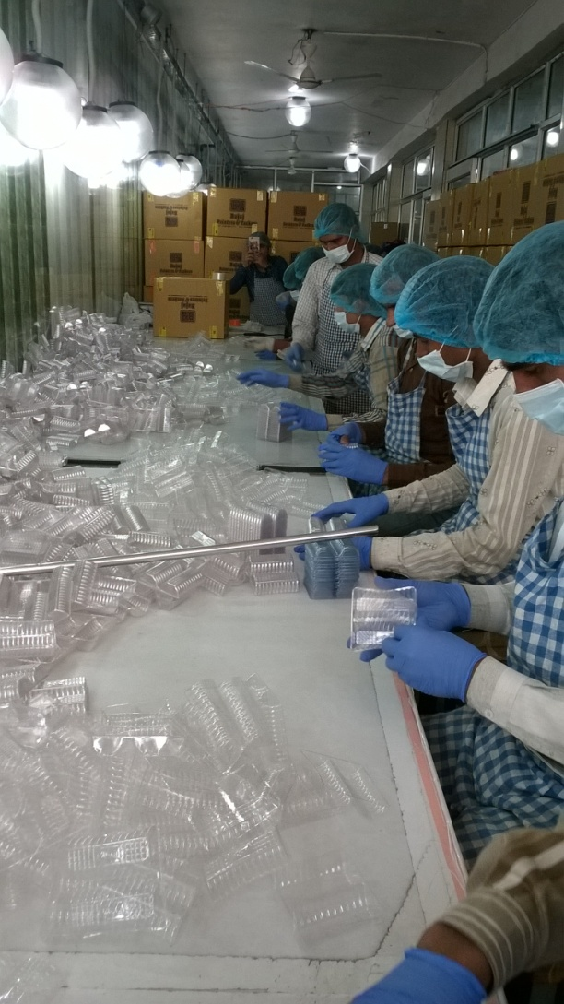
Cont :Stacking , Inspection & Packing ( Work Centre)

Slide 36
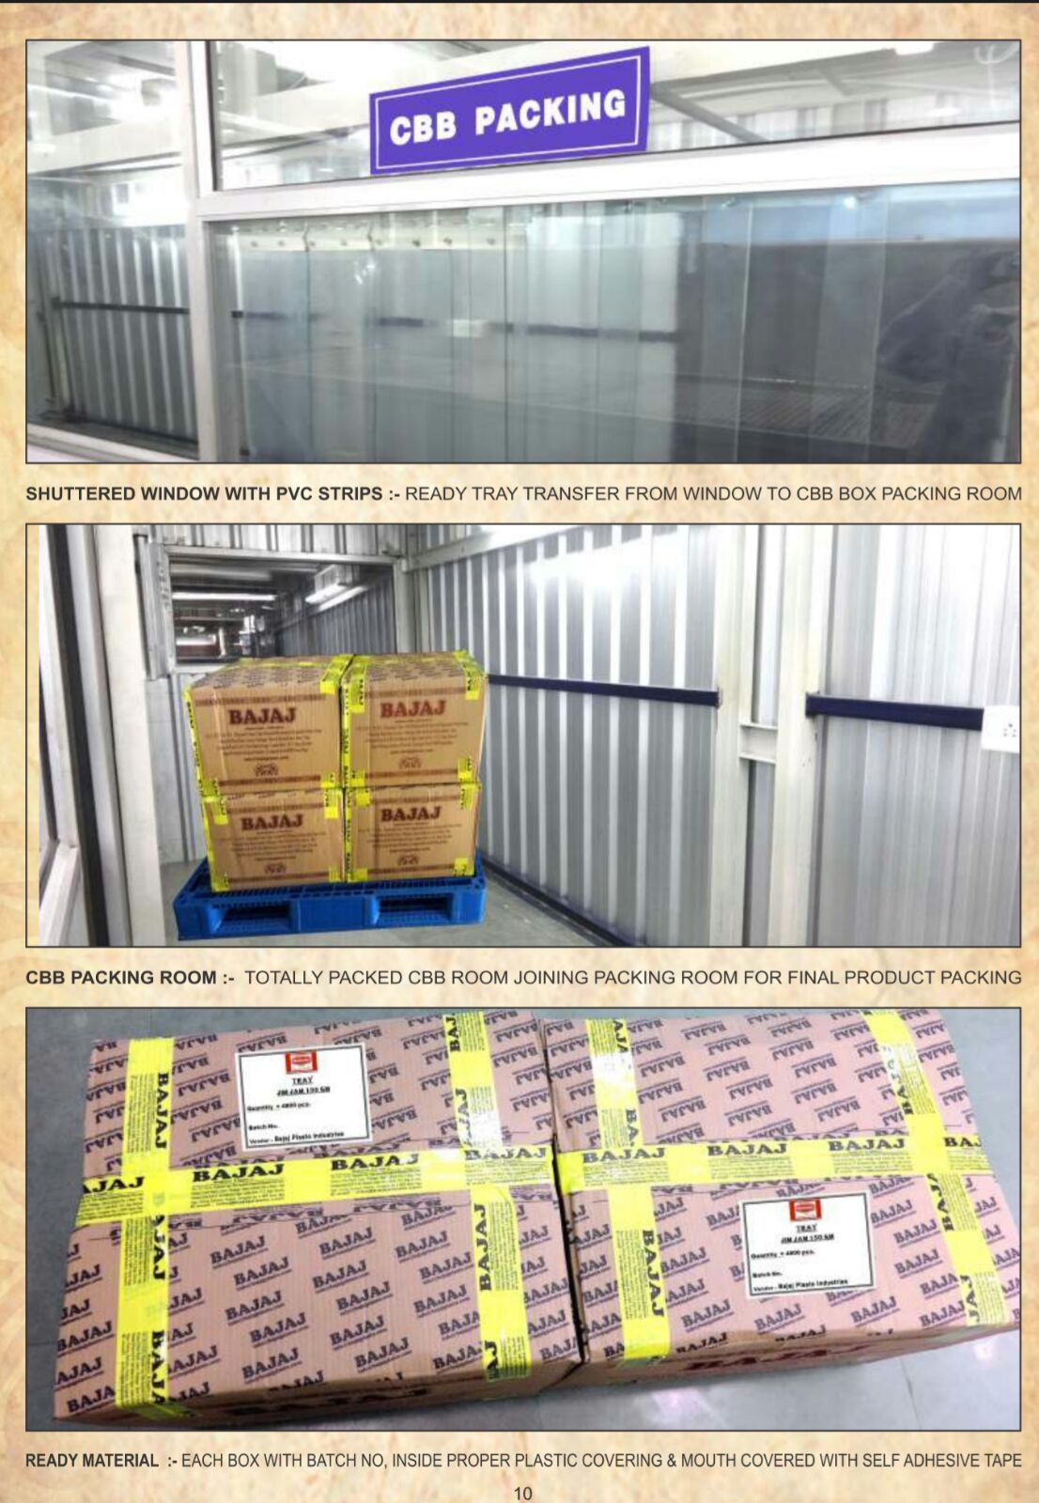
Stage 6 :Packing in CBB & Despatch ( Work Centre)

Slide 37
Possible Solution 2:
Automated Version
“Single Stage Process” using ELI Machine.
Currently this is compatible only for PP treys and not all Vendors have this expensive machine. Its 3 Crore+ M/c

Slide 38
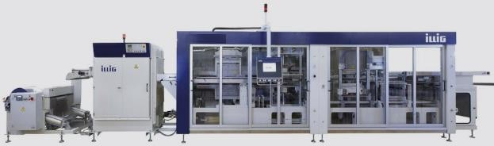
Automatic “Roll Fed >>>>>Forming >>>>>Punching

Slide 39
Solution-3
FBC machine by Faculty of IIT ( Kanpur )

Slide 40
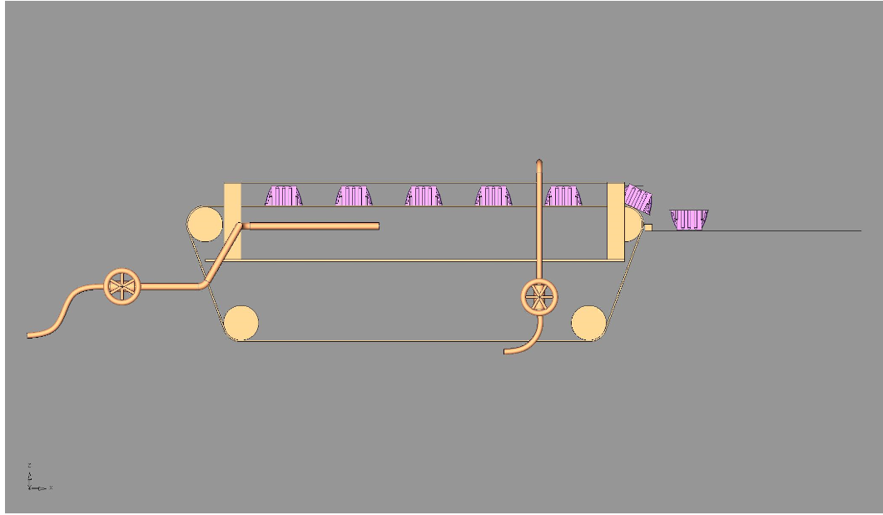
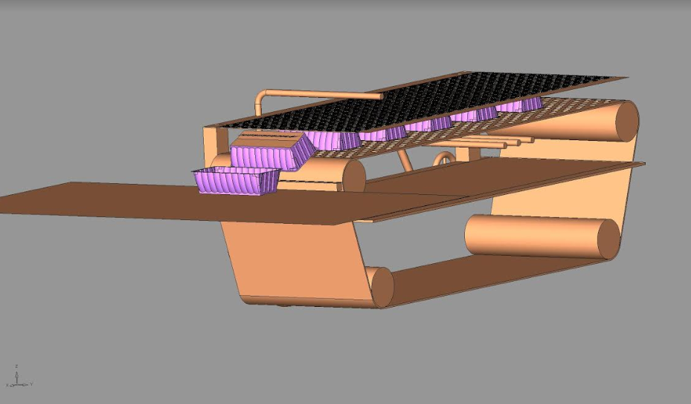
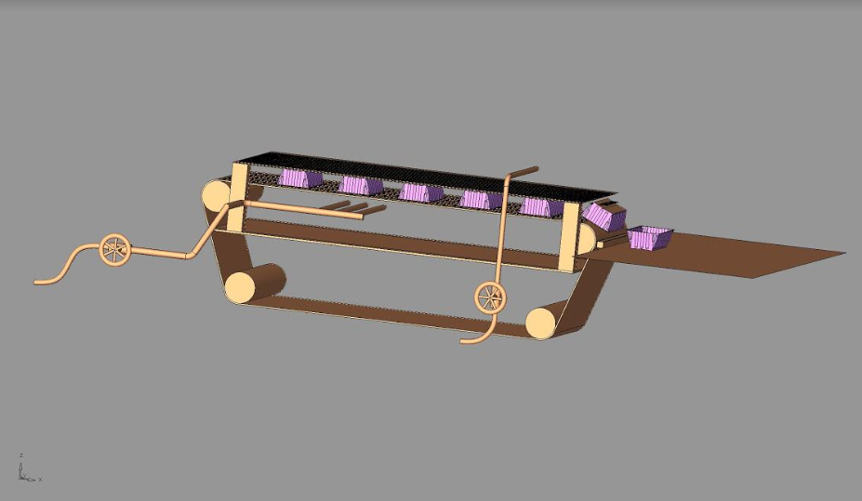

Slide 41
Project on :
Opening of a Bread Unit in Varanasi
( Ref : Excel Sheet)
( Cross Functional Team Effort )

Slide 42
Project on :
Automation of Purchase Process to make the Work Audit Proof

Slide 43
Audit Observations which were coming in Purchase Department
PR without PO
Invoice date before the PO date
>90 days old PO closure
AVL
New PR in Old PO
SOB
Same day same vendor more than 1 PO
Shot closure of PO after getting the new price

Slide 44
Purchasing Cycle
OR
SOURCING CYCLE MANAGEMENT
Starting Point
(Outer Circle
Or
Strategic circle )
Research/Profile sourcing group
Generate Supplier portfolio/Outreach
Execute sourcing strategy
Negotiate
Contract
Develop Sourcing Strategy
Starting Point
(Inner Circle
OR
Execution Circle
OR
Operational Circle )
Strategic Sourcing ( Outer Circle)
Category Management
Price Discovery
VENDOR LIFECYCLE MANAGEMENT
Objective: Create Competitive Advantage through Sourcing Strategies.
Procurement Planning
Purchase Requisition ( PR)
Purchase Order (PO)
Vendor Confirmation
Delivery /Receipt
Invoice
Payment
Transactional Execution ( Inner Circle)
SUPPLY CYCLE MANAGEMENT
Supply Management
Governance and Compliance Management
Objective: Deliver Goods and Services at Minimum Total Cost.
Supplier Management
VENDOR RELATIONSHIP MANAGEMENT
Vendor lifecycle management
Supplier Relationship Management ( SRM)
Supplier Development
Objective: Productively manage supply base to support Sourcing Strategy.

Slide 45
How to ensure that we align our processes
Strategic Sourcing
Competitiveness
Category Management
Price Discovery
Manage Commodity cost by:
Deciding Best Buying strategy
Deciding when and why to source
Category Profiling
Supply Market analysis
Sourcing Strategy Development
Supplier selection
Business Continuity Planning
Implementation plan inline with sourcing strategy
Contract
Transactional Execution
Operational Excellence
Develop process efficiencies to support strategy by:
Automation and simplification
Elimination of rework
Improved Governance
Supply Management
Governance and Compliance Management
Optimize Inventory Planning
Simplify and mistake proof order placement
Improve delivery performance
Improve delivery planning and Scheduling
Improve compliance to negotiated terms and contracts
SOPs
Improve MDM hygiene
- Exception Reporting
Supplier Management
Supplier Lifecycle Management
Supplier relationship Management
Supplier Development
-Standardize and workflow Vendor selection and introduction
Evaluate supplier performance
Develop and standardize vendor separation processes
Improve transaction visibility to supplier
Improve payment performance
Give feedback on performance
Track supplier market place
Indentify alternate vendors inline with sourcing strategy
Operational Excellence
Keep Sourcing strategies Relevant by:
Upgrading vendor relationships
Maintaining most appropriate supply base
Notes:
Supply Management --- Delivery performance [OTIF] >>> Understand the benefit >>> Availabilityv

Slide 46
Project on :
Automation of Demand Planning Process
Or
Automation of SNOP Process

Slide 47
Demand & Supply Planning
Inputs for Demand Planning
7th of month
Incorporate Product Lifecycle Changes
Newness / Intervention
Demand
Planning
Clean History & Develop
Baseline Forecast
Gather Data
During QOP Cycle
Brand Inputs for QOP
@ Q – 2M
Intervention history,
Short Supplies, Outliers, Month end Closing Stock
SPS
9th
Measure and Monitor Demand Plan Effectiveness
Correct Sales History
Generate Statistical Forecast
10th
Final Demand Plan @ SKU/AW
SMC - Final QOP @ Q – 1M
Develop Baseline Forecast
10th
Reports
20th
Alerts
2
Incorporate Brand
Rolling Demand Plan
& Sales Plan
Trade Activity Calendar
Consensus Plan from M-1
BI
Commercial Inputs
21th
Final Demand Plan @ SKU / Sales District
Rolling Demand Plan
Current & Future NSV
28th
1a
1b
25th
Consensus demand plan
3
Sales Plan
Supply Constrained plan - Sales Alignment Meeting
Newness/Intervention
Newness/Intervention Meeting
Consensus Demand – Workflow
28th
4
Supply
Planning
Run Optimizer – FSD Plan
Run FSD for next month
No Capacity
Feasibility Check for Capacity
5
Revise short
Term demand
Production Planning & Scheduling
6
7
Master Data for New SKUs
RM/PM Planning
Distribution Planning
Notes:
47

Slide 48
What is SNOP that got Digitalised

Slide 49
Process Planning Deals with specific technology and procedure needed to deliver a product.
Strategic capacity Planning
Deals with determining long term capabilities of production system ( size & scope )
Process Planning
Long Term
Done for 2 things :
Manufacturing Process
Design of Logistic process
that deliver the product.
Supply Network Planning
Strategic capacity Planning
Forecasting and Demand Management
Determination of expected Demand is the focus here.from these data detailed SNOP is worked out
Supply Network Planning
Deals with (1)how product will be distributed to the customer,(2) warehouse location (3)Type of transportation
Forecasting and Demand Management
Sales and Operations Aggregate Planning
Sales Plan
Aggregate Operations Planning
Medium
Term
( Cont ..)
Sales Plan: These are the Plans to sell.
Operations Planning :
These are inputs into Manufacturing, Logistics and Services.
Manuafacturing
Logistics
Services

Slide 50
Long Term
Done for 2 things :
Manufacturing Process
Design of Logistic process
that deliver the product.
Process Planning
Supply Network Planning
Strategic capacity Planning
Sales and Operations Aggregate Planning
Sales Plan
Aggregate Operations Planning
Forecasting and Demand Management
Medium
Term
Manufacturing
Logistics
Services
Master scheduling
Vehicle capacity Planning
Weekly workforce Scheduling
Material Requirement Planning ( MRP )
Vehicle Loading
Short
Term
Order Scheduling
Vehicle Dispatching
Daily workforce scheduling
Manufacturing (Master Scheduling & MRP) : These are detailed scheduling that indicate when material is neded as per production plan.
Warehouse Receipt planning
Logistics :
Proper Transportation Management has to be done for movement of FG.
Services :Manpower laning has to be done to meet the Production plan

Slide 51
Project :
On Logo Change

Slide 52


Journey of the Logo Change
1997
( Last change happened in 1997)
2018
( And then in 2018 )

Slide 54
All are parallel activities to give ROI to Share holders :
Project Triangle
Supply Chain Triangle
Business Triangle
Value Chain

Slide 55
The Project Management Triangle
Quality
Cost
Schedule
Performance Objectives

Slide 56
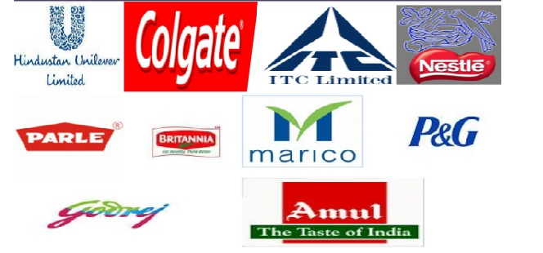
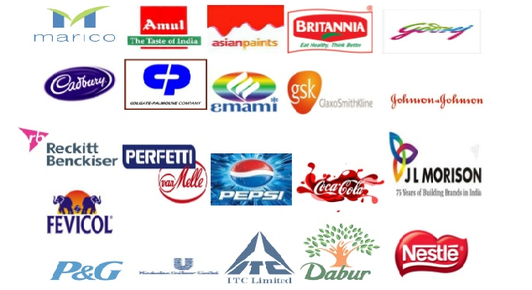




Business Triangle
Top line
( Sales )
Trick to a Business is to FOCUS on Growing both NET PROFIT & MARKET SHARE
Bottom Line or Net Profit
Market Share

Slide 57


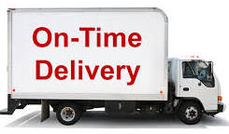
Supply Chain Triangle
Possible approach :
1)Total Delivered Cost to customer.
2) Target Costing : 70 % of products which are sold in FMCG space is of 5Rs -10 Rs Price point.
3)TCO ( Total Cost of Ownership)
4)M2M Mark to Market( Company Vs Competition ) Or Buying Efficiency.
Cost
CEP/ Efficiency Next ( Across the Globe in all Good Companies 2 % of Operating Cost has to be taken out Y-o-Y .In Emerged Economy where growth is low this is one of the Levers from where the profit comes.
Quality
Delivery
Possible approach :
1)Statutary Compliance to FSSAI & FSSR.
Possible approach :
1)OTIF (PDP On Time in Full).
2) Line Fill Ratio
3) Case Fill Ratio
4)PDP Compliance ( Pre-Despatch Plan )
5)CRSE Compliance ( Continuous Replenishment ).
6) Premiun Food Delivery in 30 Minutes, BLINK -IT etc
7) NIL Under Delivery or Machine Down time through JIT,VMI , Part Load, Parcel Load and FCL Load ).

Slide 58
If both the Business Triangle and Supply Chain Triangle are in place then the result is encouraging…….
Top line
( Sales )
Project Triangle
Cost
Quality
Cost
Schedule
Trick to a Business is to FOCUS on Growing both NET PROFIT & MARKET SHARE
B Next/ Efficiency Next ( Across the Globe in all Good Companies 2 % of cost has to be taken out Y-o-Y .In Emerged Economy where growth is low this is one of the Levers from where the profit comes.
Bottom Line or Net Profit
Market Share
Quality
Delivery

Slide 59
Lets look at two supporting's :
Excel sheet on the set of activities of an FMCG company
Detailed PDF of activities in a North East Factory.

Slide 60
Thanks

Slide 61
5 Formats of Manufacturing Facility or Production Processes

Slide 62
5 Formats of Manufacturing Facility or Production Processes.
Assembly Line
Continuous process
Workcenter (Job shop)
Project
The product remains in a fixed location ( eg Green Field Project , Aircraft making, Builing etc )
Manufacturing cell
A dedicated area where products that are similar in processing requirements are produced ( eg Computer Chips , Metal Fabrication )
Work processes are arranged according to the progressive steps by which the product is made eg FMCG Products ( Packaged Food Industry, Automobiles etc )
Is similar to Assembly line only difference is the flow is continuous such as with liquids eg ( Liquid Industry )
Similar equipment or functions are grouped together. And Similar functions are also known as DEPARTMENTS ( eg In PVC Trey making workcentre’s are Air Blowing workcentre, Tapping workcentre,Stacking Workcentre,Packing Workcentre,Shipping & Despatch workcentre )
Manufacturing equipment is moved to the product.
Notes:
11

Slide 63
Product Process Matrix

Slide 64
Product Standarisation
Product Process Matrix
Inefficient Process
High
Continuous Process
Eg Liquids like Petrol, Gasoline, Milk, Flavours High Volume --High Product Standarisation
Assembly Line Process
Eg FMCG Products
High Volume --High Product Standarisation
Manufacturing Cell
Eg Computer Chips Projects
Medium Volume --Medium Product Standarisation
Work Centre Eg PVC Trey Making Low Volume-- Low Product Standarisation
Projects
Eg Green field Projects
Low Volume --Low Product Standarisation
Mass Customisation
Volume
Low
Low
High

