Slide 1

Dealing with Competition

Slide 3
Value To Consumers
  Choosing (STP)
  Creating (Product, Price)
  Communicating (Promotion)
  Delivering (Place)
Competition Superior Value Core Competency Competitive Advantage
Core competency is a combination of multiple resources and skills that distinguishes a firm in the marketplace.
Competitive advantage is a condition or circumstance that puts a company in a favorable or superior business position.
https://www.youtube.com/watch?v=OhuOtnX_4zc

Slide 4
Contribution of Resource Based View
Focused on company specific resources in context of the competitive environment
Combining internal and external perspectives
Explains 1) Why some businesses are more profitable 2) what is core competency 3) which diversification strategies to follow
Core competency can be in form of a
  Physical Asset
  Intangible Asset
  Organizational Capability (Embedded in routines, processes and culture)
How to identify a core competency
  It is hard to copy (Physical Uniqueness; Path Dependency; Causal Ambiguity; Economic Deterrence)
  It depreciates slowly
  Its value is controlled by the company
  It is not easily substituted
  It is better than competitors similar resources

Slide 5
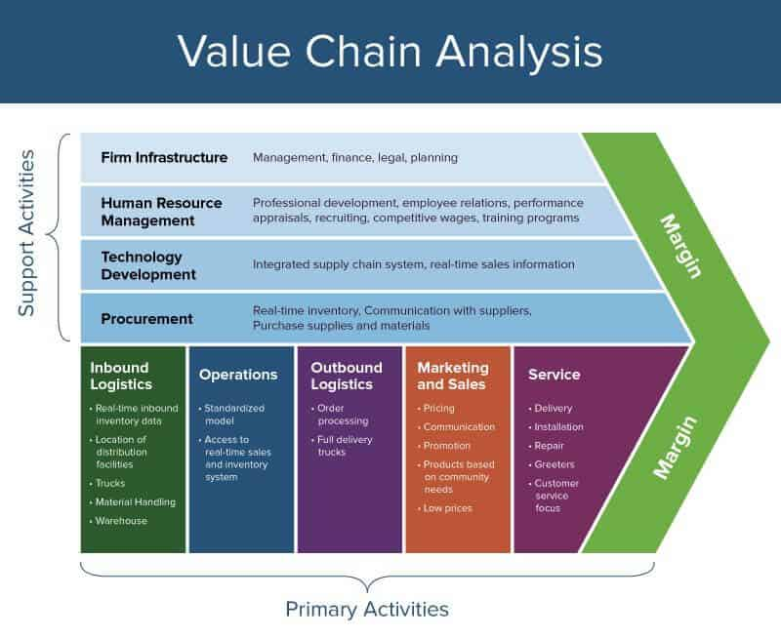
Value to Superior Value

Slide 6
Why do companies outsource?
What is the core competency of Public Sector Banks?
Actionable Implications
  Investing, Upgrading and Leveraging Resources

Slide 7
Competing on customer journeys
What kind of challenges are being posed for businesses by EMPOWERED consumers?
  They have access to lot of information which helps them in deciding what, when, how they buy?
  Limiting the role of businesses- Only providing information or helping the customers in the journey
Sungevity
https://www.youtube.com/watch?app=desktop&v=i35xfEGAu-I
Malls and IKEA
Customer Journeys are important part of customer experience
Way to achieve Competitive Advantage

Slide 8
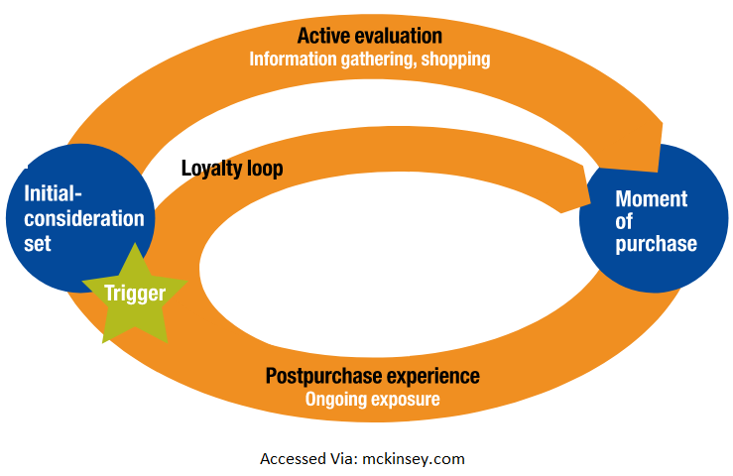
Lead customers proactively- Use technologies, processes and organizational structures
Treat journeys like products
Four capabilities for building effective journeys
Automation
Personalization
Contextual Interaction
Journey Innovation
Redesign your operations and organization to support or design the journeys
Integrating with other service providers- L’Oreal

