Slide 1

Services Marketing

Slide 2
Breaking Free From Product Marketing

Slide 3
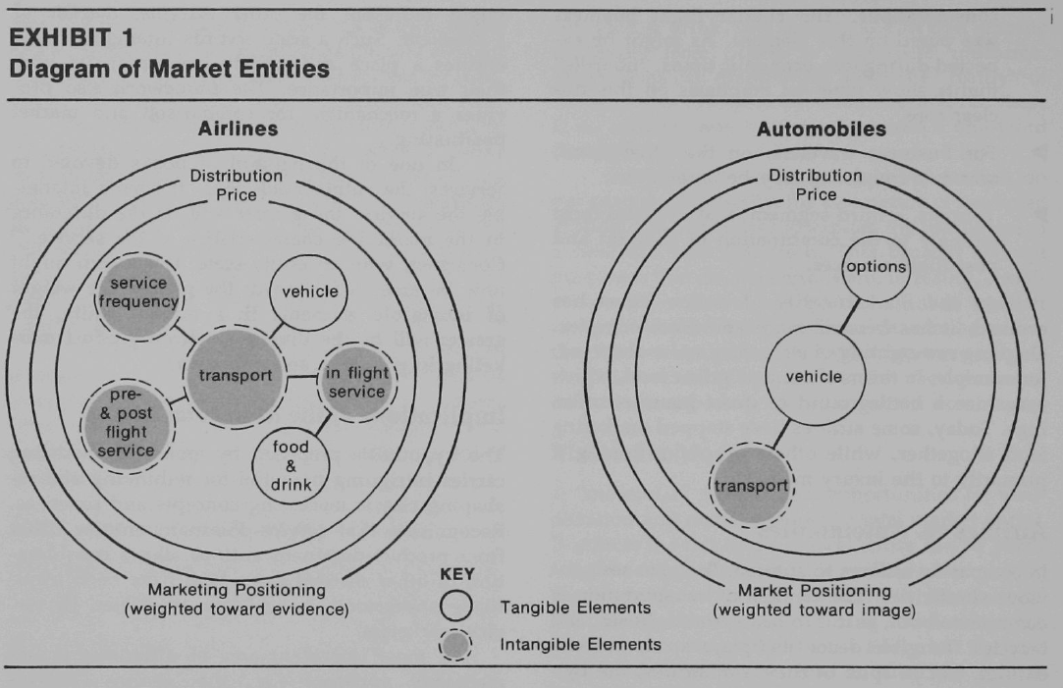
Product-oriented marketing for Services
  Intangible Product
  Confusion
  No guidance
  Myopia
Complexity Involved
  No physical ownership
  Its an experience unlike a product
  Value was created by objects
  Intangibility was not the core element of marketing
Are there any pure products or pure services?
  What are automobiles?
  What is an airline?
Molecular Model
  Nucleus may consist of multiple elements related to each other
  Both tangible and intangible elements exist (One may dominate)

Slide 4
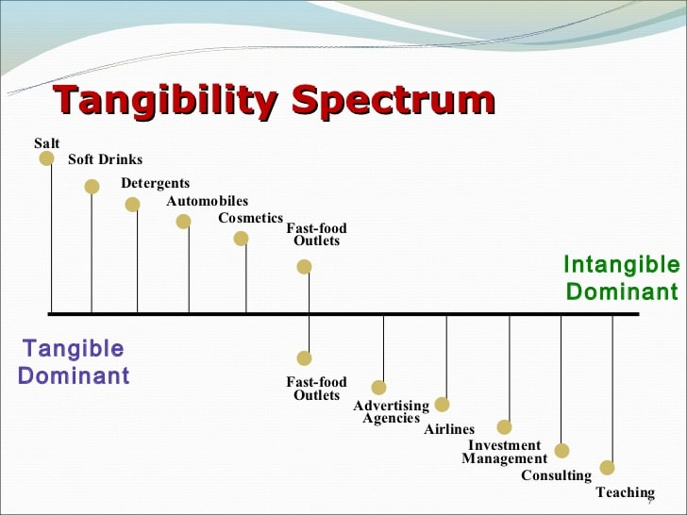
Airlines vs Automobiles
  Transportation and Tangible Décor is a common element
  Still they are different- mirror opposites
  Car (Physical Possession)- Promise a service
  Airline (Intangible)- promise a destination as a product
Elements decide marketing mix
The weight of elements decide position on the continuum
Greater the weight of intangible element, greater the divergence from product marketing

Slide 5
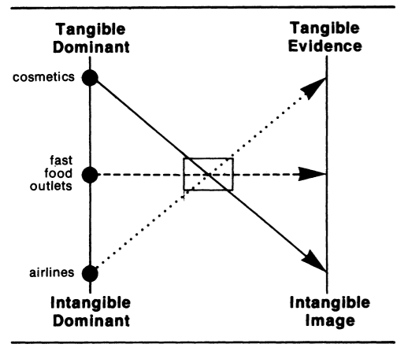
Defining Service Dominant Offerings
  Product Knowledge vs Service Knowledge
  Easy (Physical examination; Quantitative Measurement, Replicable)
  vs
  Difficult (Dynamic; Subjective; Cannot be touched, seen or tasted)
Representing the tangible or intangible elements to the market
Enhancing physical objects through abstract associations (Coca Cola, Axe)
Enhancing services through tangible cues
Also a way of differentiation

Slide 6
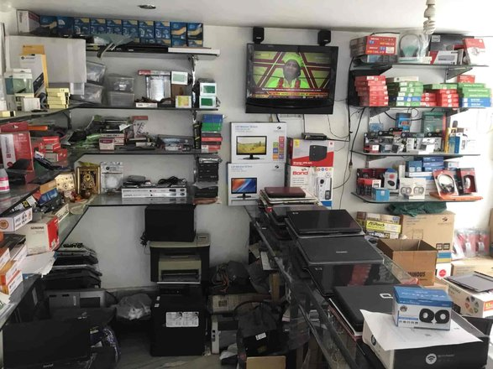
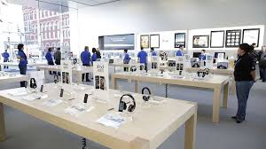
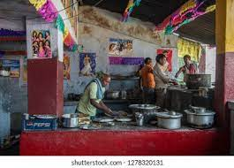
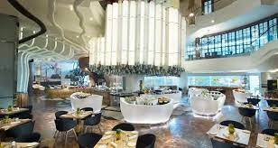
Environment as Evidence
Why Services need more control over the environment?

Slide 7
People as Evidence
More important in services
Oil Industry
Media as Evidence
Media abstracts the physical
Media may make service entities look more hazy instead of concrete

Slide 8
Accommodation of Services in Marketing
Characteristics of Services
  Intangibility
  Inseparability
  Heterogeneity
  Perishability

Slide 9
Implications of Intangibility
  Services cannot be inventoried
  Services cannot be readily displayed or communicated
  Pricing is difficult
Implications of Inseparability
  Customer participate and influence the transaction
  Customer affect each other
  Employees affect the service outcome
  Mass Production is difficult

Slide 10
Implications of Heterogeneity
  Services delivery and customer satisfaction depend on employee and customer actions
  Services quality depends upon many uncontrollable factors
  Difficult to ensure that delivered service matches with what was planned
Implications of Perishability
  Difficult to match demand and supply
  Services cannot be returned or resold

Slide 11
Traditional Marketing Mix
  Product
  Price
  Place
  Promotion
Expanded Marketing Mix for Services
  People
  Physical Evidence
  Process

Slide 12
Service-Profit Chain

Slide 13
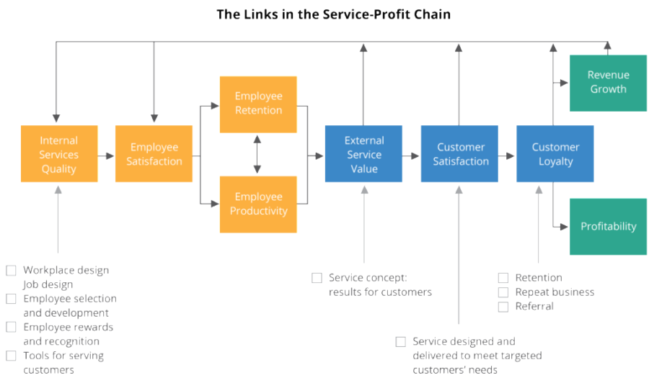
Focus on customers and employees
5% increase in customer loyalty- 25% to 85% increase in profits
Lifetime Value

Slide 14
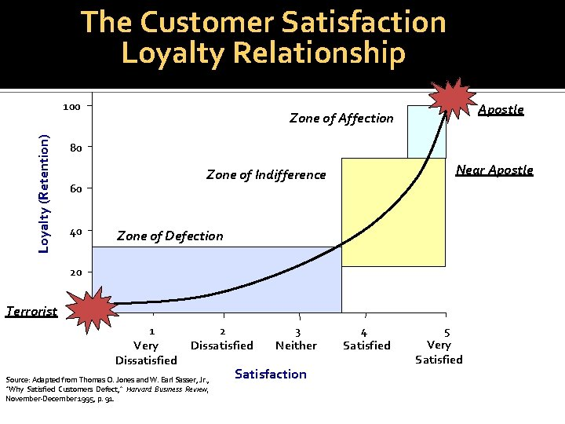
Xerox- 4,80,000 customers satisfaction levels --- 6X difference

Slide 15
Value Drives Customer Satisfaction- Insurance
Employee Productivity Drives Value- Southwest
Employee Loyalty Drives Productivity- Taco Bell
Employee Satisfaction Drives Loyalty
Internal Quality Drives Employee Satisfaction

Slide 16
What is the source of employee job satisfaction?
How to enhance these relationships?
  Effort required to hire people; Measuring Satisfaction; Accounting referrals and retention

Slide 17
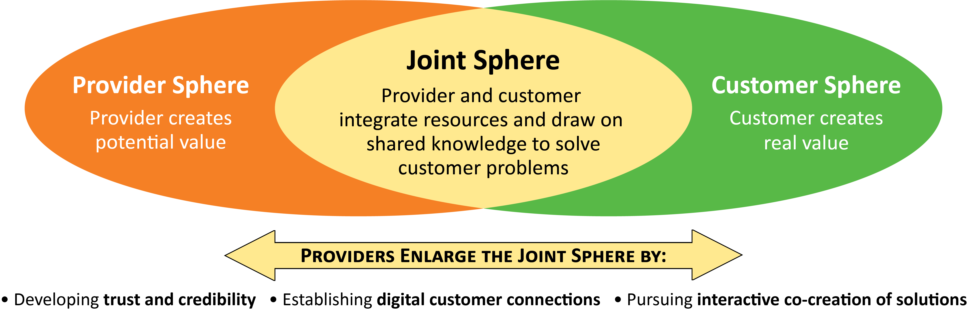
Service dominant logic
Is there a difference between products and services?
Who creates value?
What is customer participation? Do we need to increase customer participation?
Traditional View
  Provider controls value creation
  Customer helps provider in value creation
SDL
  Provider as value facilitator; Customer as value creator
  Provider helps customers in value creation
Potential Value vs Real Value
Firms should look for ways to extend joint sphere to enhance value creation
What happens to provider offerings when they adopt a SDL perspective?

Slide 18
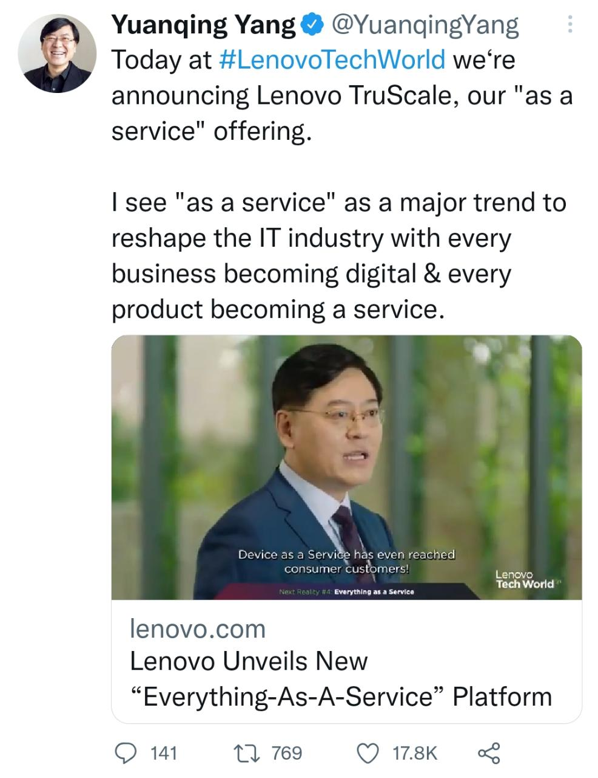

Slide 19
Thank You

