Slide 1

Sales and Marketing Fundamentals
Prof Gurbir Singh

Slide 2
What is Marketing?

Slide 3
All the activities undertaken to satisfy customer needs profitably.
Identifying, creating, communicating and delivering value to customers.

Slide 4

Marketing is a societal process by which individuals and groups obtain what they need and want through creating, offering, and freely exchanging products and services of value with others.
Value
Perceived Value
Benefits = Functional Benefits + Psychological Benefits (Status; Sense of Control, Accomplishment, Power)
Cost = Monetary Cost + Non-monetary Cost (Time; Effort; Usage; Disposal)
Perceived Value = Benefits – Cost
How to increase value offered to customer?

Slide 5
Need
Basic human requirements such as air, food water. It includes psychological requirements.
Feeling deprived of these basic human requirements
Want
Specific need satisfiers
Demand
Want backed by ability to pay

Slide 6
Can we create a need?

Slide 7
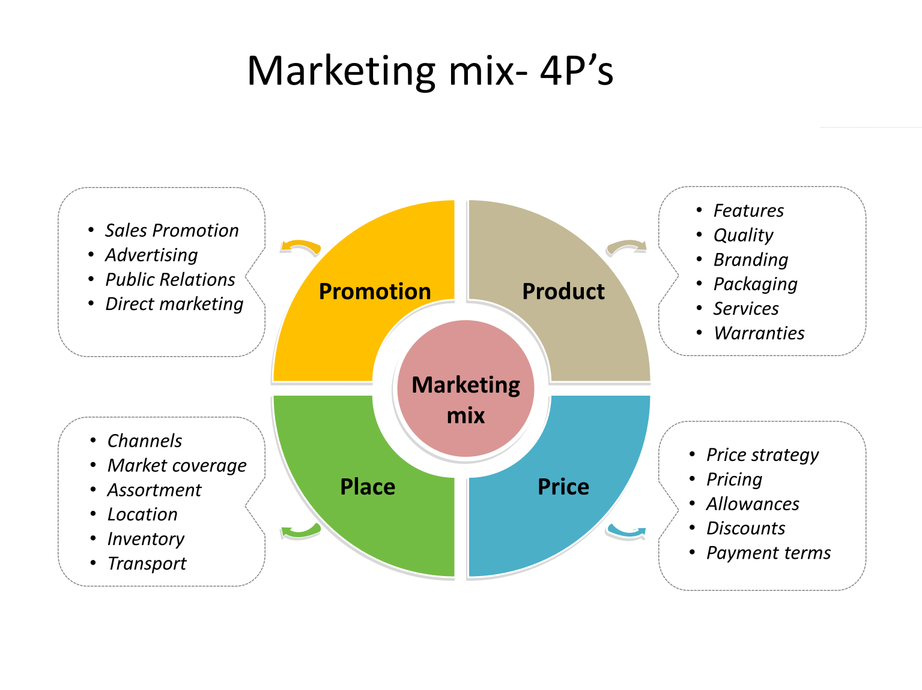
What decisions you take as a Marketer?
What is Marketed?
Goods; Services; Events; Experiences; Persons; Places; Properties; Organizations; Information; Ideas

Slide 8
Customer is king
Customers doesn't know anything
Video
Stated Needs; Real Needs; Unstated Needs; Delight Needs; Secret Needs
Marketers should understand and find ways to satisfy customers needs

Slide 9
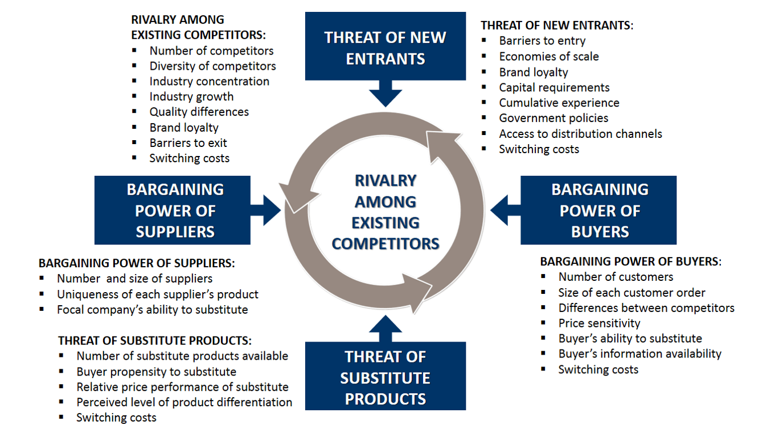
STP
Segmentation; Targeting; Positioning
STP and 4Ps
Environment (Broad vs Task)
Socio-cultural; Technological; Legal; Economic; Political

Slide 10
Marketing Myopia

Slide 12




What happened to these companies?

Slide 13
Marketing Myopia
What it means?
short-sighted and inward looking
focuses on fulfillment of immediate needs of the company rather than focusing on marketing from consumers’ point of view
Myths which aggravates Marketing Myopia
Expanding Population
  (Automatically expanding markets curbs imaginative thinking; Expanding the distribution channels; Focus on increasing efficiency of products rather than increasing their value to customers,)
No Substitute
  (Mobiles)
Mass Production
  (Focus shifts to selling; Finding more uses for its product vs Customer focus)
Focus on R&D
  (Superior products will sell itself, Don’t organize your companies around breakthrough innovations, R&D to focus on customer)
Problem with Marketing Myopia
Way we define our business
Way we define our customers
Way we identify our competitors
Is oil industry in India suffering from Marketing Myopia?

Slide 14
Had Oil industry suffered from Marketing Myopia?
Crude Oil as a Patent Medicine (Smauel Kier in 1852)
Oil in Kerosene Lamps
Invention of light bulb
Kerosene in space heaters
Coal-burning Domestic central-heating
Internal combustion engine
By 1920’s there was a slowdown
Central Oil heater
Demand stabilized again
Wartime demand for Aviation fuel
Expansion of civil aviation, demand for cars and trucks
Use of natural gas for heating
https://www.youtube.com/watch?v=hw8FfogTUhU

Slide 15
What’s Happening Around Us?
Hydrogen Powered All-Electric Cars
  Toyota, Hyundai and Honda are leading this change
  In 2018, 65 filling stations in California
  Japan plans to have 40000 fuel cell vehicles and 160 hydrogen stations
Heliogen
  cutting-edge solar technology
  creates immense heat, exceeding 1,000 degrees Celsius (1,832 Fahrenheit)
  replace traditional fuels such as coal, gas and oil in the production of materials such as cement, steel and petrochemicals
  on track to ultimately produce temperatures up to 1,500 degrees Celsius, hot enough to split carbon dioxide and water to make hydrogen and other fossil-free fuels
Breakthrough Energy Ventures
  Producing Biofuels with microbes
  Travelling Wave Reactors- Using the depleted uranium
  Bill Gates; Jeff Bezos; Richard Branson; Jack Ma
Ineos Group (Ratcliffe)
  Tie up with Hyundai to supply hydrogen
  Plans to launch a SUV similar to Land Rover Defender
  https://www.youtube.com/watch?v=YeiFMirdToA
  Which other industries are going to change in future?

Slide 16
Birkin Bags
  https://www.cnbc.com/video/2019/09/24/birkin-bag-collectors-pay-thousands-for-one-bag.html?__source=sharebar|email&par=sharebar
  How is this video related to Marketing Myopia?
New Marketing Myopia (Smith and Drumwright)
Business Orientation
  Production Concept
  Product Concept
  Selling Concept
  Marketing Concept
How would you define the business of a shirt button maker without being Myopic?

Slide 17
Ending the War Between Sales and Marketing

Slide 18
Sales vs marketing
Marketing
Setting price too high
Marketing budget for more salesforce
Out of touch with customers
Advertising effectiveness is questionable
Wrong timing of product launch
Lack of features in products
Sales
- Poor Execution of plans
- Too much focus on individual customers
- Lack of focus on overall market and future prospects
- Fulfilling demand but not creating it

Slide 19
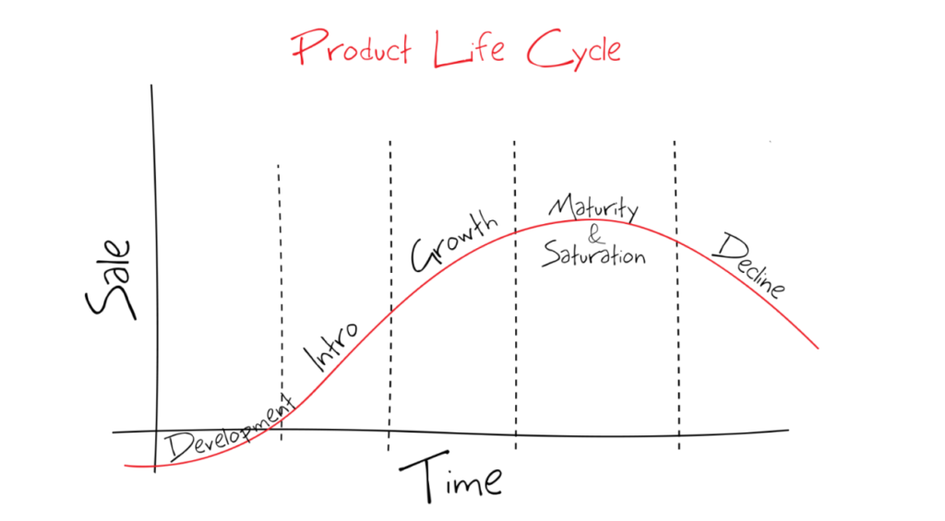
Roles of Sales and Marketing as per PLC

Slide 20
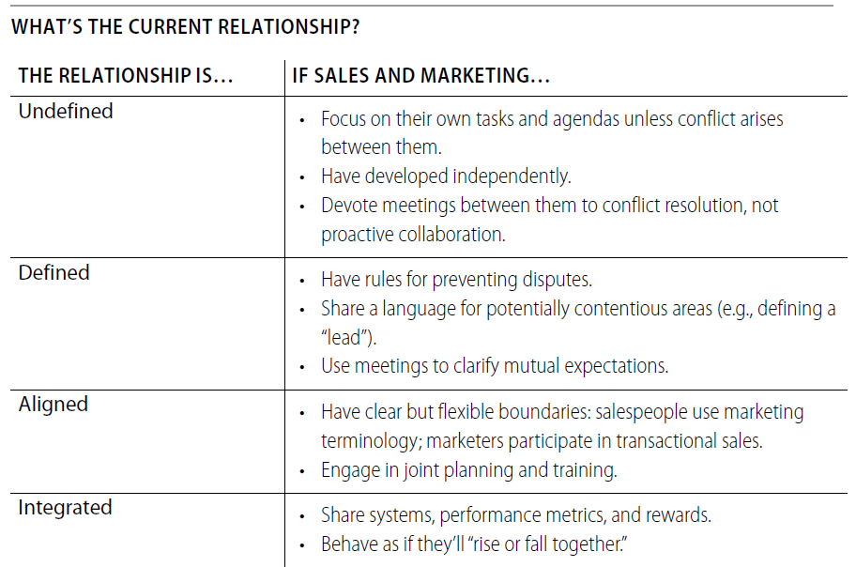

Slide 21
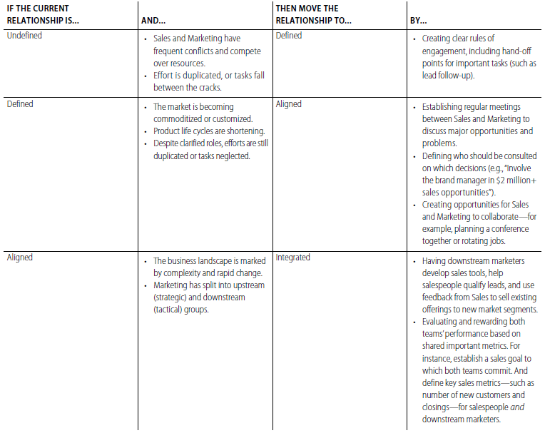
Do you need more interconnections?

Slide 22
Relationship between sales and marketing

Slide 23
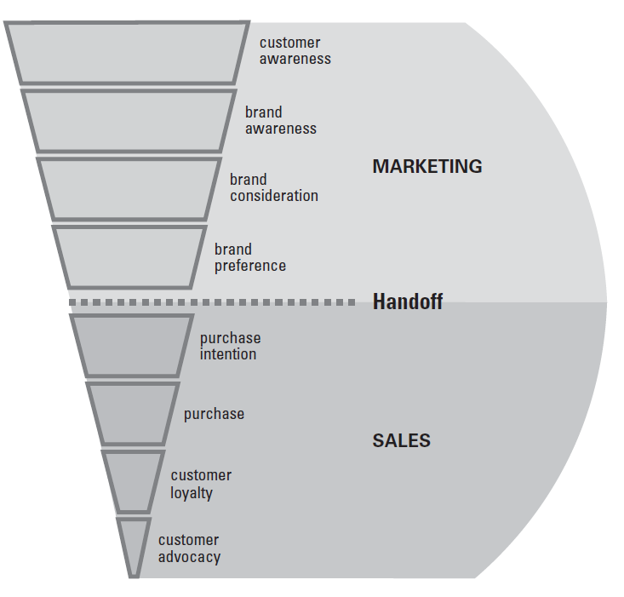
Buying Funnel

Slide 24
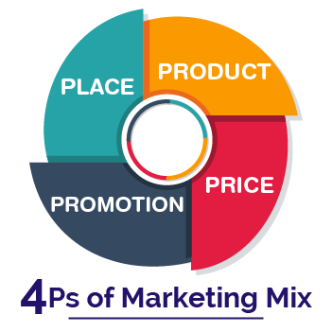
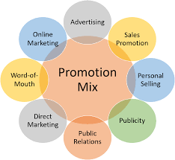
Identifying Value
Creating Value
Communicating Value
Delivering Value

Slide 25
Thank you

