Slide 1
Personality and Leadership

Slide 2
personality
What is personality?
What does not personality
Is it important, from an organizational point-of-view, to understand employee personality? Why or Why not?
What are the different theories/frameworks of personality?

Slide 3
MBTI Styles
Personality
Source of energy
Introversion
Extroversion
Orientation to world
Perceiving
Judging
Thinking
Feeling
Sensing
Intuition

Slide 4
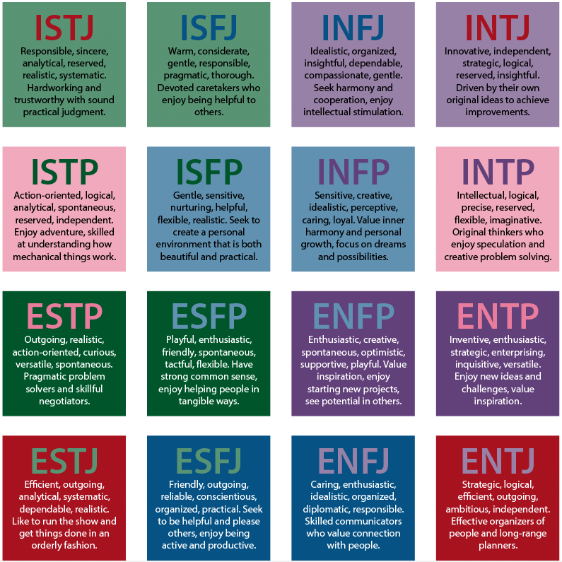
MBTI

Slide 5
MBTi concepts
Dominant function: Function shown to outer world
Auxiliary function: Function supporting the dominant process
Inferior function: Function opposite to the dominant world
Four Temperaments:
  NT
  NF
  SP
  SJ

Slide 6
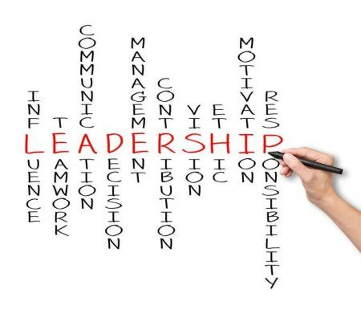
leadership

Slide 7
Basics of Leadership
Leadership is an influence relationship among leaders and followers who intend real changes and outcomes that reflect their shared purposes (Rost, 1993, p.99)
Leadership and Management differ with respect to:
  Direction: Managers create short-term plans and leaders vision
  Alignment: Managers align people to tasks and leaders people to culture
  Relationships: Managers invest in goods and leaders in people
  Personal Qualities: Managers value emotional distance and leaders emotional connections
  Outcomes: Managers maintain stability and leaders create change
Envisioning: https://www.youtube.com/watch?v=QDUDQnPiHYc&feature=youtu.be

Slide 8
Leaders and Power
Power is the ability to influence someone to do something they otherwise would not have done
  Leadership and management both involve exercise of power
  Management relies mostly on authority and leadership mostly on emotional and rational persuasion
Bases of power are:
  Legitimate
  Reward
  Coercive
  Expert
  Referent

Slide 9
Personality and Leadership
MBTI suggests that different personality types lead to different leadership styles
Leadership primarily focuses on acquiring and interpreting information:
  ST: Focus on bottom-line
  SF: Focus on fulfilling subordinate needs
  NF: Focus on developing subordinates
  NT: Focus on analysing subordinates

Slide 10
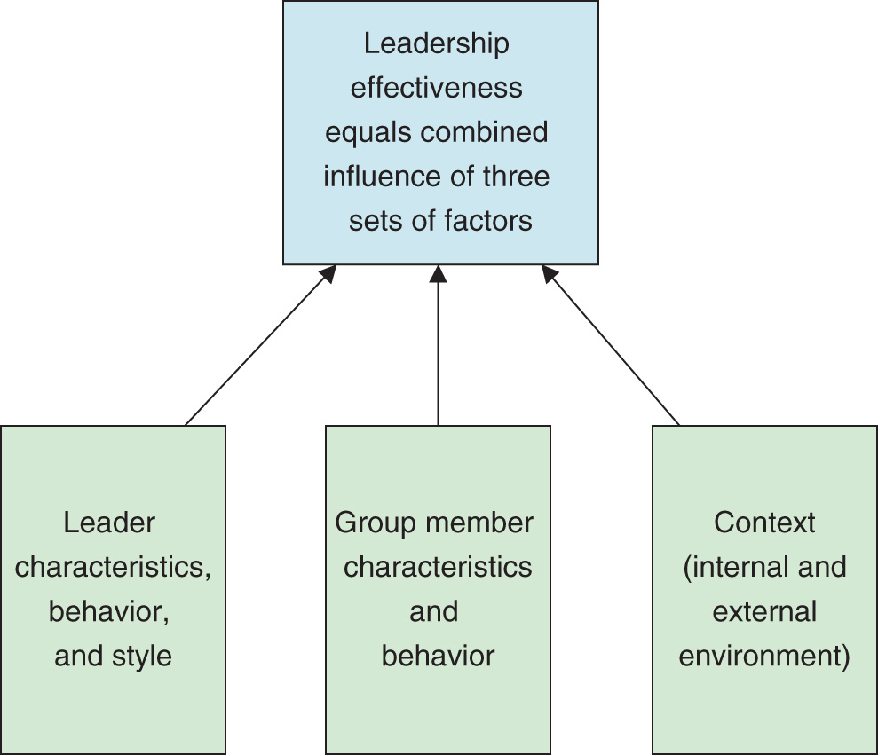
Framework for Understanding Leaders
© Cengage Learning

Slide 11
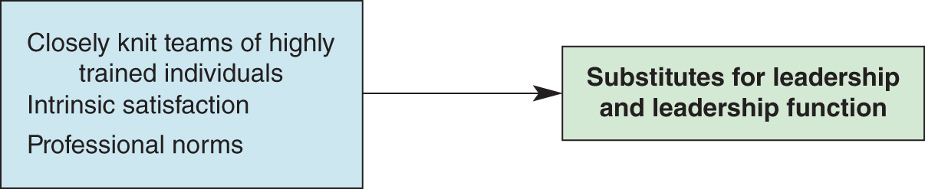
Substitutes for Leadership
© Cengage Learning

Slide 12
Key Leadership Activities
Envisioning
Empowerment of people
Leadership principles
  Building trust and morale
Importance of ethics
Understanding people
Leadership equation
Multiplying effectiveness
Developing others
Performance Management

Slide 13
Vision and Success
  Vision → Skills → Incentives → Resources → Action Plan
  What happens when any link is missing?
  Can we link this framework to key leadership activities?
  Can we use this framework to analyse Coach K’s methods?

Slide 14
References
MBTI: https://www.myersbriggs.org/my-mbti-personality-type/mbti-basics/
MBTI Styles: https://www.researchgate.net/figure/A-chart-with-descriptions-of-each-Myers-Briggs-personality-type-24_fig1_358145283
Leadership Image: https://in.pinterest.com/pin/256986722461663432/
Basics of Leadership: Rost, J. C. (1993). Leadership development in the new millennium. Journal of Leadership Studies, 1(1), 91-110.

