Slide 1



Product & Brand Management
अयम् आत्मा ब्रह्म
Dr. Neeraj Singh
Marketing & Strategy Area
Indian Institute of Management Rohtak

Slide 2
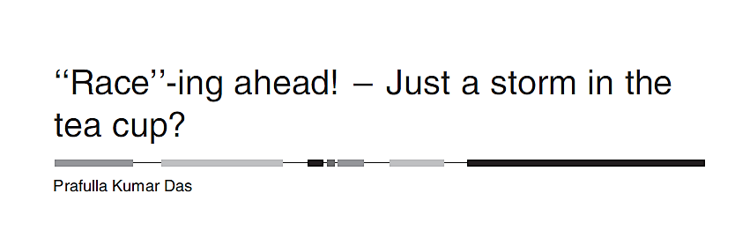

Slide 3
Customers & Competitors
Jack Welch→ ex-CEO of General Electric
A firm should monitor its customers and competitors.
Why it is important to monitor your competitor?
How can you do that?

Slide 4
Customers & Competitors
Jack Welch→ ex-CEO of General Electric
A firm should monitor its customers and competitors.
Why it is important to monitor your customers ?
How can you do that?

Slide 5
Customers & Competitors
The risk of not monitoring your Customers/ Competitors increases the likelihood of market elimination.

Slide 6
Artichem
Large-scale pharmaceutical firm.
Operates in Domestic and International Markets.
Started operations in 1950.
What are the reasons behind the success of Artichem?

Slide 7
Artichem
Domestic/ International Growth: Organic and Inorganic means.
How are these two approaches different ?
Discuss !

Slide 8
Artichem
Domestic/ International Growth: Organic and Inorganic means.
Organic: Right selection of products and marketing.
Inorganic growth: Acquisition of firms with compatible products and turning them around.
What are compatible products? Discuss…

Slide 9
Discuss
What is the nature of the pharmaceutical market?
Discuss…

Slide 10
Artichem:
Generics → Antibiotics, NSAID, Anti-Ulcer…
R&D→ Novel Drugs + Novel Drug Delivery System + Clinical Trial
Standalone R&D and Collaborative R&D:
  What is the difference for the manager? Discuss

Slide 11
Product in focus: Omeprazole
Identify the attributes

Slide 12
Product in focus: Omeprazole
Very Popular: Why?
Acidity treatment: Better substitutes in the market like Lansoprazole, Pantoprazole, Rabeprazole……
Why these substitute products, despite having better efficacy are not so popular ??

Slide 13
Product in focus: Omeprazole
Why many products with superior attributes are not always popular in the market?

Slide 14
Race: Omeprazole
Market size of Omeprazole: Rs 160 Cr
The market size of Anti-ulcerates: Rs 400 Cr
Race: Rs 13 Cr
The growth rate of Race = Growth rate of the Indian pharmaceutical market
Competitors’ market size:
  Arvee’s Ocil (Rs 49/160 Crore)
  MTN’s Onil (Rs 33/ 160 Crore)
  GMK’s Z-tec (Rs 80 Crore/160)

Slide 15
Race: Omeprazole
Market size: Rs 160 Cr
Race: 13/160 Crore
The growth rate of Race = Growth rate of the Indian pharmaceutical market
Discuss!
Competitors’ market size:
  Arvee’s Ocil (Rs 49 Crore)
  MTN’s Onil (Rs 33 Crore)
The India Pharmaceutical Market is expected to register a CAGR of 10.7%
Source: https://www.mordorintelligence.com/industry-reports/pharmaceuticals-industry-in-india#:~:text=Indian%20Pharmaceutical%20Market%20Analysis,the%20outbreak%20of%20COVID%2D19.

Slide 16

SWOT Analysis

Slide 17
SWOT Analysis
Within Organization
Outside Organization

Slide 18
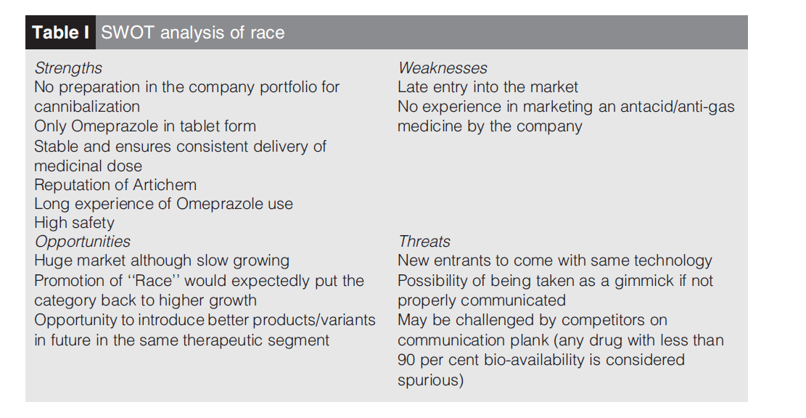

Slide 19
Why introduce Race so late in the market
Discuss

Slide 20
Why introduce Race so late in the market
Market maturing: But still growing.
The newer technology of formulation→ Better consistency of the product
Enforce Artichem into a lifestyle segment??
  Acidity is a lifestyle disease→ The market of lifestyle products is very attractive.
  Why??

Slide 21
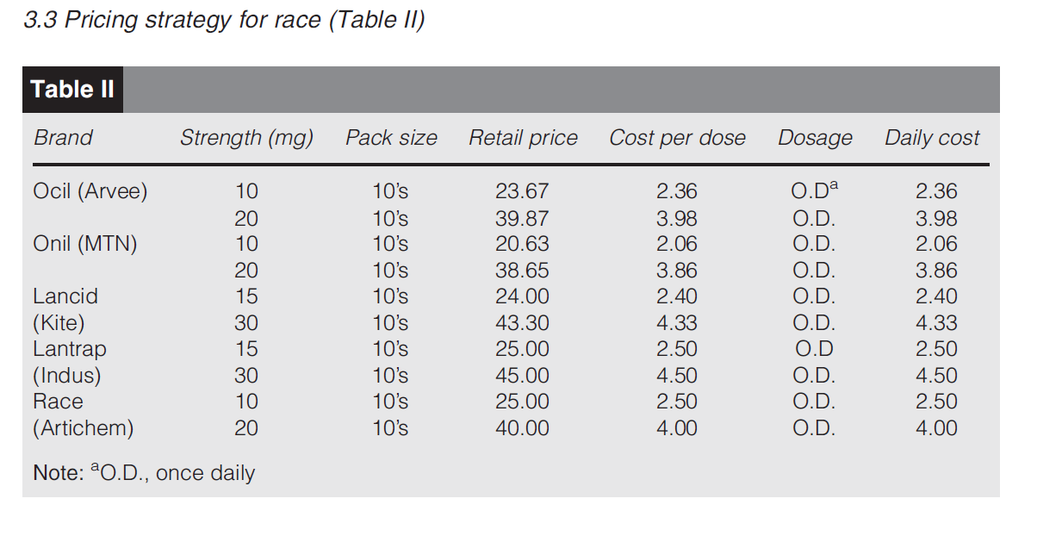
Pricing: Discuss about the pricing approach

Slide 22
Pricing: Discuss about the pricing approach
Cost-Based Pricing.
Value-based Pricing.
Competition-Based Pricing

Slide 23
Brand Positioning
‘‘Race’’ – The better Omeprazole.
What modification would you suggest in the punch line?
Discuss

Slide 24
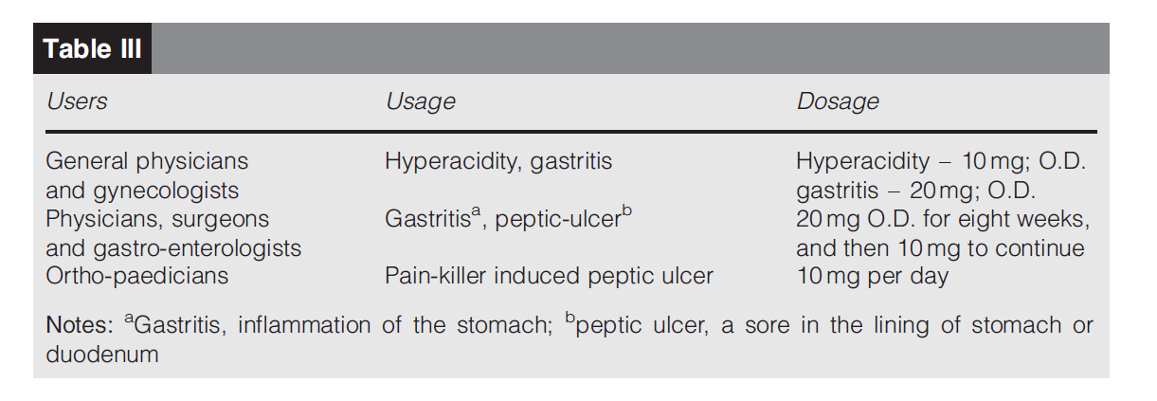
Target users
Discuss!

Slide 25
Decision Situation
Should Artichem continue with Race or not !!

Slide 26
Decision Situation
Should Artichem introduce newer molecules in the segment?

Slide 27
Product→ Services Switch
Can we convert a product into a service offering?
Discuss !!

Slide 28
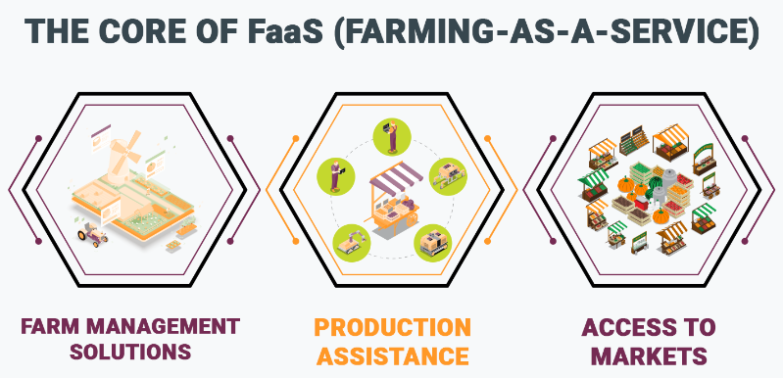
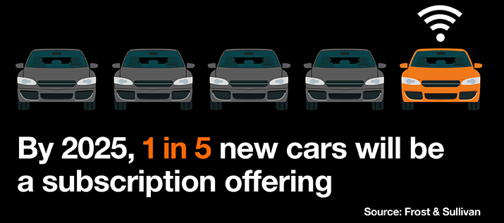
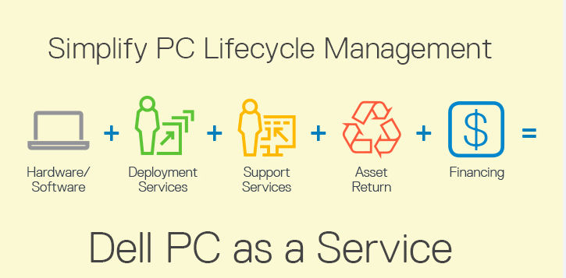
XaaS model in Businesses
What is this model? Discuss…

Slide 29
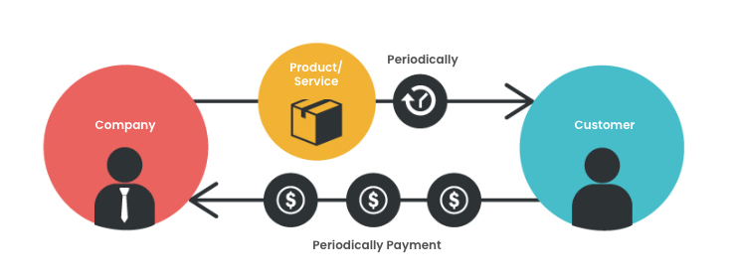
XaaS model

Slide 30
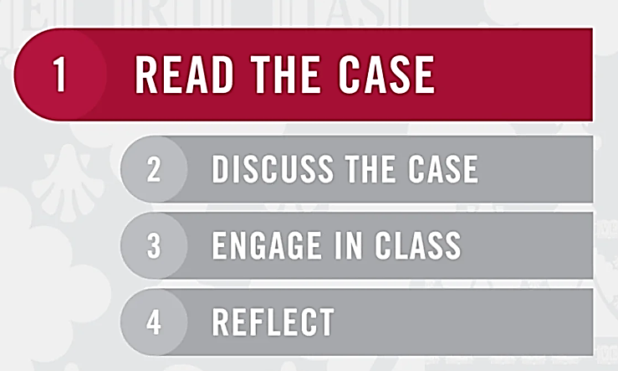
Learning through Cases

Slide 31
Case-based Pedagogy
Pre-class components
During the Class
Post-class

