Slide 1
Brand Extensions

Slide 2
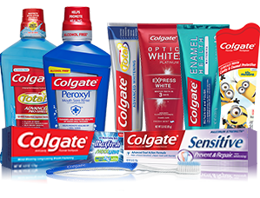
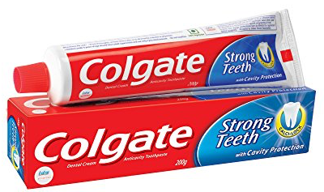
Brand Extensions

Slide 3
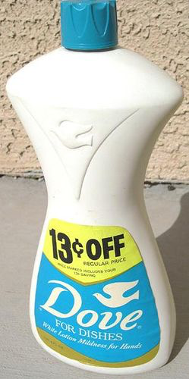
How about this?

Slide 4
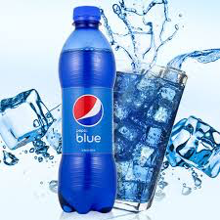
Or this?

Slide 5
Introduction
Brand extension or brand stretching is a marketing strategy in which a firm marketing a product with a well-developed image uses the same brand name in a different product category.
Brand Extension is the use of an established brand name in new product categories. This new category to which the brand is extended can be related or unrelated to the existing product categories.
  Related Brand Extension: Amul
  Unrelated Brand Extension: Wipro From IT to FMCG

Slide 6
Common terms in extension
Parent Brand:
An existing brand that gives rise to a brand extension is referred to as parent brand.
Extended Brand:
The new product coming from the parent brand is termed as extended brand

Slide 7
Advantages
To increase the product line and product mix
To create brand image
To maximize the customer’s perceived value towards brands
To occupy the market share
To meet the benefits of the economies of scale
To enhance the parent brand image
To occupy the new market segments
To make the customers purchase and repurchase the same brand’s products

Slide 8
Advantages
For better market positioning
To gain the competitive advantage
To face the severe competition
To create positive attitude in the target customer’s mind towards brand
To reduce the efforts, money and time while promoting new products
To get rid of the customer confusions about brands

Slide 9
Disadvantages
Unsuccessful brand extensions can dilute the parent brand image
Lack of similarity, quality, familiarity and inconsistency can disturb the image of the entire brand family
A single mistake while extension can disturb the brand image
Unsuccessful brand strategies can create negatively perceived value towards brands in the minds of the loyal customers
Increase in brand extensions may lead to customer confusions due to over information
Some brand extensions can succeed but these can show negative impact on the parent brand

Slide 10
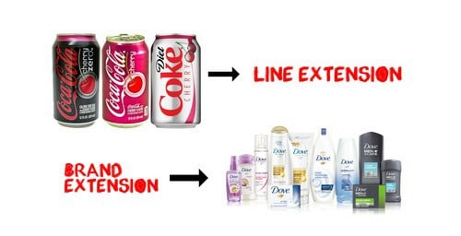
Approach to Brand Extension

Slide 11
How does consumer evaluate brand extensions?
Attitude toward the original brand – as overall quality
Fit between the original and extension product classes
Dimensions of fit
  COMPLEMENT
  SUBSTITUTE
  TRANSFER
Perceived difficulty of making the extension

Slide 12
Brand Extensions: The Good, the bad, and the ugly
Source: Aaker 1990

Slide 13
Brand Extensions: The Good
What the brand name contributes:
  Brand Associations
    Same product different form – Tide
    Distinct taste, ingredient, or component – Oreo
    Companion Product – Colgate
    Same Customer Franchise – Nivea, J&J
    Expertise – Gillette in men’s grooming products
    Benefit, attribute, feature - Dettol
    Designer or ethnic image - Raymond
  Quality Associations
  Awareness and Presence
  Trial Purchase
Enhancement of the Core Brand

Slide 14
Brand Extensions: The Bad
No Value Added
Negative Associations
Name Confuses
Poor Fit
Poor Quality Perception
Extension Not Supported

Slide 15
Brand Extensions: The Ugly
Undesirable Association Are Created
Existing Association Is Weakened
Quality Image Is Affected
A Disaster Occurs
The Brand Franchise Is Cannibalized
Opportunity To Create a New Brand Foregone

Slide 16
Brands Management Strategies
Source: Keller (1999)

Slide 17
Brand Reinforcement
Use marketing actions that consistently convey the meaning of the brand to consumers in terms of awareness and image
Fortify the brand by raising awareness and building favorable associations - sponsorships, product placements

Slide 18
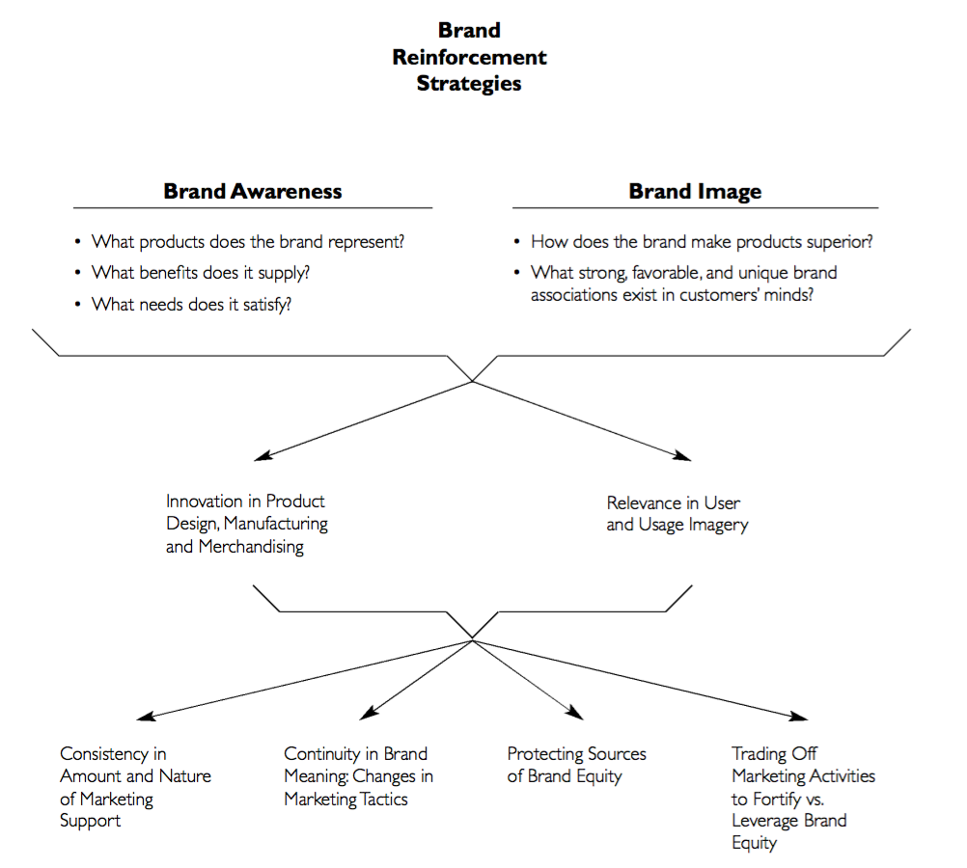

Slide 19
Brand Revitalization
Recapturing lost sources of equity
Returning to values of original brand
Repositioning
Expanding awareness and image

Slide 20
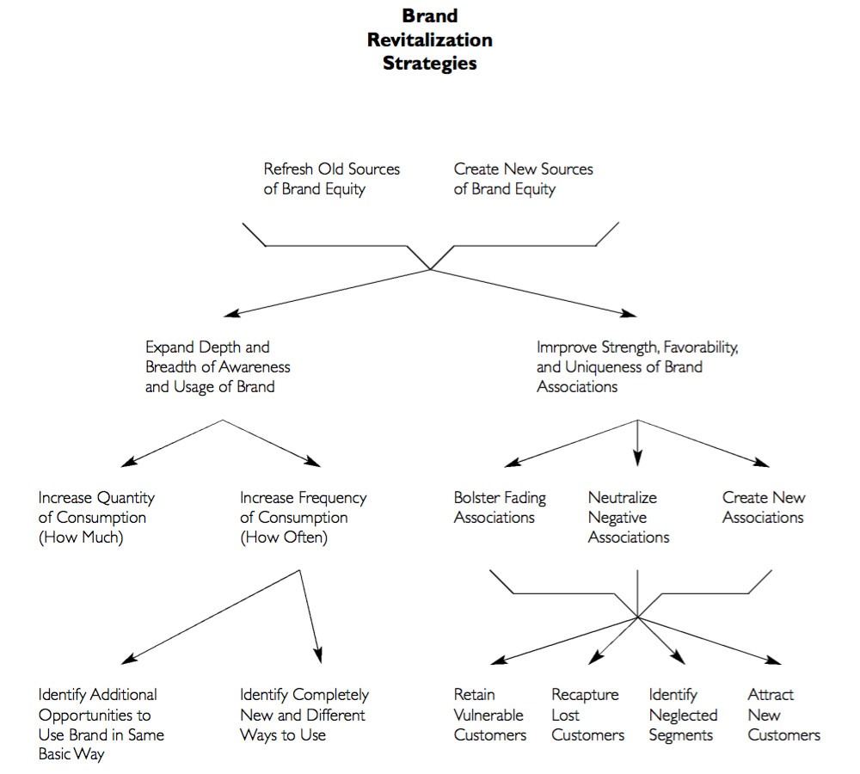

Slide 21
THANK YOU

