Slide 1
Product and Brand Management
(Executive Education Program - Online)

Slide 2
Why is This an Important Field of Study?
Big Industry – Every year billions of dollars are being spent yearly on R&D.
  Untold millions of the dollars are being wasted every year on marketing of 100+ new products which have eventually got failed.
Survival Requirement
  To create point-of-difference i.e. competitive advantage
  To command premium pricing
One of 4 P’s of Marketing-Mix.

Slide 3
Why is This an Important Field of Study?
“A successful new product does more good for an organization than anything else that can happen.”

Slide 4
Product Vs. Goods Vs. Services

Slide 5
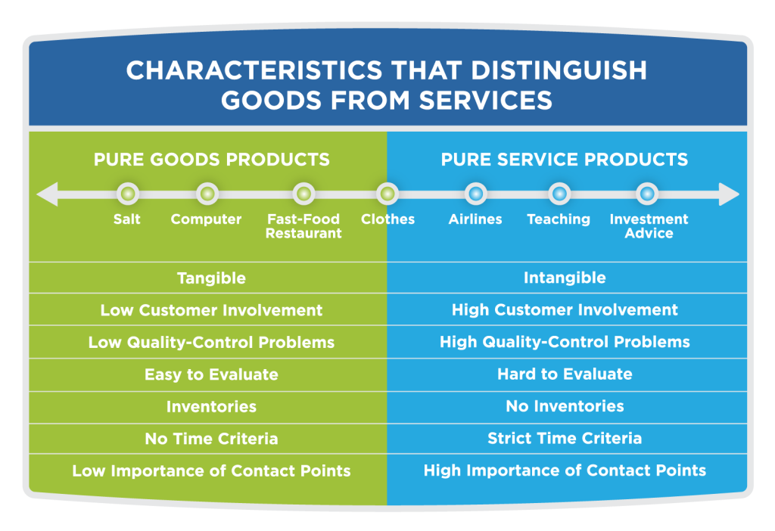

Slide 6
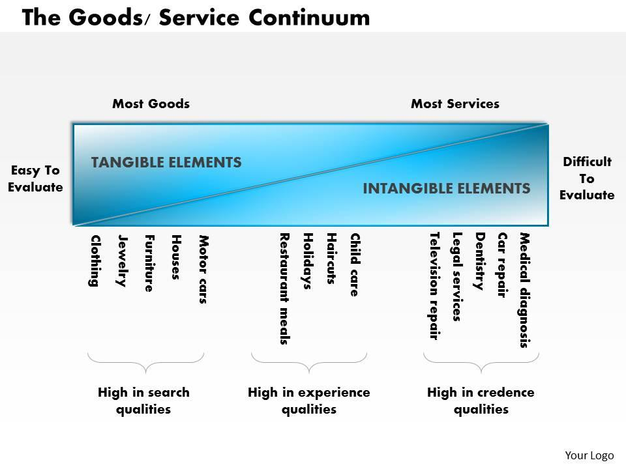

Slide 7
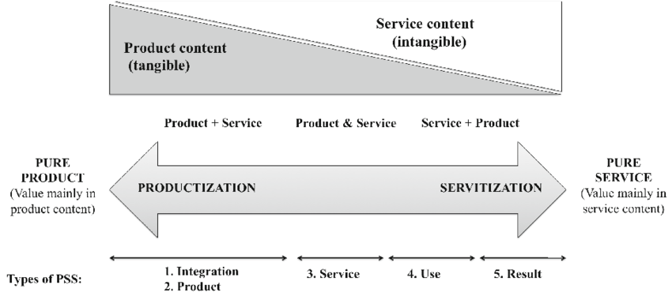
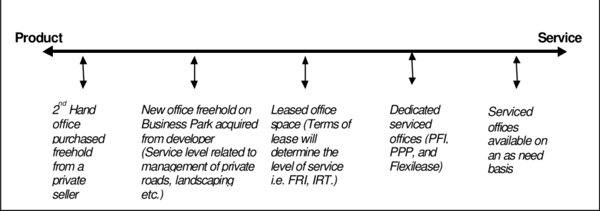

Slide 8
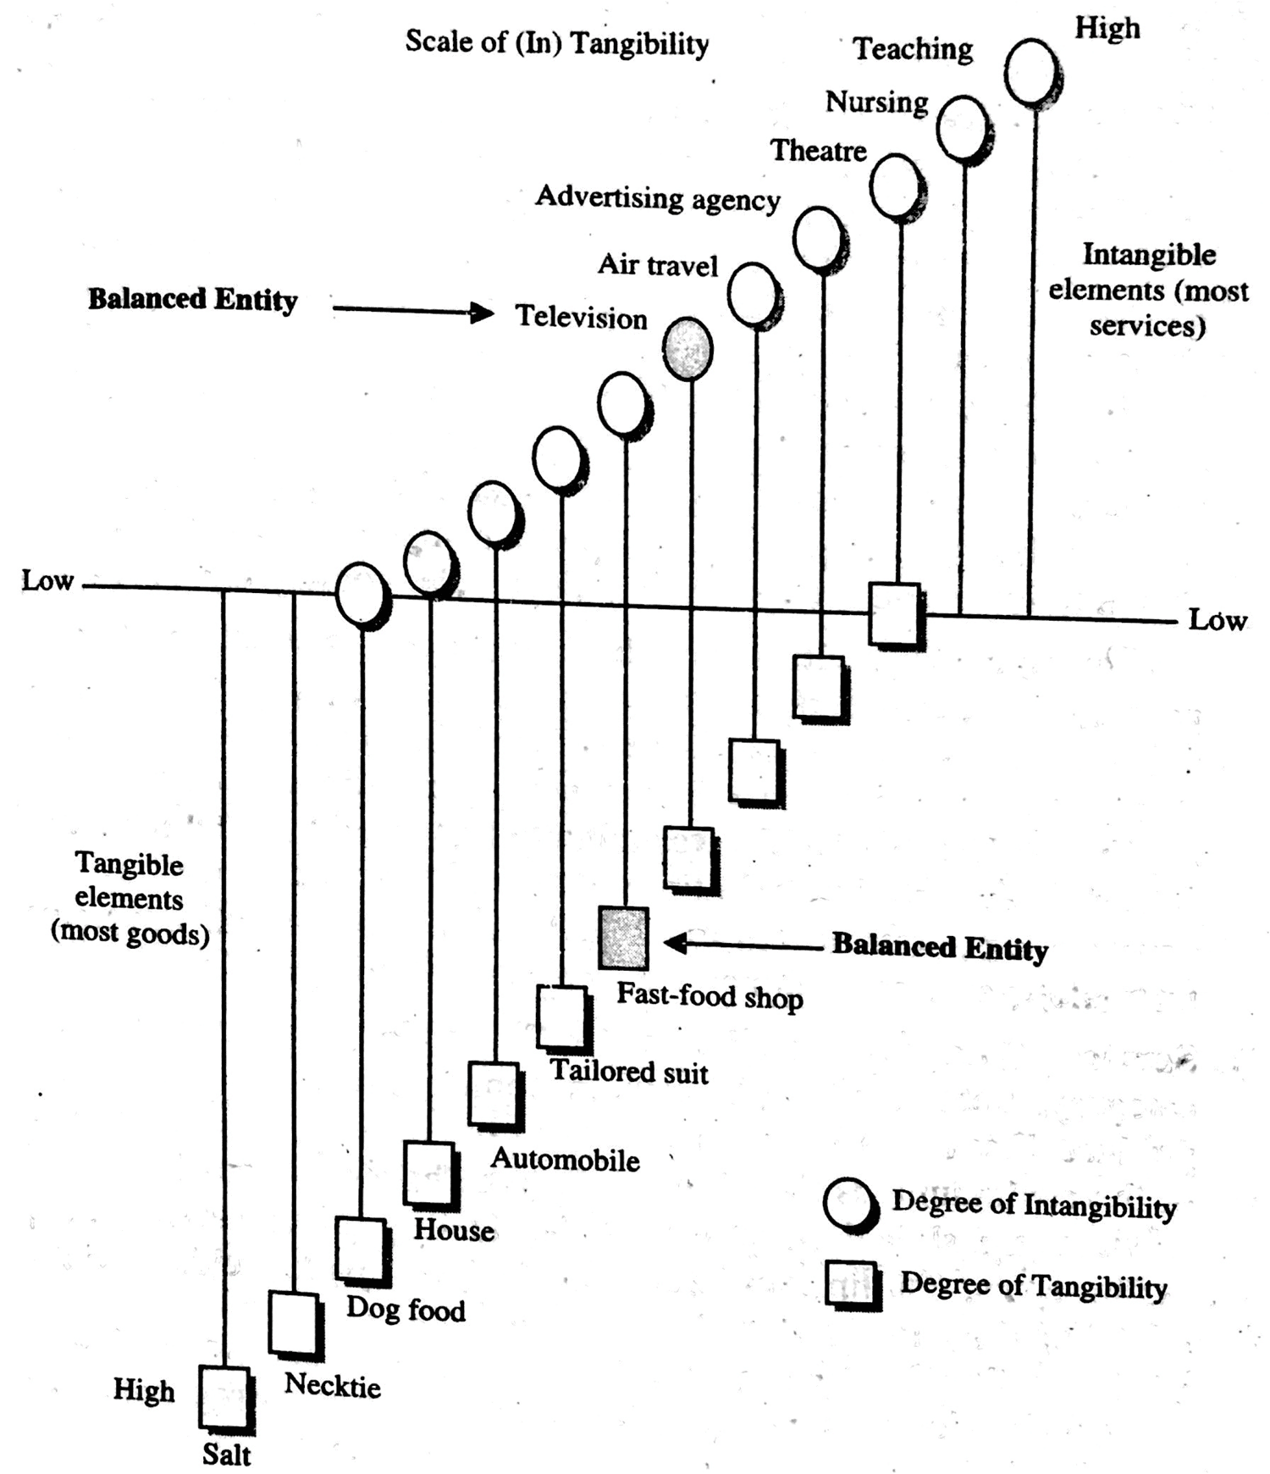

Slide 9
B2B Products Vs B2C Products

Slide 10
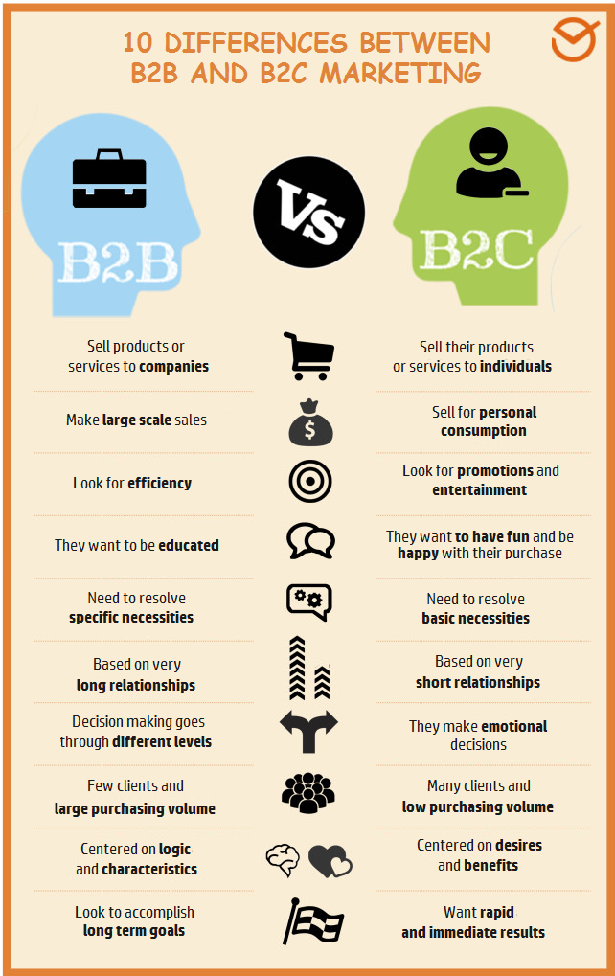

Slide 11
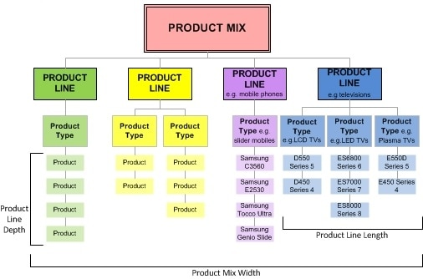
What is a “Product-Mix” ?

Slide 12

Example: “Product-Mix” of Google

Slide 13
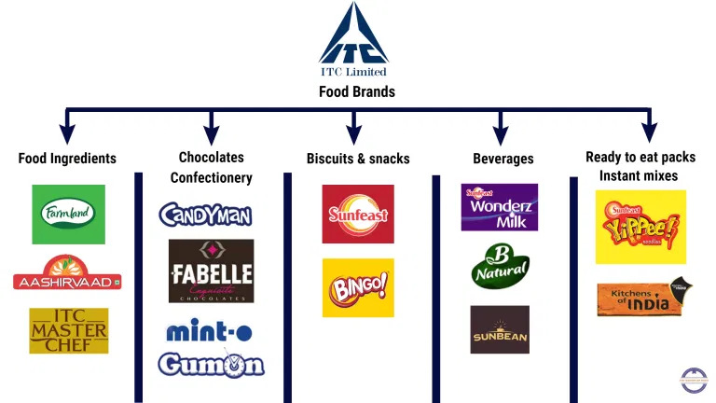
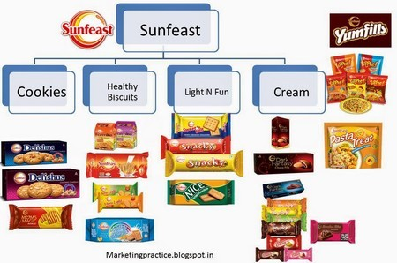
Example: “Product-Mix” of ITC

Slide 14
What is a “New” Product?
New to the World
  Hardly 10% of the innovations are inventions. E.g. AR, VR, etc.
New to the Firm
  E.g. Metaverse, PeeBuddy, etc.
Addition to existing Product Line
  Metaverse Games

Slide 15
What is a “New” Product?
Improvement and Revision to Existing Products
  Call of Duty 3.0
Repositioning
  Marlboro Cigarettes, Blinkit
Cost Reductions
  Bottom of the Pyramid

Slide 16
Is Product and Brand Management
“An Art” or “A Science” ?

Slide 17
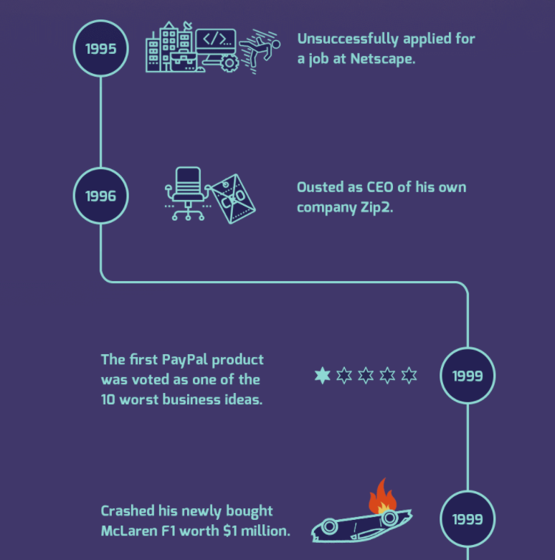


Slide 18
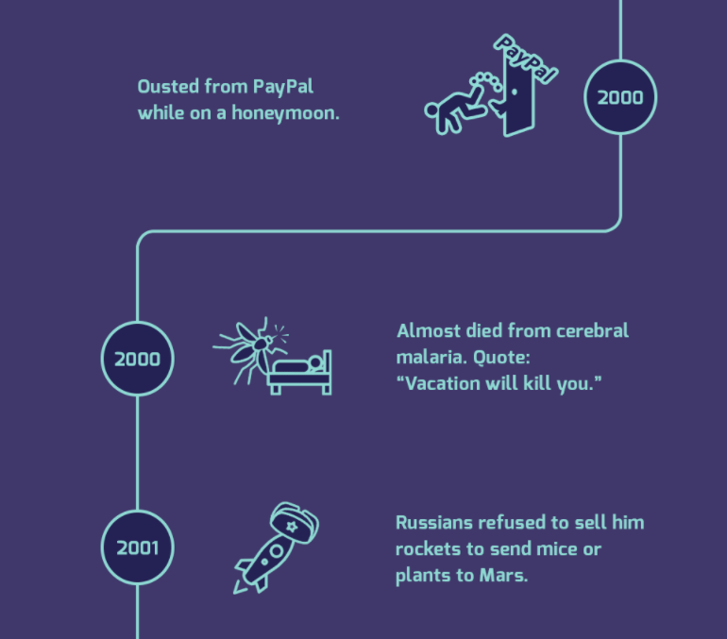

Slide 19
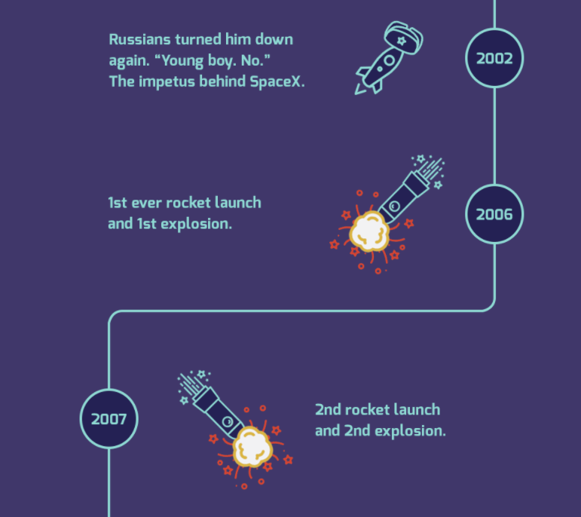

Slide 20
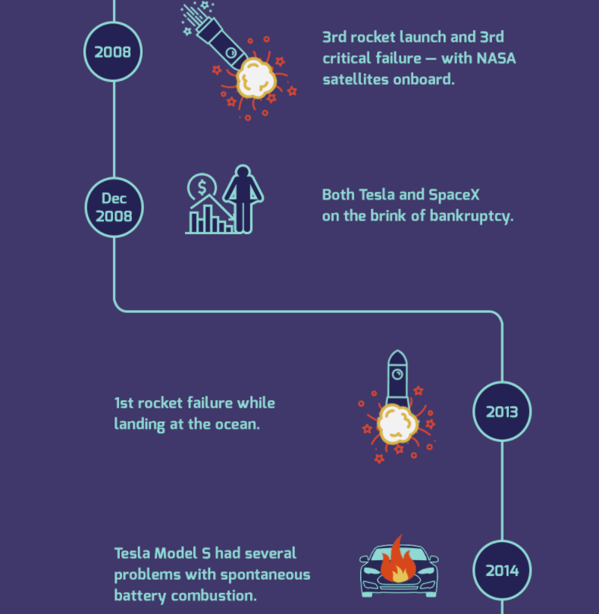

Slide 21
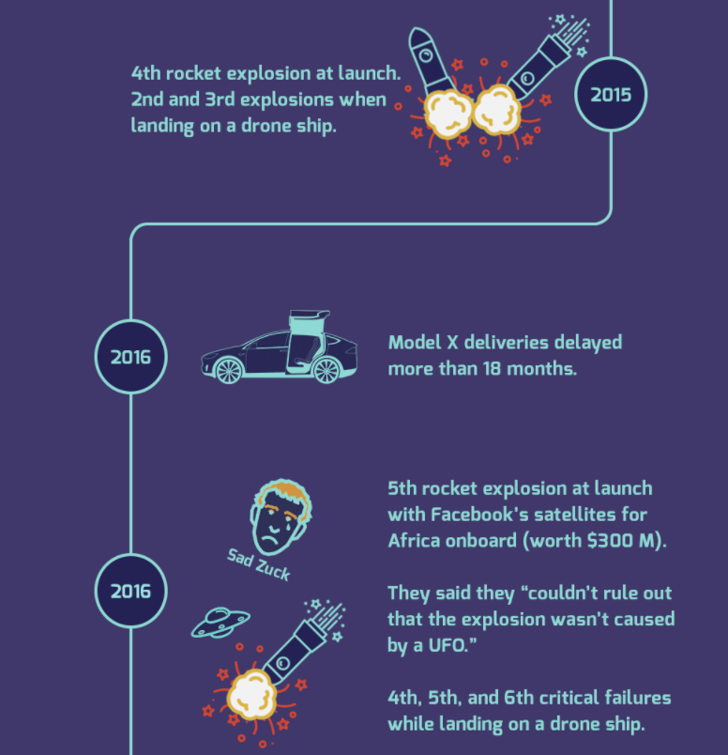

Slide 22
The Basic New Product Development Process

Slide 23
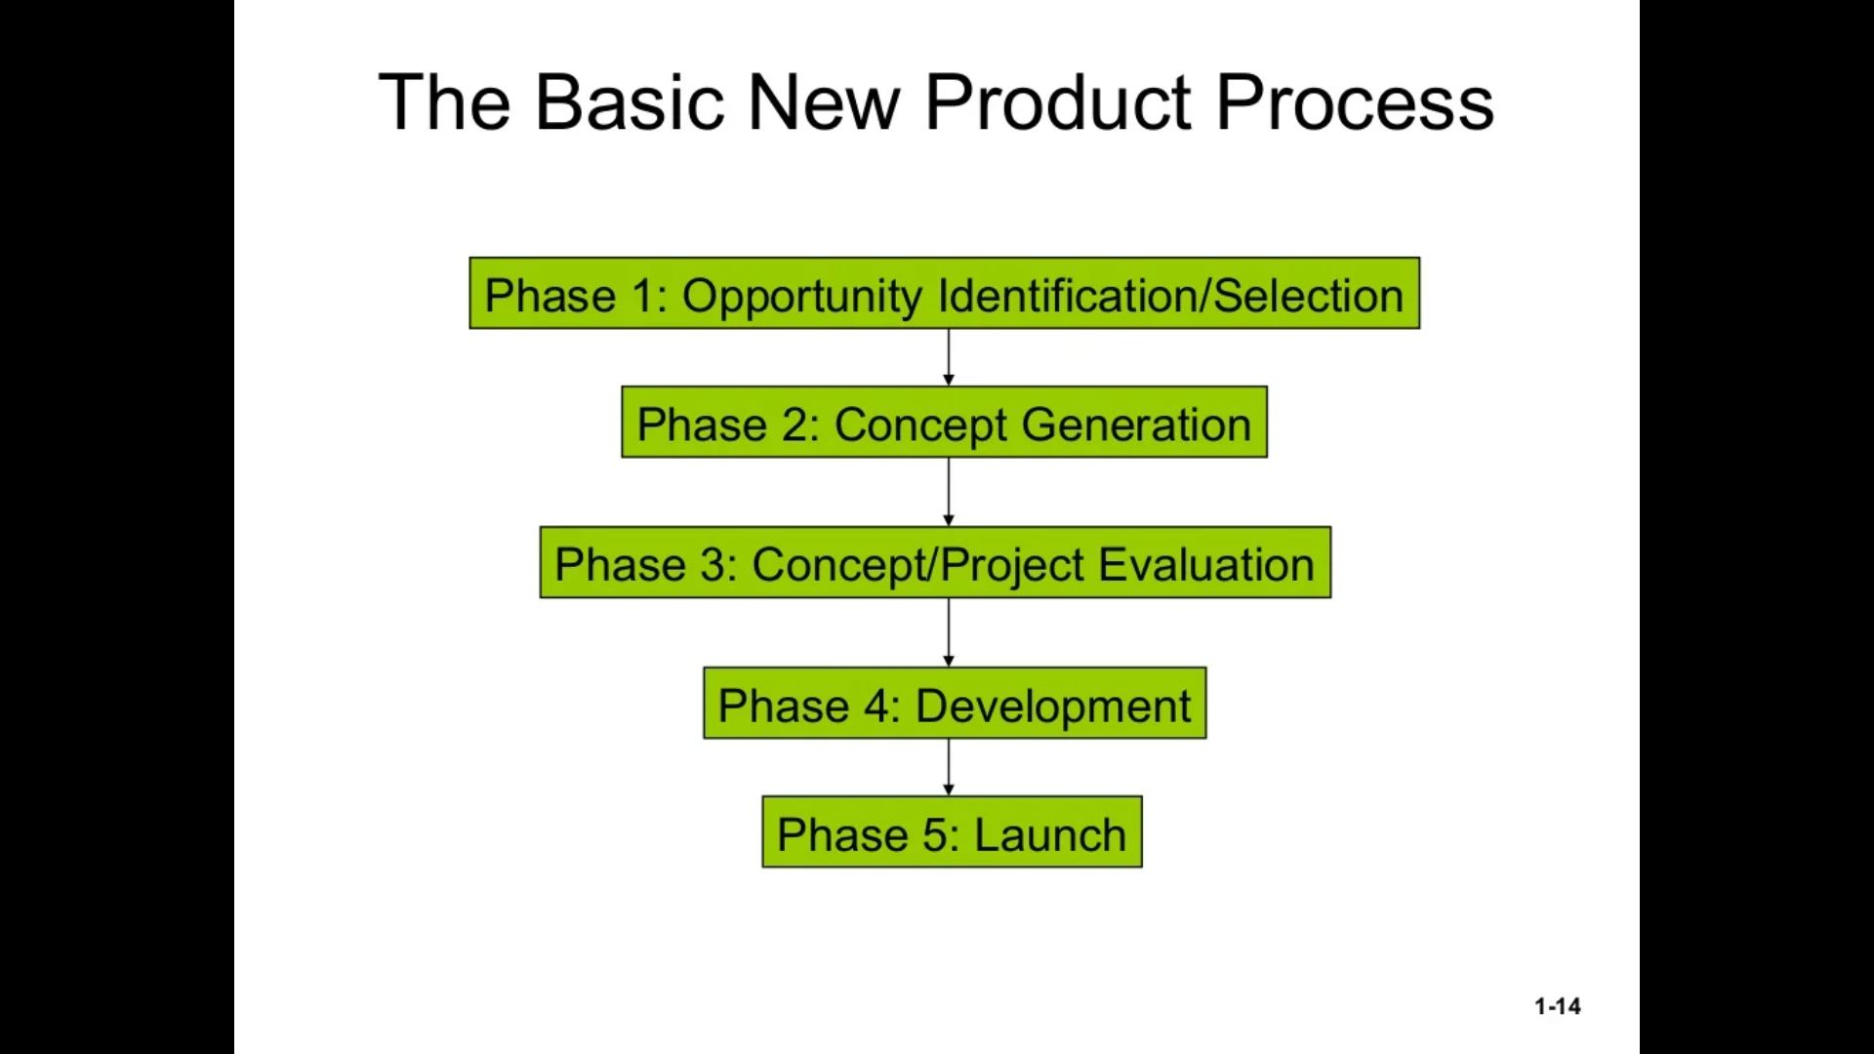

Slide 24
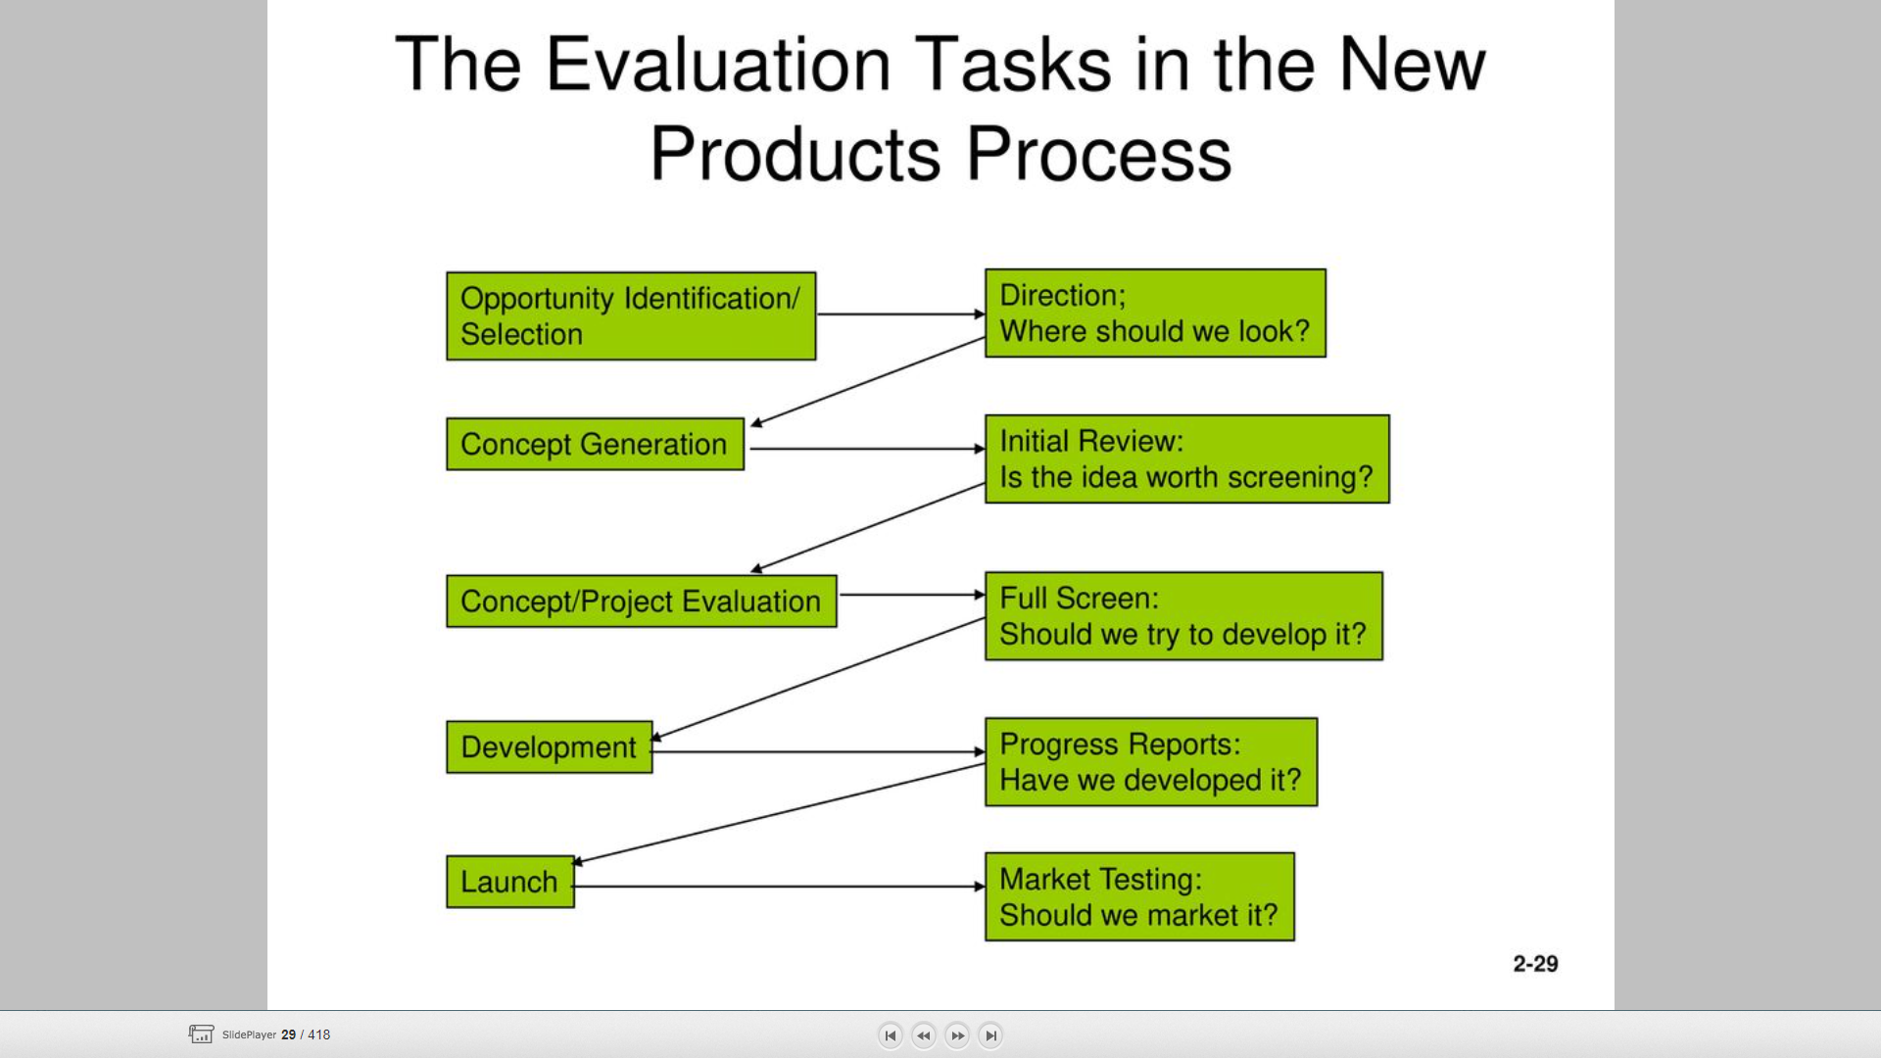

Slide 25
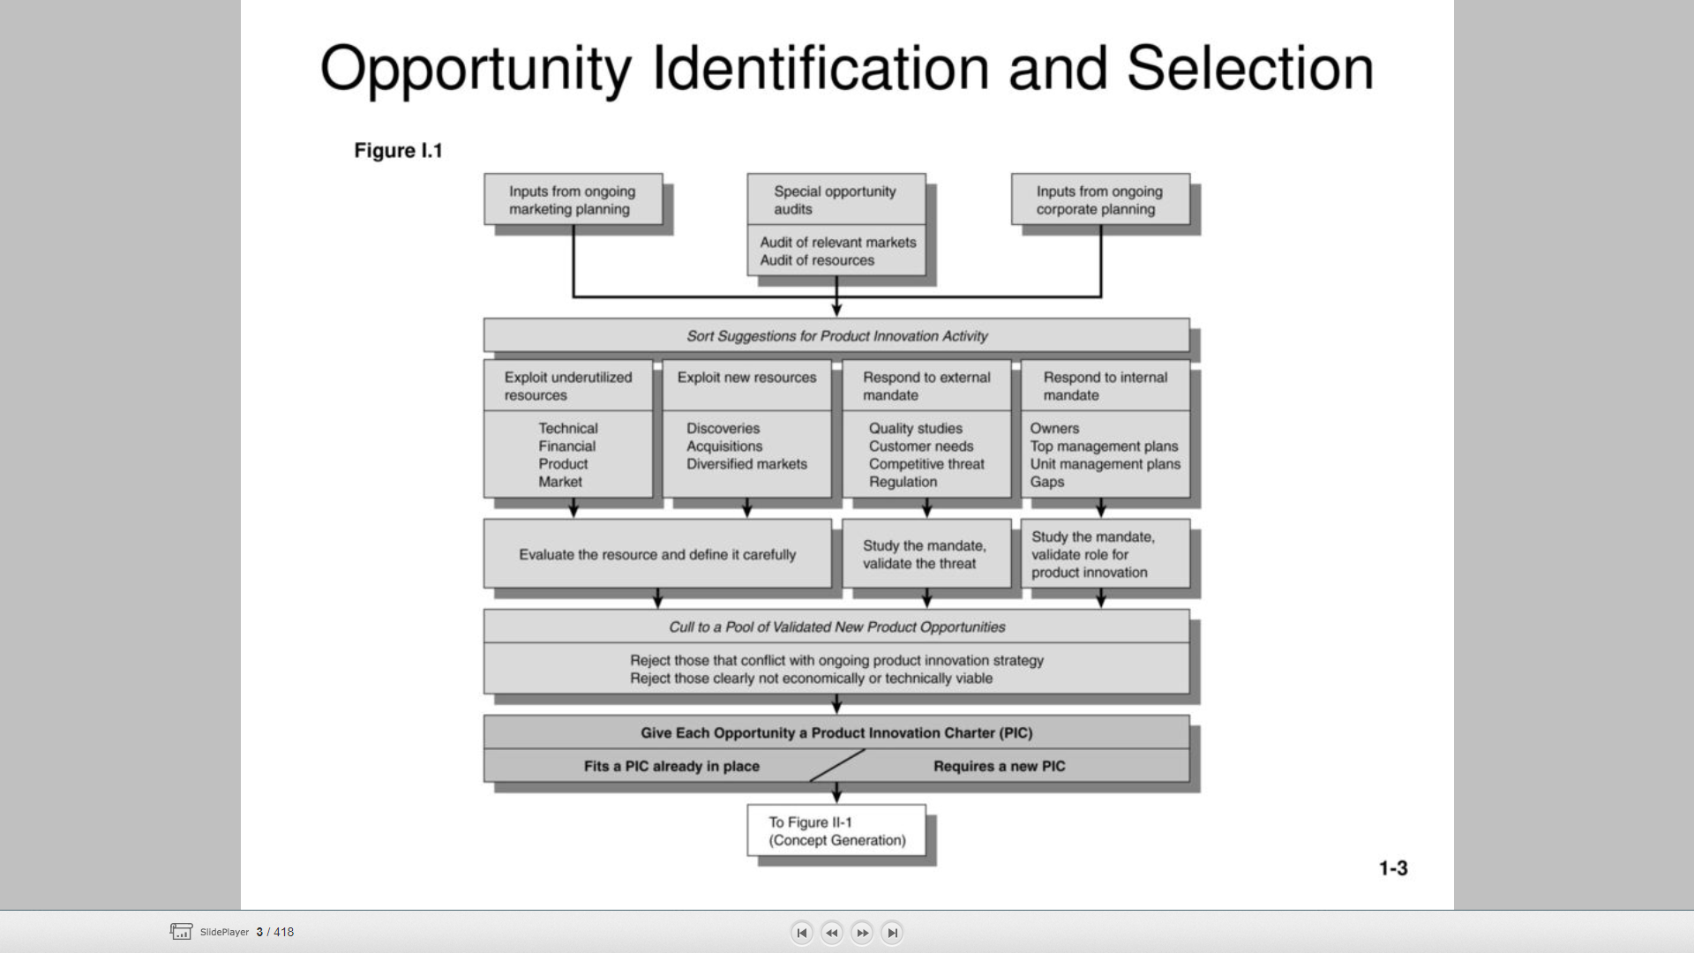

Slide 26
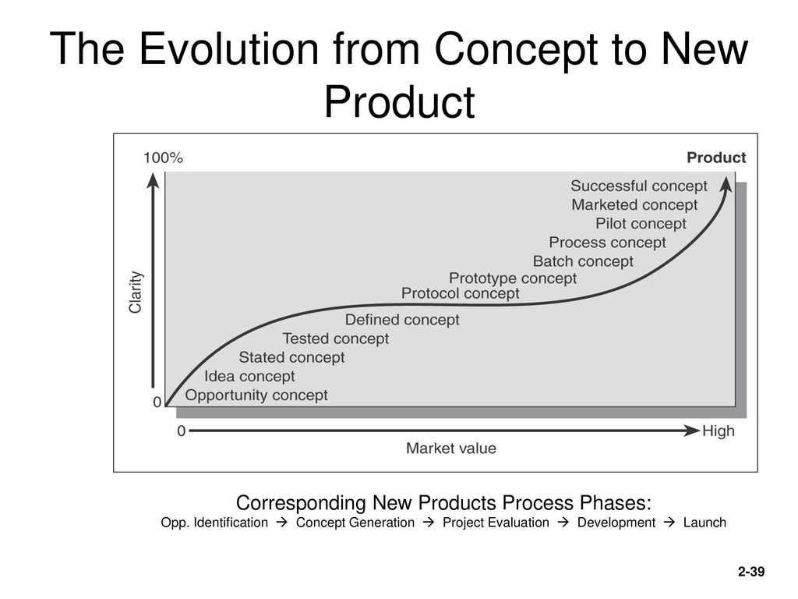

Slide 27
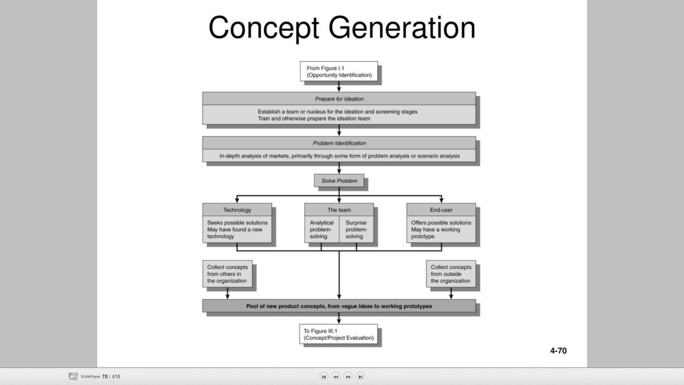

Slide 28
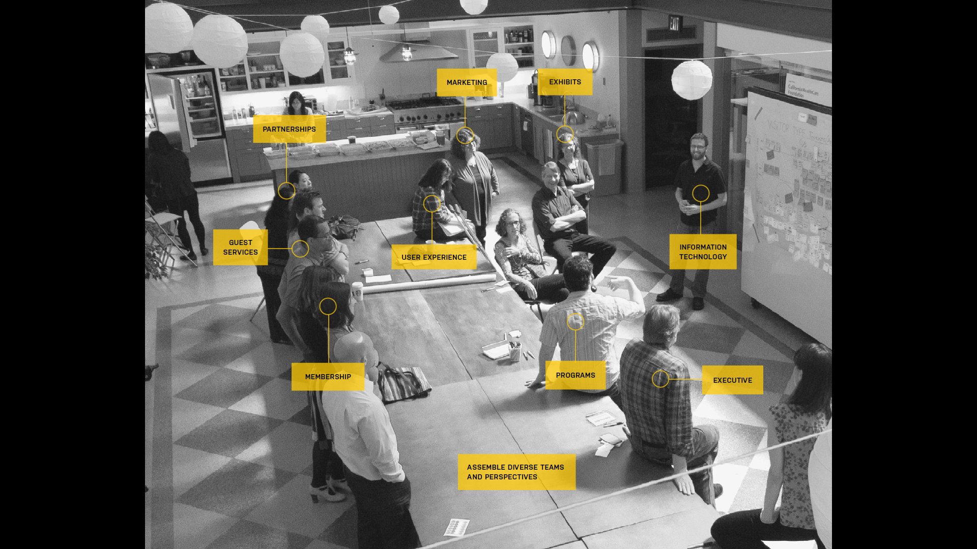

Slide 29


Slide 30
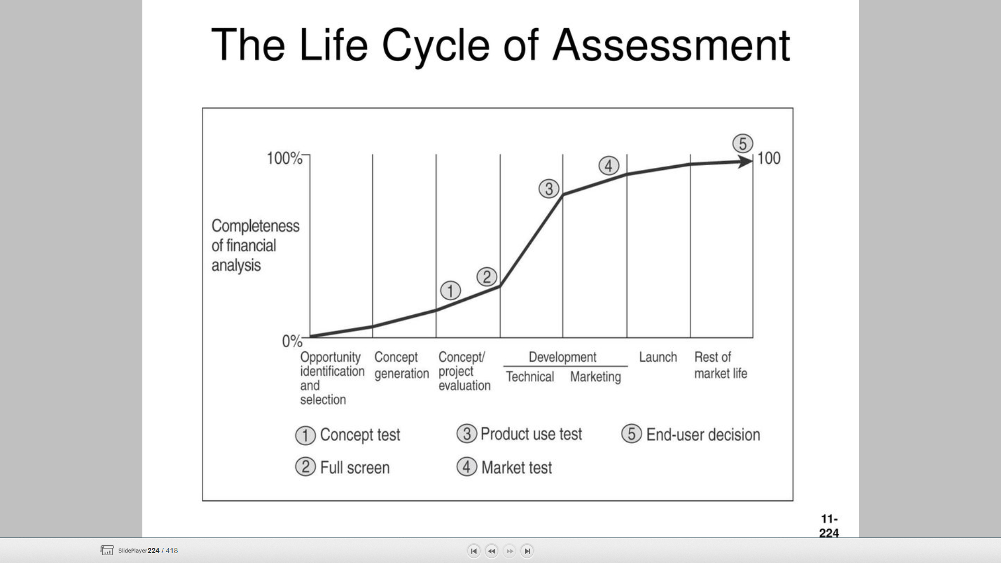

Slide 31
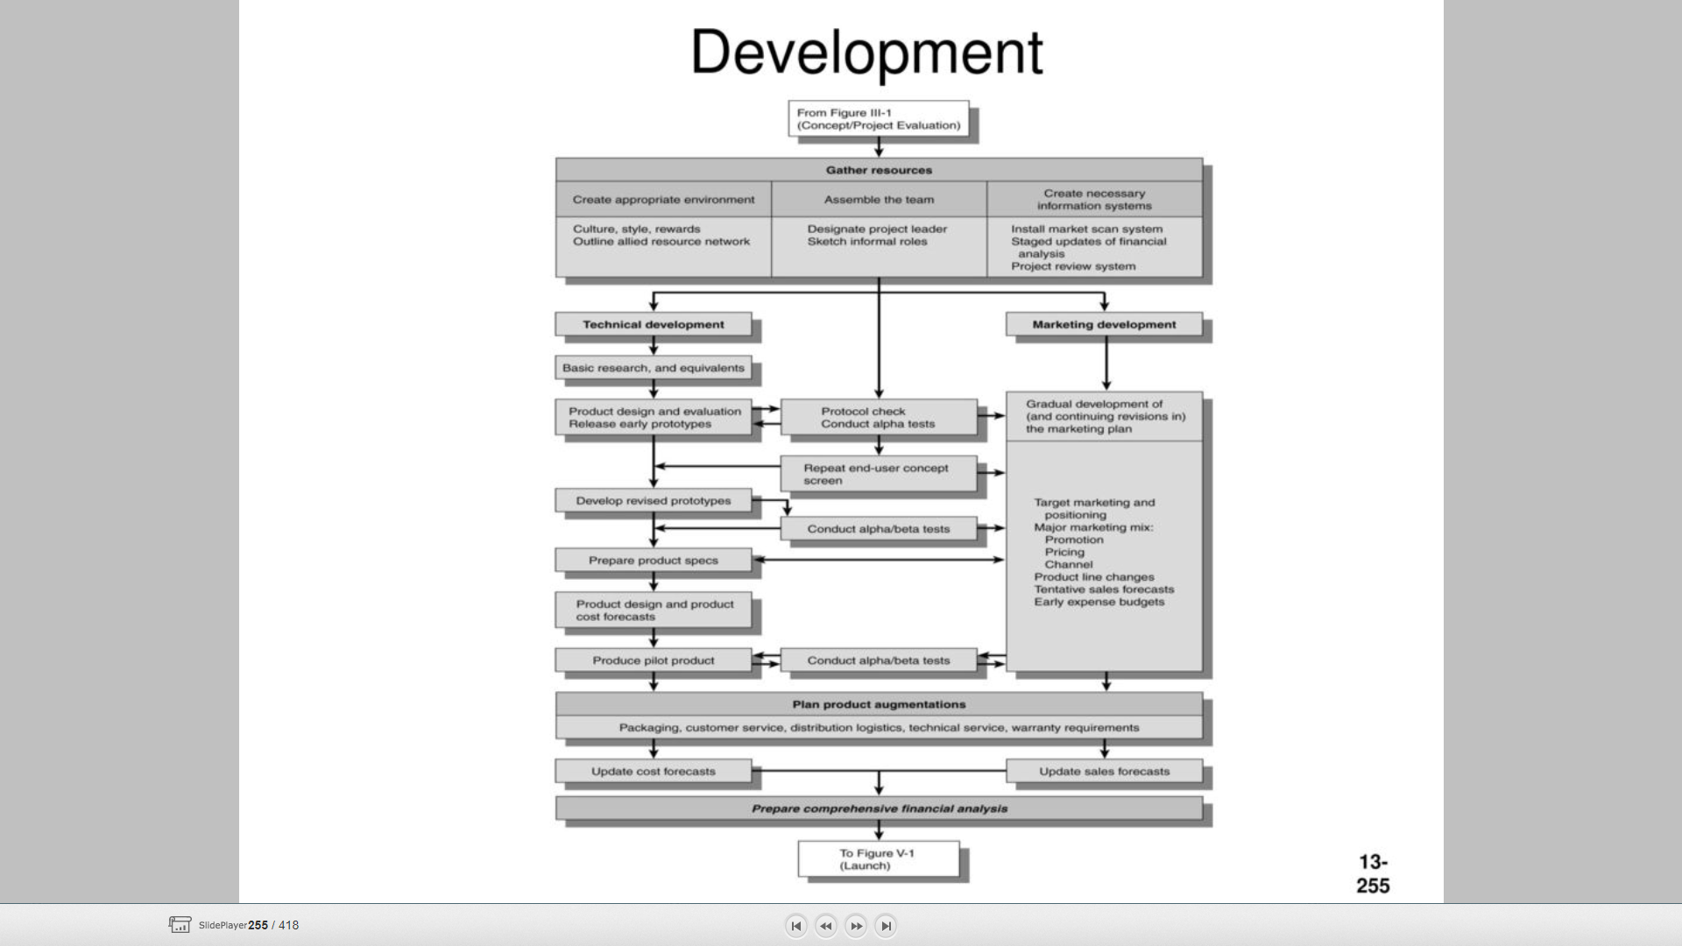

Slide 36
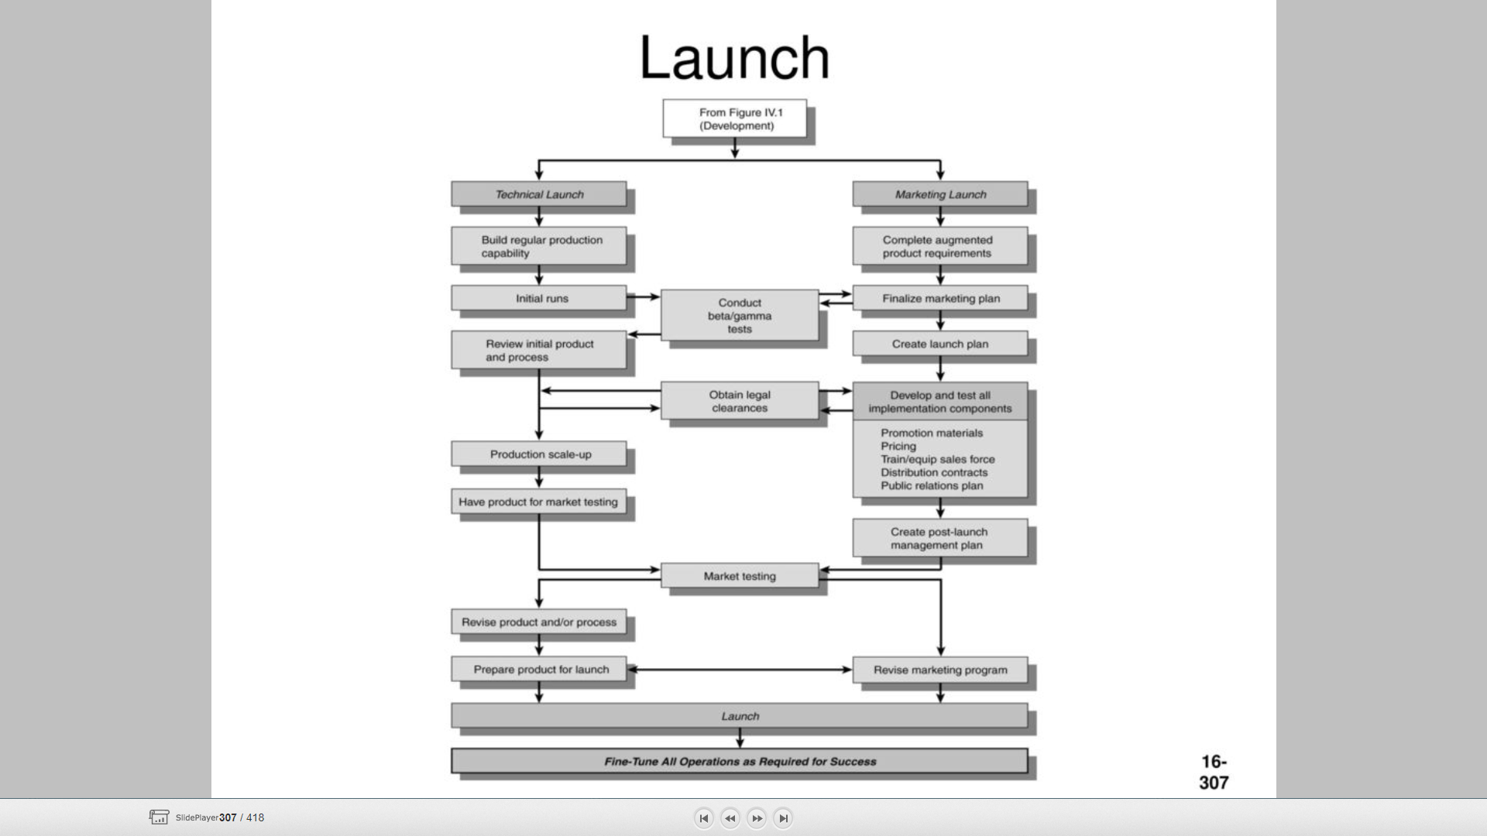

Slide 40
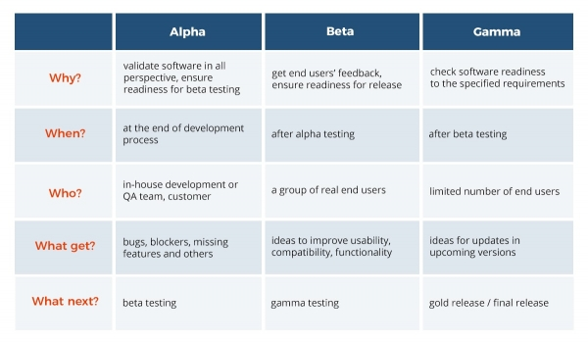

Slide 41
Let’s Connect the Dots

Slide 42
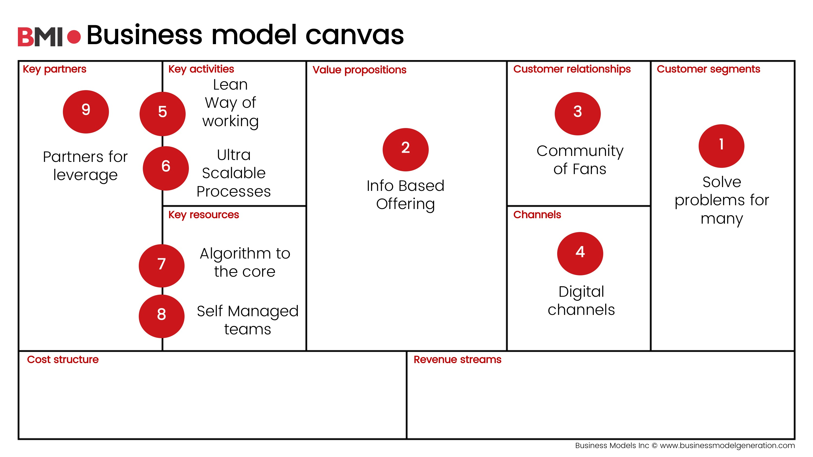

Slide 43
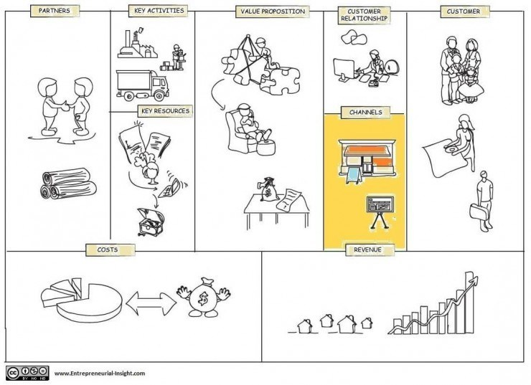

Slide 44
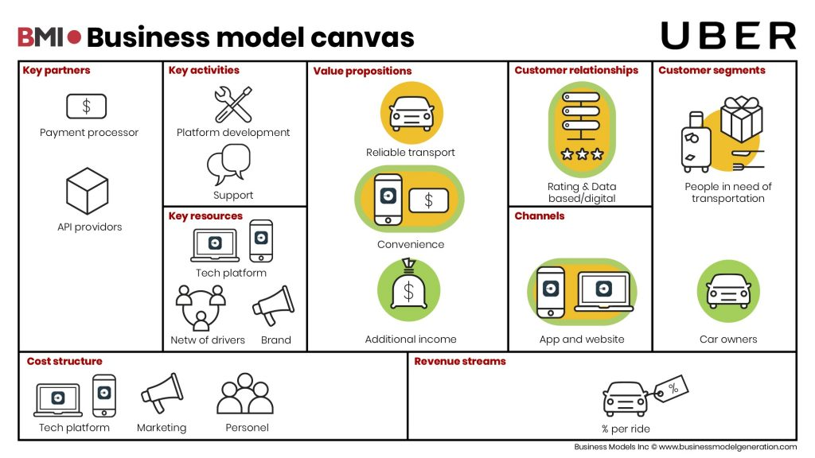

Slide 45
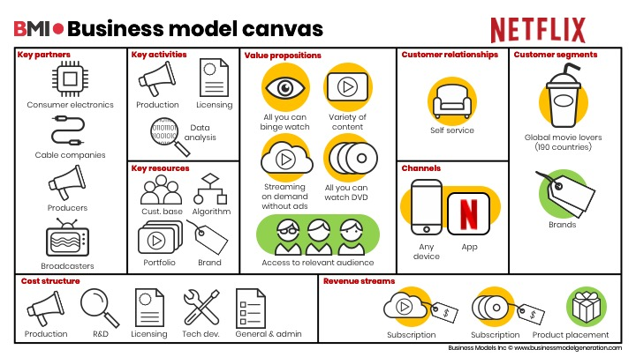

Slide 46
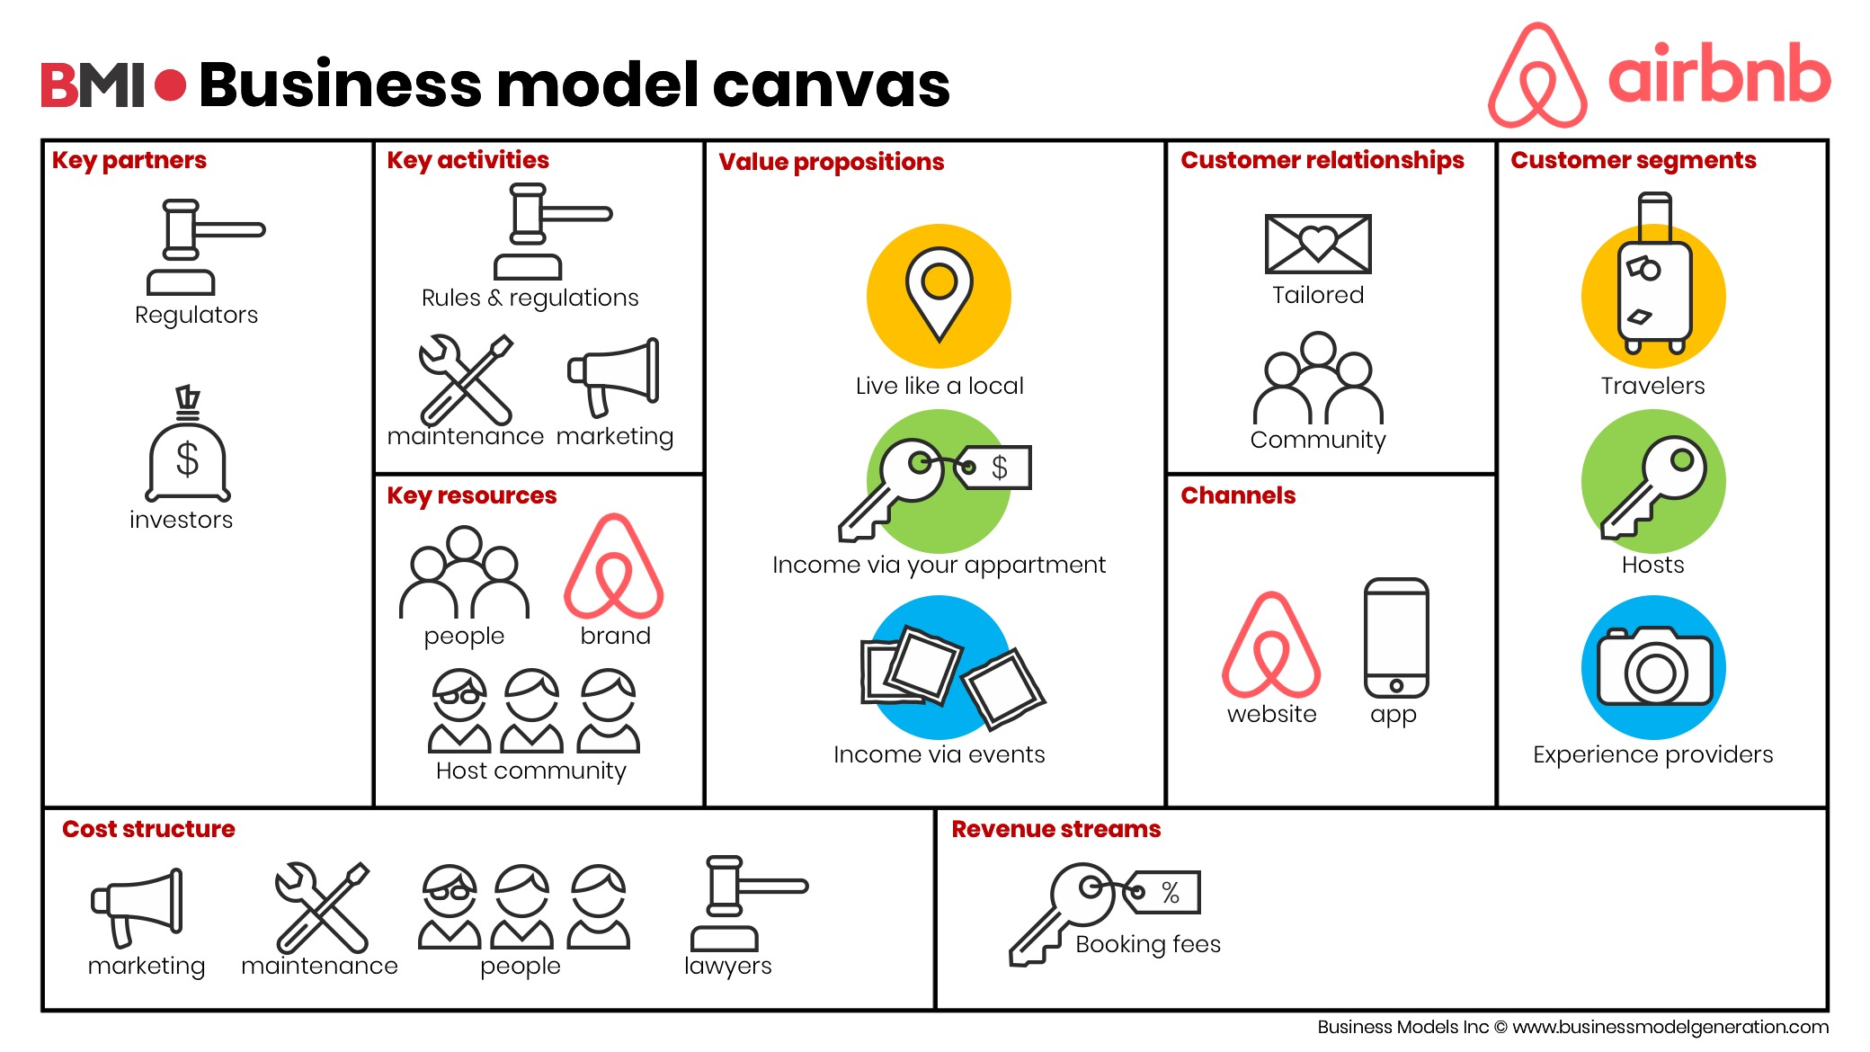

Slide 47
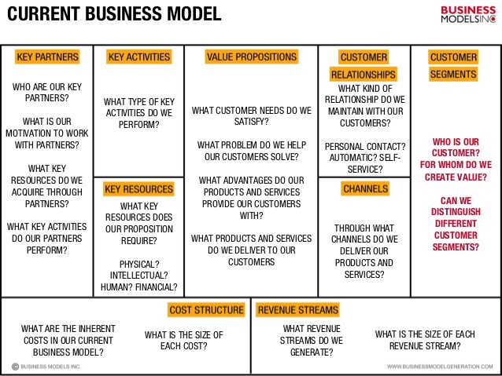

Slide 48


Slide 49
