Slide 1
Product and Brand Management

Slide 11
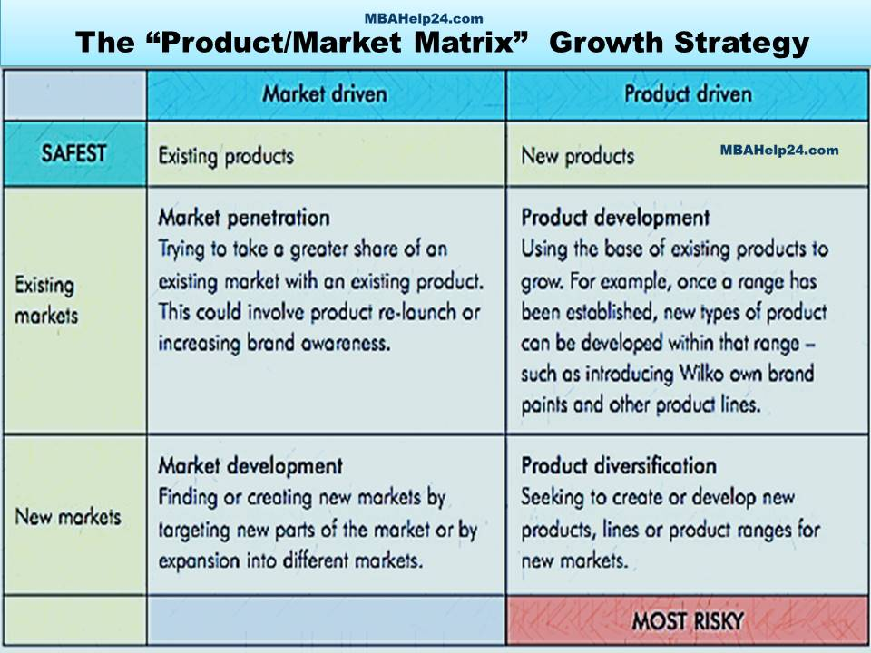

Slide 12
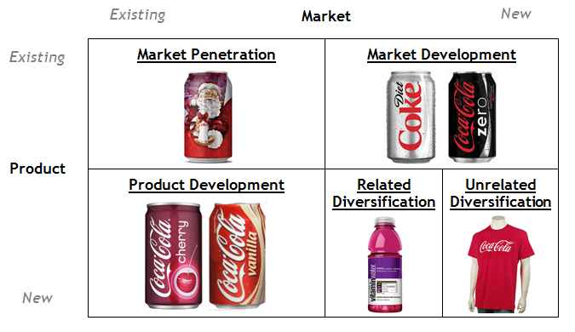
Example – Ansoff Matrix

Slide 13
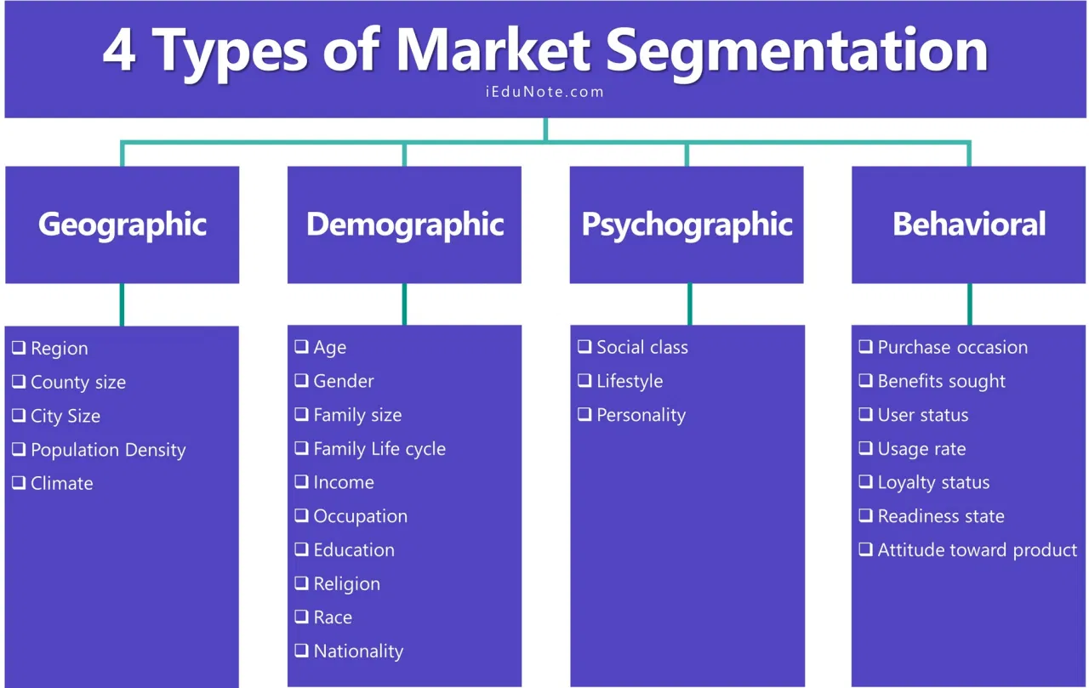

Slide 14
Which segment “W”should Target??

Slide 16
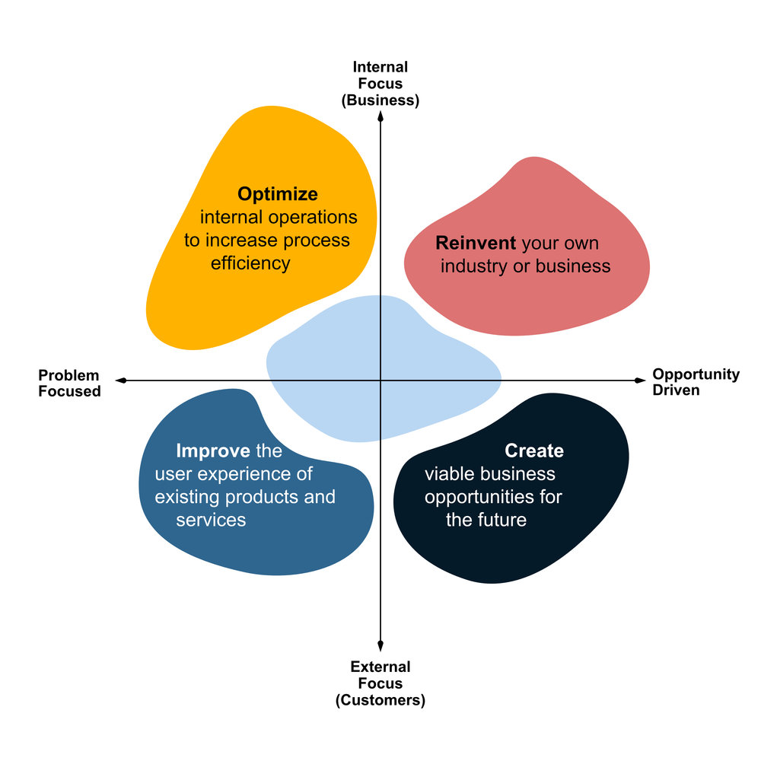
Where you place Micromax? Why

Slide 17
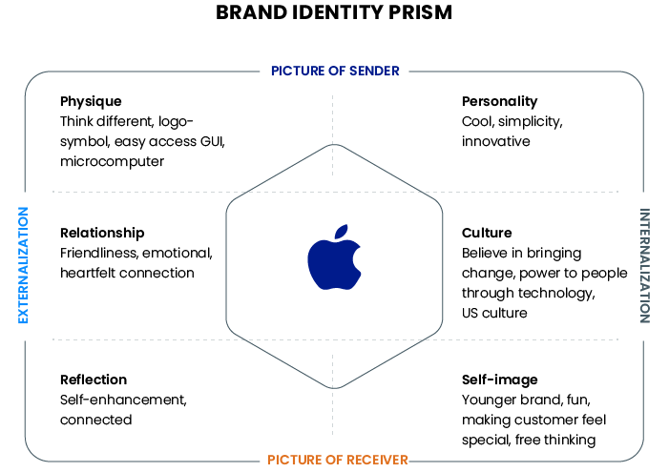

Slide 18
Create Brand Prism of Micromax?

Slide 19
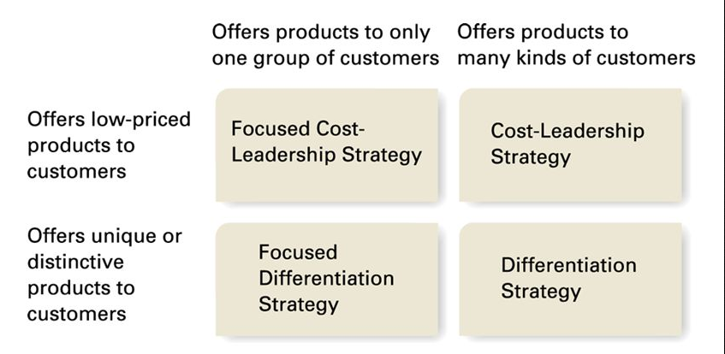
Business Strategy

Slide 20
What is strategy of Micromax?

Slide 21
Is Mr. Pal, the CMO, justified in promoting Hugh Jackman as the brand ambassador for Canvas range of smartphones?

Slide 22
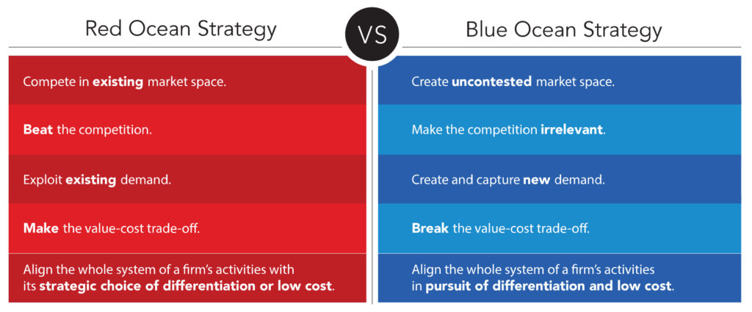
Business Strategy

