Slide 1
Product and Brand Management

Slide 14
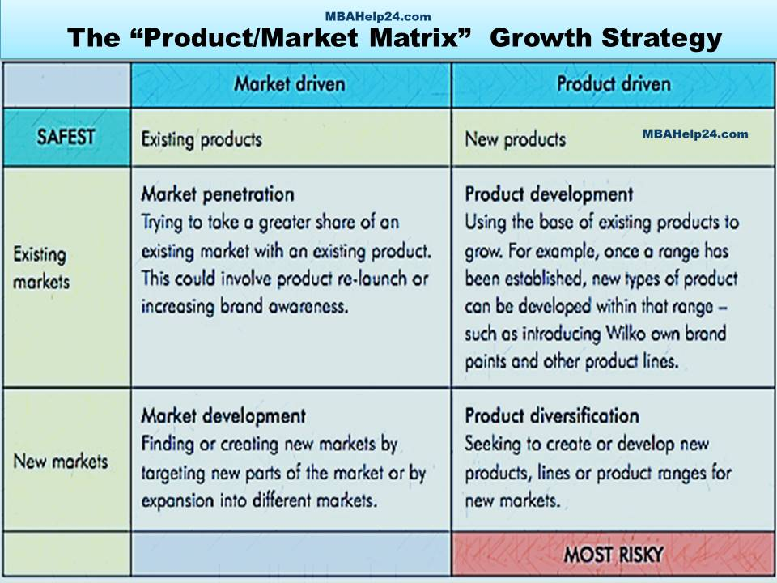

Slide 15
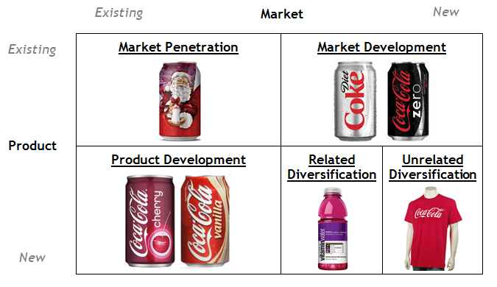
Example – Ansoff Matrix

Slide 16
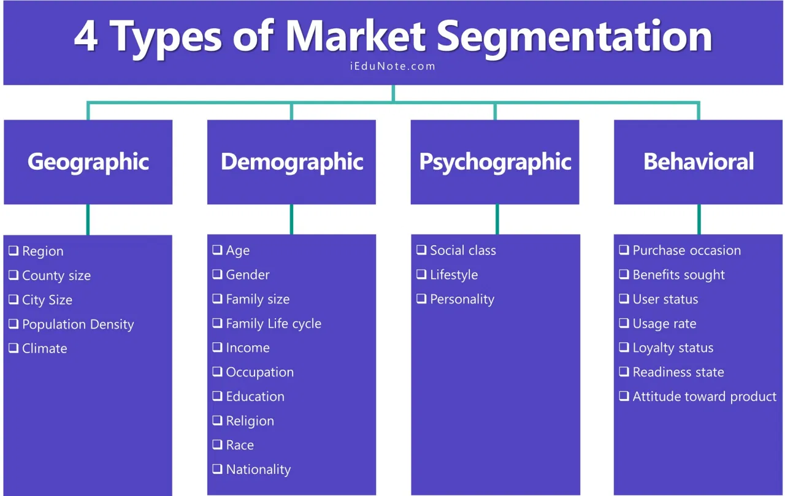

Slide 17
Which segment “W”should Target??

Slide 18
MicroMax Case

Slide 19
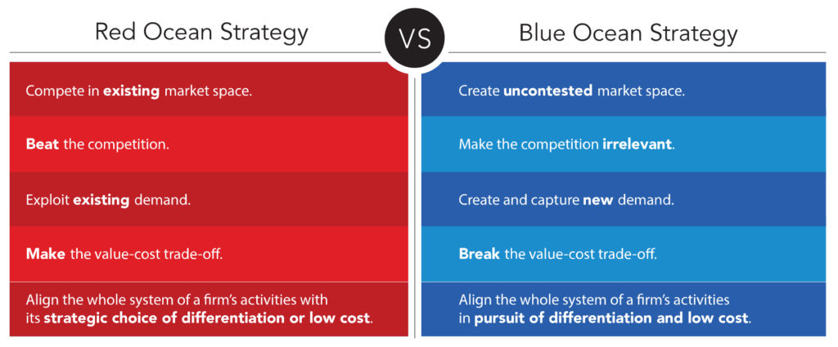
Business Strategy

Slide 20
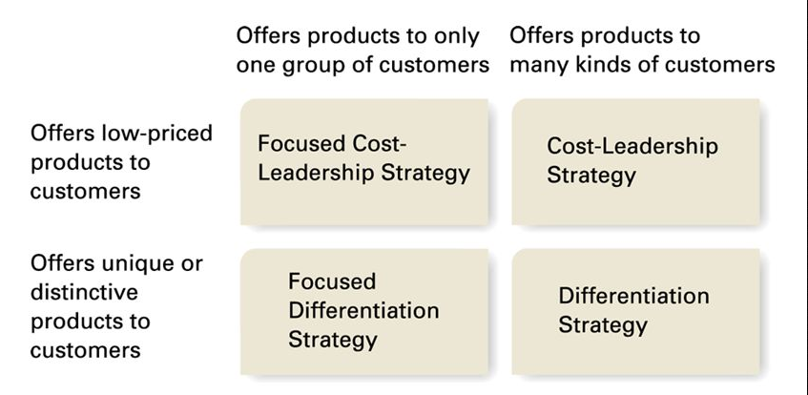
Business Strategy

Slide 21
What is strategy of Micromax?

Slide 22
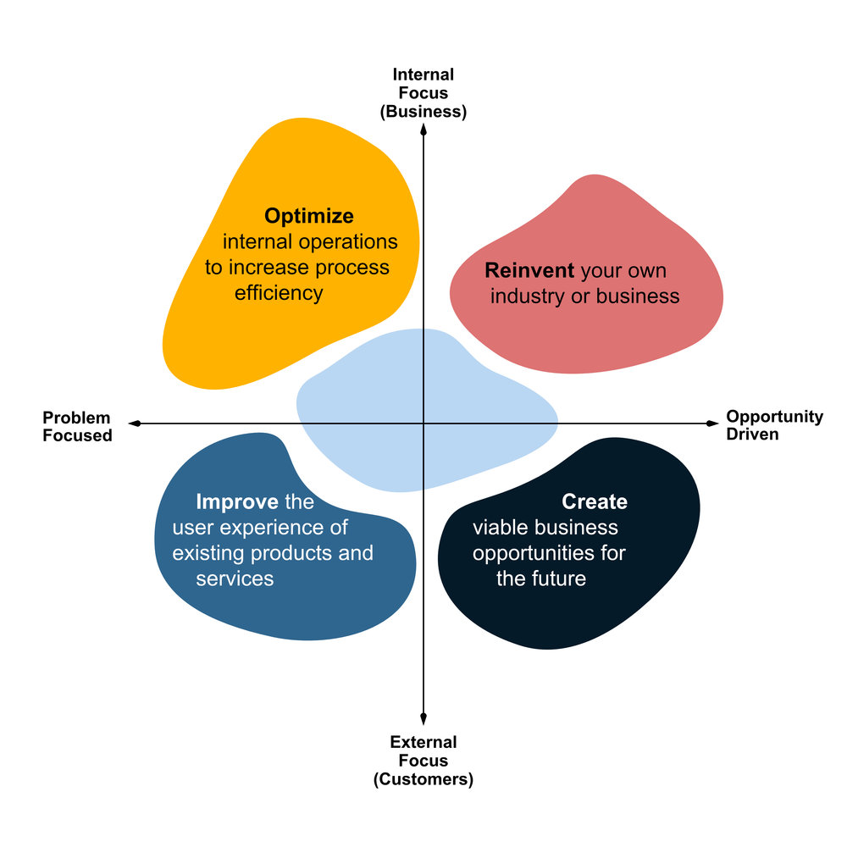
Where you place Micromax? Why

Slide 23
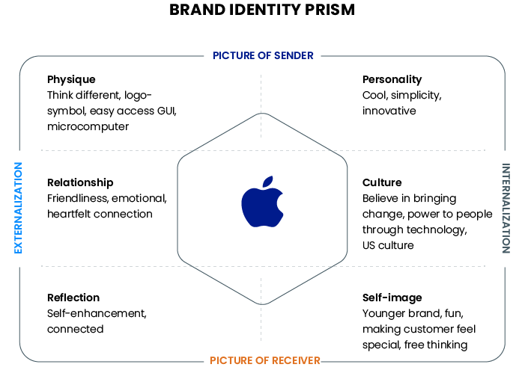

Slide 24
Is Mr. Pal, the CMO, justified in promoting Hugh Jackman as the brand ambassador for Canvas range of smartphones?

