Slide 1
Options Strategies and Swaps

Slide 2
Agenda
Overview of Derivative Markets
• Call Option
• Put Option
• Properties of Options
• Revision
• Factors affecting option Pricing
• Put-Call Parity
• Binomial Option Pricing Model
• Option Strategies
• Swaps
Forward Rate Agreement
CDS

Slide 3
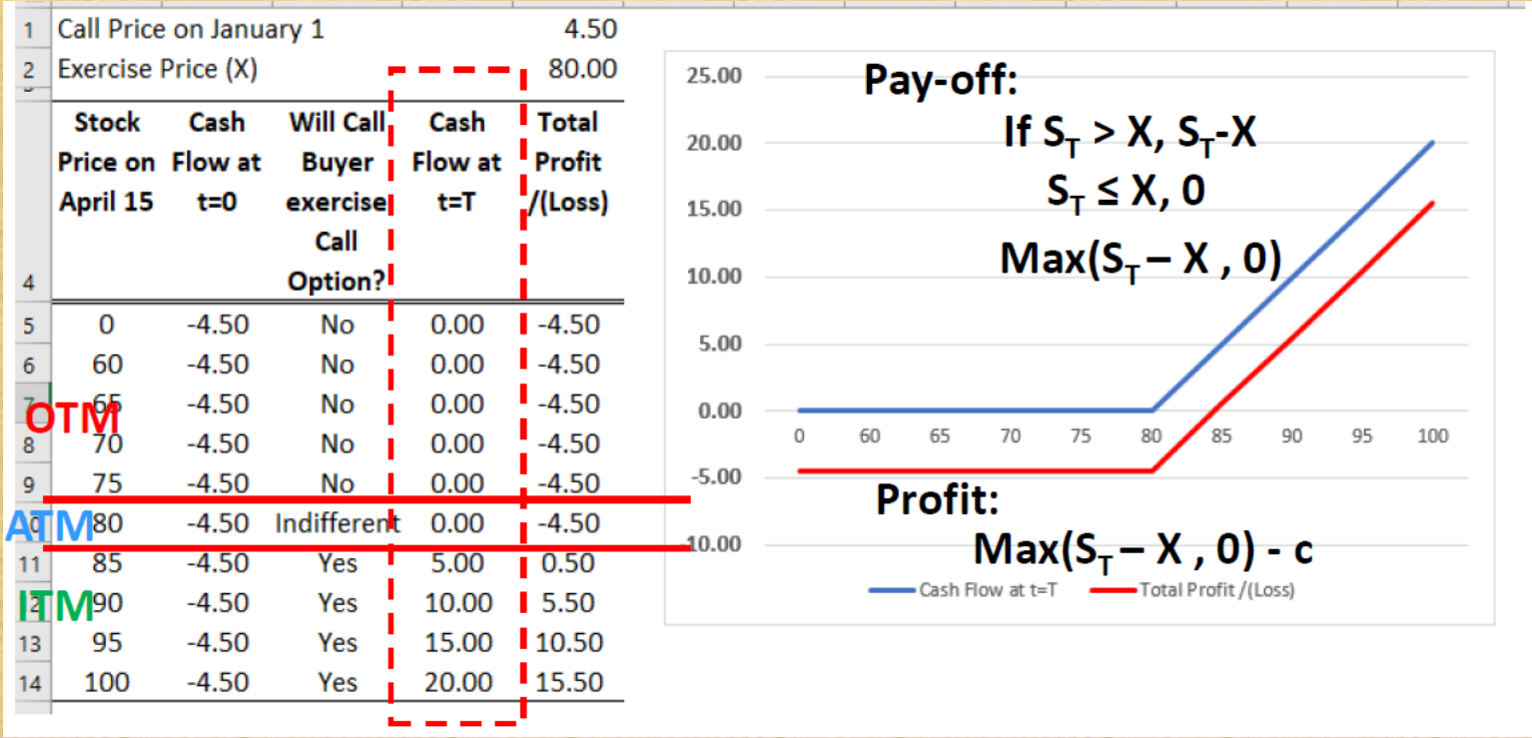
Pay-off & Profit (Loss) for Call Option Holder

Slide 4
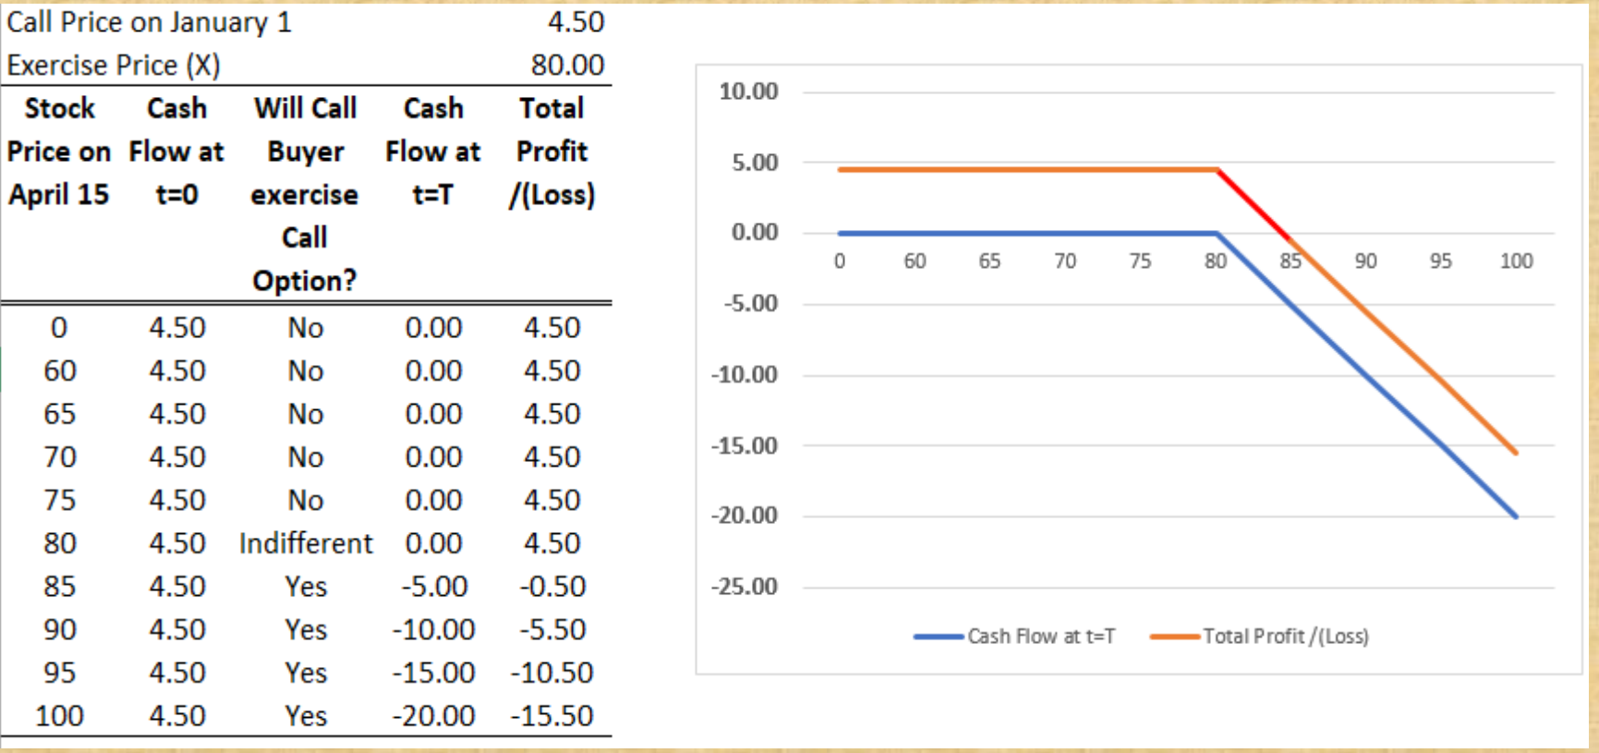

Pay-off & Profit (Loss) for Call Option Seller

Slide 5
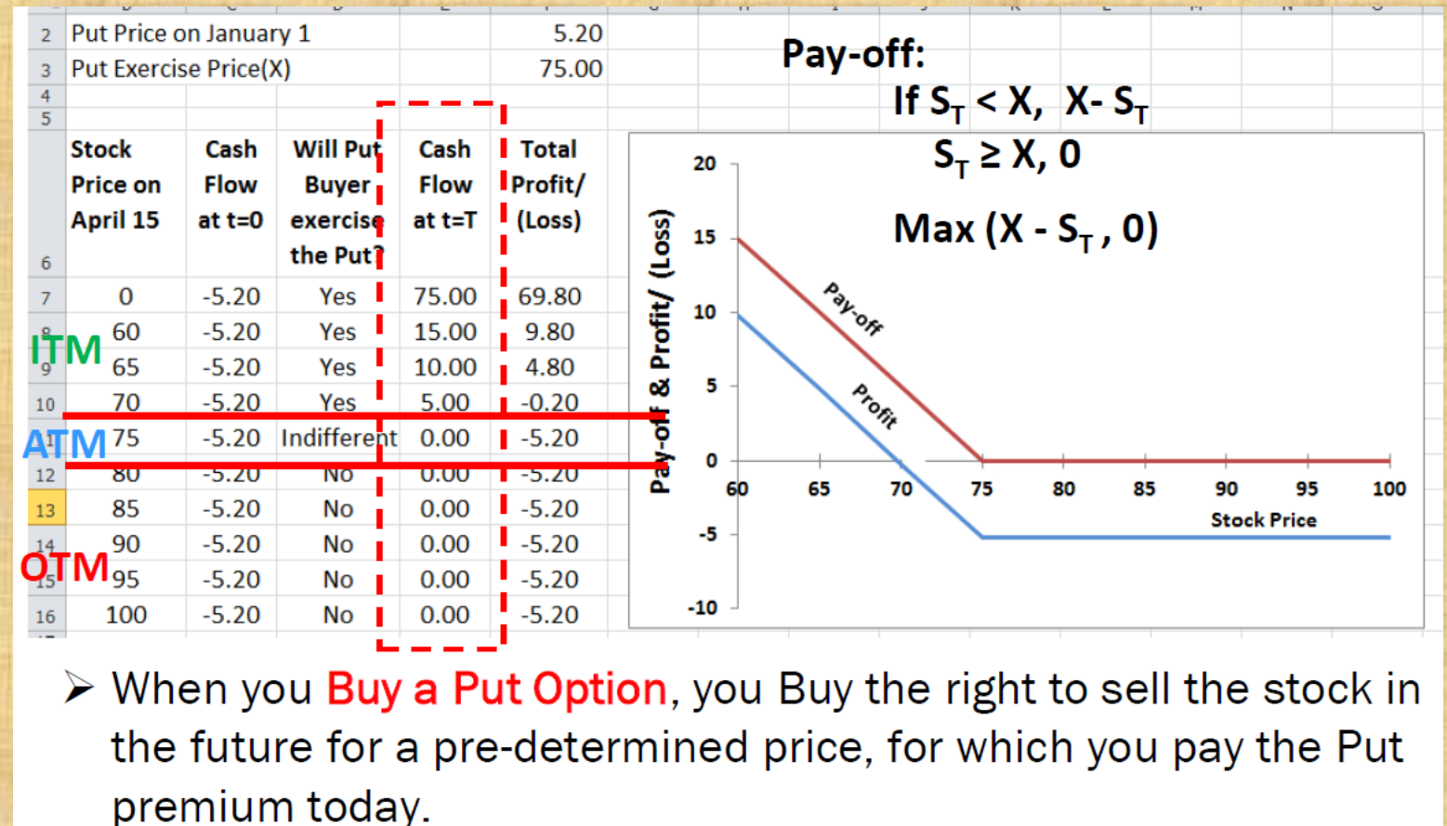

Profit/(Loss) for Put Option Holder
Algorooms.com, opstra, Zerodha Black Scholes

Slide 6
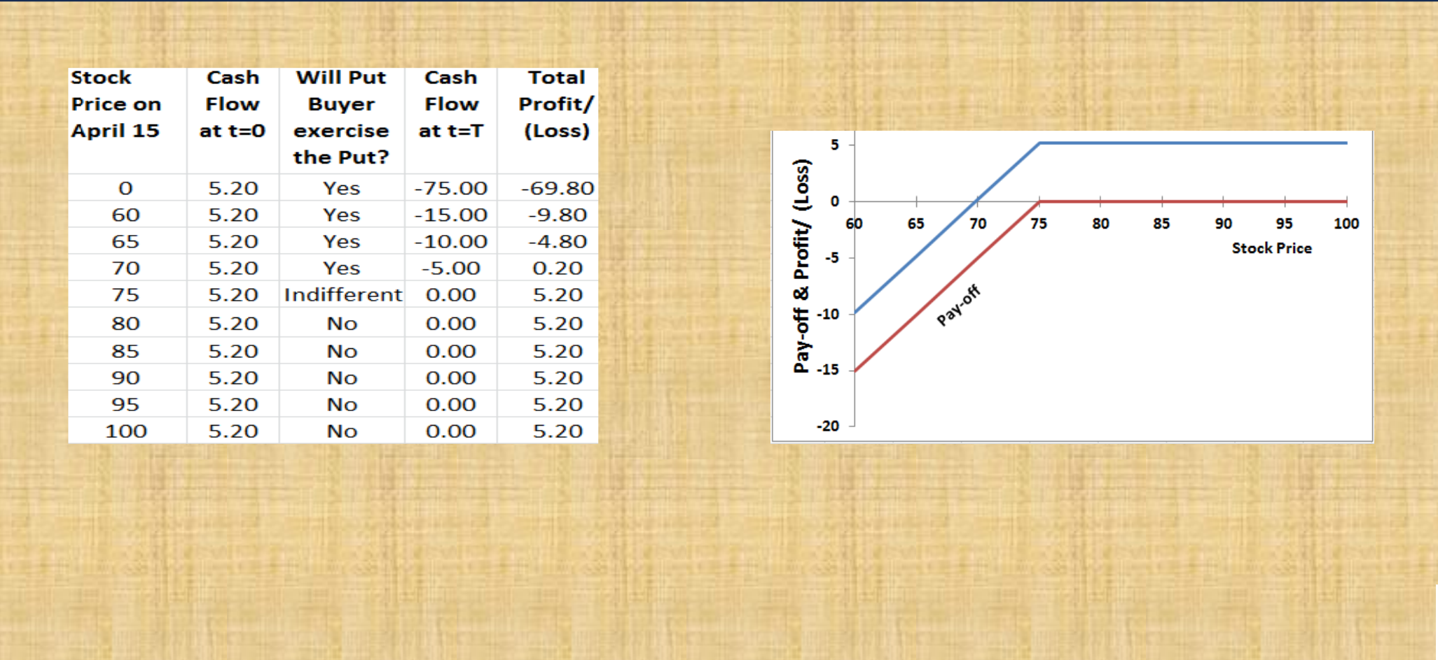

Profit/(Loss) for Put Option Writer

Slide 7
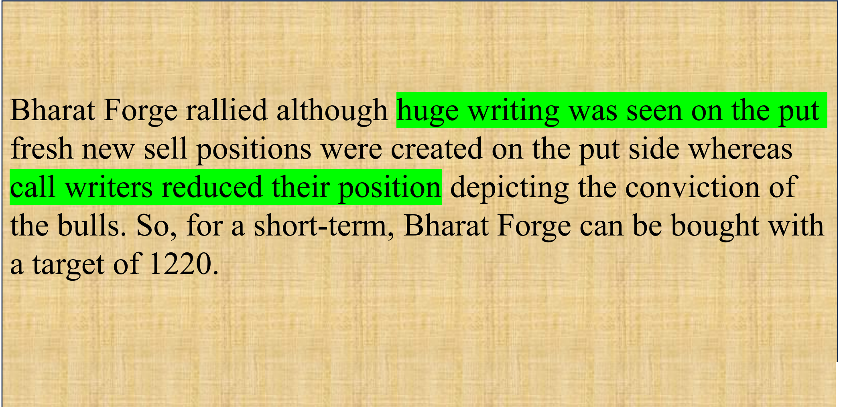




Derivatives in India

Slide 8
Adjustments for Corporate Actions (Stock Options)
Corporate actions like dividends, bonus shares or stock splits change the value of underlying stock and hence options of these stock would also change in value.
• Adjustment for Dividends: Exchange traded options do not provide for adjustment for dividends.
• For dividends upto10% of the market value of underlying stock, no adjustment is made to no. of share or exercise price is made.
• For extra-ordinary dividends (above 10%), amount of dividend is reduced from the all the exercise prices on the stock (w.e.f. ex-dividend date).

Slide 9
Adjustments for Corporate Actions (Bonus Shares)
Adjustment for Bonus Shares (Stock Dividend) : Bonus shares do not change the aggregate value of shares but affects the stock price.
For an ‘a:b’ bonus issue. No. of shares increase to (1+ a/b)of its previous value and Exercise price goes down by 1/ (1+ a/b)of its previous value.
No. of Shares in 1 Options Contract 500 (1+Bonus ratio)
500*(1+2/5) =700
Exercise Price 140 = 1/(1+Bonus ratio)
140* 1/(1+2/5) = 100

Slide 10
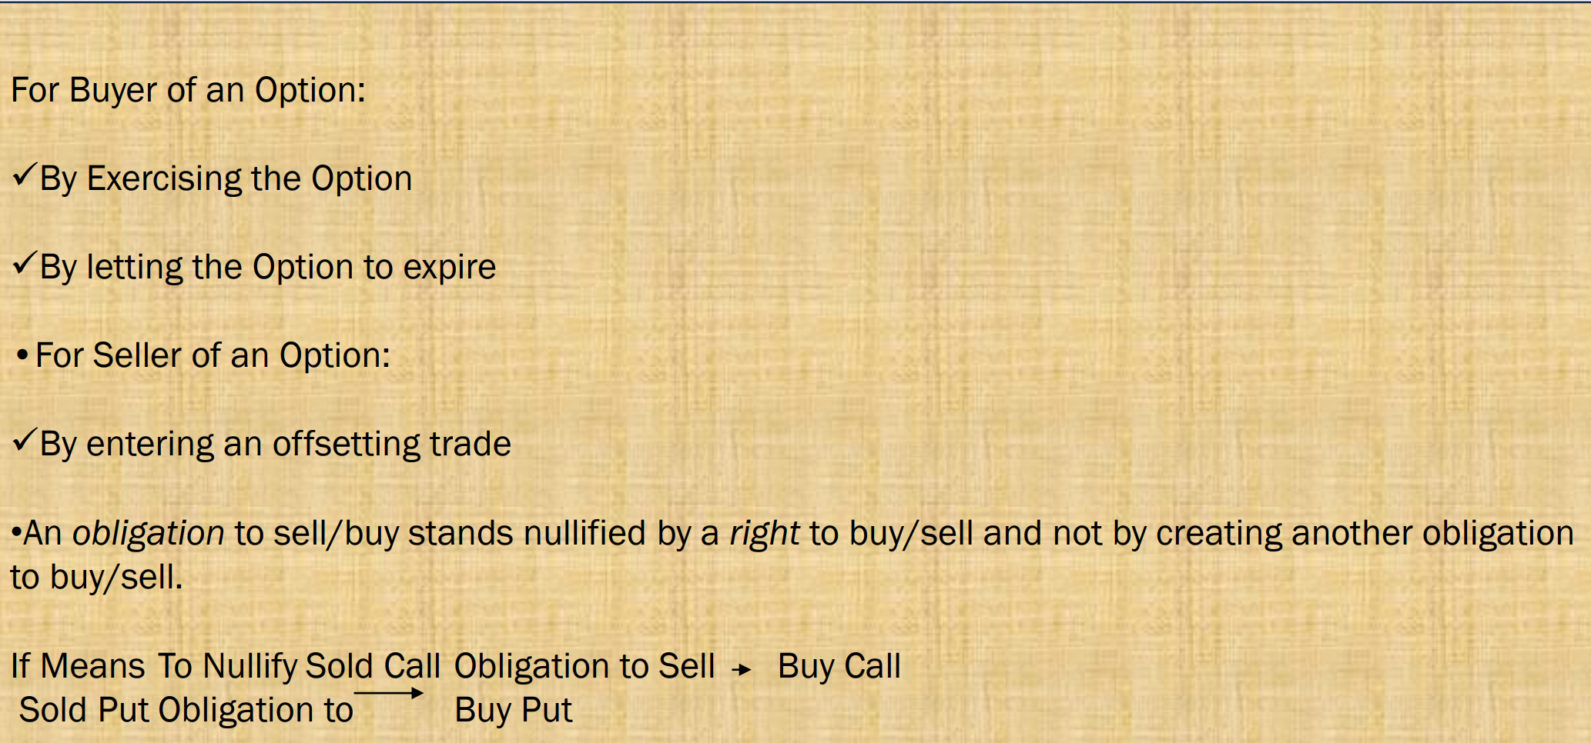
Closure of Options

Slide 11
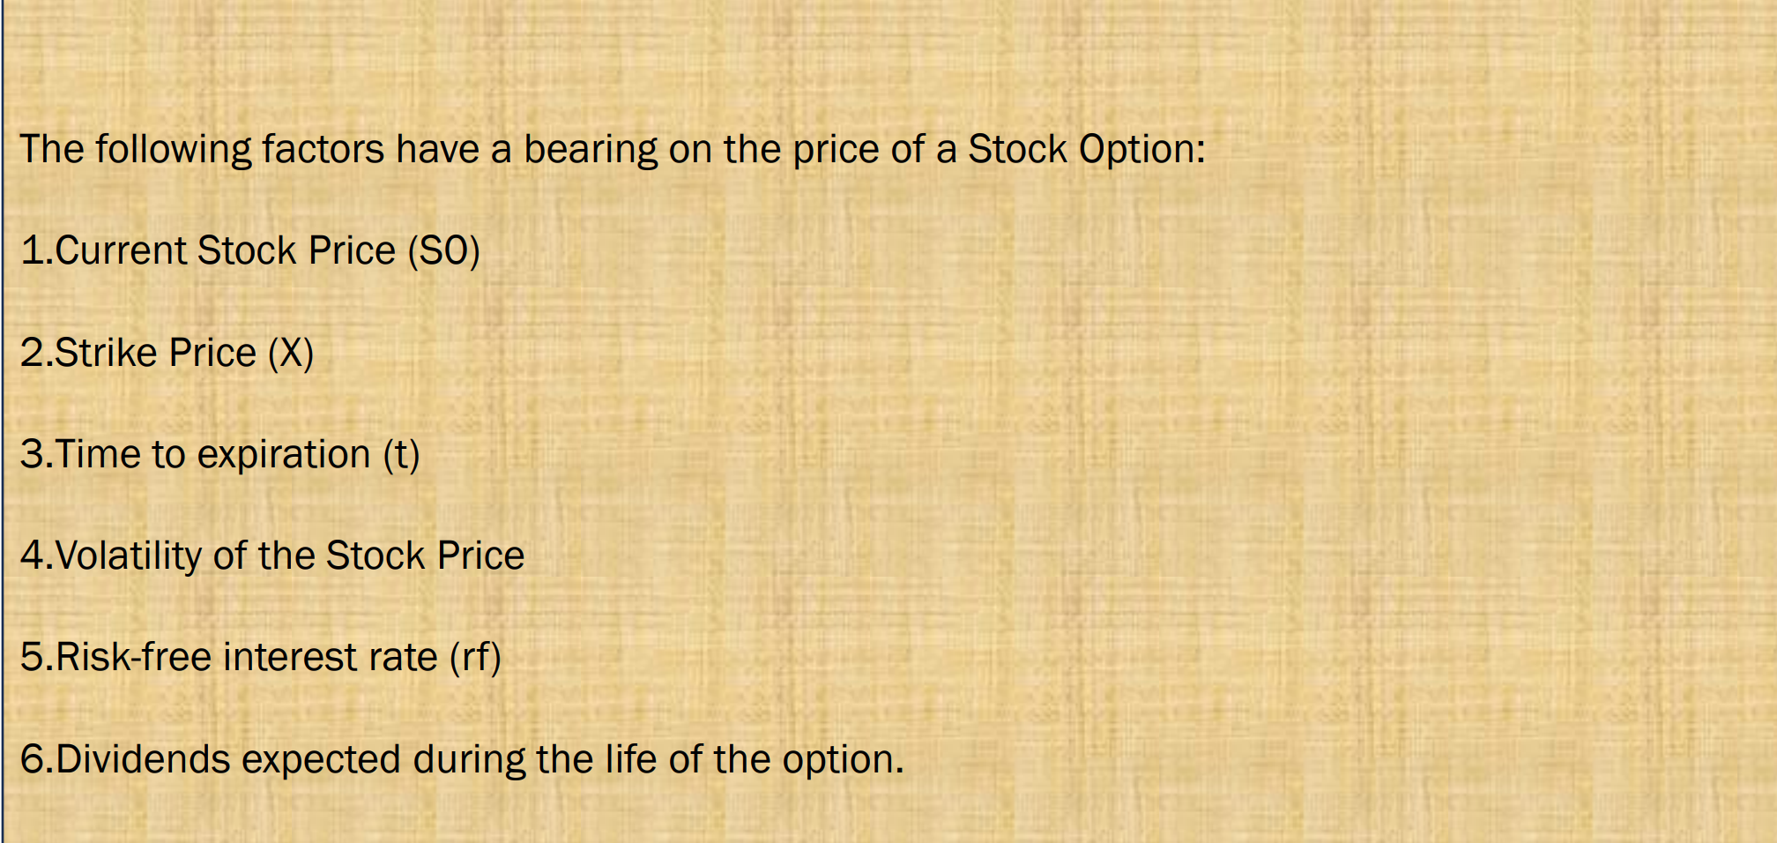
Factors Affecting Option Prices

Slide 12
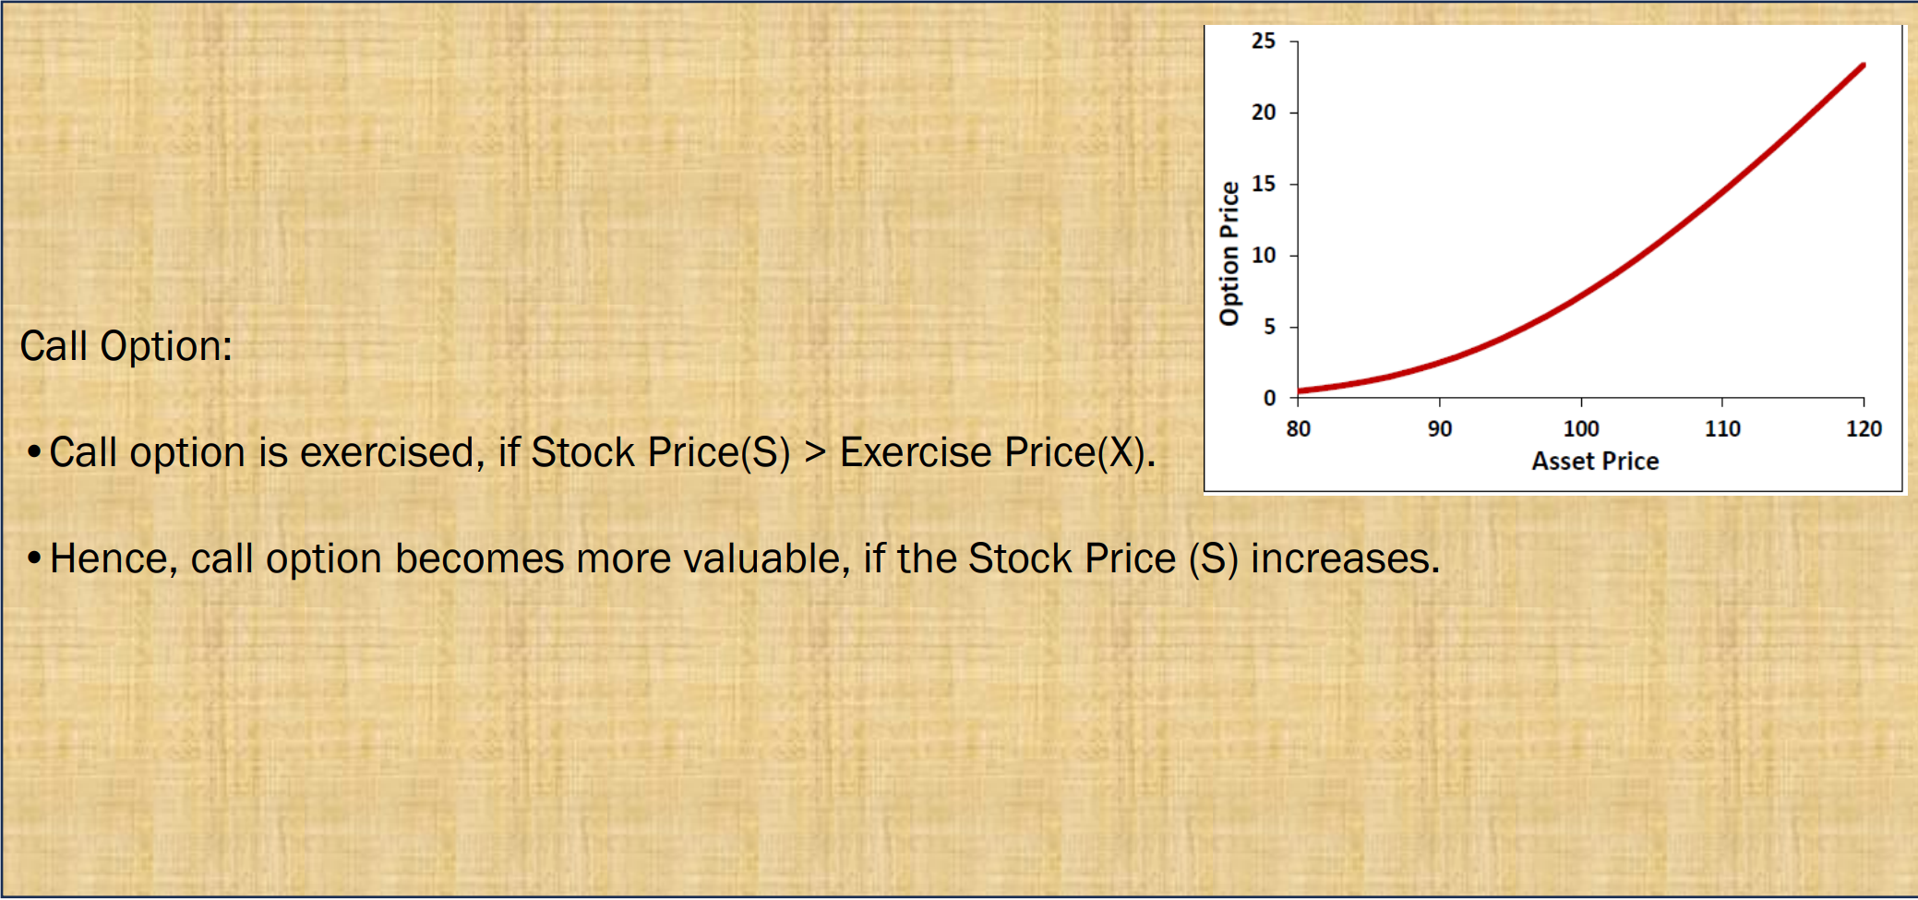
Stock Prices

Slide 13
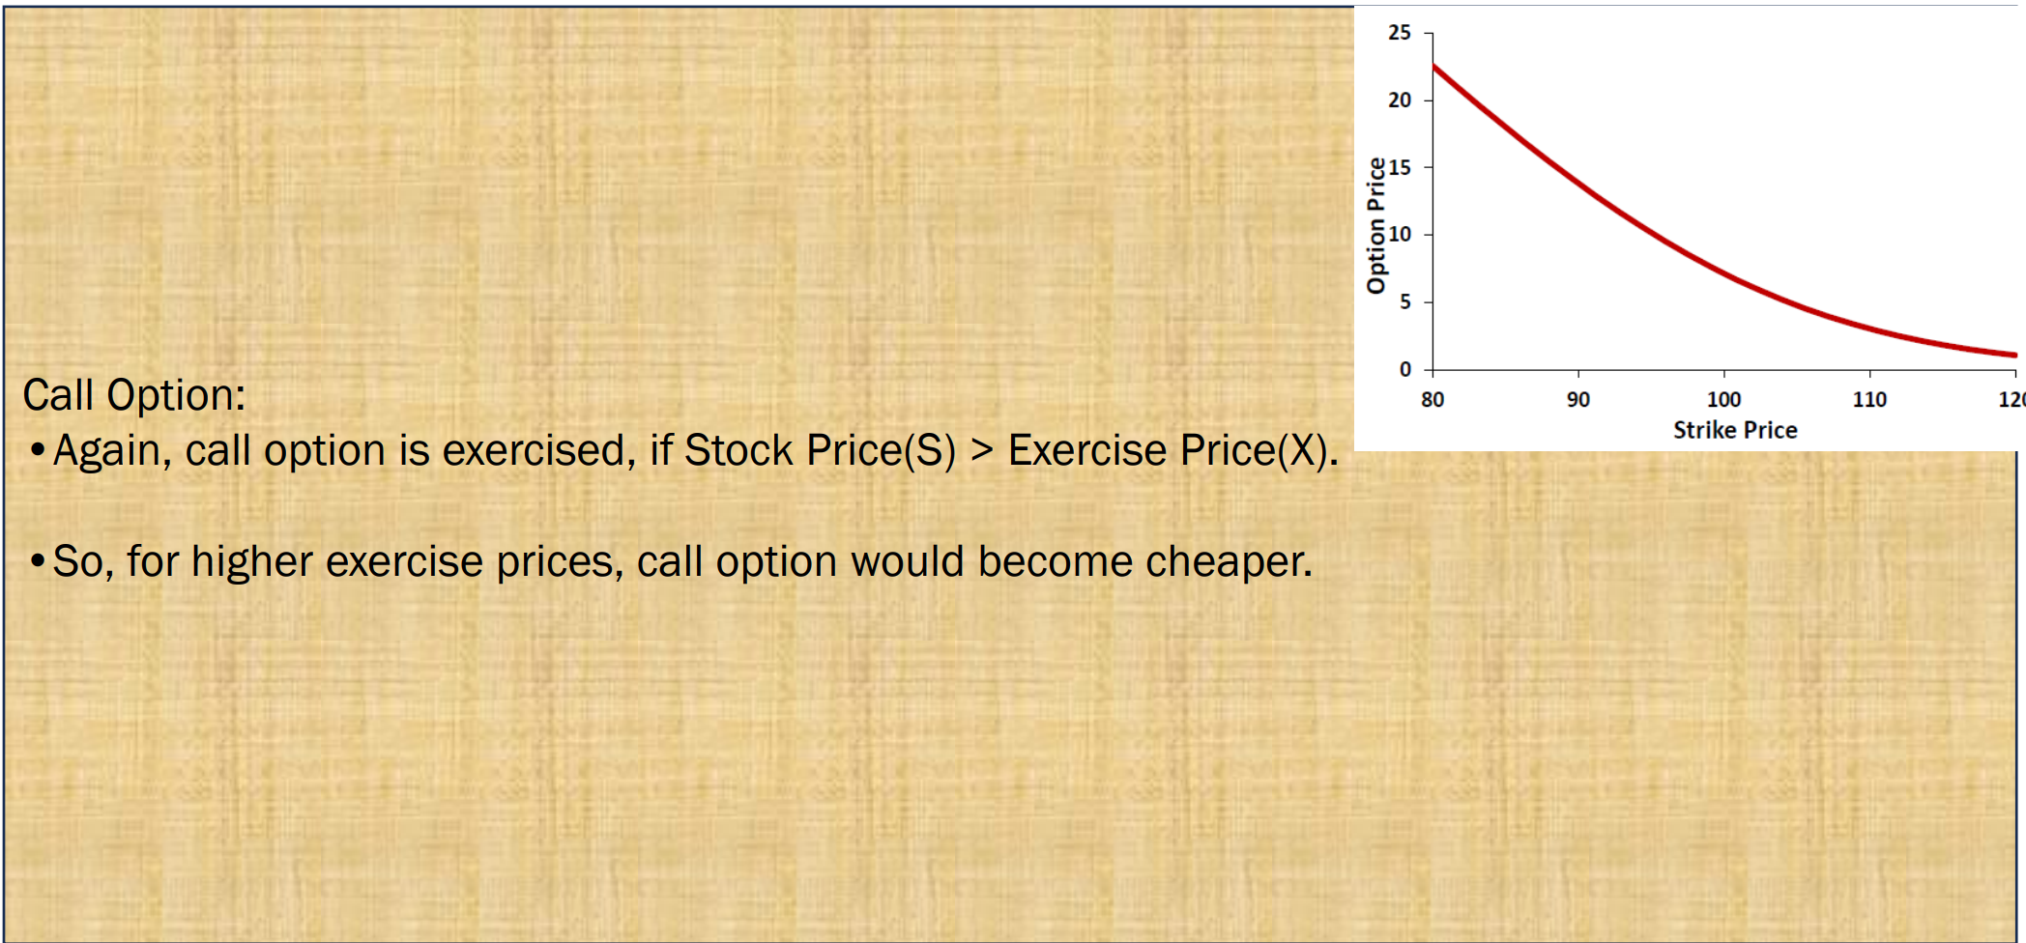
Exercise/Strike Price

Slide 14
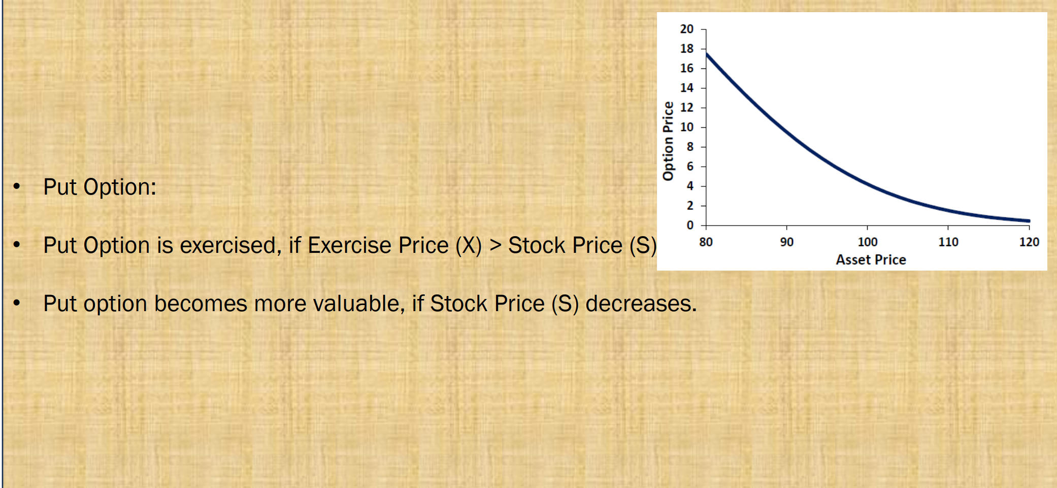
PUT Options

Slide 15
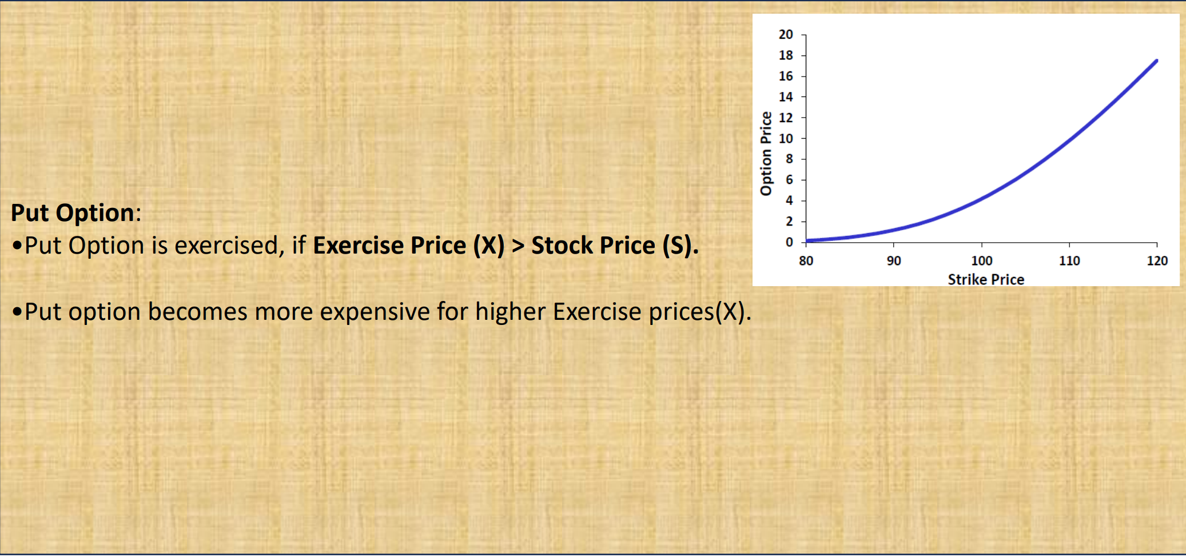
PUT Option

Slide 16
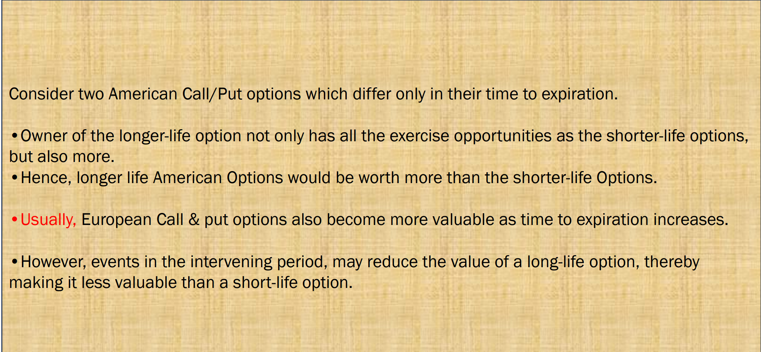
Time to Expiration

Slide 17
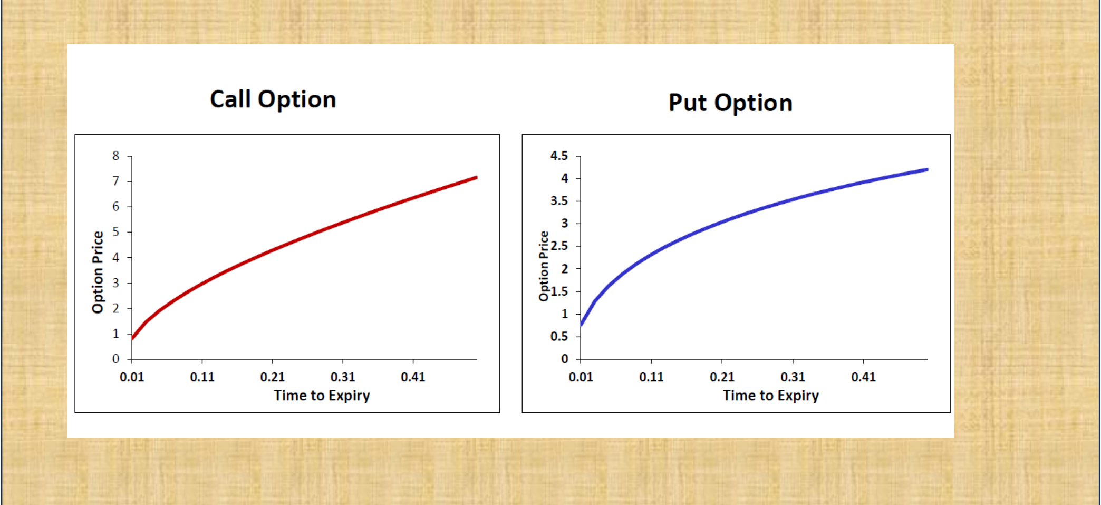
Time to Expiration

Slide 18
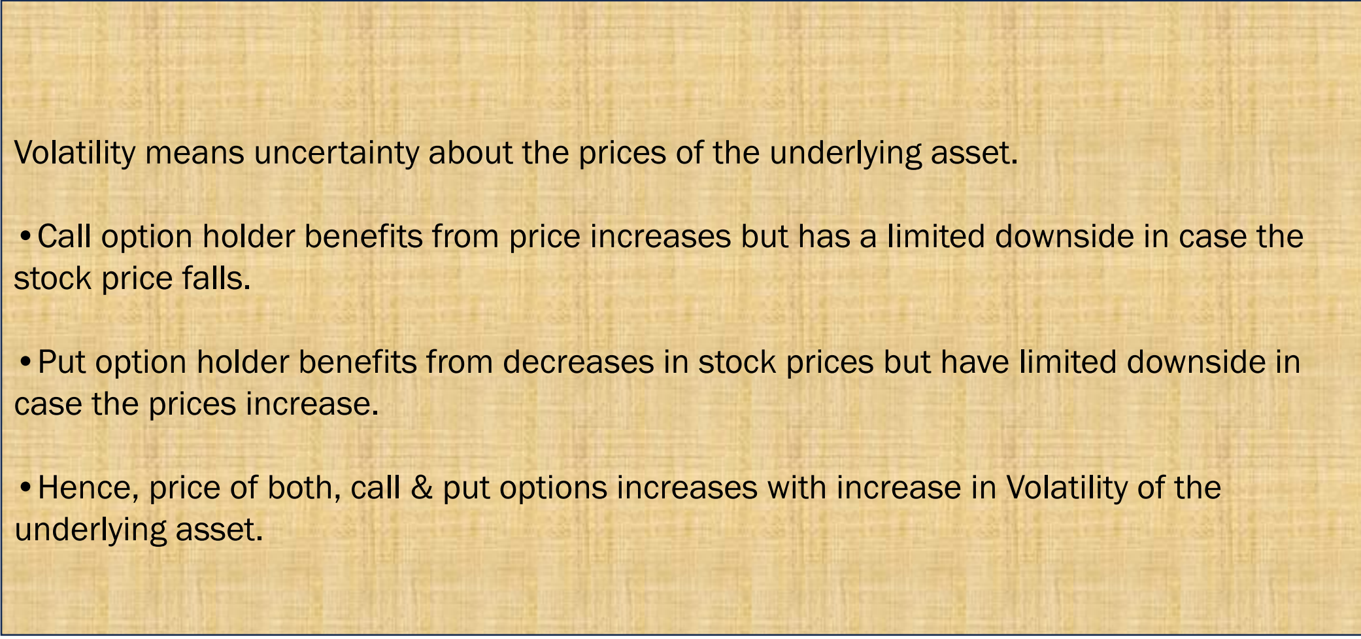
Volatility

Slide 19
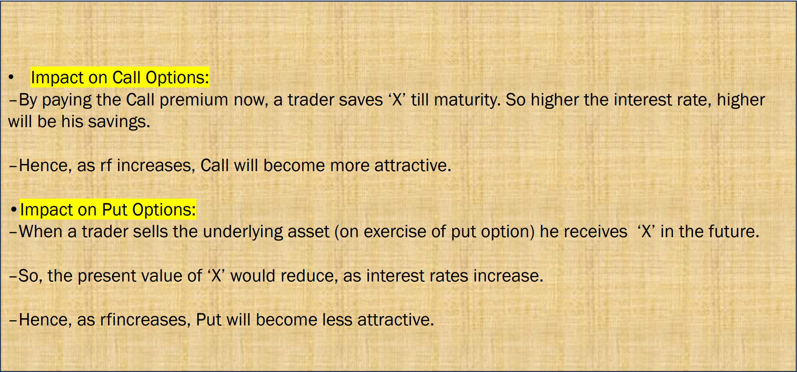
Risk-free Interest Rate

Slide 20
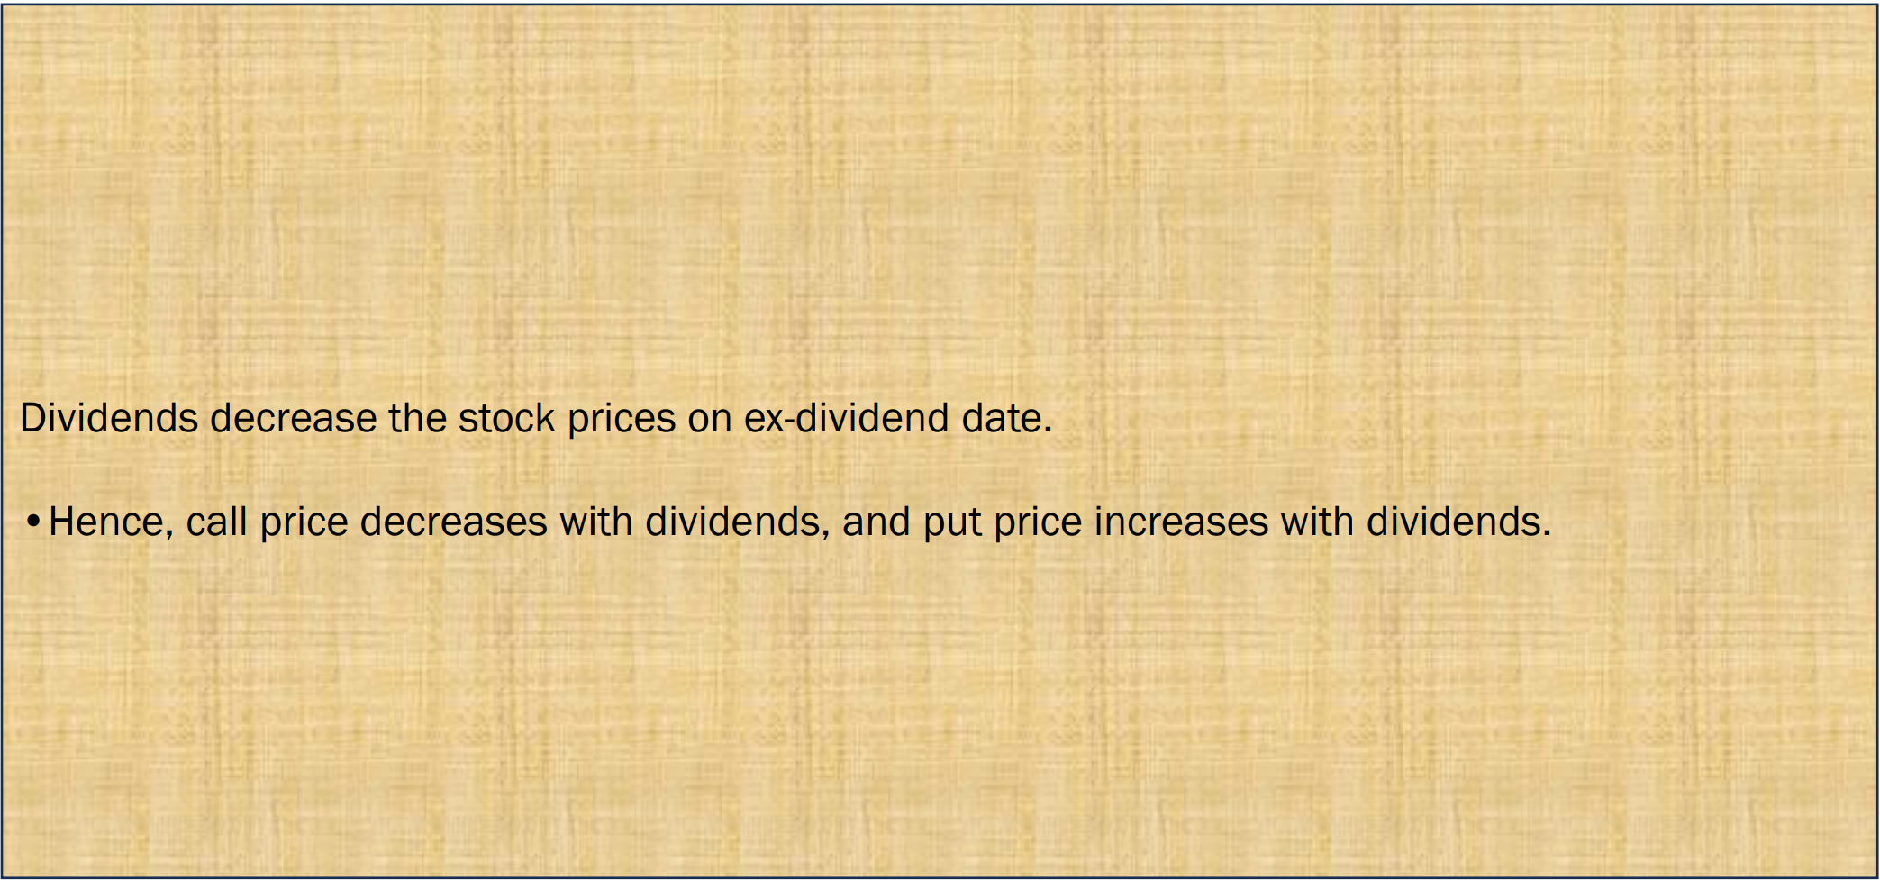
Dividends

Slide 21
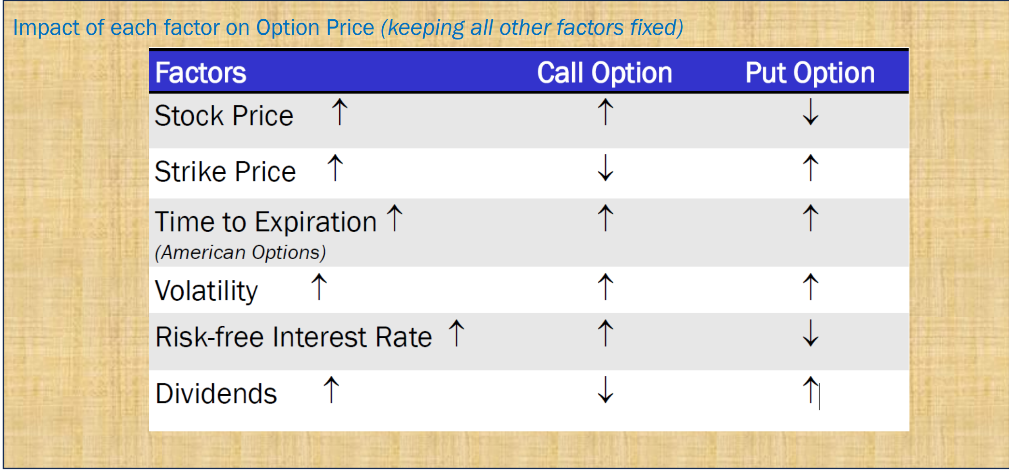
Summary

Slide 22
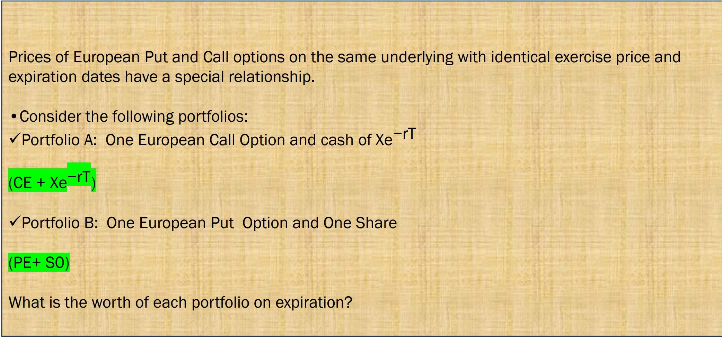
Put –Call Parity

Slide 23
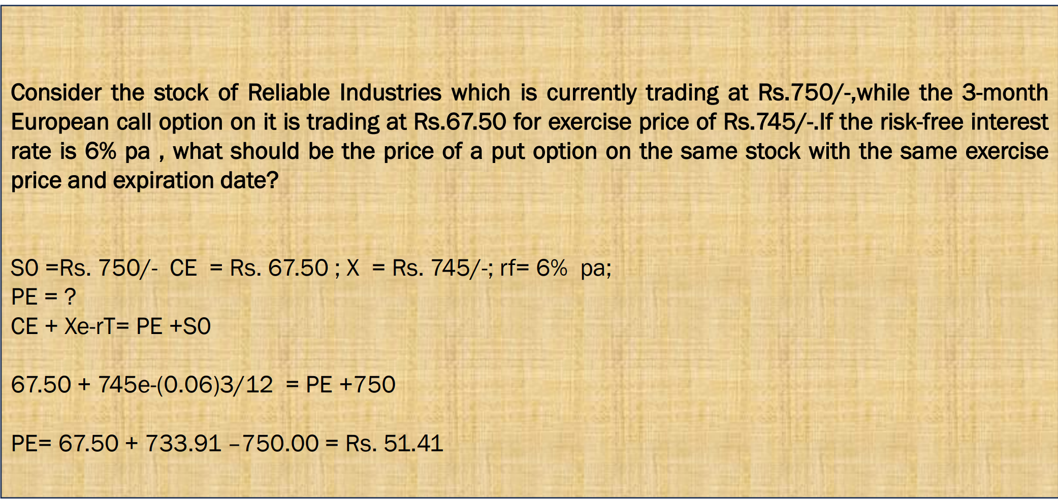
Put –Call Parity

Slide 24
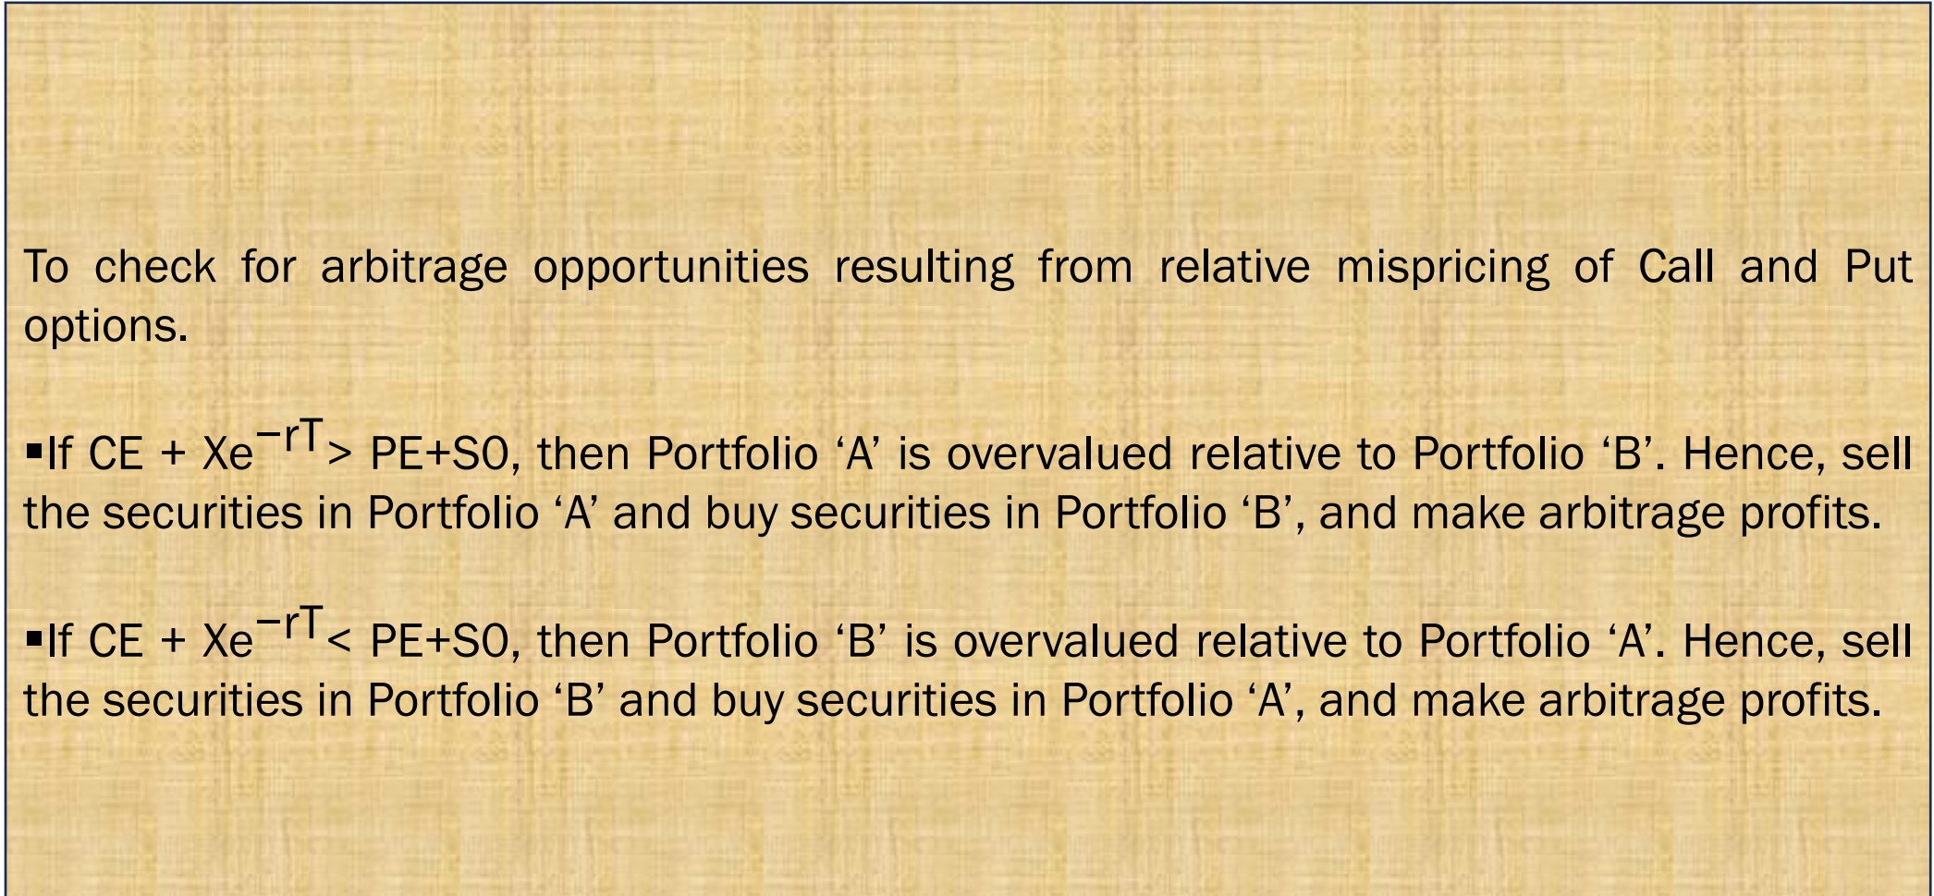
Uses of Put –Call Parity

Slide 25
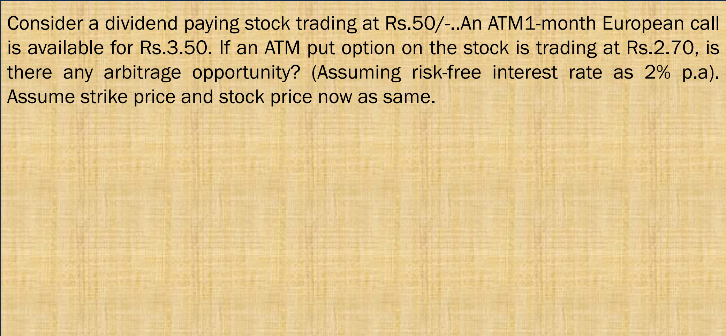




Uses of Put –Call Parity

Slide 26
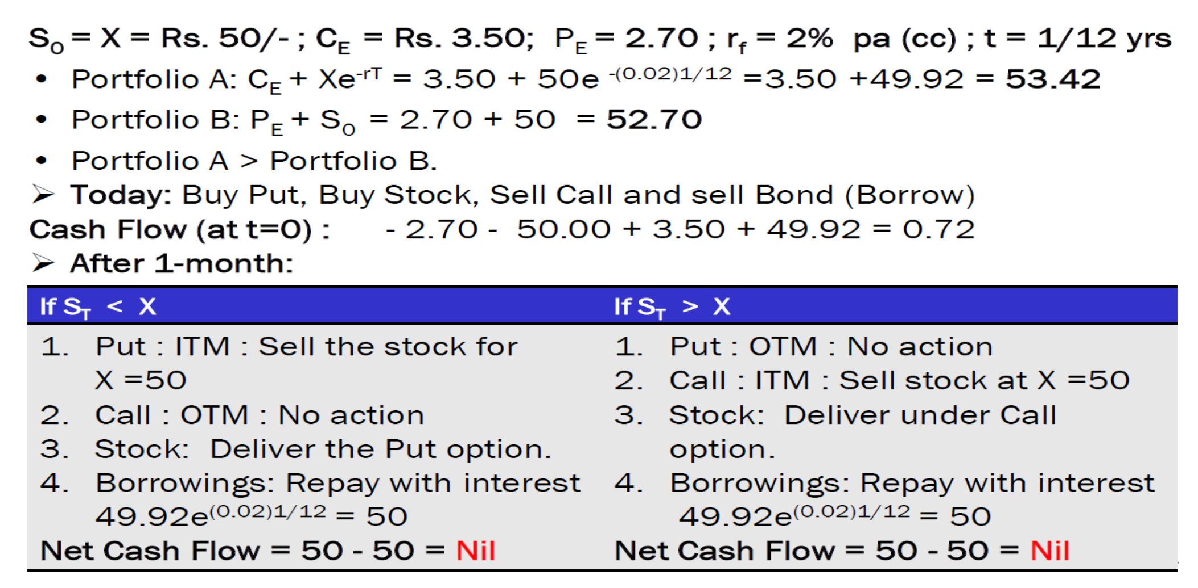
Put –Call Parity

Slide 27
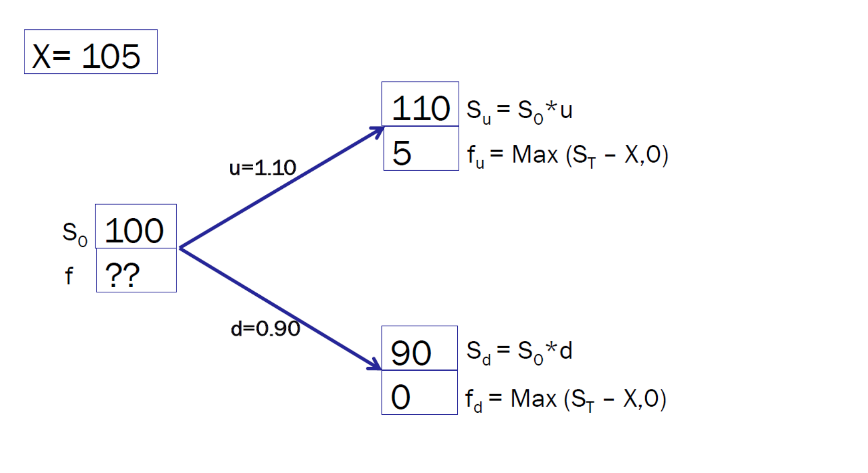
Binomial Option Pricing Model

Slide 28
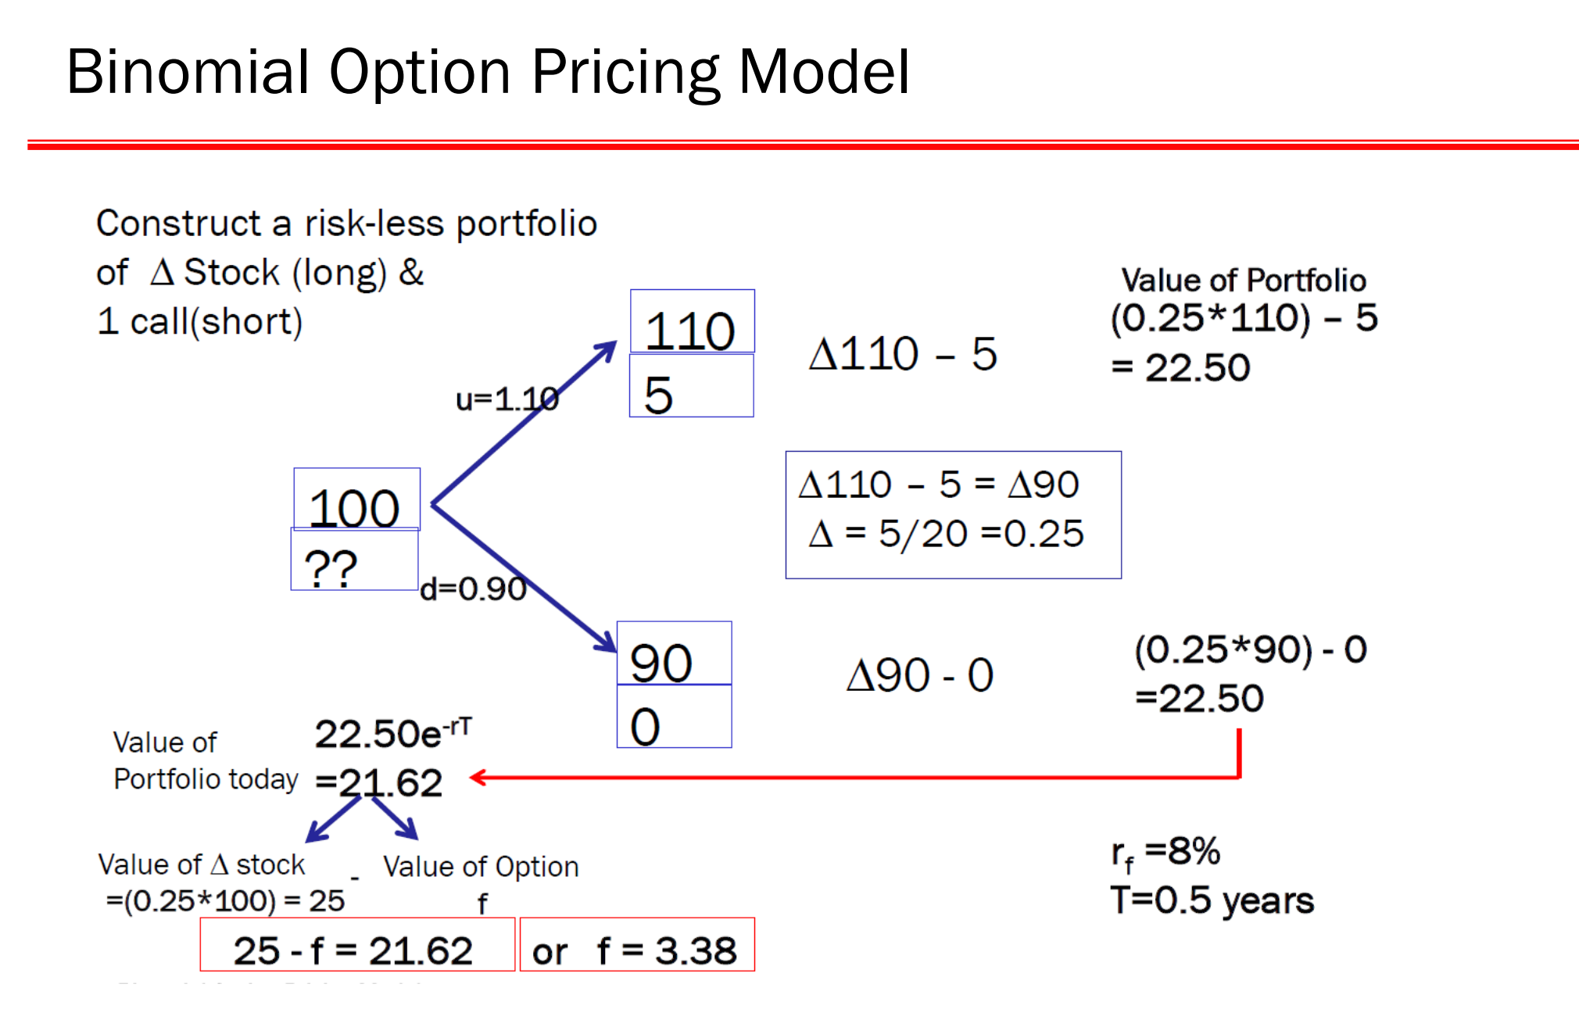

Slide 29
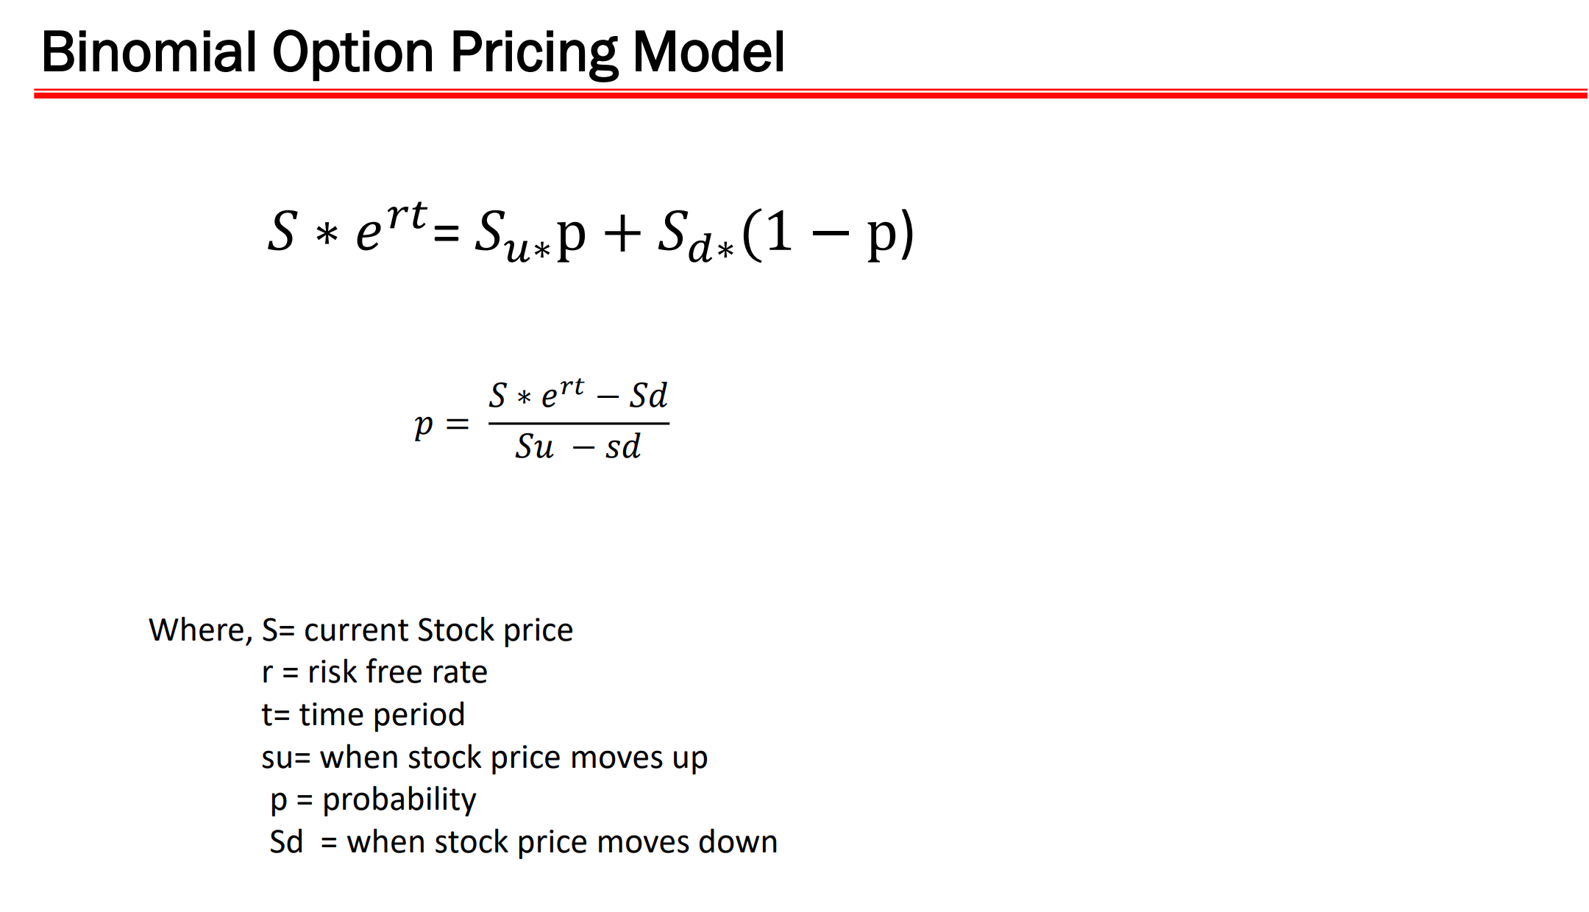

Slide 30
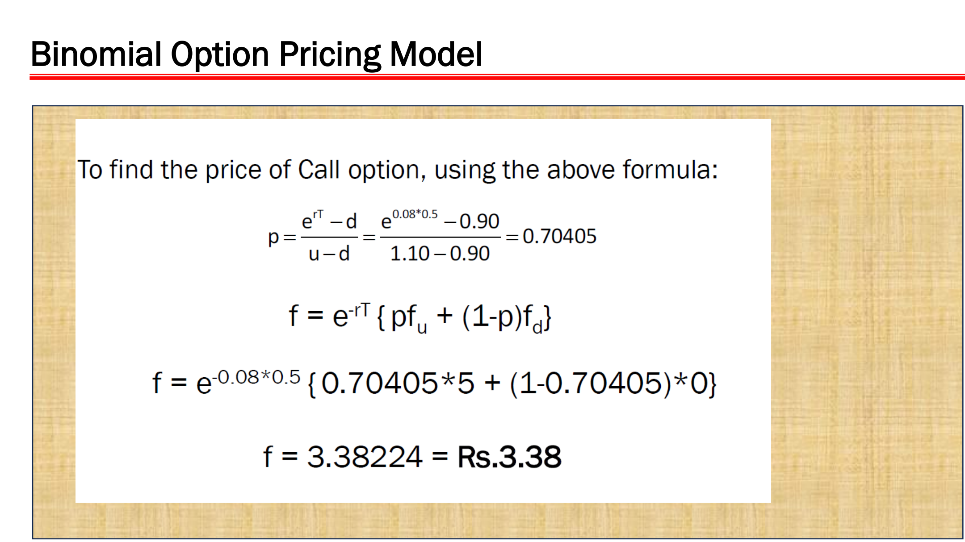

Slide 31
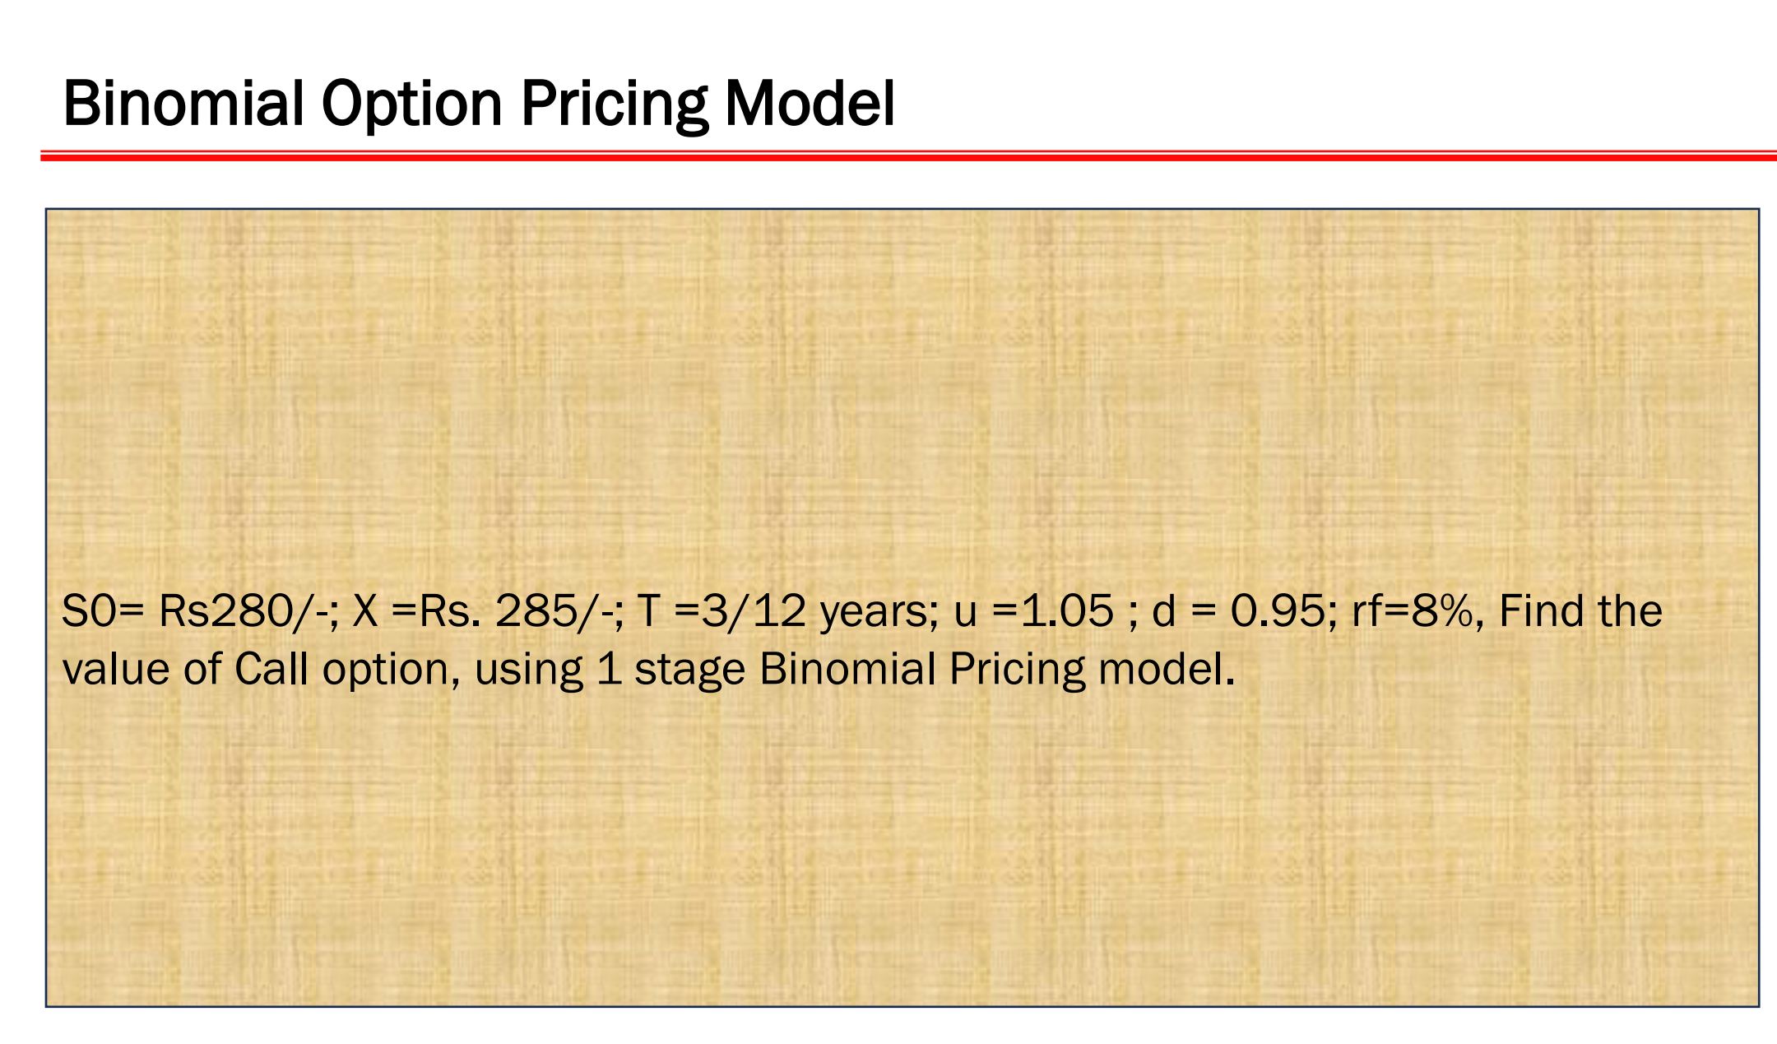

Slide 32
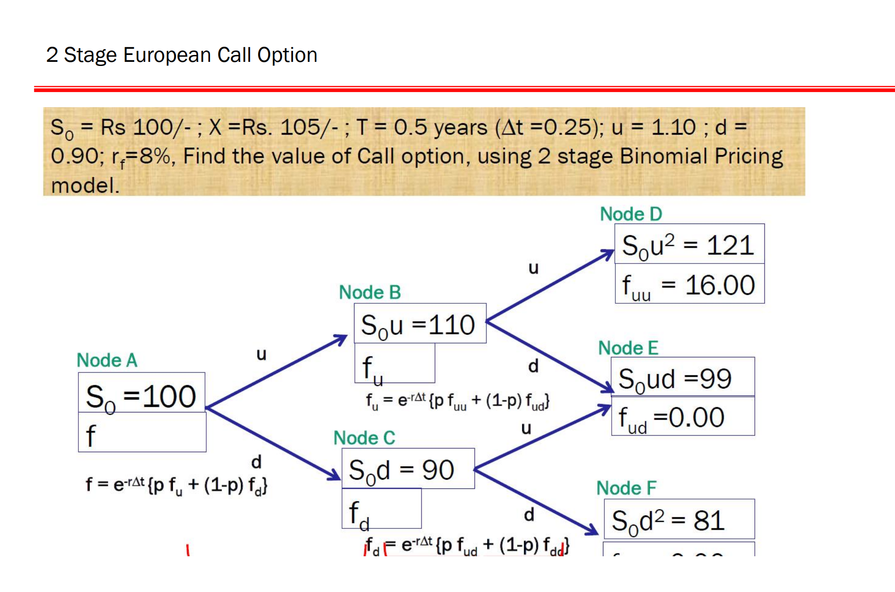

Slide 33
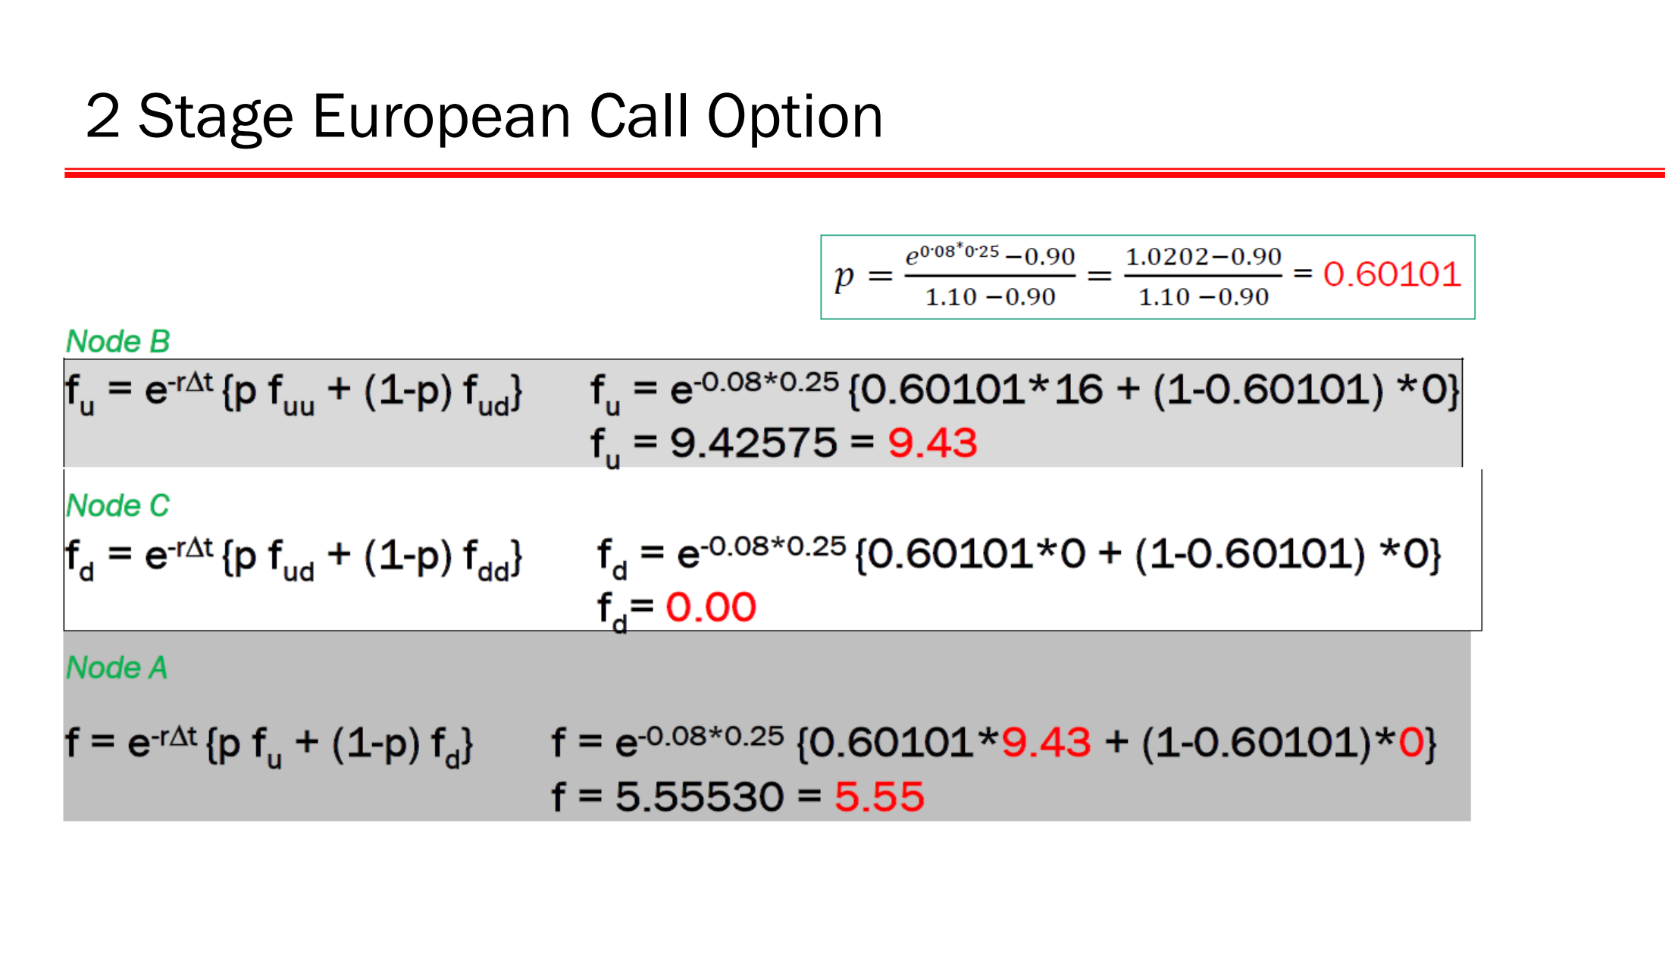

Slide 34
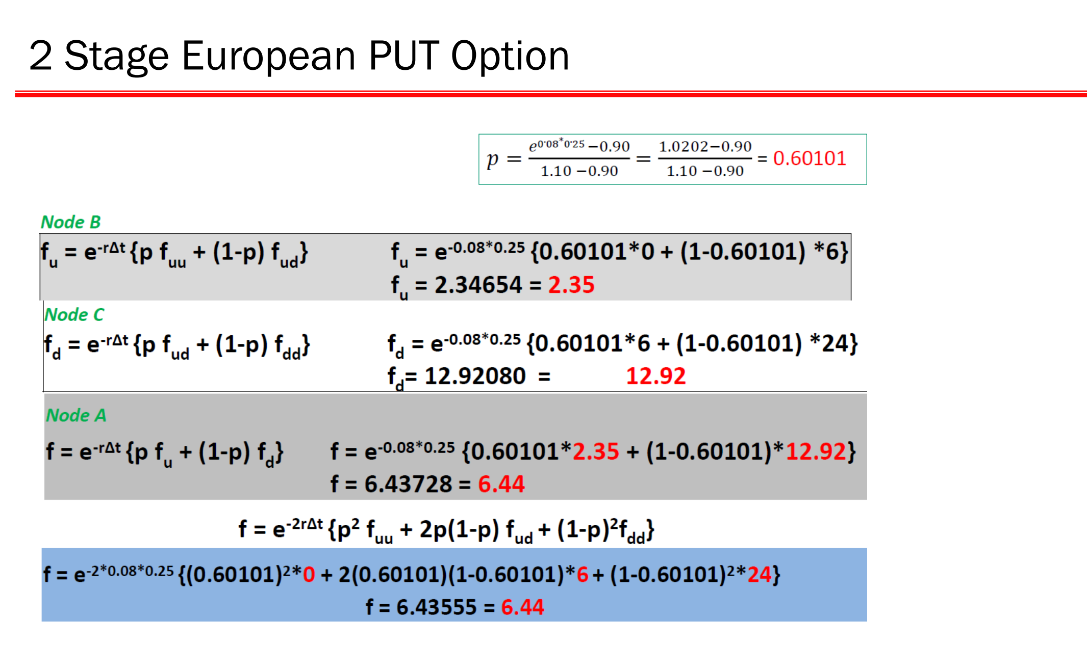

Slide 35
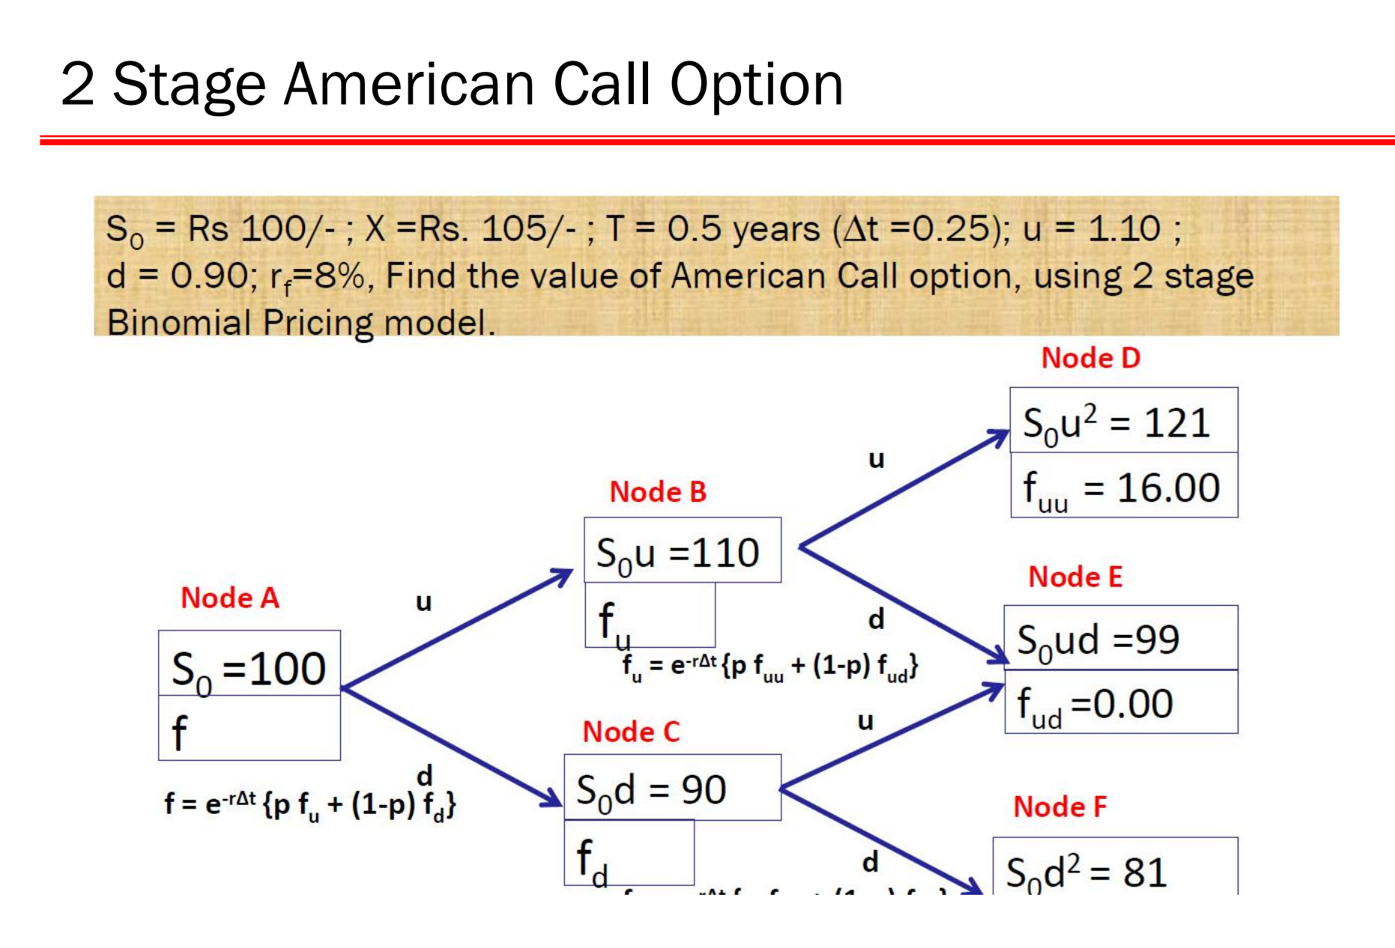

Slide 36
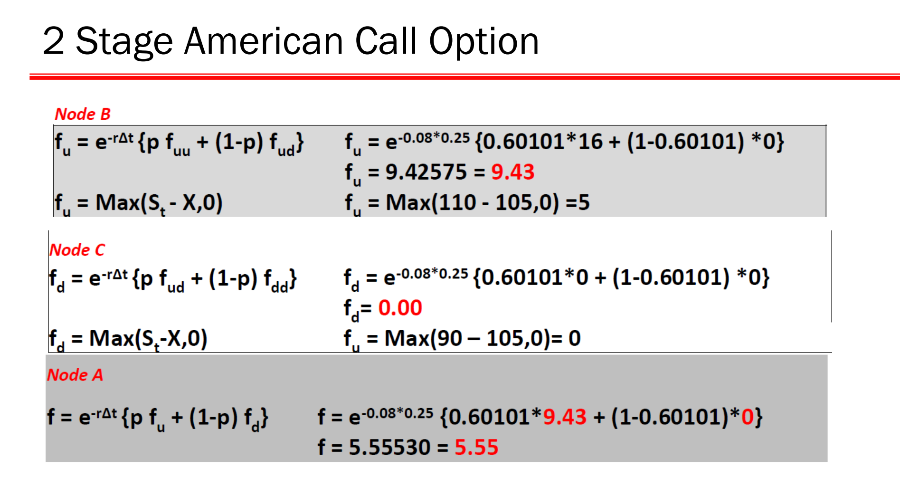

Slide 37
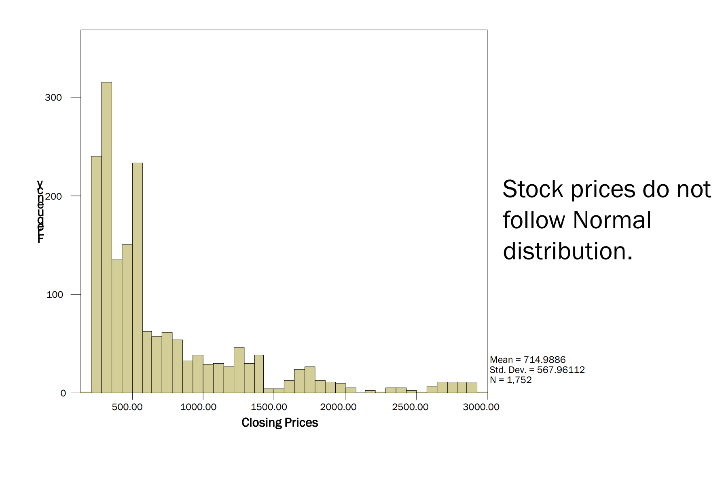

Slide 38
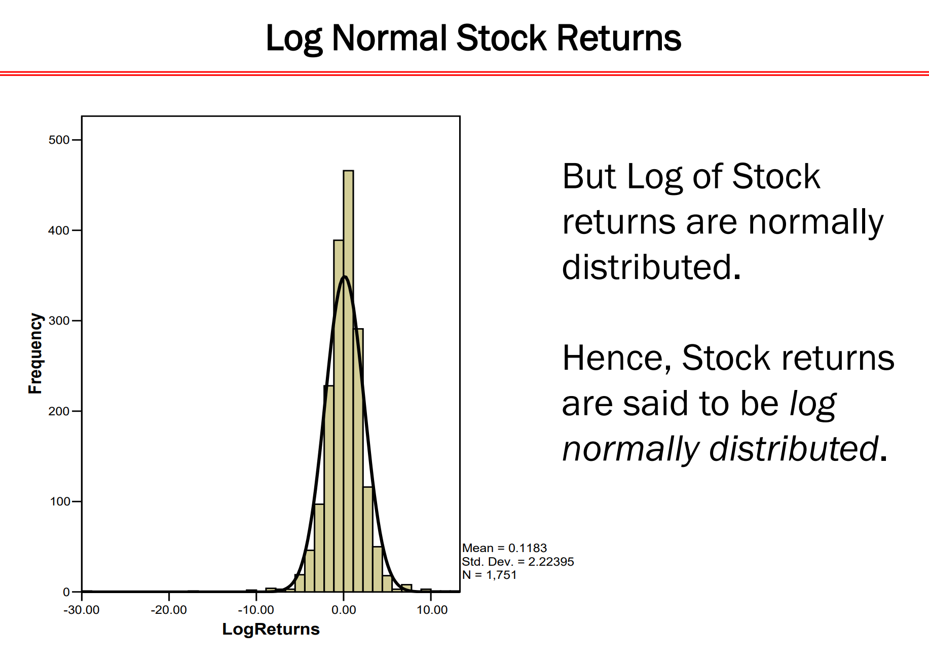

Slide 39
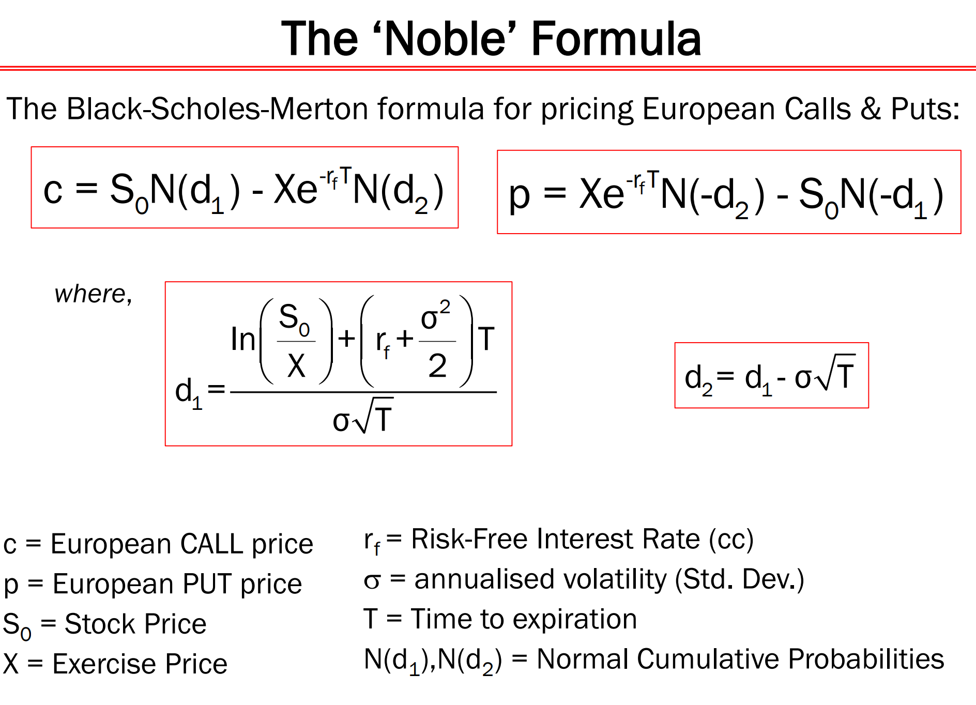

Slide 40
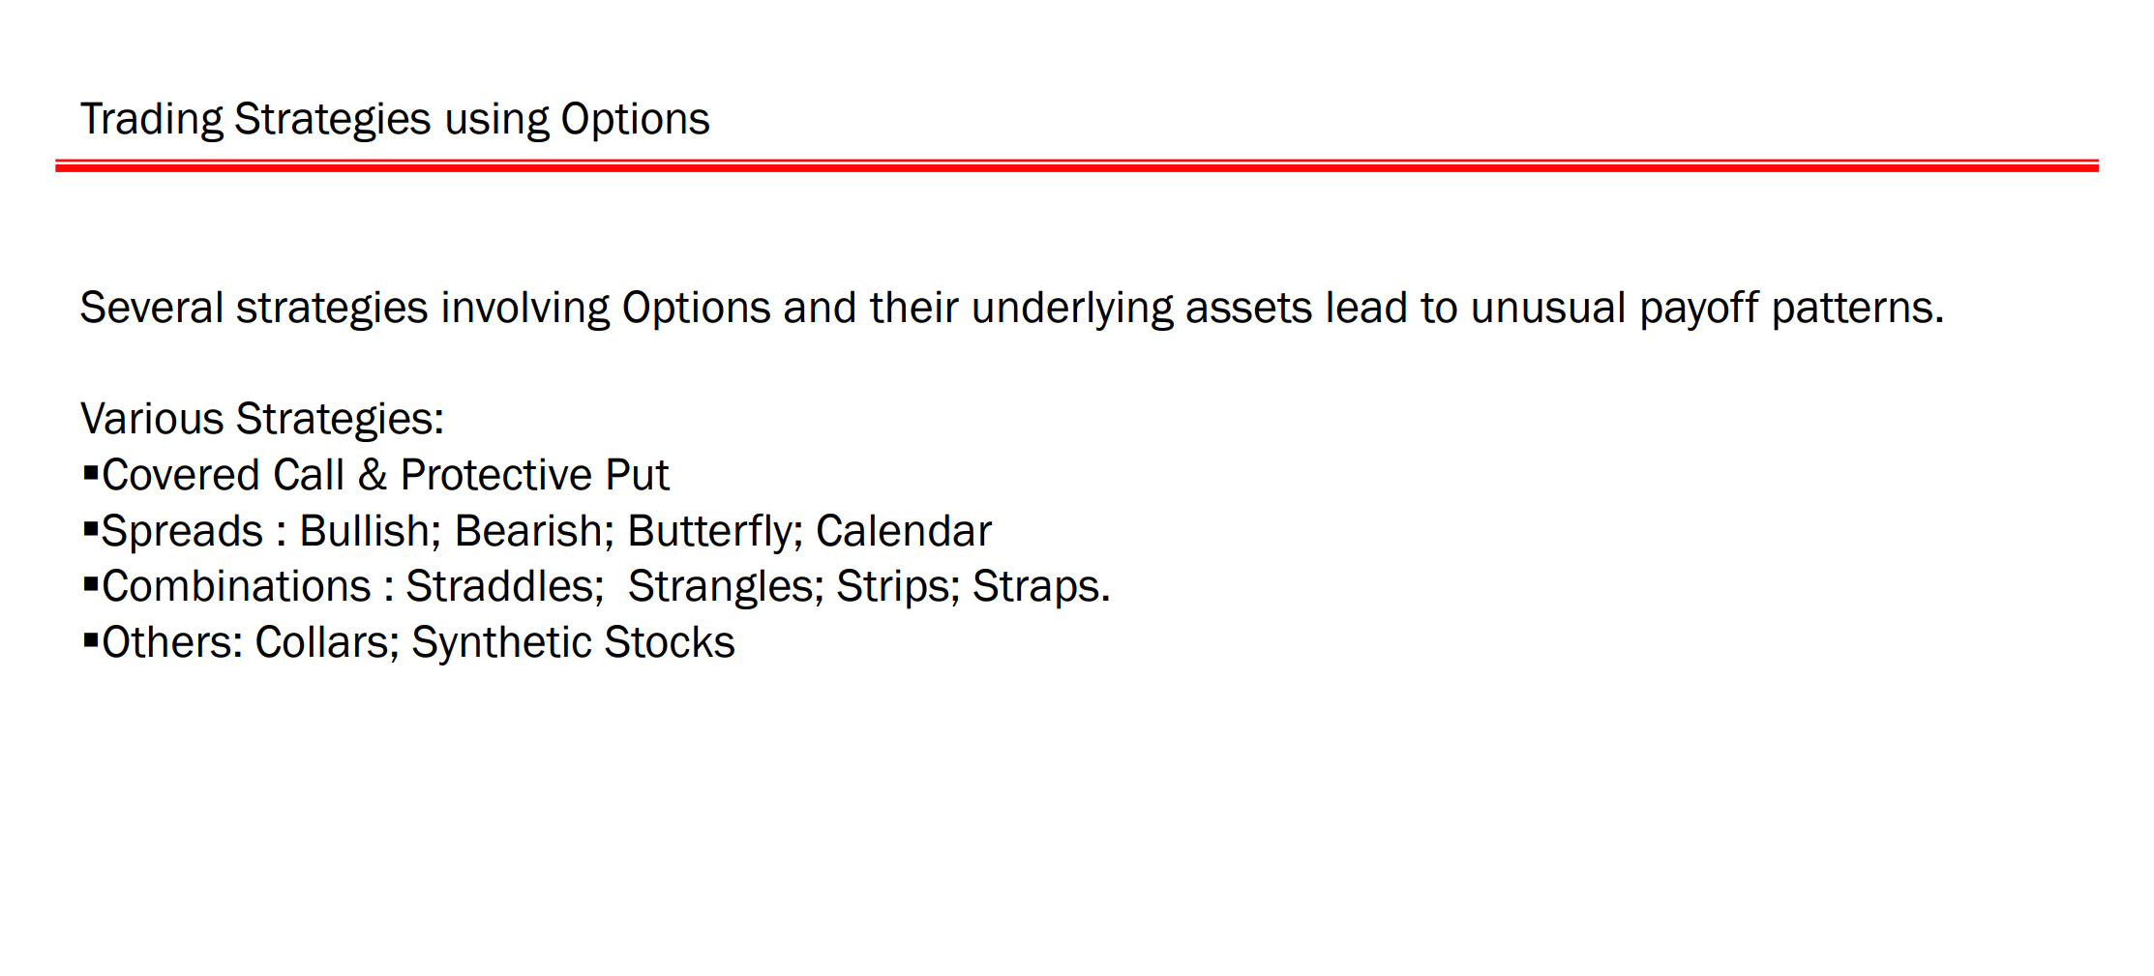

Slide 41
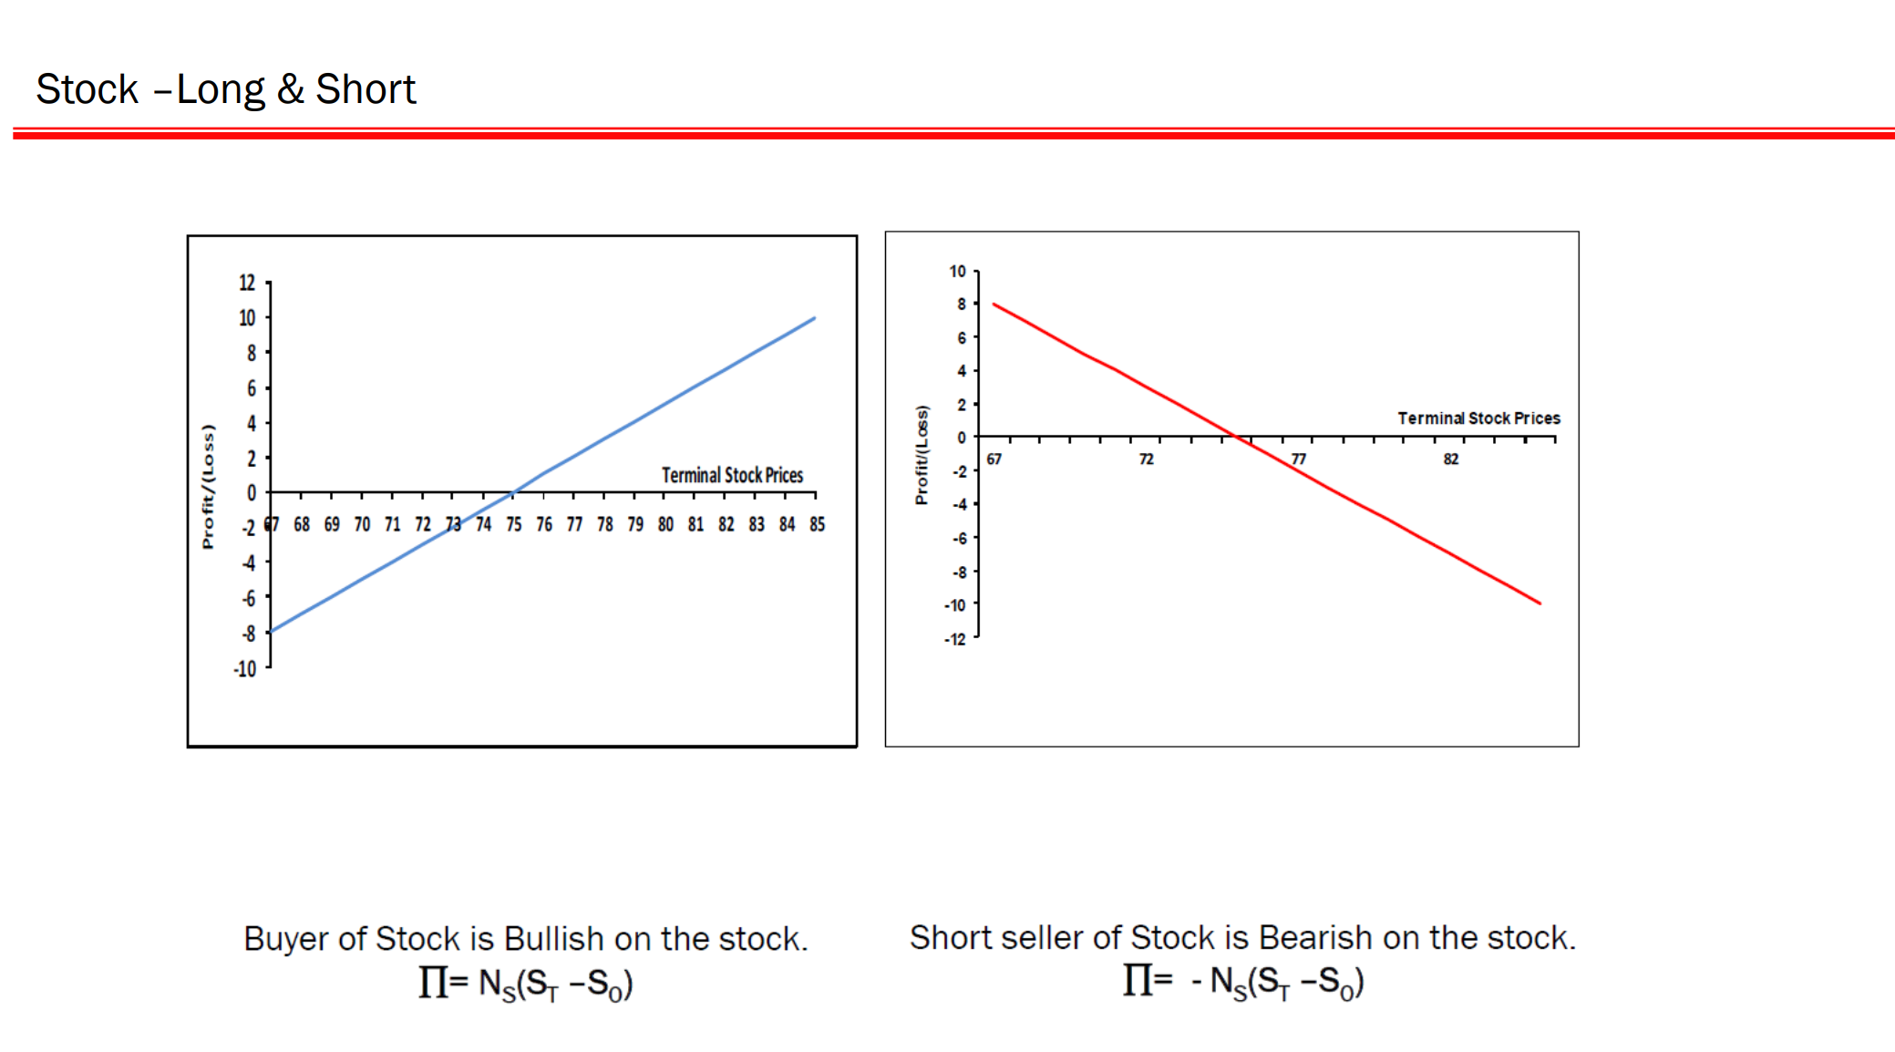

Slide 42
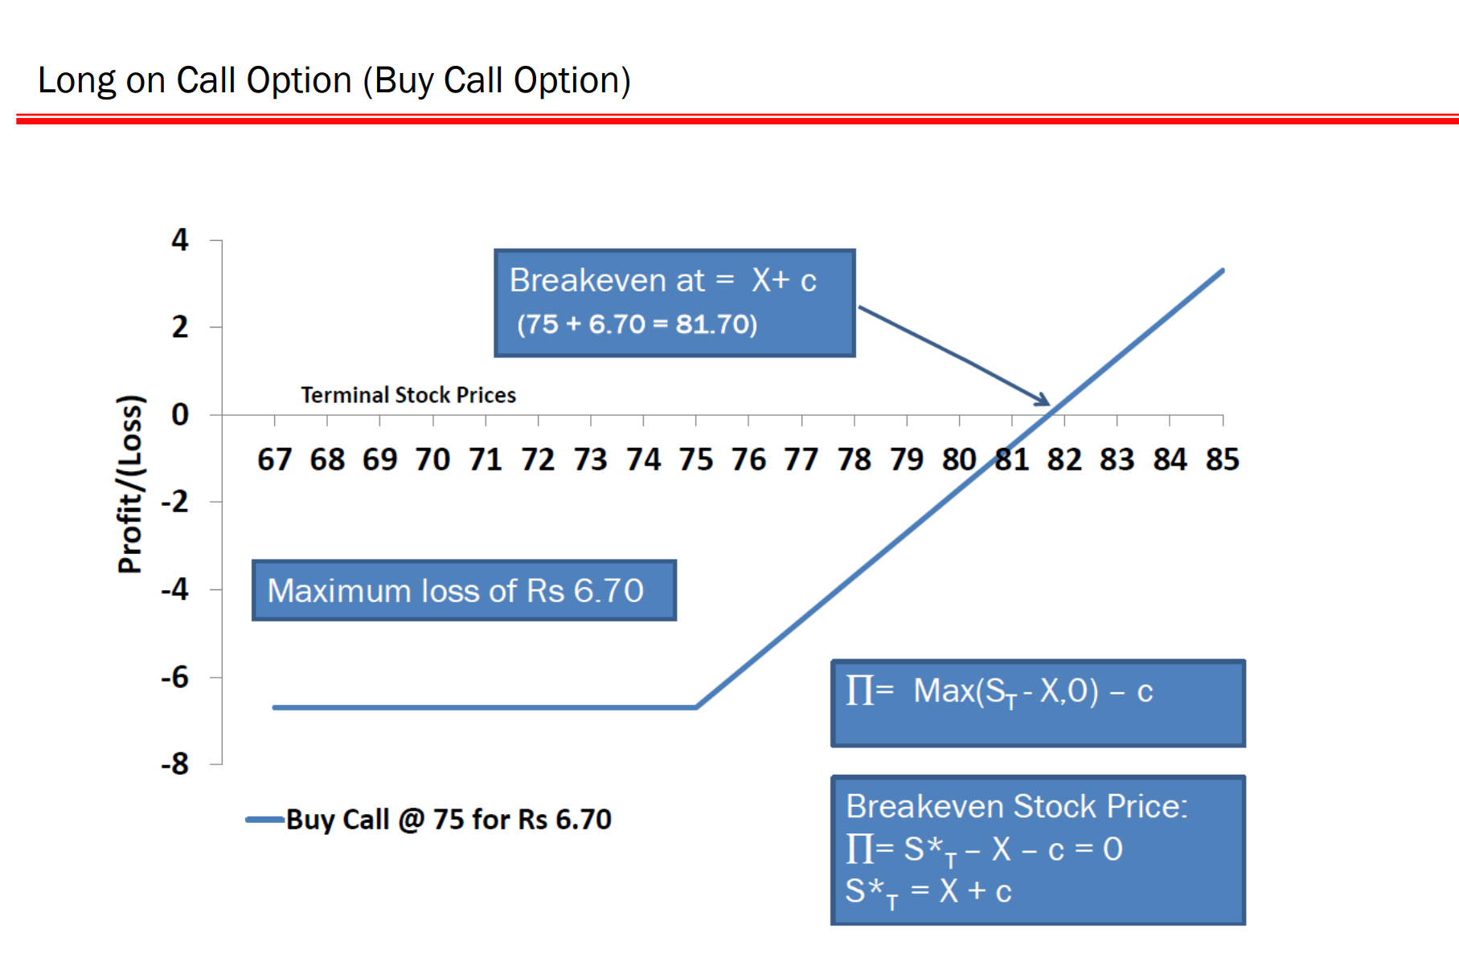
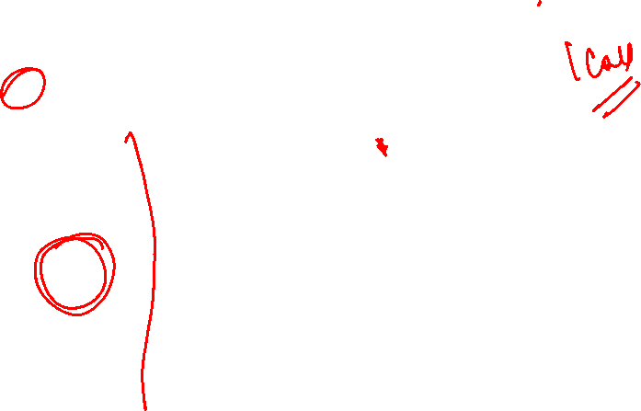

Slide 43
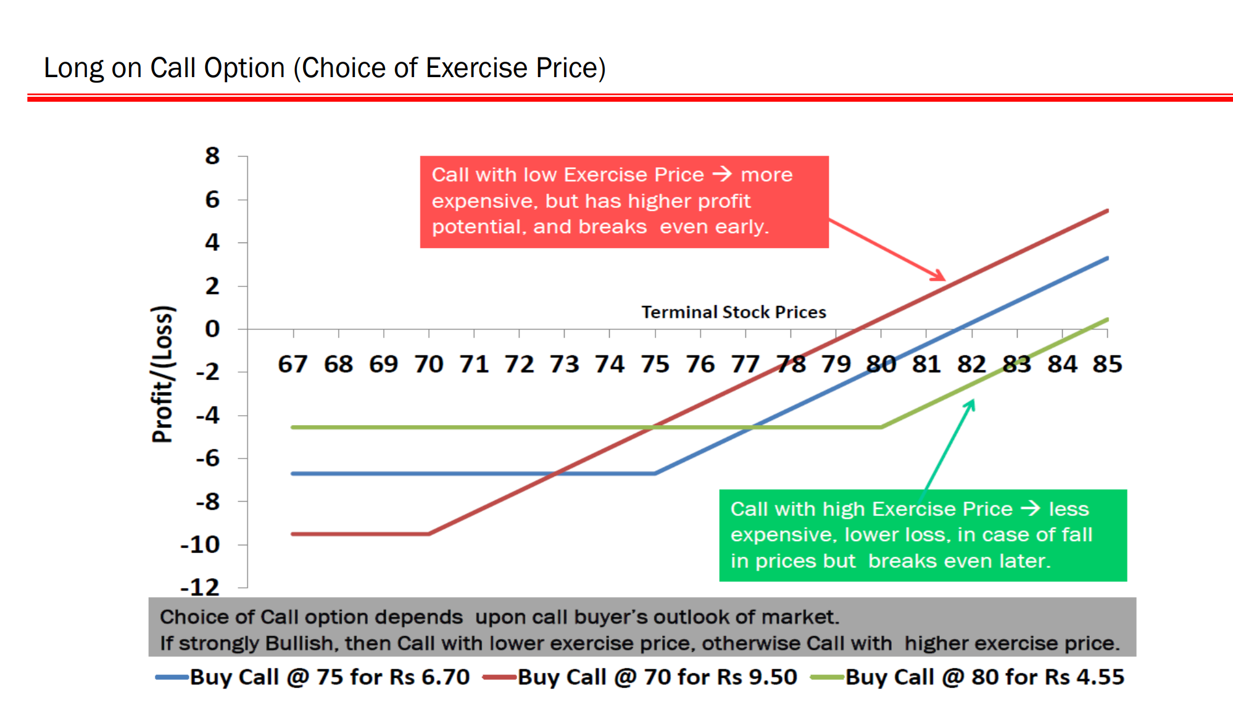


Slide 44
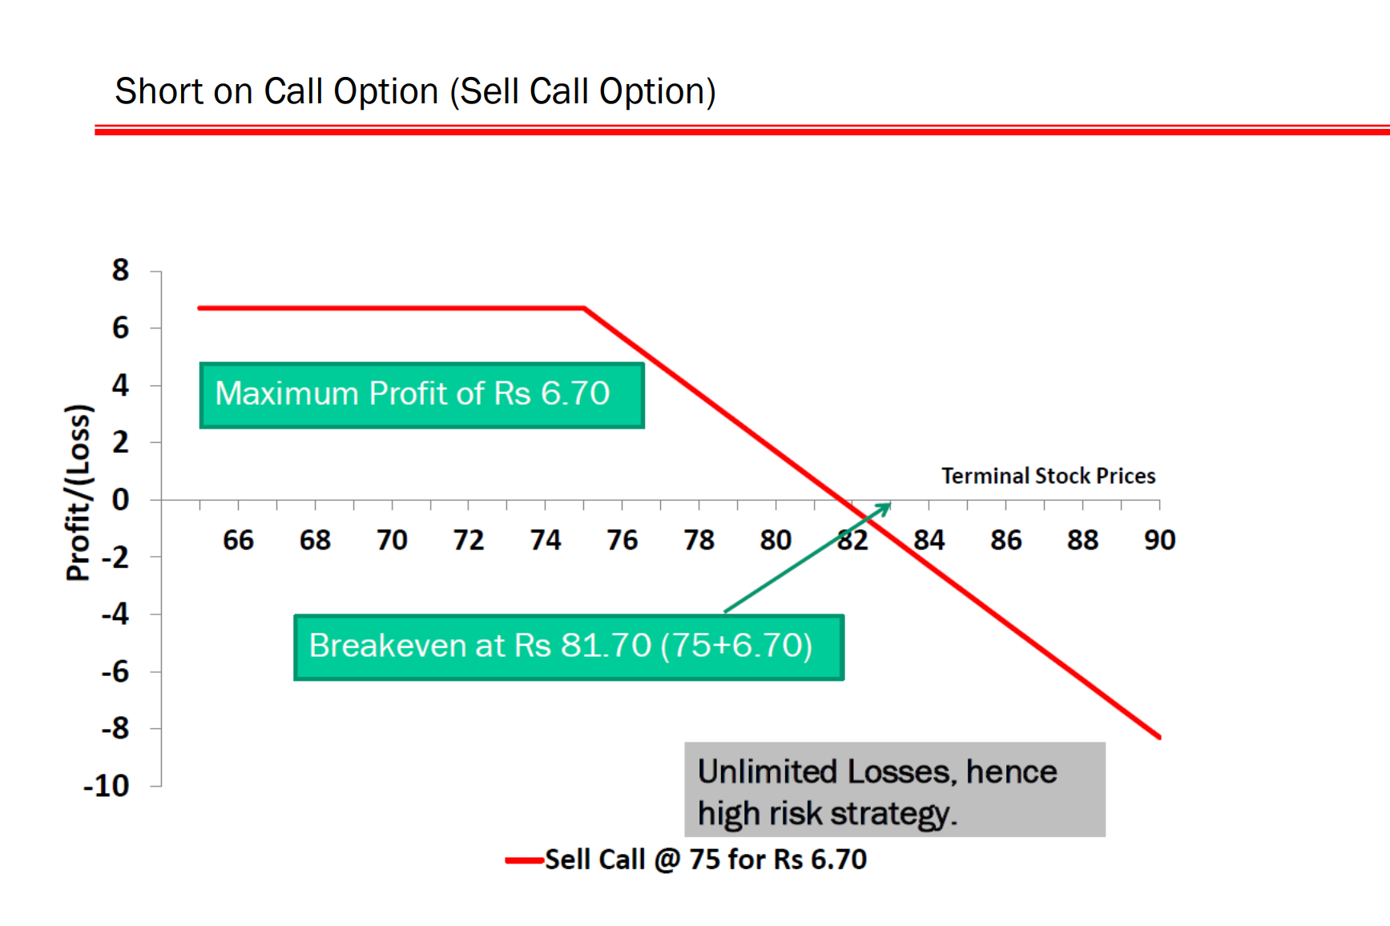
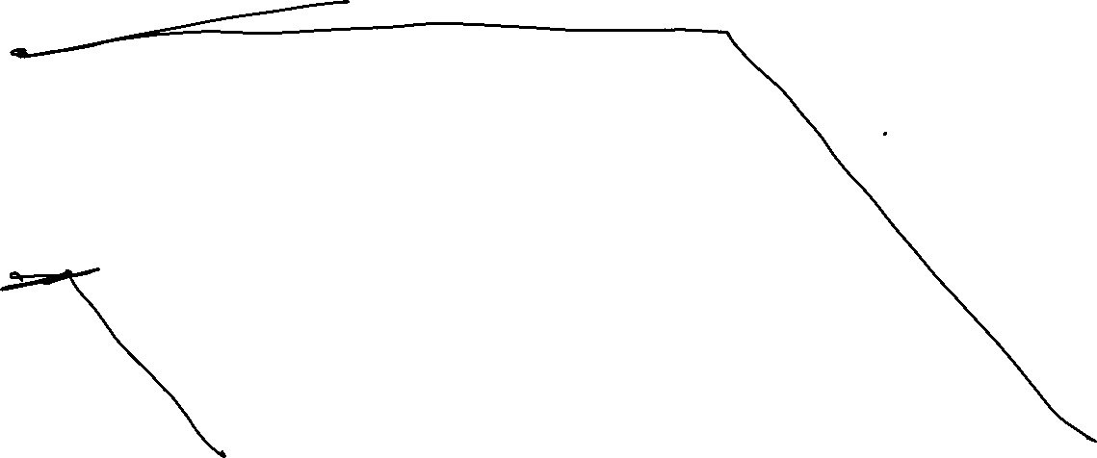

Slide 45
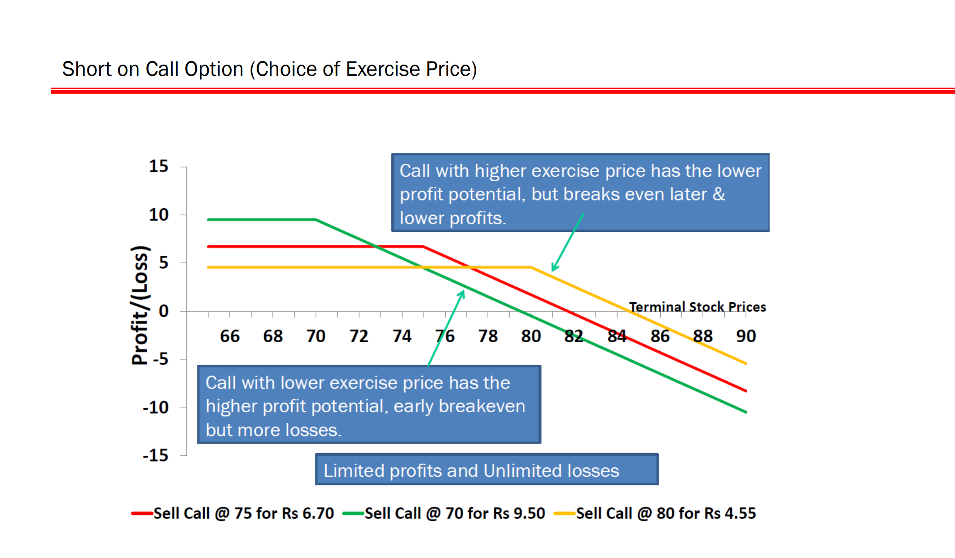


Slide 46
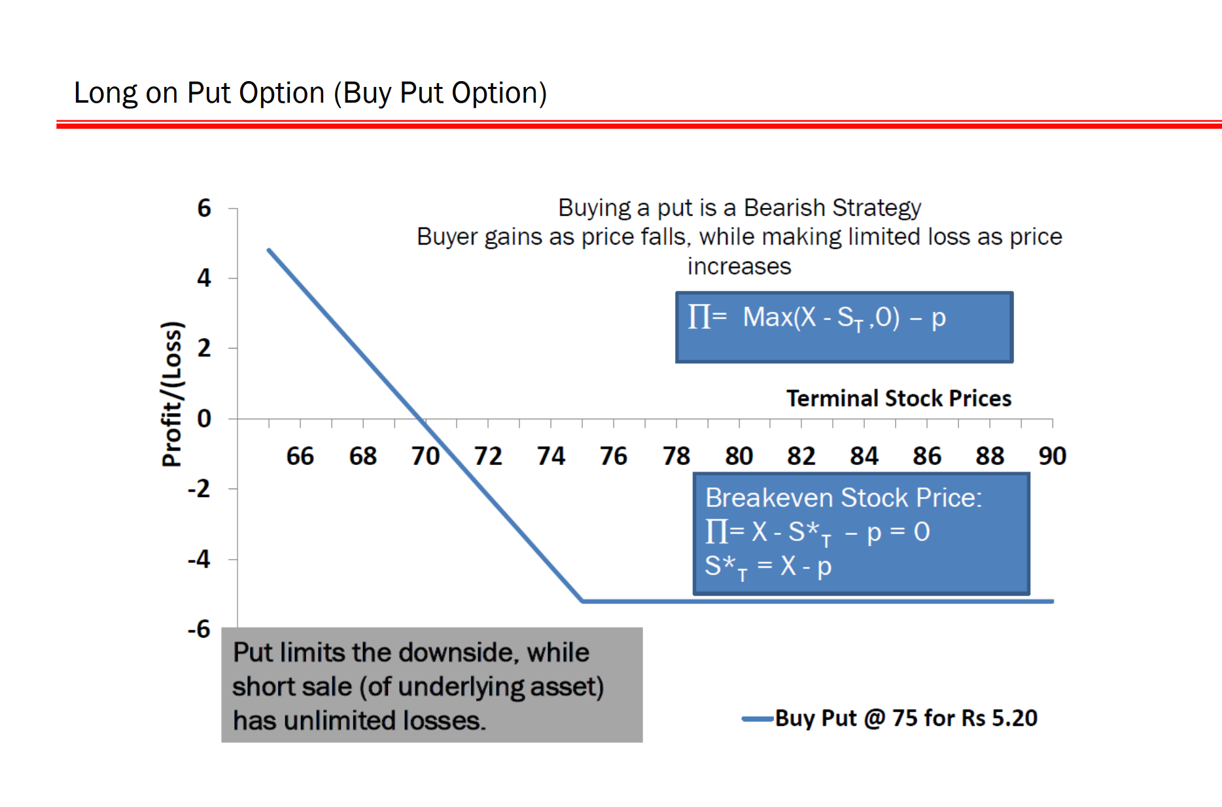
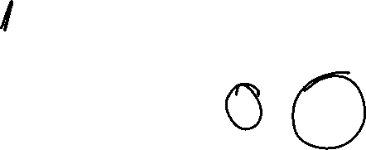

Slide 47
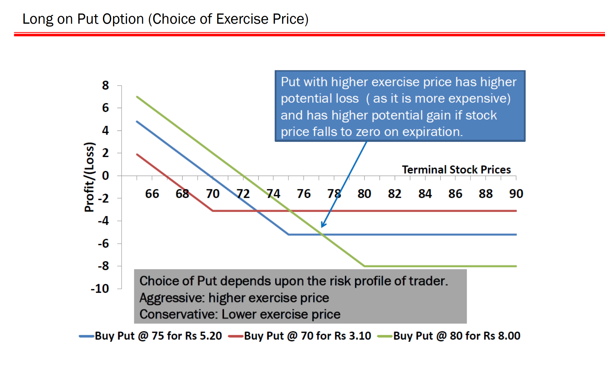


Slide 48
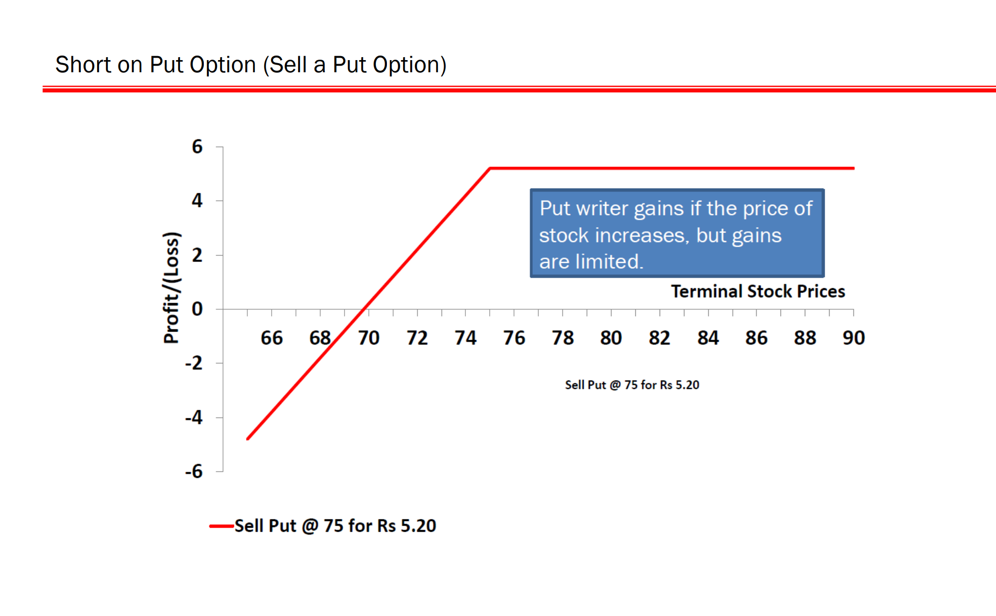

Slide 49
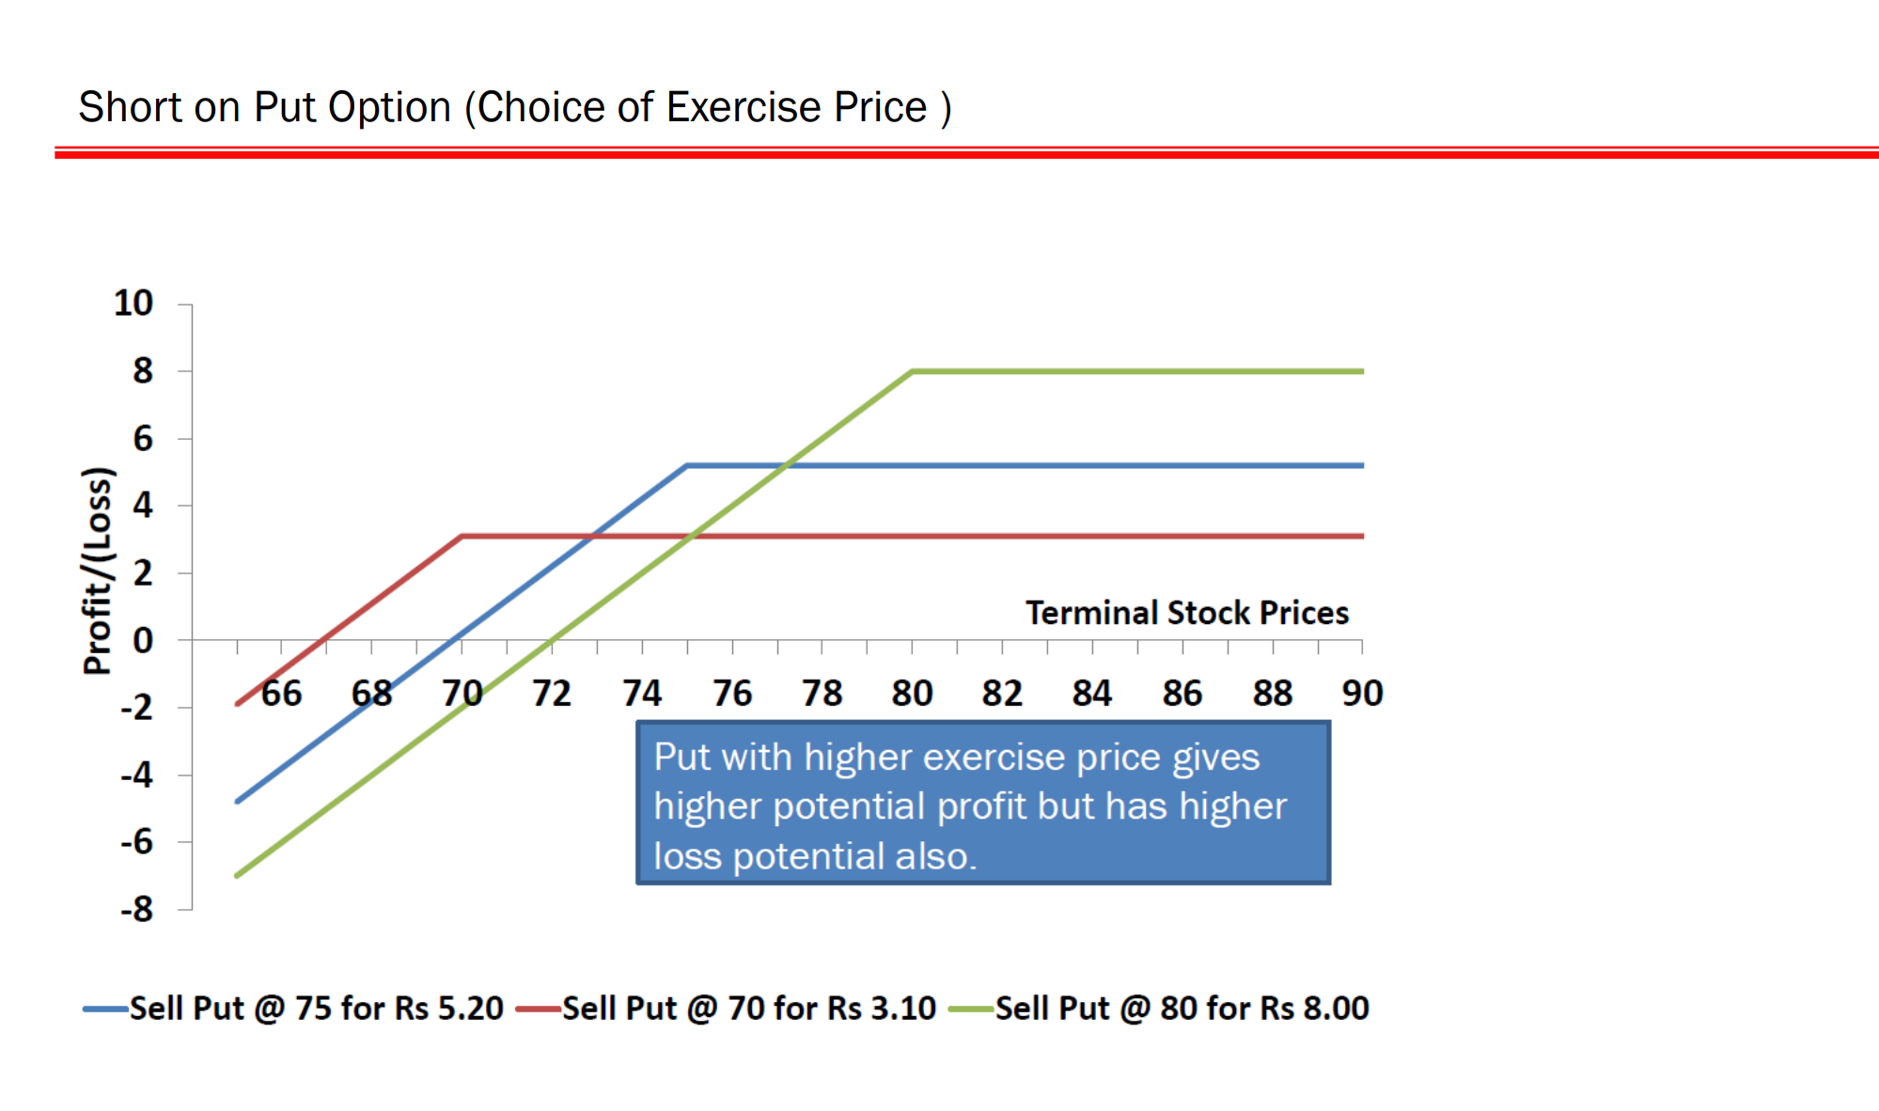

Slide 50
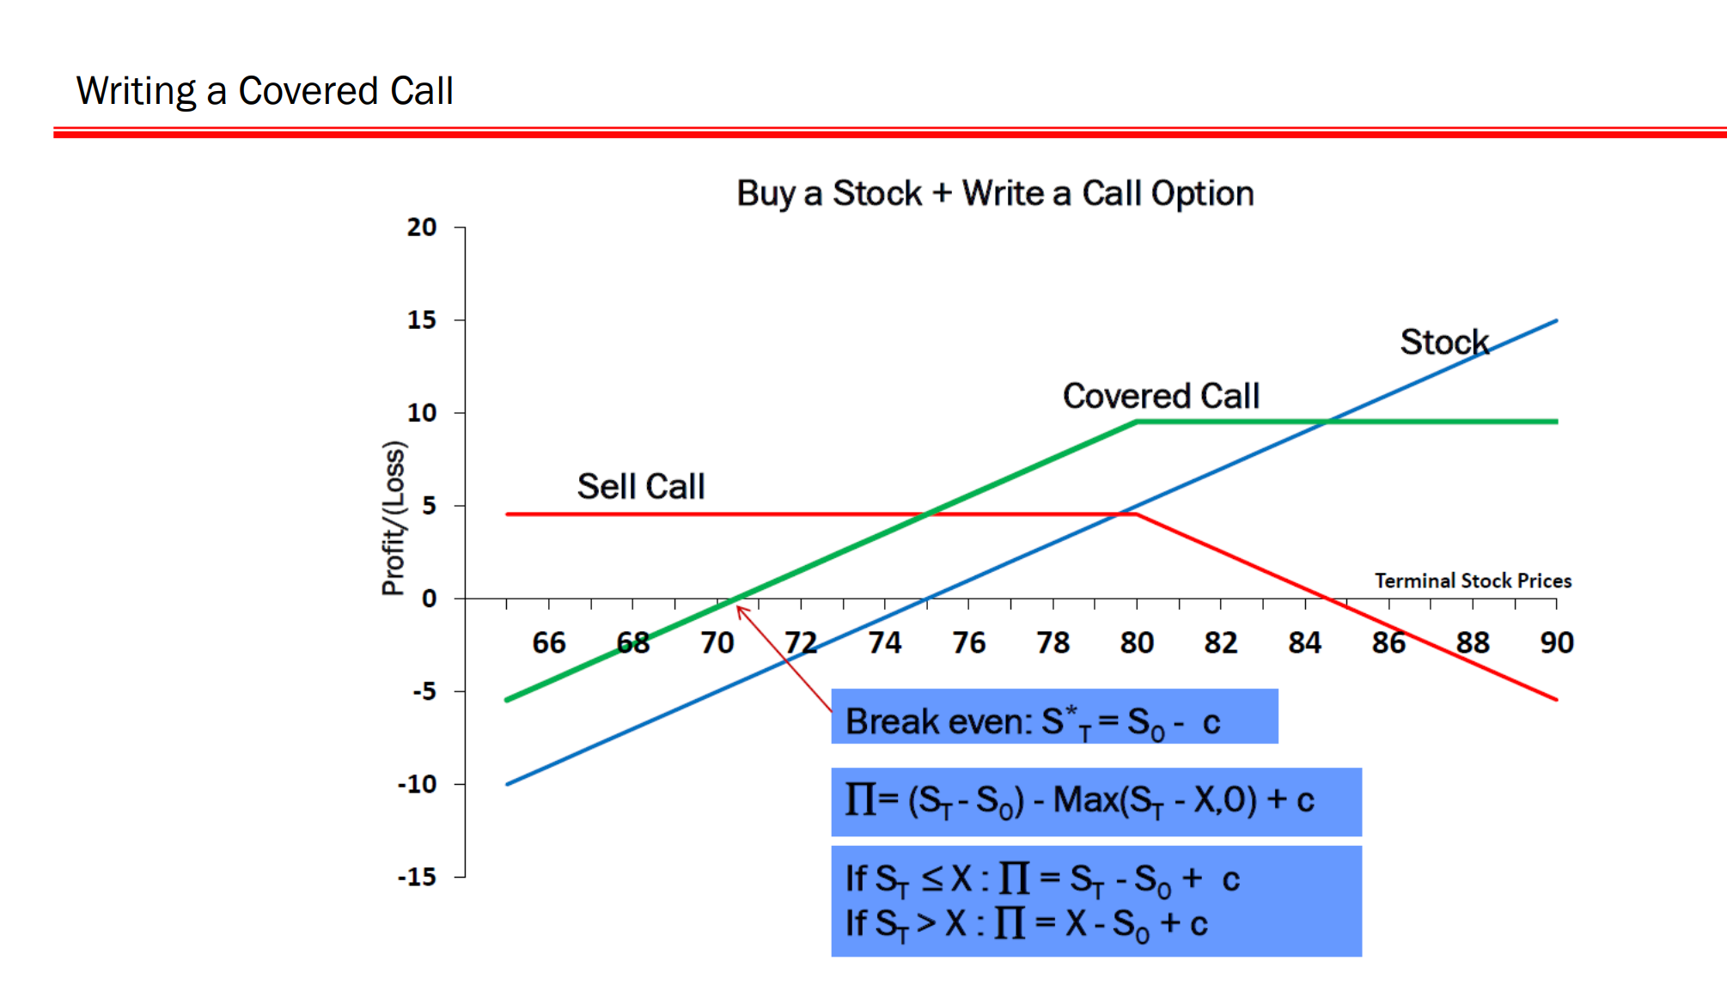
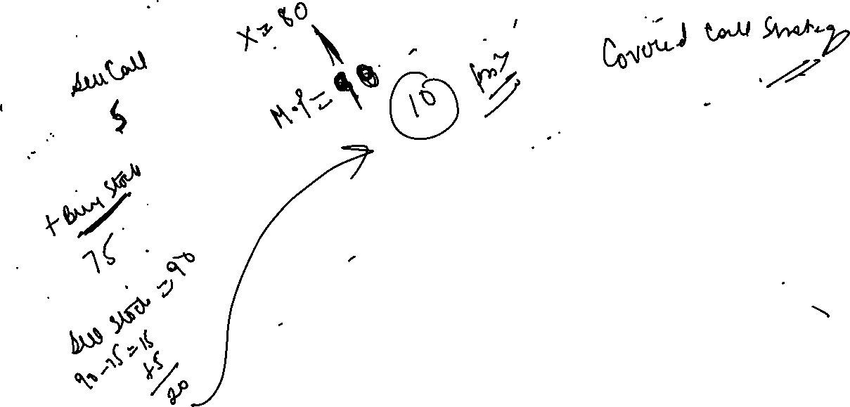


Slide 51


Slide 52


Slide 53


Slide 54


Slide 55


Slide 56

Staddle Strategy
Not sure about movement of stock.
Buy 1 call and 1 put with same exercise price.

Slide 57





Staddle Strategy
Lower ( if price moves down)- 1100- 70 = 1030
If price moves up = 1100+ 70 = 1170

Slide 58

Strangle
Uncertain about future price movement. But want to have minimum cost.

Slide 59

Payoff

Slide 60


A very Good article on derivative trading strategies

Slide 61


Slide 62


Slide 63


Slide 64


Slide 65


Slide 66
Forward Rate Agreements
When an FRA is traded, the buyer is borrowing a specified notional sum at a fixed rate of interest for a specified period which is to commence at an agreed date in the future.
Buyer (or the borrower) would benefit, if the interest rate rises between the date on which FRA is traded and the date on which it comes into effect.
If the interest rate falls, the buyer must pay the difference between the rate at which FRA was traded and the actual rate, as a %age of the notional sum.
The counterparty (the Seller of FRA), being the lender of notional amount, will gain if the interest rate falls.

Slide 67
Forward Rate Agreements
In FRA trading only the payment that arises as a result of the difference in interest rate.
There is no exchange of cash at the time of trade.
The cash payment that does arise is the difference between the Interest rates at which FRA is traded and the actual rate prevailing when FRA is settled, as a percentage of the notional amount.
FRA traded today and which starts 3-months from now and lasts for the next 3-months is refereed to as 3*6
1*4 FRA –is 3-month loan starting 1 month from now.

Slide 68

Forward Rate Agreements

Slide 69













Forward Rate Agreements
It is used for two purposes 1) Hedge 2) Arbitrage

Slide 70









Forward Rate Agreements

Slide 71








Forward Rate Agreements

Slide 72






Forward Rate Agreements

Slide 73



Forward Rate Agreements

Slide 74

CDS

Slide 75
CDS
Most popular Credit Derivative is a Credit Default Swap.
It is a contract that provides insurance to the Protection Buyer, against the risk of default by a borrower company (Reference entity), by the Insurance protection seller.
The Insurance buyer obtains the right to sell the bonds issued by the Reference entity for their face value in case of default (Credit event).
The total face value of the bonds that can be sold is known as the Credit Default Swap’s notional principal.
The buyer of CDS makes periodic payments (usually in arrears every quarter) to the seller until the end of the life of CDS or until the credit event occurs.
The settlement in the event of default involves either physical delivery of bonds or cash payment.

Slide 76

CDS
(Borrower Reference Entity)
Invest in bond
Issues Bond
Pays Periodic premium
Default protection seller
(Lender)
Payment in case of default by Reference Entity

Slide 77
Let’s understand the concept of credit spread…
Normally, it is the difference between the Yield of bonds of the Government of India or sovereign bonds and the Yield on corporate bonds of same maturity.
Basically, credit spread is the difference in yield between two bonds of similar maturity but of different credit quality.
We can have credit spread between AAA bonds and A bond; AAA bond and BBB bonds.

