Slide 1
Operational Excellence
Maximize (20 X + 10Y + 15Z)
s.t.
3X + 2Y + 5Z <= 55 (Capacity 1)
2X + Y+ Z <= 26 (Capacity 2)
X + Y+ 3Z <=30 (Capacity 3)
5X + 2Y + 4Z <= 57 (Capacity 4)
X, Y, Z >= 0
A manufacturing company produces three different types of products, each of the profitabilities and capacities required for producing these three types of products are given beside. Production of partial units are allowed as well.
The top management can increase capacities of the four capacity type (assume same investment costs in per unit increase in capacities), but is restricted in that it can increase capacity for only two capacity types?
Which two capacity it should invest in enhancing?
Which capacity it must not invest in enhancing?

Slide 2


Operational Excellence
Maximize (20 X + 10Y + 15Z)
s.t.
3X + 2Y + 5Z <= 55 (Capacity 1)
2X + Y+ Z <= 26 (Capacity 2)
X + Y+ 3Z <=30 (Capacity 3)
5X + 2Y + 4Z <= 57 (Capacity 4)
X, Y, Z >= 0
Z(optimal) = 268
Shadow price corresponding to a constraint is essentially how much the objective function would improve (deteriorate) given that one puts in (takes away) one additional unit of resource

Slide 3
Facility Location Decisions and Service Facility Layout

Slide 4
Why cities are where they are?

Slide 5
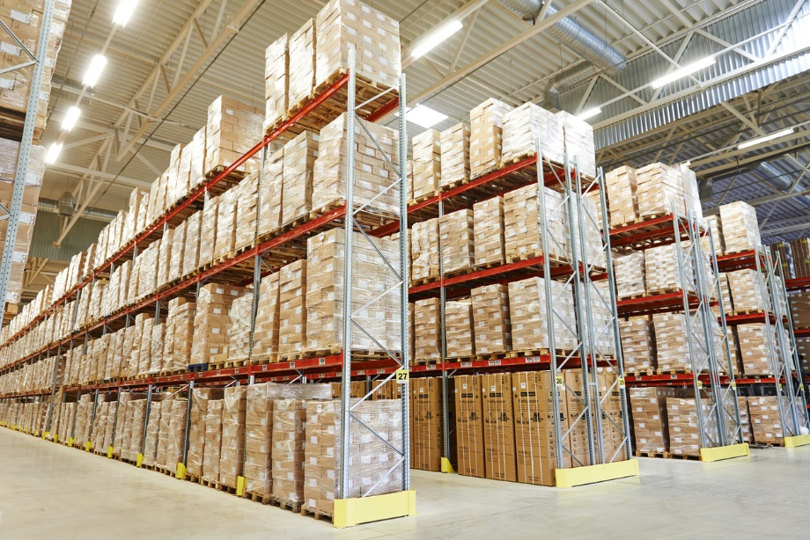
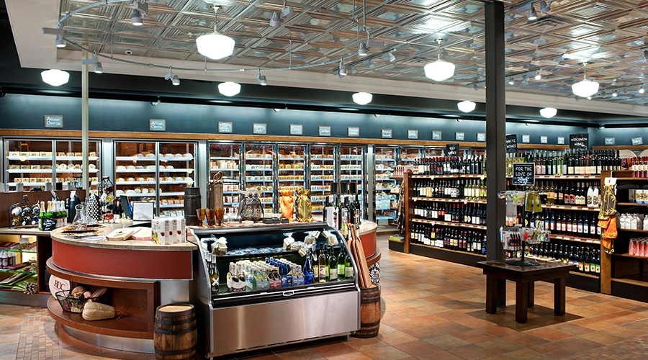
Facility location criterions
Private sector location criteria
Warehouse/distribution center
Retail store
Nature of service delivery?
Cost minimization approach
Revenue maximization approach

Slide 6
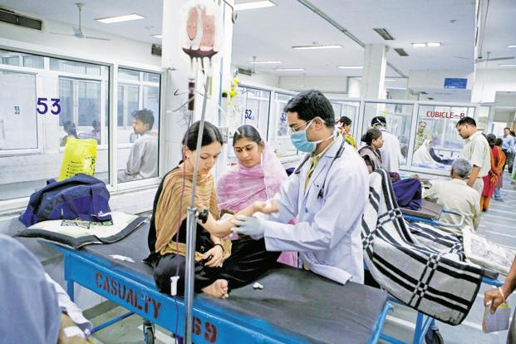
Public sector criteria
Maximization of societal benefits
PHC (public healthcare service)
Average distance travelled by service seekers
Maximal service distance

Slide 7
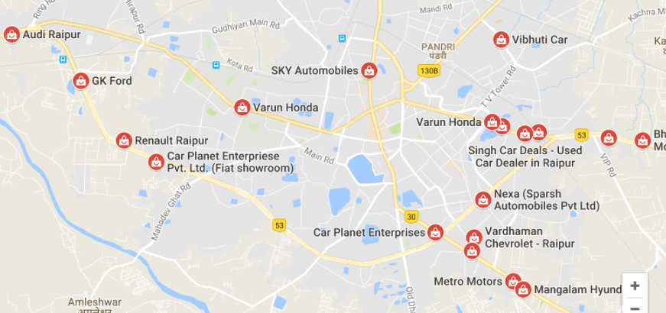
Some key strategies in Facility Location Decisions
Competitive Clustering
When shopping for items such as automobiles, customer like to make comparisons for convenience seek out the area where dealers are concentrated

Slide 8
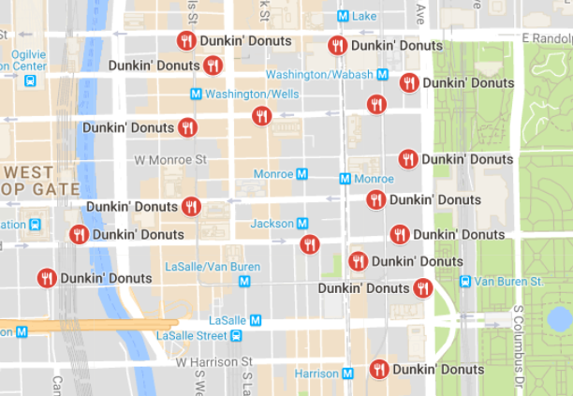
Saturation marketing
Idea is to group outlets of the same firm tightly in urban and high-traffic area such that advantages arising out of reduced advertisement, easier supervision, and customer awareness can overwhelm the competition

Slide 9
Key variables for service facility location decisions
Hotel location
Competitive factors: a) Price per night; b) Room types; c) Hotels within vicinity
Demand generators : a) Office spaces near by; b) Vicinity of airports/railways station; c) Annual tourists; d) Shopping mall square footage; e) Retail activity near; f) Traffic count; g)
Area demographics : a) Average family incomes; d) Residential population
Market awareness: a) Urban population per hotel; b) Years/months since hotel is operating
Physical attributes: a) Accessibility; b) Sign visibility; c) Nearness to ,major highway/roads

Slide 10
Locational decisions in overnight shipping
(How overnight shipping works)

Slide 11
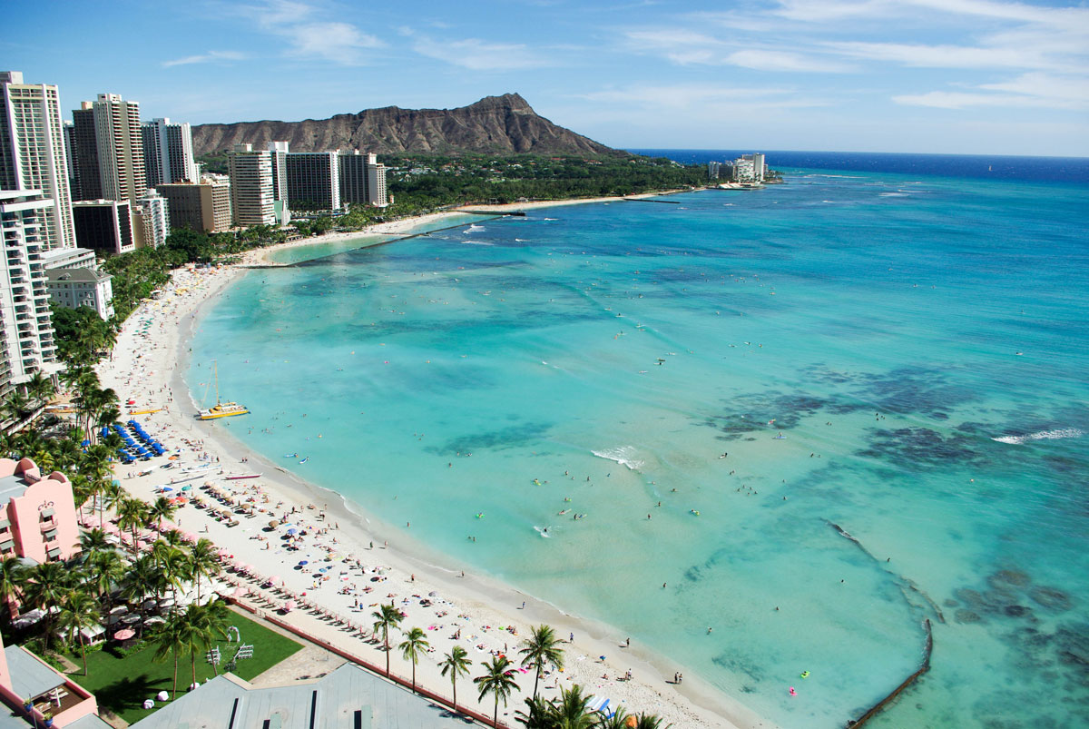
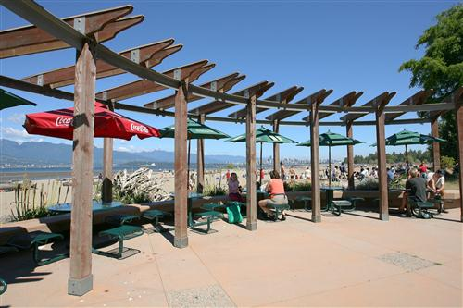
Service facility along a line
No. of Bathers on beach on a given day on a given site | Distance from marked off point (meters)
35 | 120
(2) 35 | 250
(3) 20 | 365
(4) 15 | 470
(5) 10 | 595
(6) 50 | 725
(7) 35 | 850
(8) 15 | 1000
Waikiki beach @Hawaii
Beach concession stand

Slide 12
Public facility location
Services such as “delivery of public healthcare” is delivered through CHCs (community health centers) particularly in rural area.
Government puts a cap on the distance that customers would have to travel to nearest CHC.
Maximal service distance
Minimum number and location of facilities that would serve the demand within maximal service distance

Slide 13
Service Facility

Slide 14
Serviceascape
Ambient conditions
Servicescape
Space/functions
Sign, symbols, & artifacts
Servicescape describes the physical surroundings of the service system. As soon as the customer enters the service system, he/she perceives the physical surroundings that lead to cognitive, emotional, and physiological responses in them thus affecting customer’s behavior.

Slide 15
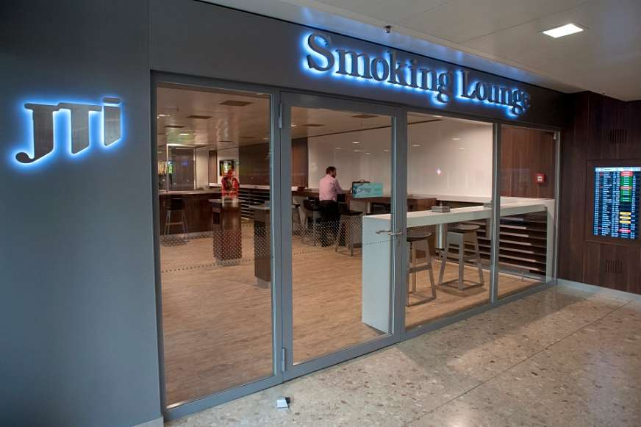
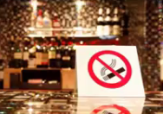
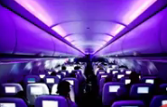
Ambient conditions – Quality of air
Separate smoking zones at airports
Separate smoking areas in some restaurants
Bouts of humid air is pumped to fly at high altitude in cabin

Slide 16

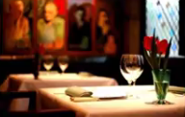
Ambient conditions – Sound and Music
Some hospitals play soft and soothing music, and spiritual chants to foster calmness and wellness of patients
Jazz music is played in five-star restaurants for add to the service experience of fine dining

Slide 17
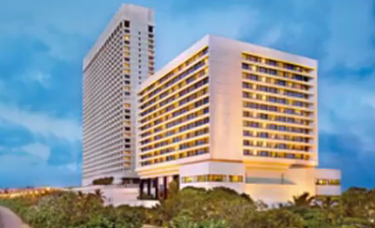
Ambient conditions – Smell and fragrance
At Oberoi hotel in Mumbai, diffusers at placed in common area to set-off a specific Madurai jasmine.
Sense of luxury

Slide 18
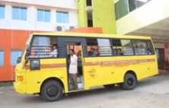
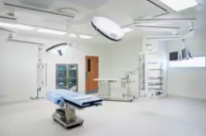
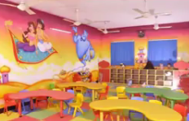
Ambient conditions – Color
Compared to other colors, yellow catches the attention the most
White color is usually associated with purity, calmness, and cleanliness
Playschools are made colorful and attractive to make ambience more lively

Slide 19
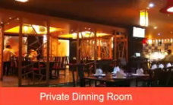
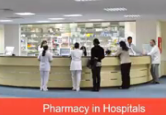
Space/functions – Layout design
Restaurant China gate has a private dining area for larger families to avoid inconvenience to other guests
Pharmacies at many hospitals are placed on ground floor for easier access to patients and their relatives

Slide 20
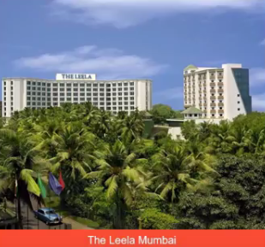
Space/functions – Exterior facilities
The Leela Mumbai hotel near international airport is an island of green.
Exterior of hotels include 11 acres of gardens and waterfalls

Slide 21


Sign, symbols, & artifacts
Symbols for safety measures such in airlines
Anti ragging directives on notice on boards

Slide 22
Different type of services which impact Servicescape
Banks/Hospitals
Facilitate interaction between service providers and customer
Interpersonal Service
(Customer-Employees)
Types of service
Self-service
(only Customer present in service system)
ATMs/Vending machine
Servicescape should be to guide customer effectively.

Slide 23
Innovations at McDonalds in US
Indoor seating – 1950s
Drive through window – 1970s
Adding breakfast to the menu – 1980s
Adding play areas for children – Late 1980s
Self service kiosk – 2004
4 out of 5 innovations pertains to layout

Slide 24
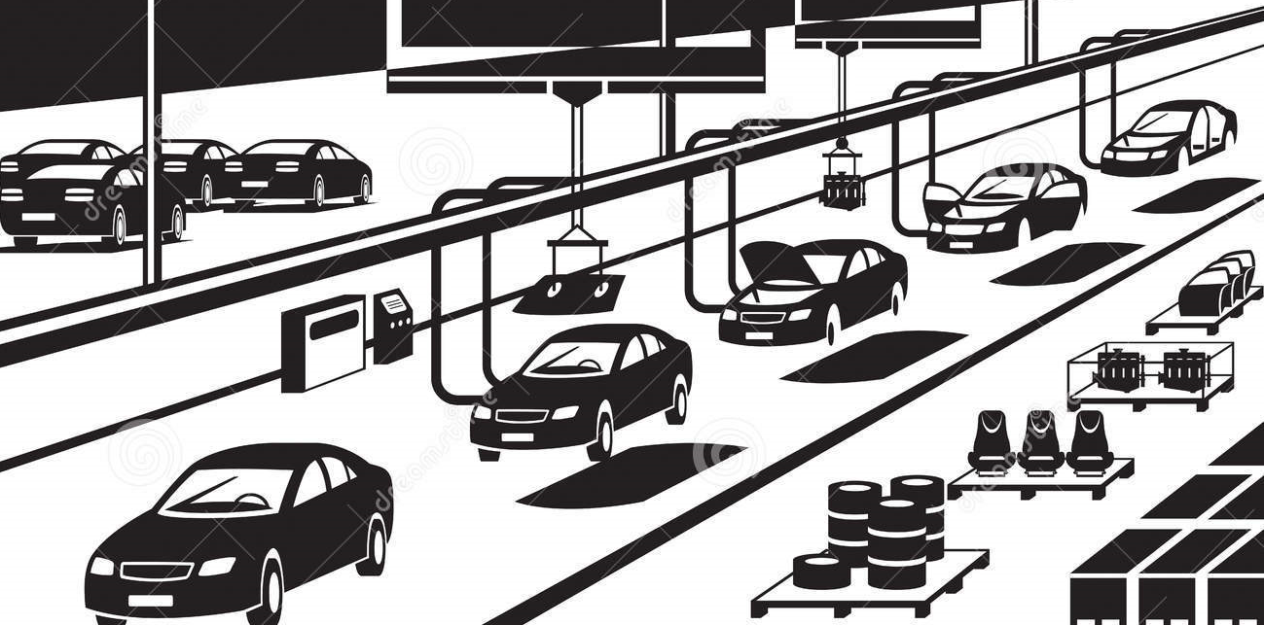
Service Facility Layout
Product layout
Chassis
drop
Engine
mounting
Cab mounting
……………........
……………………
Type fitment
Vehicle rollout
Why product layout ??
Volume and variety

Slide 25

Adopting product layout in service
Standard service to a large number of customers
A Typical Cafeteria’s layout (1 hour time window for lunch)
Serve drinks
Serve starters & soup
Serve Main course
Serve dessert
20 seconds
30 seconds
40 seconds
15 seconds
Customer as Input to the system
Is it a efficient service layout?
Can it be improved in any manner from a both service provider’s perspective and customer’s perspective?

Slide 26
What should be the ideal layout??
Serve drinks
Serve starters & soup
Serve Main course
Serve dessert
26.25 sec
26.25 sec
26.25 sec
26.25 sec
Ideal service process capacity=
137.14
Service labor utilization =
100%
Customer served per worker =
34.28
Labor utilization = (Total labor content) / {Process cycle time) x (No. of workers) }

Slide 27
120 customers/hour
240 customers/hour
Serve drinks
Serve starters & soup
Serve Main course
Serve dessert
20 seconds
30 seconds
40 seconds
15 seconds
180 customers/hour
90 customers/hour
Bottleneck elimination/ Minimization
Service process capacity=
90 customers
Service labor utilization =
65.63%
Customer served per worker =
22.5
Labor utilization = (Total labor content) / {Process cycle time) x (No. of workers) }
Notes:
Process cycle time is 40 seconds. Every 40 second a product is being rolled out

Slide 28
Bottleneck elimination/ Minimization
Serve drinks
Serve starters & soup
Serve Main course
Serve dessert
20 seconds
30 seconds
20 seconds
15 seconds
Service process capacity=
120 customers
Service labor utilization =
70 %
Cost vs. capacity trade-off
Customer served per worker =
24
Labor utilization = (Total labor content) / {Process cycle time) x (No. of workers) }

Slide 29
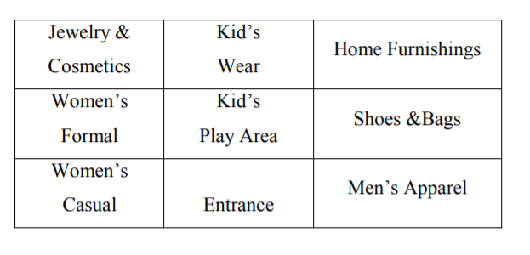
Process layout in service
Typical layout of a retail shop

Slide 30
Optimal layout
Process layout
Aggregate Flow Matrix
A
B
C
 | A | B | C | D | E | F
A | - | 150 | 300 | 0 | 150 | 60
B |  | - | 120 | 400 | 100 | 80
C |  |  | - | 200 | 80 | 80
D |  |  |  | - | 300 | 60
E |  |  |  |  | - | 100
F |  |  |  |  |  | -
D
E
F
Classroom building - A
Library building - B
Study hall - C
Concert hall - D
Student services - E
Administration - F

Slide 31
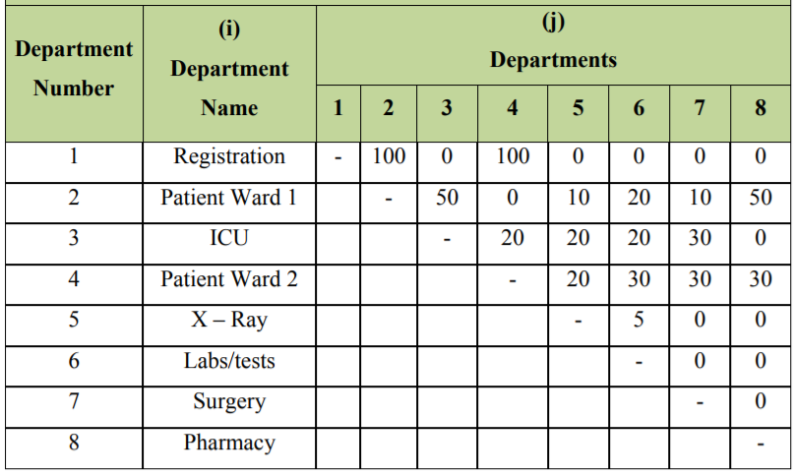
Registration
ICU
X-ray
Considering upto 5 iterations what best layout can be achieved?
Lab tests
Pharmacy
Patient ward 1
Surgery
Patient ward 2

Slide 32
Retailing
Retail store layout
Typical objective is to maximize the net profit per square of display space
Video - Super market psychology and layout
Some take-aways
Movement is in sync with driving pattern
Essentials kept far in the store and along the periphery
Eye level is buy-level
End cap display
Serviceascape related

Slide 33
Service Design Factors
Objectives of service
Nature of core service drives the parameters of service design.
i. Emergency ward of any hospital must be free from traffic and easy to approach.
ii. A petrol pump station can be painted in bright color such that customers can see them from a distance.
b) Space requirement based on location of service site
Cost considerations (Rural vs. urban)
Service organizations in Urban area undertakes vertical expansion.

Slide 34
c) Security
Protecting assets.
Proper security arrangement should be incorporated while designing facilities such that losses to product and human lives can be minimized.
i. Installation of surveillance cameras and related control systems.
ii. Biometric devises to detect the identity of passengers used in immigration section at airports.

Slide 35
d) Flexibility
Service facility design must be adaptable to changing customer requirements.
Ability to introduce new equipment or automated systems etc. must be capture during designing service facilities.
i. Provision for further expansion

