Slide 1
Operational Excellence
Productivity vs. Efficiency
 | Plant A | Plant B
8-hour shift | 200 | 250
Capacity | 250 | 400
Which plant is more productive?
Which plant is more efficient?

Slide 2
Operational Excellence
If Bob sells $10,000 worth of insurance during the month while Joe sells $9,000, who is more productive?
If Bob sells $10,000 worth of insurance during the month (and incurs traveling expense of $3000), while Joe sells $9,000 (incurs $100 of phone expense) who is more efficient?

Slide 3
Operational Excellence
A furniture dealer deals in only two items–tables and chairs. He has Rs 50,000 to invest and has storage space of at most 60 pieces. A table costs Rs 2500 and a chair Rs 500. He estimates that from the sale of one table, he can make a profit of Rs 250 and that from the sale of one chair a profit of Rs 75. He wants to know how many tables and chairs he should buy from the available money so as to maximise his total profit, assuming that he can sell all the items which he buys.

Slide 4
Operational Excellence
The liquid portion of a diet is to provide at least 300 calories, 36 units of vitamin A, and 90 units of vitamin C daily. A cup of dietary drink X provides 60 calories, 12 units of vitamin A, and 10 units of vitamin C. A cup of dietary drink Y provides 60 calories, 6 units of vitamin A, and 30 units of vitamin C. Now, suppose that dietary drink X costs $0.12 per cup and drink Y costs $0.15 per cup. How many cups of each drink should be consumed each day to minimize the cost and still meet the stated daily requirements

Slide 5
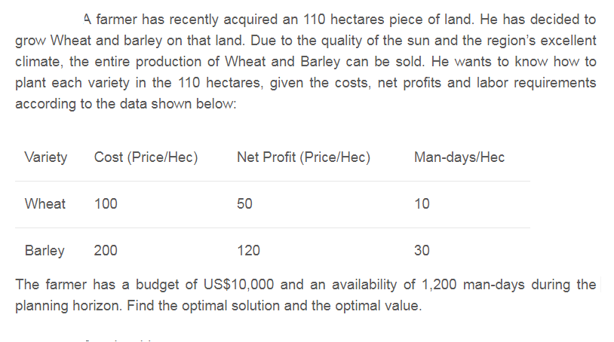
Operational Excellence

Slide 6

Operational Excellence
The Two Mines Company own two different mines that produce an ore which, after being crushed, is graded into three classes: high, medium and low-grade. The company has contracted to provide a smelting plant with 12 tons of high-grade, 8 tons of medium-grade and 24 tons of low-grade ore per week. The two mines have different operating characteristics as detailed below.
How many days per week should each mine be operated to fulfil the smelting plant contract?

Slide 7
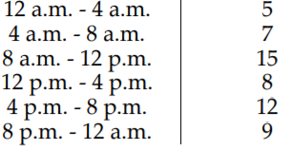
Operational Excellence
Scheduling Nurses in individual shifts
Contract requires the employees to work 8 consecutive hours
Give your recommended plan
Minimum strength needed
Shifts

