Slide 1





Operations Management with Six Sigma
Dr. Gopal Kumar
gopalkumar@iimraipur.ac.in
IIM Raipur
08 February 2020

Slide 2
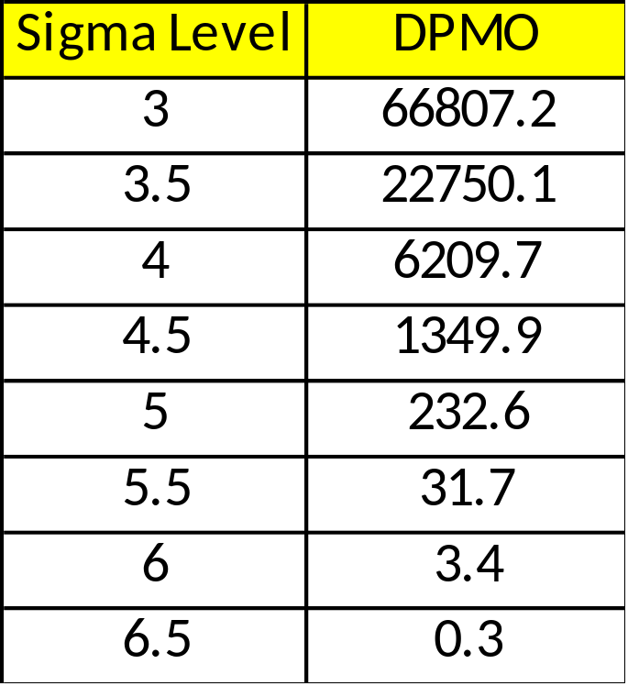




Quality Measurements
Customer Focus
Defects per million opportunities (DPMO)
$$≈10 fold improvement$$
$$≈28 fold improvement$$
$$≈70 fold improvement$$
It is generally easy to move from 2 or 3 sigma level
to 4 sigma level, but moving beyond that requires
much more effort
Notes:
Essentially, they are the “hows” by which the company will respond to the “whats”—the customer requirements that will determine customer satisfaction or delight, often called critical to quality characteristics (CTQs).

Slide 3
Quality Measurements
Customer Focus
Defects per million opportunities (DPMO)
In manufacturing, fault is called defect, i.e., defect per
million opportunity (DPMO)
In service, fault is called error, i.e., error per million
opportunity (EPMO)
Notes:
Essentially, they are the “hows” by which the company will respond to the “whats”—the customer requirements that will determine customer satisfaction or delight, often called critical to quality characteristics (CTQs).

Slide 4
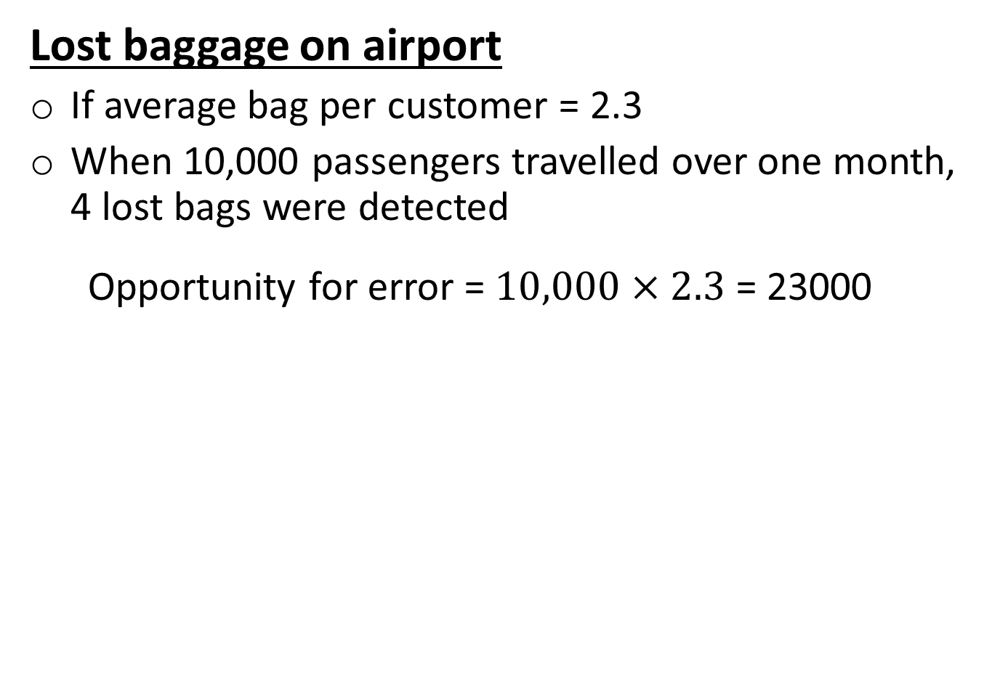
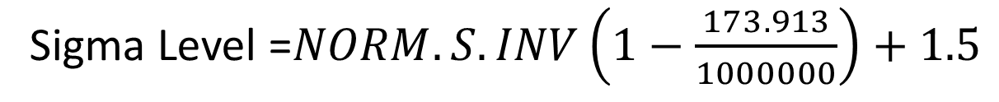

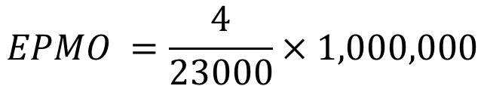
Error per million opportunities (EPMO)
Customer Focus
Lost baggage on airport
If average bag per customer = 2.3
When 10,000 passengers travelled over one month, 4 lost bags were detected
Opportunity for error = $10,000×2.3$ = 23000
$$EPMO =\frac{4}{23000}×1,000,000$$
$$=173.913$$
Sigma Level =$NORM.S.INV\left(1−\frac{173.913}{1000000}\right)+1.5$
= 5.0768
Baggage handling system on the airport is operating at
more than 5 sigma level
Notes:
Essentially, they are the “hows” by which the company will respond to the “whats”—the customer requirements that will determine customer satisfaction or delight, often called critical to quality characteristics (CTQs).

Slide 5
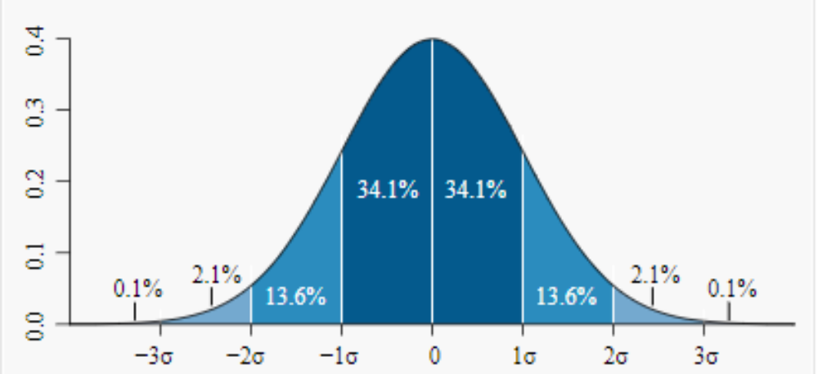

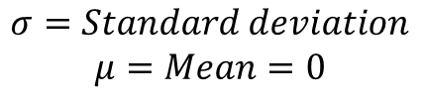


Normal Distribution
7 Quality Tools
$$σ=Standard deviation$$
$$μ=Mean=0$$
.
Area under
the curve is
probability
$$±1σ$$
(68%)
$$±2σ$$
(95%)
$$±3σ$$
(99.7%)
68% of the population will lie within 1 standard deviation, 1σ, of the mean
95% of the population will lie within 2 standard deviations, 2σ, of the mean
99.7% of the population will lie within 3 standard deviations, 3σ, of the mean

Slide 6
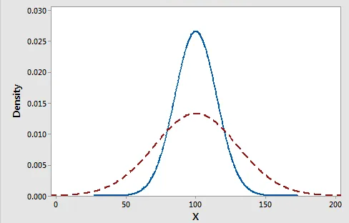
Normal Distribution
7 Quality Tools
.

Slide 7
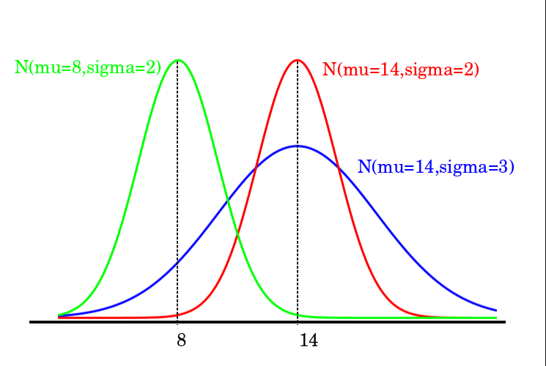
Normal Distribution
7 Quality Tools
.

Slide 8
Seven Quality Tools
7 Quality Tools
Tools for Generating Ideas
  Check Sheet
  Scatter Diagram
  Cause-and-Effect Diagram
Tools to Organize the Data
  Pareto Chart
  Flowchart (Process Diagram)
Tools for Identifying Problems
  Histogram
  Statistical Process Control Chart

Slide 9
Check Sheet
7 Quality Tools
  Check Sheet: An organized method of recording data/defects
//
2
////
4
////
5
////
//
7

Slide 10
Check Sheet
7 Quality Tools
  Inspecting smartphone
    A: Defect in camera
    B: Defect in display
    C: Defect in audio system
Hour
Defect 1 2 3 4 5 6 7 8
A
B
C
/
/
/
/
/
/
/
/
/
/
/
/
/
/
/
/
/
/
/
/
/
/
/
/
/
/
/
/
/
/

Slide 11
Scatter Diagram
7 Quality Tools
  Scatter Diagram: A graph of the value of one variable vs. another variable
If data points form a tight band, the two variables are closely related.
If data points are scattered, the items are unrelated.
Absenteeism vs. Productivity
Productivity
Absenteeism
Absenteeism and productivity are inversely related .

Slide 12
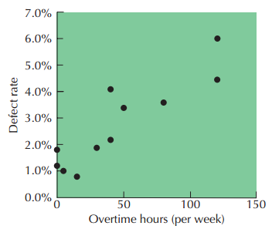
Scatter Diagram
7 Quality Tools
  .
Defect rate vs. overtime hours
Defect rate and overtime hours are positively related.

Slide 13
Cause-and-Effect Diagram
7 Quality Tools
  .
Causes of any
problem are 4 Ms:
Man
Method
Material
Machine
Cause
Effect
Materials
Methods
Manpower
Machinery
Ishikawa diagram or fish-bone diagram

Slide 14
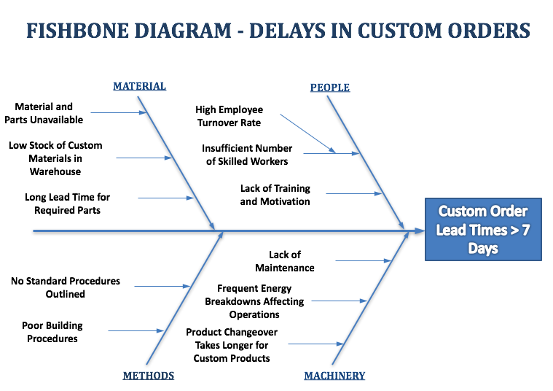
Cause-and-Effect Diagram
7 Quality Tools
Causes: 4 Ms
Ishikawa diagram or fish-bone diagram

Slide 15
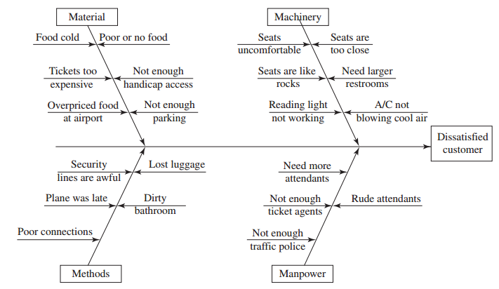
Cause-and-Effect Diagram
7 Quality Tools
  Problem: Dissatisfied airline customer
Causes: 4 Ms
Ishikawa diagram or fish-bone diagram

Slide 16
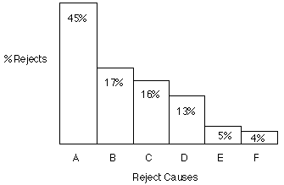
Pareto Chart
7 Quality Tools
  80% of the problems come from 20% of the causes (machines, raw materials, operators etc.)
General use, to decide where to apply initial
effort for maximum effect.
Pareto charts are
a method of
organizing errors,
problems, or
defects to help
focus on problem
solving efforts.

Slide 17
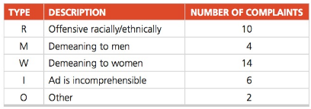
Pareto Chart
7 Quality Tools
  An avant-garde clothing manufacturer runs a series of high-profile, risqué ads on a billboard on Highway 101 and regularly collects protest calls from people who are offended by them. The company has no idea how many people in total see the ads, but it has been collecting statistics on the number of phone calls from irate viewers:
  a) Depict this data with a Pareto chart. Also depict the cumulative complaint line.
  b) What percent of the total complaints can be attributed to the most prevalent complaint?

Slide 18
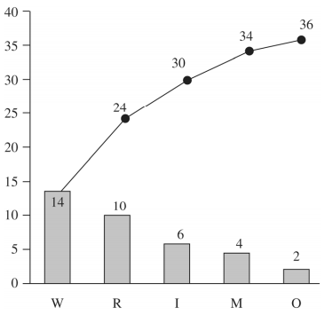
Pareto Chart
7 Quality Tools
  .

Slide 19
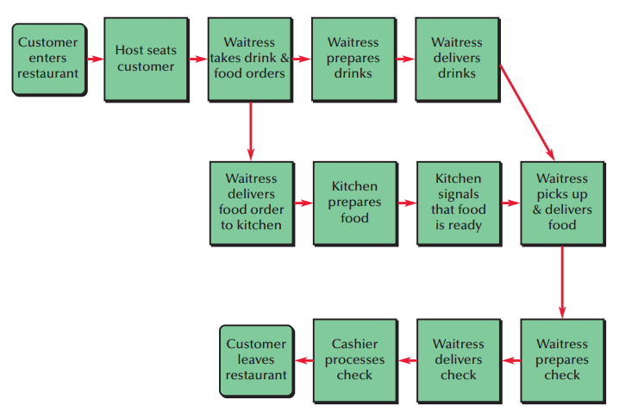
Flowchart
7 Quality Tools
  Flowchart (Process Diagram): A chart that describes the steps in a process

Slide 20
Histogram
7 Quality Tools
  Histogram: A distribution showing the frequency of occurrences of a variable
Distribution
22
18
18
Frequency
11
11
7
7
3
3
5
10
15
20
25
30
35
40
45
50
Repair time (minutes)

Slide 21
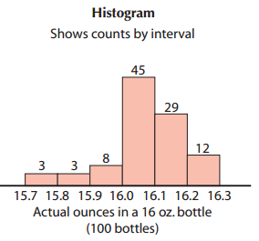
Histogram
7 Quality Tools
  Histogram:
Frequency

Slide 22
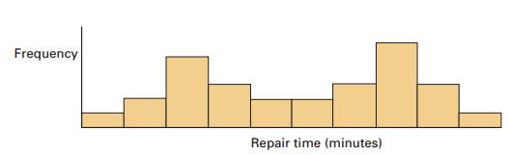
Histogram
7 Quality Tools
  Histogram
  Possible causes might be two workers or two suppliers with different quality.

Slide 23
  Statistical Process Control Chart
7 Quality Tools
Uses statistics and control charts to tell when to take corrective action
As per Shewhart and Deming, there are two causes of variations:
  Natural causes or common causes (Usual, historical, quantifiable variation in a system)
  Special causes or assignable causes (unusual, not previously observed, non-quantifiable variation)
Notes:
https://www.safaribooksonline.com/library/view/operations-management-an/9781118122679/ch6-sec006.html

Slide 24
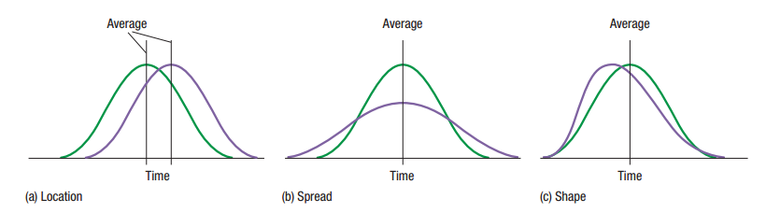
  Statistical Process Control Chart
7 Quality Tools
Uses statistics and control charts to tell when to take corrective action
Notes:
A histogram is a pictorial representation of a set of data. It is created by grouping the measurements into ‘‘cells.’’ Histograms are used to determine the shape of a data set.

Slide 25
  Statistical Process Control Chart
7 Quality Tools
Uses statistics and control charts to tell when to take corrective action
If only natural causes of variation are present, the output of a process forms a distribution that is stable over time and is predictable
Prediction
Frequency
Time
Weight
Notes:
A histogram is a pictorial representation of a set of data. It is created by grouping the measurements into ‘‘cells.’’ Histograms are used to determine the shape of a data set.

Slide 26
  Statistical Process Control Chart
7 Quality Tools
Uses statistics and control charts to tell when to take corrective action
If assignable causes are present, the process output is not stable over time and is not predicable
?
?
?
?
?
?
?
?
?
?
?
?
?
?
?
?
?
?
?
Prediction
Frequency
Time
Weight
Notes:
A histogram is a pictorial representation of a set of data. It is created by grouping the measurements into ‘‘cells.’’ Histograms are used to determine the shape of a data set.

Slide 27
  Statistical Process Control Chart
7 Quality Tools
Uses statistics and control charts to tell when to take corrective action
(a) In statistical control and capable of producing within control limits
Frequency
Lower control limit
Upper control limit
(b) In statistical control but not capable of producing within control limits
(c) Out of control
Size
(weight, length, speed, etc.)
Notes:
A histogram is a pictorial representation of a set of data. It is created by grouping the measurements into ‘‘cells.’’ Histograms are used to determine the shape of a data set.

Slide 28
  Process Capability
Process capability is ability of a process producing conformance to the specification.
It is a measure of the relationship between the natural variation of the process and the design specifications
  Where is the process centered?
  How much variability exists in the process?
  Is the performance relative to specifications acceptable?
  What proportion of output will be expected to meet specifications?
  What factors contribute to variability?

Slide 29
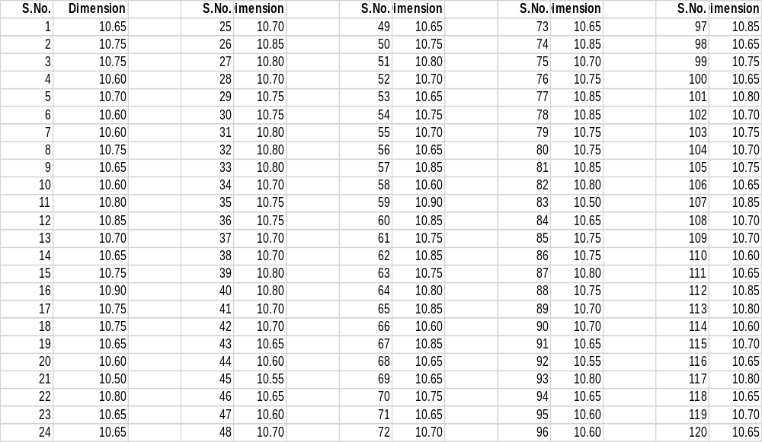


  Process Capability
$$\overline{X}=10.7171$$
$$s=0.0868$$

Slide 30
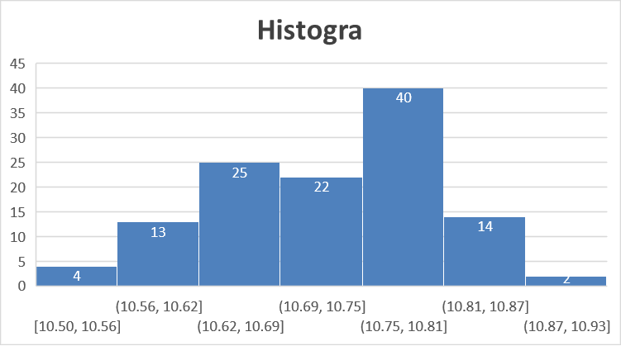








  Process Capability
$$\overline{X}=10.7171$$
$$s=0.0868$$
Approximately normal distribution
$$LL=\overline{X}−3s$$
$$=10.7171−3×0.0868$$
$$=10.4566$$
$$UL=\overline{X}+3s$$
$$=10.7171+3×0.0868$$
$$=10.9766$$

Slide 31
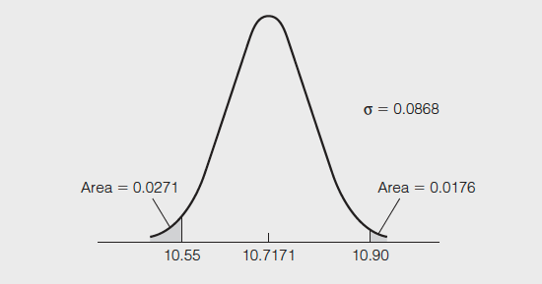






  Process Capability
If design specifications are between 10.55 and 10.90, the process will produce some non-conforming units.
$$LL=\overline{X}−3s$$
$$=10.7171−3×0.0868$$
$$=10.4566$$
$$UL=\overline{X}+3s$$
$$=10.7171+3×0.0868$$
$$=10.9766$$
Area below the lower specification (10.55)
= NORM.DIST(10.55, 10.7171, 0.0868, TRUE)
=0.0271

Slide 32
  Process Capability
If design specifications are between 10.55 and 10.90, the process will produce some non-conforming units.
$$LL=\overline{X}−3s$$
$$=10.7171−3×0.0868$$
$$=10.4566$$
$$UL=\overline{X}+3s$$
$$=10.7171+3×0.0868$$
$$=10.9766$$
Area above the upper specification (10.90)
=1- NORM.DIST(10.90, 10.7171, 0.0868, TRUE)
=0.0176

Slide 33
  Process Capability
Probability that output or a part will not meet specification
= 0.0271 + 0.0176 = 0.0447
OR
4.47%

Slide 34
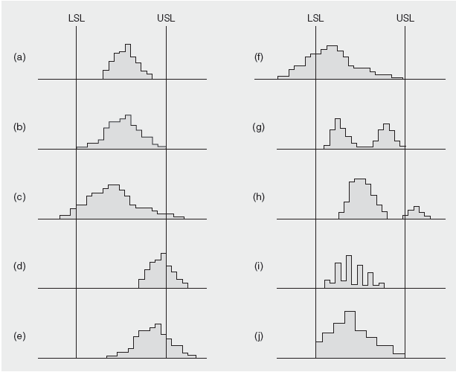
  Process Capability
Not capable

Slide 35
  Process Capability
Process capability is a measure of the relationship between the natural variation of the process and the design specifications
A capable process must have a C_{p} of at least 1.0
Often a target value of C_{p} = 1.33 is used to allow for off-center processes
Six Sigma quality requires a C_{p} = 2.0
Upper Specification – Lower Specification
6σ
C_{p} =

Slide 36
  Process Capability
Axles production:
Process mean x = 25 cm
Process standard deviation σ = 0.005 cm
Design specification = 25 ± 0.02 cm
Upper Specification - Lower Specification
6σ
C_{p} =
25.02 – 24.98
6(0.005)
Process is capable
=
= 1.33

Slide 37
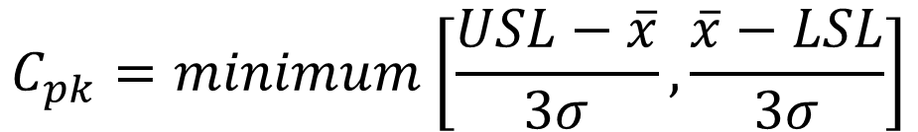
  Process Capability Index
Axles production:
A capable process is not necessarily in the center of the specification, but it falls within the specification limit at both extremes
$$C_{pk}=minimum\left[\frac{USL−\overline{x}}{3σ}, \frac{\overline{x}−LSL}{3σ}\right]$$
A capable process must have a C_{pk} of at least 1.0

Slide 38
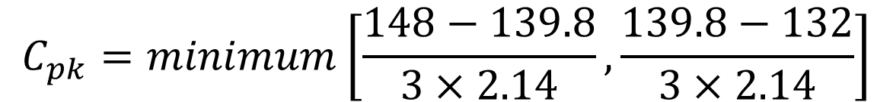
  Process Capability Index
.
Target value for the process mean = 140 degrees
Process mean x = 139.8 degrees
Process standard deviation σ = 2.14 degree
Design specification: USL=148 degrees
LSL=132 degrees
$$C_{pk}=minimum\left[\frac{148−139.8}{3×2.14}, \frac{139.8−132}{3×2.14}\right]$$
Process is capable
= 1.21

Slide 39
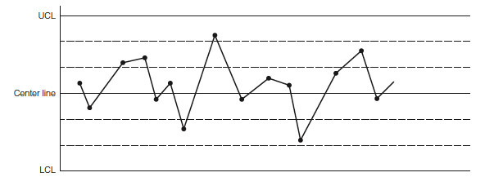
  Pattern in Control Chart
Controlled Process
No points are outside control limits.
The number of points above and below the center line is about the same.
The points seem to fall randomly above and below the center line.
Most points, but not all, are near the center line, and only a few are close to the control limits.

Slide 40
  Pattern in Control Chart
Out-of-Control Pattern
Sudden shift in process average
Cycles
Trends
Hugging the center line
Hugging the control limits

Slide 41
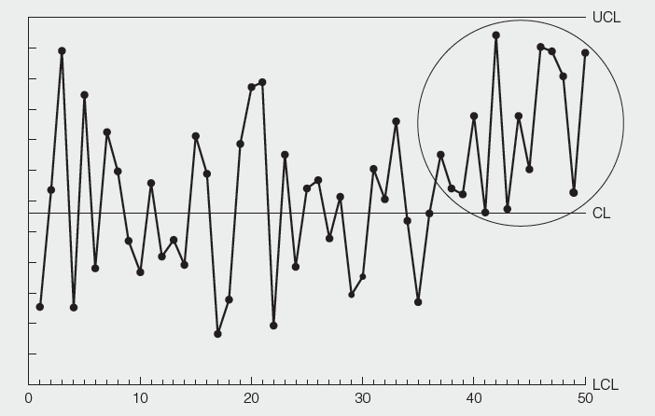
  Pattern in Control Chart
Out-of-Control Pattern
Sudden shift in process average

Slide 42
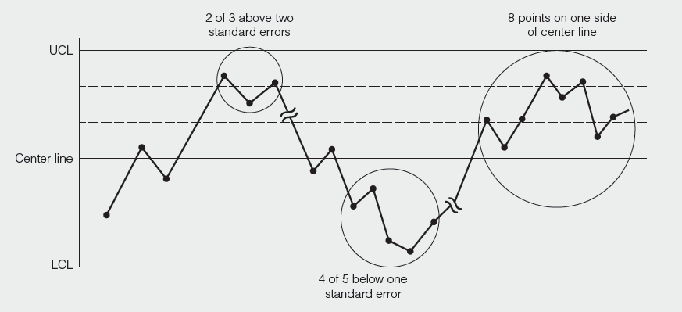
  Pattern in Control Chart
Out-of-Control Pattern
Sudden shift in process average

Slide 43
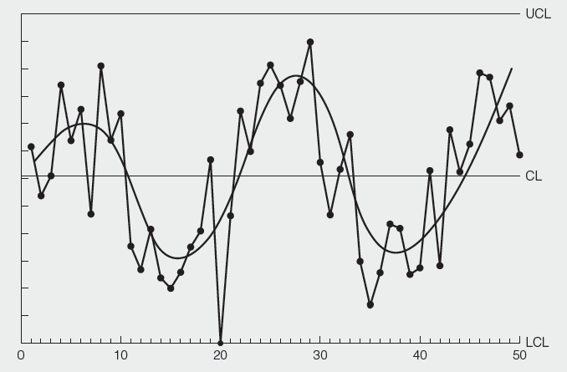
  Pattern in Control Chart
Out-of-Control Pattern
Cycles
Possible causes
Operator rotation
Fatigue at the
end of the shift
Different gauges
used by different
inspectors
Seasonal effects

Slide 44
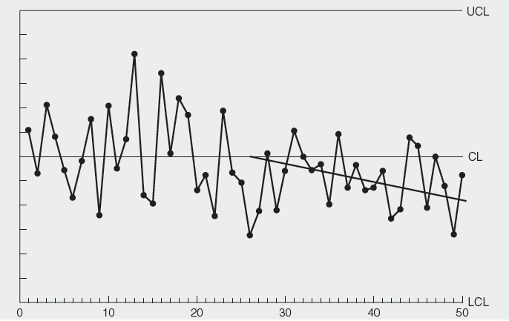
  Pattern in Control Chart
Out-of-Control Pattern
Trends
Possible causes
Improving skills
Improving fatigue
Removing dirt
Changes in temp.
Changes in
humidity
Tool wear

Slide 45
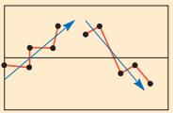
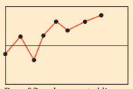
  Pattern in Control Chart
Out-of-Control Pattern
Trends
Possible causes
Improving skills
Improving fatigue
Removing dirt
Changes in temp.
Changes in
humidity
Tool wear
Investigate

Slide 46
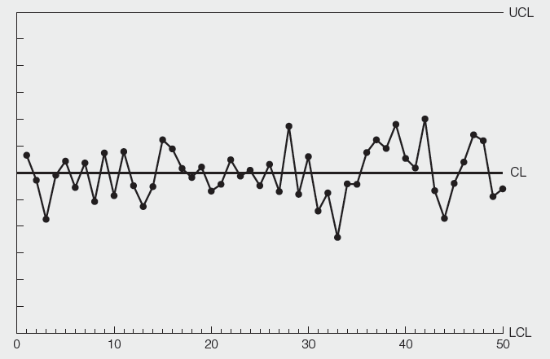
  Pattern in Control Chart
Out-of-Control Pattern
Hugging the center line
Possible causes
Miscalculation of
control limit
Wrong placement
of decimal point

Slide 47
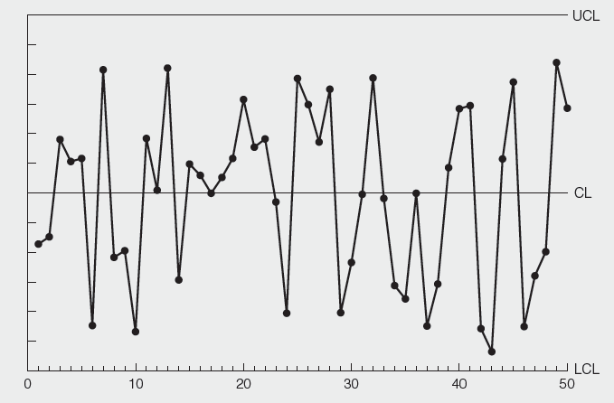
  Pattern in Control Chart
Out-of-Control Pattern
Hugging the control limits
Possible causes
Miscalculation of
control limit
Wrong placement
of decimal point

Slide 48
  Statistical Process Control Chart
7 Quality Tools
Uses statistics and control charts to tell when to take corrective action
Plot the percent of free throws missed
40%
20%
0%
Upper control limit
Coach’s target value
| | | | | | | | |
1 2 3 4 5 6 7 8 9
Lower control limit
Game number

Slide 49
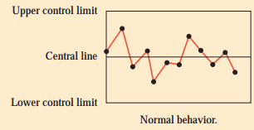
  Statistical Process Control Chart
7 Quality Tools
Sampling
The purpose of sampling is to find when the process has changed in some nonrandom way, so that the reason for the change can be quickly determined.
Acceptable

Slide 50
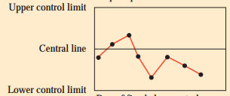
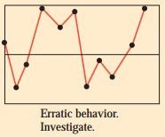
  Statistical Process Control Chart
7 Quality Tools
Sampling
Investigate

Slide 51
  Control Charts for Variables
7 Quality Tools (SPC)
.
x-chart tracks changes in the central tendency
R-chart indicates a gain or loss of dispersion

Slide 52
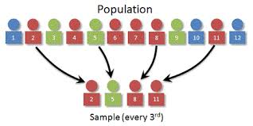




  Control Charts for Variables
7 Quality Tools (SPC)
Population and sample
$$Mean:μ$$
$$Standard deviation:σ$$
$$Mean: \overline{x}$$
$$Standard deviation: σ_{x}$$

Slide 53
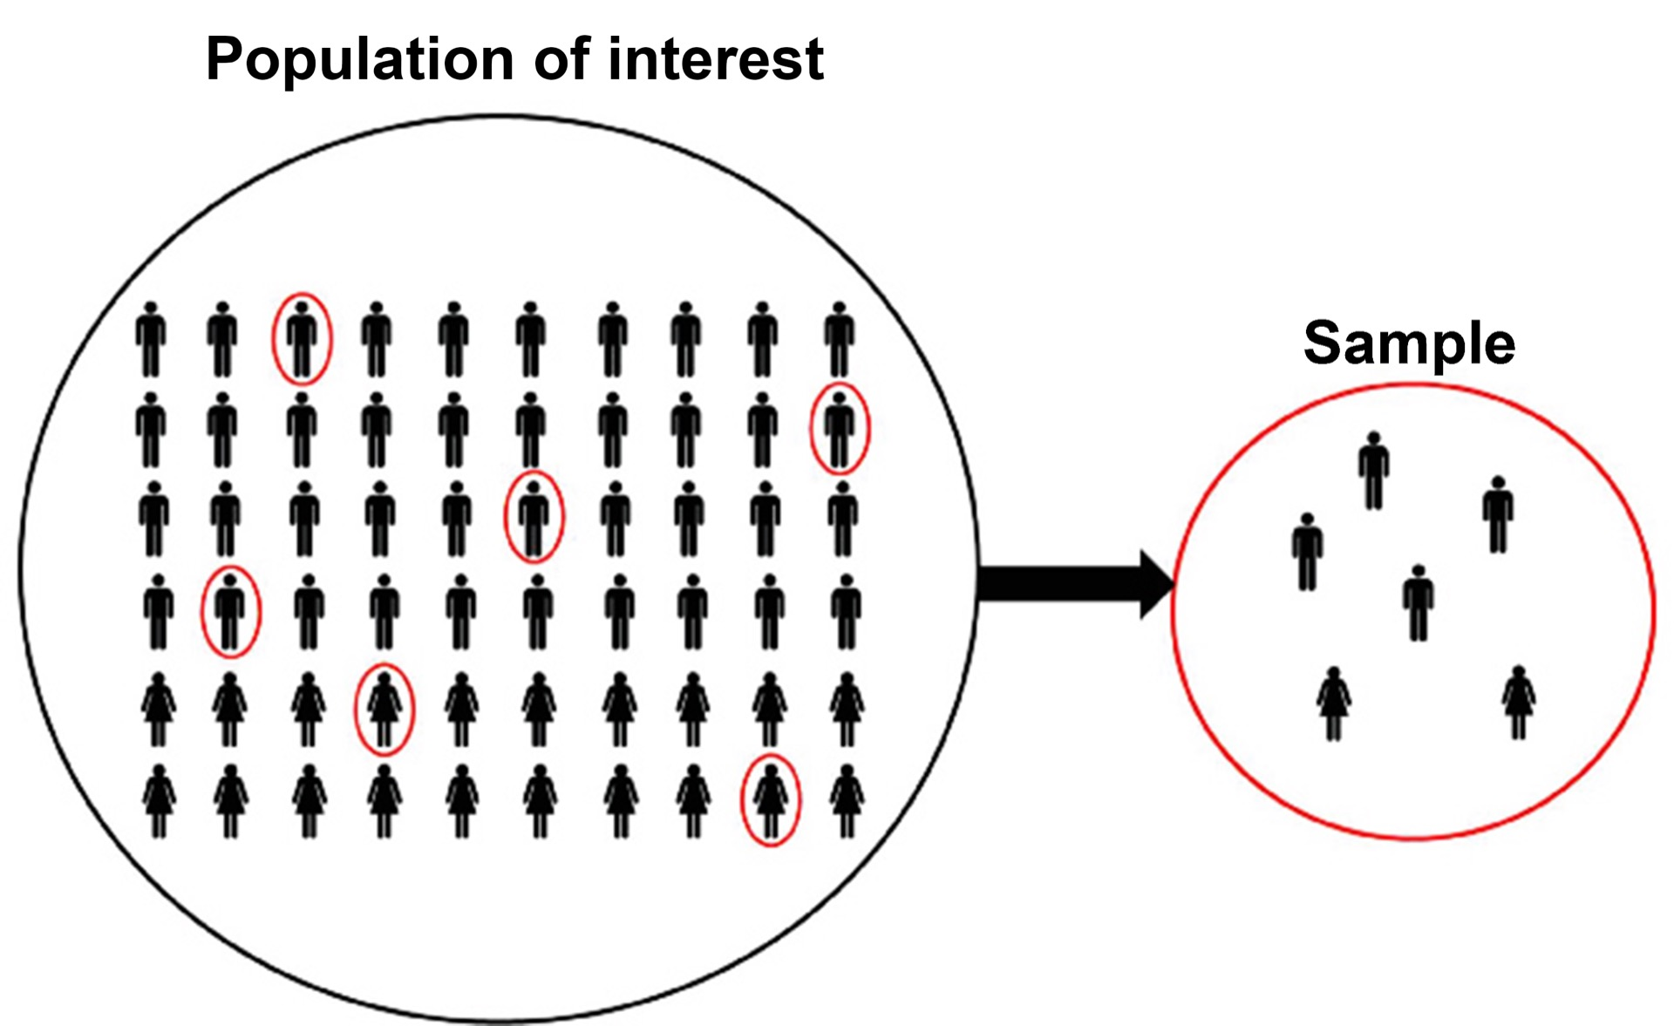




  Control Charts for Variables
7 Quality Tools (SPC)
Population and sample
$$Mean:μ$$
$$Mean: \overline{x}$$
$$Standard deviation:σ$$
$$Standard deviation: σ_{x}$$

Slide 54
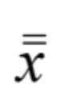

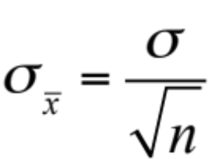
  Control Charts for Variables
7 Quality Tools (SPC)
Central Limit Theorem
If μ is the population mean and σ is population standard deviation. Then,
The mean of the sampling distribution =
The standard deviation of the sampling distribution =

Slide 55
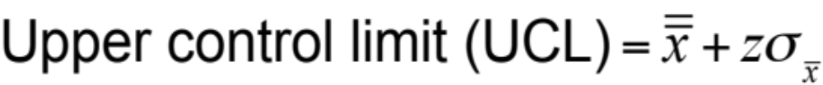
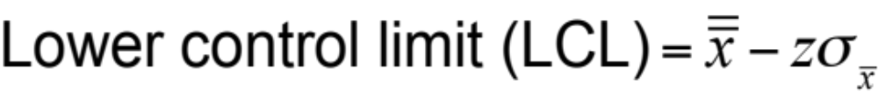



  Control Charts for Variables
7 Quality Tools (SPC)
.
For x-Charts when σ is known
Where = mean of the sample means or a target value set for the process
z = number of normal standard deviations
= standard deviation of the sample means
σ = population (process) standard deviation
n = sample size
Notes:
A histogram is a pictorial representation of a set of data. It is created by grouping the measurements into ‘‘cells.’’ Histograms are used to determine the shape of a data set.

Slide 56

  Control Charts for Variables
7 Quality Tools (SPC)
Population std. dev., σ = 1
Example
1 2 3 4 5 6 7 8 9
Sample 1
A sample of size 9
Usually 25 to 30 samples of size 3 to 10 are used.

Slide 57
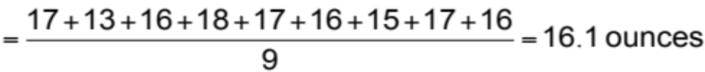
  Control Charts for Variables
7 Quality Tools (SPC)
Population std. dev., σ = 1
Example
1 2 3 4 5 6 7 8 9
Sample 1
Average weight in the first sample
WEIGHT OF SAMPLE |  | WEIGHT OF SAMPLE |  | WEIGHT OF SAMPLE
HOUR | (AVG. OF 9 BOXES) | HOUR | (AVG. OF 9 BOXES) | HOUR | (AVG. OF 9 BOXES)
1 | 16.1 | 5 | 16.5 | 9 | 16.3
2 | 16.8 | 6 | 16.4 | 10 | 14.8
3 | 15.5 | 7 | 15.2 | 11 | 14.2
4 | 16.5 | 8 | 16.4 | 12 | 17.3

Slide 58
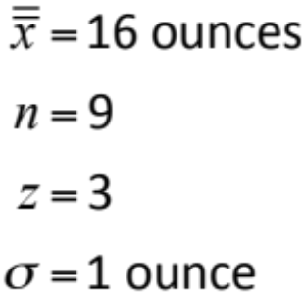
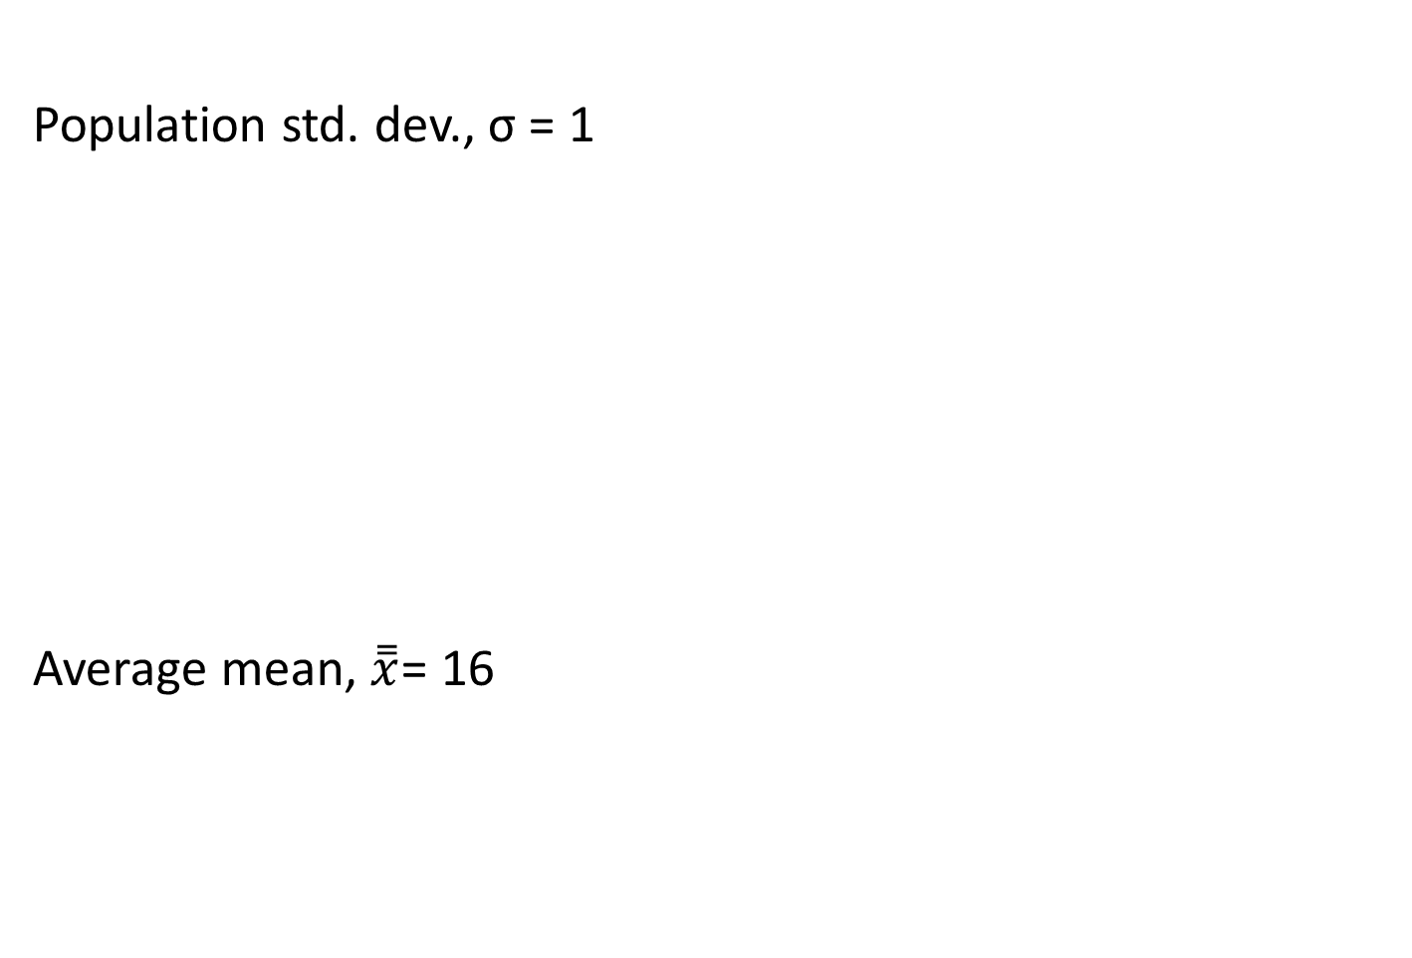
  Control Charts for Variables
7 Quality Tools (SPC)
Population std. dev., σ = 1
Average mean, $\overset{̿}{x}$= 16
Example
WEIGHT OF SAMPLE |  | WEIGHT OF SAMPLE |  | WEIGHT OF SAMPLE
HOUR | (AVG. OF 9 BOXES) | HOUR | (AVG. OF 9 BOXES) | HOUR | (AVG. OF 9 BOXES)
1 | 16.1 | 5 | 16.5 | 9 | 16.3
2 | 16.8 | 6 | 16.4 | 10 | 14.8
3 | 15.5 | 7 | 15.2 | 11 | 14.2
4 | 16.5 | 8 | 16.4 | 12 | 17.3
Number
of samples = 12
Notes:
A histogram is a pictorial representation of a set of data. It is created by grouping the measurements into ‘‘cells.’’ Histograms are used to determine the shape of a data set.

Slide 59
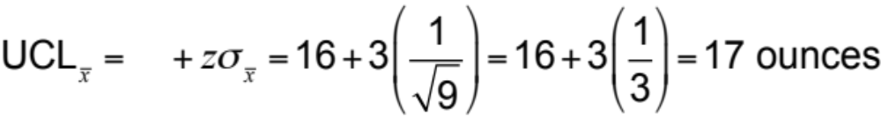

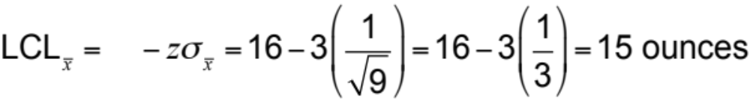
  Control Charts for Variables
7 Quality Tools (SPC)
Population std. dev., σ = 1
Example
Number
of samples = 12

Slide 60
  Control Charts for Variables
7 Quality Tools (SPC)
Population std. dev., σ = 1
Example
Control Chart for samples of 9 boxes
Out of control
Variation
due to assignable causes
17 = UCL
16 = Mean
Variation due to natural causes
15 = LCL
Variation
due to assignable causes
| | | | | | | | | | | |
1 2 3 4 5 6 7 8 9 10 11 12
Out of control
Sample number
Notes:
A histogram is a pictorial representation of a set of data. It is created by grouping the measurements into ‘‘cells.’’ Histograms are used to determine the shape of a data set.

Slide 61
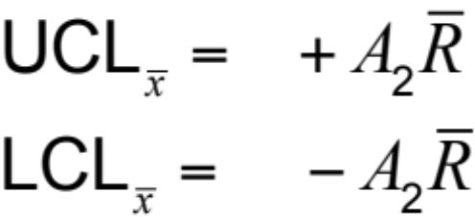
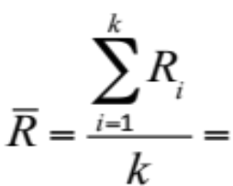



  Control Charts for Variables
7 Quality Tools (SPC)
For x-Charts when we don't know σ
Example
X-chart
R-chart
$${UCL}_{R}=D_{4}\overline{R}$$
$${LCL}_{R}=D_{3}\overline{R}$$
Where average range of the samples
A₂, D₃, and D₄ = control chart factor shown in Table
= mean of the sample means
R_{i} = range for sample i
k = total number of samples
Notes:
A histogram is a pictorial representation of a set of data. It is created by grouping the measurements into ‘‘cells.’’ Histograms are used to determine the shape of a data set.

Slide 62
  Control Charts for Variables
7 Quality Tools (SPC)
For x-Charts when we don't know σ
Example
 | Factors for Computing Control Chart Limits (3 sigma)
SAMPLE SIZE, n |  | MEAN FACTOR, A₂ | UPPER RANGE, D₄ | LOWER RANGE, D₃
2 |  | 1.880 | 3.268 | 0
3 |  | 1.023 | 2.574 | 0
4 |  | .729 | 2.282 | 0
5 |  | .577 | 2.115 | 0
6 |  | .483 | 2.004 | 0
7 |  | .419 | 1.924 | 0.076
8 |  | .373 | 1.864 | 0.136
9 |  | .337 | 1.816 | 0.184
10 |  | .308 | 1.777 | 0.223
12 |  | .266 | 1.716 | 0.284
Notes:
A histogram is a pictorial representation of a set of data. It is created by grouping the measurements into ‘‘cells.’’ Histograms are used to determine the shape of a data set.

Slide 63
  Control Charts for Variables
7 Quality Tools (SPC)
For x-Charts when we don't know σ
Example
Oat flakes labeled as "net weight 12 ounces"
Process average = 12 ounces
Sample size = 5

Slide 64
  Control Charts for Variables
7 Quality Tools (SPC)
For x-Charts when we don't know σ
Example
SAMPLE | WEIGHT OF LIGHTEST PACKET IN SAMPLE OF n = 5 | WEIGHT OF HEAVIEST PACKET IN SAMPLE OF n = 5
1 | 11.50 | 11.72
2 | 11.97 | 12.00
3 | 11.55 | 12.05
4 | 12.00 | 12.20
5 | 11.95 | 12.00
6 | 10.55 | 10.75
7 | 12.50 | 12.75
8 | 11.00 | 11.25
9 | 10.60 | 11.00
10 | 11.70 | 12.10
Sum
RANGE
.22
.03
.50
.20
.05
.20
.25
.25
.40
.40
2.5
Notes:
A histogram is a pictorial representation of a set of data. It is created by grouping the measurements into ‘‘cells.’’ Histograms are used to determine the shape of a data set.

Slide 65

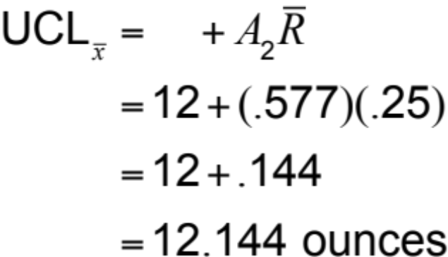

  Control Charts for Variables
7 Quality Tools (SPC)
For x-Charts when we don't know σ
Example
SAMPLE SIZE, n | A₂ | D₄
2 | 1.880 | 3.268
3 | 1.023 | 2.574
4 | .729 | 2.282
5 | .577 | 2.115
6 | .483 | 2.004
7 | .419 | 1.924
8 | .373 | 1.864
9 | .337 | 1.816
10 | .308 | 1.777
12 | .266 | 1.716

Slide 66
  Control Charts for Variables
7 Quality Tools (SPC)
For x-Charts when we don't know σ
Example
UCL = 12.144
Mean = 12
LCL = 11.856

Slide 67

  Control Charts for Variables
7 Quality Tools (SPC)
R – Chart
For x-Charts when we don't know σ
Example
= 2.115*0.25 =
0.52875
= 0.00*0.25
=0
UCL = 0.5287
Mean = 0.25
LCL = 0

Slide 68
7 Quality Tools (SPC)
.
Control Chart for Attributes Data

Slide 69
  Control Chart for Attributes Data
SPC
A unit of work is nonconforming (defect or error) or not.
If a unit of work may have one or more nonconformances, entire unit becomes nonconformaning.
Attributes chart captures nonconforming as well as number of nonconforming. Sudden shift in process average.
p-charts monitors proportion of nonconforming units
c-charts and u-charts monitor the number of nonconformances per unit

Slide 70




  p-charts (Fraction nonconforming)
SPC
P-chart with fixed sample size
Sample size needs to be large enough
Collect k samples. Let y_{i} represent the number of nonconforming units in sample i, and n_{i} be the size of sample i.
Compute the fraction nonconforming in each sample, p_{i} = y_{i} /n_{i}
Average fraction nonconforming
Average

Slide 71


  p-charts (Fraction nonconforming)
SPC
P-chart with fixed sample size
.
Collect k samples. Let y_{i} represent the number of nonconforming units in sample i, and n_{i} be the size of sample i.
Compute the fraction nonconforming in each sample, p_{i} = y_{i} /n_{i}
Average fraction nonconforming
Compute standard deviation
$$s_{\overline{p}}=\sqrt{\frac{\overline{p}(1−\overline{p})}{n}}$$

Slide 72





  p-charts (Fraction nonconforming)
SPC
P-chart with fixed sample size
.
Compute standard deviation
$${LCP}_{p}=\overline{p}−3s_{\overline{p}}$$
$${UCP}_{p}=\overline{p}+3s_{\overline{p}}$$
$$s_{\overline{p}}=\sqrt{\frac{\overline{p}(1−\overline{p})}{n}}$$
$$=\sqrt{\frac{0.022(1−0.022)}{100}}$$
$$=0.01467$$
$${LCP}_{p}=0.022−3×0.01467=−0.022$$
$${UCP}_{p}=0.022+3×0.01467=0.066$$

Slide 73
  p-charts (Fraction nonconforming)
SPC
P-chart with fixed sample size
.
Decreasing trend represents improvement
Upper trend or value above UCL conveys
need for improvement

Slide 74

  p-charts (Fraction nonconforming)
SPC
P-chart with fixed sample size
.
Sample size = 350

Slide 75






  p-charts (Fraction nonconforming)
SPC
P-chart with variable sample size
.
$${UCL}_{p},{LCL}_{p}=\overline{p}±3×\sqrt{\frac{\overline{p}(1−\overline{p})}{n_{i}}}$$
$$\overline{p}=\frac{271}{2980}=0.0909$$

Slide 76
  p-charts (Fraction nonconforming)
SPC
P-chart with variable sample size
.
$${UCL}_{p},{LCL}_{p}=\overline{p}±3×\sqrt{\frac{\overline{p}(1−\overline{p})}{n_{i}}}$$

Slide 77



  np-charts (Fraction nonconforming)
SPC
np-chart with fixed sample size
.
$$n\overline{p}=\frac{Total no. of nonconforming}{No. of Sample}=\frac{y_{i}}{k}$$
$${Standard deviation, s}_{n\overline{p}}=\sqrt{n\overline{p}(1−\overline{p})}$$
${UCL}_{n\overline{p}}=n\overline{p}+3$ $\sqrt{n\overline{p}(1−\overline{p})}$
${LCL}_{n\overline{p}}=n\overline{p}−3$ $\sqrt{n\overline{p}(1−\overline{p})}$

Slide 78





  np-charts (Fraction nonconforming)
SPC
np-chart with fixed sample size
.
$$n\overline{p}=\frac{55}{25}=2.2$$
$$\overline{p}=\frac{2.2}{100}=0.022$$
$${Standard deviation, s}_{n\overline{p}}=\sqrt{2.2 (1−0.022)}$$
= 1.4668
$${UCL}_{n\overline{p}}=2.2+3\left(1.4668\right)=6.6$$
$${LCL}_{n\overline{p}}=2.2−3\left(1.4668\right)=−2.20$$

Slide 79

  np-charts (Fraction nonconforming)
SPC
np-chart with fixed sample size
.

Slide 80




  c-charts for nonconforming
SPC
Collect samples of equal size and count the number of nonconformances
Compute the average number of nonconformances per unit, c-bar
Standard deviation
Control limits
$s_{c}=$ $\sqrt{\overline{c}}$
${UCL}_{c}=\overline{c}+3$ $\sqrt{\overline{c}}$
$${LCL}_{c}=\overline{c}−3 \sqrt{\overline{c}}$$

Slide 81






  c-charts for nonconforming
SPC
.
$$\overline{c}=\frac{45}{25}=1.8$$
${UCL}_{c}=1.8+3$ $\sqrt{1.8}=5.82$
$${LCL}_{c}=1.8−3 \sqrt{1.8}=−2.22 or 0$$

Slide 82

  c-charts for nonconforming
SPC
.

Slide 83




  u-charts for nonconforming
SPC
.
Applies if the samples are of unequal size
Collect samples and count the number of nonconformances
Compute the average number of nonconformances per unit, u-bar
Standard deviation
Control limits

Slide 84


  u-charts for nonconforming
SPC
.

Slide 85

  u-charts for nonconforming
SPC
.

Slide 86
References.
Managing for Quality and Performance Excellence, Evans, J.R. and William M. Lindsay, W.M., Cengage Learning, India
The Six Sigma Handbook, Tomas Pyzdek and Paul Keller, Fourth edition, McGraw Hill India.
Total Quality Management, Besterfield et al., Revised third edition, Pearson India
The Management and Control of Quality, J. Evans, and W. Lindsay, Third edition, Cengage Learning

Slide 87
.
Thanks!

