Slide 1





Operations Management with Six Sigma
Dr. Gopal Kumar
gopalkumar@iimraipur.ac.in
IIM Raipur
25 January 2020

Slide 2
Continuous improvement
Example
The co-owner of a diner decided to do something about the long lines that occurred everyday in their place of business. After discussion with employees, several facts came to light:
Customer waited in line for up to 15 minutes
Usually, tables were available
Many of their customers were regulars
People taking orders and preparing food were getting in each other’s way
They collected data on number of customers in line

Slide 3
Continuous improvement
Example
Plan: The owner wanted to a few changes. They decided the following change:
Provide a way for customer to fax their orders in ahead of the time
Do: Fax machine was installed. Length of line, number of empty table, and time until last person in the line was served were measured.
Check: They detected several improvement. Length of line came down (peak avg of 12 people), number of available table decreased, time in line wend down from 15 minutes to 5 minutes
Act: They held a meeting, and incorporated the changes

Slide 4



Customer Focus
TQM
“Without customers, you don’t have a business.”
- Don Peppers and Martha Rogers
Okyakusama
“Customers Don’t Grow on
Trees,”
- Fast Company magazine, July 2005
Notes:
Okyakusama (in Japanese it means both customer and honorable guest)
Ritz-Carlton hotel, Disney, Toyota’s Lexus division were built on the notion of satisfying customer.

Slide 5
Customer Focus
TQM
“If the customer is satisfied with the whole experience with the product, then you have a quality product.”
-The Executive Director of Global Quality Strategy at General Motors
Purchasing experience
Use experience
Service experience
ISO 9000:2000
Customer focus is a key requirement

Slide 6


Satisfying Customers
Customer Focus
Customer Satisfaction:
…“the result of delivering a product or service that meets customer requirements.” -ASQ
by buying large volumes of corporate business with extremely low rates and
by improving customer satisfaction levels
91 percent of contract renewals came from customers who were either satisfied or very satisfied.
Notes:
Customer satisfaction drives profitability.
The typical company gets 65 percent of its business from existing customers, and it costs five times more to find a new customer than to keep an existing one happy.
Avis’s marketing department uses a full range of research and analysis to keep pace with changing market trends and develops programs that respond to customers’ needs.
Avis also monitors trends and levels of customer satisfaction, and calls numerous customers each month to assess in detail satisfaction levels.
Statistics show that growth in market share and financial success are strongly correlated with customer satisfaction.
One study found that businesses with a 98 percent customer retention rate are twice as profitable as those at 94 percent.
JCI
A percentage point increase in the overall satisfaction score was worth $13 million in service contract renewals annually.
After seeing the financial impact of customer satisfaction, JCI made improving customer satisfaction a key initiative.

Slide 7
Satisfying Customers
Customer Focus
Customer Satisfaction:
A customer who are merely satisfied may buy products or services from competitors because of convenience, promotion, etc.
A loyal customer goes out of their way or pay premium to stay with the company
…“Satisfaction is an attitude and loyalty is a behavior.”
-Patrick Mehne, former quality officer at the Ritz-Carlton Hotel
Notes:
Customer satisfaction drives profitability.
The typical company gets 65 percent of its business from existing customers, and it costs five times more to find a new customer than to keep an existing one happy.
Avis’s marketing department uses a full range of research and analysis to keep pace with changing market trends and develops programs that respond to customers’ needs.
Avis also monitors trends and levels of customer satisfaction, and calls numerous customers each month to assess in detail satisfaction levels.
Statistics show that growth in market share and financial success are strongly correlated with customer satisfaction.
One study found that businesses with a 98 percent customer retention rate are twice as profitable as those at 94 percent.
JCI
A percentage point increase in the overall satisfaction score was worth $13 million in service contract renewals annually.
After seeing the financial impact of customer satisfaction, JCI made improving customer satisfaction a key initiative.

Slide 8
Customer Engagement
Customer Focus
.. customers’ investment in or commitment to a brand and product offerings.
Characteristics:
  customer retention and loyalty,
  customers’ willingness to make an effort to do business with the organization, and
  customers’ willingness to actively advocate for and recommend the brand and product offerings.
…introduced in the 2009-10 Balbridge Criteria for Performance Excellence
Notes:
We build our customer loyalty by telling our customers the truth, whether it is good or bad news. – Small Business Owner

Slide 9
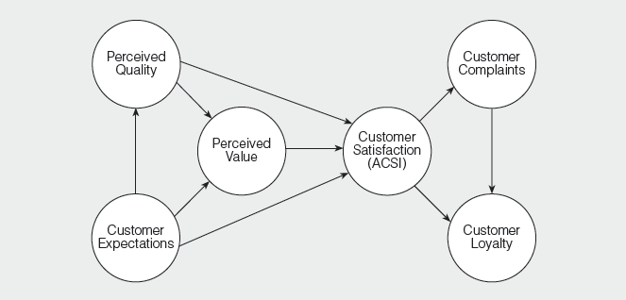
Customer Engagement
Customer Focus
American Customer Satisfaction Index (ACSI)
.
Introduced in 1994
Notes:
American Customer Satisfaction Index (ACSI)
- Measures customer satisfaction at a national level
- Introduced in 1994 by University of Michigan and American Society for Quality
Based on results of telephone interviews conducted in a national sample of 46,000 consumers who recently bought or used a company’s product or service.
Overall national index declined until 1997 but generally improved overall since.

Slide 10
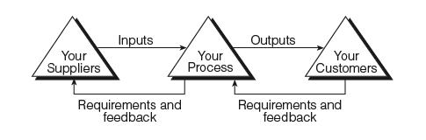
Who Your Customers Are?
Customer Focus
Customer-supplier relationship
Purchasing
Manufacturing
Hospital laundary
Nursing unit

Slide 11
Who Your Customers Are?
Customer Focus
Customer-supplier relationship
Internal customers – Other departments, processes, or individual workers
External customers - those who fall between the organization and the consumer, but are not part of the organization.
Consumers - those people who ultimately purchase and use a company’s products.

Slide 12

Segmentation
Customer Focus
Demographic
Geography
Volumes
“Vital few” and “useful many”
Profit potential
World region
Sales distribution channel
Notes:
Juran suggested classifying customers into two main groups: the vital few and the useful many.

Slide 13
Segmentation
Customer Focus
.
Volume
Potential
and
existing
customers
Geography
Profit

Slide 14
Voice of the Customer (VOC)
Customer Focus
…customer requirements in their own terms
Customers’ Meaning
The consumer speaks in code.
- The VP of marketing at Whirlpool
Notes:
Whirlpool’s research showed that consumers wanted clean refrigerators, refrigerators, which could be interpreted to mean that they wanted easy-to-clean refrigerators.

Slide 15
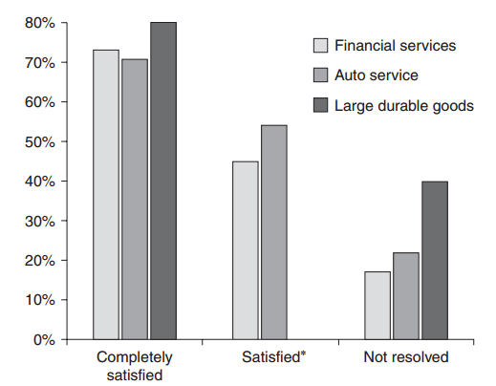
Voice of the Customer (VOC)
Customer Focus
Collecting VOC
Operational feedback systems
Percent planning to repurchase versus how complaint was handled.
Notes:
Considering that customers who complain are likely to tell as many as 14 others of their experience, the importance of complaint handling in customer relations becomes obvious.
Complaints represent people who were not only unhappy, they were unhappy enough to report that dissatisfaction to the company.
Research indicates that up to 96% of unhappy customers never tell the company.
Complaints should be actively sought, an activity decidedly against human nature.

Slide 16
Voice of the Customer (VOC)
Customer Focus
Collecting VOC
Comment cards and formal surveys
Focus groups
Direct customer contact
Field intelligence
Complaints
Internet and social media monitoring
Developing questionnaire
Notes:
The process excellence leader should not be reticent in recommending that survey budgets be allocated for conducting small, routine, periodic surveys rather than infrequent “big studies.”
A focus group can thus be defined as a carefully planned discussion designed to obtain perceptions on a defined area of interest in a permissive, nonthreatening environment.

Slide 17
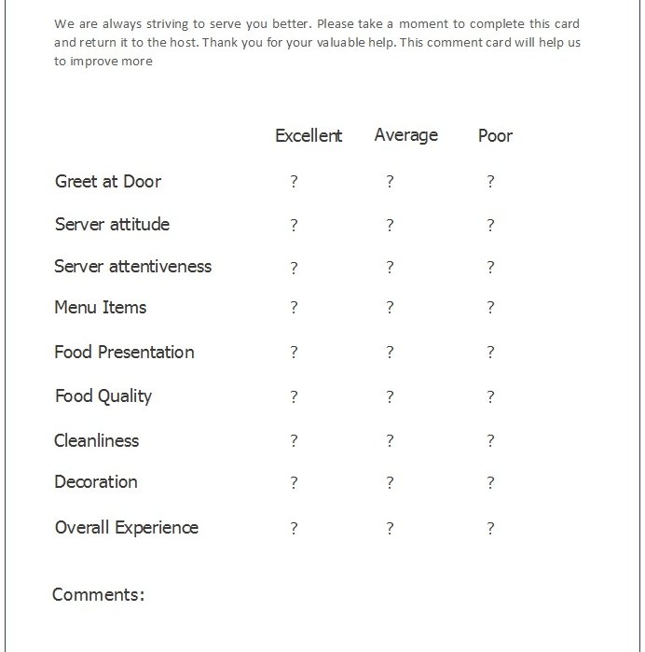
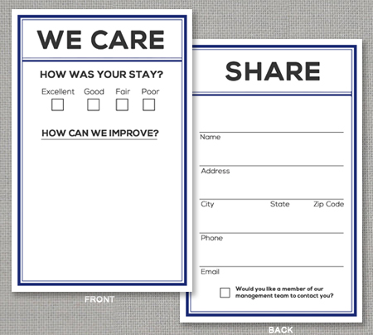
Voice of the Customer (VOC)
Customer Focus
Collecting VOC
Comment cards and formal surveys
Notes:
The process excellence leader should not be reticent in recommending that survey budgets be allocated for conducting small, routine, periodic surveys rather than infrequent “big studies.”
A focus group can thus be defined as a carefully planned discussion designed to obtain perceptions on a defined area of interest in a permissive, nonthreatening environment.

Slide 18
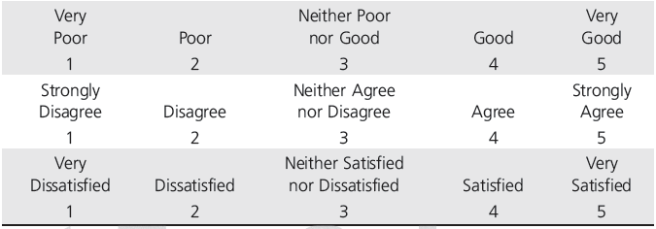
Voice of the Customer (VOC)
Customer Focus
Collecting VOC
Comment cards and formal surveys
Likert Scales Used for Customer Satisfaction Measurement
Notes:
The process excellence leader should not be reticent in recommending that survey budgets be allocated for conducting small, routine, periodic surveys rather than infrequent “big studies.”
A focus group can thus be defined as a carefully planned discussion designed to obtain perceptions on a defined area of interest in a permissive, nonthreatening environment.

Slide 19

Voice of the Customer (VOC)
Customer Focus
Focus groups
What do you like about the product or service?
What pleases or delights you?
What do you dislike?
What problems have you encountered?
If you had the ability, how would you change the product or service?
Panel of individuals (customers or
non-customers)
Costly
Notes:
The process excellence leader should not be reticent in recommending that survey budgets be allocated for conducting small, routine, periodic surveys rather than infrequent “big studies.”
A focus group can thus be defined as a carefully planned discussion designed to obtain perceptions on a defined area of interest in a permissive, nonthreatening environment.

Slide 20
References.
Managing for Quality and Performance Excellence, Evans, J.R. and William M. Lindsay, W.M., Cengage Learning, India
Six Sigma Hand Book, Tomas Pyzdek and Paul Keller, Fourth edition, McGraw Hill India.
Total Quality Management, Besterfield et al., Revised third edition, Pearson India
The Management and Control of Quality, J. Evans, and W. Lindsay, Third edition, Cengage Learning

Slide 21



Voice of the Customer (VOC)
Customer Focus
Field intelligence
Repair technician
Observations
Notes:
Employees simply observe customer behavior. One hotel noticed that customers did not use the complimentary bath crystals, so they eliminated the crystals (saving costs) and added other features that customers wanted.
Field intelligence is perhaps one of the least-exploited approaches to listening and learning.

Slide 22





Voice of the Customer (VOC)
Customer Focus
Complaints
Notes:
Hewlett-Packard, for example, assigns every piece of customer feedback to an “owner” in the company who must act on

Slide 23
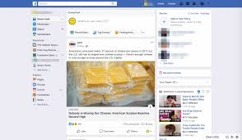
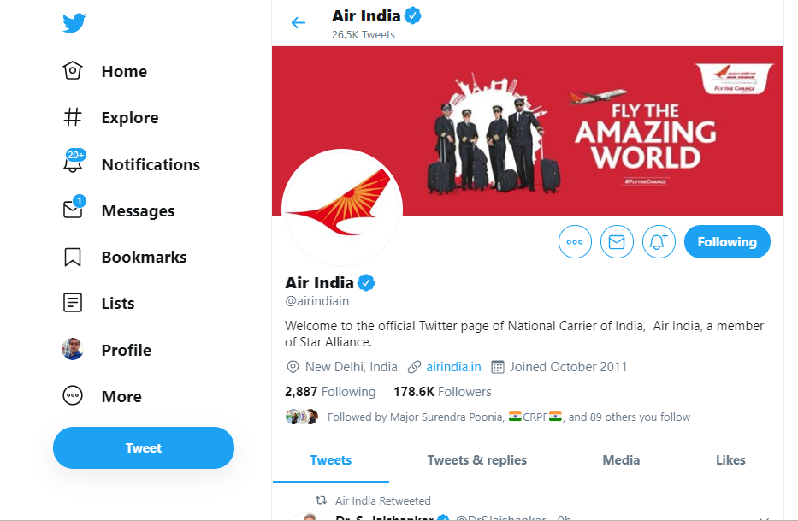
Voice of the Customer (VOC)
Customer Focus
Internet and social media monitoring
Notes:
The process excellence leader should not be reticent in recommending that survey budgets be allocated for conducting small, routine, periodic surveys rather than infrequent “big studies.”
A focus group can thus be defined as a carefully planned discussion designed to obtain perceptions on a defined area of interest in a permissive, nonthreatening environment.

Slide 24


Voice of the Customer (VOC)
Customer Focus
Some innovative ways
Notes:
The process excellence leader should not be reticent in recommending that survey budgets be allocated for conducting small, routine, periodic surveys rather than infrequent “big studies.”
A focus group can thus be defined as a carefully planned discussion designed to obtain perceptions on a defined area of interest in a permissive, nonthreatening environment.

Slide 25


Analyzing Voice of the Customer Data
Customer Focus
.
Text mining
Notes:
JetBlue Airways receives nearly 500 e-mails from passengers every day and more than 40,000 survey responses per month.
JetBlue decided to implement text analytics software to help automate the process of tracking and analyzing the customer feedback.
The software automatically extracts relevant data from survey responses, e-mail messages, web forums, blog entries, news articles, and other customer communications to provide analysts and managers with deeper insights into customer satisfaction, sentiment, and loyalty.
In addition to active daily, weekly, and monthly analysis of customer feedback, managers at JetBlue receive customized reports that summarize the customer feedback, allowing executives and managers to make informed decisions about the company’s long-term strategic activities.

Slide 26
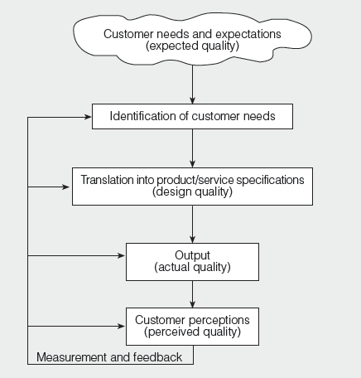
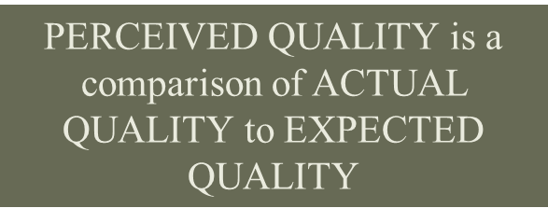
Gap Model – Linking the VOC to Internal Processes
Customer Focus
.
QFD
Notes:
QFD is a customer-driven process for planning products and services.
It starts with the voice of the customer, which becomes the basis for setting requirements. QFD matrices, sometimes called “the house of quality,” are graphical displays of the result of the planning process.
The matrices are created by interdepartmental teams (entire company), thus overcoming some of the barriers which exist in functionally organized systems.
A system that moves methodically from customer requirements to specifications for the
product or service.

Slide 27
Gap Model – Linking the VOC to Internal Processes
Customer Focus
.
Customer requirement
Actionable information
Smooth handling
Dimensions of smartphone
Easy in reading
Dimensions of smartphone
Easy to start
Car should start within 10 sec
Soap application make skin soft
pH or hardness specifications
Notes:
QFD is a customer-driven process for planning products and services.
It starts with the voice of the customer, which becomes the basis for setting requirements. QFD matrices, sometimes called “the house of quality,” are graphical displays of the result of the planning process.
The matrices are created by interdepartmental teams (entire company), thus overcoming some of the barriers which exist in functionally organized systems.
A system that moves methodically from customer requirements to specifications for the
product or service.
QFD originated in 1972 at Mitsubishi’s Kobe shipyard site. Toyota began to develop the concept shortly thereafter, and has used it since 1977

Slide 28
Analyzing and Using Customer Feedback
Customer Focus
The following customer satisfaction results (measured on 5-point scale) for a fast food restaurant are observed.
Attributes | Importance | Performance
Fresh-buns | 4.83 | 4.80
Cheese is melted | 4.26 | 4.82
Drink is not watery | 4.88 | 4.64
Fries are crisp | 4.85 | 4.80
Fries are seasoned | 4.12 | 4.48
Service is fast | 4.93 | 4.61
Open 24 hours | 3.91 | 4.81
Good variety of food | 4.46 | 3.87
Nutritional data displayed | 3.76 | 4.65
Children’s menu available | 4.80 | 3.97
Tables kept clean | 4.91 | 4.89
Low-fat items available | 3.62 | 4.55
Notes:
QFD is a customer-driven process for planning products and services.
It starts with the voice of the customer, which becomes the basis for setting requirements. QFD matrices, sometimes called “the house of quality,” are graphical displays of the result of the planning process.
The matrices are created by interdepartmental teams (entire company), thus overcoming some of the barriers which exist in functionally organized systems.
A system that moves methodically from customer requirements to specifications for the
product or service.

Slide 29
Analyzing and Using Customer Feedback
Customer Focus
.
Not good
Importance
Vulnerable
Strengths
High
Low
Who cares?
Overkill
Low High
Performance
Resource wastage
Notes:
QFD is a customer-driven process for planning products and services.
It starts with the voice of the customer, which becomes the basis for setting requirements. QFD matrices, sometimes called “the house of quality,” are graphical displays of the result of the planning process.
The matrices are created by interdepartmental teams (entire company), thus overcoming some of the barriers which exist in functionally organized systems.
A system that moves methodically from customer requirements to specifications for the
product or service.

Slide 30
Analyzing and Using Customer Feedback
Customer Focus
5.1
4.9
4.7
4.5
4.3
4.1
3.9
3.7
3.5
.
4.61
4.89
Importance
4.64
3.97
4.8
4.8
High
Low
3.87
4.82
4.48
4.81
4.65
4.55
3.7 3.9 4.1 4.3 4.5 4.7 4.9 5.1
Performance
Low High
Notes:
QFD is a customer-driven process for planning products and services.
It starts with the voice of the customer, which becomes the basis for setting requirements. QFD matrices, sometimes called “the house of quality,” are graphical displays of the result of the planning process.
The matrices are created by interdepartmental teams (entire company), thus overcoming some of the barriers which exist in functionally organized systems.
A system that moves methodically from customer requirements to specifications for the
product or service.

Slide 31
Analyzing and Using Customer Feedback
Customer Focus
The following customer satisfaction results (measured on 5-point scale) for a fast food restaurant are observed.
Attributes | Importance | Performance
Fresh-buns | 4.83 | 4.80
Cheese is melted | 4.26 | 4.82
Drink is not watery | 4.88 | 4.64
Fries are crisp | 4.85 | 4.80
Fries are seasoned | 4.12 | 4.48
Service is fast | 4.93 | 4.61
Open 24 hours | 3.91 | 4.81
Good variety of food | 4.46 | 3.87
Nutritional data displayed | 3.76 | 4.65
Children’s menu available | 4.80 | 3.97
Tables kept clean | 4.91 | 4.89
Low-fat items available | 3.62 | 4.55
Notes:
QFD is a customer-driven process for planning products and services.
It starts with the voice of the customer, which becomes the basis for setting requirements. QFD matrices, sometimes called “the house of quality,” are graphical displays of the result of the planning process.
The matrices are created by interdepartmental teams (entire company), thus overcoming some of the barriers which exist in functionally organized systems.
A system that moves methodically from customer requirements to specifications for the
product or service.

Slide 32
Target and Tolerance Design
Customer Focus
National Highway Traffic Safety Administration dictates standards for motor vehicles:
Two windshield wiper speeds, one of which must be
  faster than 45 cycles per minute and
  the other at least 15 cycles per minute slower than the faster speed but no slower than one cycle every three seconds.
Notes:
Essentially, they are the “hows” by which the company will respond to the “whats”—the customer requirements that will determine customer satisfaction or delight, often called critical to quality characteristics (CTQs).

Slide 33
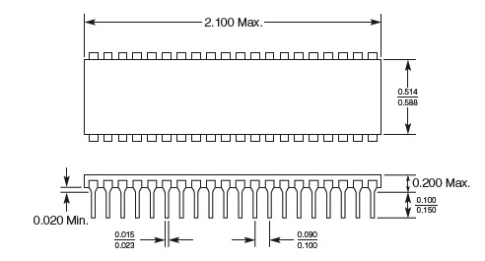
Target and Tolerance Design
Customer Focus
.
Notes:
Tolerance design involves determining the permissible variation in a dimension.
Uncertainty regarding the maximum variation allowable and compatibility with satisfactory product performance.
Narrow tolerances tend to raise manufacturing costs but they also increase the interchangeability of parts within the plant and in the field, product performance, durability, and appearance.
Wide tolerances, on the other hand, increase material utilization, machine throughput, and labor productivity, but have a negative impact on product characteristics,

Slide 34
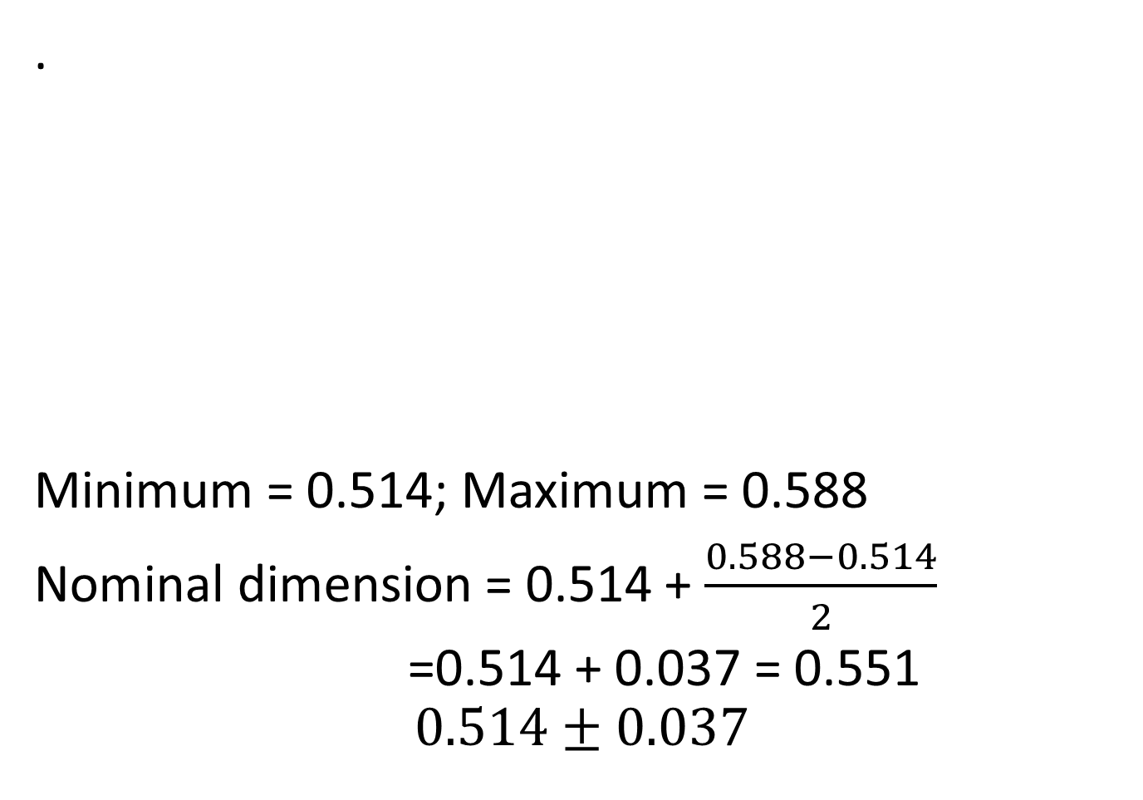
Target and Tolerance Design
Customer Focus
.
Minimum = 0.514; Maximum = 0.588
Nominal dimension = 0.514 + $\frac{0.588−0.514}{2}$
=0.514 + 0.037 = 0.551
$$0.514±0.037$$
Notes:
Tolerance design involves determining the permissible variation in a dimension.
Uncertainty regarding the maximum variation allowable and compatibility with satisfactory product performance.
Narrow tolerances tend to raise manufacturing costs but they also increase the interchangeability of parts within the plant and in the field, product performance, durability, and appearance.
Wide tolerances, on the other hand, increase material utilization, machine throughput, and labor productivity, but have a negative impact on product characteristics,

Slide 35
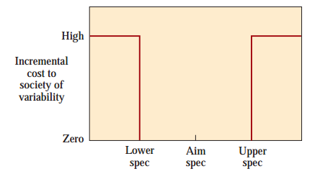
Taguchi concepts
TQM
Traditional View of the Cost of Variability:

Slide 36
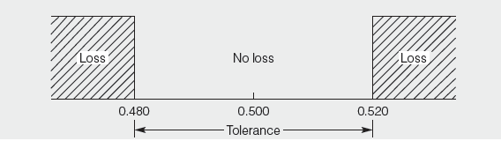
Taguchi concepts
TQM
Traditional View of the Cost of Variability:

Slide 37
Taguchi concepts
TQM
Traditional View of the Cost of Variability:

Slide 38
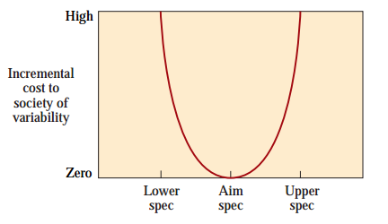
Taguchi concepts
TQM
.

Slide 39
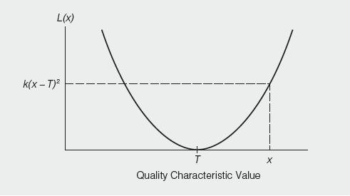

Taguchi concepts
TQM
.
Taguchi assumes that losses can be approximated by a quadratic function so that larger deviations from target corresponds to increasingly larger losses.
Taguchi Loss Function
$$L\left(x\right)=k{(x−T)}^{2}$$

Slide 40


Six Sigma
6σ
Lower limits
Upper limits
3.4 defects/million
2,700 defects/million
Mean
±3σ
±6σ
$$Process width=μ±3σ$$
$$Specification width=μ±3σ$$
Notes:
There is no harm in going from 6 to 7 og 8. In fact airline industry operate at 10 or more for flight take off & landing, but for all practical purposses in an industry where human life is not at risk six sigma is a good enough improvement benchmark.
More than that may not be worth the Time, money$$ and effort.

Slide 41
Six Sigma
  A process that is 99.9997% capable, 3.4 defects per million opportunities (DPMO)
  A program designed to reduce defects, lower costs, save time, and improve customer satisfaction
6σ
Developed by Motorola and enhanced by Honeywell and GE
Highly structured way to process improvement
  A discipline – DMAIC
  A set of 7 tools
Notes:
There is no harm in going from 6 to 7 og 8. In fact airline industry operate at 10 or more for flight take off & landing, but for all practical purposses in an industry where human life is not at risk six sigma is a good enough improvement benchmark.
More than that may not be worth the Time, money$$ and effort.

Slide 42
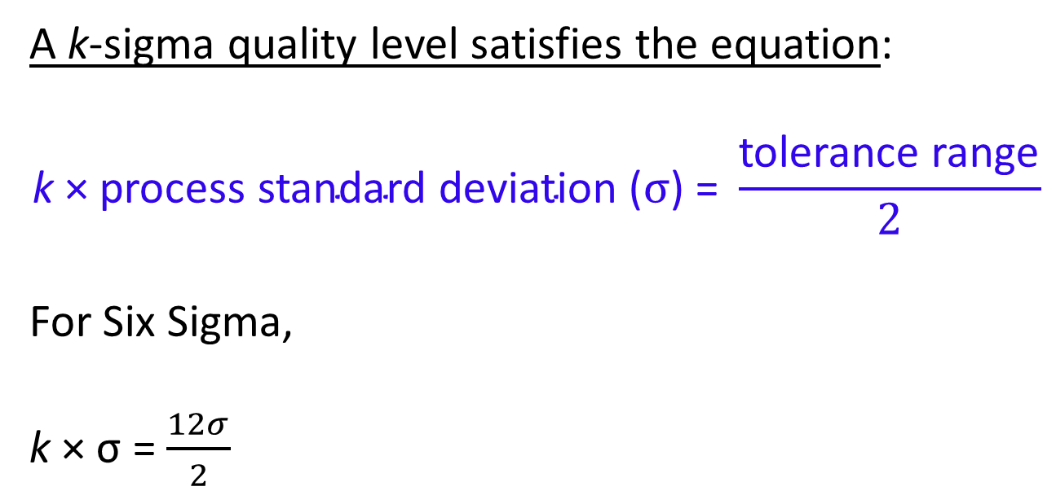
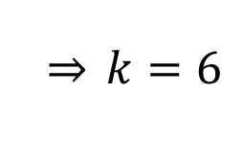
Six Sigma
A k-sigma quality level satisfies the equation:
$$\text{k}\text{ × }\text{process} \text{standard} \text{deviation}\text{ (}σ\text{)}\text{ = }\frac{\text{tolerance} \text{range}}{2}$$
For Six Sigma,
k × σ = $\frac{12σ}{2}$
$$\overset{⇒}{} k=6$$
Notes:
There is no harm in going from 6 to 7 og 8. In fact airline industry operate at 10 or more for flight take off & landing, but for all practical purposses in an industry where human life is not at risk six sigma is a good enough improvement benchmark.
More than that may not be worth the Time, money$$ and effort.

Slide 43
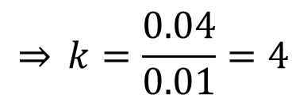
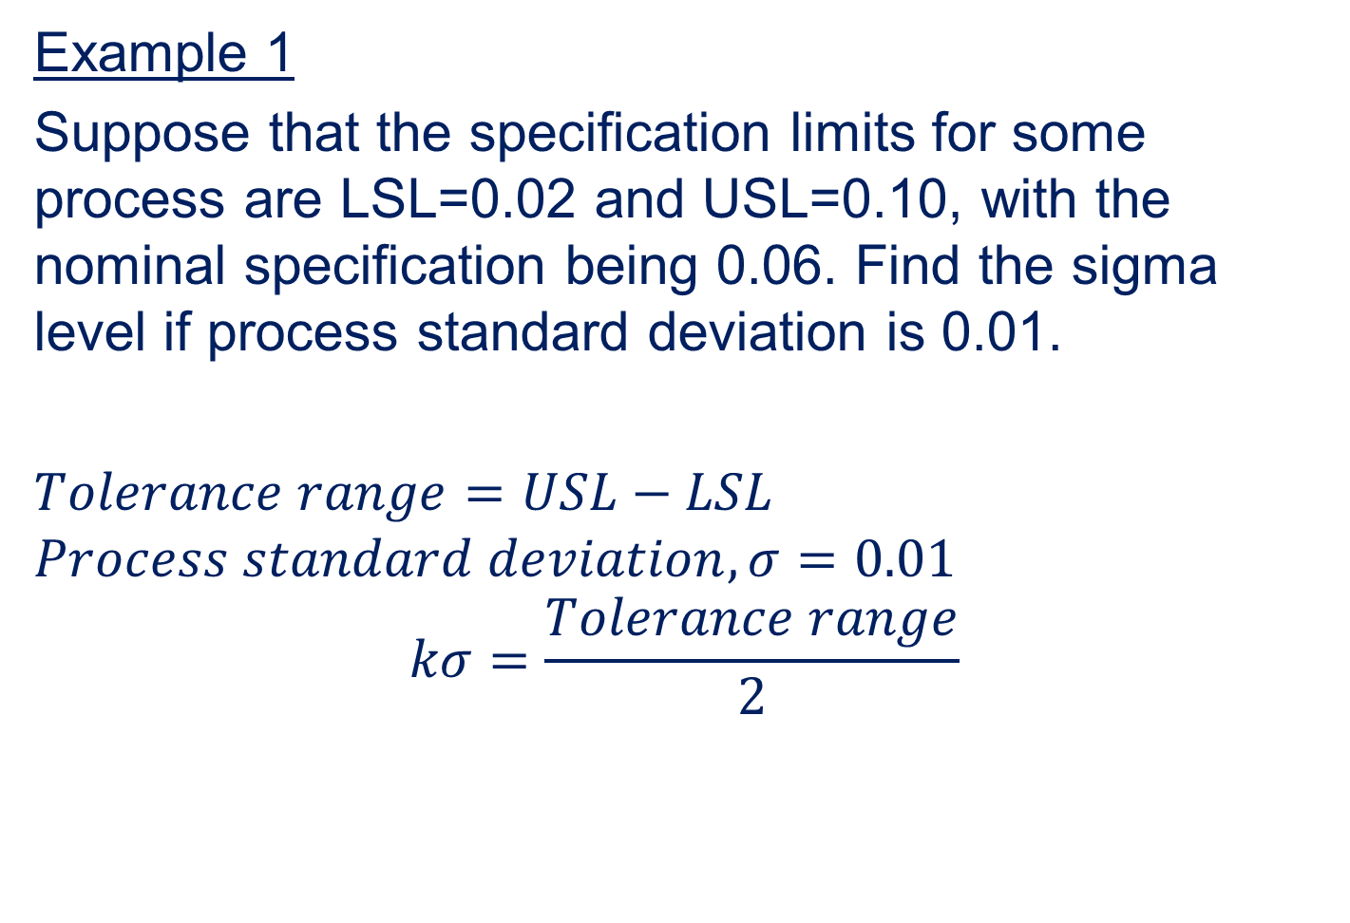
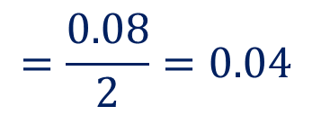


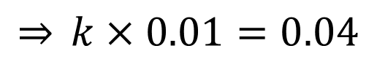
Six Sigma
Example 1
Suppose that the specification limits for some process are LSL=0.02 and USL=0.10, with the nominal specification being 0.06. Find the sigma level if process standard deviation is 0.01.
$Tolerance range=USL−LSL$
$$Process standard deviation, σ=0.01$$
$$kσ=\frac{Tolerance range}{2}$$
$$=0.10−0.02$$
$$=0.08$$
$$=\frac{0.08}{2}=0.04$$
$$\overset{⇒}{} k=\frac{0.04}{0.01}=4$$
$$\overset{⇒}{} k×0.01=0.04$$
Notes:
There is no harm in going from 6 to 7 og 8. In fact airline industry operate at 10 or more for flight take off & landing, but for all practical purposses in an industry where human life is not at risk six sigma is a good enough improvement benchmark.
More than that may not be worth the Time, money$$ and effort.

Slide 44

Quality Measurements
TQM
  A unit of work
  Nonconformance
  Nonconforming unit of work
  Error
  Measures
  Attributes measurement (presence, absence, counts, proportions)
  Variable measurement (weight, length, time, etc.)
$$50±0.05 cm$$

Slide 45
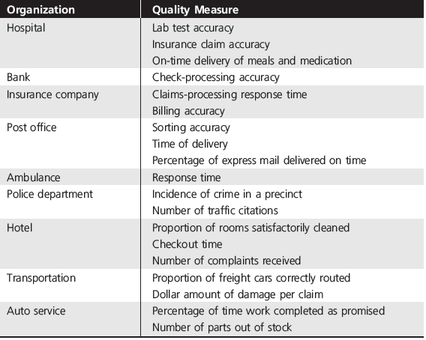
Quality Measurements
TQM
  .

Slide 46
Quality Measurements
TQM
  Inspecting smartphone
  10 quality characteristics (Camera, GPS, fingerprint, visuals, sound system, recording etc.)
  One day 500 smartphones were inspected
  18 of them were found nonconforming
$$Proportion nonconforming=\frac{Number of nonconforming units found}{Number of units inspected}$$
$$Nonconformances per unit (NPU)=\frac{Total number of nonconformances}{Number of units inspected}$$

Slide 47
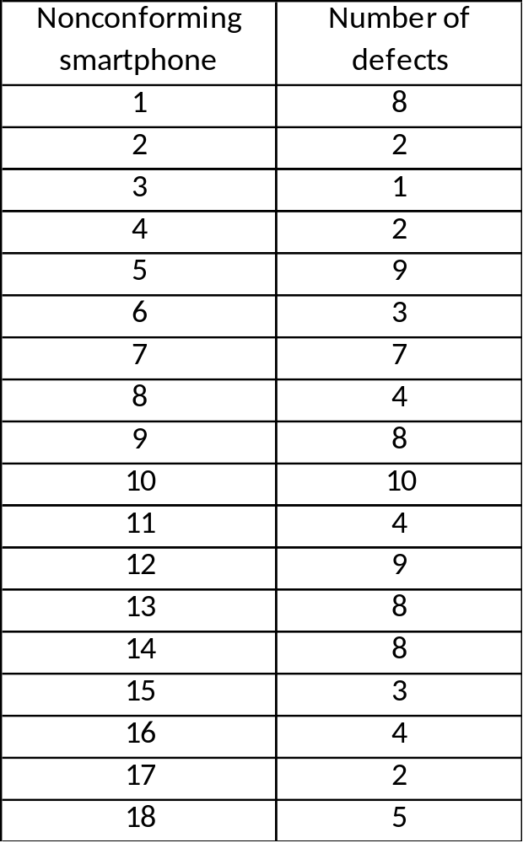
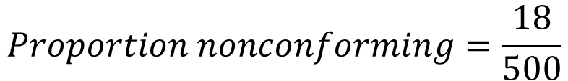
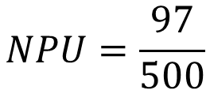
Quality Measurements
TQM
$$Proportion nonconforming=\frac{18}{500}$$
= 0.036
$$NPU=\frac{97}{500}$$
= 0.194
Total = 97

Slide 48

Quality Measurements
TQM
  Defects
  Critical defects
  Major defects
  Minor defects
 | Error Type | Weight
1 | Complaints reopened
2 | Damaged package
3 | Invoice adjustments
4 | Late pickup stops
5 | Lost packages
6 | Missed proof of delivery
7 | Right date late
8 | Traces
3
10
1
3
10
1
1
3

Slide 49
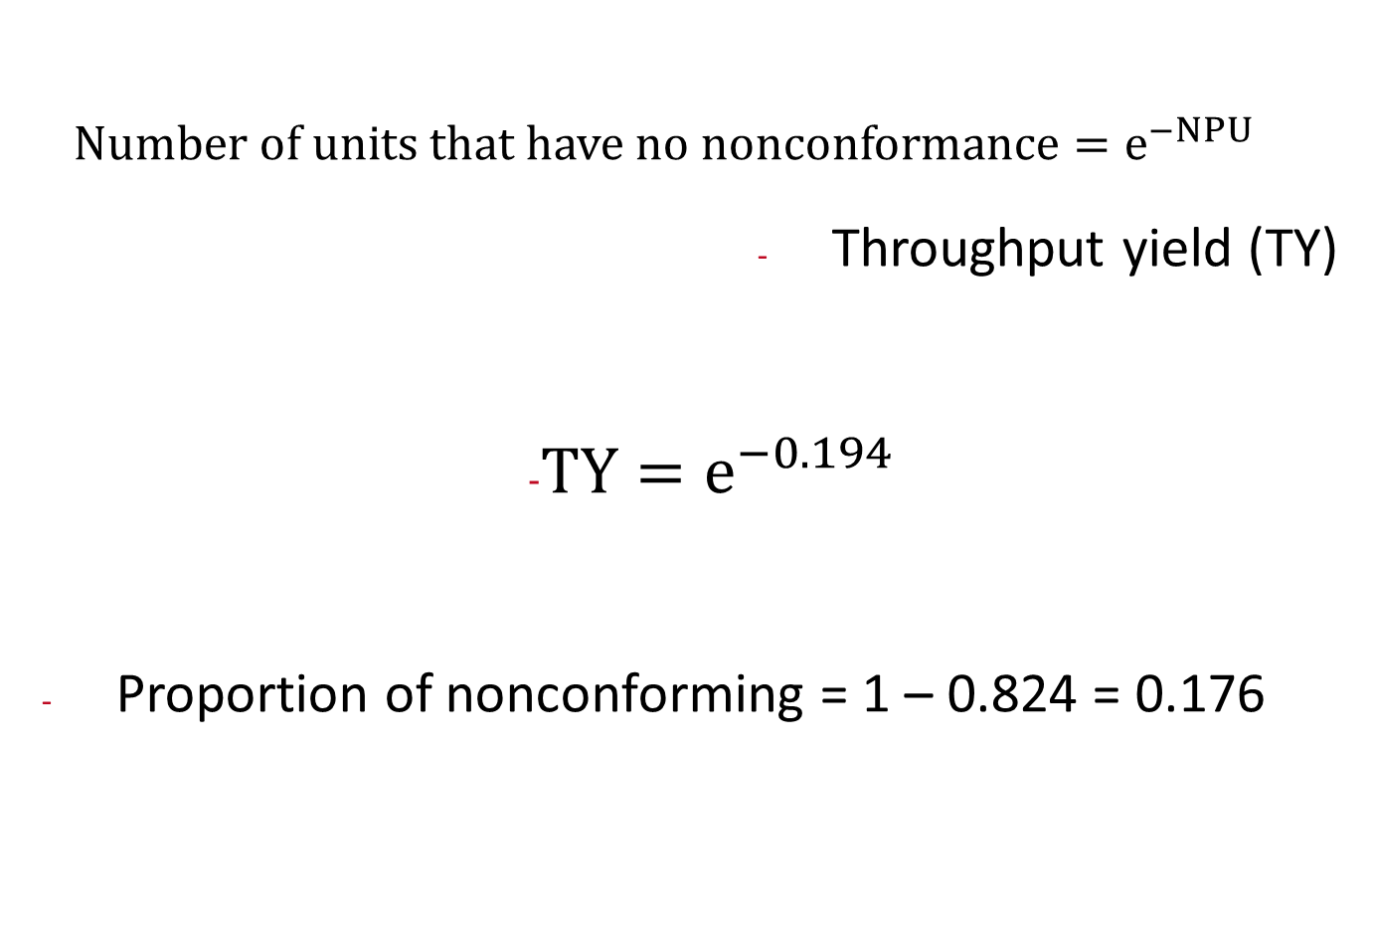
Quality Measurements
TQM
  $$Number of units that have no nonconformance=e^{−NPU}$$
  Throughput yield (TY)
                $TY=e^{−0.194}$
  Proportion of nonconforming = 1 – 0.824 = 0.176
= 0.824

Slide 50


Quality Measurements
Customer Focus
Rolled throughput yield (RTY)
y₁
y₂
y₃
Process 1
Process 2
Process 3
0.98
0.95
0.97
$$RTY=y_{1}×y_{2}×y_{3}$$
$$RTY=0.98×0.95×0.97$$
= 0.903
Proportion nonconforming = 1 – 0.903 = 0.097
Notes:
Essentially, they are the “hows” by which the company will respond to the “whats”—the customer requirements that will determine customer satisfaction or delight, often called critical to quality characteristics (CTQs).

Slide 51
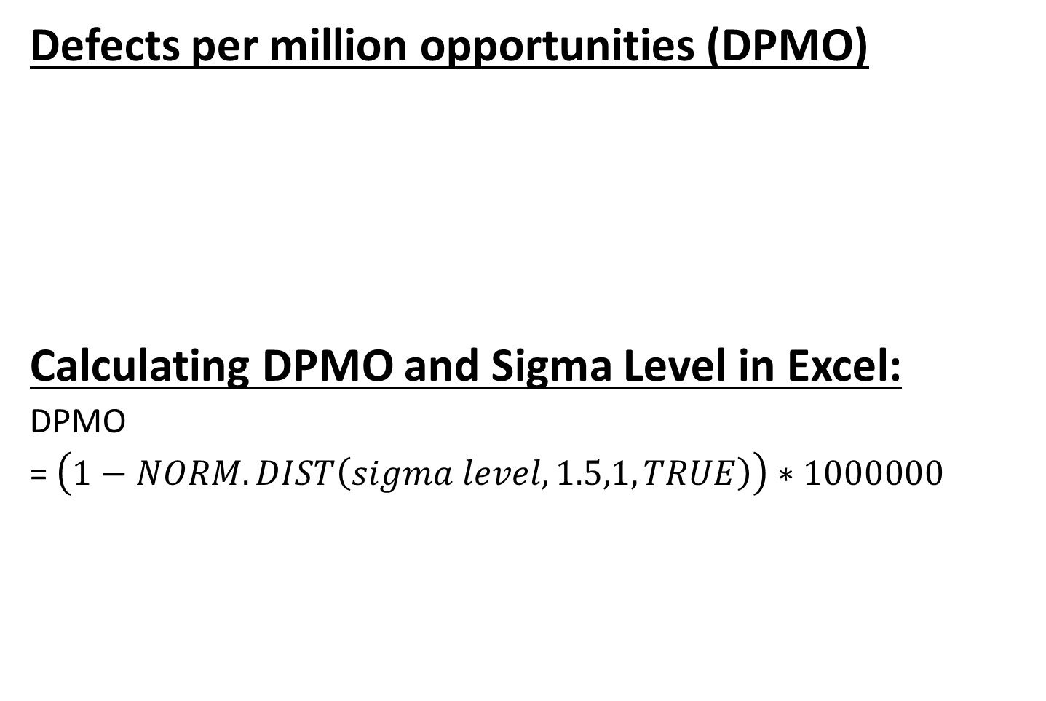
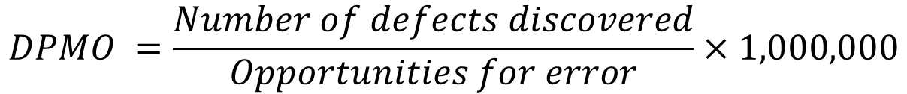
Quality Measurements
Customer Focus
Defects per million opportunities (DPMO)
Calculating DPMO and Sigma Level in Excel:
DPMO
= $\left(1−NORM.DIST\left(sigma level,1.5,1,TRUE\right)\right)∗1000000$
$$DPMO =\frac{Number of defects discovered}{Opportunities for error}×1,000,000$$
Sigma Level =$NORM.S.INV\left(1−\frac{DPMO}{1000000}\right)+1.5$
Notes:
Essentially, they are the “hows” by which the company will respond to the “whats”—the customer requirements that will determine customer satisfaction or delight, often called critical to quality characteristics (CTQs).

Slide 52
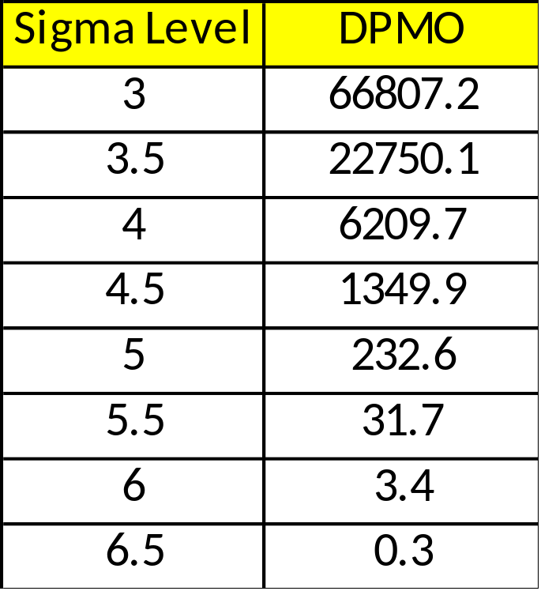
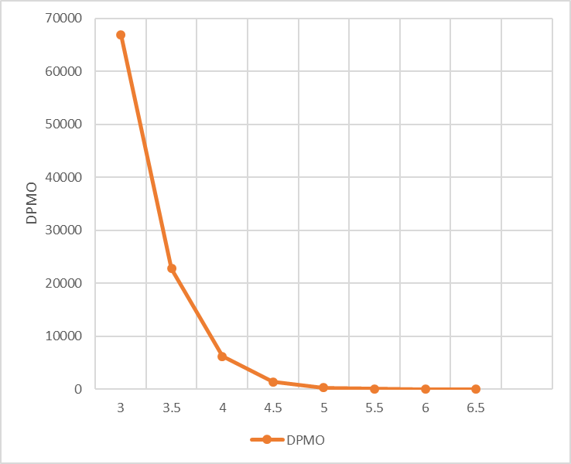
Quality Measurements
Customer Focus
Defects per million opportunities (DPMO)
Notes:
Essentially, they are the “hows” by which the company will respond to the “whats”—the customer requirements that will determine customer satisfaction or delight, often called critical to quality characteristics (CTQs).

Slide 53




Quality Measurements
Customer Focus
Defects per million opportunities (DPMO)
$$≈10 fold improvement$$
$$≈28 fold improvement$$
$$≈70 fold improvement$$
It is generally easy to move from 2 or 3 sigma level
to 4 sigma level, but moving beyond that requires
much more effort
Notes:
Essentially, they are the “hows” by which the company will respond to the “whats”—the customer requirements that will determine customer satisfaction or delight, often called critical to quality characteristics (CTQs).

Slide 54
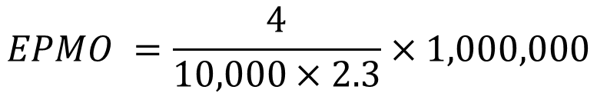
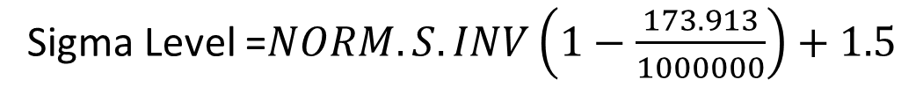

Quality Measurements
Customer Focus
Defects per million opportunities (DPMO)
Lost baggage on airport
Average bag per customer = 2.3
4 lost bags for 10,000 passengers over one month
In manufacturing fault is called defect, i.e., DPMO
In service fault is called error, i.e., EPMO
$$EPMO =\frac{4}{10,000×2.3}×1,000,000$$
$$=173.913$$
Sigma Level =$NORM.S.INV\left(1−\frac{173.913}{1000000}\right)+1.5$
= 5.0768
Baggage handling system on the airport is operating at
more than 5 sigma level
Notes:
Essentially, they are the “hows” by which the company will respond to the “whats”—the customer requirements that will determine customer satisfaction or delight, often called critical to quality characteristics (CTQs).

Slide 55
Six Sigma Implementation
6σ
Think in terms of key business processes and customer requirements with a clear focus on overall strategic objectives.
Focus on corporate sponsors responsible for championing projects, support team activities, help to overcome resistance to change, and obtain resources.
Emphasize such quantifiable measures as DPMO that can be applied to all parts of an organization: manufacturing, engineering, administrative, software, and so on.
Notes:
There is no harm in going from 6 to 7 og 8. In fact airline industry operate at 10 or more for flight take off & landing, but for all practical purposses in an industry where human life is not at risk six sigma is a good enough improvement benchmark.
More than that may not be worth the Time, money$$ and effort.

Slide 56
Six Sigma Implementation
Ensure that appropriate metrics are identified early in the process and that they focus on business results, thereby providing incentives and accountability.
Provide extensive training followed by project team deployment to improve profitability, reduce non-value-added activities, and achieve cycle time reduction.
Create highly qualified process improvement experts (“Green Belts,” “Black Belts,” and “Master Black Belts”) who can apply improvement tools and lead teams.
Set stretch objectives for improvement.
6σ
Notes:
There is no harm in going from 6 to 7 og 8. In fact airline industry operate at 10 or more for flight take off & landing, but for all practical purposses in an industry where human life is not at risk six sigma is a good enough improvement benchmark.
More than that may not be worth the Time, money$$ and effort.

Slide 57














Six Sigma Companies
Six Sigma

Slide 58
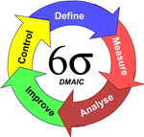
Six Sigma Methodology
Six Sigma
DMAIC
DMAIC: Dumb Managers Always Ignore Customers
Defines the project’s purpose, scope, and outputs, then identifies the required process information keeping in mind the customer’s definition of quality
Measures the process and collects data
Analyzes the data ensuring
repeatability and reproducibility
Improves by modifying or
redesigning existing
processes and procedures
Controls the new process
to make sure performance
levels are maintained
Create qualified process improvement experts (Black Belts, Green Belts, etc.)
Notes:
Cummins India Ltd., Tata Consultancy Services is one such name. TATA Motors, John Deere, Mahindra & Mahindra, KPMG, GenPact, Gabriel Motors, Lear Corporation are few other industry giants that are using Six Sigma methodologies.

Slide 59

DMAIC Tools and Techniques
Six Sigma
.
Notes:
Cummins India Ltd., Tata Consultancy Services is one such name. TATA Motors, John Deere, Mahindra & Mahindra, KPMG, GenPact, Gabriel Motors, Lear Corporation are few other industry giants that are using Six Sigma methodologies.

Slide 60
References.
Managing for Quality and Performance Excellence, Evans, J.R. and William M. Lindsay, W.M., Cengage Learning, India
The Six Sigma Handbook, Tomas Pyzdek and Paul Keller, Fourth edition, McGraw Hill India.
Total Quality Management, Besterfield et al., Revised third edition, Pearson India
The Management and Control of Quality, J. Evans, and W. Lindsay, Third edition, Cengage Learning

Slide 61
.
Thanks!

