Slide 1





Operations Management with Six Sigma
Dr. Gopal Kumar
gopalkumar@iimraipur.ac.in
IIM Raipur
08 March 2020

Slide 2
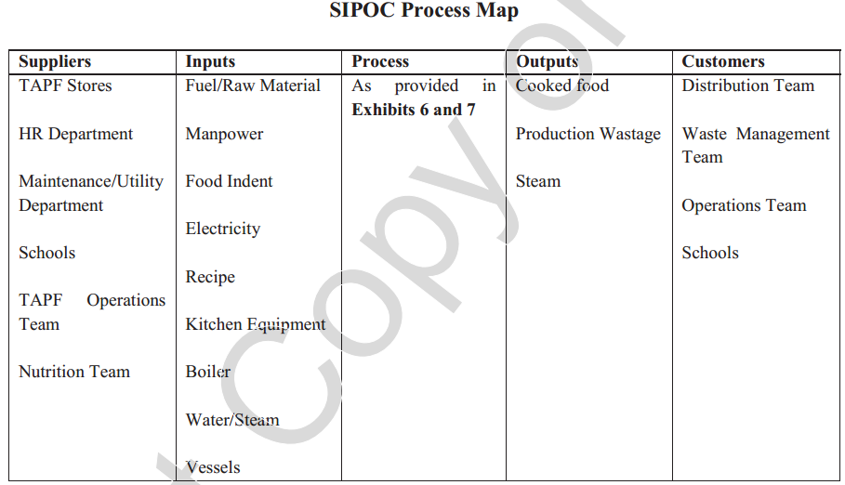
Era of Quality at the Akshaya Patra Foundation
Case Study
1. Developing a high level process map for the Akshay Patra Foundation using SIPOC.
Notes:
In any event, since we seek to understand the actual process in the Measure stage, the input of the process personnel is necessary.
Later, in the Improve stage, we will document a desired process after receiving input from all stakeholders.

Slide 3
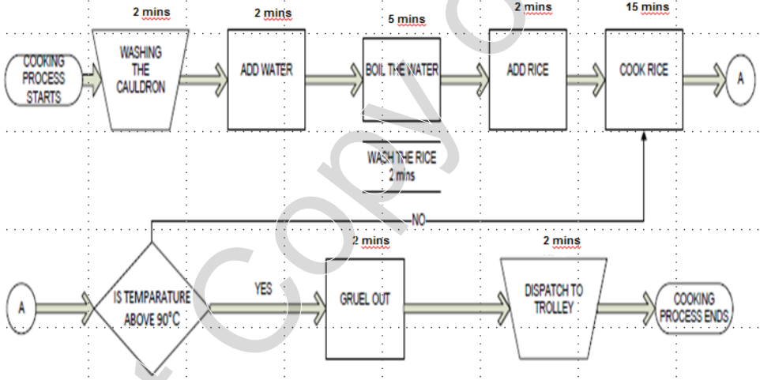
Era of Quality at the Akshaya Patra Foundation
Case Study
Process Map for Rice
Notes:
In any event, since we seek to understand the actual process in the Measure stage, the input of the process personnel is necessary.
Later, in the Improve stage, we will document a desired process after receiving input from all stakeholders.

Slide 4
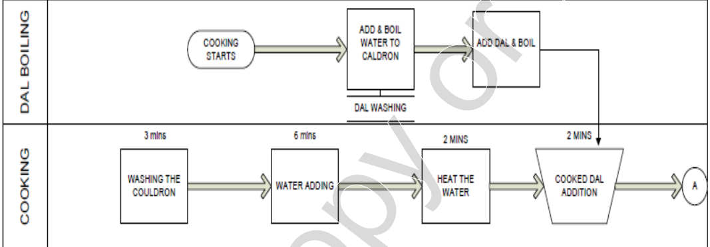
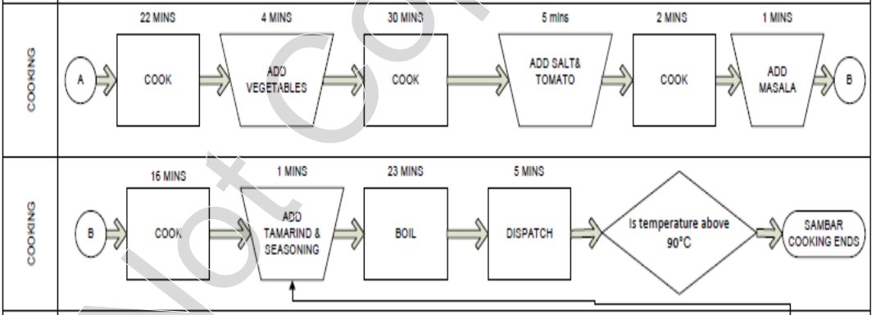
Era of Quality at the Akshaya Patra Foundation
Case Study
Process Map for Sambar
Notes:
In any event, since we seek to understand the actual process in the Measure stage, the input of the process personnel is necessary.
Later, in the Improve stage, we will document a desired process after receiving input from all stakeholders.

Slide 5
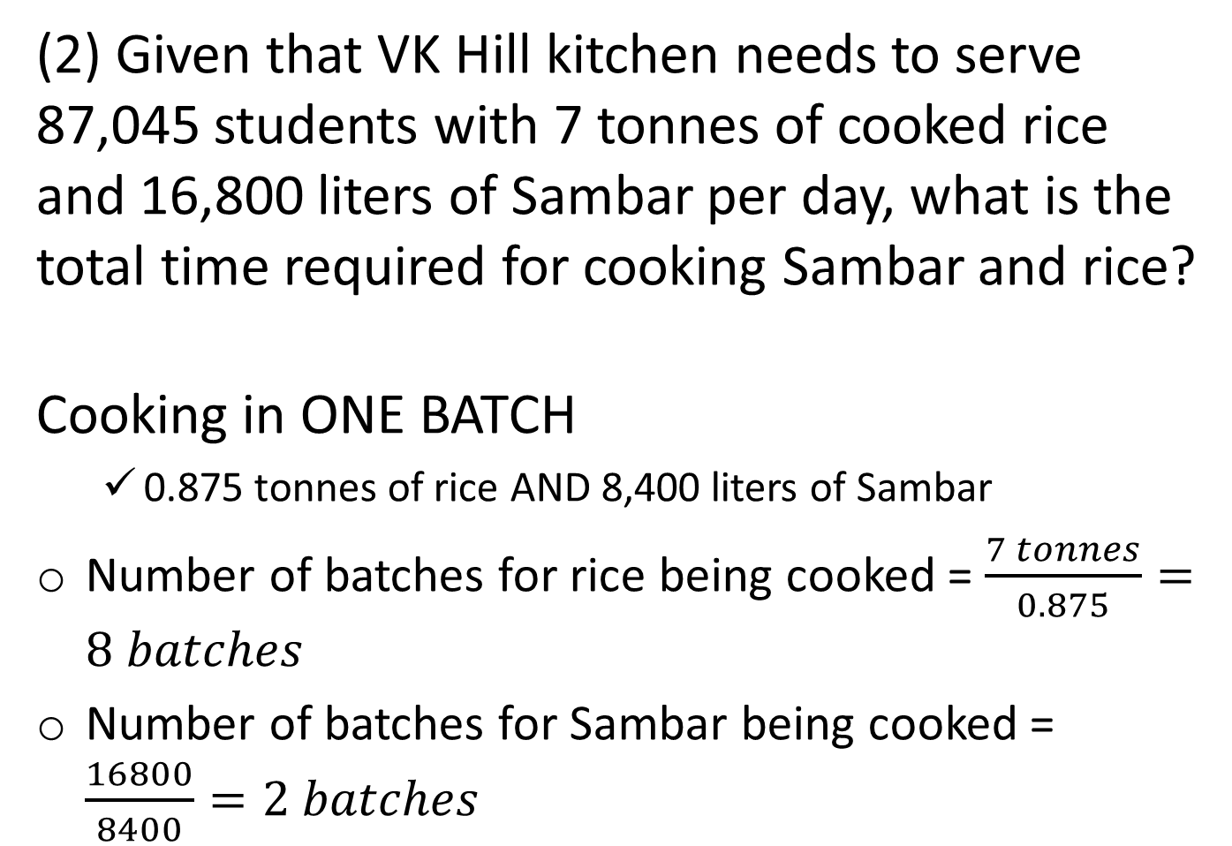
Era of Quality at the Akshaya Patra Foundation
Case Study
(2) Given that VK Hill kitchen needs to serve 87,045 students with 7 tonnes of cooked rice and 16,800 liters of Sambar per day, what is the total time required for cooking Sambar and rice?
Cooking in ONE BATCH
  0.875 tonnes of rice AND 8,400 liters of Sambar
Number of batches for rice being cooked = $\frac{7 tonnes}{0.875}=8 batches$
Number of batches for Sambar being cooked = $\frac{16800}{8400}=2 batches$
Notes:
In any event, since we seek to understand the actual process in the Measure stage, the input of the process personnel is necessary.
Later, in the Improve stage, we will document a desired process after receiving input from all stakeholders.

Slide 6
Era of Quality at the Akshaya Patra Foundation
Case Study
Time required to cook one batch of rice = 30 minutes (i.e., half an hour)
Time required to cook one batch of Sambar = 122 minutes (i.e., around 2 hours)
Time required to cook 8 batches of rice = $8×30=240 minutes$
Time required to cook 2 batches of Sambar = $2×122=244 minutes$
Total hour required to complete the cooking
= max(240, 244)/60 = 4 hours (approximately).
Notes:
In any event, since we seek to understand the actual process in the Measure stage, the input of the process personnel is necessary.
Later, in the Improve stage, we will document a desired process after receiving input from all stakeholders.

Slide 7
Era of Quality at the Akshaya Patra Foundation
Case Study
(3) If the food has to be delivered by 12.00 noon at the farthest school from the Vasanthapura kitchen (which takes 4 hours to reach), what are the LSL and USL for completion of the first batch of Sambar? If the cooking starts at 5.00 am, calculate the corresponding Sigma Score (assume that the std. dev for Sambar cooking is 10 minutes, while the average cooking time is as per Exhibit 7).
CTQ is cooking-to-consumption time ($≤6 hours$)
Time required to cook one batch of Sambar = 122 minutes (i.e., around 2 hours)
LSL (earliest time to end cooking)
= 12 noon – 6 hours = 6 am
Notes:
In any event, since we seek to understand the actual process in the Measure stage, the input of the process personnel is necessary.
Later, in the Improve stage, we will document a desired process after receiving input from all stakeholders.

Slide 8
Era of Quality at the Akshaya Patra Foundation
Case Study
First batch of rice and Sambar needs to be dispatched to the farthest location that takes 4 hours to ship
LSL (earliest time to end cooking) = 12 noon – 6 hours = 6 am
USL (latest time to end cooking)
= 12 noon – 4 hours (shipment time) – 0.30 minutes (loading time)
= 7:30 am
If cooking starts at 5.00 am, the mean completion time of the first batch of Sambar
= 5.00 am + 122 minutes = 7.02 am.
Notes:
In any event, since we seek to understand the actual process in the Measure stage, the input of the process personnel is necessary.
Later, in the Improve stage, we will document a desired process after receiving input from all stakeholders.

Slide 9
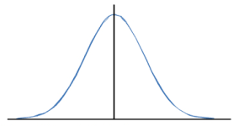
Era of Quality at the Akshaya Patra Foundation
Case Study
.
Mean time
LSL
USL
6 am
7.02 am
7.30 am
$$Sigma score=min\left(\frac{USL−mean}{σ}, \frac{Mean−LSL}{σ}\right)$$
$$=Min\left(\frac{7.30am−7.02am}{10}, \frac{7.02am−6am}{10}\right)$$
$$=Min\left(\frac{28}{10}, \frac{62}{10}\right)$$
$$=2.8$$
Notes:
In any event, since we seek to understand the actual process in the Measure stage, the input of the process personnel is necessary.
Later, in the Improve stage, we will document a desired process after receiving input from all stakeholders.

Slide 10
Era of Quality at the Akshaya Patra Foundation
Case Study
(4) For the upper and lower limits calculated in question 3 for Sambar cooking, calculate the optimal start time for Sambar cooking that will maximize the Sigma score.
Notes:
In any event, since we seek to understand the actual process in the Measure stage, the input of the process personnel is necessary.
Later, in the Improve stage, we will document a desired process after receiving input from all stakeholders.

Slide 11
Era of Quality at the Akshaya Patra Foundation
Case Study
Knowing the LSL and USL, defects can occur owing to the following reasons:
If 1st batch of cooking completes before 6 am (thus exceeding the cooking-to-consumption time, i.e., 6 hours)
If 1st batch of cooking is completed after 7.30 am (causing food may not be able to deliver to the farthest school before 12 noon)
LSL
USL
6 am
7.30 am
Notes:
In any event, since we seek to understand the actual process in the Measure stage, the input of the process personnel is necessary.
Later, in the Improve stage, we will document a desired process after receiving input from all stakeholders.

Slide 12
Era of Quality at the Akshaya Patra Foundation
Case Study
.
LSL
USL
6 am
7.30 am
x1
x2
Probability before x1 =
NORM.DIST(x1, Mean, Stdev, TRUE)
Probability after x1 =
1 - NORM.DIST(x1, Mean, Stdev, TRUE)
Total defect proportion = x1 + x2
Sigma Score = NORM.S.INV(x1 + x2)
Notes:
In any event, since we seek to understand the actual process in the Measure stage, the input of the process personnel is necessary.
Later, in the Improve stage, we will document a desired process after receiving input from all stakeholders.

Slide 13
Era of Quality at the Akshaya Patra Foundation
Case Study
.
LSL
USL
6 am
7.30 am
4 am
120 min
210 min
105 min
195 min
4:15 am
Notes:
In any event, since we seek to understand the actual process in the Measure stage, the input of the process personnel is necessary.
Later, in the Improve stage, we will document a desired process after receiving input from all stakeholders.

Slide 14
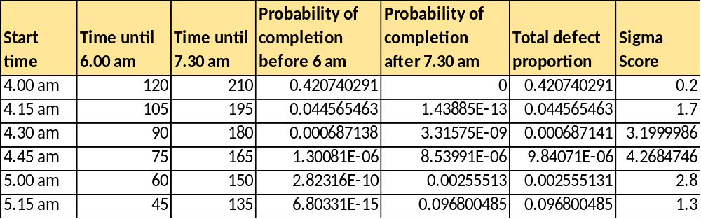
Era of Quality at the Akshaya Patra Foundation
Case Study
.
=NORM.DIST(120,122,10,TRUE)
=1-NORM.DIST(210,122,10,TRUE)
Notes:
In any event, since we seek to understand the actual process in the Measure stage, the input of the process personnel is necessary.
Later, in the Improve stage, we will document a desired process after receiving input from all stakeholders.

Slide 15
Era of Quality at the Akshaya Patra Foundation
Case Study
(5) Identify cost-effective means of reducing cooking cycle time, thereby increasing the Sigma score.
Non-availability of vessels
Quality of Toor Daal
Less manpower
Usage of cold water
Poor quality steam
Complex packaging specification
Design of cauldron
Notes:
In any event, since we seek to understand the actual process in the Measure stage, the input of the process personnel is necessary.
Later, in the Improve stage, we will document a desired process after receiving input from all stakeholders.

Slide 16
Era of Quality at the Akshaya Patra Foundation
Case Study
Guest visit during production
Less area in kitchen
Less capacity of Sambar vessel
Menu complexity
Delay in packing
Poor quality of raw material
Water unavailability
Notes:
In any event, since we seek to understand the actual process in the Measure stage, the input of the process personnel is necessary.
Later, in the Improve stage, we will document a desired process after receiving input from all stakeholders.

Slide 17
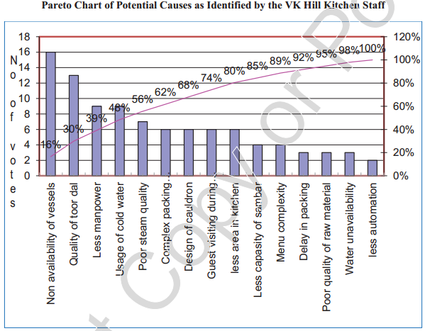
Era of Quality at the Akshaya Patra Foundation
Case Study
.
Notes:
In any event, since we seek to understand the actual process in the Measure stage, the input of the process personnel is necessary.
Later, in the Improve stage, we will document a desired process after receiving input from all stakeholders.

Slide 18
Era of Quality at the Akshaya Patra Foundation
Case Study
Improve
Implement the solution
Notes:
In any event, since we seek to understand the actual process in the Measure stage, the input of the process personnel is necessary.
Later, in the Improve stage, we will document a desired process after receiving input from all stakeholders.

Slide 19
Era of Quality at the Akshaya Patra Foundation
Case Study
Control
Notes:
In any event, since we seek to understand the actual process in the Measure stage, the input of the process personnel is necessary.
Later, in the Improve stage, we will document a desired process after receiving input from all stakeholders.

Slide 20
Era of Quality at the Akshaya Patra Foundation
Case Study
(6) After improving the Sigma score, what type of control mechanism needs to be adopted?
The TAPF should introduce a control mechanism to ensure that the cooking starts every day at 4.45 am
The start time of cooking should be recorded everyday and any deviation from 4.45 am should be analyzed and any causes of early or late start should be eliminated.
X-bar chart can be used to monitor and ensure that the cooking cycle time is maintained within the 3-sigma control limit.
Notes:
In any event, since we seek to understand the actual process in the Measure stage, the input of the process personnel is necessary.
Later, in the Improve stage, we will document a desired process after receiving input from all stakeholders.

Slide 21
Era of Quality at the Akshaya Patra Foundation
Case Study
(6) After improving the Sigma score, what type of control mechanism needs to be adopted?
LCL = 122 – 3*10 = 92
UCL = 122 + 3*10 = 152
Notes:
In any event, since we seek to understand the actual process in the Measure stage, the input of the process personnel is necessary.
Later, in the Improve stage, we will document a desired process after receiving input from all stakeholders.

Slide 22
Era of Quality at the Akshaya Patra Foundation
Case Study
(7) What strategies TAPF should use to orient and motivate the unskilled workers of the kitchen on quality aspects?
Notes:
In any event, since we seek to understand the actual process in the Measure stage, the input of the process personnel is necessary.
Later, in the Improve stage, we will document a desired process after receiving input from all stakeholders.

Slide 23
Inventory Management

Slide 24
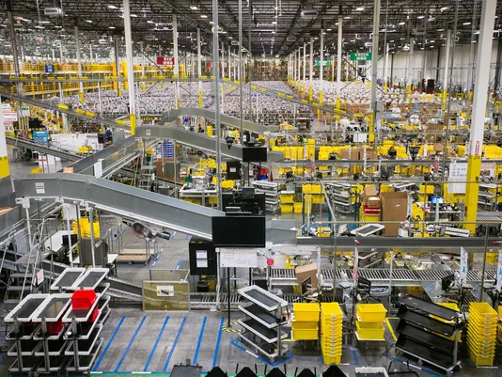

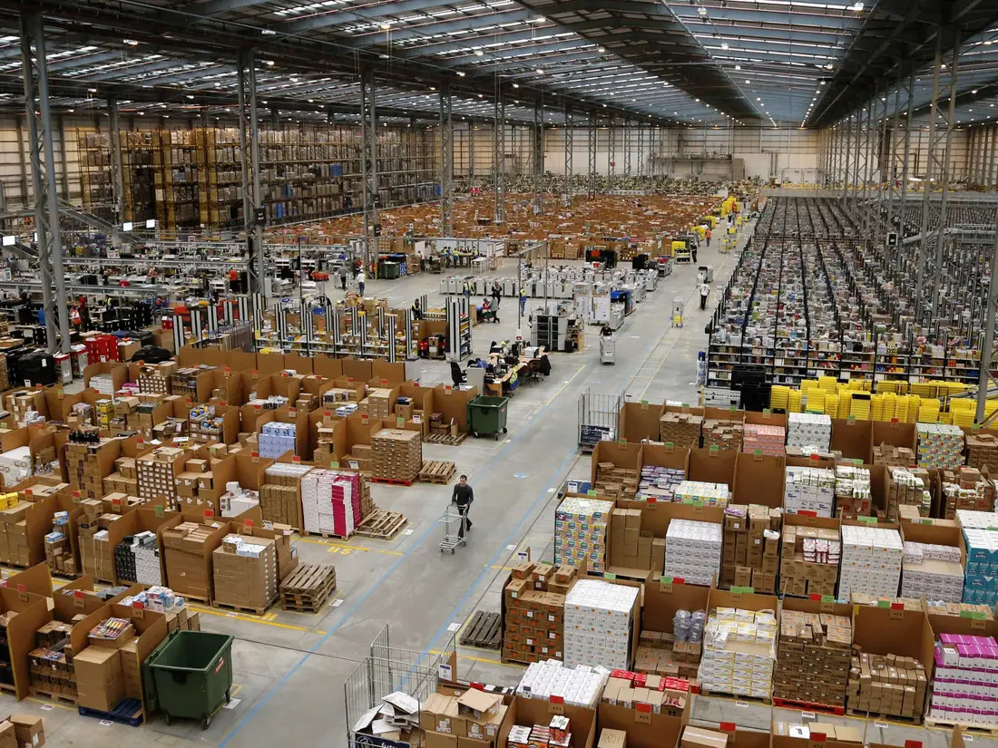
Amazon.com
1995, virtual retailer
Millions of items of inventory
Hundreds of thousands of bins on shelves
Over 175 warehouses around the world
Notes:
Managing this massive inventory precisely is the key for Amazon to be the world-class leader in warehouse automation and management.
As Amazon.com well knows, inventory is one of the most expensive assets of many companies, representing as much as 50% of total invested capital.

Slide 25

IKEA
Maximum/minimum settings
The in-store logistics managers use an inventory replenishment management process developed by IKEA called ‘minimum/maximum settings’ to respond to store-level inventory reorder points and reorder products.
Minimum settings: The minimum amount of products available before reordering.
Maximum settings: The maximum amount of a particular product to order at one time.
All IKEA inventory is stocked at night
Using IKEA’s proprietary inventory system, logistics managers know what is sold through point-of-sale (POS) data
The process meets customer demand while minimising ordering too few or too many products.
Notes:
https://www.tradegecko.com/blog/ikeas-inventory-management-strategy-ikea

Slide 26

Inventory
Inventory
A stock of materials used to satisfy customer demand or to support the production of services or goods.
Inventory management
The planning and controlling of inventories to meet the competitive priorities of the organization.
Notes:
The objective of inventory management is to strike a balance between inventory investment and customer service

Slide 27
Holding, Ordering, and Setup Costs
Holding costs are the costs associated with holding or “carrying” inventory over time.
Example: Obsolescence, storage cost, extra staffing, opportunity cost, interest payments, scrap
2. Ordering cost: This cost incurs whenever an order is placed. This cost includes costs of supplies, forms, order processing, purchasing, clerical support, and so forth.
3. Setup cost is the cost to prepare a machine or process for manufacturing an order.
Example: Time and labor to clean and change tools or holders
Notes:
The objective of inventory management is to strike a balance between inventory investment and customer service

Slide 28
Pressures for Large and Small Inventories
Increase in Inventory
Increase in Inventory
Increases
Increases
Holding cost
Customer service
Investment
Storage and handling cost
Decreases
Insurance
Setup cost
Ordering cost
Shrinkage
Unfavourable
Favourable

Slide 29
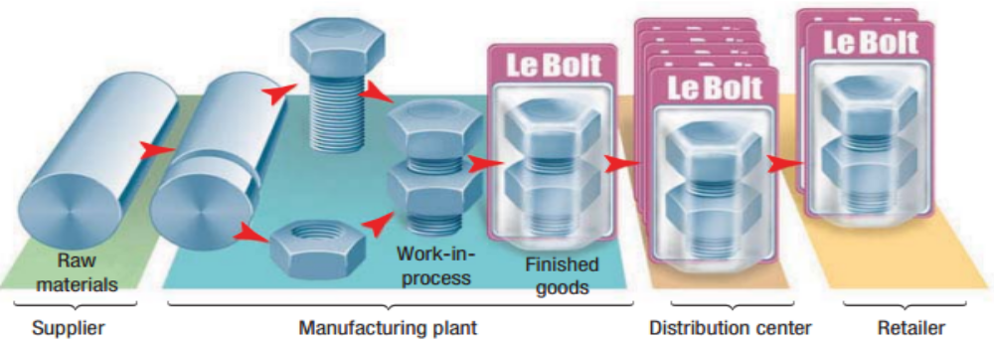
Types of inventory
Types of Inventory
Based on accounting
Raw materials
Work-in-process
Finished goods
Maintenance/repair/operating (MRO)
Notes:
‘Pipeline’ inventory exists because transformed resources cannot be moved instantaneously between the point of supply and the point
of demand.

Slide 30
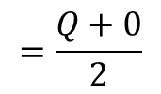
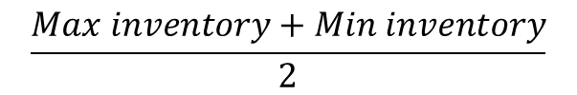
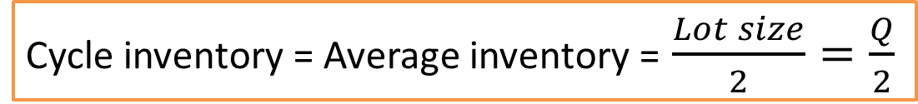
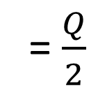
Types of inventory
Inventory
Q
Q
Average inventory
Lot size = Q
0
1
2
3
Time t
$$\frac{Max inventory+Min inventory}{2}$$
$$=\frac{Q+0}{2}$$
= $\frac{Q}{2}$
Average cycle inventory =
Cycle inventory = Average inventory = $\frac{Lot size}{2}=\frac{Q}{2}$
Notes:
Avg Inventory - End of class 8, Sec A & B

Slide 31
ABC Classification
Pareto principle: Critical few and trivial many
100 —
90 —
80 —
70 —
60 —
50 —
40 —
30 —
20 —
10 —
0 —
Class C
Class B
ABC Analysis
The process of dividing SKUs into three classes, according to their values, so that managers can focus on items that have the highest value.
Class A
Percentage of total value
10
20
30
40
50
60
70
80
90
100
Percentage of SKUs

Slide 32
ABC Classification
A Items
80 –
70 –
60 –
50 –
40 –
30 –
20 –
10 –
0 –
Percentage of annual dollar usage
B Items
C Items
| | | | | | | | | |
10 20 30 40 50 60 70 80 90 100
Percentage of inventory items

Slide 33
Economic Order Quantity (EOQ)
Q = Number of items per order
D = Annual demand in units for the inventory item
S = Setup or ordering cost for each order
H = Holding or carrying cost per unit per year
Number of order = $\frac{D}{Q}$
Time between order = $\frac{Q}{D}$

Slide 34
Economic Order Quantity (EOQ)
Annual holding cost
Annual holding cost = (Average cycle inventory) × (Unit holding cost)
$$=\frac{Q}{2}$$
H
Annual ordering cost
Annual ordering cost=(Number of orders/Year) × (Ordering or setup costs)
$$=\frac{D}{Q}$$
S
Total annual cycle inventory cost
Total costs = Annual holding cost + Annual ordering or setup cost
For optimal cost
$\frac{D}{Q}$S = $\frac{Q}{2}H$
Q* $= \sqrt{\frac{2DS}{H}}$

Slide 35
Economic Order Quantity (EOQ)
Total cost
Q* (EOQ)
Annual cost
Holding cost
Ordering cost
Lot Size (Q)

Slide 36
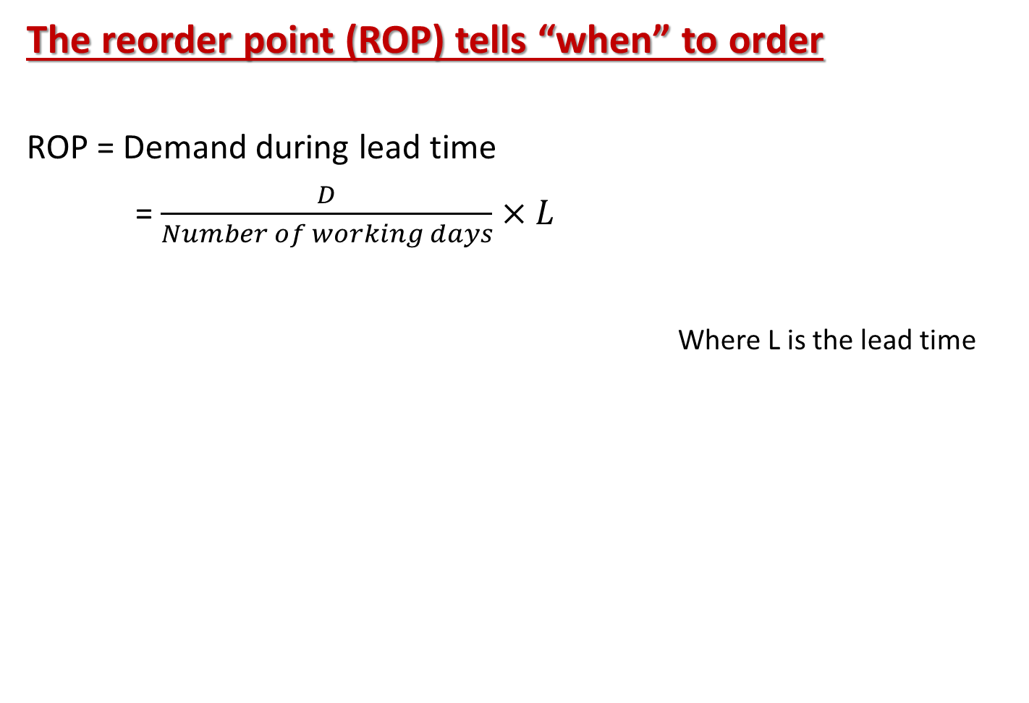
Reorder Points
The reorder point (ROP) tells “when” to order
ROP = Demand during lead time
= $\frac{D}{Number of working days}×L$
Where L is the lead time
Inventory position = Inventory on hand (OH) + Scheduled receipt (SR) - Backorder (BO)

Slide 37
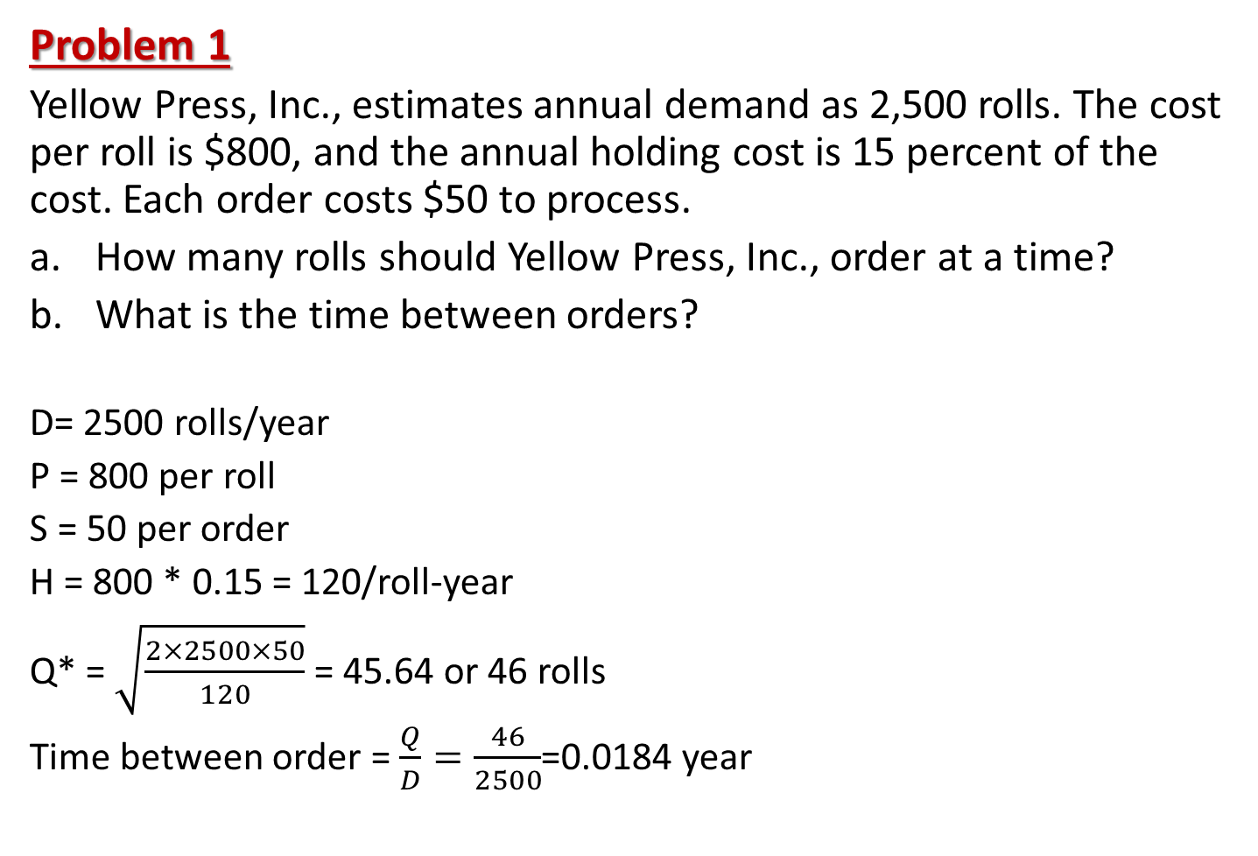
Economic Order Quantity (EOQ)
Problem 1
Yellow Press, Inc., estimates annual demand as 2,500 rolls. The cost per roll is $800, and the annual holding cost is 15 percent of the cost. Each order costs $50 to process.
How many rolls should Yellow Press, Inc., order at a time?
What is the time between orders?
D= 2500 rolls/year
P = 800 per roll
S = 50 per order
H = 800 * 0.15 = 120/roll-year
Q* = $\sqrt{\frac{2×2500×50}{120}}$ = 45.64 or 46 rolls
Time between order = $\frac{Q}{D}=\frac{46}{2500}$=0.0184 year

Slide 38
Economic Order Quantity (EOQ)
Exercise 1
Leaky Pipe, a local retailer of plumbing supplies, faces demand for one of its SKUs at a constant rate of 30,000 units per year. It costs Leaky Pipe $10 to process an order to replenish stock and $1 per unit per year to carry the item in stock. Stock is received 4 working days after an order is placed. No backordering is allowed. Assume 300 working days a year.
Find out optimal order quantity and total cost?
What is the optimal number of orders per year?
What is the optimal interval (in working days) between orders?
What is demand during the lead time?
What is the reorder point?
What is the inventory position immediately after an order has been placed?
775
39
7.7 days
400 units
400 units
1175 units

Slide 39
References.
Managing for Quality and Performance Excellence, Evans, J.R. and William M. Lindsay, W.M., Cengage Learning, India
The Six Sigma Handbook, Tomas Pyzdek and Paul Keller, Fourth edition, McGraw Hill India.
Total Quality Management, Besterfield et al., Revised third edition, Pearson India
The Management and Control of Quality, J. Evans, and W. Lindsay, Third edition, Cengage Learning

Slide 40
.
Thanks!

