Slide 1





Operations Management with Six Sigma
Dr. Gopal Kumar
gopalkumar@iimraipur.ac.in
IIM Raipur
01 March 2020

Slide 2
Deliverables
Define
Cost
Quality
Schedule
CTx
Success of Six Sigma Project
Critical to Quality
Critical to Schedule
Critical to Cost
Deliverables are validated and refined in the Measure stage through a thorough statistical analysis.

Slide 3
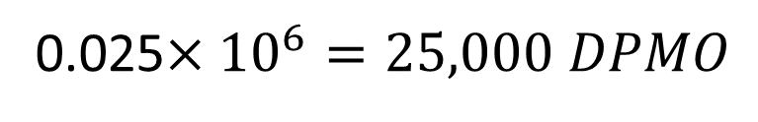
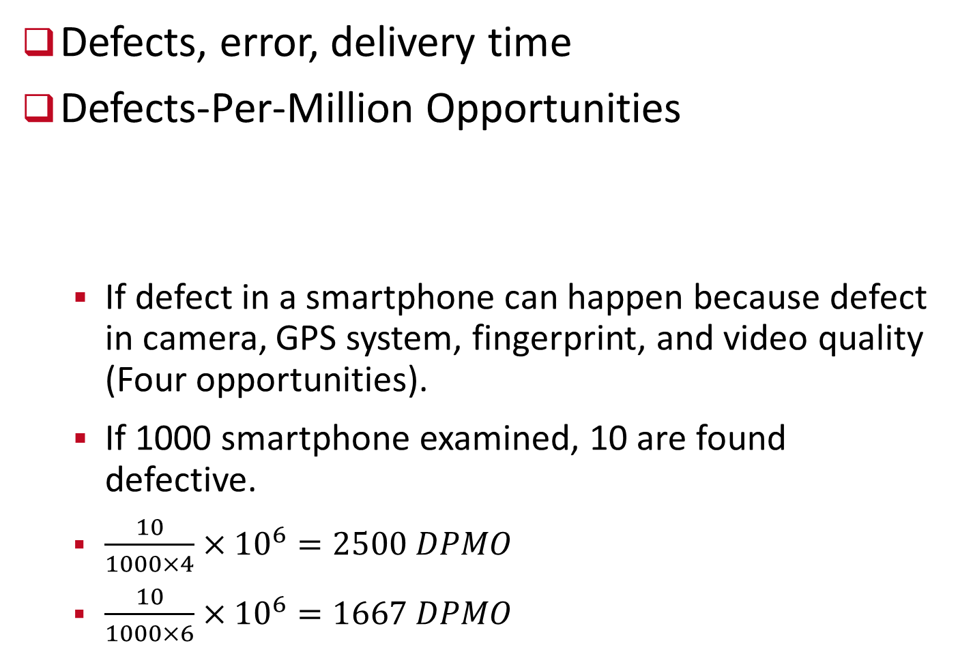
Critical to Quality
Define
Defects, error, delivery time
Defects-Per-Million Opportunities
  If defect in a smartphone can happen because defect in camera, GPS system, fingerprint, and video quality (Four opportunities).
  If 1000 smartphone examined, 10 are found defective.
  $\frac{10}{1000×4}×{10}^{6}=2500 DPMO$
  $\frac{10}{1000×6}×{10}^{6}=1667 DPMO$
2.5% defects
0.025$×{10}^{6}=25,000 DPMO$

Slide 4
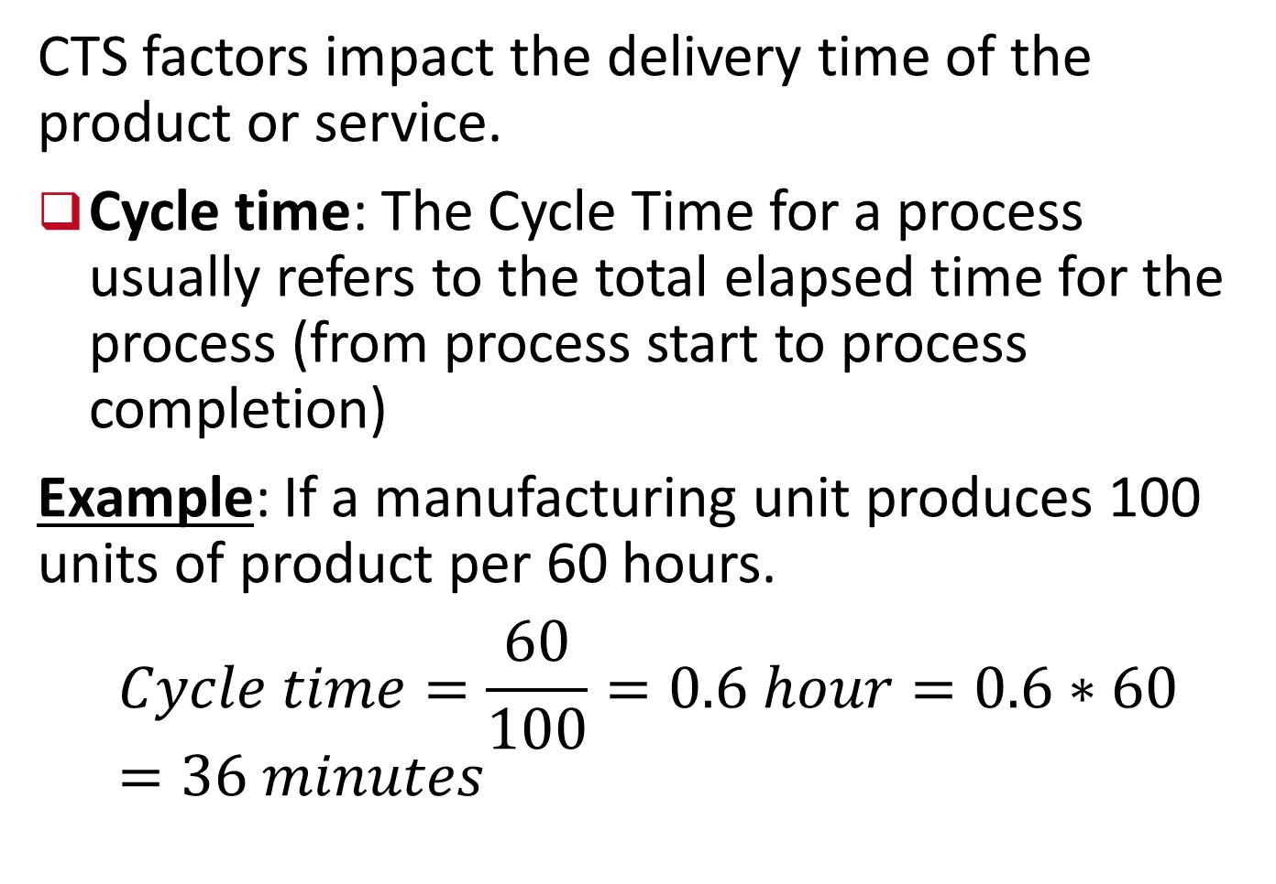
Critical to Schedule (CTS)
Define
CTS factors impact the delivery time of the product or service.
Cycle time: The Cycle Time for a process usually refers to the total elapsed time for the process (from process start to process completion)
Example: If a manufacturing unit produces 100 units of product per 60 hours.
$$Cycle time=\frac{60}{100}=0.6 hour=0.6∗60=36 minutes$$
On an average it takes 36 minutes to produce a unit of product.

Slide 5
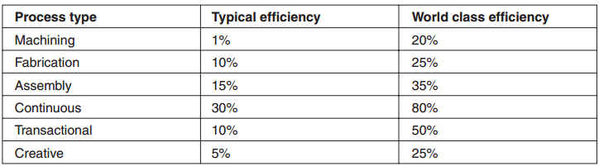
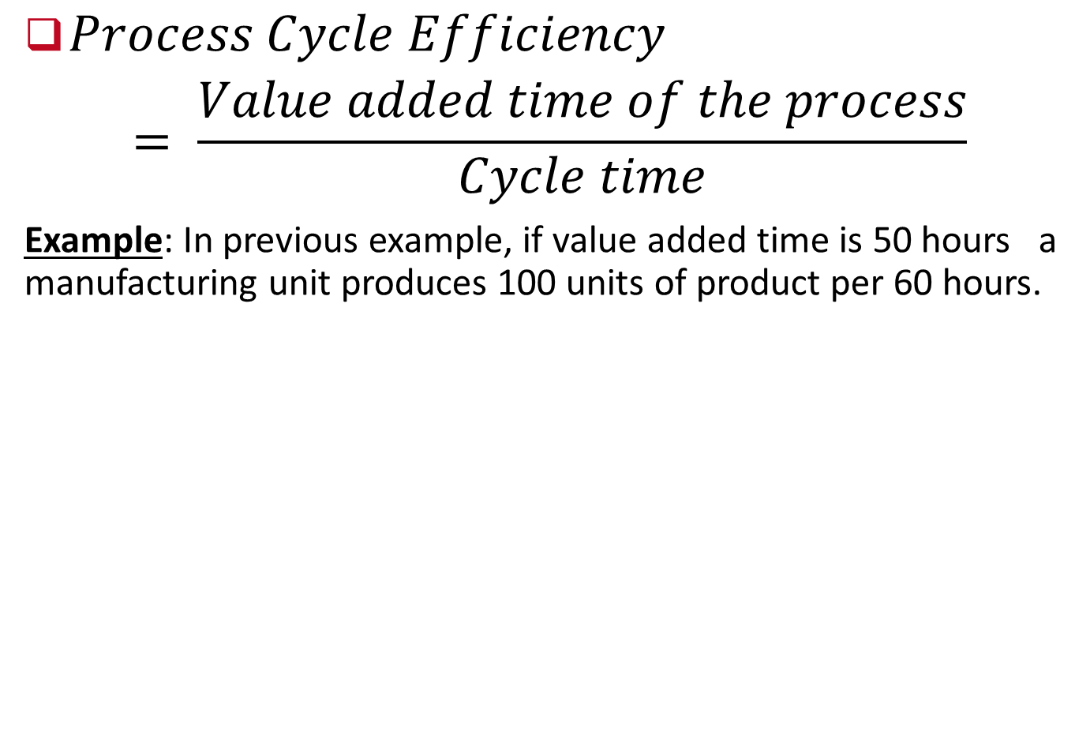

Critical to Schedule (CTS)
Define
$Process Cycle Efficiency$
$$= \frac{Value added time of the process}{Cycle time}$$
Example: In previous example, if value added time is 50 hours a manufacturing unit produces 100 units of product per 60 hours.
$$Process cycle efficiency= \frac{50}{60}=83.33\%$$

Slide 6
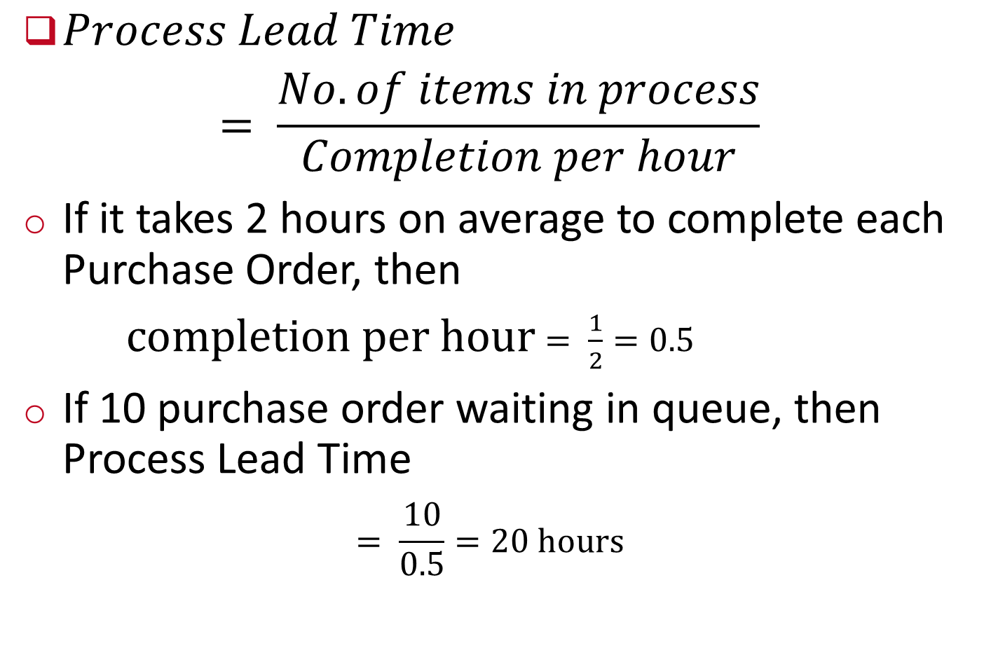
Critical to Schedule
Define
$Process Lead Time$
$$= \frac{No. of items in process}{Completion per hour}$$
If it takes 2 hours on average to complete each Purchase Order, then
$completion per hour$ $= \frac{1}{2}=0.5$
If 10 purchase order waiting in queue, then Process Lead Time
$$= \frac{10}{0.5}=20 hours$$
Notes:
New orders can’t be processed until the 20 hour lead time has allowed the existing Work in Process to be completed.

Slide 7
Critical to Cost (CTC)
Define
CTQ and CTS are often CTC as well
CTCs are similar to CTQs but deal exclusively
with the impact of cost on the customer/manufacturer.
Example includes
  work in progress,
  finished goods inventory,
  overhead,
  delivery,
  material and
  labor

Slide 8

Measure Phase
Measure
.
Notes:
Cummins India Ltd., Tata Consultancy Services is one such name. TATA Motors, John Deere, Mahindra & Mahindra, KPMG, GenPact, Gabriel Motors, Lear Corporation are few other industry giants that are using Six Sigma methodologies.

Slide 9
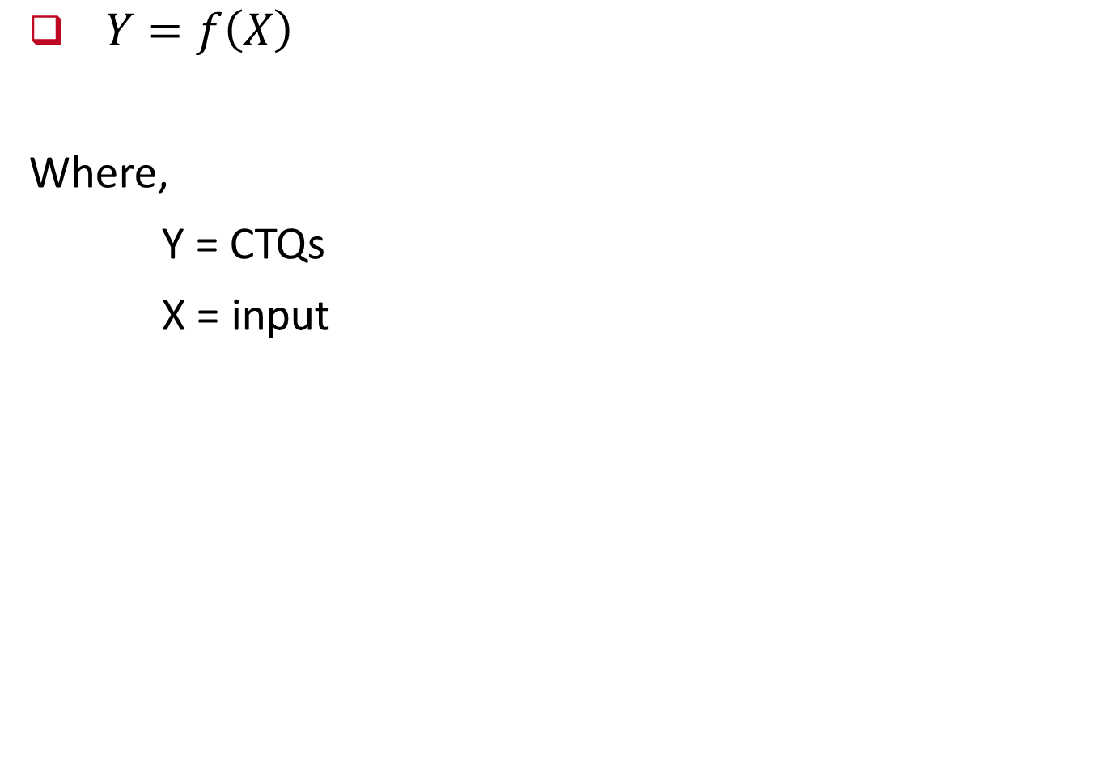
Measurement
$Y=f\left(X\right)$
Where,
Y = CTQs
X = input
Notes:
In any event, since we seek to understand the actual process in the Measure stage, the input of the process personnel is necessary.
Later, in the Improve stage, we will document a desired process after receiving input from all stakeholders.

Slide 10
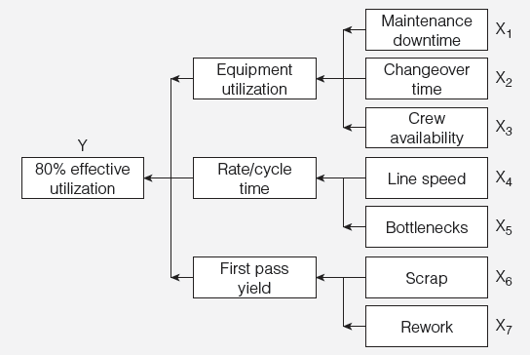

Measurement
$Y=f\left(X\right)$
Notes:
In any event, since we seek to understand the actual process in the Measure stage, the input of the process personnel is necessary.
Later, in the Improve stage, we will document a desired process after receiving input from all stakeholders.

Slide 11
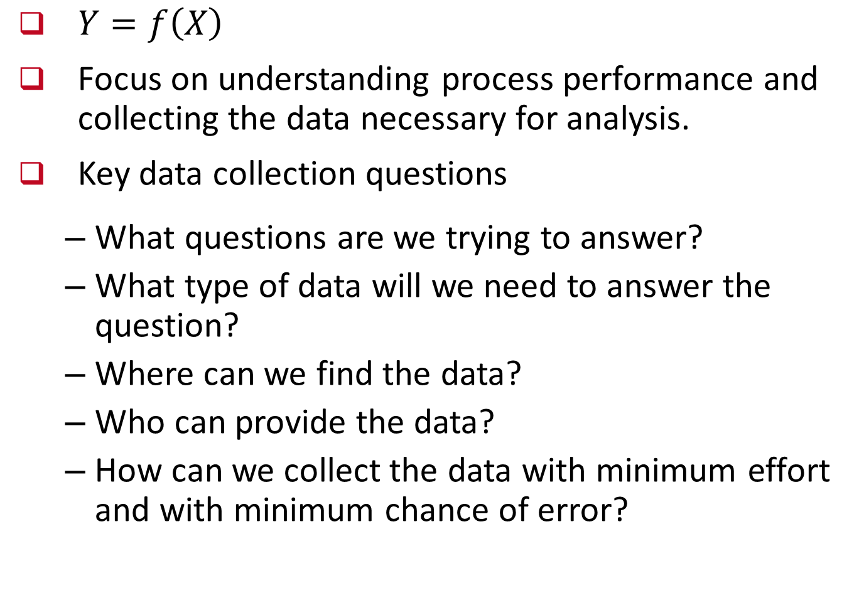
Measurement
$Y=f\left(X\right)$
Focus on understanding process performance and collecting the data necessary for analysis.
Key data collection questions
  What questions are we trying to answer?
  What type of data will we need to answer the question?
  Where can we find the data?
  Who can provide the data?
  How can we collect the data with minimum effort and with minimum chance of error?
Notes:
In any event, since we seek to understand the actual process in the Measure stage, the input of the process personnel is necessary.
Later, in the Improve stage, we will document a desired process after receiving input from all stakeholders.

Slide 12
Measurement
Operational definitions – clarify performance measures
  On-time delivery? (Does it mean within one day, two day or what?)
  Error? (Wrong information? Typographical mistakes? Or either)
  Satisfied customers?
  Quality?
Notes:
In any event, since we seek to understand the actual process in the Measure stage, the input of the process personnel is necessary.
Later, in the Improve stage, we will document a desired process after receiving input from all stakeholders.

Slide 13
Measurement System Evaluation
Measure
Observed variation in process output stems from the natural variation that occurs in the output itself as well as the measurement system.
The total observed variation in production output is the sum of the true process variation (which is what we actually want to measure) plus variation due to measurement:
Notes:
In any event, since we seek to understand the actual process in the Measure stage, the input of the process personnel is necessary.
Later, in the Improve stage, we will document a desired process after receiving input from all stakeholders.

Slide 14
Measurement System Evaluation
Measure
Manual inspection
Accuracy - the difference between the true value and the observed average of a measurement
  It is measured as the amount of error in a measurement in proportion to the total size of the measurement.
Precision - the closeness of repeated measurements to each other
  It is measured as the variance of repeated measurements.
Notes:
In any event, since we seek to understand the actual process in the Measure stage, the input of the process personnel is necessary.
Later, in the Improve stage, we will document a desired process after receiving input from all stakeholders.

Slide 15
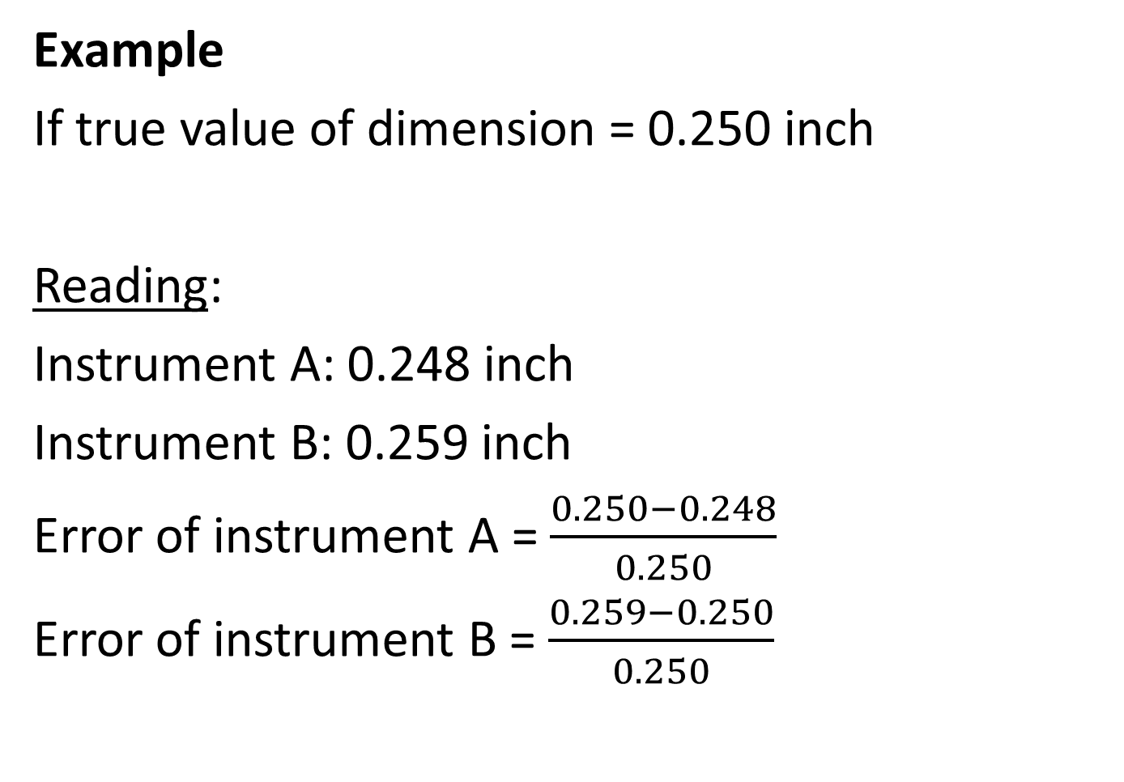
Measurement System Evaluation
Measure
Example
If true value of dimension = 0.250 inch
Reading:
Instrument A: 0.248 inch
Instrument B: 0.259 inch
Error of instrument A = $\frac{0.250−0.248}{0.250}$
Error of instrument B = $\frac{0.259−0.250}{0.250}$
More accurate
= 0.8%
= 3.6%
Notes:
In any event, since we seek to understand the actual process in the Measure stage, the input of the process personnel is necessary.
Later, in the Improve stage, we will document a desired process after receiving input from all stakeholders.

Slide 16
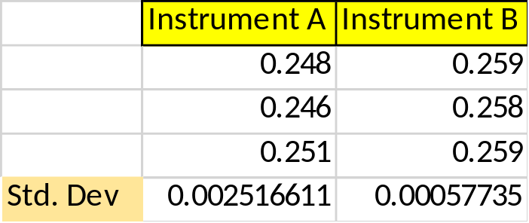
Measurement System Evaluation
Measure
Example
If true value of dimension = 0.250 inch
Reading:
Dimension has been measured three times by the both instrument A and B
Instrument A: 0.248, 0.246, 0.251
Instrument B: 0.259, 0.258, 0.259
More precise
Notes:
In any event, since we seek to understand the actual process in the Measure stage, the input of the process personnel is necessary.
Later, in the Improve stage, we will document a desired process after receiving input from all stakeholders.

Slide 17
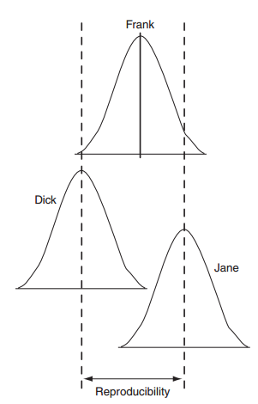
Repeatability and Reproducibility (R&R)
Measure
Repeatability (equipment variation, EV) – variation in multiple measurements by an individual using the same instrument.
Reproducibility
(appraiser variation, AV) –
variation in the same measuring
instrument used
by different individuals.
Notes:
In any event, since we seek to understand the actual process in the Measure stage, the input of the process personnel is necessary.
Later, in the Improve stage, we will document a desired process after receiving input from all stakeholders.

Slide 18
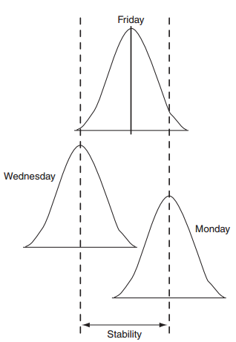
Repeatability and Reproducibility
Measure
Stability – Variance in the average when measuring over extended time period
Notes:
In any event, since we seek to understand the actual process in the Measure stage, the input of the process personnel is necessary.
Later, in the Improve stage, we will document a desired process after receiving input from all stakeholders.

Slide 19
Process Capability
Measure
We have already covered.
Notes:
In any event, since we seek to understand the actual process in the Measure stage, the input of the process personnel is necessary.
Later, in the Improve stage, we will document a desired process after receiving input from all stakeholders.

Slide 20
Data
Measure
Recording data
  Columnar
  Tabular forms
  Check sheets
Notes:
In any event, since we seek to understand the actual process in the Measure stage, the input of the process personnel is necessary.
Later, in the Improve stage, we will document a desired process after receiving input from all stakeholders.

Slide 21
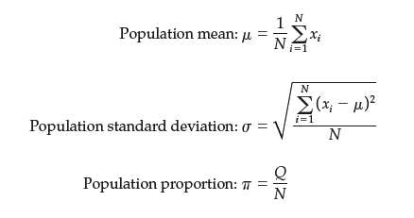
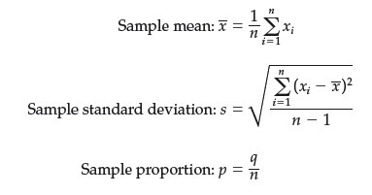
Descriptive Statistics
Measure
Populations
Sample
Notes:
In any event, since we seek to understand the actual process in the Measure stage, the input of the process personnel is necessary.
Later, in the Improve stage, we will document a desired process after receiving input from all stakeholders.

Slide 22
Descriptive Statistics
Measure
Mean: AVERAGE(data range)
Median: MEDIAN(data range)
Mode: MODE.SNGL(data range) or MODE.MULT(data range)
Range: =MAX(data range) – MIN(data range)
Variance: VAR.S(data range) or VAR.P(data range)
Standard deviation: STDEV.S(data range) or STDEV.P(data range)
Excel Functions for Descriptive Statistics
Notes:
In any event, since we seek to understand the actual process in the Measure stage, the input of the process personnel is necessary.
Later, in the Improve stage, we will document a desired process after receiving input from all stakeholders.

Slide 23
Descriptive Statistics
Measure
Example
U-bolts are used in automotive assembly. A sample of 120 measurements of a critical dimension of U-bolts is collected. Analyze the data using descriptive statistics.
Notes:
In any event, since we seek to understand the actual process in the Measure stage, the input of the process personnel is necessary.
Later, in the Improve stage, we will document a desired process after receiving input from all stakeholders.

Slide 24
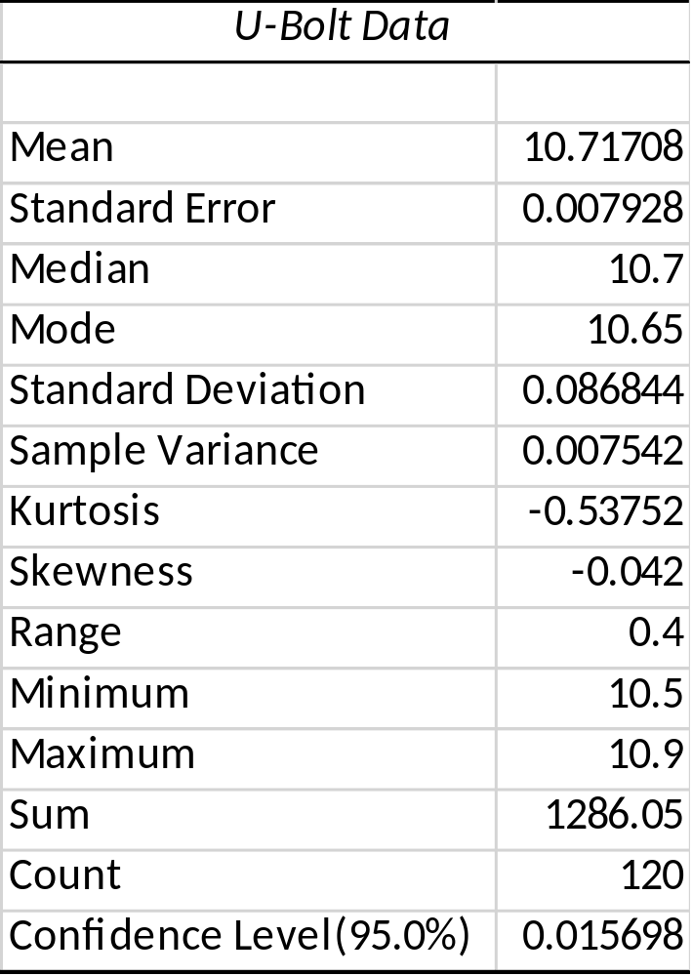
Descriptive Statistics
Measure
Example
Close to zero
(-1 < Skewness < +1)
Lower limit = 10.717-0.016
=10.70
Upper limit = 10.717+0.016
=10.73
Notes:
In any event, since we seek to understand the actual process in the Measure stage, the input of the process personnel is necessary.
Later, in the Improve stage, we will document a desired process after receiving input from all stakeholders.

Slide 25
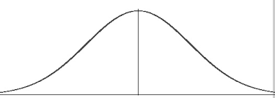
Descriptive Statistics
Measure
Example
10.70
10.73
10.717
LL
UL
Notes:
In any event, since we seek to understand the actual process in the Measure stage, the input of the process personnel is necessary.
Later, in the Improve stage, we will document a desired process after receiving input from all stakeholders.

Slide 26
Descriptive Statistics
Measure
Exercise 01
The times for carrying out a blood test at Rivervalley Labs for 100 tests are recorded in Excel workbook. The data were studied in order to better understand the process.
Apply the Descriptive Statistics tool to compute summary statistics and explain the results.
Also, construct a frequency distribution and histogram, for the data taken from set. From what type of distribution might you suspect the data are drawn?
Notes:
In any event, since we seek to understand the actual process in the Measure stage, the input of the process personnel is necessary.
Later, in the Improve stage, we will document a desired process after receiving input from all stakeholders.

Slide 27
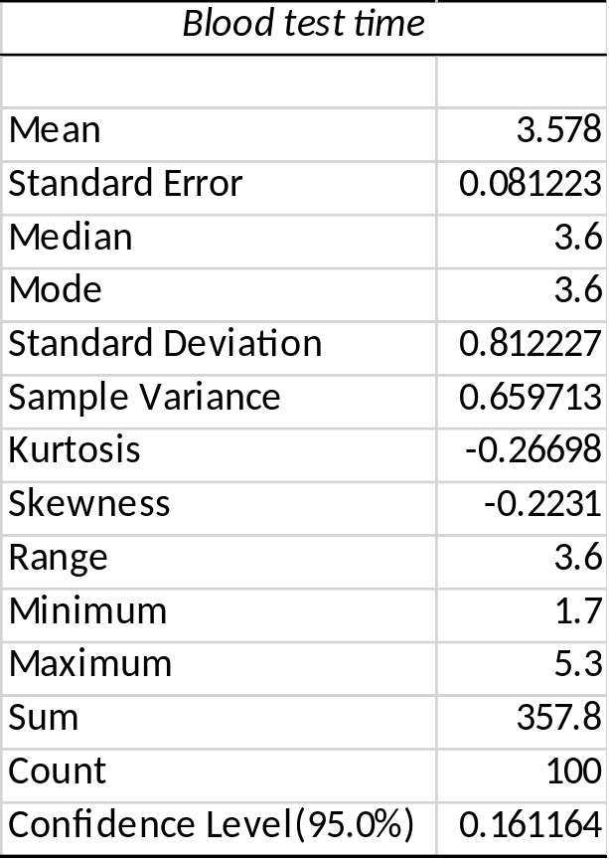
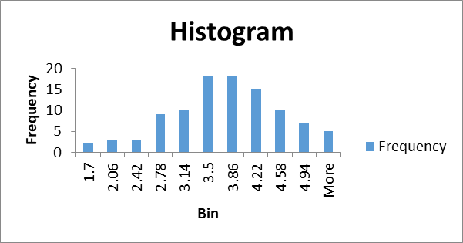
Descriptive Statistics
Measure
Exercise 01
Notes:
In any event, since we seek to understand the actual process in the Measure stage, the input of the process personnel is necessary.
Later, in the Improve stage, we will document a desired process after receiving input from all stakeholders.

Slide 28
Descriptive Statistics
Measure
Exercise 02
Use the data for Twenty-first Century Laundry for the weights of loads of clothes processed through their washing department in a week.
Apply the Excel Descriptive Statistics tool to compute the mean, standard deviation, and other relevant statistics, and interpret the results in a meaningful fashion.
Use the Frequency Distribution and Histogram Excel template to construct a frequency distribution and histogram for the data.
Notes:
In any event, since we seek to understand the actual process in the Measure stage, the input of the process personnel is necessary.
Later, in the Improve stage, we will document a desired process after receiving input from all stakeholders.

Slide 29
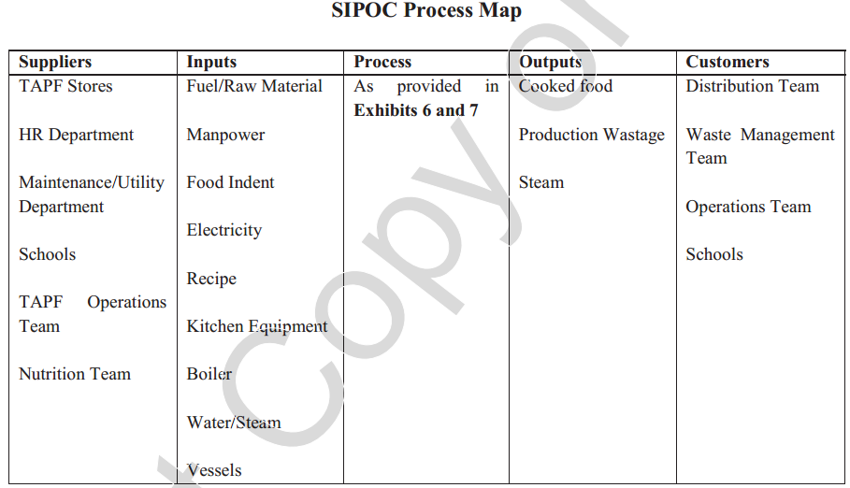
Era of Quality at the Akshaya Patra Foundation
Case Study
1. Developing a high level process map for the Akshay Patra Foundation using SIPOC.
Notes:
In any event, since we seek to understand the actual process in the Measure stage, the input of the process personnel is necessary.
Later, in the Improve stage, we will document a desired process after receiving input from all stakeholders.

Slide 30
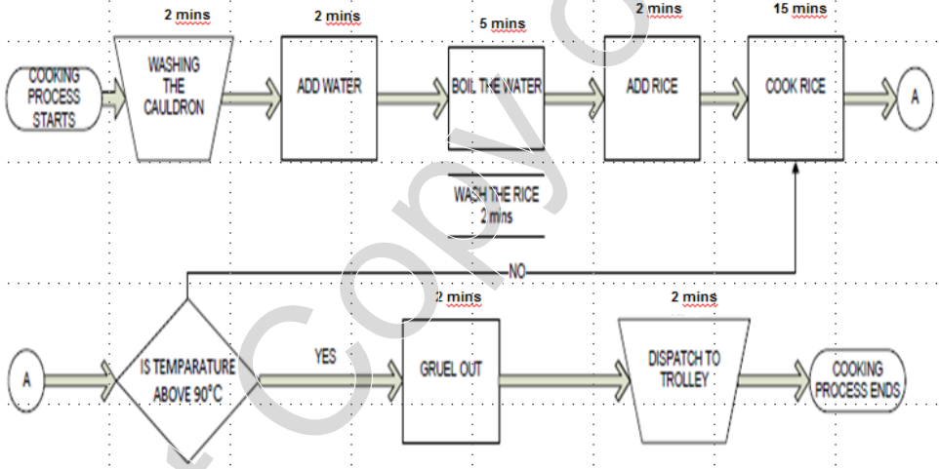
Era of Quality at the Akshaya Patra Foundation
Case Study
Process Map for Rice
Notes:
In any event, since we seek to understand the actual process in the Measure stage, the input of the process personnel is necessary.
Later, in the Improve stage, we will document a desired process after receiving input from all stakeholders.

Slide 31
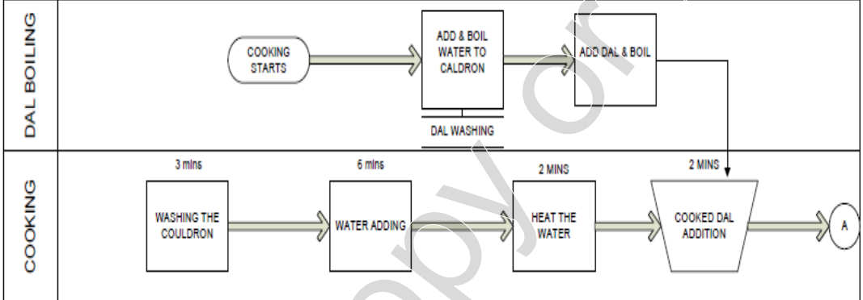
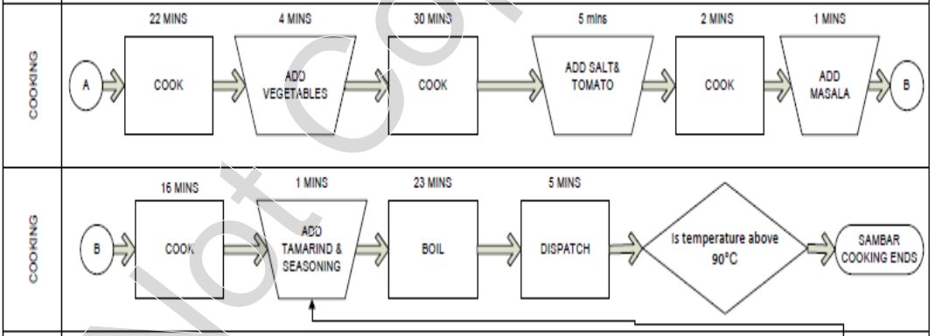
Era of Quality at the Akshaya Patra Foundation
Case Study
Process Map for Sambar
Notes:
In any event, since we seek to understand the actual process in the Measure stage, the input of the process personnel is necessary.
Later, in the Improve stage, we will document a desired process after receiving input from all stakeholders.

Slide 32
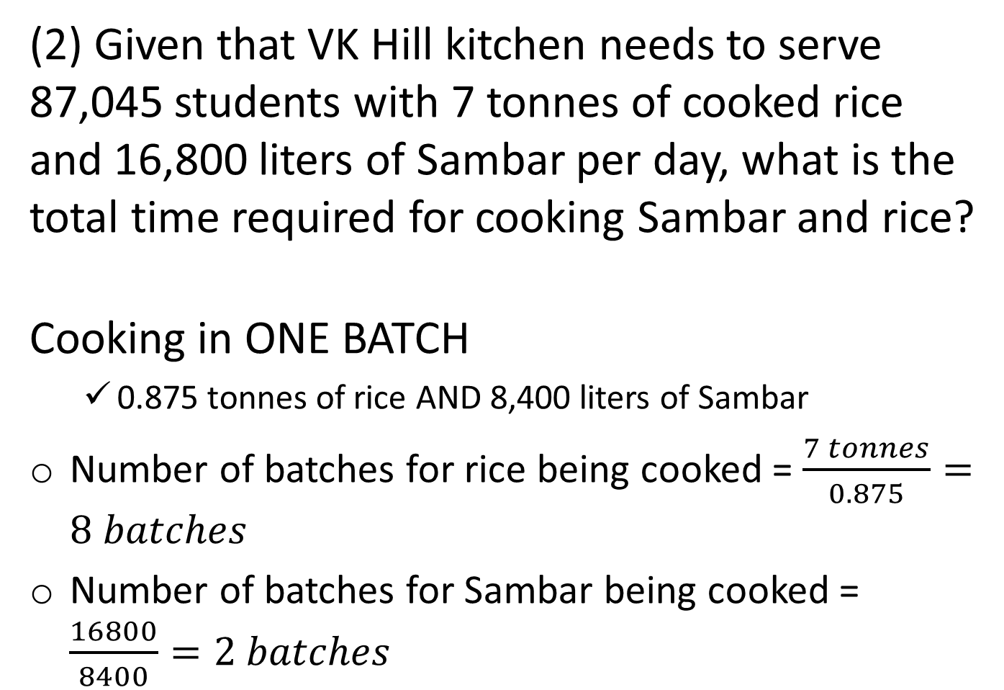
Era of Quality at the Akshaya Patra Foundation
Case Study
(2) Given that VK Hill kitchen needs to serve 87,045 students with 7 tonnes of cooked rice and 16,800 liters of Sambar per day, what is the total time required for cooking Sambar and rice?
Cooking in ONE BATCH
  0.875 tonnes of rice AND 8,400 liters of Sambar
Number of batches for rice being cooked = $\frac{7 tonnes}{0.875}=8 batches$
Number of batches for Sambar being cooked = $\frac{16800}{8400}=2 batches$
Notes:
In any event, since we seek to understand the actual process in the Measure stage, the input of the process personnel is necessary.
Later, in the Improve stage, we will document a desired process after receiving input from all stakeholders.

Slide 33
Era of Quality at the Akshaya Patra Foundation
Case Study
Time required to cook one batch of rice = 30 minutes (i.e., half an hour)
Time required to cook one batch of Sambar = 122 minutes (i.e., around 2 hours)
Time required to cook 8 batches of rice = $8×30=240 minutes$
Time required to cook 2 batches of Sambar = $2×122=244 minutes$
Total hour required to complete the cooking
= max(240, 244)/60 = 4 hours (approximately).
Notes:
In any event, since we seek to understand the actual process in the Measure stage, the input of the process personnel is necessary.
Later, in the Improve stage, we will document a desired process after receiving input from all stakeholders.

Slide 34
Era of Quality at the Akshaya Patra Foundation
Case Study
(3) If the food has to be delivered by 12.00 noon at the farthest school from the Vasanthapura kitchen (which takes 4 hours to reach), what are the LSL and USL for completion of the first batch of Sambar? If the cooking starts at 5.00 am, calculate the corresponding Sigma Score (assume that the std. dev for Sambar cooking is 10 minutes, while the average cooking time is as per Exhibit 7).
CTQ is cooking-to-consumption time ($≤6 hours$)
Time required to cook one batch of Sambar = 122 minutes (i.e., around 2 hours)
LSL (earliest time to end cooking)
= 12 noon – 6 hours = 6 am
Notes:
In any event, since we seek to understand the actual process in the Measure stage, the input of the process personnel is necessary.
Later, in the Improve stage, we will document a desired process after receiving input from all stakeholders.

Slide 35
Era of Quality at the Akshaya Patra Foundation
Case Study
First batch of rice and Sambar needs to be dispatched to the farthest location that takes 4 hours to ship
LSL (earliest time to end cooking) = 12 noon – 6 hours = 6 am
USL (latest time to end cooking)
= 12 noon – 4 hours (shipment time) – 0.30 minutes (loading time)
= 7:30 am
If cooking starts at 5.00 am, the mean completion time of the first batch of Sambar
= 5.00 am + 122 minutes = 7.02 am.
Notes:
In any event, since we seek to understand the actual process in the Measure stage, the input of the process personnel is necessary.
Later, in the Improve stage, we will document a desired process after receiving input from all stakeholders.

Slide 36
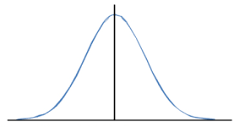
Era of Quality at the Akshaya Patra Foundation
Case Study
.
Mean time
LSL
USL
6 am
7.02 am
7.30 am
$$Sigma score=min\left(\frac{USL−mean}{σ}, \frac{Mean−LSL}{σ}\right)$$
$$=Min\left(\frac{7.30am−7.02am}{10}, \frac{7.02am−6am}{10}\right)$$
$$=Min\left(\frac{28}{10}, \frac{62}{10}\right)$$
$$=2.8$$
Notes:
In any event, since we seek to understand the actual process in the Measure stage, the input of the process personnel is necessary.
Later, in the Improve stage, we will document a desired process after receiving input from all stakeholders.

Slide 37
Era of Quality at the Akshaya Patra Foundation
Case Study
(4) For the upper and lower limits calculated in question 3 for Sambar cooking, calculate the optimal start time for Sambar cooking that will maximize the Sigma score.
Knowing the LSL and USL, defects can occur owing to the following reasons:
If 1st batch of cooking completes before 6 am (thus exceeding the cooking-to-consumption time, i.e., 6 hours)
If 1st batch of cooking is completed after 7.30 am (causing food may not be able to deliver to the farthest school before 12 noon)
Notes:
In any event, since we seek to understand the actual process in the Measure stage, the input of the process personnel is necessary.
Later, in the Improve stage, we will document a desired process after receiving input from all stakeholders.

Slide 38
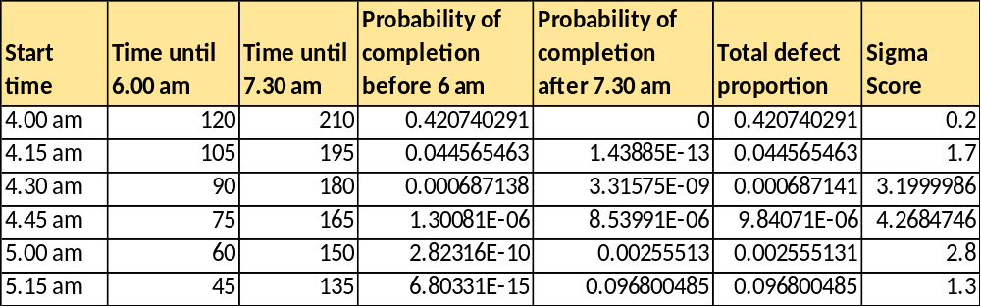
Era of Quality at the Akshaya Patra Foundation
Case Study
.
=NORM.DIST(120,122,10,TRUE)
=1-NORM.DIST(210,122,10,TRUE)
Notes:
In any event, since we seek to understand the actual process in the Measure stage, the input of the process personnel is necessary.
Later, in the Improve stage, we will document a desired process after receiving input from all stakeholders.

Slide 39
Era of Quality at the Akshaya Patra Foundation
Case Study
(5) Identify cost-effective means of reducing cooking cycle time, thereby increasing the Sigma score.
Non-availability of vessels
Quality of Toor Daal
Less manpower
Usage of cold water
Poor quality steam
Complex packaging specification
Design of cauldron
Notes:
In any event, since we seek to understand the actual process in the Measure stage, the input of the process personnel is necessary.
Later, in the Improve stage, we will document a desired process after receiving input from all stakeholders.

Slide 40
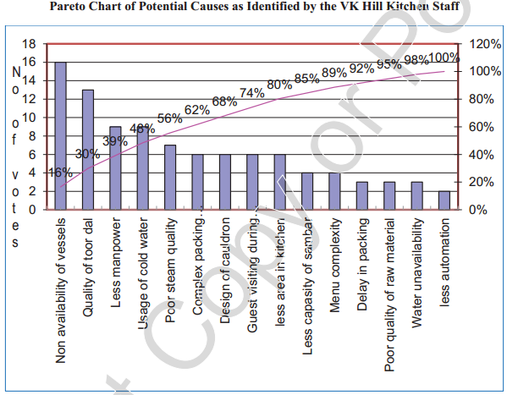
Era of Quality at the Akshaya Patra Foundation
Case Study
.
Notes:
In any event, since we seek to understand the actual process in the Measure stage, the input of the process personnel is necessary.
Later, in the Improve stage, we will document a desired process after receiving input from all stakeholders.

Slide 41
Era of Quality at the Akshaya Patra Foundation
Case Study
(6) Identify cost-effective means of reducing cooking cycle time, thereby increasing the Sigma score.
Guest visit during production
Less area in kitchen
Less capacity of Sambar vessel
Menu complexity
Delay in packing
Poor quality of raw material
Water unavailability
Notes:
In any event, since we seek to understand the actual process in the Measure stage, the input of the process personnel is necessary.
Later, in the Improve stage, we will document a desired process after receiving input from all stakeholders.

Slide 42
Era of Quality at the Akshaya Patra Foundation
Case Study
(6) After improving the Sigma score, what type of control mechanism needs to be adopted?
The TAPF should introduce a control mechanism to ensure that the cooking starts every day at 4.45 am
The start time of cooking should be recorded everyday and any deviation from 4.45 am should be analyzed and any causes of early or late start should be eliminated.
X-bar chart can be used to monitor and ensure that the cooking cycle time is maintained within the 3-sigma control limit.
Notes:
In any event, since we seek to understand the actual process in the Measure stage, the input of the process personnel is necessary.
Later, in the Improve stage, we will document a desired process after receiving input from all stakeholders.

Slide 43
Era of Quality at the Akshaya Patra Foundation
Case Study
(7) After improving the Sigma score, what type of control mechanism needs to be adopted?
LCL = 122 – 3*10 = 92
UCL = 122 + 3*10 = 152
Notes:
In any event, since we seek to understand the actual process in the Measure stage, the input of the process personnel is necessary.
Later, in the Improve stage, we will document a desired process after receiving input from all stakeholders.

Slide 44
Era of Quality at the Akshaya Patra Foundation
Case Study
(7) What strategies TAPF should use to orient and motivate the unskilled workers of the kitchen on quality aspects?
Notes:
In any event, since we seek to understand the actual process in the Measure stage, the input of the process personnel is necessary.
Later, in the Improve stage, we will document a desired process after receiving input from all stakeholders.

Slide 45
Queries
What has to be basics of project?
Can I demonstrate a problem which is to be solved/improved in my organization?
Should I necessarily use all the concepts/tools taught in sessions?
Does the assignment/project has to be on PPT or Word format(PDFs)?
Does project has to be prepared based on Operations Management concepts only, or we are required to incorporate some of the applications of six sigma methodologies too?
Notes:
In any event, since we seek to understand the actual process in the Measure stage, the input of the process personnel is necessary.
Later, in the Improve stage, we will document a desired process after receiving input from all stakeholders.

Slide 46
References.
Managing for Quality and Performance Excellence, Evans, J.R. and William M. Lindsay, W.M., Cengage Learning, India
The Six Sigma Handbook, Tomas Pyzdek and Paul Keller, Fourth edition, McGraw Hill India.
Total Quality Management, Besterfield et al., Revised third edition, Pearson India
The Management and Control of Quality, J. Evans, and W. Lindsay, Third edition, Cengage Learning

Slide 47
.
Thanks!

