Slide 1





Operations Management with Six Sigma
Dr. Gopal Kumar
gopalkumar@iimraipur.ac.in
IIM Raipur
23 February 2020

Slide 2

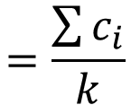
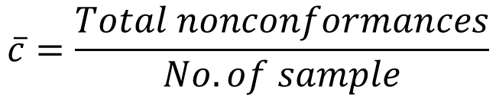


  c-charts for nonconforming
SPC
Collect 25-30 samples of equal size and count the number of nonconformances
Compute the average number of nonconformances per unit, c-bar
Standard deviation
Control limits
$$\overline{c}=\frac{Total nonconformances}{No. of sample}$$
$$=\frac{\sum{c_{i}}}{k}$$
$s_{c}=$ $\sqrt{\overline{c}}$
${UCL}_{c}=\overline{c}+3$ $\sqrt{\overline{c}}$
$${LCL}_{c}=\overline{c}−3 \sqrt{\overline{c}}$$

Slide 3
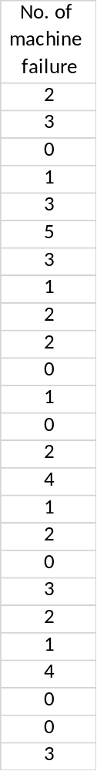
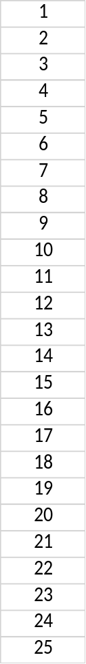



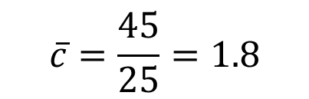

  c-charts for nonconforming
SPC
Number of machine failures over 25-day period
.
$$\overline{c}=\frac{45}{25}=1.8$$
${UCL}_{c}=\overline{c}+3$ $\sqrt{\overline{c}}$
$=1.8+3$ $\sqrt{1.8}=5.82$
$${LCL}_{c}=\overline{c}−3 \sqrt{\overline{c}}$$
$$=1.8−3 \sqrt{1.8}=−2.22 or 0$$
Sum 45

Slide 4
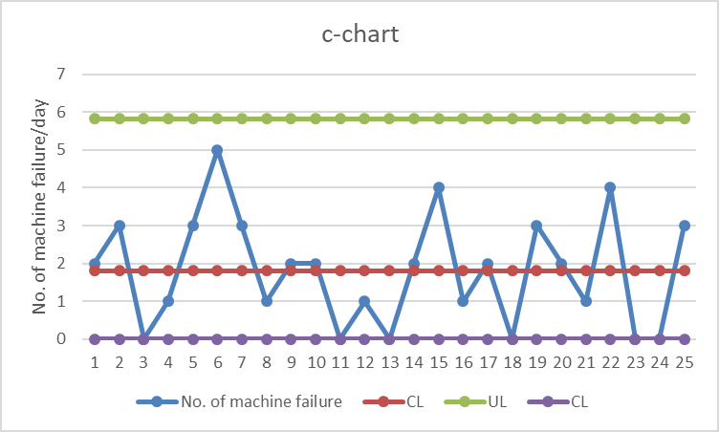
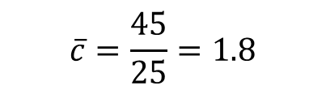




  c-charts for nonconforming
SPC
Number of machine failures over 25-day period
.
$$\overline{c}=\frac{45}{25}=1.8$$
${UCL}_{c}=\overline{c}+3$ $\sqrt{\overline{c}}$
$=1.8+3$ $\sqrt{1.8}=5.82$
$${LCL}_{c}=\overline{c}−3 \sqrt{\overline{c}}$$
$$=1.8−3 \sqrt{1.8}=−2.22 or 0$$
Sum 45

Slide 5
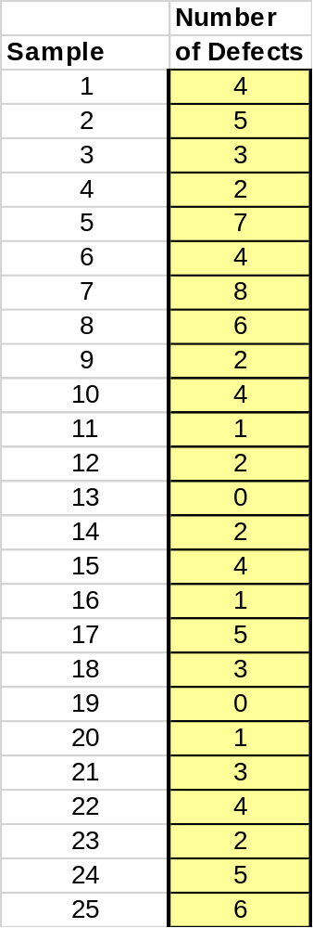
  c-charts for nonconforming
SPC
.

Slide 6
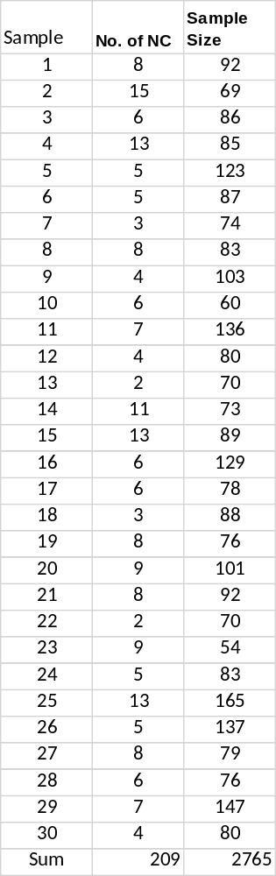


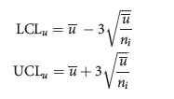
  u-charts for nonconforming
SPC
.
Applies if the samples are of unequal size
Collect samples and count the number of nonconformances
Compute the average number of nonconformances per unit, u-bar
Standard deviation
Control limits

Slide 7
  u-charts for nonconforming
SPC
A catalog distributor ships a variety of orders each day.
The packing slips often contain errors such as wrong purchase order numbers, wrong quantities, or incorrect sizes.
Error data is shown.
Because sample size varies each day, a u-chart will be appropriate.

Slide 8
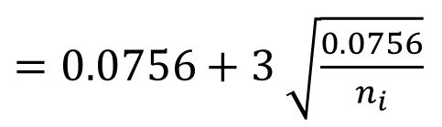
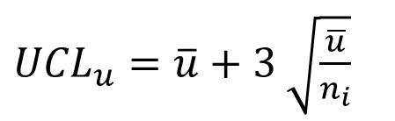
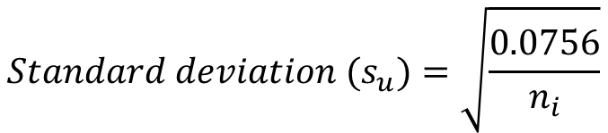

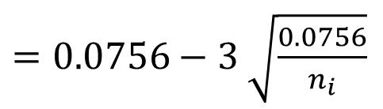
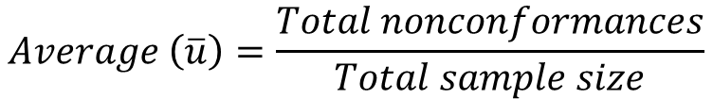
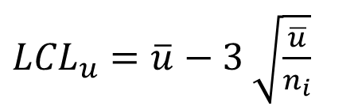
  u-charts for nonconforming
SPC
.
$$Average \left(\overline{u}\right)=\frac{Total nonconformances}{Total sample size}$$
$$=\frac{209}{2765}$$
=0.0756
$$Standard deviation (s_{u})=\sqrt{\frac{0.0756}{n_{i}}}$$
${UCL}_{u}=\overline{u}+3$ $\sqrt{\frac{\overline{u}}{n_{i}}}$
$=0.0756+3$ $\sqrt{\frac{0.0756}{n_{i}}}$
${LCL}_{u}=\overline{u}−3$ $\sqrt{\frac{\overline{u}}{n_{i}}}$
$=0.0756−3$ $\sqrt{\frac{0.0756}{n_{i}}}$

Slide 9
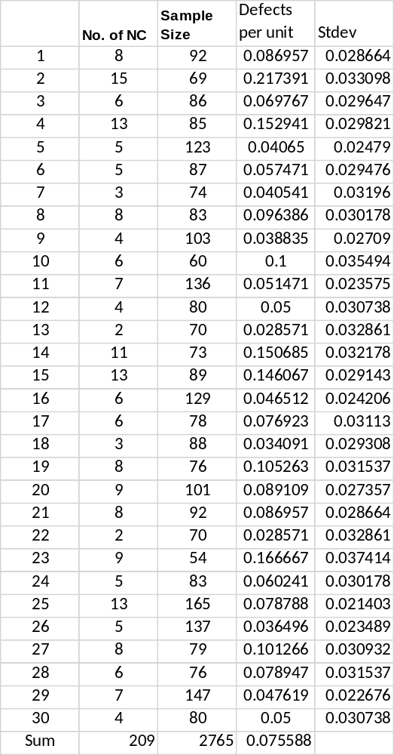
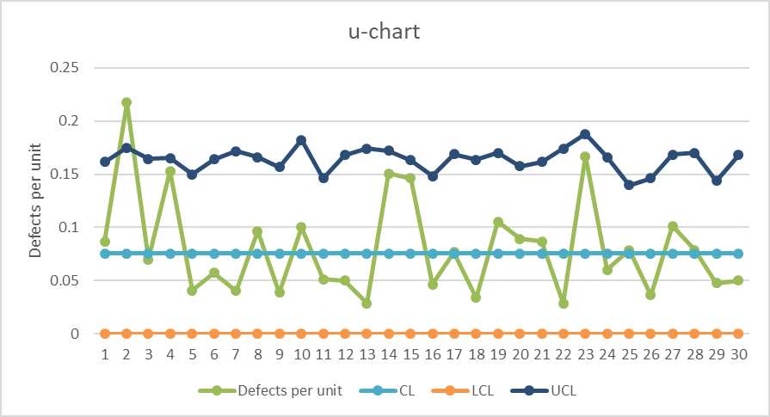
  u-charts for nonconforming
SPC
.

Slide 10
  u-charts for nonconforming
SPC
Exercise
Top Billers processes bills for customers. Lately, they have been getting complaints of errors in the bills they have processed. Bills can contain errors due to a number of causes, such as incorrect amounts, wrong dates, wrong customer information, etc. The quality manager for Top Billers decides to sample one customer’s batch of bills, per day, to determine the number and proportion of errors. Use the u-chart to analyze the data shown below.

Slide 11
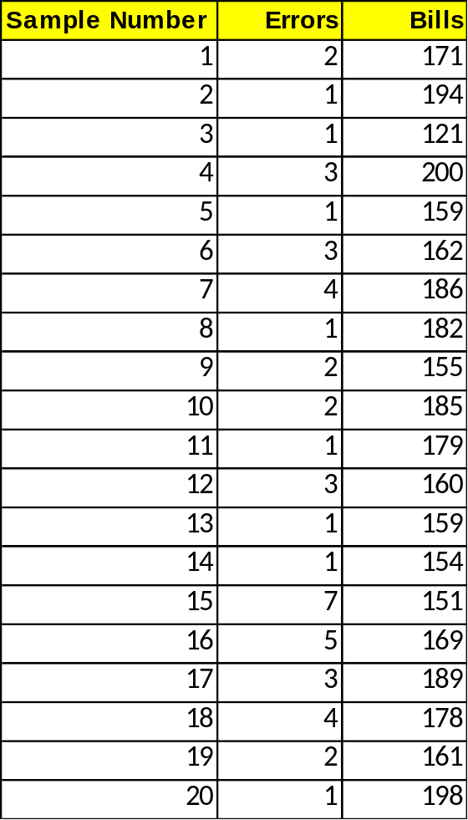
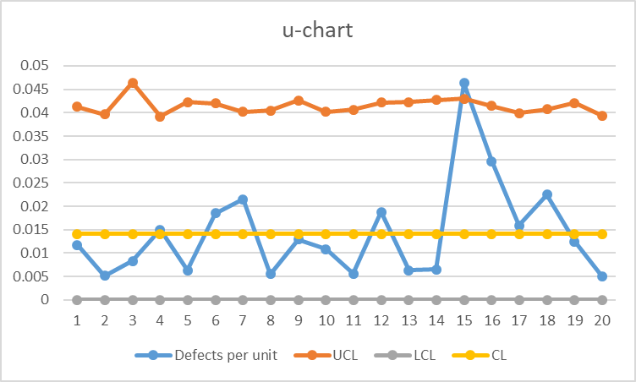
  u-charts for nonconforming
SPC
Exercise

Slide 12
Types of Six Sigma Problems
Six Sigma
Conformance problem
Efficiency problem
Unstructured performance problem
Product design problems
Process design problems
.
Notes:
Cummins India Ltd., Tata Consultancy Services is one such name. TATA Motors, John Deere, Mahindra & Mahindra, KPMG, GenPact, Gabriel Motors, Lear Corporation are few other industry giants that are using Six Sigma methodologies.

Slide 13
Six Sigma Teams
Six Sigma
Projects are the vehicles that are used to organize and to implement Six Sigma.
Six Sigma Project
.
Champions
Master Black Belts
Black Belts
Green Belts
Team Members
Notes:
Cummins India Ltd., Tata Consultancy Services is one such name. TATA Motors, John Deere, Mahindra & Mahindra, KPMG, GenPact, Gabriel Motors, Lear Corporation are few other industry giants that are using Six Sigma methodologies.

Slide 14
Six Sigma Teams
Six Sigma
Champions: Senior-level managers who promote and lead the deployment of Six Sigma in a significant area of the business.
Master Black Belts: Full-time Six Sigma experts who are responsible for Six Sigma strategy, training, mentoring, deployment, and results.
Black Belts: Fully-trained Six Sigma experts with extensive technical training who perform much of the technical analysis required in Six Sigma projects, usually on a full-time basis.
Notes:
Cummins India Ltd., Tata Consultancy Services is one such name. TATA Motors, John Deere, Mahindra & Mahindra, KPMG, GenPact, Gabriel Motors, Lear Corporation are few other industry giants that are using Six Sigma methodologies.

Slide 15
Six Sigma Teams
Six Sigma
Green Belts: Functional employees who are trained in introductory Six Sigma tools and methodology and work on projects on a part-time basis, assisting Black Belts while developing their own knowledge and expertise.
Team Members: Individuals from various functional areas who support specific projects.
Notes:
Cummins India Ltd., Tata Consultancy Services is one such name. TATA Motors, John Deere, Mahindra & Mahindra, KPMG, GenPact, Gabriel Motors, Lear Corporation are few other industry giants that are using Six Sigma methodologies.

Slide 16
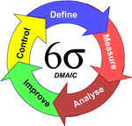
Six Sigma Methodology
Six Sigma
DMAIC
DMAIC: Dumb Managers Always Ignore Customers
Defines the project’s purpose, scope, and outputs, then identifies the required process information keeping in mind the customer’s definition of quality
Measures the process and collects data
Analyzes the data ensuring
repeatability and reproducibility
Improve by modifying or
redesigning existing
processes and procedures
Controls the new process
to make sure performance
levels are maintained
Create qualified process improvement experts (Black Belts, Green Belts, etc.)
Notes:
Cummins India Ltd., Tata Consultancy Services is one such name. TATA Motors, John Deere, Mahindra & Mahindra, KPMG, GenPact, Gabriel Motors, Lear Corporation are few other industry giants that are using Six Sigma methodologies.

Slide 17

DMAIC Tools and Techniques
Six Sigma
.
Notes:
Cummins India Ltd., Tata Consultancy Services is one such name. TATA Motors, John Deere, Mahindra & Mahindra, KPMG, GenPact, Gabriel Motors, Lear Corporation are few other industry giants that are using Six Sigma methodologies.

Slide 18
The Define Phase
Define
Develop the Project Charter
  Define scope, objectives, and schedule
  Define the process (top-level) and its stakeholders
  Select team members
  Obtain authorization from sponsor
Assemble and train the team

Slide 19
Factors in Six Sigma Project Selection
Define
Financial return, as measured by costs associated with quality and process performance, and impacts on revenues and market share
Impacts on customers and organizational effectiveness
Probability of success
Impact on employees
Fit to strategy and competitive advantage

Slide 20
Pareto Analysis
Define
.
A Pareto distribution is one in which the characteristics observed are ordered from largest frequency to smallest.
A Pareto diagram is a graphical description of a Pareto distribution.

Slide 21
Cost of Quality Analysis
Define
Prevention Costs
Appraisal Costs
Internal Failure Costs
External Failure Costs

Slide 22
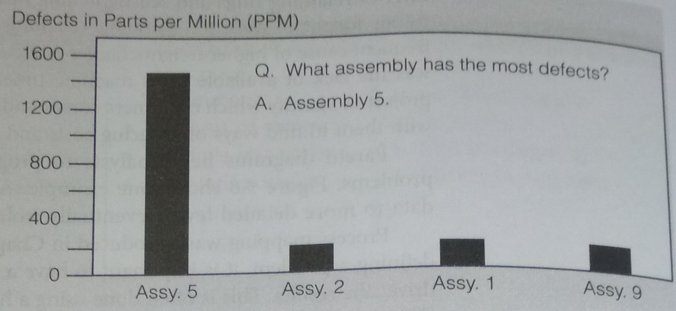
Pareto Analysis
Define
.

Slide 23
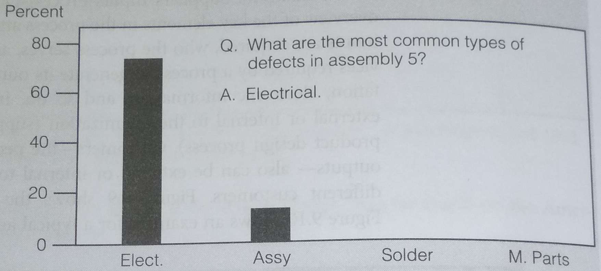
Pareto Analysis
Define
.

Slide 24
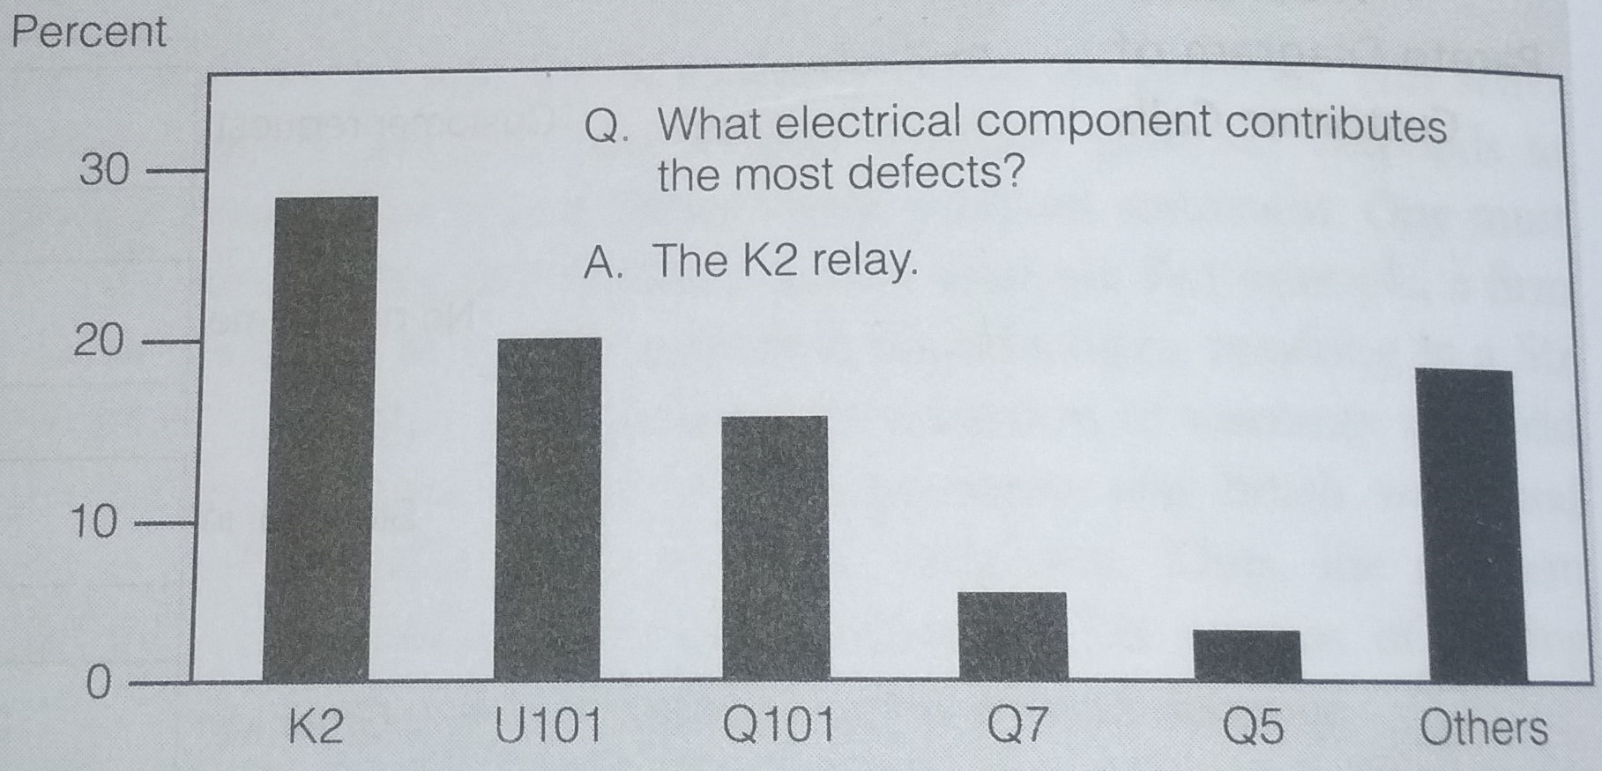
Pareto Analysis
Define
.

Slide 25
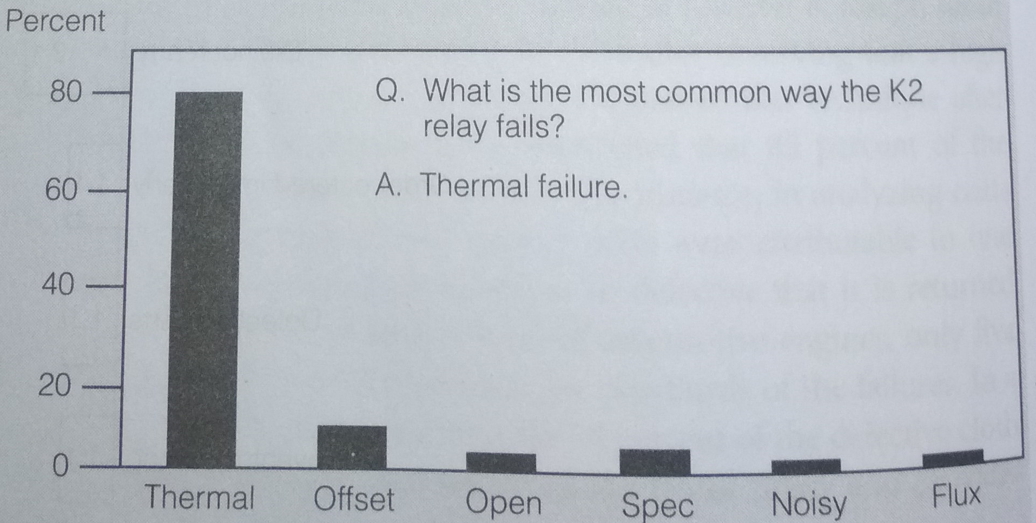
Pareto Analysis
Define
.
Pareto analysis helps isolating most important issues in define phase.

Slide 26
Factors in Six Sigma Project Selection
TQM
Return on Quality (ROQ)
…balancing quality costs against expected revenue gains
Principles
  Quality is an investment
  Quality efforts must be made financially accountable.
  It is possible to spend too much on quality.
  Not all quality expenditures are equally valid.

Slide 27
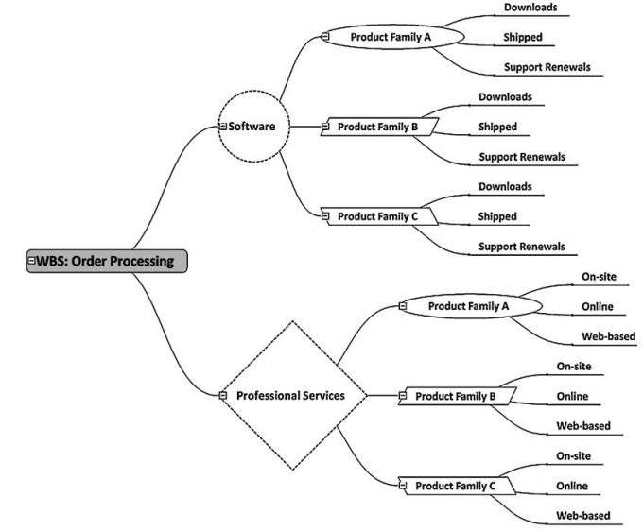
The Define Phase
TQM
.

Slide 28
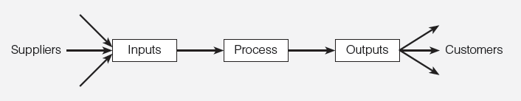
High Level Process Mapping
Define
SIPOC Diagram
Supplier
Input
Process
Output
Customer
Notes:
Cummins India Ltd., Tata Consultancy Services is one such name. TATA Motors, John Deere, Mahindra & Mahindra, KPMG, GenPact, Gabriel Motors, Lear Corporation are few other industry giants that are using Six Sigma methodologies.

Slide 29
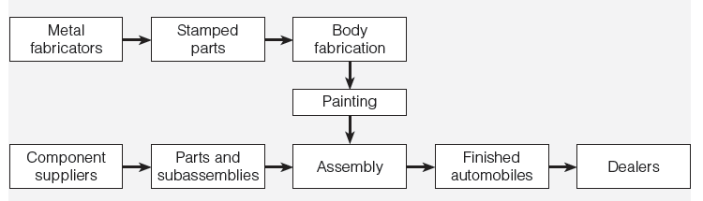
High Level Process Mapping
Define
SIPOC Diagram
SIPOC diagram of a typical automobile manufacturer
Notes:
Cummins India Ltd., Tata Consultancy Services is one such name. TATA Motors, John Deere, Mahindra & Mahindra, KPMG, GenPact, Gabriel Motors, Lear Corporation are few other industry giants that are using Six Sigma methodologies.

Slide 30
High Level Process Mapping
Define
SIPOC Diagram
SIPOC diagram of a typical automobile manufacturer
Notes:
Cummins India Ltd., Tata Consultancy Services is one such name. TATA Motors, John Deere, Mahindra & Mahindra, KPMG, GenPact, Gabriel Motors, Lear Corporation are few other industry giants that are using Six Sigma methodologies.

Slide 31
The Measurement Phase
Define
SIPOC Diagram
SIPOC diagram of a typical automobile manufacturer
Notes:
Cummins India Ltd., Tata Consultancy Services is one such name. TATA Motors, John Deere, Mahindra & Mahindra, KPMG, GenPact, Gabriel Motors, Lear Corporation are few other industry giants that are using Six Sigma methodologies.

Slide 32
Deliverables
Define
Cost
Quality
Schedule
CTx
Success of Six Sigma Project
Critical to Quality
Critical to Schedule
Critical to Cost
Deliverables are validated and refined in the Measure stage through a thorough statistical analysis.

Slide 33
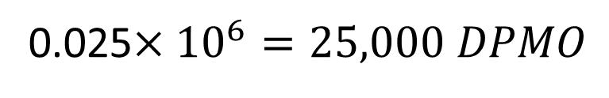
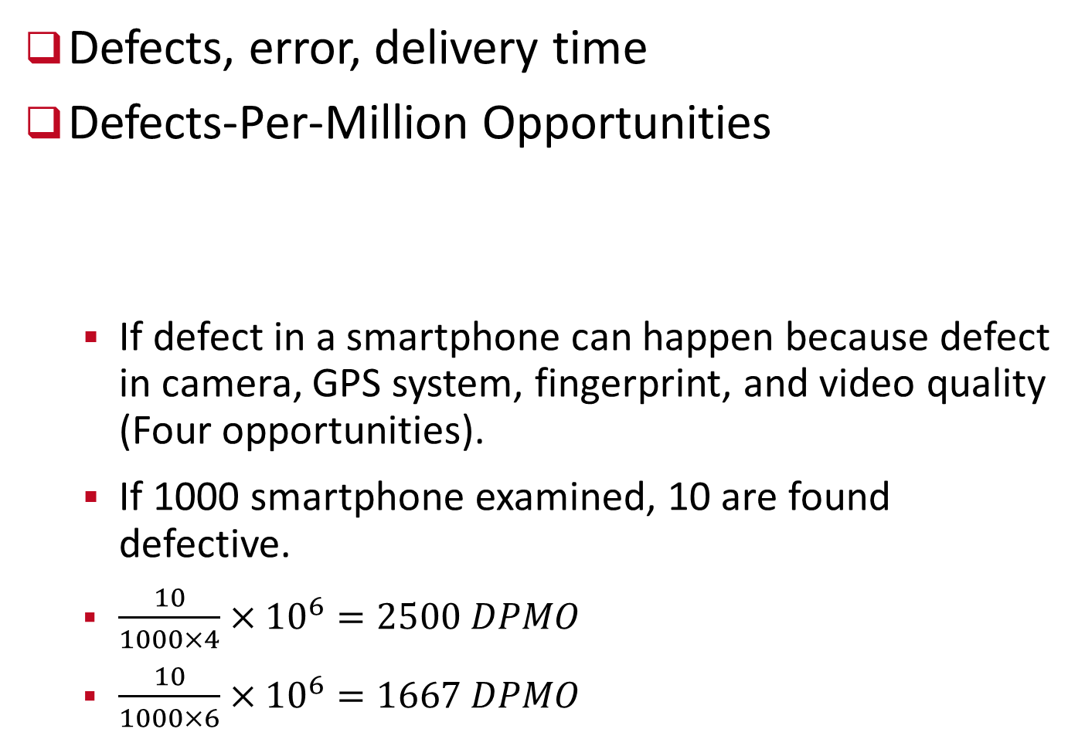
Critical to Quality
Define
Defects, error, delivery time
Defects-Per-Million Opportunities
  If defect in a smartphone can happen because defect in camera, GPS system, fingerprint, and video quality (Four opportunities).
  If 1000 smartphone examined, 10 are found defective.
  $\frac{10}{1000×4}×{10}^{6}=2500 DPMO$
  $\frac{10}{1000×6}×{10}^{6}=1667 DPMO$
2.5% defects
0.025$×{10}^{6}=25,000 DPMO$

Slide 34
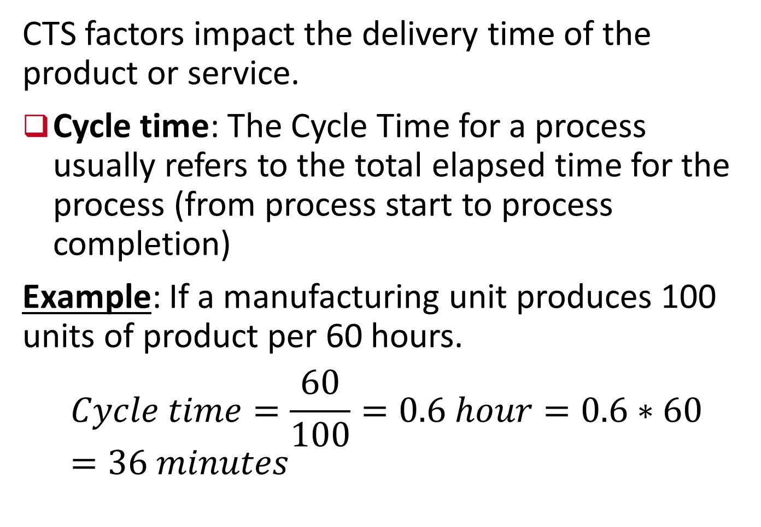
Critical to Schedule (CTS)
Define
CTS factors impact the delivery time of the product or service.
Cycle time: The Cycle Time for a process usually refers to the total elapsed time for the process (from process start to process completion)
Example: If a manufacturing unit produces 100 units of product per 60 hours.
$$Cycle time=\frac{60}{100}=0.6 hour=0.6∗60=36 minutes$$
On an average it takes 36 minutes to produce a unit of product.

Slide 35
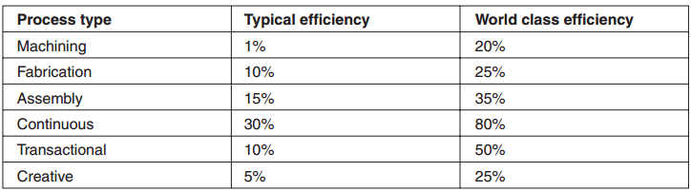
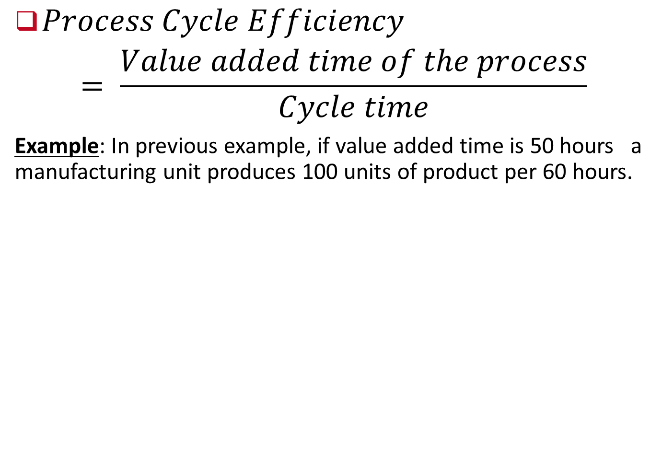

Critical to Schedule (CTS)
Define
$Process Cycle Efficiency$
$$= \frac{Value added time of the process}{Cycle time}$$
Example: In previous example, if value added time is 50 hours a manufacturing unit produces 100 units of product per 60 hours.
$$Process cycle efficiency= \frac{50}{60}=83.33\%$$

Slide 36
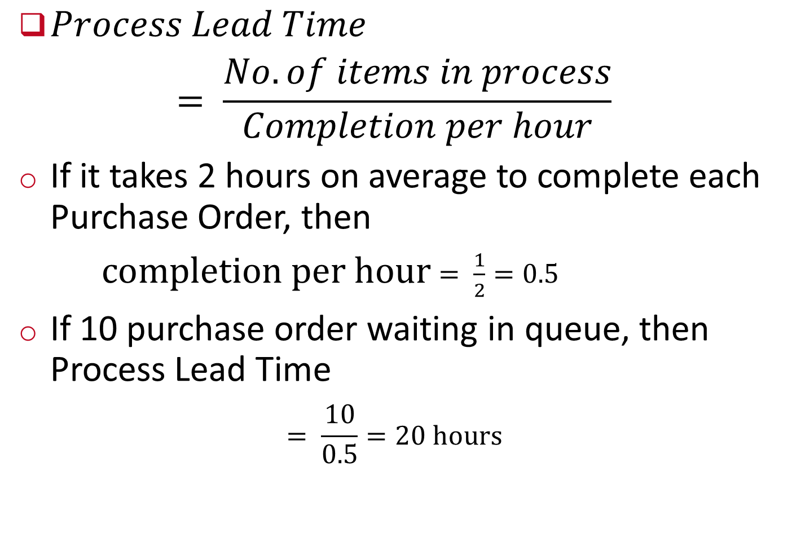
Critical to Schedule
Define
$Process Lead Time$
$$= \frac{No. of items in process}{Completion per hour}$$
If it takes 2 hours on average to complete each Purchase Order, then
$completion per hour$ $= \frac{1}{2}=0.5$
If 10 purchase order waiting in queue, then Process Lead Time
$$= \frac{10}{0.5}=20 hours$$
Notes:
New orders can’t be processed until the 20 hour lead time has allowed the existing Work in Process to be completed.

Slide 37
Critical to Cost (CTC)
Define
CTQ and CTS are often CTC as well
CTCs are similar to CTQs but deal exclusively
with the impact of cost on the customer/manufacturer.
Example includes
  work in progress,
  finished goods inventory,
  overhead,
  delivery,
  material and
  labor

Slide 38
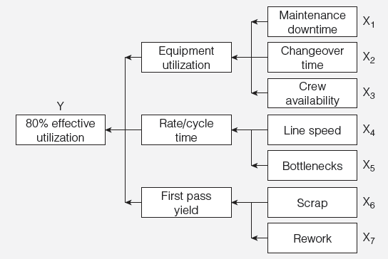
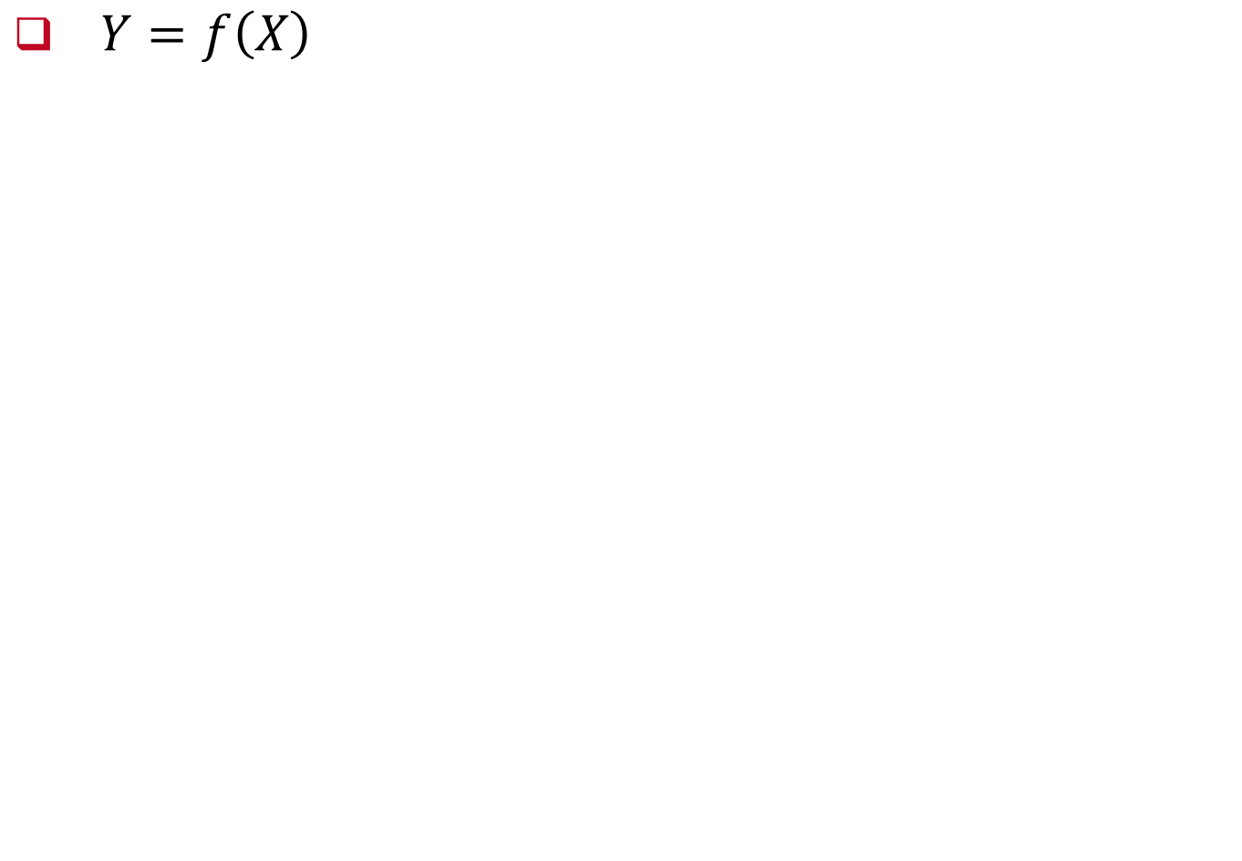
Measurement
$Y=f\left(X\right)$
Notes:
In any event, since we seek to understand the actual process in the Measure stage, the input of the process personnel is necessary.
Later, in the Improve stage, we will document a desired process after receiving input from all stakeholders.

Slide 39
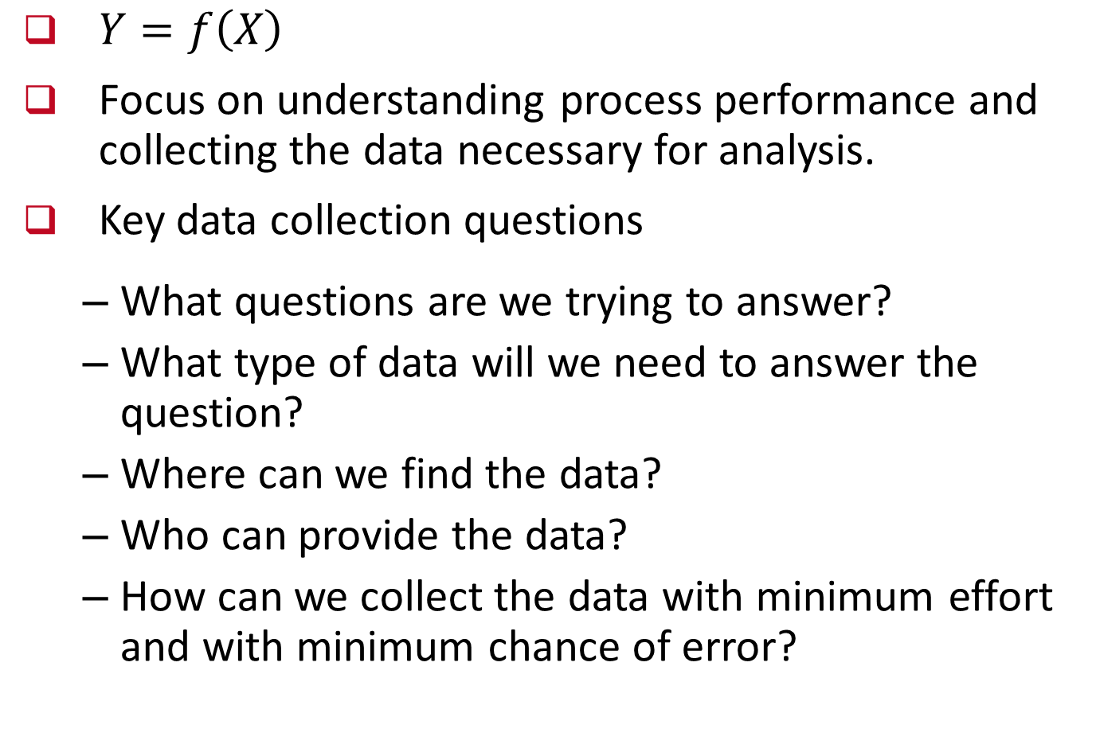
Measurement
$Y=f\left(X\right)$
Focus on understanding process performance and collecting the data necessary for analysis.
Key data collection questions
  What questions are we trying to answer?
  What type of data will we need to answer the question?
  Where can we find the data?
  Who can provide the data?
  How can we collect the data with minimum effort and with minimum chance of error?
Notes:
In any event, since we seek to understand the actual process in the Measure stage, the input of the process personnel is necessary.
Later, in the Improve stage, we will document a desired process after receiving input from all stakeholders.

Slide 40
Measurement
Operational definitions – clarify performance measures
  On-time delivery? (Does it mean within one day, two day or what?)
  Error? (Wrong information? Typographical mistakes? Or either)
  Satisfied customers?
  Quality?
Notes:
In any event, since we seek to understand the actual process in the Measure stage, the input of the process personnel is necessary.
Later, in the Improve stage, we will document a desired process after receiving input from all stakeholders.

Slide 41
Measurement
Tools to define the process
Process maps
Flowcharts
Suppliers-Inputs-Process-Outputs-Customers
(SIPOC)
Notes:
In any event, since we seek to understand the actual process in the Measure stage, the input of the process personnel is necessary.
Later, in the Improve stage, we will document a desired process after receiving input from all stakeholders.

Slide 42
Measurement System Evaluation
Measure
Suppliers-Inputs-Process-Outputs-Customers
(SIPOC)
SIPOC of Automobile manufacturing process
Notes:
In any event, since we seek to understand the actual process in the Measure stage, the input of the process personnel is necessary.
Later, in the Improve stage, we will document a desired process after receiving input from all stakeholders.

Slide 43
Measurement Scale
Measure
Measuring process and outputs
Process baseline estimate
Enumerative studies
Analytical studies
Notes:
In any event, since we seek to understand the actual process in the Measure stage, the input of the process personnel is necessary.
Later, in the Improve stage, we will document a desired process after receiving input from all stakeholders.

Slide 44
Measurement System Evaluation
Measure
Observed variation in process output stems from the natural variation that occurs in the output itself as well as the measurement system.
The total observed variation in production output is the sum of the true process variation (which is what we actually want to measure) plus variation due to measurement:
Notes:
In any event, since we seek to understand the actual process in the Measure stage, the input of the process personnel is necessary.
Later, in the Improve stage, we will document a desired process after receiving input from all stakeholders.

Slide 45
Measurement System Evaluation
Measure
Manual inspection
Accuracy - the difference between the true value and the observed average of a measurement
  It is measured as the amount of error in a measurement in proportion to the total size of the measurement.
Precision - the closeness of repeated measurements to each other
  It is measured as the variance of repeated measurements.
Notes:
In any event, since we seek to understand the actual process in the Measure stage, the input of the process personnel is necessary.
Later, in the Improve stage, we will document a desired process after receiving input from all stakeholders.

Slide 46
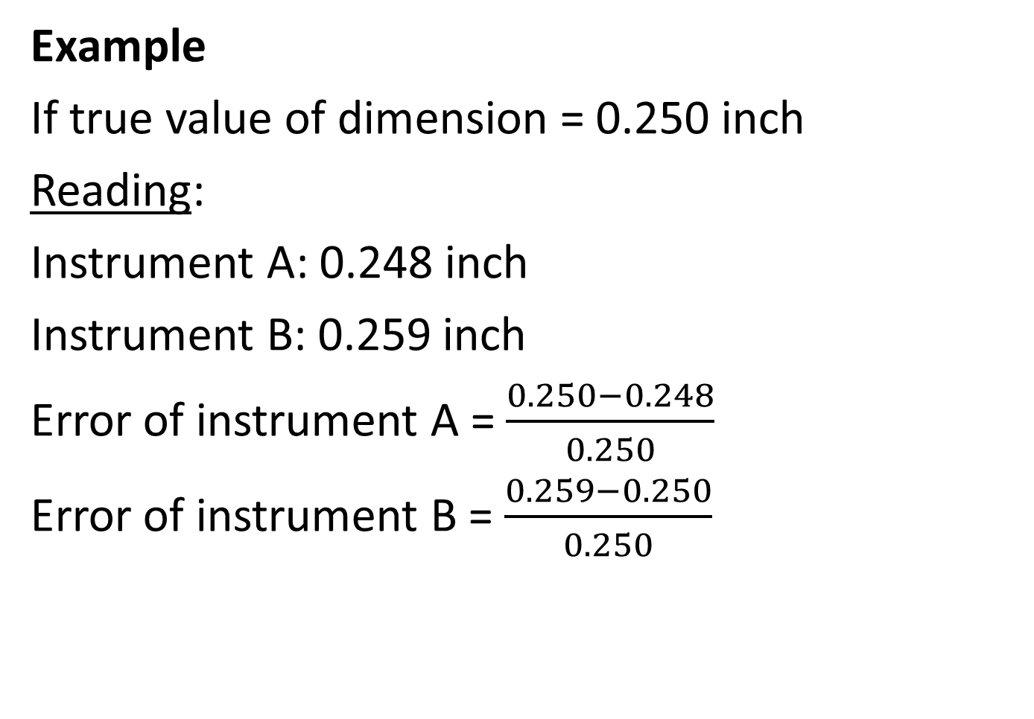
Measurement System Evaluation
Measure
Example
If true value of dimension = 0.250 inch
Reading:
Instrument A: 0.248 inch
Instrument B: 0.259 inch
Error of instrument A = $\frac{0.250−0.248}{0.250}$
Error of instrument B = $\frac{0.259−0.250}{0.250}$
More accurate
= 0.8%
= 3.6%
Notes:
In any event, since we seek to understand the actual process in the Measure stage, the input of the process personnel is necessary.
Later, in the Improve stage, we will document a desired process after receiving input from all stakeholders.

Slide 47
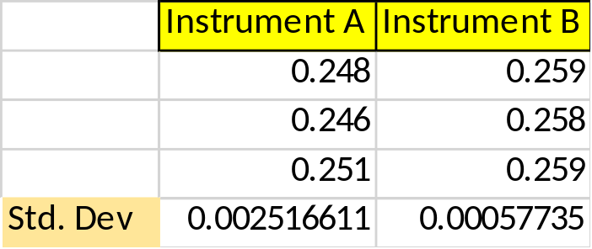
Measurement System Evaluation
Measure
Example
If true value of dimension = 0.250 inch
Reading:
Dimension has been measured three times by the both instrument A and B
Instrument A: 0.248, 0.246, 0.251
Instrument B: 0.259, 0.258, 0.259
More precise
Notes:
In any event, since we seek to understand the actual process in the Measure stage, the input of the process personnel is necessary.
Later, in the Improve stage, we will document a desired process after receiving input from all stakeholders.

Slide 48
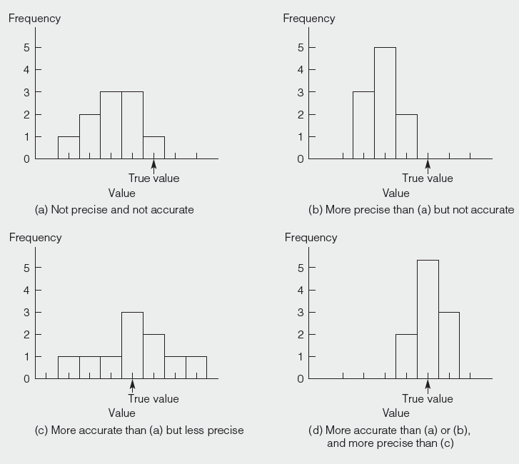
Measurement System Evaluation
Measure
Accuracy
and
Precision
Notes:
In any event, since we seek to understand the actual process in the Measure stage, the input of the process personnel is necessary.
Later, in the Improve stage, we will document a desired process after receiving input from all stakeholders.

Slide 49
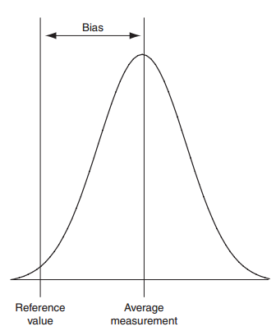
Measurement System Evaluation
Measure
Bias
Notes:
In any event, since we seek to understand the actual process in the Measure stage, the input of the process personnel is necessary.
Later, in the Improve stage, we will document a desired process after receiving input from all stakeholders.

Slide 50
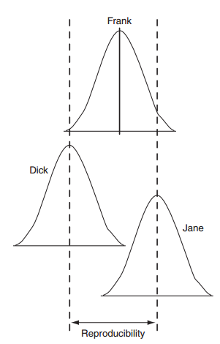
Repeatability and Reproducibility Analysis
Measure
Repeatability (equipment variation, EV) – variation in multiple measurements by an individual using the same instrument.
Reproducibility (appraiser variation, AV) - variation in the same
measuring instrument used
by different individuals.
Notes:
In any event, since we seek to understand the actual process in the Measure stage, the input of the process personnel is necessary.
Later, in the Improve stage, we will document a desired process after receiving input from all stakeholders.

Slide 51
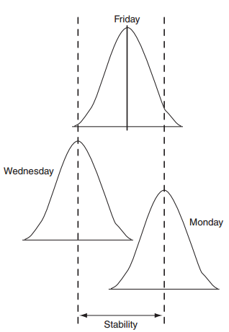
Repeatability and Reproducibility Analysis
Measure
Stability – Variance in the average when measuring over extended time period
Notes:
In any event, since we seek to understand the actual process in the Measure stage, the input of the process personnel is necessary.
Later, in the Improve stage, we will document a desired process after receiving input from all stakeholders.

Slide 52
References.
Managing for Quality and Performance Excellence, Evans, J.R. and William M. Lindsay, W.M., Cengage Learning, India
The Six Sigma Handbook, Tomas Pyzdek and Paul Keller, Fourth edition, McGraw Hill India.
Total Quality Management, Besterfield et al., Revised third edition, Pearson India
The Management and Control of Quality, J. Evans, and W. Lindsay, Third edition, Cengage Learning

Slide 53
.
Thanks!

