Slide 1





Operations Management with Six Sigma
Dr. Gopal Kumar
gopalkumar@iimraipur.ac.in
IIM Raipur
16 February 2020

Slide 2
  Control Charts for Variables
7 Quality Tools (SPC)
For x-Charts when we don't know σ
Notes:
A histogram is a pictorial representation of a set of data. It is created by grouping the measurements into ‘‘cells.’’ Histograms are used to determine the shape of a data set.

Slide 3
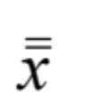
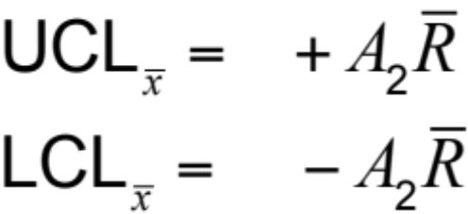
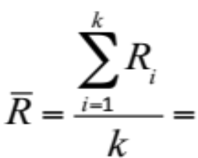



  Control Charts for Variables
7 Quality Tools (SPC)
For x-Charts when we don't know σ
Example
X-chart
R-chart
$${UCL}_{R}=D_{4}\overline{R}$$
$${LCL}_{R}=D_{3}\overline{R}$$
Where average range of the samples
A₂, D₃, and D₄ = control chart factor shown in Table
= mean of the sample means
R_{i} = range for sample i
k = total number of samples
Notes:
A histogram is a pictorial representation of a set of data. It is created by grouping the measurements into ‘‘cells.’’ Histograms are used to determine the shape of a data set.

Slide 4
  Control Charts for Variables
7 Quality Tools (SPC)
For x-Charts when we don't know σ
Example
 | Factors for Computing Control Chart Limits (3 sigma)
SAMPLE SIZE, n |  | MEAN FACTOR, A₂ | UPPER RANGE, D₄ | LOWER RANGE, D₃
2 |  | 1.880 | 3.268 | 0
3 |  | 1.023 | 2.574 | 0
4 |  | .729 | 2.282 | 0
5 |  | .577 | 2.115 | 0
6 |  | .483 | 2.004 | 0
7 |  | .419 | 1.924 | 0.076
8 |  | .373 | 1.864 | 0.136
9 |  | .337 | 1.816 | 0.184
10 |  | .308 | 1.777 | 0.223
12 |  | .266 | 1.716 | 0.284
Notes:
A histogram is a pictorial representation of a set of data. It is created by grouping the measurements into ‘‘cells.’’ Histograms are used to determine the shape of a data set.

Slide 5
  Control Charts for Variables
7 Quality Tools (SPC)
For x-Charts when we don't know σ
Example
Oat flakes labeled as "net weight 12 ounces"
Process average = 12 ounces
Sample size = 5

Slide 6
  Control Charts for Variables
7 Quality Tools (SPC)
For x-Charts when we don't know σ
Example
SAMPLE | WEIGHT OF LIGHTEST PACKET IN SAMPLE OF n = 5 | WEIGHT OF HEAVIEST PACKET IN SAMPLE OF n = 5
1 | 11.50 | 11.72
2 | 11.97 | 12.00
3 | 11.55 | 12.05
4 | 12.00 | 12.20
5 | 11.95 | 12.00
6 | 10.55 | 10.75
7 | 12.50 | 12.75
8 | 11.00 | 11.25
9 | 10.60 | 11.00
10 | 11.70 | 12.10
Sum
RANGE
.22
.03
.50
.20
.05
.20
.25
.25
.40
.40
2.5
Notes:
A histogram is a pictorial representation of a set of data. It is created by grouping the measurements into ‘‘cells.’’ Histograms are used to determine the shape of a data set.

Slide 7

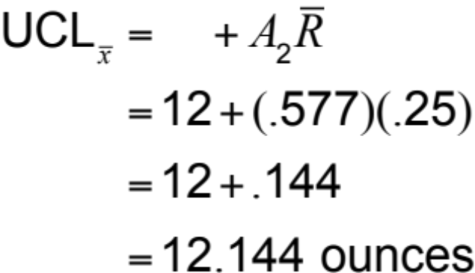
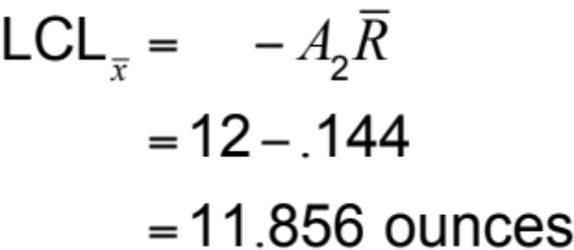
  Control Charts for Variables
7 Quality Tools (SPC)
For x-Charts when we don't know σ
Example
SAMPLE SIZE, n | A₂ | D₄
2 | 1.880 | 3.268
3 | 1.023 | 2.574
4 | .729 | 2.282
5 | .577 | 2.115
6 | .483 | 2.004
7 | .419 | 1.924
8 | .373 | 1.864
9 | .337 | 1.816
10 | .308 | 1.777
12 | .266 | 1.716

Slide 8
  Control Charts for Variables
7 Quality Tools (SPC)
For x-Charts when we don't know σ
Example
UCL = 12.144
Mean = 12
LCL = 11.856

Slide 9
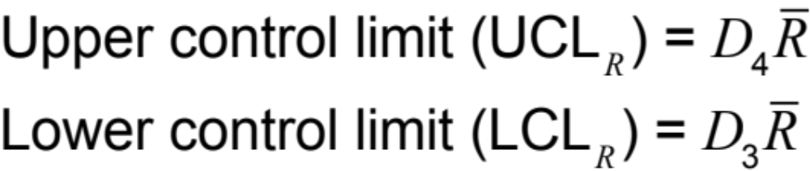
  Control Charts for Variables
7 Quality Tools (SPC)
R – Chart
For x-Charts when we don't know σ
Example
= 2.115*0.25 =
0.52875
= 0.00*0.25
=0
UCL = 0.5287
Mean = 0.25
LCL = 0

Slide 10
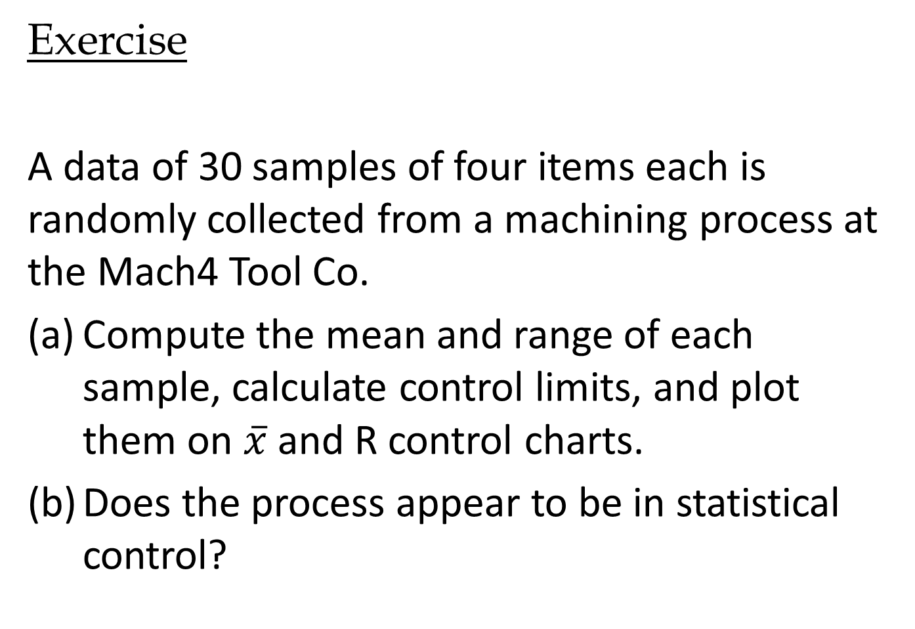
  Exercise
Control Chart
Exercise
A data of 30 samples of four items each is randomly collected from a machining process at the Mach4 Tool Co.
Compute the mean and range of each sample, calculate control limits, and plot them on $\overline{x}$ and R control charts.
Does the process appear to be in statistical control?

Slide 11
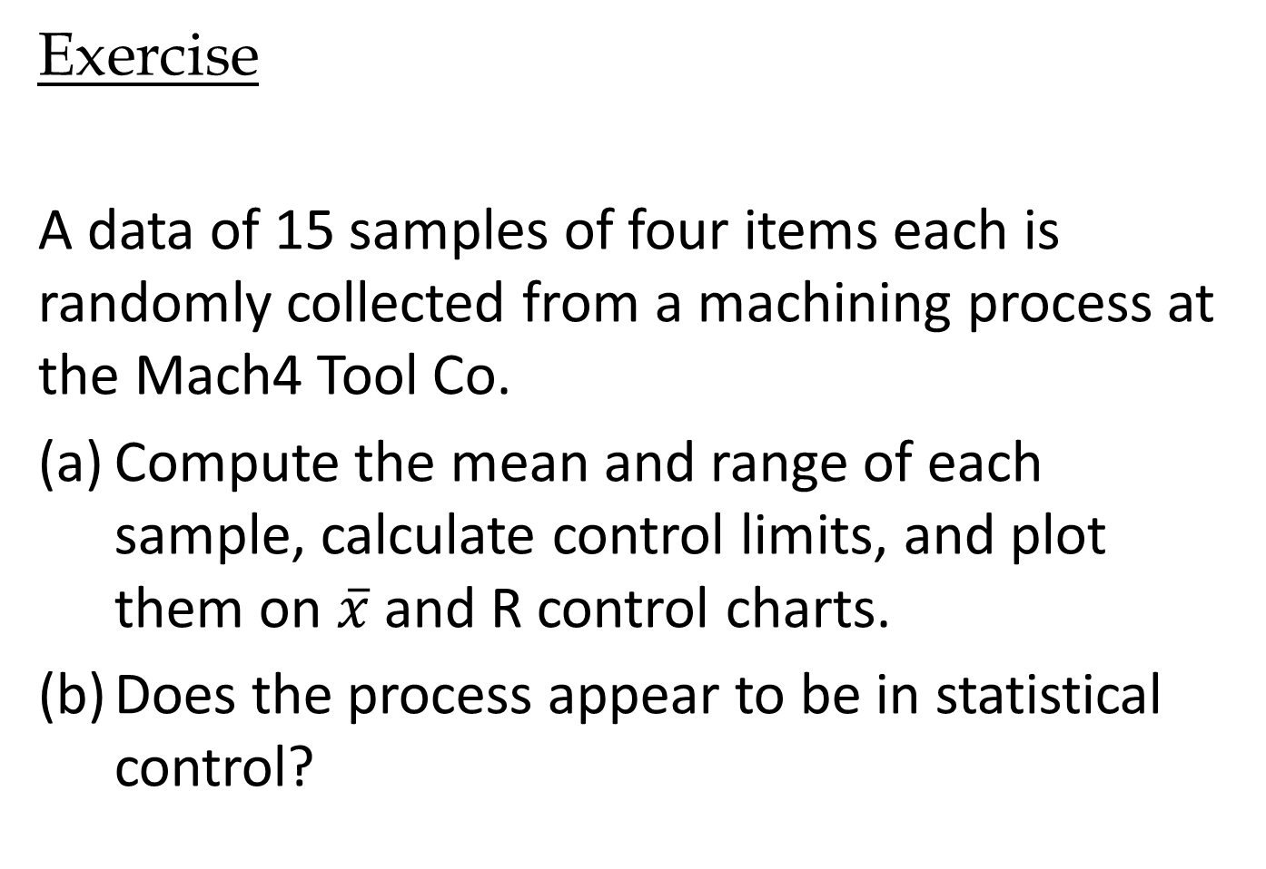
  Control Charts for Variables
Control Chart
Exercise
A data of 15 samples of four items each is randomly collected from a machining process at the Mach4 Tool Co.
Compute the mean and range of each sample, calculate control limits, and plot them on $\overline{x}$ and R control charts.
Does the process appear to be in statistical control?

Slide 12


  Control Charts for Variables
Control Chart
.
DATA | Number of samples
 | 1 | 2 | 3 | 4 | 5 | 6 | 7 | 8 | 9 | 10 | 11 | 12 | 13 | 14 | 15
1 | 1.220 | 1.360 | 1.220 | 1.100 | 1.280 | 1.260 | 1.240 | 1.360 | 1.260 | 1.220 | 1.240 | 1.320 | 1.250 | 1.170 | 1.140
2 | 1.320 | 1.320 | 1.250 | 1.210 | 1.260 | 1.250 | 1.190 | 1.180 | 1.280 | 1.230 | 1.250 | 1.190 | 1.210 | 1.170 | 1.140
3 | 1.210 | 1.310 | 1.330 | 1.200 | 1.190 | 1.300 | 1.220 | 1.360 | 1.250 | 1.260 | 1.160 | 1.250 | 1.210 | 1.290 | 1.350
4 | 1.350 | 1.370 | 1.280 | 1.170 | 1.290 | 1.220 | 1.210 | 1.160 | 1.290 | 1.230 | 1.200 | 1.190 | 1.220 | 1.290 | 1.240
Average | 1.275 | 1.34 | 1.270 | 1.170 | 1.255 | 1.258 | 1.215 | 1.265 | 1.270 | 1.235 | 1.213 | 1.238 | 1.223 | 1.230 | 1.218
Range | 0.140 | 0.06 | 0.110 | 0.110 | 0.100 | 0.080 | 0.050 | 0.200 | 0.040 | 0.040 | 0.090 | 0.130 | 0.040 | 0.120 | 0.210
$$\overset{̿}{x}=1.245$$
$$\overline{R}=0.101$$

Slide 13














  Control Charts for Variables
Control Chart
$$\overset{̿}{x}=1.245$$
.
SAMPLE SIZE, n | A₂ | D₄ | D₃
2 | 1.880 | 3.268 | 0
3 | 1.023 | 2.574 | 0
4 | .729 | 2.282 | 0
5 | .577 | 2.115 | 0
6 | .483 | 2.004 | 0
7 | .419 | 1.924 | 0.076
8 | .373 | 1.864 | 0.136
9 | .337 | 1.816 | 0.184
10 | .308 | 1.777 | 0.223
12 | .266 | 1.716 | 0.284
$$\overline{R}=0.101$$
X-chart
$${UCL}_{x}=\overset{̿}{x}+A_{2}\overline{R}$$
$$=1.245+0.729×0.101$$
$$=1.318$$
$${LCL}_{x}=\overset{̿}{x}−A_{2}\overline{R}$$
$$=1.245−0.729×0.101$$
$$=1.171$$
R-chart
$${UCL}_{R}=D_{4}\overline{R}$$
$=$ $2.282×0.101$
$=$ $0.231$
$${LCL}_{R}=D_{3}\overline{R}$$
$=$ $0×0.101$
$=$ $0$

Slide 14
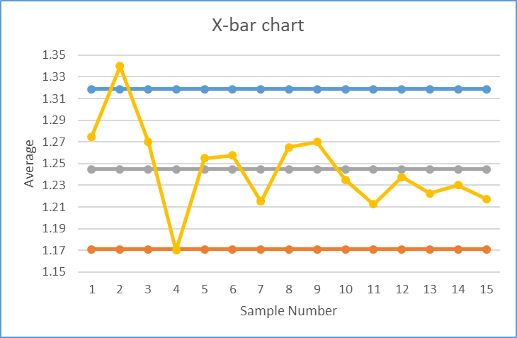

  Control Charts for Variables
Control Chart
$$\overset{̿}{x}=1.245$$
.
$$\overline{R}=0.101$$
UCL=1.318
CL=1.245
Out of control
LCL=0.171
$$\overline{x} chart is out of control$$

Slide 15
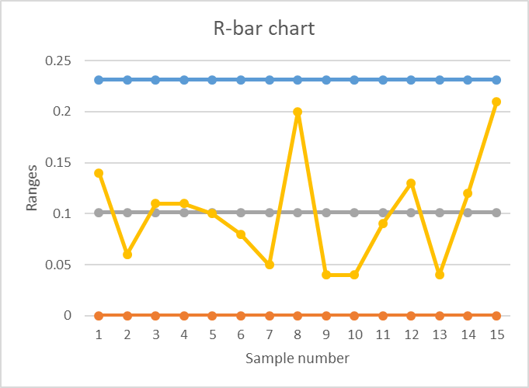
  Control Charts for Variables
Control Chart
$$\overset{̿}{x}=1.245$$
.
$$\overline{R}=0.101$$
UCL=0.231
CL=0.101
LCL=0
As x-bar chart is out of control, machining process is out of control.

Slide 16
  Control Charts for Variables
Control Chart
$$\overset{̿}{x}=1.245$$
.
$$\overline{R}=0.101$$
As x-bar chart is out of control, machining process
is out of control.

Slide 17
7 Quality Tools (SPC)
.
Control Chart for Attributes Data

Slide 18
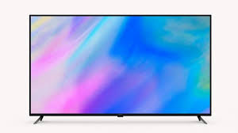
  Control Chart for Attributes Data
SPC
Attributes chart captures nonconforming as well as number of nonconforming.
One
nonconformance
Defective unit
15
nonconformances
Defective unit

Slide 19
  Control Chart for Attributes Data
SPC
One
nonconformance
Defective unit
15
nonconformances
Defective unit
p-chart
It monitors proportion of nonconforming units
Number of nonconformances
per unit
c-charts and u-charts

Slide 20
  Control Chart for Attributes Data
SPC
With fixed sample size
p-chart
With variable sample size

Slide 21
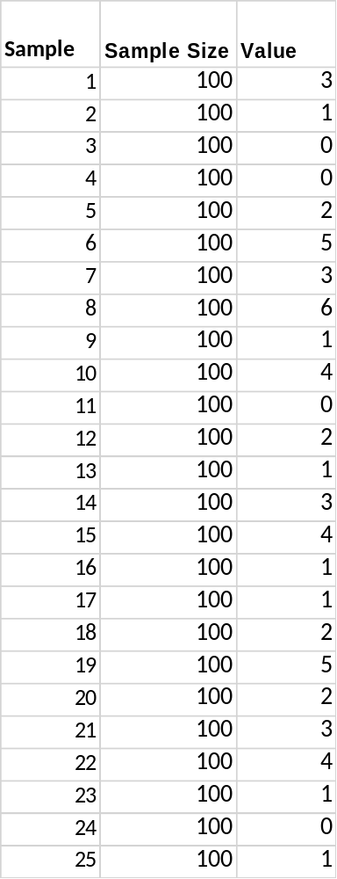
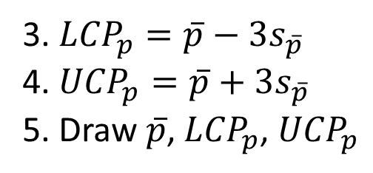
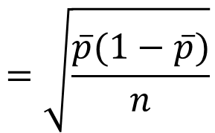
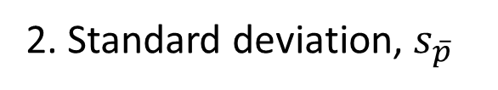
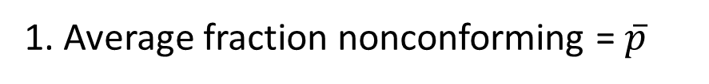
  p-charts (Fraction nonconforming)
SPC
P-chart with fixed sample size
Sample size needs to be large enough
Compute:
1. Average fraction nonconforming = $\overline{p}$
$$=\sqrt{\frac{\overline{p}(1−\overline{p})}{n}}$$
2. Standard deviation, $s_{\overline{p}}$
3. ${LCP}_{p}=\overline{p}−3s_{\overline{p}}$
4. ${UCP}_{p}=\overline{p}+3s_{\overline{p}}$
5. Draw $\overline{p}$, ${LCP}_{p}$, ${UCP}_{p}$

Slide 22
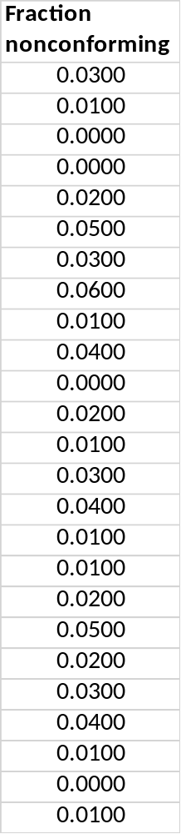

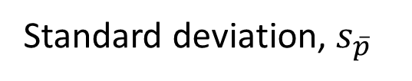
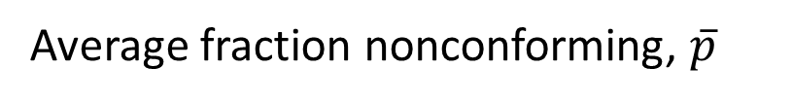

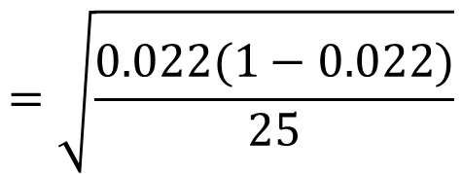
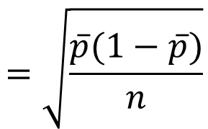
  p-charts (Fraction nonconforming)
SPC
P-chart with fixed sample size
Sample size needs to be large enough
Average fraction nonconforming, $\overline{p}$
= 0.022
$$=\sqrt{\frac{\overline{p}(1−\overline{p})}{n}}$$
Standard deviation, $s_{\overline{p}}$
$$=\sqrt{\frac{0.022(1−0.022)}{25}}$$
$$=0.0146$$
Average

Slide 23
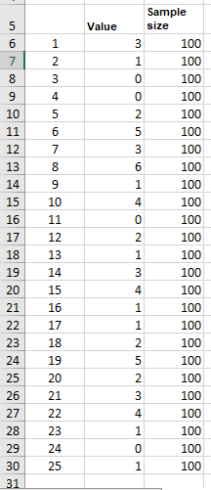

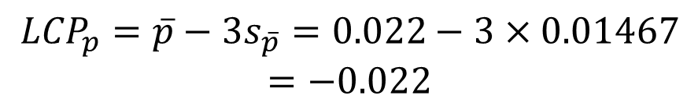
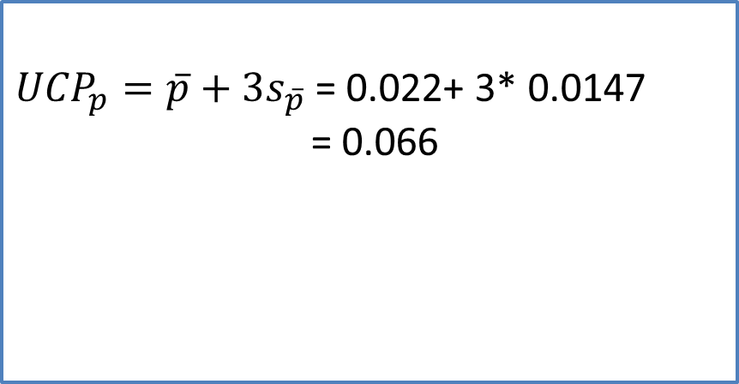
  p-charts (Fraction nonconforming)
SPC
P-chart with fixed sample size
.
${UCP}_{p}=\overline{p}+3s_{\overline{p}}$ = 0.022+ 3* 0.0147
= 0.066
$${LCP}_{p}=\overline{p}−3s_{\overline{p}}=0.022−3×0.01467$$
$$=−0.022$$
If LCP is negative, take
LCP = 0

Slide 24
  p-charts (Fraction nonconforming)
SPC
P-chart with fixed sample size
.
Decreasing trend represents improvement
Upper trend or value above UCL conveys
need for improvement

Slide 25
  p-charts (Fraction nonconforming)
SPC
P-chart with fixed sample size
Exercise
One hundred insurance claim forms are inspected daily at Life Insurance Co. over 25 working days, and the number of forms with errors have been recorded.
Construct a p-chart. If any points occur outside the control limits, assume that assignable causes have been determined. Then construct a revised chart.
.

Slide 26
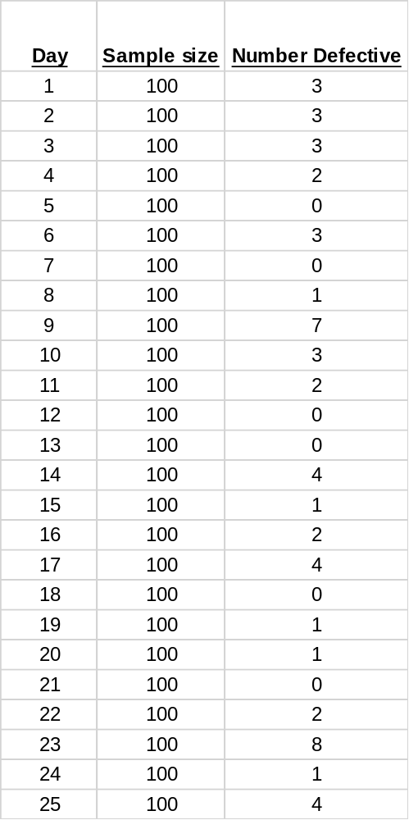
  p-charts (Fraction nonconforming)
SPC
P-chart with fixed sample size
.
Sample size = 100

Slide 27
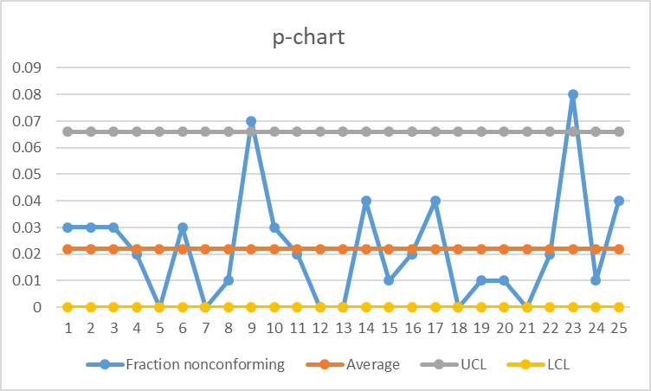
  p-charts (Fraction nonconforming)
SPC
P-chart with fixed sample size
.

Slide 28
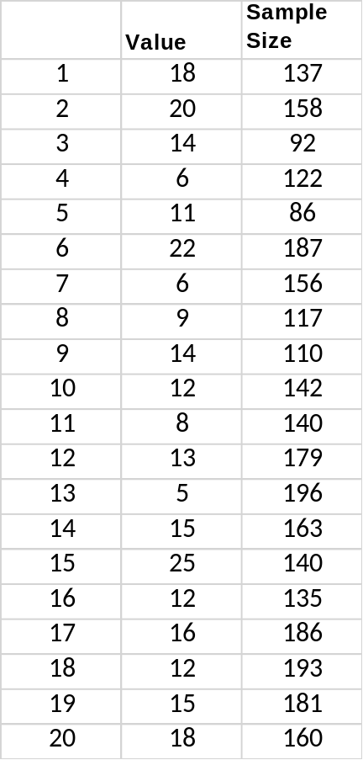
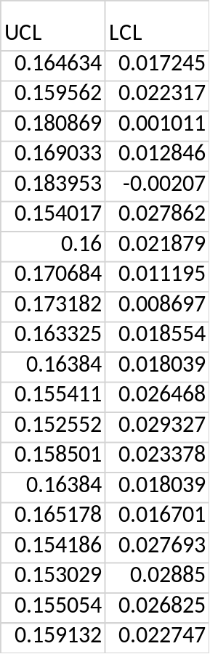
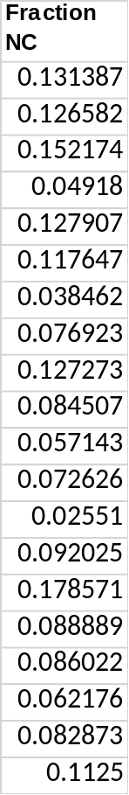

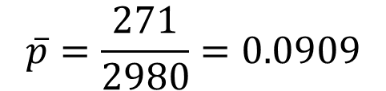
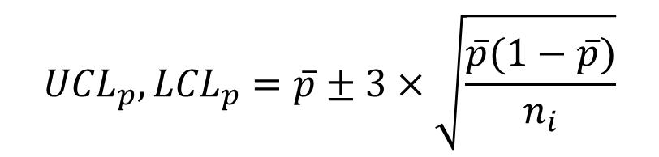
  p-charts (Fraction nonconforming)
SPC
P-chart with variable sample size
.
$${UCL}_{p},{LCL}_{p}=\overline{p}±3×\sqrt{\frac{\overline{p}(1−\overline{p})}{n_{i}}}$$
$$\overline{p}=\frac{271}{2980}=0.0909$$

Slide 29
  p-charts (Fraction nonconforming)
SPC
P-chart with variable sample size
.
$${UCL}_{p},{LCL}_{p}=\overline{p}±3×\sqrt{\frac{\overline{p}(1−\overline{p})}{n_{i}}}$$

Slide 30



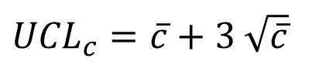
  c-charts for nonconforming
SPC
Collect samples of equal size and count the number of nonconformances
Compute the average number of nonconformances per unit, c-bar
Standard deviation
Control limits
$s_{c}=$ $\sqrt{\overline{c}}$
${UCL}_{c}=\overline{c}+3$ $\sqrt{\overline{c}}$
$${LCL}_{c}=\overline{c}−3 \sqrt{\overline{c}}$$

Slide 31
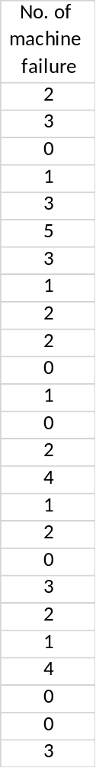
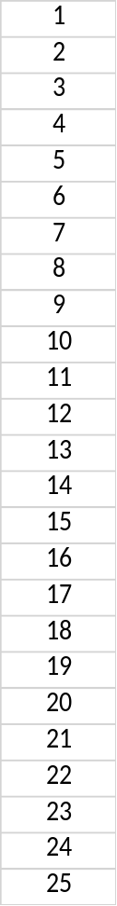
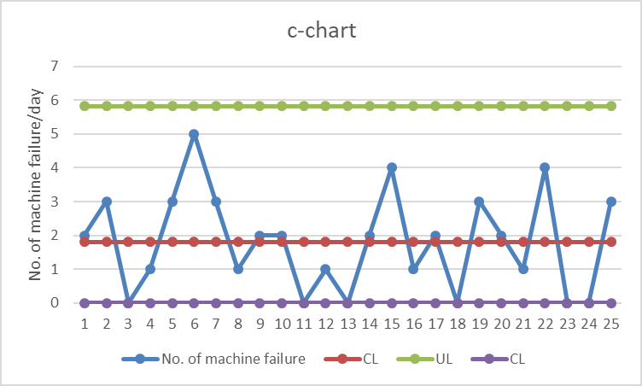



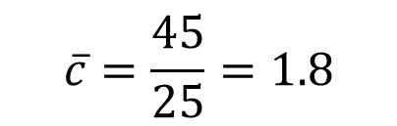

  c-charts for nonconforming
SPC
.
$$\overline{c}=\frac{45}{25}=1.8$$
${UCL}_{c}=\overline{c}+3$ $\sqrt{\overline{c}}$
$=1.8+3$ $\sqrt{1.8}=5.82$
$${LCL}_{c}=\overline{c}−3 \sqrt{\overline{c}}$$
$$=1.8−3 \sqrt{1.8}=−2.22 or 0$$
Sum 45

Slide 32
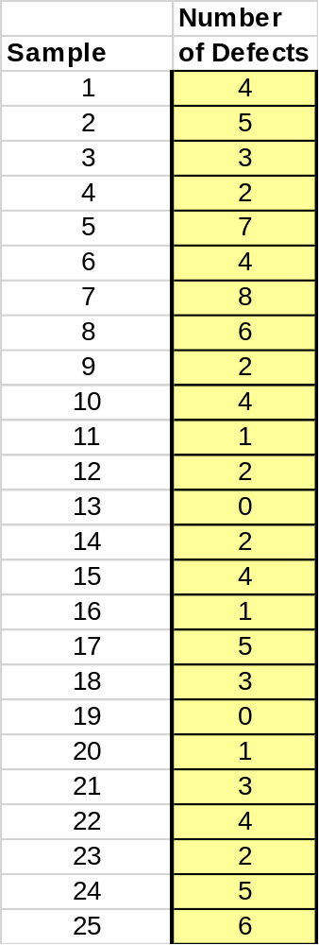
  c-charts for nonconforming
SPC
.

Slide 33
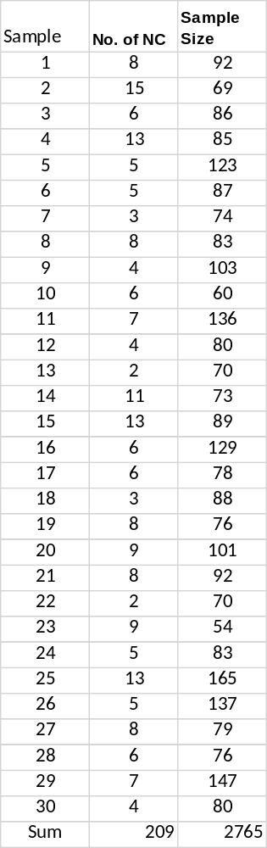


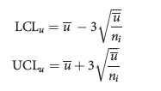
  u-charts for nonconforming
SPC
.
Applies if the samples are of unequal size
Collect samples and count the number of nonconformances
Compute the average number of nonconformances per unit, u-bar
Standard deviation
Control limits

Slide 34
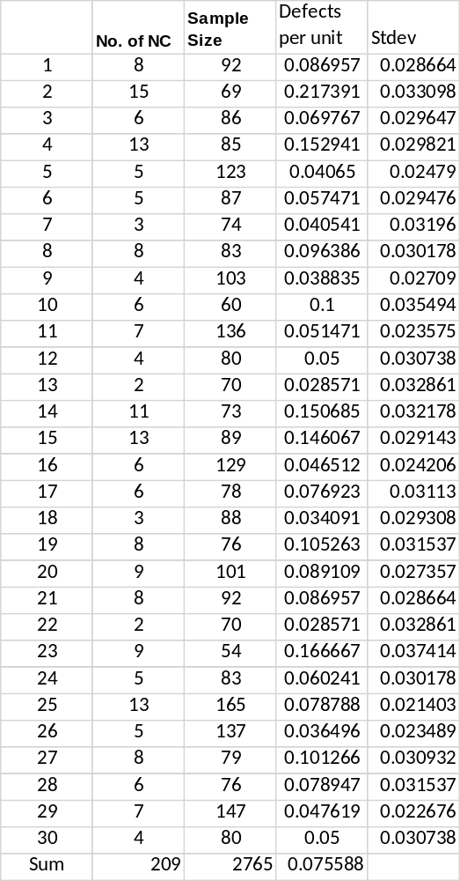
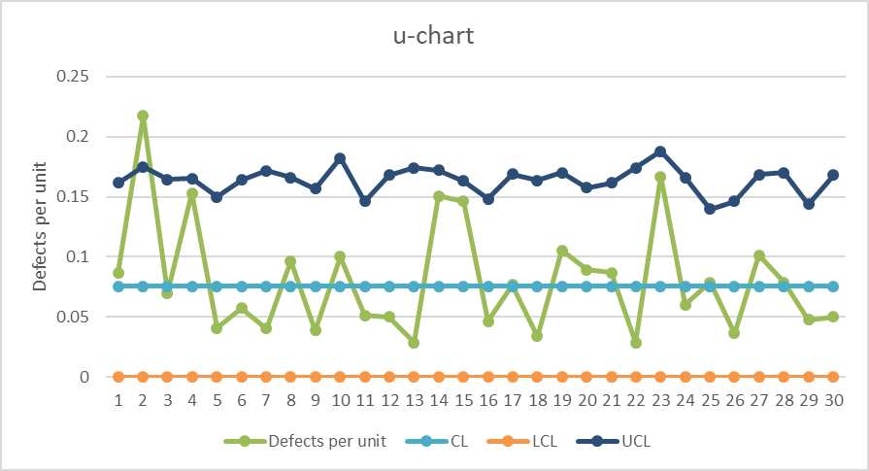
  u-charts for nonconforming
SPC
.

Slide 35
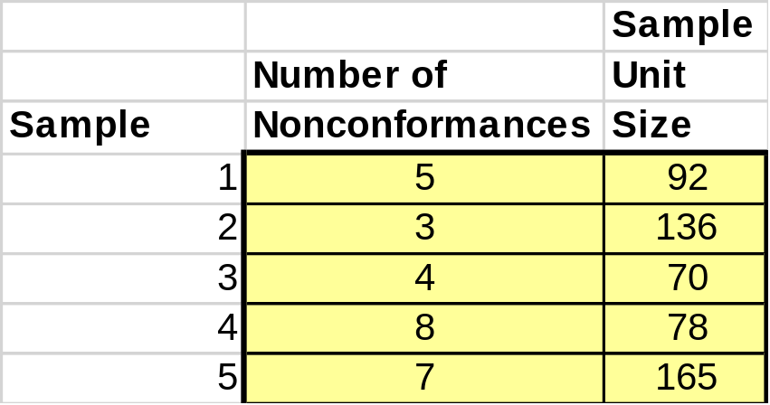
  u-charts for nonconforming
SPC
.

Slide 36
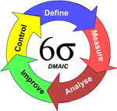
Six Sigma Methodology
Six Sigma
DMAIC
DMAIC: Dumb Managers Always Ignore Customers
Defines the project’s purpose, scope, and outputs, then identifies the required process information keeping in mind the customer’s definition of quality
Measures the process and collects data
Analyzes the data ensuring
repeatability and reproducibility
Improve by modifying or
redesigning existing
processes and procedures
Controls the new process
to make sure performance
levels are maintained
Create qualified process improvement experts (Black Belts, Green Belts, etc.)
Notes:
Cummins India Ltd., Tata Consultancy Services is one such name. TATA Motors, John Deere, Mahindra & Mahindra, KPMG, GenPact, Gabriel Motors, Lear Corporation are few other industry giants that are using Six Sigma methodologies.

Slide 37

DMAIC Tools and Techniques
Six Sigma
.
Notes:
Cummins India Ltd., Tata Consultancy Services is one such name. TATA Motors, John Deere, Mahindra & Mahindra, KPMG, GenPact, Gabriel Motors, Lear Corporation are few other industry giants that are using Six Sigma methodologies.

Slide 38
Types of Problem
Six Sigma
Conformance problem
Efficiency problem
Unstructured performance problem
Product design problems
Process design problems
.
Notes:
Cummins India Ltd., Tata Consultancy Services is one such name. TATA Motors, John Deere, Mahindra & Mahindra, KPMG, GenPact, Gabriel Motors, Lear Corporation are few other industry giants that are using Six Sigma methodologies.

Slide 39
Six Sigma Teams
Six Sigma
Projects are the vehicles that are used to organize and to implement Six Sigma.
Six Sigma Project
.
Champions
Master Black Belts
Black Belts
Green Belts
Team Members
Notes:
Cummins India Ltd., Tata Consultancy Services is one such name. TATA Motors, John Deere, Mahindra & Mahindra, KPMG, GenPact, Gabriel Motors, Lear Corporation are few other industry giants that are using Six Sigma methodologies.

Slide 40
Six Sigma Teams
Six Sigma
Champions: Senior-level managers who promote and lead the deployment of Six Sigma in a significant area of the business.
Master Black Belts: Full-time Six Sigma experts who are responsible for Six Sigma strategy, training, mentoring, deployment, and results.
Black Belts: Fully-trained Six Sigma experts with extensive technical training who perform much of the technical analysis required in Six Sigma projects, usually on a full-time basis.
Notes:
Cummins India Ltd., Tata Consultancy Services is one such name. TATA Motors, John Deere, Mahindra & Mahindra, KPMG, GenPact, Gabriel Motors, Lear Corporation are few other industry giants that are using Six Sigma methodologies.

Slide 41
Six Sigma Teams
Six Sigma
Green Belts: Functional employees who are trained in introductory Six Sigma tools and methodology and work on projects on a part-time basis, assisting Black Belts while developing their own knowledge and expertise.
Team Members: Individuals from various functional areas who support specific projects.
Notes:
Cummins India Ltd., Tata Consultancy Services is one such name. TATA Motors, John Deere, Mahindra & Mahindra, KPMG, GenPact, Gabriel Motors, Lear Corporation are few other industry giants that are using Six Sigma methodologies.

Slide 42
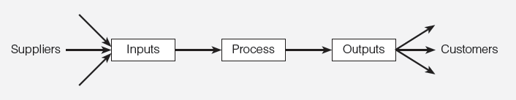
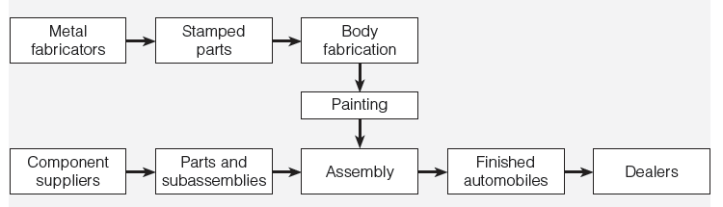
SIPOC Diagram
Six Sigma
.
Notes:
Cummins India Ltd., Tata Consultancy Services is one such name. TATA Motors, John Deere, Mahindra & Mahindra, KPMG, GenPact, Gabriel Motors, Lear Corporation are few other industry giants that are using Six Sigma methodologies.

Slide 43
References.
Managing for Quality and Performance Excellence, Evans, J.R. and William M. Lindsay, W.M., Cengage Learning, India
The Six Sigma Handbook, Tomas Pyzdek and Paul Keller, Fourth edition, McGraw Hill India.
Total Quality Management, Besterfield et al., Revised third edition, Pearson India
The Management and Control of Quality, J. Evans, and W. Lindsay, Third edition, Cengage Learning

Slide 44
.
Thanks!

