Slide 1





Operations Management with Six Sigma
Dr. Gopal Kumar
gopalkumar@iimraipur.ac.in
IIM Raipur
09 February 2020

Slide 2
  Process Capability
Process capability is ability of a process producing conformance to the specification.
It is a measure of the relationship between the natural variation of the process and the design specifications
  Where is the process centered?
  How much variability exists in the process?
  Is the performance relative to specifications acceptable?
  What proportion of output will be expected to meet specifications?
  What factors contribute to variability?

Slide 3
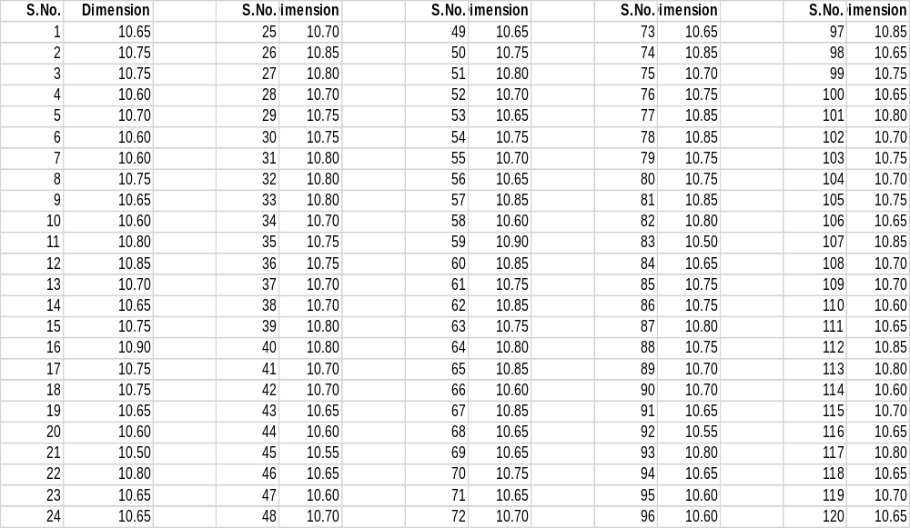


  Process Capability
$$\overline{X}=10.7171$$
$$s=0.0868$$

Slide 4
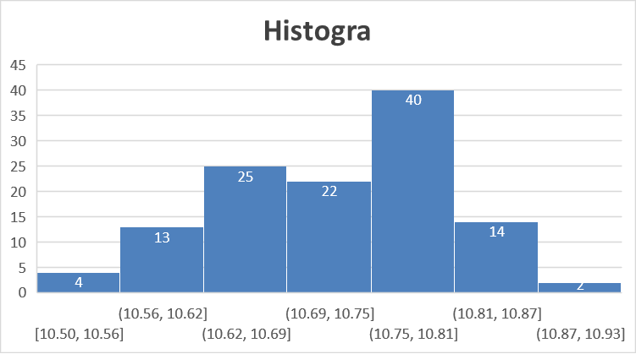








  Process Capability
$$\overline{X}=10.7171$$
$$s=0.0868$$
Approximately normal distribution
$$LL=\overline{X}−3s$$
$$=10.7171−3×0.0868$$
$$=10.4566$$
$$UL=\overline{X}+3s$$
$$=10.7171+3×0.0868$$
$$=10.9766$$

Slide 5
  Process Capability
LSL
USL
Tolerance
UL
Process is capable
(Process variation < Tolerance)
LL
Process variation
LSL
USL
Tolerance
LL
UL
Process is not capable
(Process variation > Tolerance)
Process variation

Slide 6






  Process Capability
$$LL=\overline{X}−3s$$
$$=10.7171−3×0.0868$$
$$=10.4566$$
If lower specification limit is 10.55 and upper specification limit is 10.90, the process will produce some non-conforming units.
$$UL=\overline{X}+3s$$
$$=10.7171+3×0.0868$$
$$=10.9766$$
LSL=10.55
USL=10.90
Process is not capable
(Process variation > Tolerance)
LL=10.456
UL=10.90
The process is producing some defective units, i.e., non-conformance
to the specification.

Slide 7
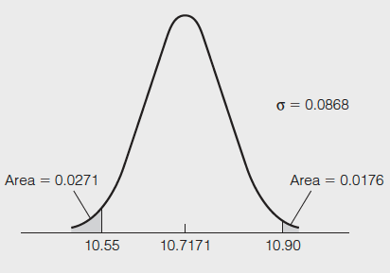
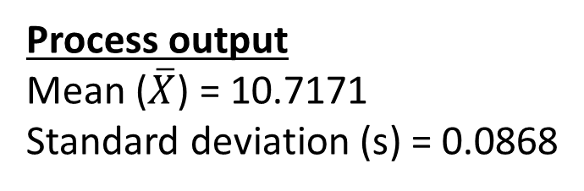
  Process Capability
Process output
Mean ($\overline{X}$) = 10.7171
Standard deviation (s) = 0.0868
Area below the lower specification (10.55)
= NORM.DIST(10.55, 10.7171, 0.0868, TRUE) = 0.0271
Area above the upper specification (10.90)
=1- NORM.DIST(10.90, 10.7171, 0.0868, TRUE)= 0.0176
Probability that output or a part will not meet specification
= 0.0271 + 0.0176 = 0.0447 OR 4.47%

Slide 8
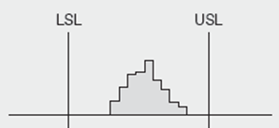




  Process Capability
Capable
Capable
Not
capable

Slide 9
  Process Capability
Process capability is a measure of the relationship between the natural variation of the process and the design specifications
A capable process must have a C_{p} of at least 1.0
Six Sigma quality requires a C_{p} = 2.0
Upper Specification – Lower Specification
6σ
C_{p} =

Slide 10
  Process Capability
Axles production:
Process mean x = 25 cm
Process standard deviation σ = 0.005 cm
Design specification = 25 ± 0.02 cm
Upper Specification - Lower Specification
6σ
C_{p} =
25.02 – 24.98
6(0.005)
Process is capable
=
= 1.33

Slide 11
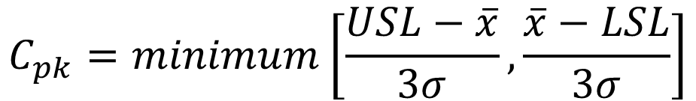
  Process Capability Index
Axles production:
When process mean is not at the center of the specification:
A capable process is not necessarily in the center of the specification, but it falls within the specification limit at both extremes
$$C_{pk}=minimum\left[\frac{USL−\overline{x}}{3σ}, \frac{\overline{x}−LSL}{3σ}\right]$$
A capable process must have a C_{pk} of at least 1.0

Slide 12
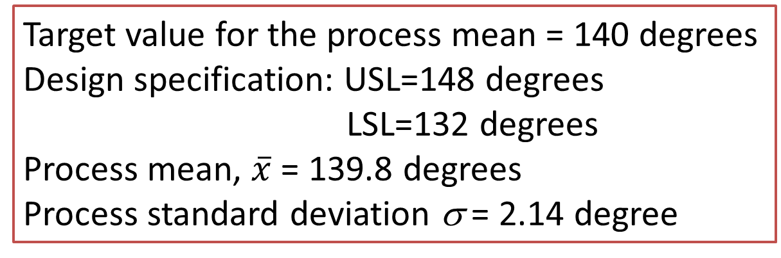
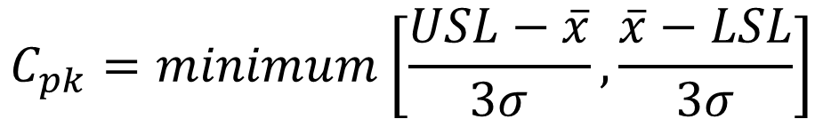
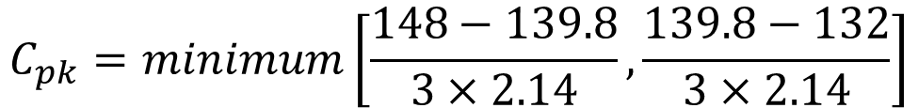
  Process Capability Index
Target value for the process mean = 140 degrees
Design specification: USL=148 degrees
LSL=132 degrees
Process mean, $\overline{x}$ = 139.8 degrees
Process standard deviation σ = 2.14 degree
.
Process mean (139.8 degrees) $≠Target value (140 degree)$
$$C_{pk}=minimum\left[\frac{USL−\overline{x}}{3σ}, \frac{\overline{x}−LSL}{3σ}\right]$$
$$C_{pk}=minimum\left[\frac{148−139.8}{3×2.14}, \frac{139.8−132}{3×2.14}\right]$$
Process is capable
= 1.21

Slide 13
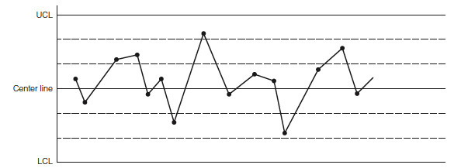
  Pattern in Control Chart
Controlled Process
No points are outside control limits.
The number of points above and below the center line is about the same.
The points seem to fall randomly above and below the center line.
Most points, but not all, are near the center line, and only a few are close to the control limits.

Slide 14
  Pattern in Control Chart
Out-of-Control Pattern
Sudden shift in process average
Cycles
Trends
Hugging the center line
Hugging the control limits

Slide 15
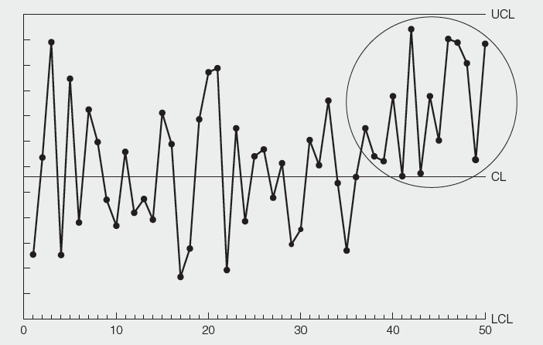
  Pattern in Control Chart
Out-of-Control Pattern
Sudden shift in process average

Slide 16
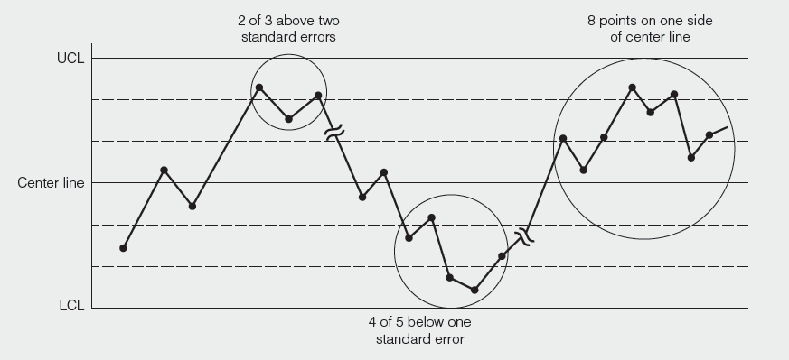
  Pattern in Control Chart
Out-of-Control Pattern
Sudden shift in process average

Slide 17
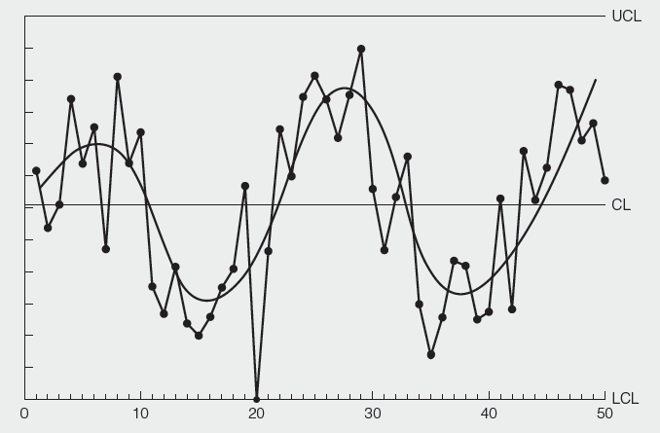
  Pattern in Control Chart
Out-of-Control Pattern
Cycles
Possible causes
Operator rotation
Fatigue at the
end of the shift
Different gauges
used by different
inspectors
Seasonal effects

Slide 18
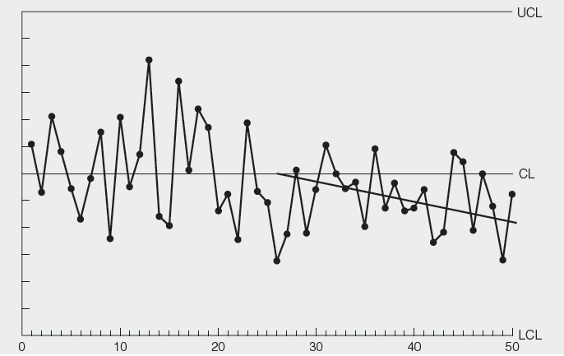
  Pattern in Control Chart
Out-of-Control Pattern
Trends
Possible causes
Improving skills
Improving fatigue
Removing dirt
Changes in temp.
Changes in
humidity
Tool wear

Slide 19
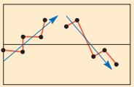
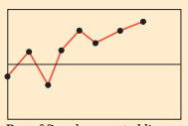
  Pattern in Control Chart
Out-of-Control Pattern
Trends
Possible causes
Improving skills
Improving fatigue
Removing dirt
Changes in temp.
Changes in
humidity
Tool wear
Investigate

Slide 20
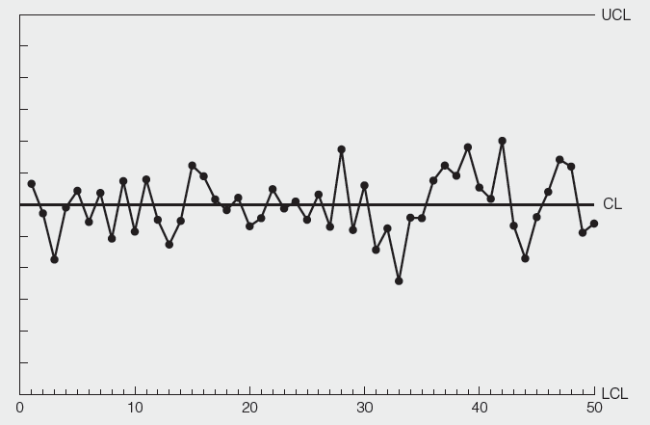
  Pattern in Control Chart
Out-of-Control Pattern
Hugging the center line
Possible causes
Miscalculation of
control limit
Wrong placement
of decimal point
Each sample
includes a mixture
of data from two
or more different
Processes.

Slide 21
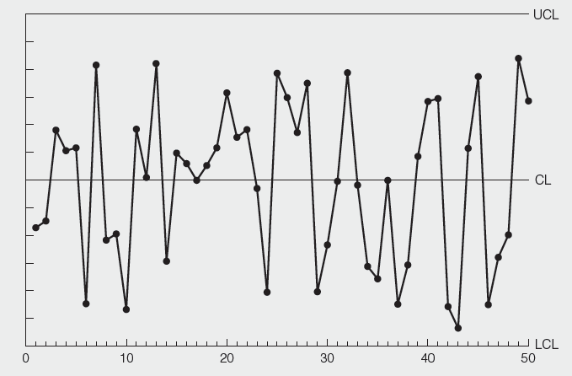
  Pattern in Control Chart
Out-of-Control Pattern
Hugging the control limits
Possible causes
Each sample is
taken from different
process (but not
mixed together)
and plotted on
the same chart.

Slide 22
  Statistical Process Control Chart
7 Quality Tools
Uses statistics and control charts to tell when to take corrective action
Plot the percent of free throws missed
40%
20%
0%
Upper control limit
Coach’s target value
| | | | | | | | |
1 2 3 4 5 6 7 8 9
Lower control limit
Game number

Slide 23


  Statistical Process Control Chart
7 Quality Tools
Sampling
The purpose of sampling is to find when the process has changed in some nonrandom way, so that the reason for the change can be quickly determined.
A sample of smartphone
Pile of smartphone

Slide 24
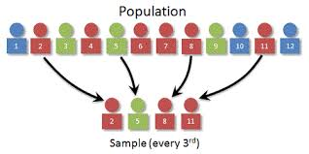




  Control Charts for Variables
7 Quality Tools (SPC)
Population and sample
$$Mean:μ$$
$$Standard deviation:σ$$
$$Mean: \overline{x}$$
$$Standard deviation: σ_{x}$$

Slide 25
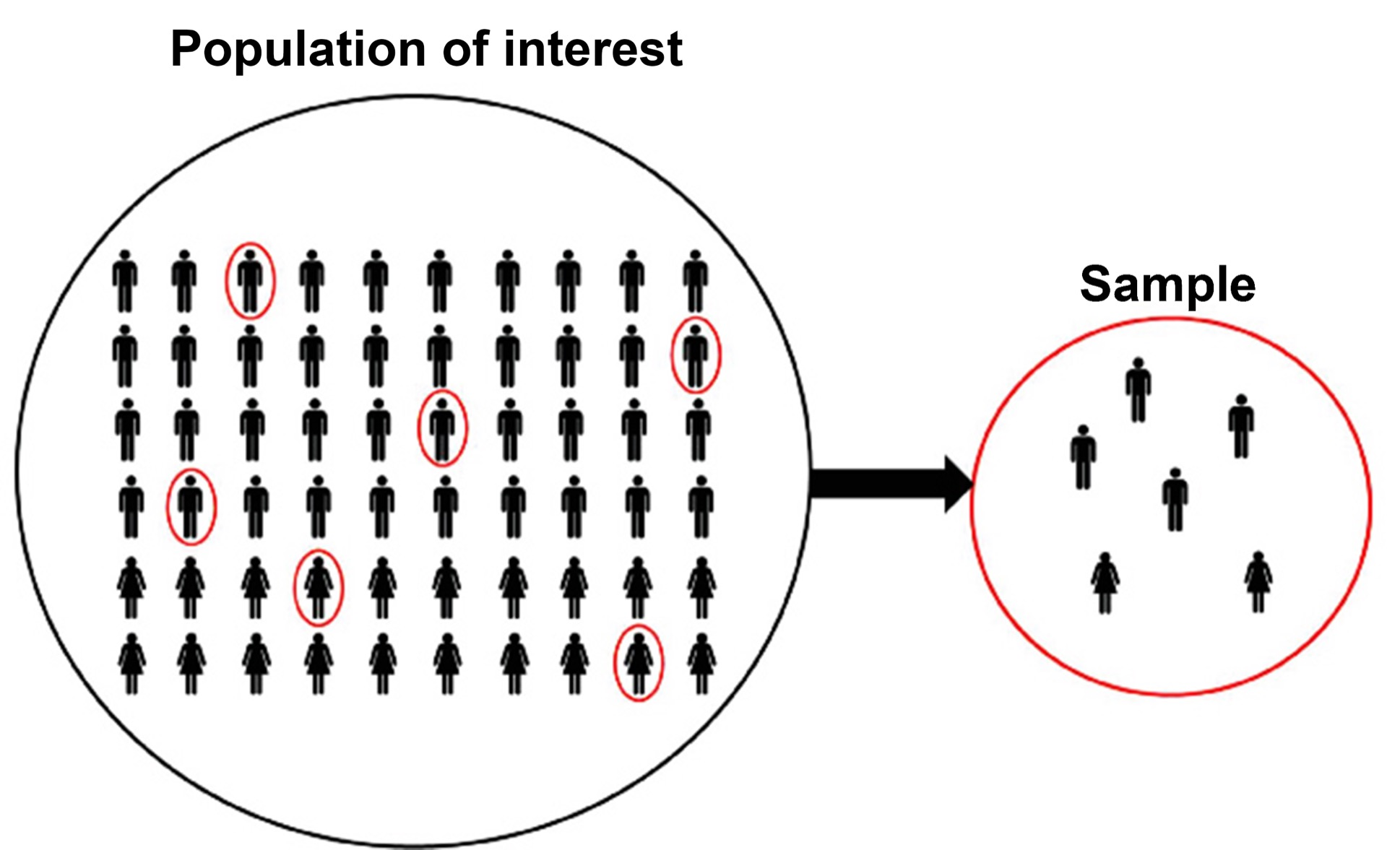




  Control Charts for Variables
7 Quality Tools (SPC)
Population and sample
$$Mean:μ$$
$$Mean: \overline{x}$$
$$Standard deviation:σ$$
$$Standard deviation: σ_{x}$$

Slide 26
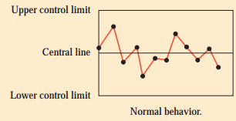
  Statistical Process Control Chart
7 Quality Tools
Sample testing
Acceptable

Slide 27
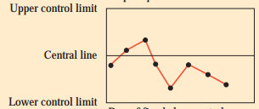
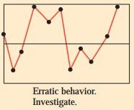
  Statistical Process Control Chart
7 Quality Tools
Sampling
Investigate

Slide 28
  Control Charts for Variables
7 Quality Tools (SPC)
.
x-chart tracks changes in the central tendency
R-chart indicates a gain or loss of dispersion

Slide 29
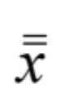

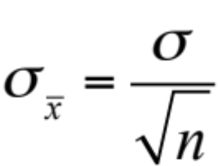
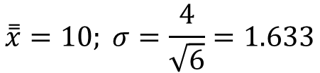

  Control Charts for Variables
7 Quality Tools (SPC)
Central Limit Theorem
If μ is the population mean and σ is population standard deviation. Then,
The mean of the sampling distribution =
The standard deviation of the sampling distribution =
Where n is the sample size
n=6
$$\overset{̿}{x}=10; σ=\frac{4}{\sqrt{6}}=1.633$$
$$μ=10; σ=4$$

Slide 30
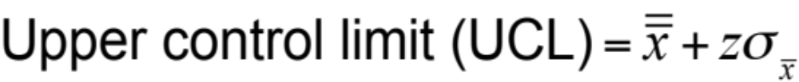
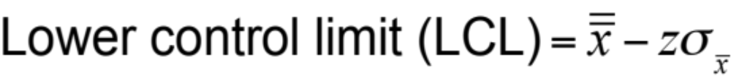



  Control Charts for Variables
7 Quality Tools (SPC)
.
For x-Charts when σ is known
Where = mean of the sample means or a target value set for the process
z = number of normal standard deviations
= standard deviation of the sample means
σ = population (process) standard deviation
n = sample size
Notes:
A histogram is a pictorial representation of a set of data. It is created by grouping the measurements into ‘‘cells.’’ Histograms are used to determine the shape of a data set.

Slide 31

  Control Charts for Variables
7 Quality Tools (SPC)
Population std. dev., σ = 1
Example
1 2 3 4 5 6 7 8 9
Sample 1
A sample of size 9
Usually 25 to 30 samples of size 3 to 10 are used.

Slide 32
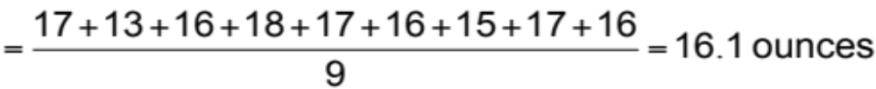
  Control Charts for Variables
7 Quality Tools (SPC)
Population std. dev., σ = 1
Example
1 2 3 4 5 6 7 8 9
Sample 1
Average weight in the first sample
WEIGHT OF SAMPLE |  | WEIGHT OF SAMPLE |  | WEIGHT OF SAMPLE
HOUR | (AVG. OF 9 BOXES) | HOUR | (AVG. OF 9 BOXES) | HOUR | (AVG. OF 9 BOXES)
1 | 16.1 | 5 | 16.5 | 9 | 16.3
2 | 16.8 | 6 | 16.4 | 10 | 14.8
3 | 15.5 | 7 | 15.2 | 11 | 14.2
4 | 16.5 | 8 | 16.4 | 12 | 17.3

Slide 33
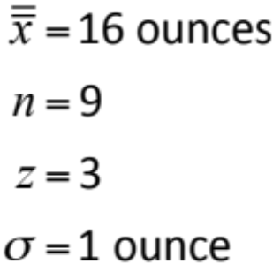
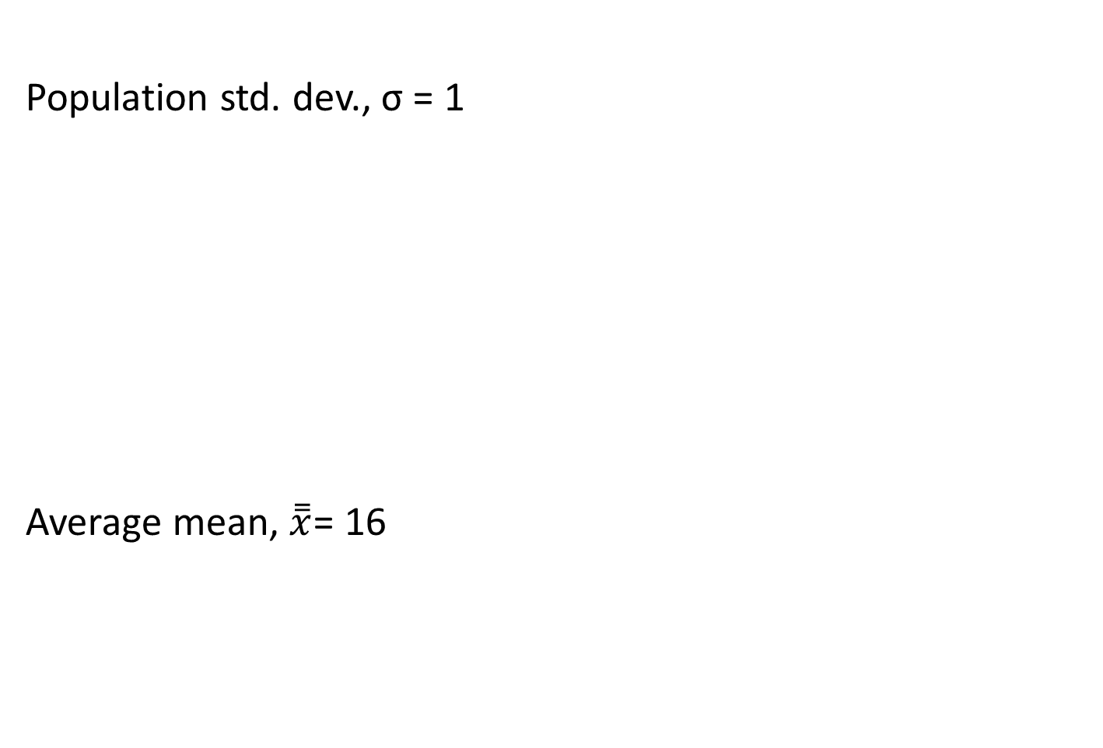
  Control Charts for Variables
7 Quality Tools (SPC)
Population std. dev., σ = 1
Average mean, $\overset{̿}{x}$= 16
Example
WEIGHT OF SAMPLE |  | WEIGHT OF SAMPLE |  | WEIGHT OF SAMPLE
HOUR | (AVG. OF 9 BOXES) | HOUR | (AVG. OF 9 BOXES) | HOUR | (AVG. OF 9 BOXES)
1 | 16.1 | 5 | 16.5 | 9 | 16.3
2 | 16.8 | 6 | 16.4 | 10 | 14.8
3 | 15.5 | 7 | 15.2 | 11 | 14.2
4 | 16.5 | 8 | 16.4 | 12 | 17.3
Number
of samples = 12
Notes:
A histogram is a pictorial representation of a set of data. It is created by grouping the measurements into ‘‘cells.’’ Histograms are used to determine the shape of a data set.

Slide 34
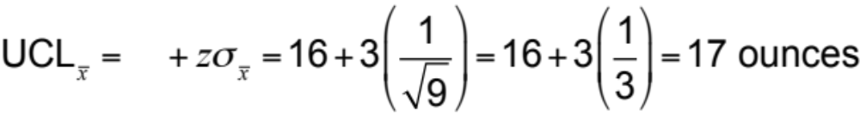

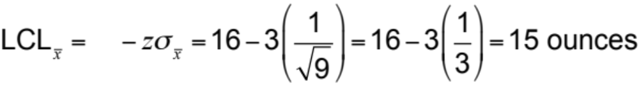
  Control Charts for Variables
7 Quality Tools (SPC)
Population std. dev., σ = 1
Example
Number
of samples = 12

Slide 35
  Control Charts for Variables
7 Quality Tools (SPC)
Population std. dev., σ = 1
Example
Control Chart for samples of 9 boxes
Out of control
Variation
due to assignable causes
17 = UCL
16 = Mean
Variation due to natural causes
15 = LCL
Variation
due to assignable causes
| | | | | | | | | | | |
1 2 3 4 5 6 7 8 9 10 11 12
Out of control
Sample number
Notes:
A histogram is a pictorial representation of a set of data. It is created by grouping the measurements into ‘‘cells.’’ Histograms are used to determine the shape of a data set.

Slide 36
  Control Charts for Variables
7 Quality Tools (SPC)
For x-Charts when we don't know σ
Notes:
A histogram is a pictorial representation of a set of data. It is created by grouping the measurements into ‘‘cells.’’ Histograms are used to determine the shape of a data set.

Slide 37
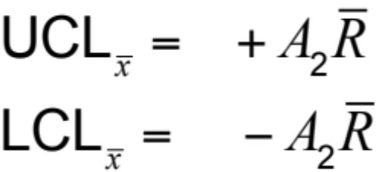
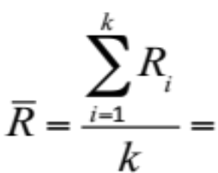



  Control Charts for Variables
7 Quality Tools (SPC)
For x-Charts when we don't know σ
Example
X-chart
R-chart
$${UCL}_{R}=D_{4}\overline{R}$$
$${LCL}_{R}=D_{3}\overline{R}$$
Where average range of the samples
A₂, D₃, and D₄ = control chart factor shown in Table
= mean of the sample means
R_{i} = range for sample i
k = total number of samples
Notes:
A histogram is a pictorial representation of a set of data. It is created by grouping the measurements into ‘‘cells.’’ Histograms are used to determine the shape of a data set.

Slide 38
  Control Charts for Variables
7 Quality Tools (SPC)
For x-Charts when we don't know σ
Example
 | Factors for Computing Control Chart Limits (3 sigma)
SAMPLE SIZE, n |  | MEAN FACTOR, A₂ | UPPER RANGE, D₄ | LOWER RANGE, D₃
2 |  | 1.880 | 3.268 | 0
3 |  | 1.023 | 2.574 | 0
4 |  | .729 | 2.282 | 0
5 |  | .577 | 2.115 | 0
6 |  | .483 | 2.004 | 0
7 |  | .419 | 1.924 | 0.076
8 |  | .373 | 1.864 | 0.136
9 |  | .337 | 1.816 | 0.184
10 |  | .308 | 1.777 | 0.223
12 |  | .266 | 1.716 | 0.284
Notes:
A histogram is a pictorial representation of a set of data. It is created by grouping the measurements into ‘‘cells.’’ Histograms are used to determine the shape of a data set.

Slide 39
  Control Charts for Variables
7 Quality Tools (SPC)
For x-Charts when we don't know σ
Example
Oat flakes labeled as "net weight 12 ounces"
Process average = 12 ounces
Sample size = 5

Slide 40
  Control Charts for Variables
7 Quality Tools (SPC)
For x-Charts when we don't know σ
Example
SAMPLE | WEIGHT OF LIGHTEST PACKET IN SAMPLE OF n = 5 | WEIGHT OF HEAVIEST PACKET IN SAMPLE OF n = 5
1 | 11.50 | 11.72
2 | 11.97 | 12.00
3 | 11.55 | 12.05
4 | 12.00 | 12.20
5 | 11.95 | 12.00
6 | 10.55 | 10.75
7 | 12.50 | 12.75
8 | 11.00 | 11.25
9 | 10.60 | 11.00
10 | 11.70 | 12.10
Sum
RANGE
.22
.03
.50
.20
.05
.20
.25
.25
.40
.40
2.5
Notes:
A histogram is a pictorial representation of a set of data. It is created by grouping the measurements into ‘‘cells.’’ Histograms are used to determine the shape of a data set.

Slide 41

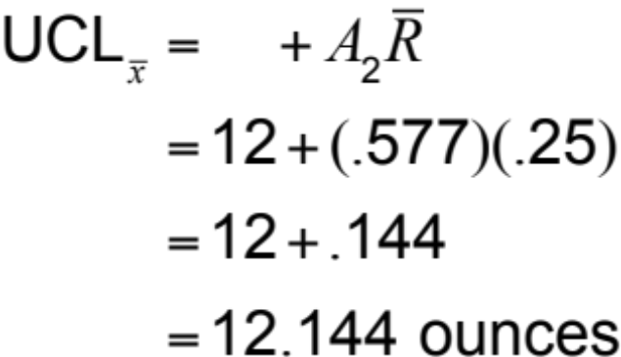
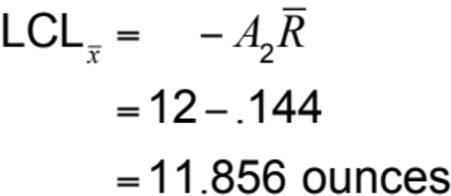
  Control Charts for Variables
7 Quality Tools (SPC)
For x-Charts when we don't know σ
Example
SAMPLE SIZE, n | A₂ | D₄
2 | 1.880 | 3.268
3 | 1.023 | 2.574
4 | .729 | 2.282
5 | .577 | 2.115
6 | .483 | 2.004
7 | .419 | 1.924
8 | .373 | 1.864
9 | .337 | 1.816
10 | .308 | 1.777
12 | .266 | 1.716

Slide 42
  Control Charts for Variables
7 Quality Tools (SPC)
For x-Charts when we don't know σ
Example
UCL = 12.144
Mean = 12
LCL = 11.856

Slide 43
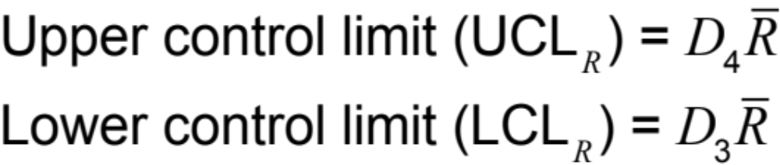
  Control Charts for Variables
7 Quality Tools (SPC)
R – Chart
For x-Charts when we don't know σ
Example
= 2.115*0.25 =
0.52875
= 0.00*0.25
=0
UCL = 0.5287
Mean = 0.25
LCL = 0

Slide 44
7 Quality Tools (SPC)
.
Control Chart for Attributes Data

Slide 45
  Control Chart for Attributes Data
SPC
A unit of work is nonconforming (defect or error) or not.
If a unit of work may have one or more nonconformances, entire unit becomes nonconformaning.
Attributes chart captures nonconforming as well as number of nonconforming. Sudden shift in process average.
p-charts monitors proportion of nonconforming units
c-charts and u-charts monitor the number of nonconformances per unit

Slide 46
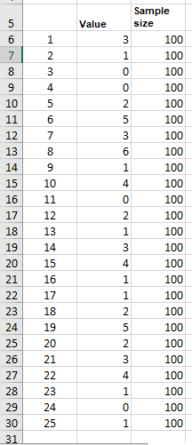
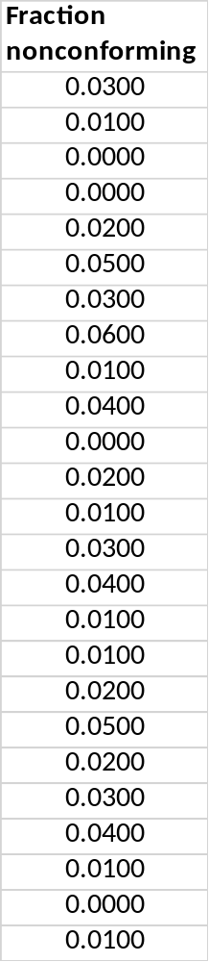


  p-charts (Fraction nonconforming)
SPC
P-chart with fixed sample size
Sample size needs to be large enough
Collect k samples. Let y_{i} represent the number of nonconforming units in sample i, and n_{i} be the size of sample i.
Compute the fraction nonconforming in each sample, p_{i} = y_{i} /n_{i}
Average fraction nonconforming
Average

Slide 47

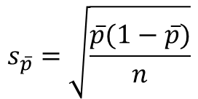
  p-charts (Fraction nonconforming)
SPC
P-chart with fixed sample size
.
Collect k samples. Let y_{i} represent the number of nonconforming units in sample i, and n_{i} be the size of sample i.
Compute the fraction nonconforming in each sample, p_{i} = y_{i} /n_{i}
Average fraction nonconforming
Compute standard deviation
$$s_{\overline{p}}=\sqrt{\frac{\overline{p}(1−\overline{p})}{n}}$$

Slide 48
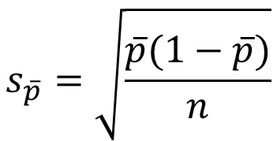

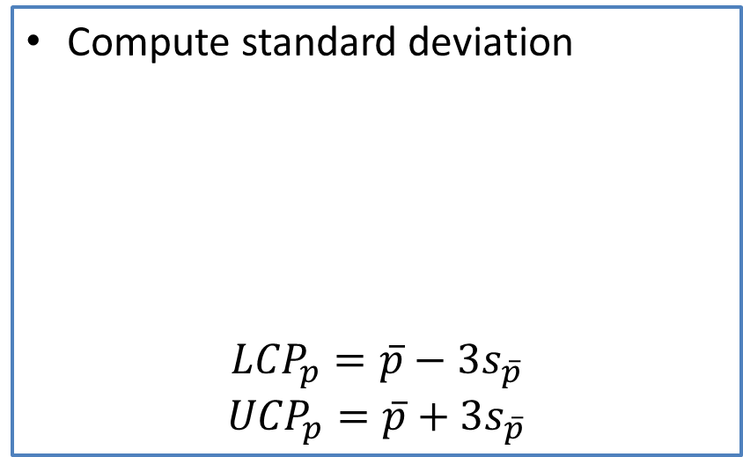

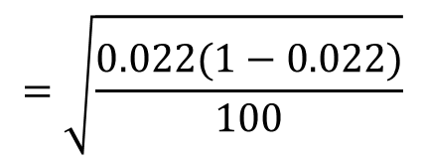
  p-charts (Fraction nonconforming)
SPC
P-chart with fixed sample size
.
Compute standard deviation
$${LCP}_{p}=\overline{p}−3s_{\overline{p}}$$
$${UCP}_{p}=\overline{p}+3s_{\overline{p}}$$
$$s_{\overline{p}}=\sqrt{\frac{\overline{p}(1−\overline{p})}{n}}$$
$$=\sqrt{\frac{0.022(1−0.022)}{100}}$$
$$=0.01467$$
$${LCP}_{p}=0.022−3×0.01467=−0.022$$
$${UCP}_{p}=0.022+3×0.01467=0.066$$

Slide 49
  p-charts (Fraction nonconforming)
SPC
P-chart with fixed sample size
.
Decreasing trend represents improvement
Upper trend or value above UCL conveys
need for improvement

Slide 50
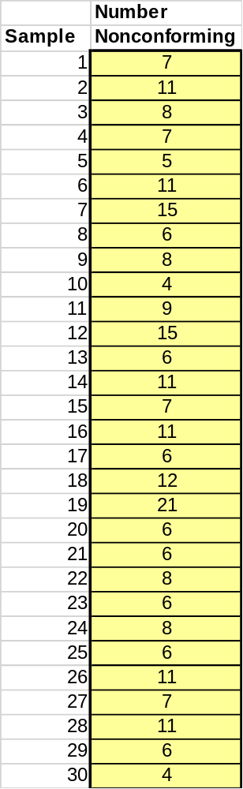
  p-charts (Fraction nonconforming)
SPC
P-chart with fixed sample size
.
Sample size = 350

Slide 51
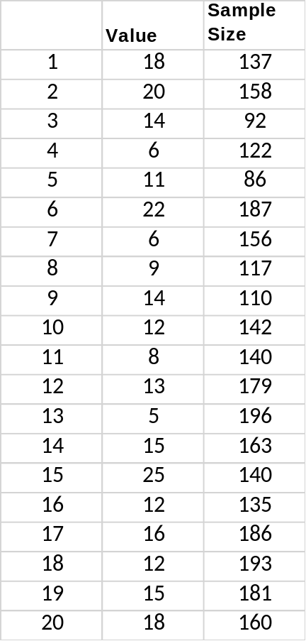
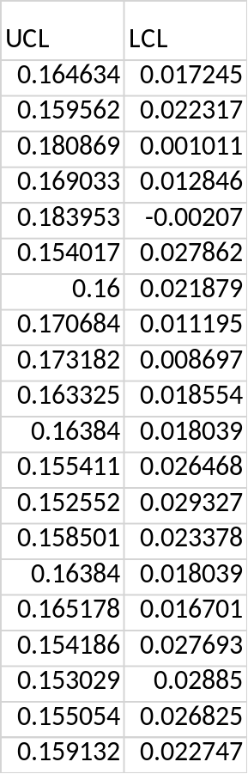
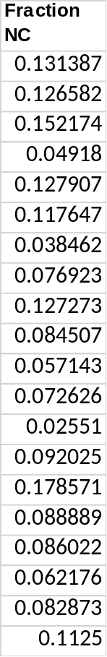

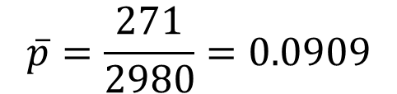
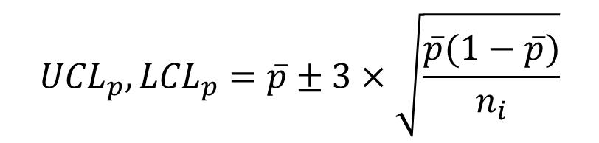
  p-charts (Fraction nonconforming)
SPC
P-chart with variable sample size
.
$${UCL}_{p},{LCL}_{p}=\overline{p}±3×\sqrt{\frac{\overline{p}(1−\overline{p})}{n_{i}}}$$
$$\overline{p}=\frac{271}{2980}=0.0909$$

Slide 52
  p-charts (Fraction nonconforming)
SPC
P-chart with variable sample size
.
$${UCL}_{p},{LCL}_{p}=\overline{p}±3×\sqrt{\frac{\overline{p}(1−\overline{p})}{n_{i}}}$$

Slide 53



  np-charts (Fraction nonconforming)
SPC
np-chart with fixed sample size
.
$$n\overline{p}=\frac{Total no. of nonconforming}{No. of Sample}=\frac{y_{i}}{k}$$
$${Standard deviation, s}_{n\overline{p}}=\sqrt{n\overline{p}(1−\overline{p})}$$
${UCL}_{n\overline{p}}=n\overline{p}+3$ $\sqrt{n\overline{p}(1−\overline{p})}$
${LCL}_{n\overline{p}}=n\overline{p}−3$ $\sqrt{n\overline{p}(1−\overline{p})}$

Slide 54





  np-charts (Fraction nonconforming)
SPC
np-chart with fixed sample size
.
$$n\overline{p}=\frac{55}{25}=2.2$$
$$\overline{p}=\frac{2.2}{100}=0.022$$
$${Standard deviation, s}_{n\overline{p}}=\sqrt{2.2 (1−0.022)}$$
= 1.4668
$${UCL}_{n\overline{p}}=2.2+3\left(1.4668\right)=6.6$$
$${LCL}_{n\overline{p}}=2.2−3\left(1.4668\right)=−2.20$$

Slide 55

  np-charts (Fraction nonconforming)
SPC
np-chart with fixed sample size
.

Slide 56




  c-charts for nonconforming
SPC
Collect samples of equal size and count the number of nonconformances
Compute the average number of nonconformances per unit, c-bar
Standard deviation
Control limits
$s_{c}=$ $\sqrt{\overline{c}}$
${UCL}_{c}=\overline{c}+3$ $\sqrt{\overline{c}}$
$${LCL}_{c}=\overline{c}−3 \sqrt{\overline{c}}$$

Slide 57






  c-charts for nonconforming
SPC
.
$$\overline{c}=\frac{45}{25}=1.8$$
${UCL}_{c}=1.8+3$ $\sqrt{1.8}=5.82$
$${LCL}_{c}=1.8−3 \sqrt{1.8}=−2.22 or 0$$

Slide 58

  c-charts for nonconforming
SPC
.

Slide 59




  u-charts for nonconforming
SPC
.
Applies if the samples are of unequal size
Collect samples and count the number of nonconformances
Compute the average number of nonconformances per unit, u-bar
Standard deviation
Control limits

Slide 60


  u-charts for nonconforming
SPC
.

Slide 61

  u-charts for nonconforming
SPC
.

Slide 62
Six Sigma Implementation
6σ
Think in terms of key business processes and customer requirements with a clear focus on overall strategic objectives.
Focus on corporate sponsors responsible for championing projects, support team activities, help to overcome resistance to change, and obtain resources.
Emphasize such quantifiable measures as DPMO that can be applied to all parts of an organization: manufacturing, engineering, administrative, software, and so on.
Notes:
There is no harm in going from 6 to 7 og 8. In fact airline industry operate at 10 or more for flight take off & landing, but for all practical purposses in an industry where human life is not at risk six sigma is a good enough improvement benchmark.
More than that may not be worth the Time, money$$ and effort.

Slide 63
Six Sigma Implementation
Ensure that appropriate metrics are identified early in the process and that they focus on business results, thereby providing incentives and accountability.
Provide extensive training followed by project team deployment to improve profitability, reduce non-value-added activities, and achieve cycle time reduction.
Create highly qualified process improvement experts (“Green Belts,” “Black Belts,” and “Master Black Belts”) who can apply improvement tools and lead teams.
Set stretch objectives for improvement.
6σ
Notes:
There is no harm in going from 6 to 7 og 8. In fact airline industry operate at 10 or more for flight take off & landing, but for all practical purposses in an industry where human life is not at risk six sigma is a good enough improvement benchmark.
More than that may not be worth the Time, money$$ and effort.

Slide 64















Six Sigma Companies
Six Sigma

Slide 65

Six Sigma Methodology
Six Sigma
DMAIC
DMAIC: Dumb Managers Always Ignore Customers
Defines the project’s purpose, scope, and outputs, then identifies the required process information keeping in mind the customer’s definition of quality
Measures the process and collects data
Analyzes the data ensuring
repeatability and reproducibility
Improves by modifying or
redesigning existing
processes and procedures
Controls the new process
to make sure performance
levels are maintained
Create qualified process improvement experts (Black Belts, Green Belts, etc.)
Notes:
Cummins India Ltd., Tata Consultancy Services is one such name. TATA Motors, John Deere, Mahindra & Mahindra, KPMG, GenPact, Gabriel Motors, Lear Corporation are few other industry giants that are using Six Sigma methodologies.

Slide 66

DMAIC Tools and Techniques
Six Sigma
.
Notes:
Cummins India Ltd., Tata Consultancy Services is one such name. TATA Motors, John Deere, Mahindra & Mahindra, KPMG, GenPact, Gabriel Motors, Lear Corporation are few other industry giants that are using Six Sigma methodologies.

Slide 67
References.
Managing for Quality and Performance Excellence, Evans, J.R. and William M. Lindsay, W.M., Cengage Learning, India
The Six Sigma Handbook, Tomas Pyzdek and Paul Keller, Fourth edition, McGraw Hill India.
Total Quality Management, Besterfield et al., Revised third edition, Pearson India
The Management and Control of Quality, J. Evans, and W. Lindsay, Third edition, Cengage Learning

Slide 68
.
Thanks!

