Slide 1
Performance Analytics

Slide 2
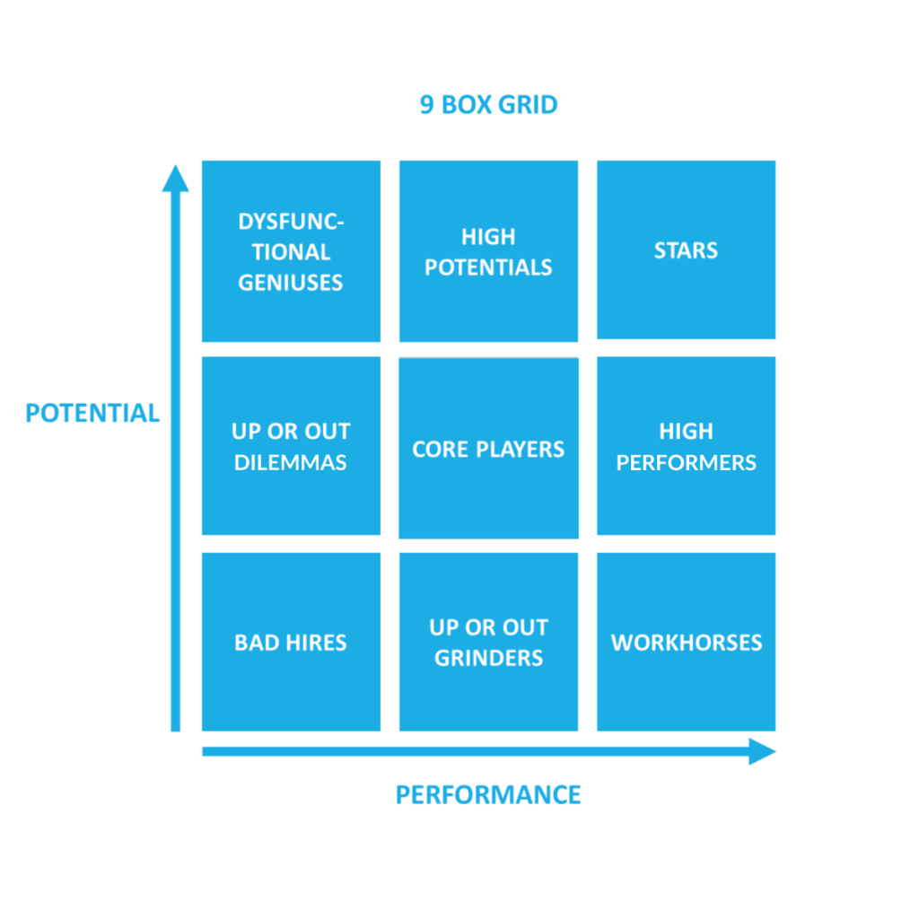

Slide 3
Bad Hires (1,1)
Action plan
Identify personal roadblocks for the low performance
However, do not over-invest in these people.
That would be unfair to the rest of the employees
4. In Gone case – Prepare exit plan

Slide 4
Up or out – Dilemma (1,2)
Mentoring is required
Provide measurable expectations and
Clearly define what good performance will look like.
Check in every month and
Evaluate progress on the plan
If No improvement within 6 months to a year,
You should create an exit plan for them

Slide 5
Dysfunctional geniuses (1,3)
Counselling
1. Communicate that you believe in them
2. Get more personal and try to figure out reasons
3. If job is not interesting – Give Job rotation
4. If family/personal problem – Give them off

Slide 6
Up or out – Grinders (2,1)
Create a personal improvement plan (PIP).
Invest in up skilling them
Give mentoring support

Slide 7
Workhorses (3,1)
Trusted professionals
Take care of them
Good work mentality
Keep them happy and reward
But don’t over reward
Keep them happy in the current role
“every employee tends to rise to his level of incompetence”

Slide 8
High potentials (2,3) or Future Stars
They haven’t had time to fully grow in the role yet.
Give them time
Set right temperament
Structured mentoring from STARS
Once STARS have a complete faith in them
Move them to the right position

Slide 9
Core players (2,2) or Future Stars
Enable them with peer coaching by a high-performing employee
Help them develop the skills
Professional coaching to solve any personal or professional issues
Classroom training and on-the-job learning opportunities

Slide 10
High Performers (2,3) or Future Stars
Keep high performers happy and engaged.
Regularly check in with them and appreciate the work they do.
Involve them in critical activities under the mentorship of STARS
Give them time to grow.

Slide 11
STARS (3,3)
Give your stars challenging assignments
Provide mentorship with Top Management
Create networking opportunities with other stars
Incentivise them to take roles as committee head etc.
Raise their public profile
Competitive compensation

