Slide 1

New Product Development Strategy

Slide 2
A new product may be classified into several different categories.
New-to-the-world products: These are innovations. These new products are the first of their kind and create an entirely new marque. This category represents only 10% of all new products.
New category entries: These are new products or lines which are not classified as new-to-the-world and take the company into a new category. A new category is an imitation of an existing product and provides an entry into new markets. Around 20% of all new products fit into this category .
Additions to product lines: This category contains items which are new to the company but which fit within an existing product line. This is one of the larger new product categories, representing more than 25% of all new products.

Slide 3
Product improvements: These are existing products which have been improved (practically, every product on the market today has been improved) and may be replacements of existing products. They provide enhanced performance or a greater perceived value over the old product and make up 25% of all new products.
Repositioning: These are products targeted toward a new usage or application. The category accounts for around 7% of all new products.
Cost reductions: These are designed to replace existing products at a lower cost.

Slide 4
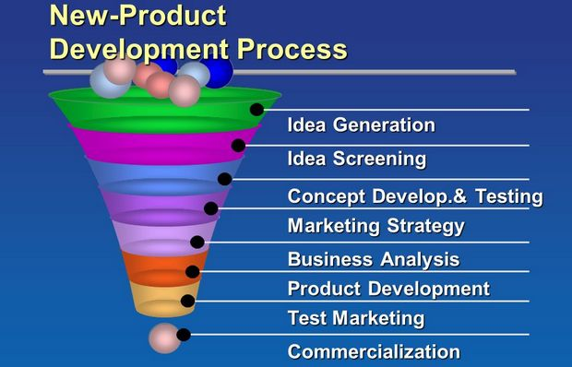
New Product Development Process and Stages:

Slide 5
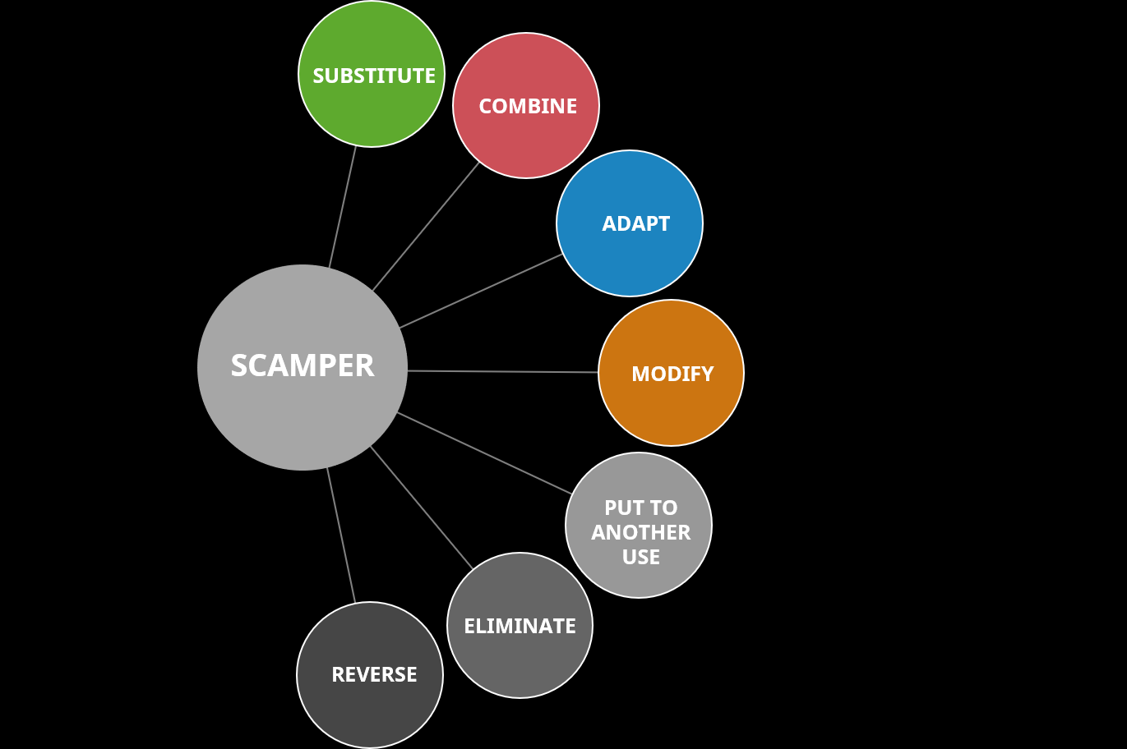
Tools of IDEA GENERATION
“Creative thinking inspires ideas. Ideas inspire change” – Barbara Januszkiewicz
SCAMPER Technique

Slide 6
Idea Challenge
Idea challenge is a focused form of innovation where you raise a problem or opportunity with the hopes of coming up with creative solutions. there are two types of idea challenges, problem centric and solution centric approaches.
Opposite Thinking
Opposite/reverse thinking is a technique that can help you question long-held assumptions related to your business. It’s a useful tool to consider if you feel your team is stuck with the conventional mindset and coming up with those “out-of-the-box ideas” seems to be difficult.
https://www.boardofinnovation.com/tools/opposite-thinking/
https://www.youtube.com/watch?v=ZxNRW2d7Zew&feature=emb_logo

Slide 7
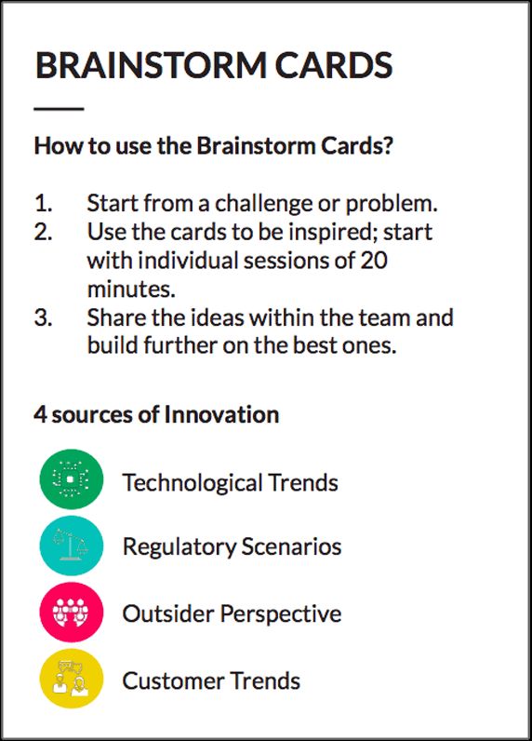
Brainstorm Cards
Brainstorm cards are a useful tool created by the Board of Innovation for coming up with dozens of new ideas related to whatever challenge or problem you are currently working with. Brainstorm cards help you consider external factors such as: societal trends, new technologies, and regulation in the context of your business.

Slide 8
Analogy Thinking
Analogy thinking is a technique for using information from one source to solve a problem in another context. Often one solution to a problem or opportunity can be used to solve another problem.
Analogy thinking can, for example, be used for analyzing a successful business, identifying what makes it great, and then applying those same principles for your business. This is an effortless method for coming up with new ideas that are pre-validated.

Slide 9
IDEA SCREENING
Idea screening is the process of evaluating ideas to drop as many ideas as possible from consideration. It is common for creative processes to begin with the optimistic and open generation of ideas. Idea screening is a complementary process that takes pessimistic views of ideas. By generating and dropping large number of ideas it is hoped that you will end up with a few ideas that are both imaginative and realistic. Criteria for idea screening
Relevance
Assumptions
Constrains
Feasibility
Value
Risk
Sanity check

Slide 10
Concept Development and Testing
A two-phase stage in the development of a new product in which potential buyers are presented first with the idea or description of the new product (concept testing) and later with the product itself in final or prototype form (product testing), in order to obtain their reaction.
What is concept testing?
Concept testing is a process that helps you assess the customer reaction to your proposed product or service prior to introducing it to the market. It typically involves surveying potential users for their opinions on the concept. For example, you may want to ask them:
Are they interested in the product?
How much do they like the product?
How desirable do they find the product's features?
What features do they like most/least?
How well would the product compare to other brands or similar product?
What price point would they find appealing?
What would they like to change about the product?

Slide 11
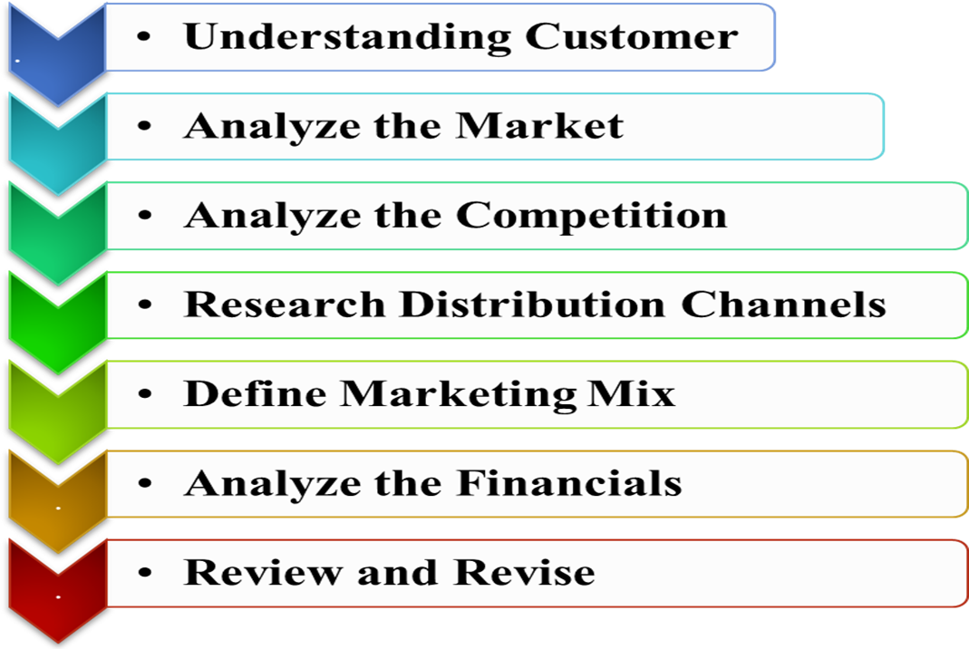
Marketing Strategy Development

Slide 12
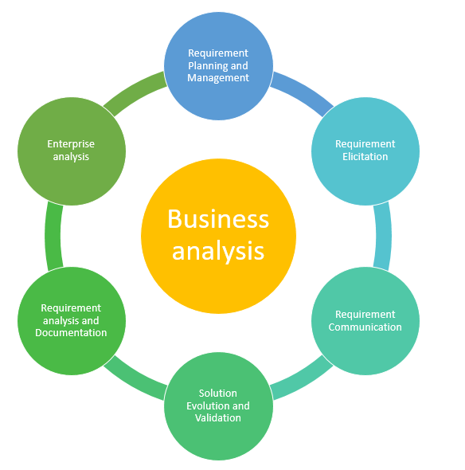
BUSINESS ANALYSIS
Business Analysis can be understood as a research discipline that helps you to find the business needs and identify solutions to business problems. These solutions may include the development of a software or system component, improvements in process, organizational changes or strategic planning and policy development. The purpose of business analysis is to identify solutions that meet the need for improvement.

Slide 13
PRODUCT DEVELOPMENT
Produce a
physical prototype
Test the product
Conduct focus group customer
Make adjustment

Slide 14
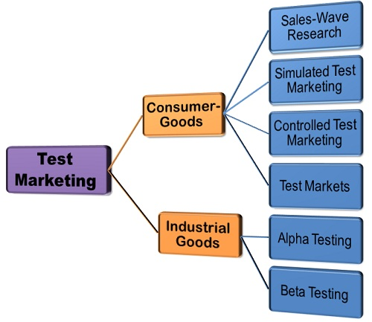
Test Marketing
The Test marketing is a tool used by the companies to check the viability of their new product or a marketing campaign before it is being launched in the market on a large scale. Through test marketing, a marketer may ascertain the success ratio of the new product and the marketing campaign and can design the marketing mix ( viz. Product, price, place, promotion) very well before its launch.

Slide 15
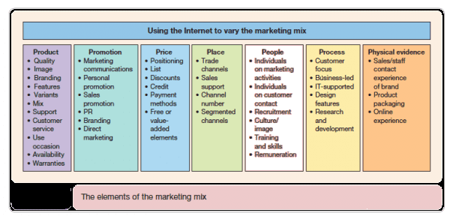
COMMERCIALIZATION
Develop the Marketing Mix :
The marketing mix is a broad concept which includes several aspects of marketing which all inquire to obtain a similar goal of creating awareness and customer loyalty.
The marketing mix is not only an important concept, but a guideline to reference back to when implementing the price, promotion, product, and distribution.
Address the 7 Key P’s
  Product [Tangible / Intangible]
  Place
  Price
  Promotion
  People
  Process
  Physical Environment
Design the Product pre-launch planning and preparation
Product business case development and general
business planning
Commercial roadmap including launch planning,
detailed resources and budgets

Slide 16
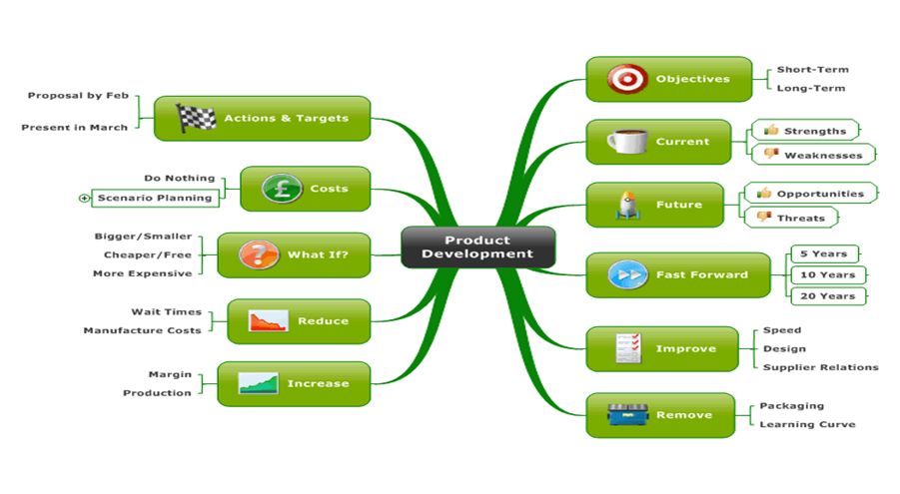
Product Development Map

Slide 17
BASES TEST
BASES (Booz-Allen Sales Estimating System) is a STM which integrates consumer response data with manufacturers’ marketing plans to assess the volumetric potential of concepts and products prior to introduction. The system was developed in 1977 by Lynn Y.S. Lin who at the time was with Burke Marketing Research. Lin was inspired by work on market simulators at Pillsbury where he was working prior to joining Burke. BASES was acquired by Nielsen in 1998.
In more than 50 percent of the cases BASES-testing is used. BASES is the Simulated Test Marketing (STM) tool suite of Nielsen and contains a number of STM tools. The concept screening tool BASES SnapShot is the most important tool for the evaluation of New Product Ideas, line extensions and relaunches. In SnapShot each concept is assessed on the basis of key parameters according to a secret black box algorithm. The Concept Potential Score (CPS) summarizes the results and indicates whether the concept goes into product development or not. The CPS is based on four criteria which should be considered in the development of successful design concepts: (1) Value Rating, (2) Purchase Intent, (3) Purchase Frequency and (4) Purchase Volume. However, some difficulties arise in the use of this criteria, if we analyse it with current knowledge from Marketing Science:

Slide 18
Value Rating indicates the degree to which consumers are convinced that the product (better) satisfies a need for a fixed price. The parameter does not provide any levers for optimization of the design. However Marketing Science provides test formats that analyse the transformation of subjective value and the probability in choices (see The Prospect Theory for more details). This approach could provide insights into how products and communication need to be framed to optimize the evaluation in terms of losses and gains. Other important points, which are not addressed with this Nielsen parameter are distinctive assets, the creation of attention and the building / refreshing of memory structures and shemata. Considerering this aspects would lead to a better evaluation of the product (→ retrieval bias effect).
The key figure Purchase Intent reflects the expected probability that a first purchase is made. However due to Marketing Science there might be a discrepancy between the forecasted and the actual buying behavior. This can be reduced by an improved measuring scale. For example, the 11-point Juster scale measure, which measures the probability of purchase, delivers more accurate results. Nevertheless, future behavior can be predicted only conditionally. The measure also provides no information about the cause of (non-)purchase and therefore no levers for design optimization. The Theory of Planned Behaviour (TPB) examines the variables that influence purchase intent. At the category level they can analyze why a category is liked and thus provide valuable knowledge for product design, development and advertisement themes.

Slide 19
Purchase Frequency indicates the expected frequency with which a product is purchased. This ratio is a loyalty measure as it represents the number of repeat purchases. This means it follows the Double Jeopardy Marketing Science Law and is therefore dependent on the size of the brands market share.
The key figure Purchase Volume predicts the expected number of items per purchase. However, fluctuation in sales volume based largely on sales promotions and seasonal variations (e.g. holiday season, bank holidays) and generally have little impact on long-term sales figures or loyalty.
What do consumers really appreciate of products in the category (→ Theory of Planned Behaviour)?
What encourages consumers to try out the new product and what are the purchase barriers (→ Prospect Theory)?
What creates distinctive brand assets and builds or refreshes memory structures (→ Brand Salience Theory)?

Slide 20
Nielsen’s BASES-testing predict whether innovations have the potential to be successful in the market. The innovation database by Nielsen reveals that concepts that are judged potentially successful in the market are concepts that try to address real consumer (and/or currently unmet) needs. According to Nielsen, success is based on ‘demand-driven innovation’, with proper execution being more important than the concept itself. This means a well executed but mediocre concept is better than a brilliant concept with mediocre execution. This leads us to the question: How are successful executions measured? Nielsen defines 12 success criteria for the testing of initiative and innovation executions. These criteria are summarized in the STM tool Introscope:

Slide 21
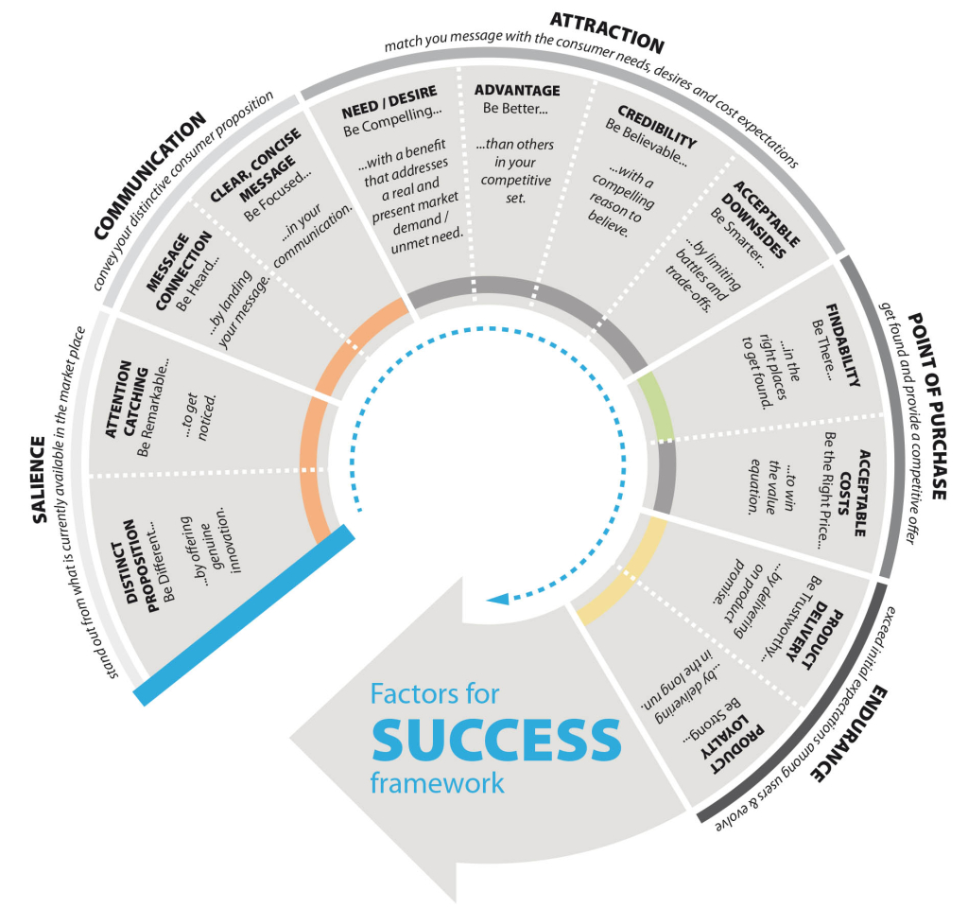

Slide 22
VOLUMETRIC FORECASTING
By empirically linking Nielson models to in-market data, BASES Volumetric Forecasting accurately predicts multi-year sales and the incremental impact of the new product’s sales on your total brand volume. Nielson take into account consumer feedback on the concept to inform trial potential and on the product to assess both long term, repeat, potential as well as the impact of product reviews on others’ trial purchases. Combining consumer response with market levers—including media spend and vehicles, promotions, distribution, and more—Nielson determine the potential of product launch. With this information, Nielson can more precisely plan production capacity and allocate the right level of marketing support for your launches.

