Slide 1
HRP

Slide 2
Dilemma in Hiring?

Slide 19
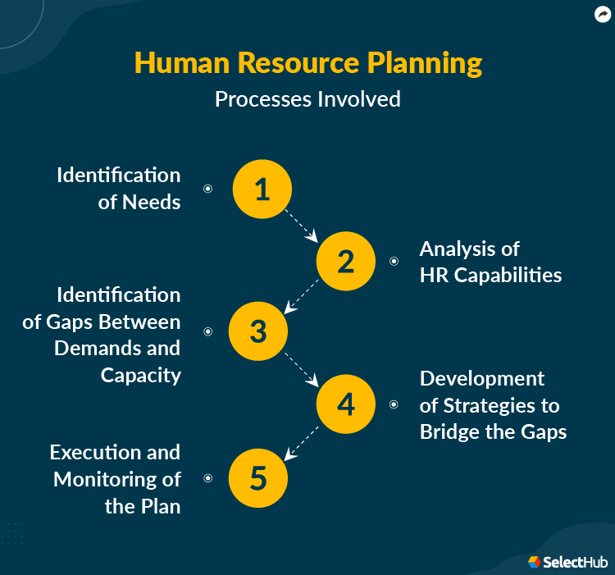

Slide 20
