Slide 1
Brand Management

Slide 2
What is identity??

Slide 9
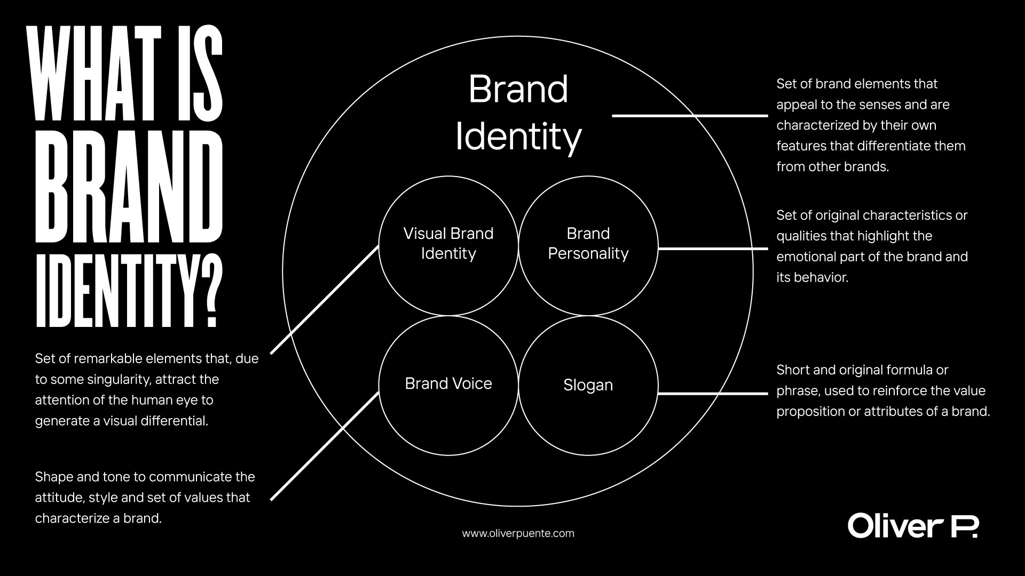

Slide 10
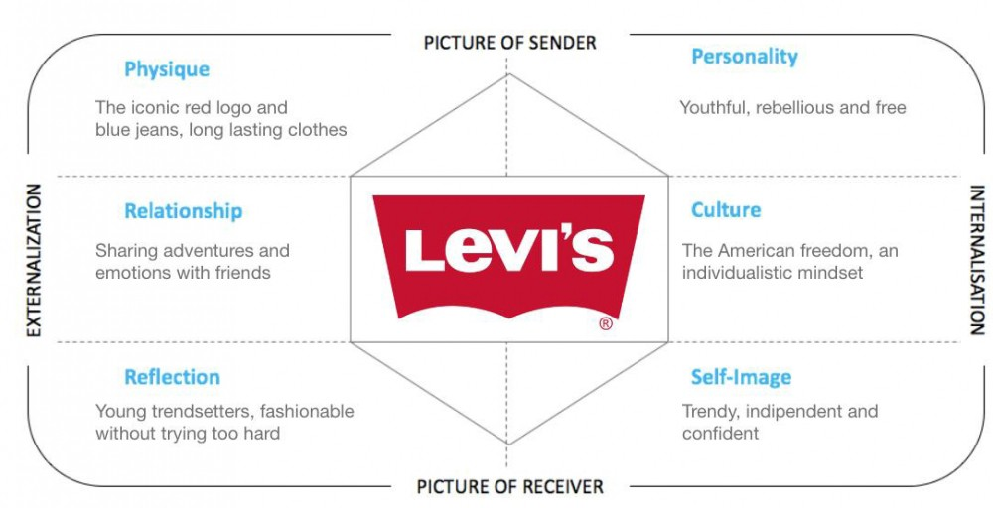

Slide 13
Flipkart & Walmart Case
Do you think Walmart Inc. should keep investing in independent brands (Myntra and Jabong) or merge them with Flipkart?
Why?? Or Why not??

Slide 14
Flipkart & Walmart Case
What should be the post-acquisition brand identity strategy of Flipkart Group?

Slide 15
Post-acquisition Brand Identity Strategy
A house of brands
Endorsed brands – The acquiring brand can endorse the “acquired brand” to provide greater credibility and substance
Branded House – The master brand (“acquiring brand”) moves from a primary driver to a dominant driver

