Slide 2
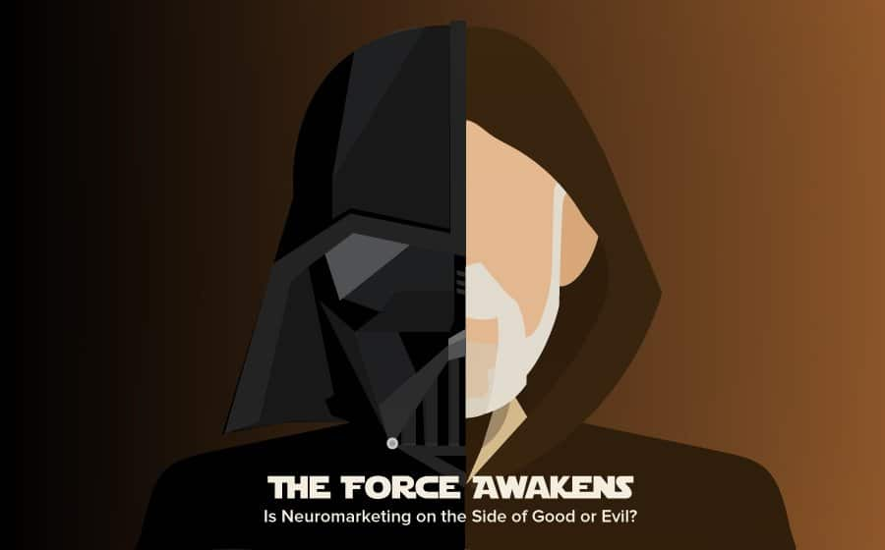
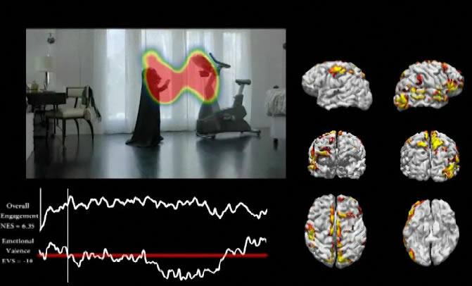
Emotions –
nostalgia (Star Wars !)
empathy (a parent’s love),
humor (the reaction from Darth himself).
When the test group viewed the commercial while attached to EEG machines, Sands found that “The Force” commercial tested nearly off the charts in terms of neuro-engagement.
https://elmlearning.com/blog/the-force-awakens-is-neuromarketing-on-the-side-of-good-or-evil/

Slide 4
Neurotech

Slide 5
Technologies developed to understand the brain, visualize its processes and even control, repair or improve its functions
Invasive vs noninvasive

Slide 6
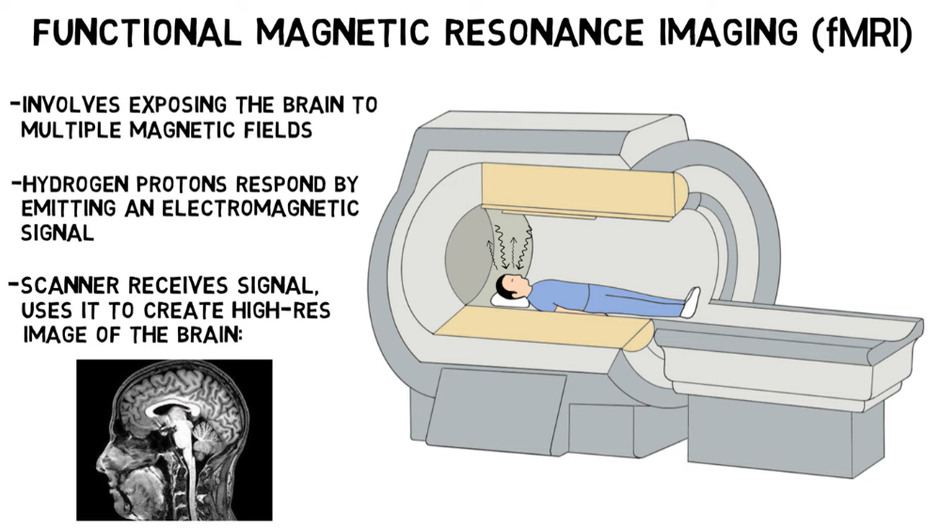

Slide 7
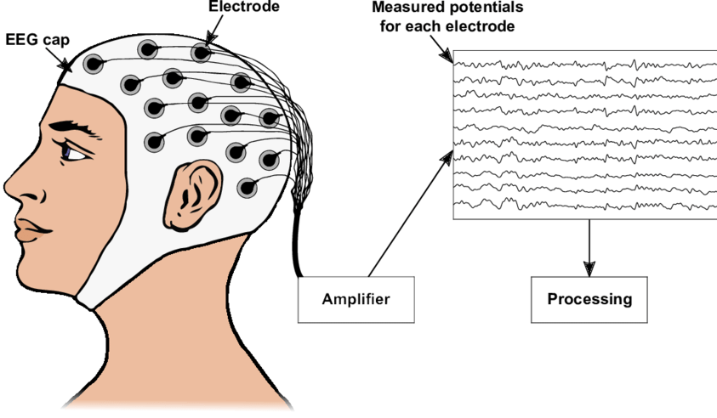








An electroencephalogram (EEG) is a test that measures electrical activity in the brain using small, metal discs (electrodes) attached to the scalp.

Slide 8
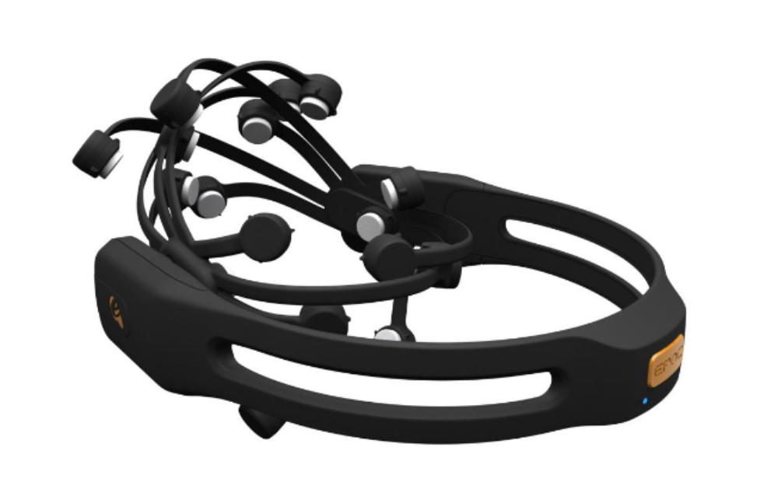

Slide 10
Can we even get what the brain is thinking !

Slide 11
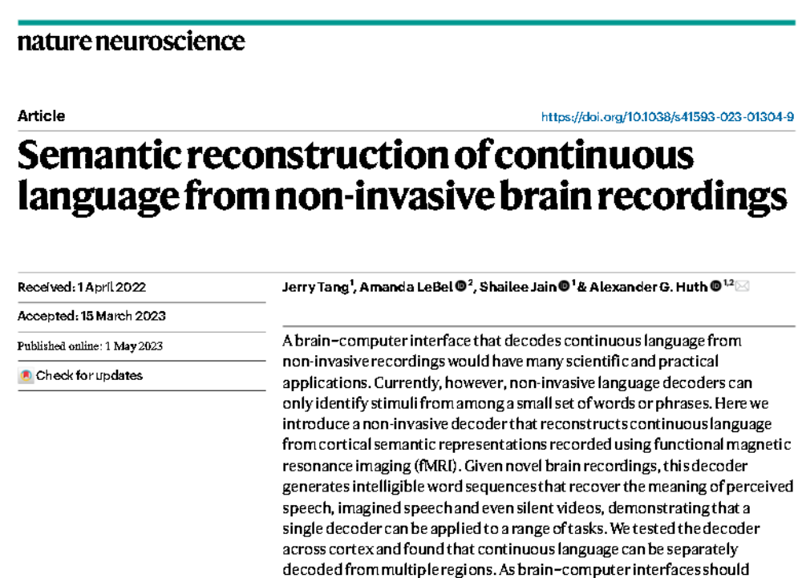

Slide 12
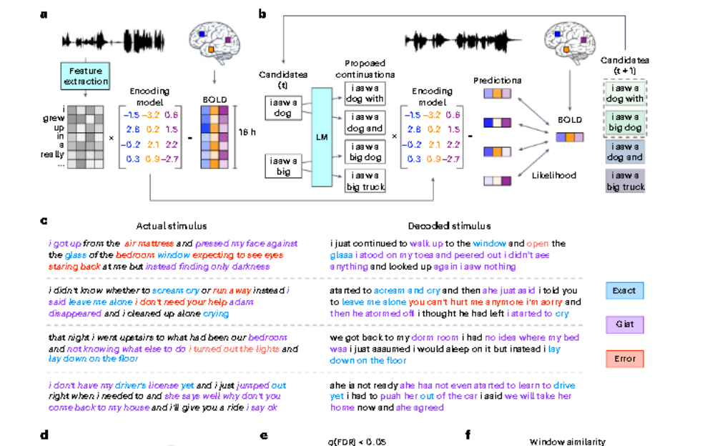

Slide 13
Vision Reconstruction

Slide 15
Invasive

Slide 16
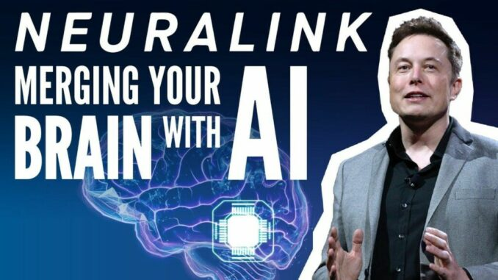
https://www.pumpitupmagazine.com/a-chip-called-neurolink-could-stream-music-directly-to-the-brain/

Slide 17
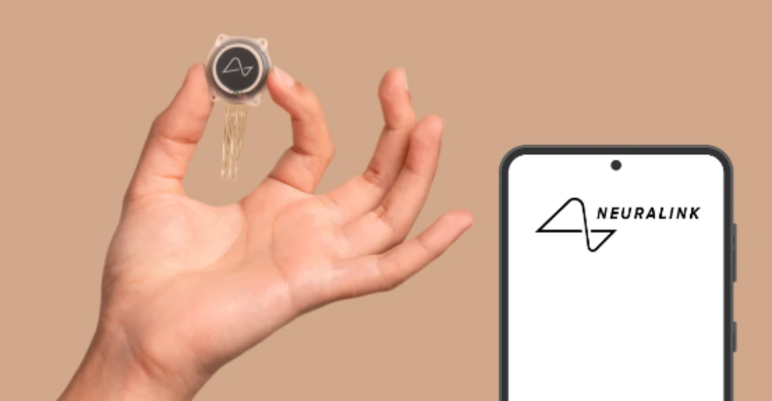

Slide 19
passthoughts

Slide 20
an alternative to passwords.
Soon, we might log into our various devices and platforms using our thoughts
biometric identification.

Slide 21
Neuralink + generative AI

Slide 22
Usecases of BCI in governance

Slide 23
