Slide 1
There are two machines
Machine 1 produces 30 Wrenches per hour
Machine 2 produces 20 wrenches per hour

Slide 2
Out of total wrenches produced , it was observed that 1% of them are defective

Slide 3
Out of all the defective wrenches , it was observed that 50% came from machine 1 , and 50% came from machine 2

Slide 4
What is the probability that a wrench produced by machine 2 is defective

Slide 5


Slide 6


Slide 7
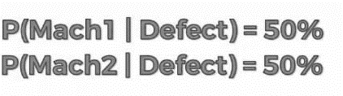

Slide 8


Slide 9
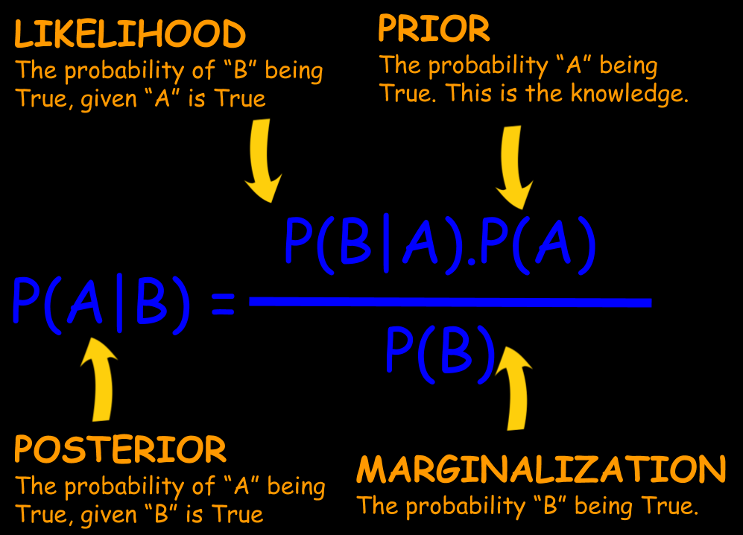
https://towardsdatascience.com/

Slide 10
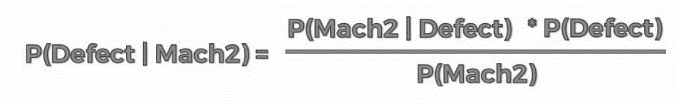
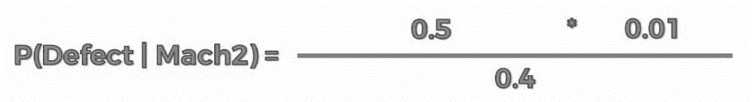


Slide 11
Naive Bayes Classifiers
Naive Bayes classifiers are a collection of classification algorithms based on Bayes’ Theorem.
It is not a single algorithm but a family of algorithms where all of them share a common principle, i.e. every pair of features being classified is independent of each other.

Slide 12
Assumption
The fundamental Naive Bayes assumption is that each feature makes an: independent and equal contribution to the outcome.

Slide 13
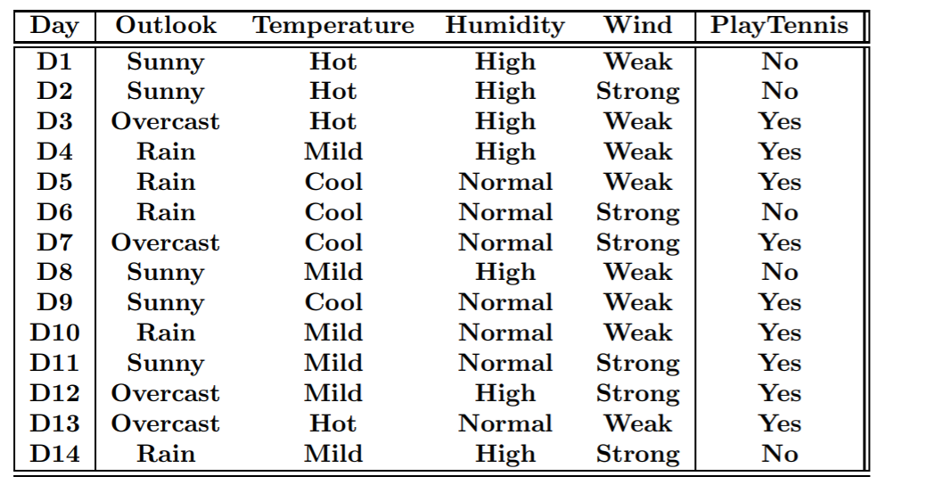

Slide 14
We assume that no pair of features are dependent. For example, the temperature being ‘Hot’ has nothing to do with the humidity or the outlook being ‘Rainy’ has no effect on the winds. Hence, the features are assumed to be independent.
Secondly, each feature is given the same weight(or importance). For example, knowing only temperature and humidity alone can’t predict the outcome accurately. None of the attributes is irrelevant and assumed to be contributing equally to the outcome.

Slide 15
Why Naïve ?

Slide 16
assumptions made by Naive Bayes are not generally correct in real-world situations, but it is good enough

Slide 17
Applications
Spam Classification
  Given an email, predict whether it is spam or not
Medical Diagnosis
  Given a list of symptoms, predict whether a patient has disease X or not
Weather
  Based on temperature, humidity, etc… predict if it will rain tomorrow

