Slide 1
Artificial Neural Network 101

Slide 2


Slide 3
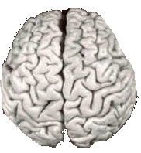
Biological Inspiration
Idea : To make the computer more robust, intelligent, and learn, …
Let’s model our computer software (and/or hardware) after the brain

Slide 4


Slide 5
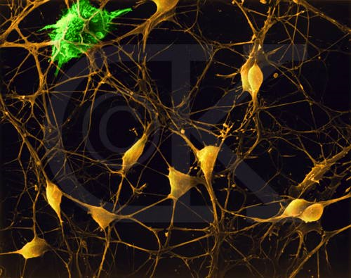
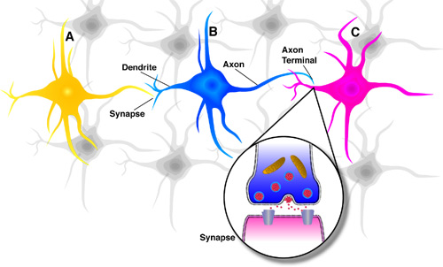
Neurons in the Brain
Although heterogeneous, at a low level the brain is composed of neurons
  A neuron receives input from other neurons (generally thousands) from its synapses
  Inputs are approximately summed
  When the input exceeds a threshold the neuron sends an electrical spike that travels that travels from the body, down the axon, to the next neuron(s)

Slide 6
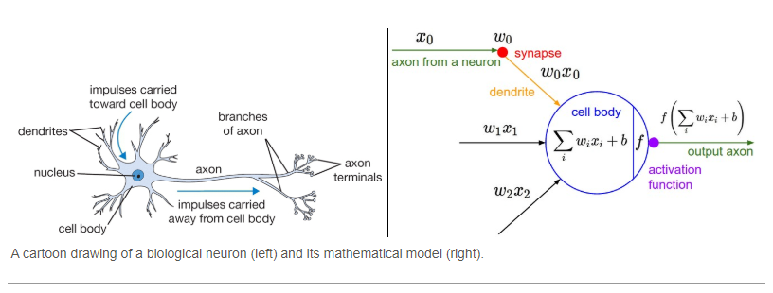

Slide 7
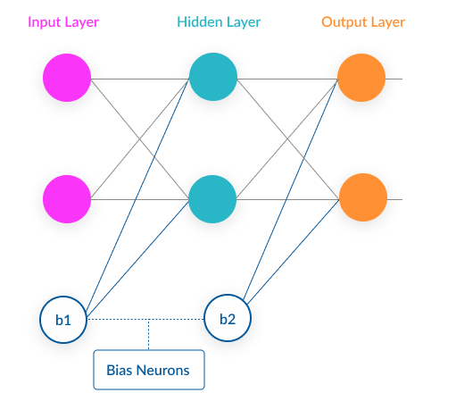

Slide 8
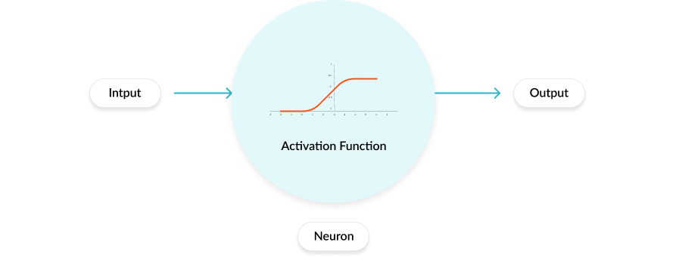
Activation functions are mathematical equations
determine the output of a neural network.
attached to each neuron in the network, and determines whether it should be activated (“fired”) or not, based on whether each neuron’s input is relevant for the model’s prediction.
also help normalize the output of each neuron to a range between 1 and 0 or between -1 and 1.

Slide 9
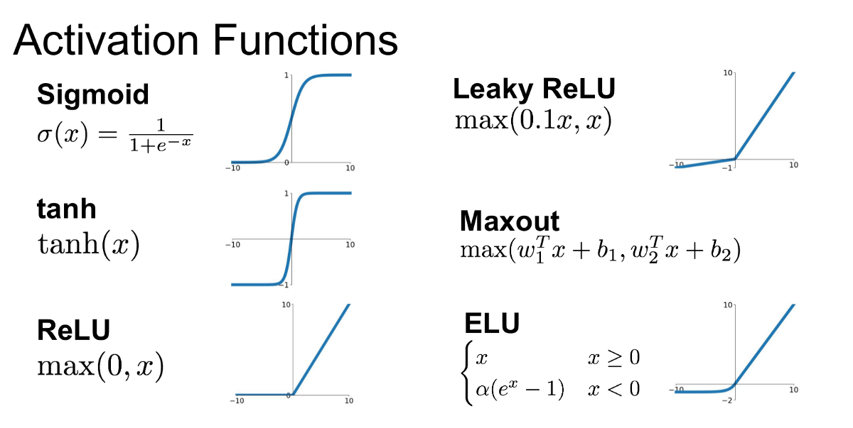

Slide 10
Loss’ in Machine learning helps us understand the difference between the predicted value & the actual value.
Loss function: Used when we refer to the error for a single training example.
Cost function: Used to refer to an average of the loss functions over an entire training dataset.

Slide 11

Cost function for regression

Slide 12
Gradient descent (GD)
iterative first-order optimization algorithm used to find a local minimum/maximum of a given function.
This method is commonly used in machine learning to minimize a cost/loss function

Slide 13
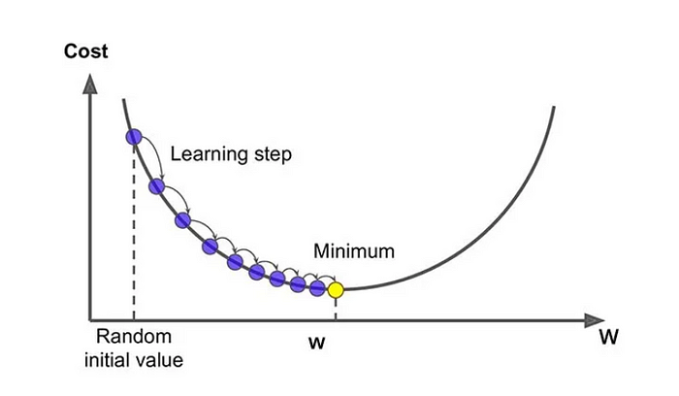

Slide 14
Back-propagation
Back-propagation is the essence of neural net training.
It is the practice of fine-tuning the weights of a neural net based on the error rate (i.e. loss) obtained in the previous epoch (i.e. iteration).
Proper tuning of the weights ensures lower error rates, making the model reliable by increasing its generalization.

Slide 15
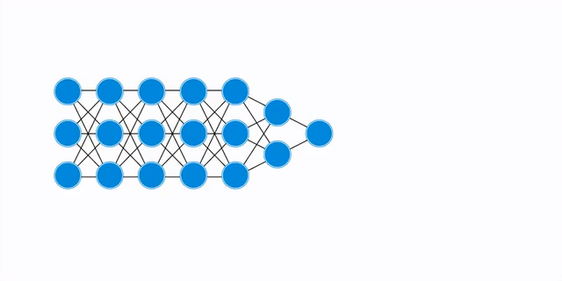

Slide 16
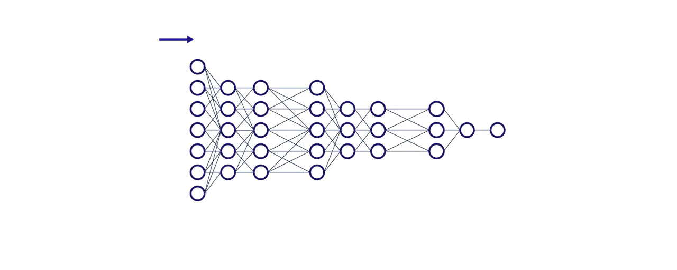

Slide 17
Learning rate
The amount that the weights are updated during training is referred to as the step size or the learning rate.
A hyperparameter that controls how much to change the model in response to the estimated error, each time the model weights are updated.

Slide 18
Epochs
The number of is a hyperparameter of gradient descent that controls the number of complete passes through the training dataset.

