Slide 1
Artificial Neural Network 101

Slide 2


Slide 3
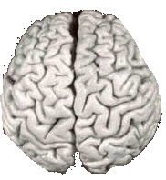
Biological Inspiration
Idea : To make the computer more robust, intelligent, and learn, …
Let’s model our computer software (and/or hardware) after the brain

Slide 4


Slide 5
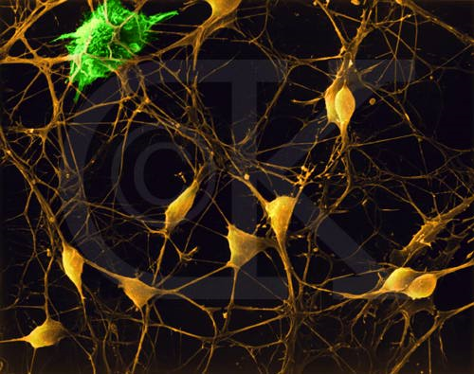
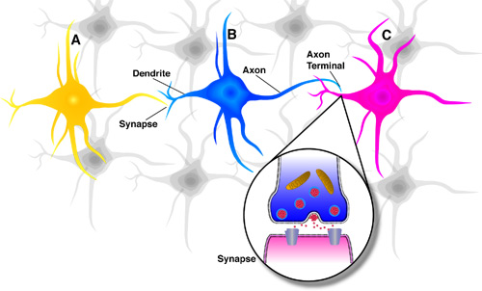
Neurons in the Brain
Although heterogeneous, at a low level the brain is composed of neurons
  A neuron receives input from other neurons (generally thousands) from its synapses
  Inputs are approximately summed
  When the input exceeds a threshold the neuron sends an electrical spike that travels that travels from the body, down the axon, to the next neuron(s)

Slide 6
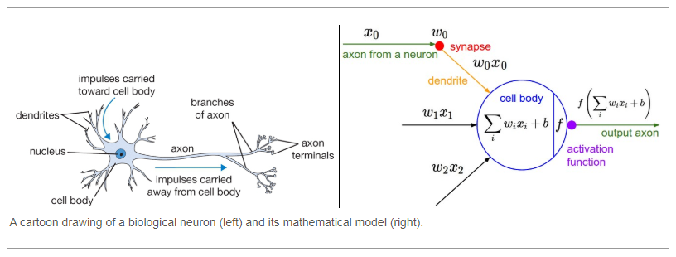

Slide 7
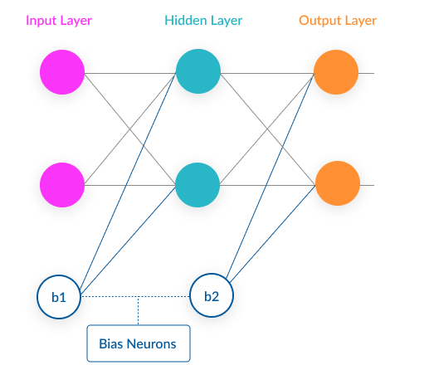

Slide 8
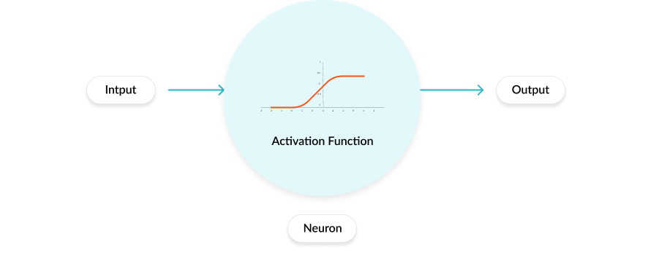
Activation functions are mathematical equations
determine the output of a neural network.
attached to each neuron in the network, and determines whether it should be activated (“fired”) or not, based on whether each neuron’s input is relevant for the model’s prediction.
also help normalize the output of each neuron to a range between 1 and 0 or between -1 and 1.

Slide 9
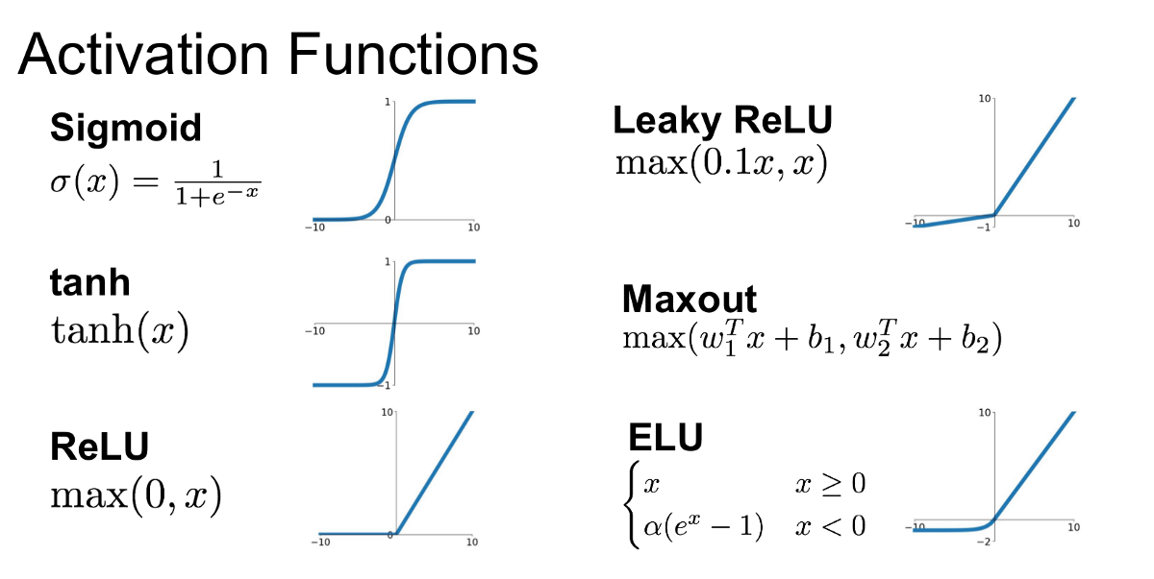

Slide 10
Loss’ in Machine learning helps us understand the difference between the predicted value & the actual value.
Loss function: Used when we refer to the error for a single training example.
Cost function: Used to refer to an average of the loss functions over an entire training dataset.

Slide 11

Cost function for regression

Slide 12
Gradient descent (GD)
iterative first-order optimization algorithm used to find a local minimum/maximum of a given function.
This method is commonly used in machine learning to minimize a cost/loss function

Slide 13
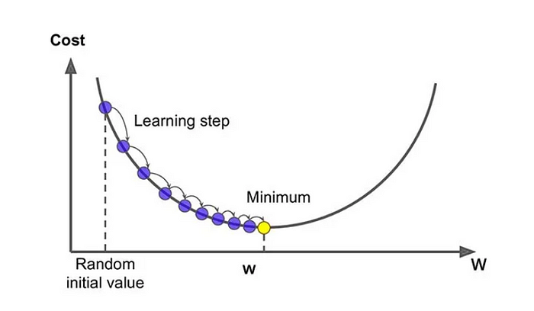

Slide 14
Back-propagation
Back-propagation is the essence of neural net training.
It is the practice of fine-tuning the weights of a neural net based on the error rate (i.e. loss) obtained in the previous epoch (i.e. iteration).
Proper tuning of the weights ensures lower error rates, making the model reliable by increasing its generalization.

Slide 15
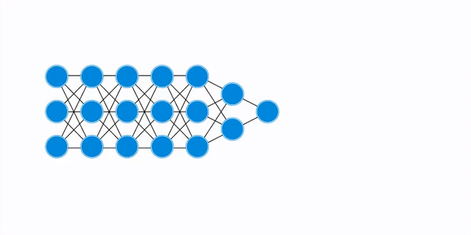

Slide 16
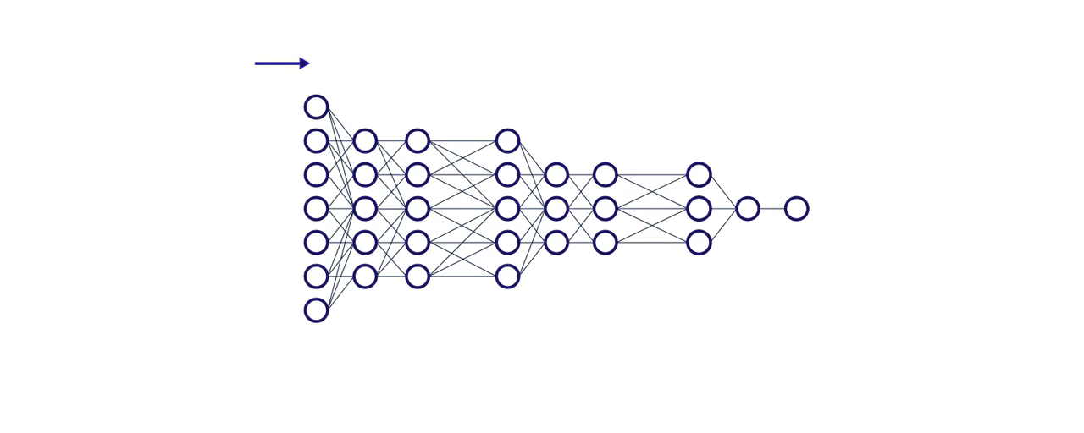

Slide 17
Learning rate
The amount that the weights are updated during training is referred to as the step size or the learning rate.
A hyperparameter that controls how much to change the model in response to the estimated error, each time the model weights are updated.

Slide 18
Epochs
The number of is a hyperparameter of gradient descent that controls the number of complete passes through the training dataset.

Slide 19
Back-propagation

Slide 20
i1 | i2
0.05 | 0.10
o1 | 02
0.01 | 0.99
@MattMazur

Slide 21
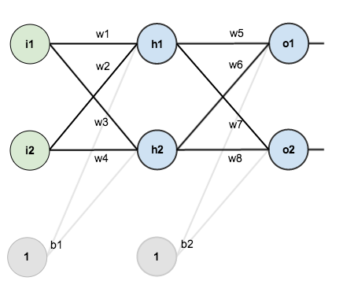
@MattMazur

Slide 22
Forward Pass
Assign some random weights

Slide 23
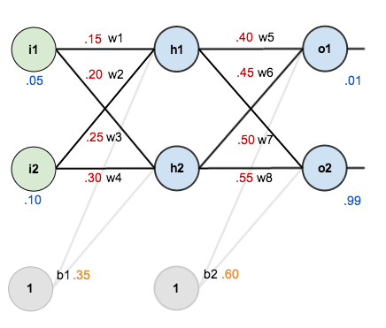

Slide 24
Net input for h1

Slide 25
We will use Logistic Function as activation function , so we will quash this net input to h1 with it to get output from h1

Slide 26
Similarly net output for h2 is calculated

Slide 27
The output from hidden layers act as input to output layer neurons, and the output of these neurons can be calculated
Net input to o1
output of o1

Slide 28
Similarly output of o2

Slide 29
Total Error
Mean Square Error

Slide 31
For Backpropagation
We want to know how much a change in w5 , will impact the total error

Slide 32
The change in w5 , will impact the total error can be calculated by differentiating Etotal1 wrt w5

Slide 33


Chain Rule

Slide 34
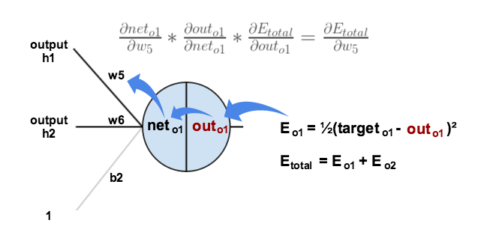

Slide 35
how much does the total error change with respect to the output o1?

Slide 36
how much does the output of o1 change with respect to its total net input o1

Slide 37
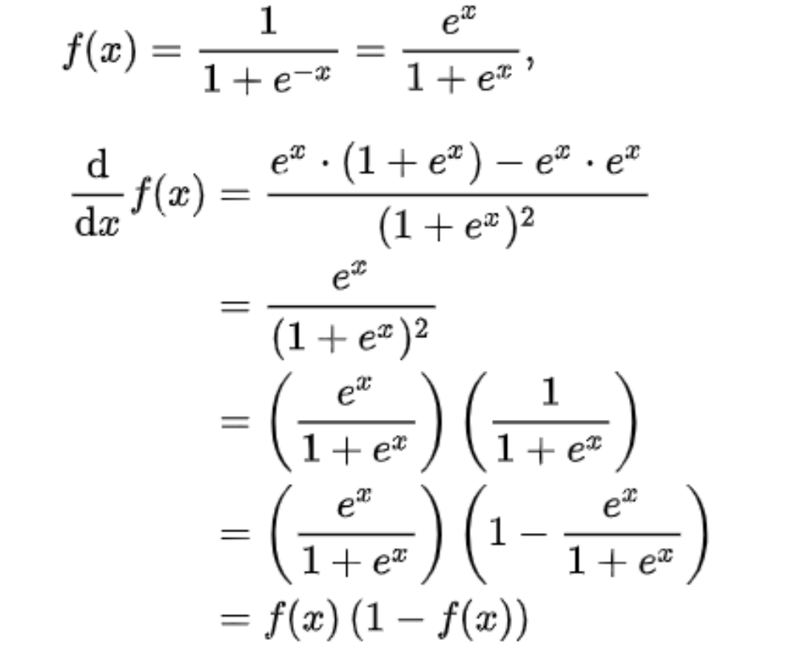

Slide 38
how much does the total net input of o1 change with respect to w5

Slide 39
Putting it all together:
So this is the gradient of Error wrt to w5

Slide 40
Recall Gradient Descent Algorithm
New Weight = Old weight - Learning Rate * Gradient of error wrt weight
Let Learning Rate be 0.5 here

Slide 42
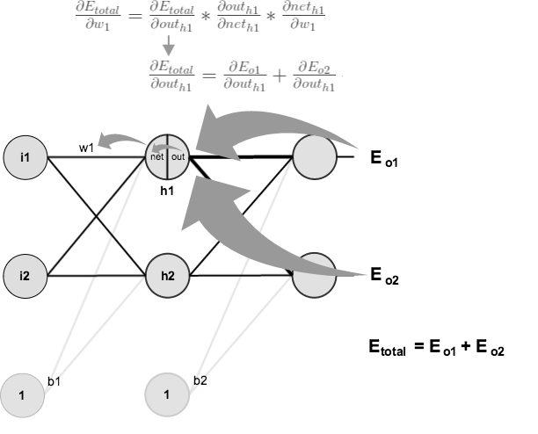

Slide 44
https://www.mladdict.com/neural-network-simulator
https://playground.tensorflow.org/

