Slide 2
Hands On for data preprocessing
Concept of Document in Knime &
Strings To Document -
Converts the specified strings to documents. For each row a documentwill be created and attached to that row. The strings of thespecified columns will be used as title, authors, andfull text. Furthermore the defined category, source, type, anddate will be set.
https://kni.me/w/ZHAExldZ5M7q6hdG

Slide 3
Classification models https://kni.me/w/ZHAExldZ5M7q6hdG

Slide 4
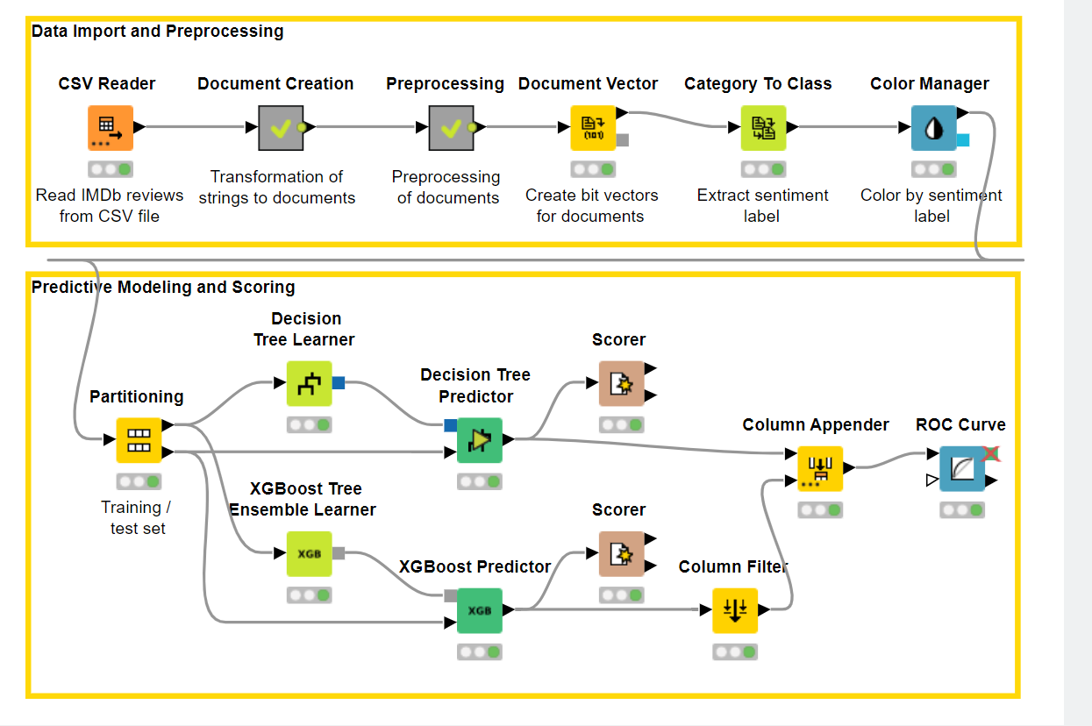

Slide 5
