Slide 1
Money Market Instruments
Commercial Paper is an unsecured short-term promissory note issued by a company to raise short-term funds mainly to meet working capital requirements.
• CPs are privately placed and usually held till maturity by the investors.
RBI Guidelines on issue of CPs
✓ Eligibility: Companies with minimum tangible net worth of Rs. 4 Crores. Should have sanctioned working capital limit from a bank and the account should be “Standard Asset”.
✓ Minimum Credit Rating: A-1 (as defined by SEBI)
✓ Maturity: Min 7 days; Max: One Year.
✓ Denomination: Rs 5Lacs and thereafter in its multiples.
✓ Investors: Individuals, Banks, Companies, NRIs, FIIs (within limits set by SEBI) , Financial Institutions can invest in CPs.
✓ CPs issued at a discount to the Face Value.

Slide 2
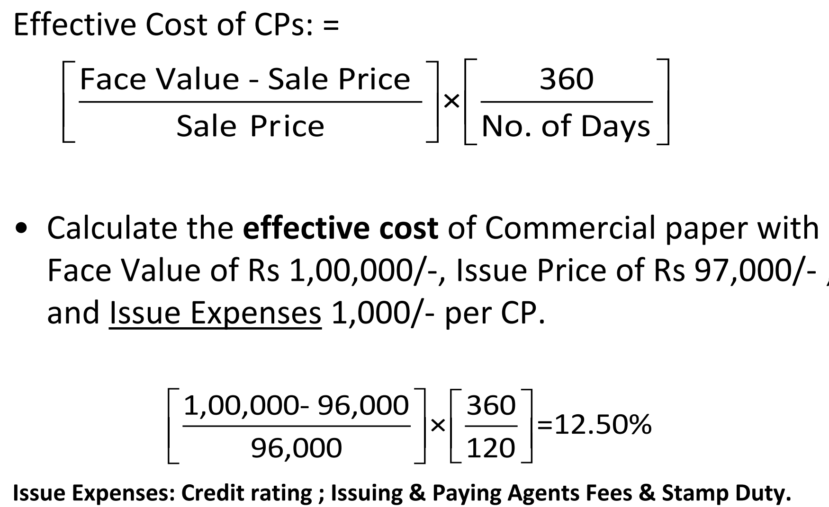
Commercial Paper (Contd.)

Slide 3
Certificates of Deposits
Certificates of Deposit (CD), introduced in June 1989, are essentially securitised short-term time deposits issued by banks during periods of tight liquidity, at relatively high interest rates
But the transaction cost of CDs is often lower as compared with that of retail deposits. When credit picks up, placing pressure on banks’ liquidity, banks try to meet their liquidity gap by issuing CDs, often at a premium.

Slide 4
Call/Notice Money Market
The overnight inter-bank call money market, in which banks trade positions to maintain cash reserves, is the key segment of the money market in India.
The call money market (CMM) the market where overnight (one day) loans can be availed by banks to meet liquidity.
Banks who seeks to avail liquidity approaches the call market as borrowers and the ones who have excess liquidity participate there as lenders.
The CMM is functional from Monday to Friday. Banks can access CMM to meet their reserve requirements (CRR and SLR) or to cover a sudden shortfall in cash on any particular day.
Effectively, the call Money Market is the main market oriented mechanism to meet the liquidity requirements of banks.
It is basically an ‘over the counter’ (OTC) market without the intermediation of brokers. Participation has been gradually widened to include other financial institutions, primary/satellite dealers, mutual funds and other participants in the bills rediscounting market and corporates (through primary dealers) besides banks, LIC and UTI. While banks and primary dealers are allowed two-way operations, other non-bank entities can only participate as lenders.

Slide 5
Call Money Market
The call money market is influenced by liquidity conditions (mainly governed by deposit mobilization, capital flows and the Reserve Bank’s operations affecting banks’ reserve requirements on the supply side and tax outflows, government borrowing programme, non-food credit off-take and seasonal fluctuations, such as, large currency withdrawals during the festival season on the demand side).
At times of easy liquidity, call rates tend to hover around the Reserve Bank’s repo rate, which provides a ready avenue for parking short-term surplus funds.
During periods of tight liquidity, call rates tend to move up towards the Bank Rate and more recently the Reserve Bank’s reverse repo rate (and sometimes beyond) as the Reserve Bank modulates liquidity in pursuit of monetary stability.

Slide 6
Mechanism of Call Money Market
Loans are availed through auction/negotiation.
The auction is made on interest rate.
Highest bidder (who is ready to give higher interest rate) can avail the loan. Average interest rate in the call market is called call rate.
Dealing in call money is done through the electronic trading platform called Negotiated Trading System (NDS).
This call money rate is an important variable for the RBI to assess the liquidity situation in the economy.
The CMM is known as the most sensitive segment of the financial system. Since the participants are banks, the call money rate tells about the overall liquidity position in the economy.
Higher call rate indicates liquidity stress in the economy. In this case, the RBI may follow up with liquidity support measures through its monetary policy instruments – cutting CRR or allowing more repos. Hence, the call money rate is taken as the operating target of monetary policy.

Slide 7
Notice Money
The call money is usually availed for one day. If the bank needs funds for more days, it can avail money through notice market. Here, the loan is provided from two days to fourteen days.
Participants in the Notice money market are banks and related entities specified by the RBI. Scheduled commercial banks (excluding RRBs), co-operative banks (other than Land Development Banks) and Primary Dealers (PDs), are permitted to participate in call/notice money market both as borrowers and lenders. As per the new regulations, Payment Banks are also allowed to participate in CMM as both lenders and borrowers.
Banks are the dominant participants hence it is often known as interbank notice money market. Surplus banks will give loans to other banks. Deficit banks that need funds will purchase it.

Slide 8
TERM Money
The Transaction tenor varies from 15 days to 1 year.

Slide 9
Collateralised Borrowing and Lending obligation(CBLO)
CBLO is a money market instrument that represents an obligation between a borrower and a lender.
The instrument works like a bond where the lender buys the CBLO and a borrower sells the money market instrument with interest.
The term, the interest rate, and the specifics of the CBLO are often all negotiable between the two parties.
A CBLO is much like a Treasury bill or very short term market instrument the primary difference is a CBLO entails collateral in the transaction.

Slide 10
CBLO
CBLOs may exist around the world, though they are most common in India. In that context, CBLOs are operated by the Clearing Corporation of India Ltd. (CCIL) and the Reserve Bank of India (RBI).
CBLOs allow short-term loans to be secured by financial institutions, helping to cover their transactions. To access these funds, the institution must provide eligible securities as collateral such as Treasury Bills that are at least six months from maturity.
The CBLO facilitates borrowing and lending for various maturities, from overnight to a maximum of one year,

Slide 11
CBLO
Types of financial institutions eligible for CBLO membership include insurance firms, mutual funds, nationalized banks, private banks, pension funds, and private dealers.
To borrow, members must open a Constituent SGL (CSGL) account with the CCIL, which is used to deposit the collateral.

Slide 12
Interest Rate on CBLO
The creditworthiness of the borrower- Borrowers with stronger credit histories may be able to secure funds at a lower rate.
Market interest rates. The prevailing rates mostly established by short-term government securities often set the general direction of rates.
The competitiveness of issuance. CBLOs may be issued through a competitive bidding process where multiple borrowers bid to secure funds from lenders. In such cases, the interest rate is determined by the lowest bid that fulfills the lender's requirements.
Relevant reference rates. Some CBLOs may use reference rates, such as a benchmark government security yield, as a basis for setting the interest rate. The rate may be quoted as a spread above or below this reference rate.
The specific agreement. Once the borrower and lender agree on the interest rate, it is specified in the CBLO documentation, along with other terms and condition
CBLOs are often tradable in the secondary market, which adds to their liquidity. Investors who hold CBLOs can buy or sell them before their maturity date, allowing them to manage their investments more effectively based on changing market conditions.

Slide 13

Repo in Corporates bonds
Repo is a money market instrument, which enables collateralised short-term borrowing and lending through sale/purchase operations in debt instruments.
Under a repo transacion, a holder of securities sells them to an investor with an agreement to repurchase at a pre-determined date and rate.
In the case of a repo, the forward clean price of the bonds is set in advance at a level which is different from the spot clean price by adjusting the difference between repo interest and coupon earned on the security.
Repo is also called a ready forward transaction as it is a means of funding by selling a security held on a spot (ready) basis and repurchasing the same on a forward basis.

Slide 14
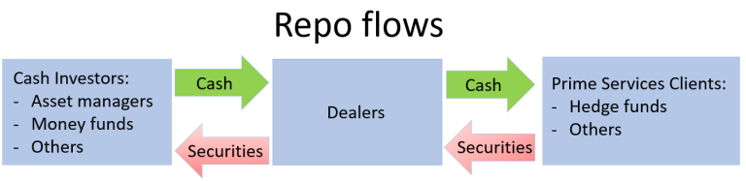
Repurchase Agreements (Repos)
As in the case of other instruments, repos also help equilibrating between demand and supply of short-term funds.
RBI has been using its repo instrument effectively for absorbing excess liquidity and for infusing funds to ease the liquidity

Slide 15
Refinance from Reserve Bank of India
Rediscount/Refinance is used by central banks to relieve liquidity shortages in the system, control monetary and credit conditions and direct credit to selective sectors.

Slide 16
RBI Liquidity operations tools
Repo rate-
Reverse repo rate-.
Marginal Standing Facility (MSF)- is the facility under which scheduled commercial banks can borrow additional amount of overnight money from the RBI at a penal rate against eligible securities. Banks are allowed to dip into their Statutory Liquidity Ratio (SLR) portfolio to borrow funds under this facility up to a limit decided by the RBI. This provides a safety valve against unanticipated liquidity shocks to the banking system

Slide 17
LAF
A liquidity adjustment facility (LAF) is a monetary policy tool used in India by the Reserve Bank of India or RBI.
The RBI introduced the LAF as part of the outcome of the Narasimham Committee on Banking Sector Reforms of 1998.
LAF's help the RBI manage liquidity and provide economic stability by offering banks the opportunity to borrow money through repurchase agreements or repos or to make loans to the RBI via reverse repo agreements.
LAF’s can manage inflation in the economy by increasing and reducing the money supply.
Daily limit for repo borrowing is 0.25% of the NDT

Slide 18
Liquidity Adjustment Facility
It enables the RBI to modulate short-term liquidity under varied financial market conditions to ensure stable conditions in the overnight (call) money market.
The LAF operates through daily repo and reverse repo auctions thereby setting a corridor for the short-term interest rate consistent with policy objectives.

Slide 19
MSF
The Marginal Standing Facility (MSF) is an overnight liquidity support scheme by the RBI to provide funds (liquidity injection) to commercial banks with a higher interest rate over the repo rate.
Basically, the MSF is an emergency liquidity facility and is available on all working days and on most of the holidays. MSF can be used by a bank even if it exhausts its eligible security holdings for borrowing under other options like the LAF repo.

Slide 20
Standing Deposit Facility
The opposite purpose of liquidity absorption (parking funds with the RBI).
The phasing out of Repo and Reverse Repo operations by the RBI have increased the significance of MSF and SDF for the respective purposes of liquidity injection and absorption respectively

Slide 21
RBI Liquidity operations tools (Revision)
Corridor- is determined by the MSF rate as ceiling and reverse repo rate as the floor of the corridor for the daily movement in the weighted average call money rate.
Bank rate- is the standard rate at which the RBI is prepared to buy or rediscount bills of exchange or other commercial papers eligible for purchase under the Reserve Bank of India Act, 1934.
Cash Reserve Ratio (CRR)-is the minimum cash balance that a scheduled commercial bank is required to maintain with the RBI as a certain percentage of its net demand and time liabilities (NDTL) relating to the second preceding fortnight.
Statutory Liquidity Ratio (SLR)- is the share of NDTL that the scheduled commercial banks are required to maintain on a daily basis in safe and liquid assets, such as unencumbered government securities and other approved securities, cash and gold

Slide 22
Temp. Open Market Operations
CB May lend securities against cash.(Increases rates)
CB lend cash against securities( Decreases interest rates)
Term of temporary operations is typically overnight or few days.
They are Repo options. Goal is to adjust level of money supply so as to keep the short -term interest rates close to the announce target rates.
In 2020 Fed Injected 7.75 billion of cash against (T-bills, MBS).

Slide 23
Repo Auctions
It allows central bank to monitor and act on a daily basis as needed to respond to the demand for reserves in the economy and keep short term Interest rates at the desired level.

Slide 24
Discount Windows
CB lends funds to Depository institutions “As a lender of last resort”
It plays complementary role to open market operations.
It is best thought of as a safety valve to relieve pressure in markets,
“Fed lend 45.5bn to DP’s on September 2001.
Normally rate is lower than repo in market.

Slide 25
Federal fund Action in 2007-2008
The ability of Fed to supply enough reserves and maintain its desired objective depends upon how crucially “money market functions”.
What happened in 2007???????

Slide 26
2007 Crisis case
In 2007 Mortgage market experience Breakdown.
This caused many banks to take write downs in Mortgage related position. And short up their capital and liquidity by issuing equity and curtailing lending.
Banks curtailed lending in Interbank market because they were not sure of exposure of other participants.
Hence interest rates in Inter- bank markets increased dramatically relative to target fed-fund rates.

Slide 27
What Fed did to stabalize
Hence interest rates in Inter- bank markets increased dramatically relative to target fed-fund rates.
On Fed Acknowledged that banks were experiencing unused funding need.
It made borrowing at discount windows only 50 BPS more expensive than federal fund rate.
Hence interest rates in Inter- bank markets increased dramatically relative to target fed-fund rates.
Fed Cut discount rate with 50 BPS on August 17, 2007
Fed announced new lending program to provide credit to other wall street firms and increase maturity to 90 days from 30 days.
Notes:
All these things increase fed risk taking behaviour and started problem of Moral hazard. Fed main motive at this time is stability than growth.

Slide 28
View Point on 2024 Debt Market Scenario
Life knows two miseries-getting what you want and not getting what you want.

Slide 29
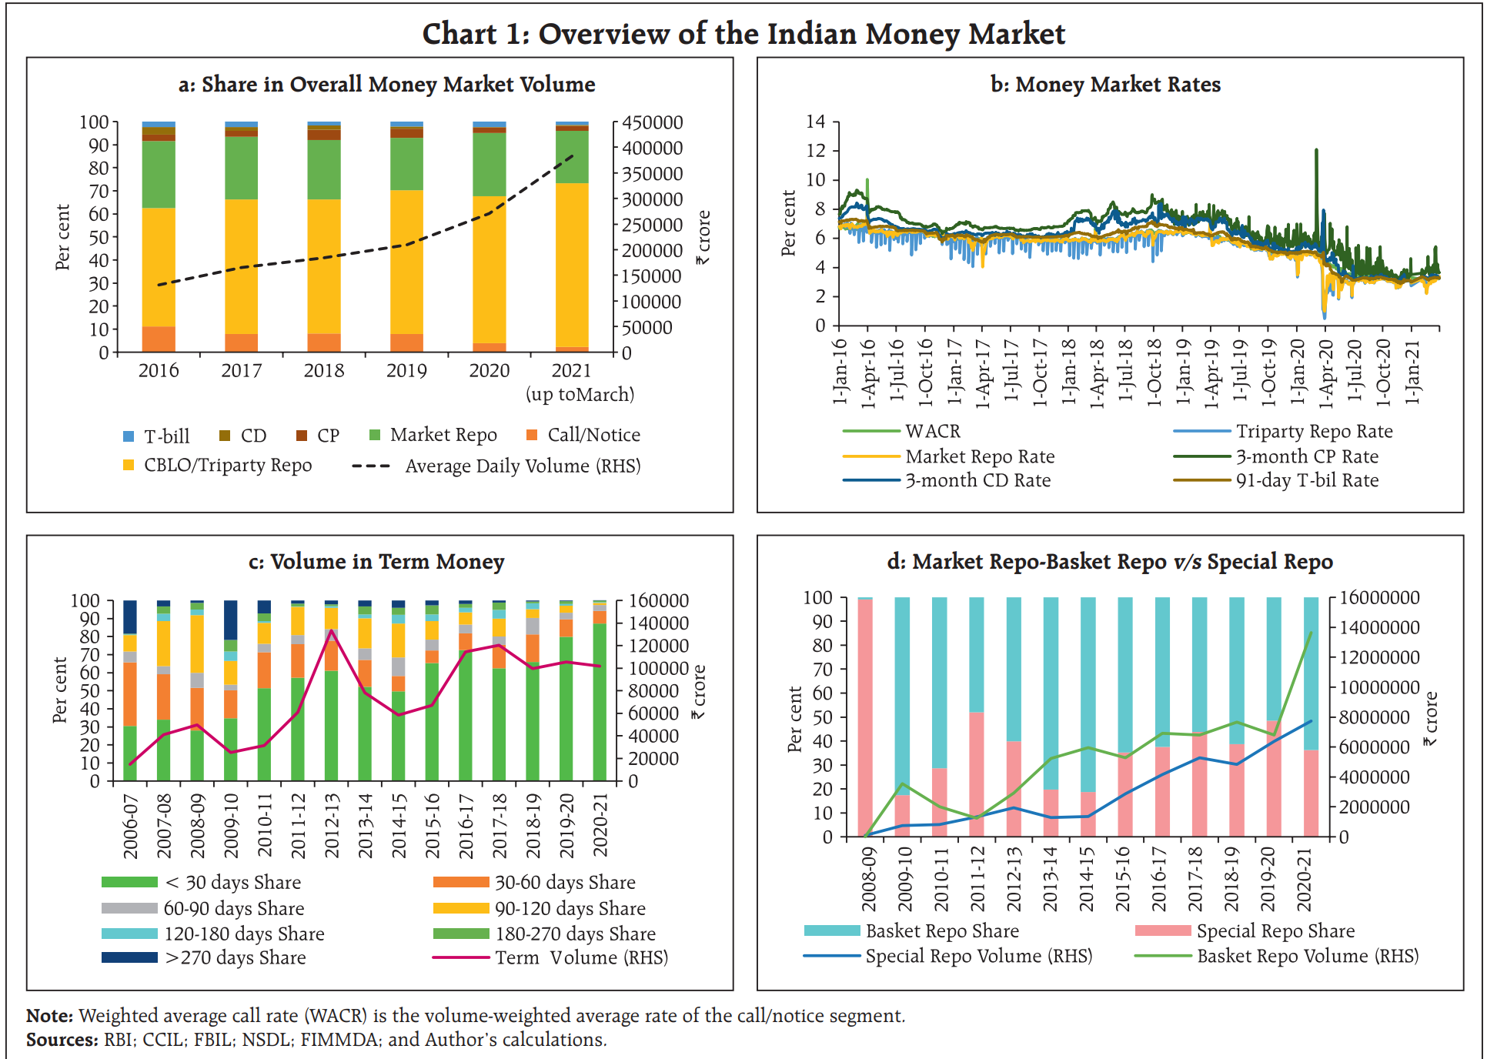

Slide 30
Issuance of G-Sec and T-Bill
Every participant of the auction process should be a member of RBI by opening subsidiary general Ledger(SGL) account with RBI. It keeps securities in dematerialised form.
One has to open a current account and subsidiary account.
They place their bids directly through E-Platform.
Non-Member can place bid through member of RBI (Gilt Account).

Slide 31
Auction process of T-bills and G-secs
RBI publishes half yearly G-secs calendar.
When issued trading.
Auction mechanism can be competitive bid and non-competitive bid.

Slide 32
Auction process of T-bills and G-secs
Announcement
When Issued Trading- trading starts in the security from the announcement
Auction Mechanism- RBI conducts auction through e- platform Kuber, Bids can be placed by investment bankers by competitive bids and retail investors by non-competitive bidding (Through a facilitator like BSE)
Allotment Mechanism-Market based price discovery.
BSE Direct.com

Slide 33
Allotment Mechanism
Yield based(new issue) and Price based(re-issue).
Suppose RBI came up with 4000 cr of G-sec for issuance.
S. No. | Bid | Bid Amount | Total
1 | 7.21 | 1500 | 1500
2 | 7.23 | 1000 | 2500
3 | 7.24 | 1000 | 3500
4 | 7.26 | 500 | 4000
5 | 7.30 | 500 | 4500

Slide 34
Was auction good??
4500/4000=1.125
Tail= (7.26-7.235) (Highest yield – Average of acceptable yield)lower tail indicates the strength.
Lower tail indicates strength.
Auction detail provide demand for the bond.

Slide 35
Auction can be:
Uniform Price- All successful bids are required to pay at the same price/yield irrespective of the yield/ price that they bid.
Multiple price auction- Bidders pay whatever they bid.

Slide 36
Role of PD in issuance of G-secs.
They participate in primary auction of G-secs.
Currently there are 7-standalone and 11 banks acting as PD’s.
When G-secs are not fully subscribed PD purchase the unsubscribed.
Successful PD are advised to make payment on settlement day, T+1 system is followed. CCIL is one for clearing.

Slide 37
Issuance of Corporate Bond
NSE/BSE has launched EBP.
Public issue of Corporate bond is listed and traded in capital markets of NSE.
Private placement happens on WDM(wholesale debt market).

Slide 38
How Bonds are traded
Market order
Limit order
Stop loss order
Validity Instructions
Day order
Good-till cancel
Immediate or Cancel order.

Slide 39
E-platform to buy G-secs
OTC/ Telephonic market.
Negotiated dealing system.
NSE WDM and RDM segment.

Slide 40
Money Market Case of India – 2022-2023
The weighted average call rate (WACR) - the operating target of monetary policy - moved gradually upward from below the floor of the policy corridor [i.e., standing deposit facility (SDF) rate] towards the policy repo rate in sync with the rate hike cycle and shift in the stance of monetary policy,.

Slide 41
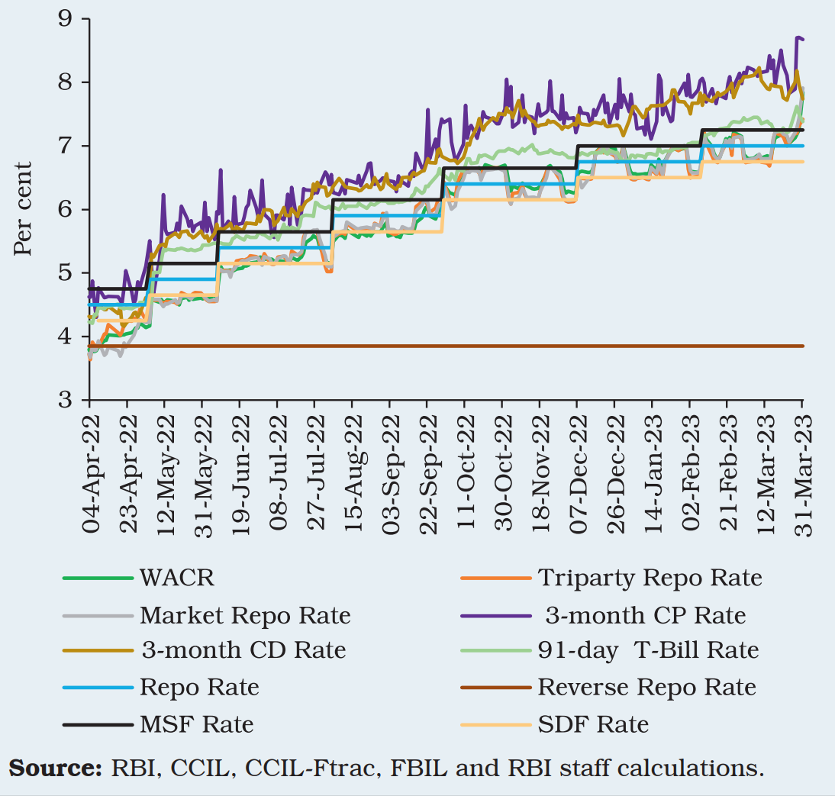
Money Market Rates and Policy Corridor

Slide 42
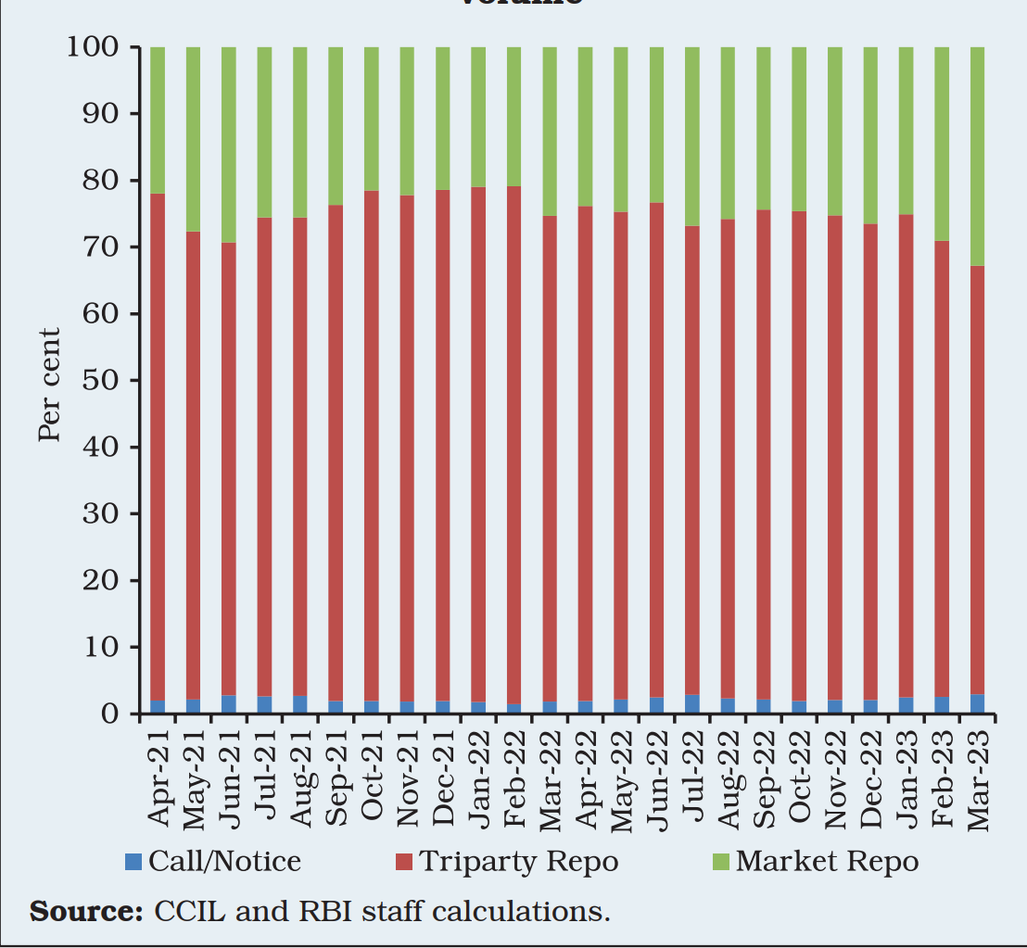
Share of Major Segments in Money Market Volume

Slide 43
Interpretation
In the call money segment, average daily volumes (excluding Saturdays) increased by 37 per cent during the year to `12,432 crore (from `9,060 crore during 2021-22) partly on account of the increase in cash reserve ratio (CRR) from 4.0 per cent to 4.5 per cent in May 2022 and the gradual decline in surplus liquidity in the system.

Slide 44
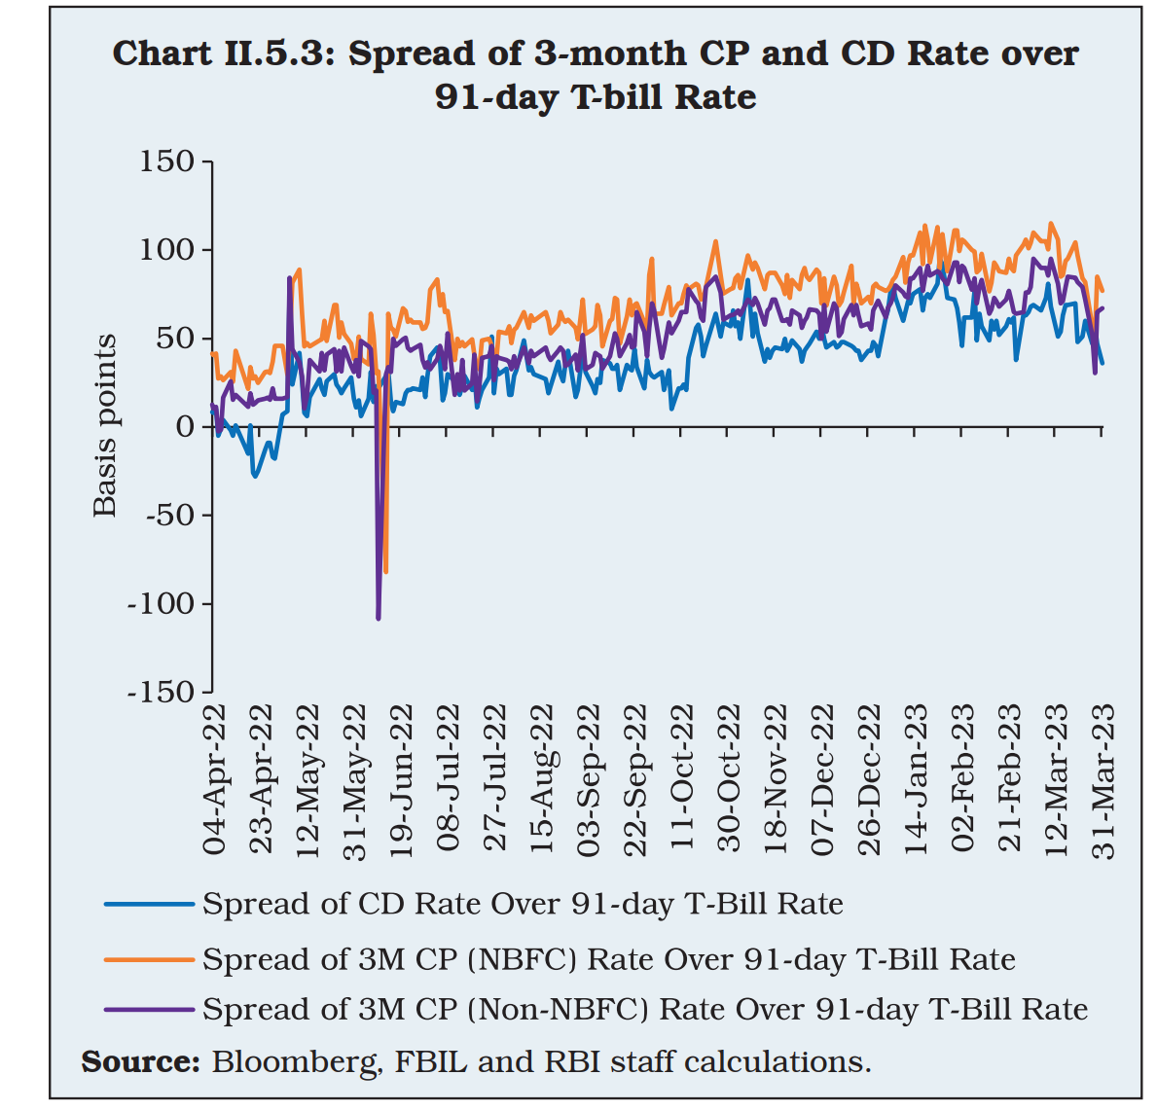
Spread
The average daily spread of CD rates and CP rates (issued by NBFCs and non NBFCs) over T-bill rates increased substantially during the year as compared to the previous year in Q4: 2022-23.

Slide 45
Interpretations
Reflecting increase in risk premia, coinciding with the reduction in surplus liquidity.
In the primary market, fresh issuance of CDs increased to `6.73 lakh crore during 2022- 23 as compared with `2.33 lakh crore in 2021-22 as banks took recourse to CDs in an atmosphere of deposit mobilisation trailing credit demand even after raising term deposit rates by a considerable magnitude.

Slide 46
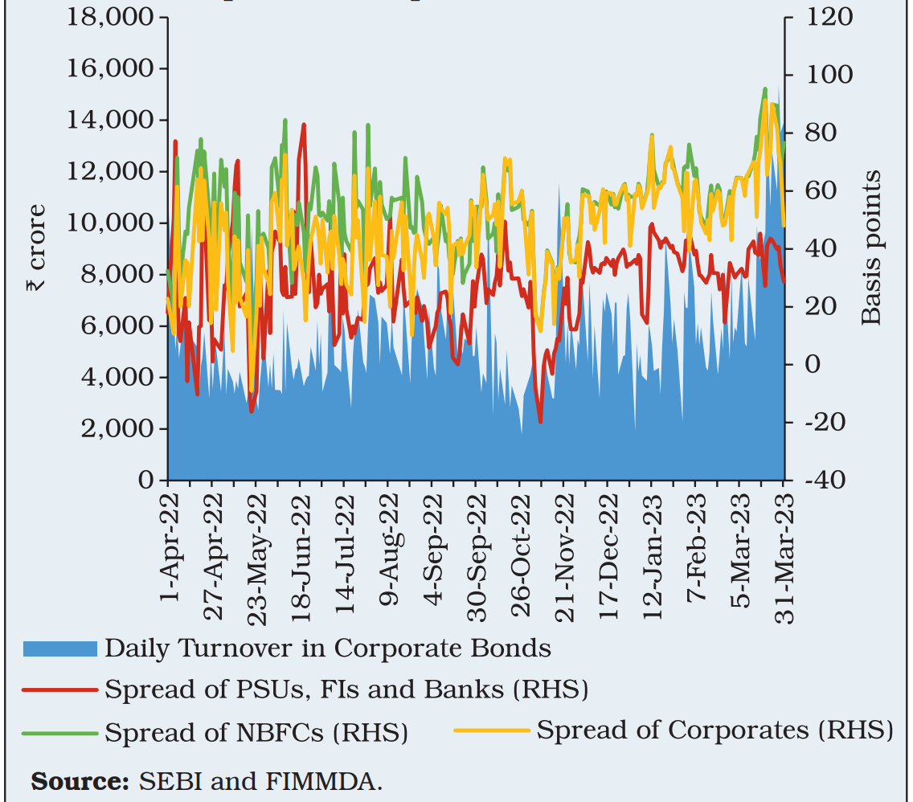
G Secs Market

Slide 47
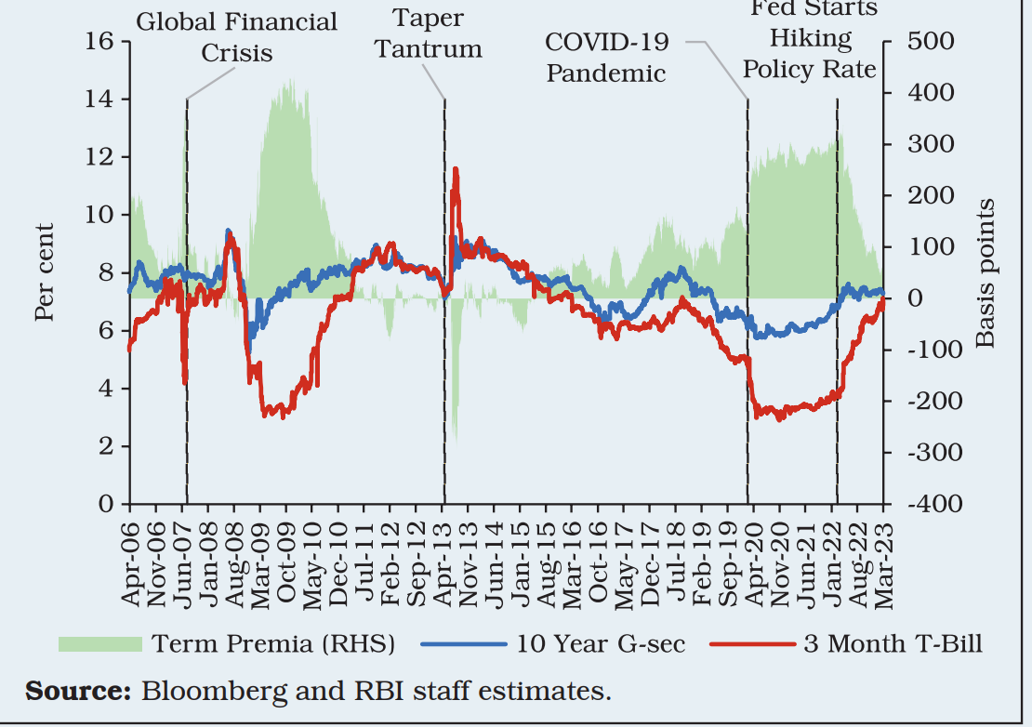
Drivers of Term Premia in Financial Markets
Term Premia

Slide 48
Drivers of Term Premia and Risk Premia in Financial Markets
The slope of the yield curve or term premia is defined as the difference in yields between long-term bond and short term bond.
Term premia is considered to be sensitive to the expected future path of growth, inflation, and monetary policy (Kopp, 2018).
In advanced economies, term premia and risk premia are considered to be inversely related as decrease in term premia may imply a slowing economy, which may translate into an increase in credit spreads.

Slide 49
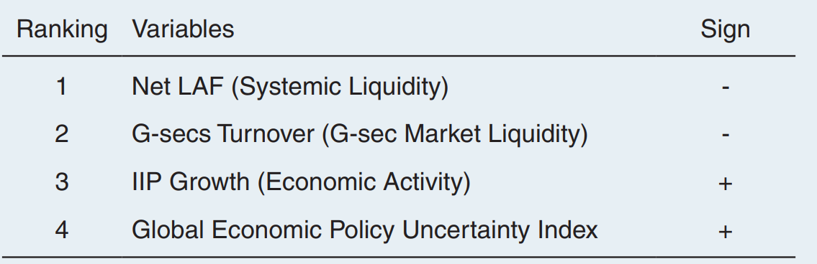
Drivers of Term Premia and Risk Premia in Financial Markets

Slide 50
Drivers of Term Premia and Risk Premia in Financial Markets
Deficit liquidity conditions tend to raise short-term bond yields in turn leading to a fall in term premia.
While higher G-sec turnover entails higher demand for G-secs and lower long-term yields leading to a fall in the term premia.
Stronger IIP growth steepens the slope of the yield curve.
While an increase in global uncertainty also raises the term premia.
The correlation between risk premia and term premia is -0.58

Slide 51
Use data and do the analysis
India VIX, inflation, change in oil prices, net LAF, US credit spreads and exchange rate volatility (1-month). Drivers of risk Premia.

Slide 52
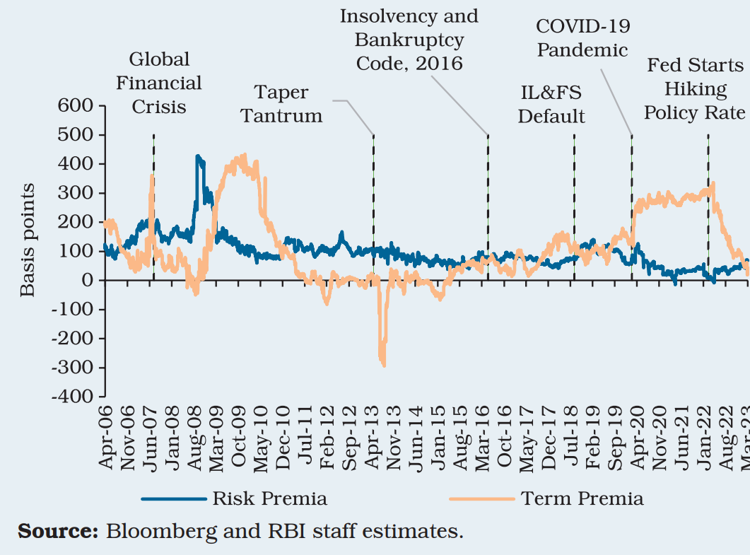
Risk Premia and Term Premia

Slide 53
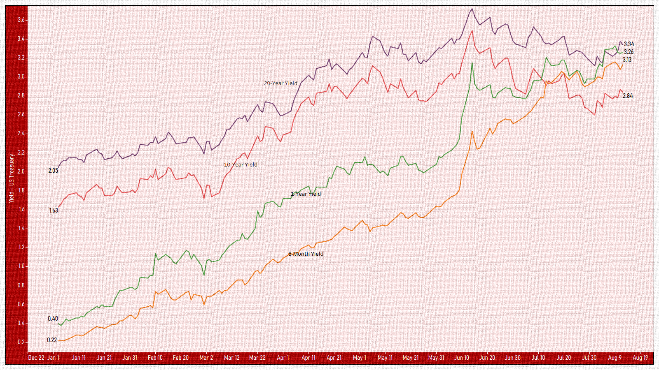
Why do we see differences in yields of different maturity?

Slide 54
Interest Rate Sensitivity of Capital Flows:
The Indian Experience
Monetary policy changes in the US have been one of the key determinants of capital flows to EMEs.
The impact, however, varies across EMEs depending on their domestic macroeconomic policies, level of external debt, fiscal deficit and reserves.

Slide 55
Interest Rate Sensitivity of Capital Flows:
The Indian Experience
In order to detect the sensitivity of gross capital inflows to interest rate differential (IRD). Specifically, the difference between quarterly average domestic policy repo rate and the US federal funds rate was used as a proxy for IRD.
Exogenous variables such as changes in INR-USD nominal exchange rate, domestic real GDP growth, and global GDP growth proxied by OECD GDP growth.
Further, in examining the impact of IRD on various components of capital flows – foreign portfolio investment (FPI), short-term trade credit (STC), external commercial borrowings (ECB), banking capital (BC) flows and foreign direct investment (FDI) – appropriate proxies for IRD have been employed.

Slide 56
RESULTS
There is a positive relationship between change in IRD and growth in gross FPI, STC, ECB and banking capital inflows with a lag of 1-2 quarter.
A one standard deviation (s.d.) shock to change in IRD raises the growth in gross FPI inflows by 0.07 per cent, gross STC inflows by 0.07 per cent, gross ECB inflows by 0.13 per cent, and gross banking capital inflows by 0.09 per cent.
Gross FDI inflows do not seem to be sensitive to IRD.

Slide 57
Results
To sum up, the analysis indicates that interest rate differential is an important factor in influencing portfolio, trade financing, banking capital and ECB flows, but not the overall gross capital inflows to India.
ECBs recorded a fall in terms of the number of ECB agreements as well as amount during 2022-23 as compared with a year ago.

Slide 58
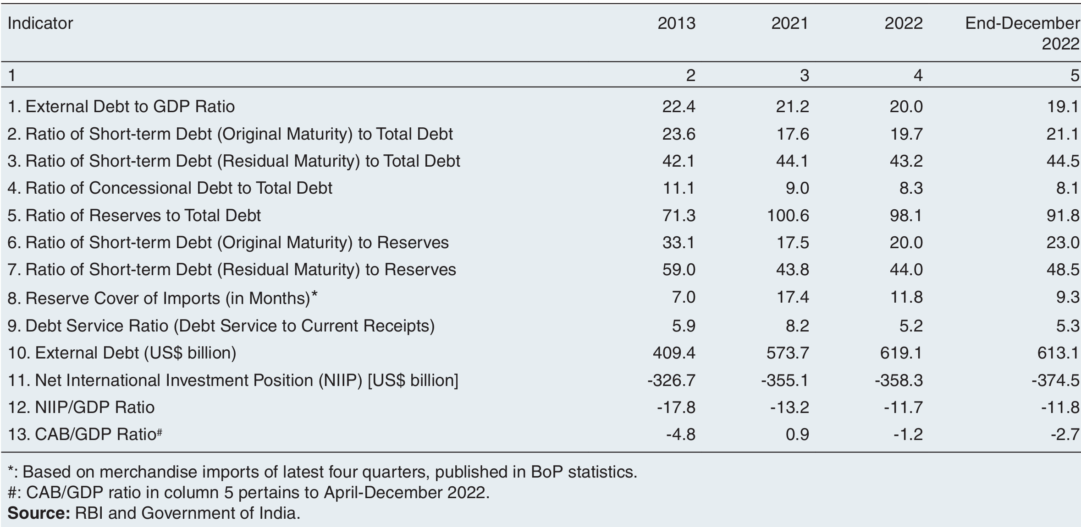
External Vulnerability Indicators

Slide 59
Factors affecting Bond Markets
The general level of interest rates, therefore, depends on identifying the important factors determining the aggregate demand and supply of existing bonds.
Among the determining factors are
the overall state of the economy,
(2) government policies, such as monetary and fiscal policies.
(3) Bond risk relative to the risk of investing in other assets such as equity or real estate,
(4) international factors, such as foreign interest rates and exchange rates that influence the inflow and outflow of foreign capital, and
(5) the current level of inflation and the expectation about future inflation.

Slide 60
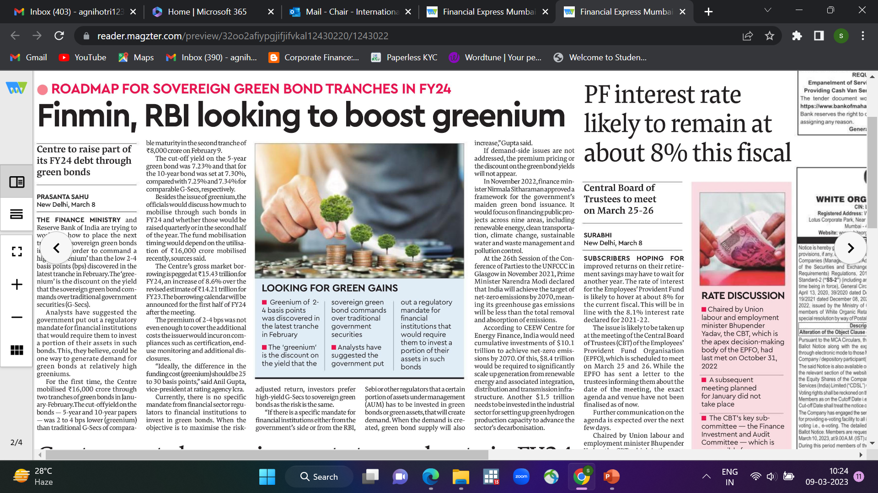

Slide 61
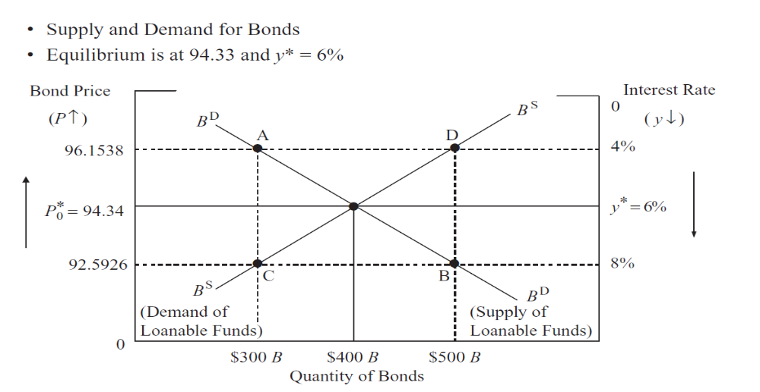
Bond Demand and Supply Curve Analysis

Slide 62
Bond Demand and Supply Curve Analysis
The bond price or interest rate that ultimately prevails in the market is the one at
which the quantity demanded of bonds equals the quantity supplied: BD = BS
Notes:
The equilibrium
interest rate of 6% is the market-clearing interest rate and the equilibrium price
of 94.34 is the market-clearing price. If the bond price were below this equilibrium
price (or equivalently the interest rate were above the equilibrium rate), then investors
would want more bonds than issuers were willing to sell. This excess demand would
drive the price of the bonds up, decreasing the demand (movement down along the
demand curve) and increasing the supply (movement along the supply curve) until the
excess was eliminated. On the other hand, if the price on bonds were higher than the
equilibrium price (or interest rates lower that the equilibrium rate), then bondholders
would want fewer bonds, whereas issuers would want to sell more bonds. This excess
supply in the market would lead to lower prices and higher interest rates, increasing
bond demand (movement along the bond demand curve) and reducing bond supply
(movement along the supply curve) until the excess supply was eliminated. Thus,
only at P∗
0 and y∗, where bond demand equals bond supply, is there an equilibrium
where bondholders and suppliers do not want to change.

Slide 63
Comparative Equilibrium
The insights that one can gain from supply and demand analysis come from identifying the important factors that affect the positions of the demand and supply curves.
Analytically, changes in these factors cause shifts in the demand or supply curves that, in turn, lead to a new equilibrium bond price and interest rate levels.

Slide 64
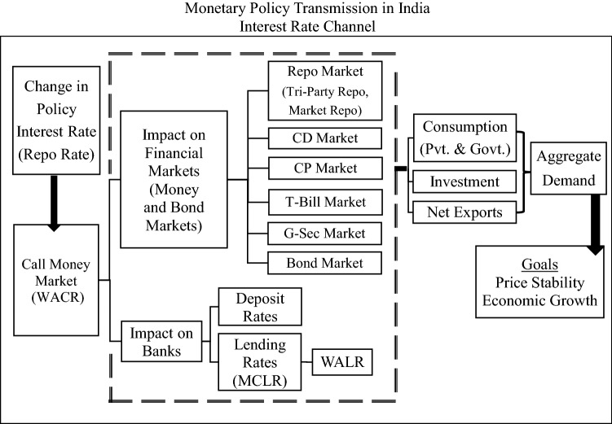

Slide 65
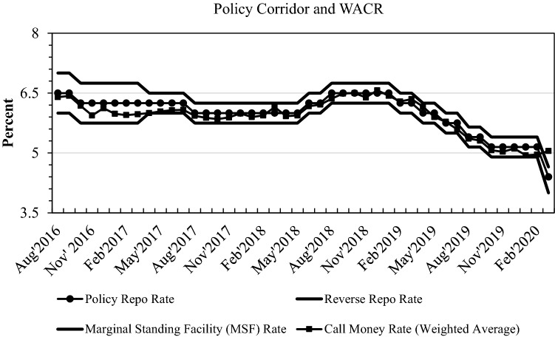

Slide 66
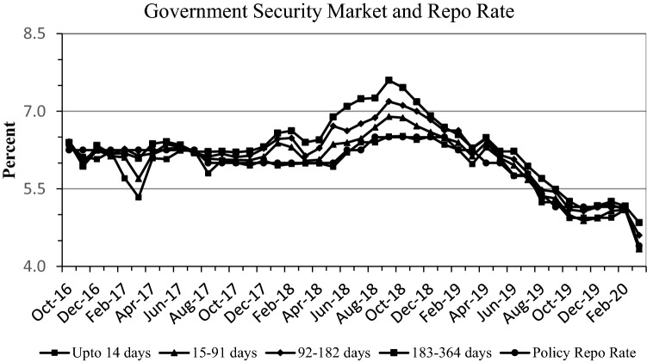

Slide 67
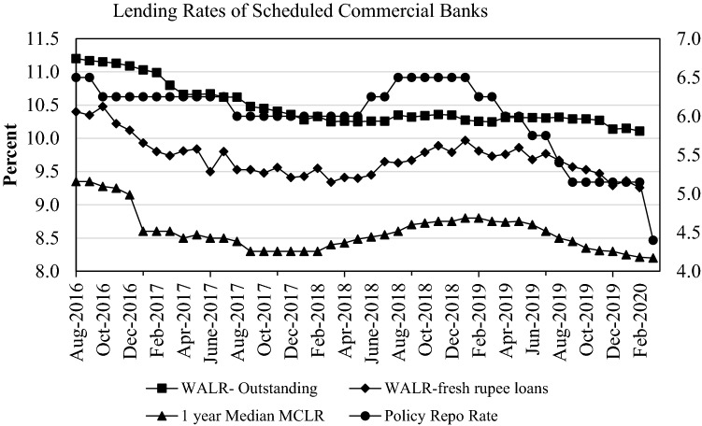

Slide 68
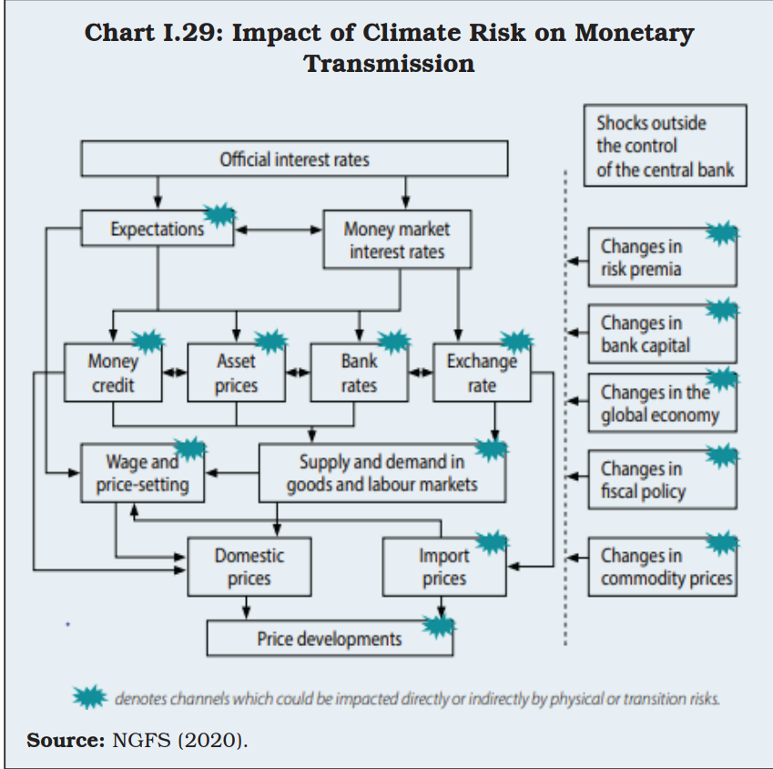

Slide 69
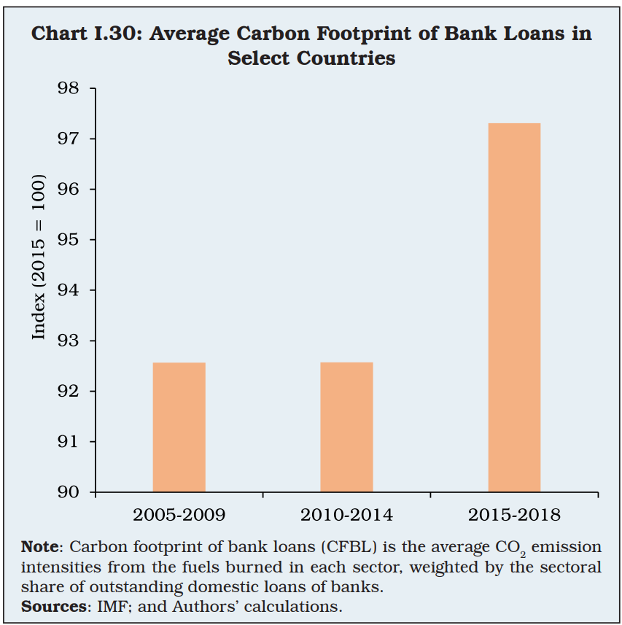

Slide 70
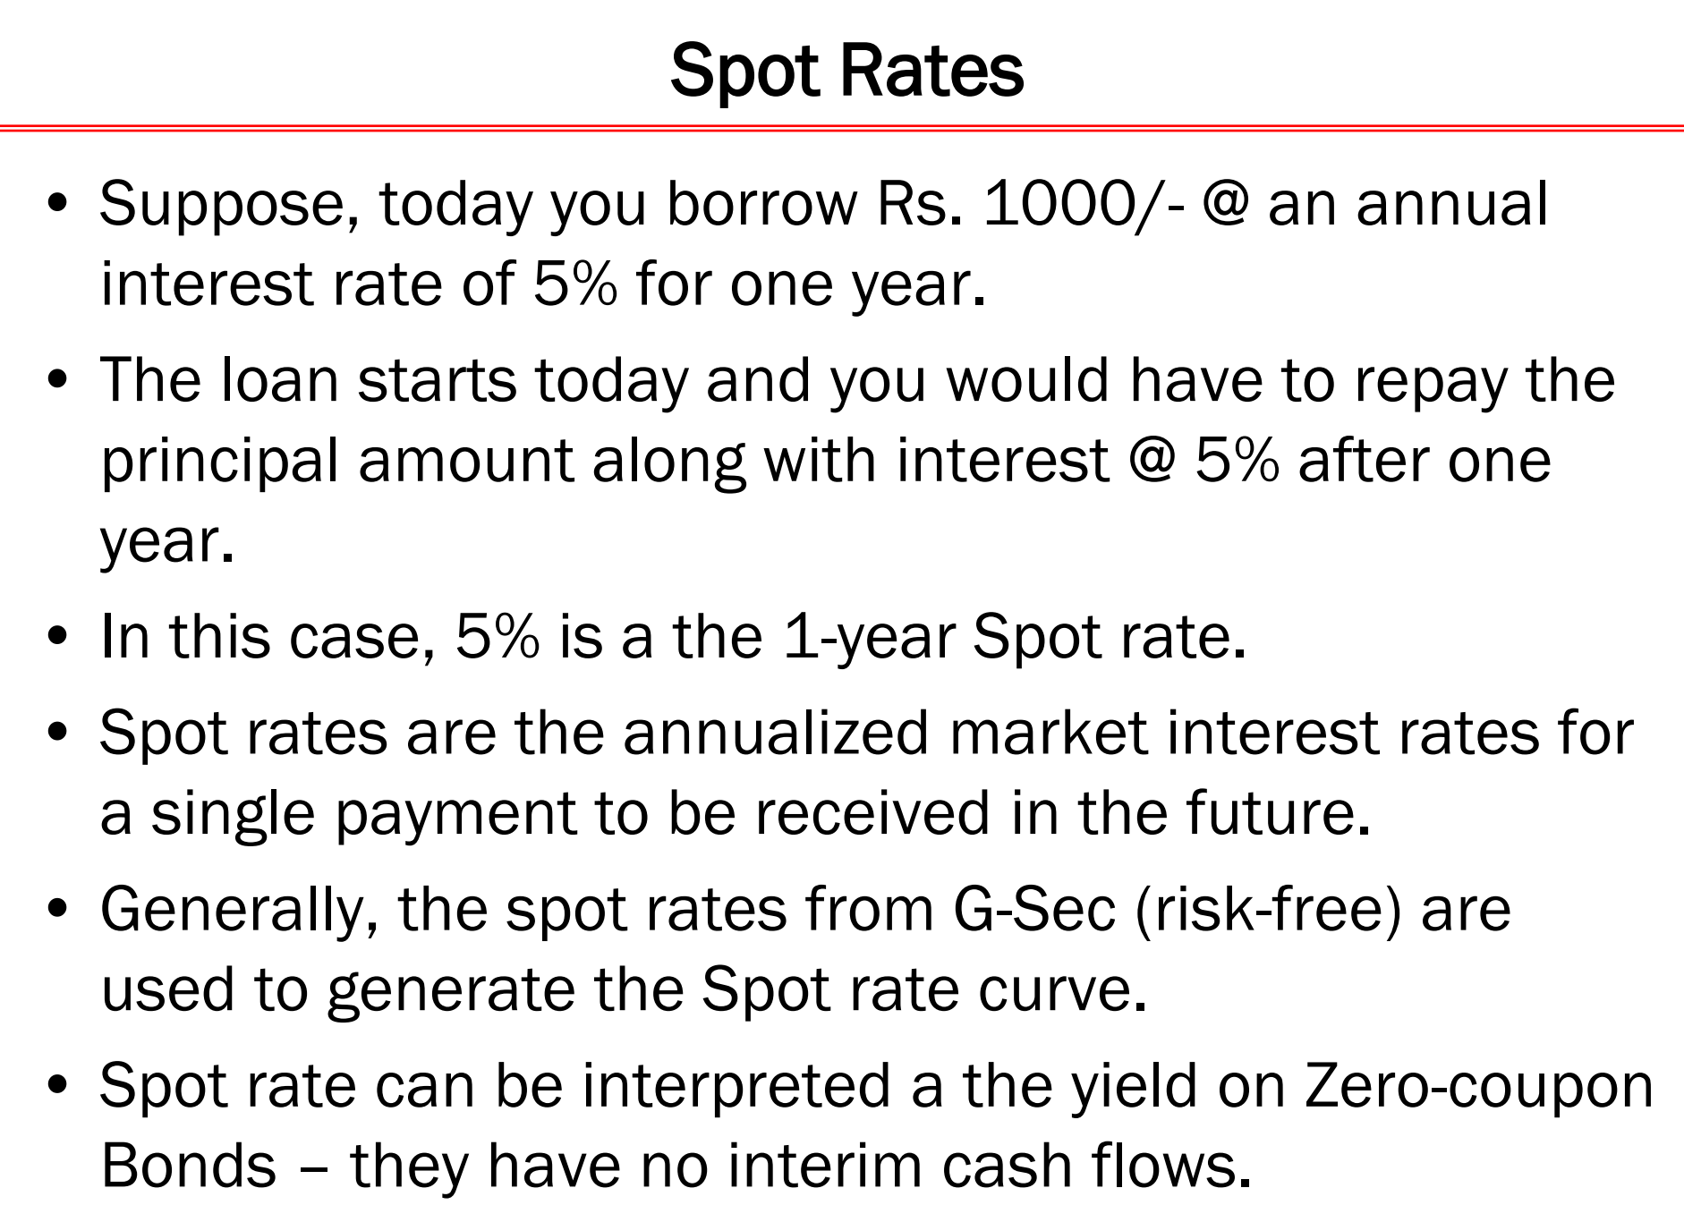

Slide 71
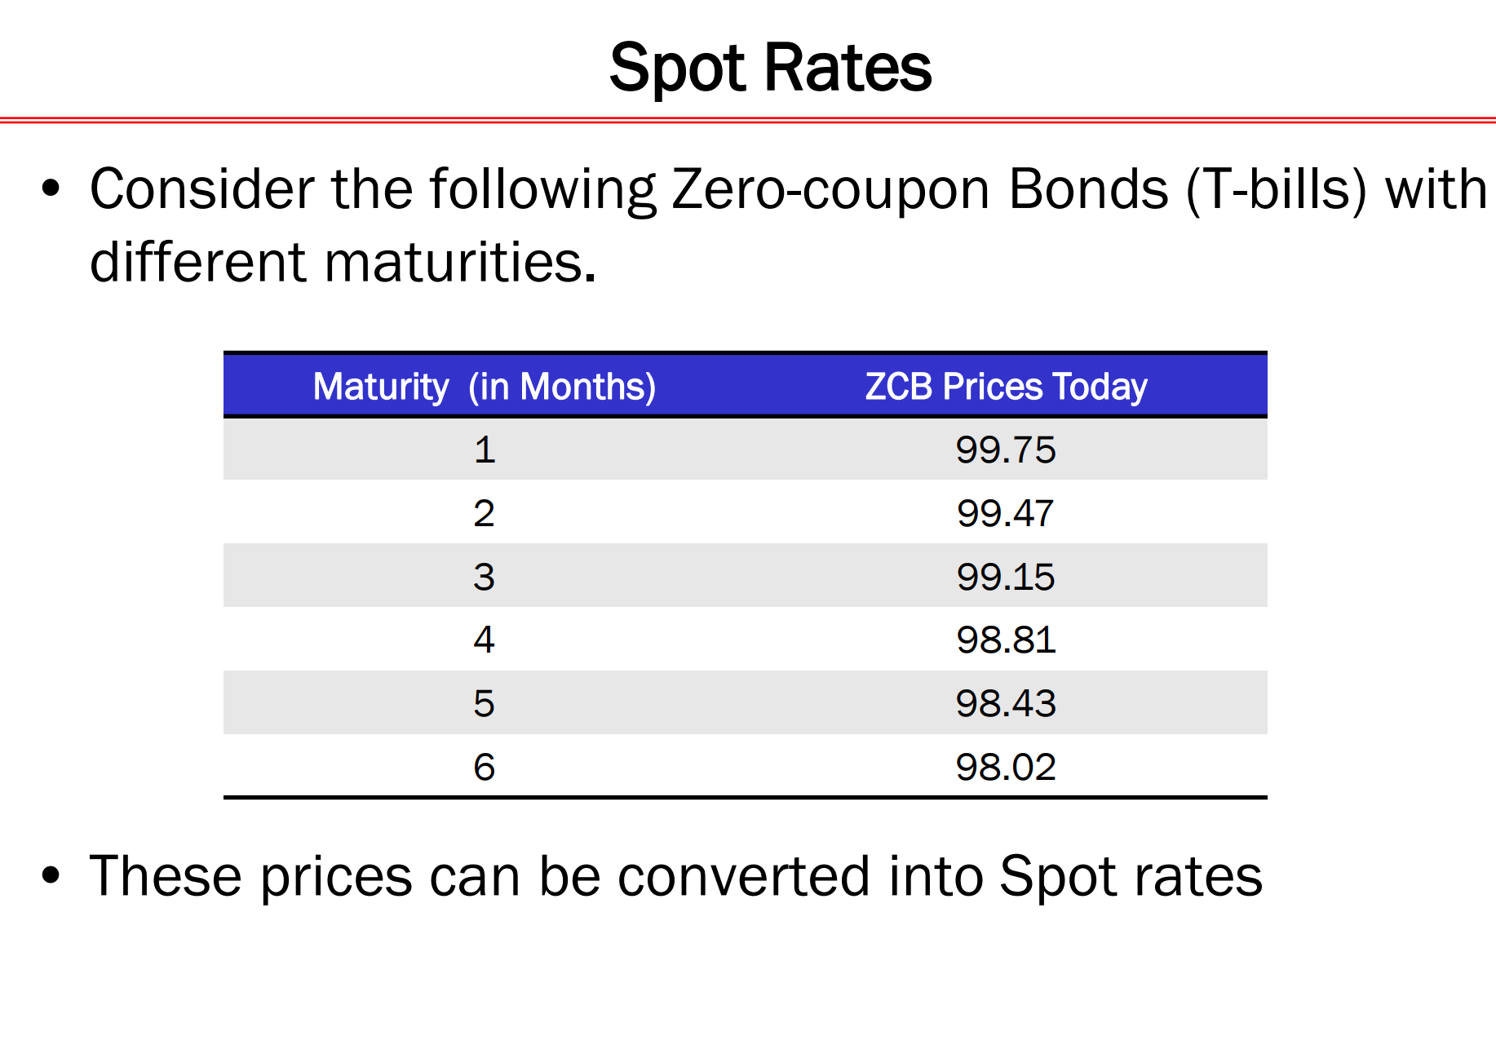

Slide 72
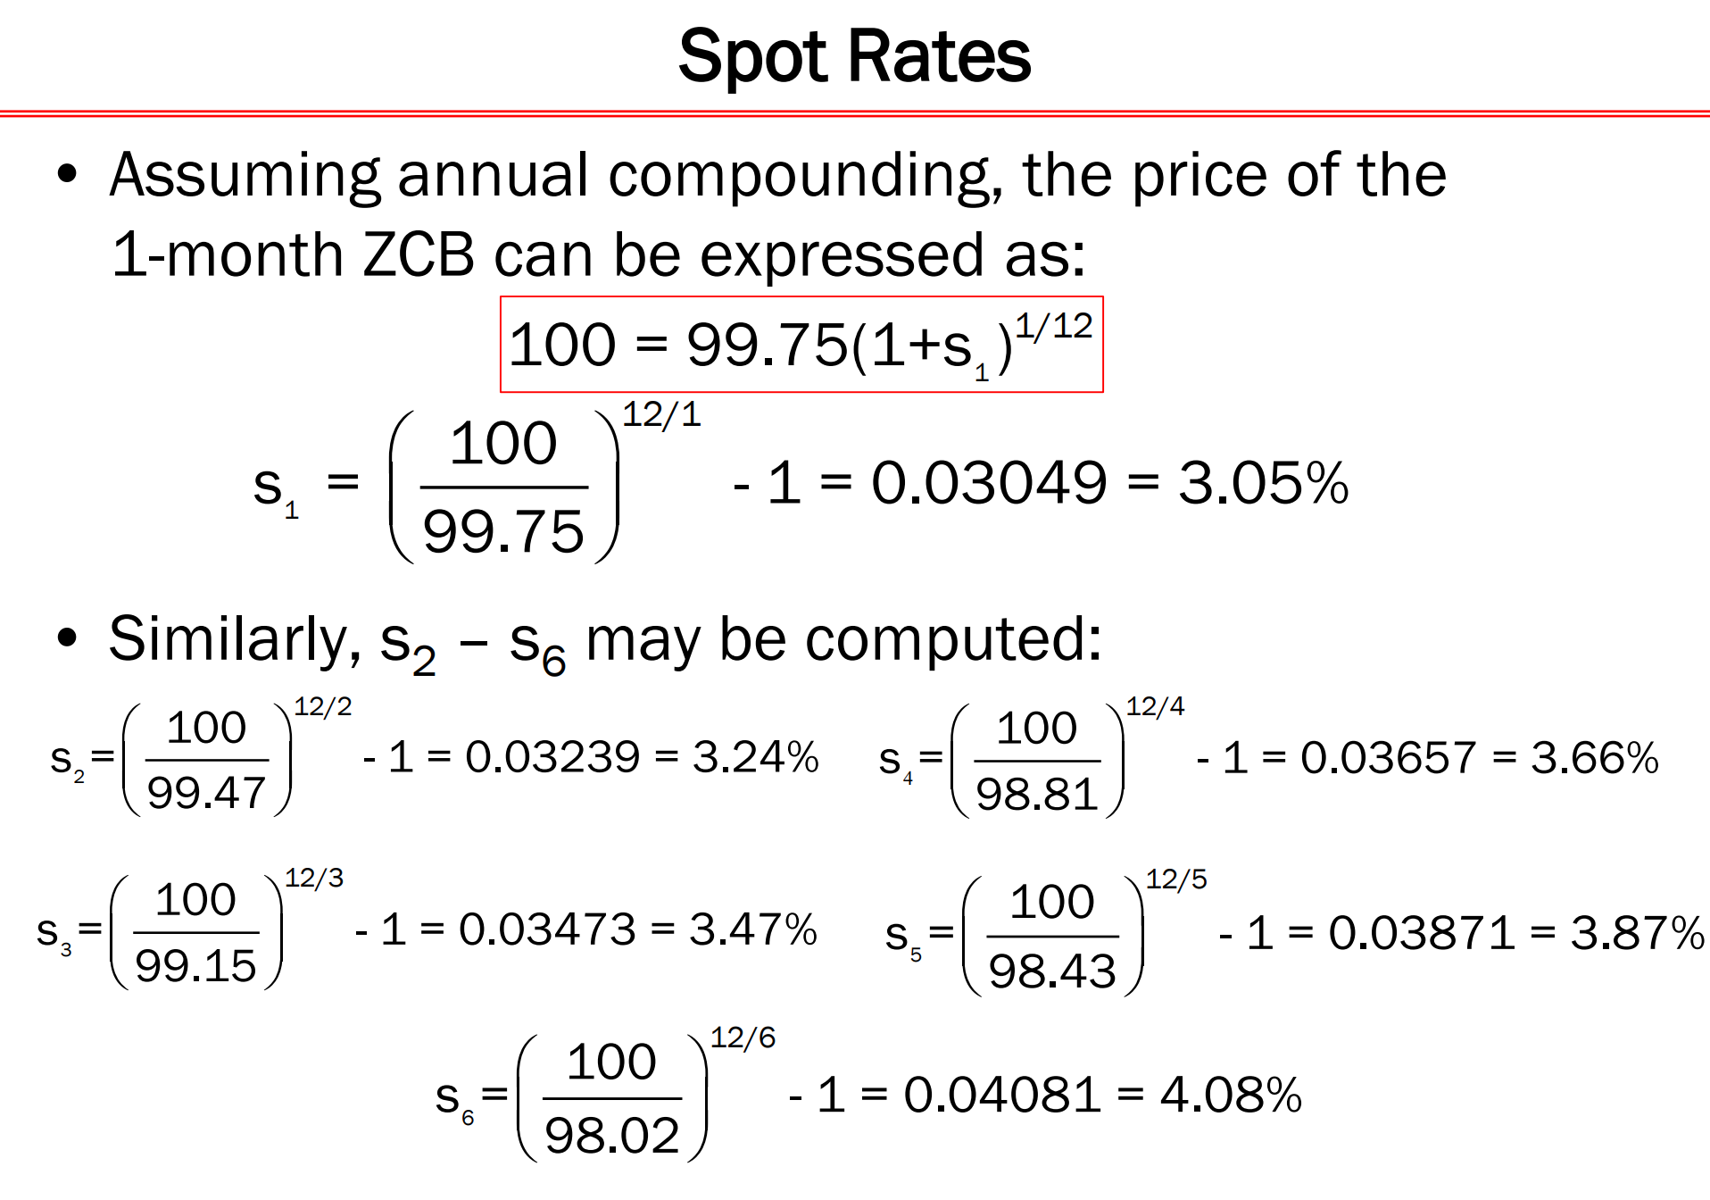

Slide 73
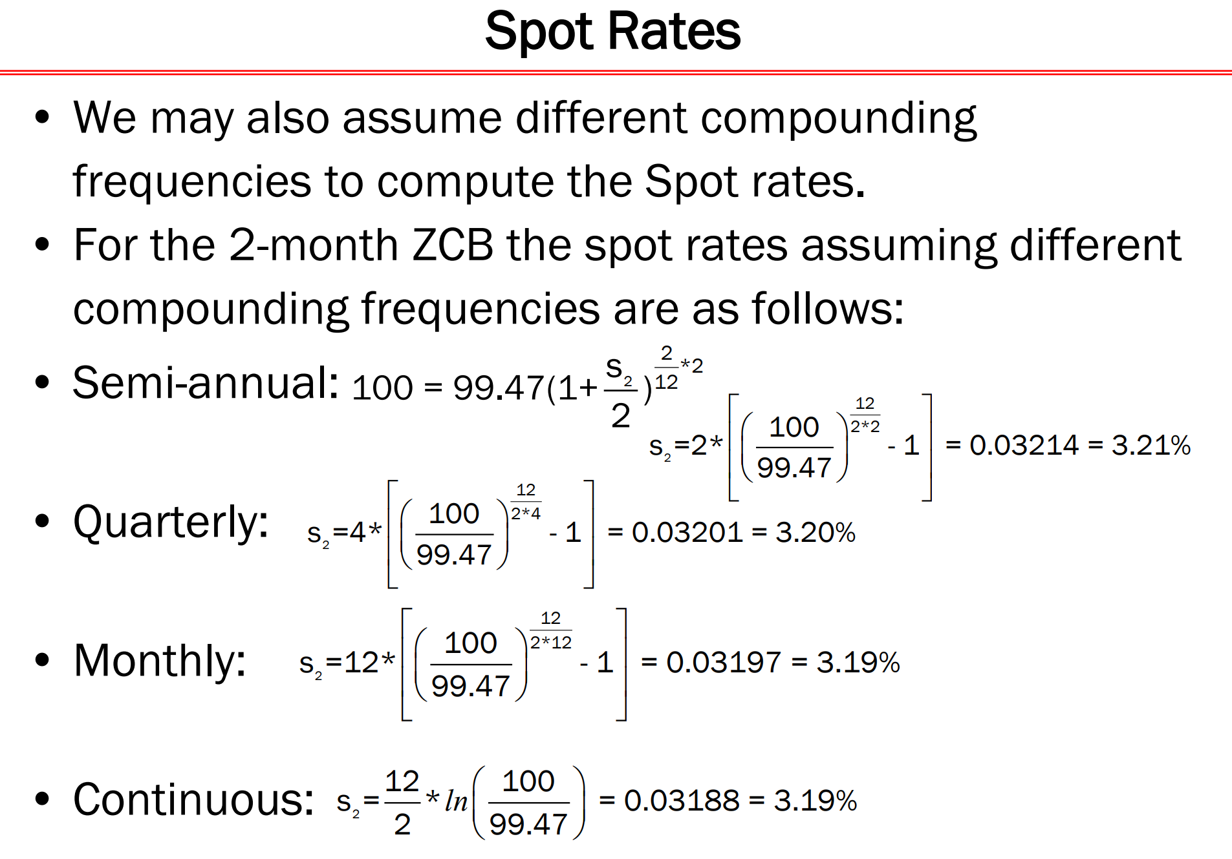

Slide 74
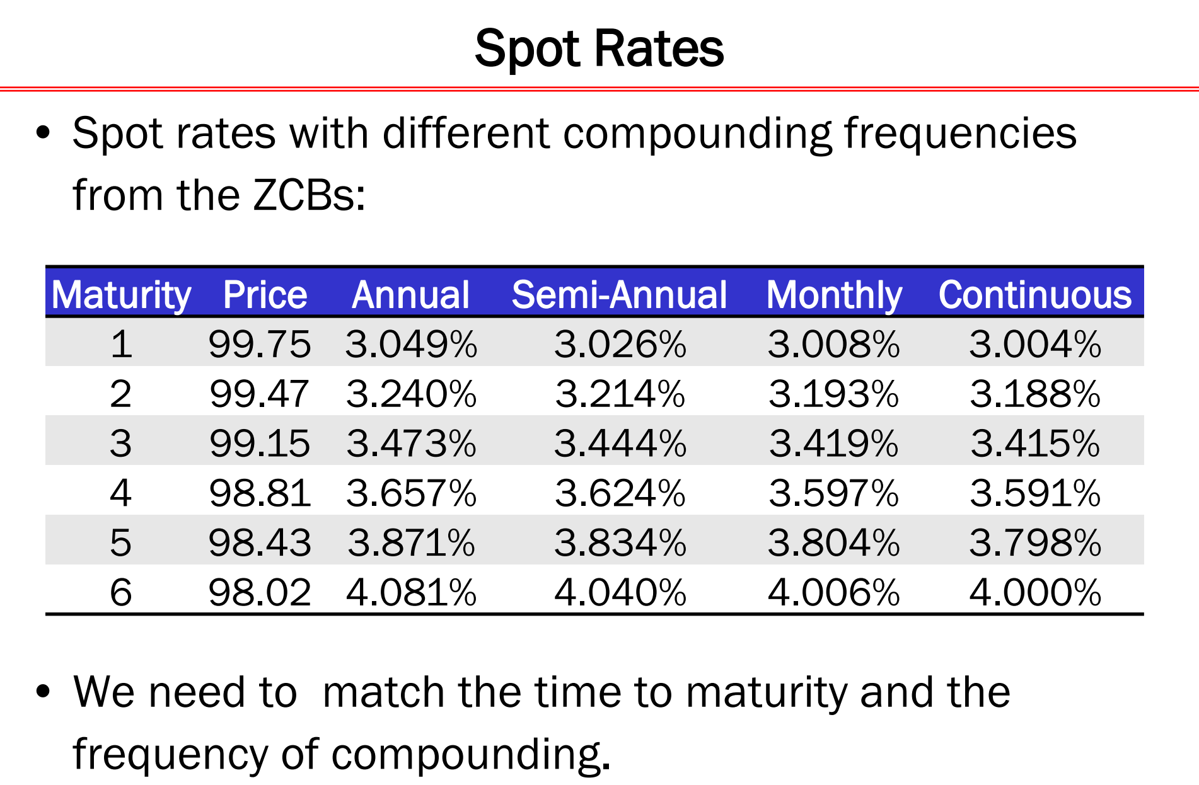

Slide 75
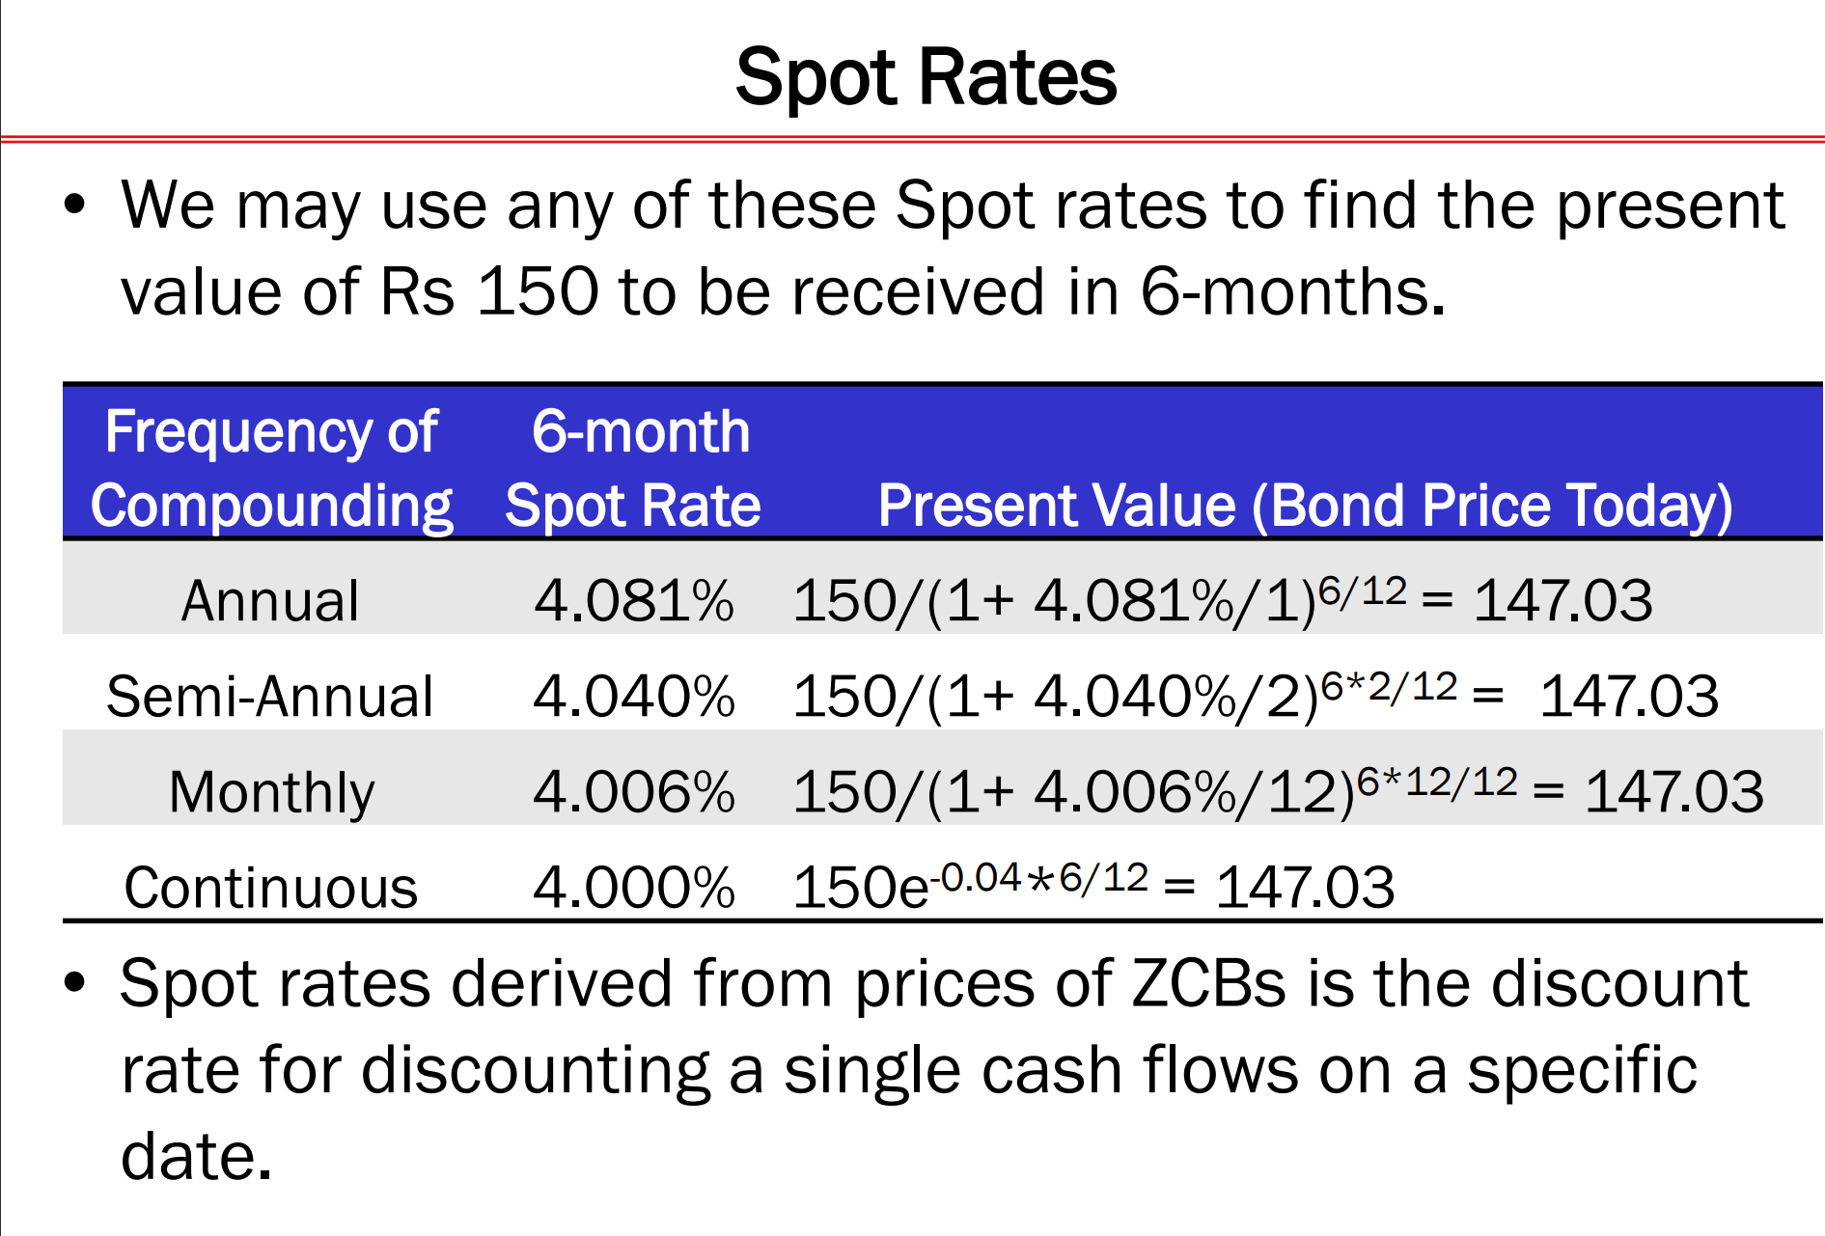

Slide 76
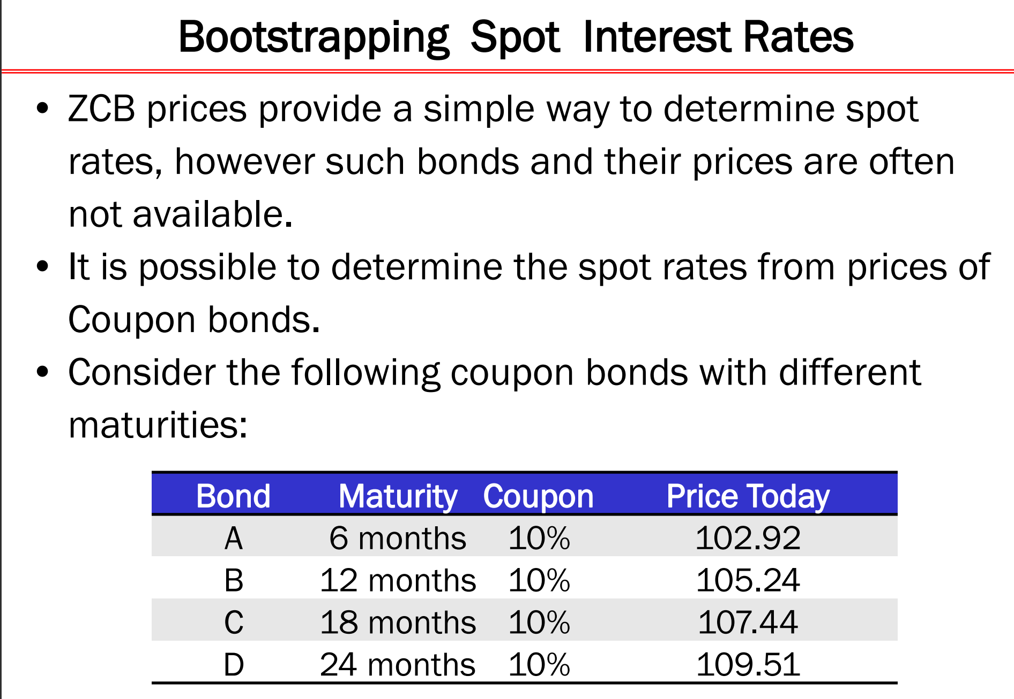

Slide 77
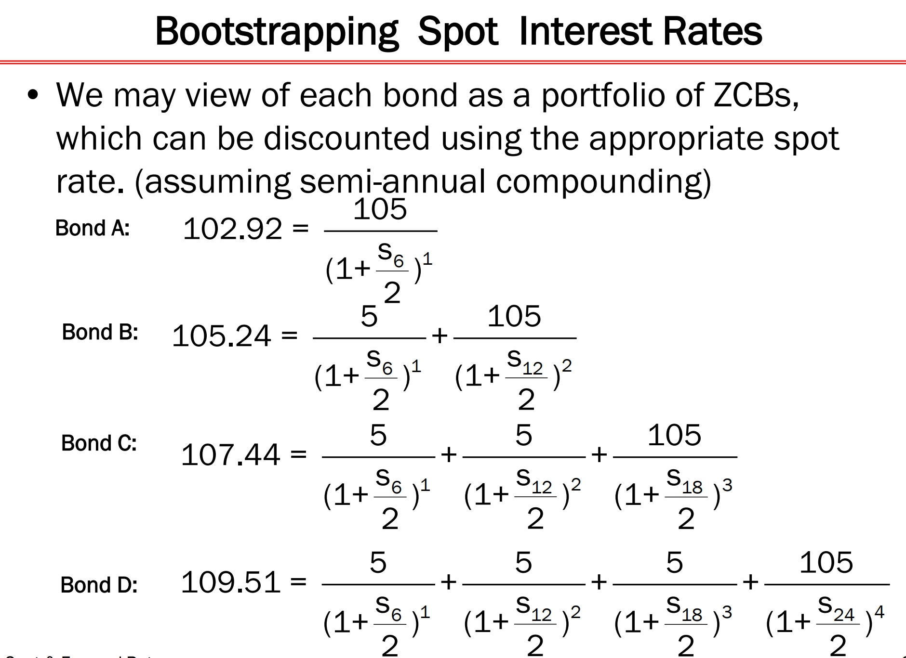

Slide 78
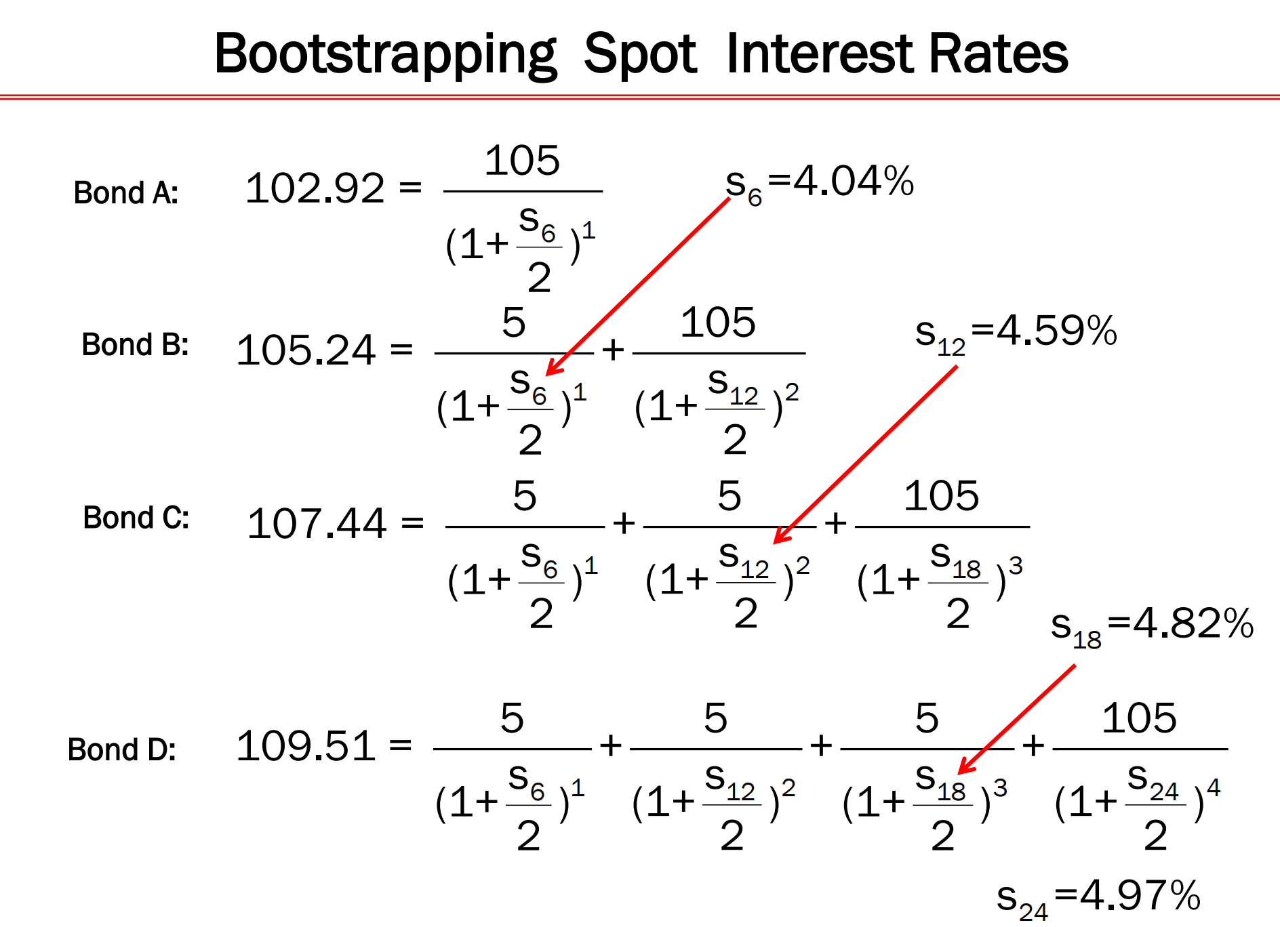

Slide 79
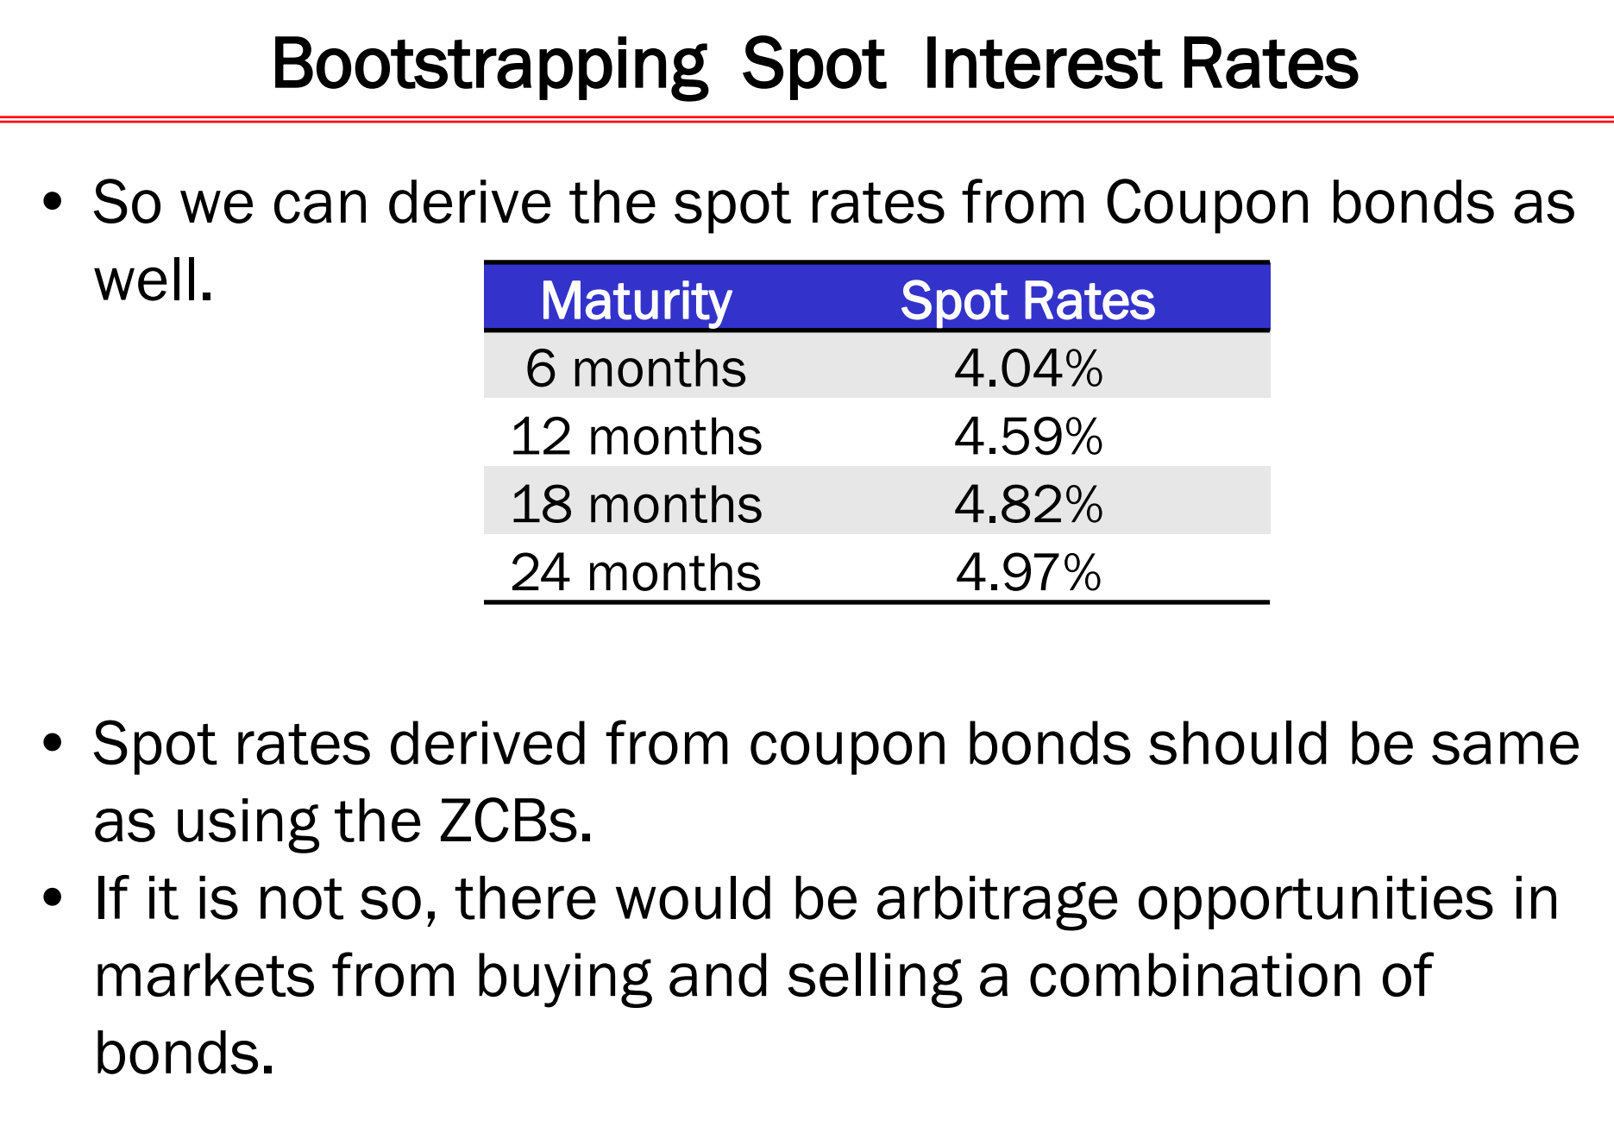

Slide 80
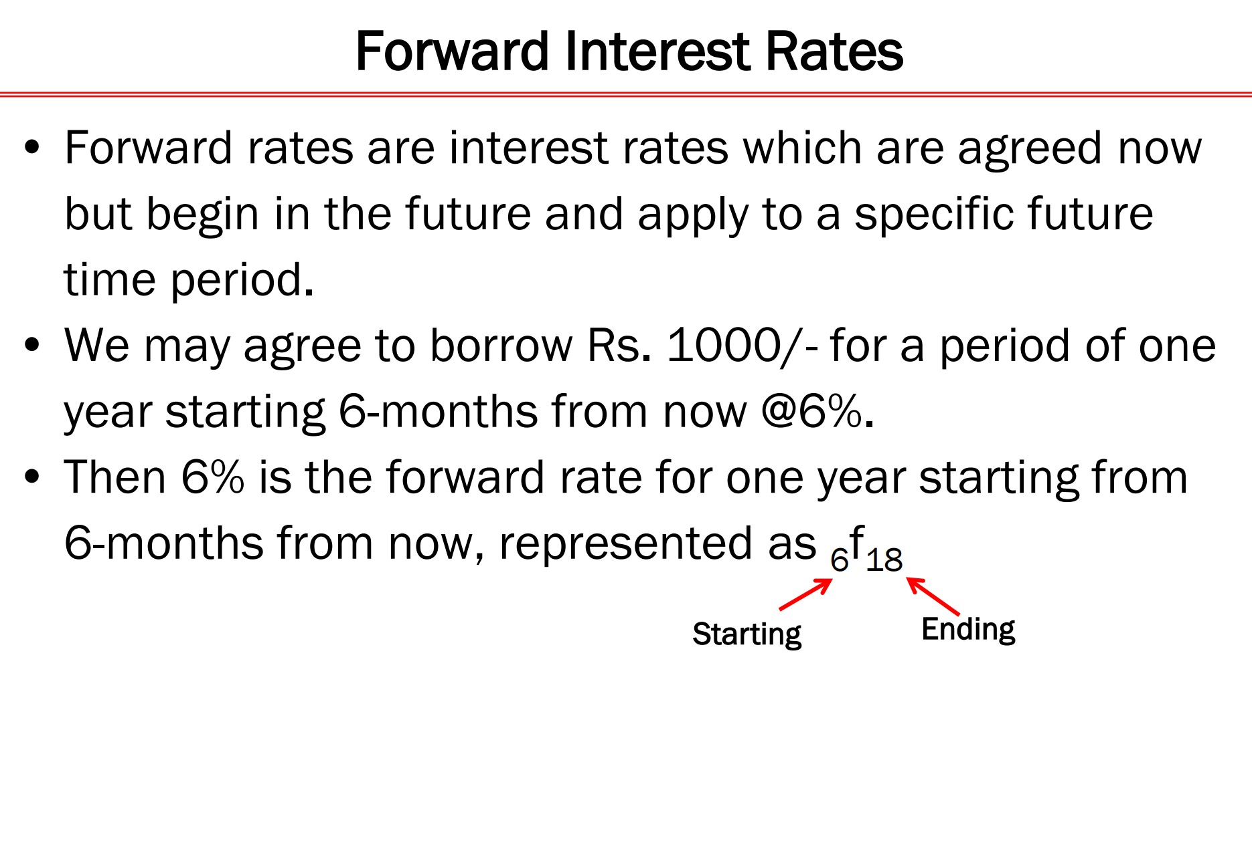

Slide 81
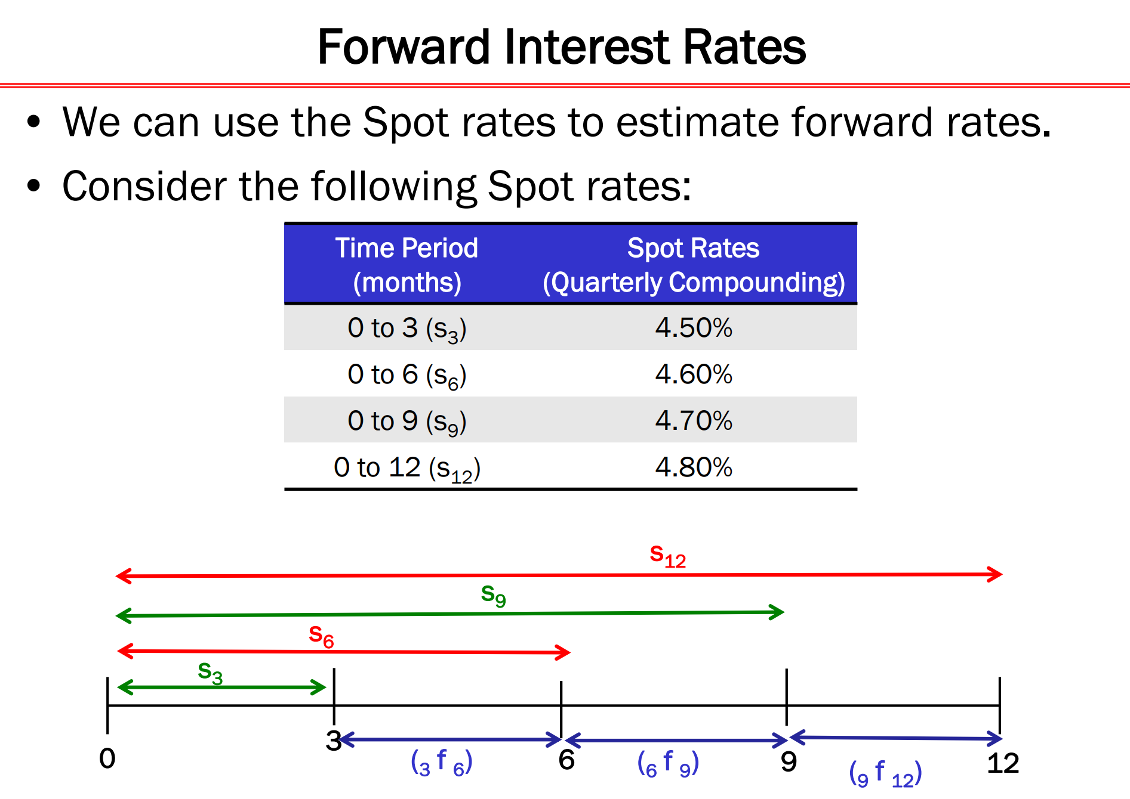

Slide 82
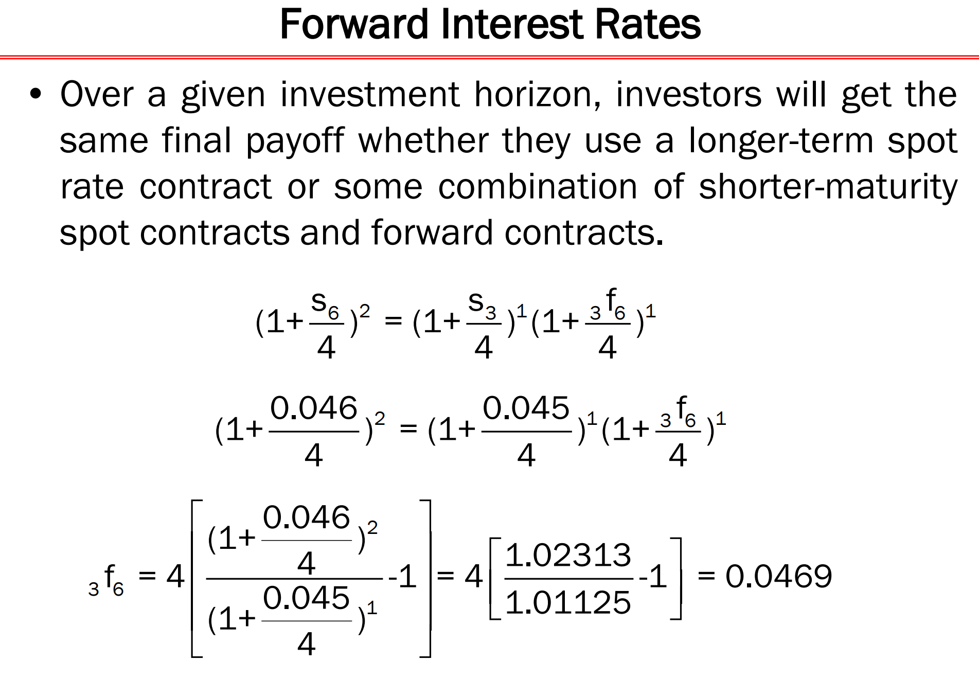

Slide 83
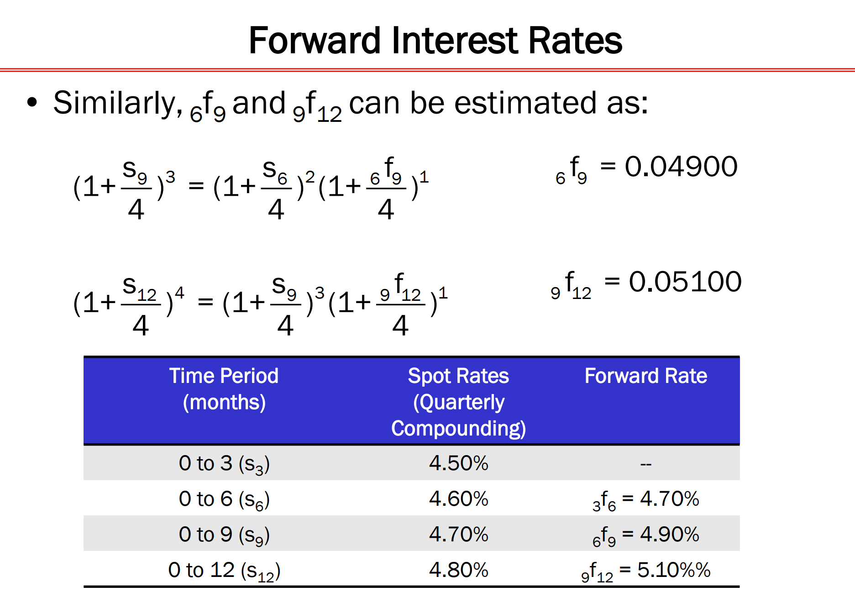

Slide 84
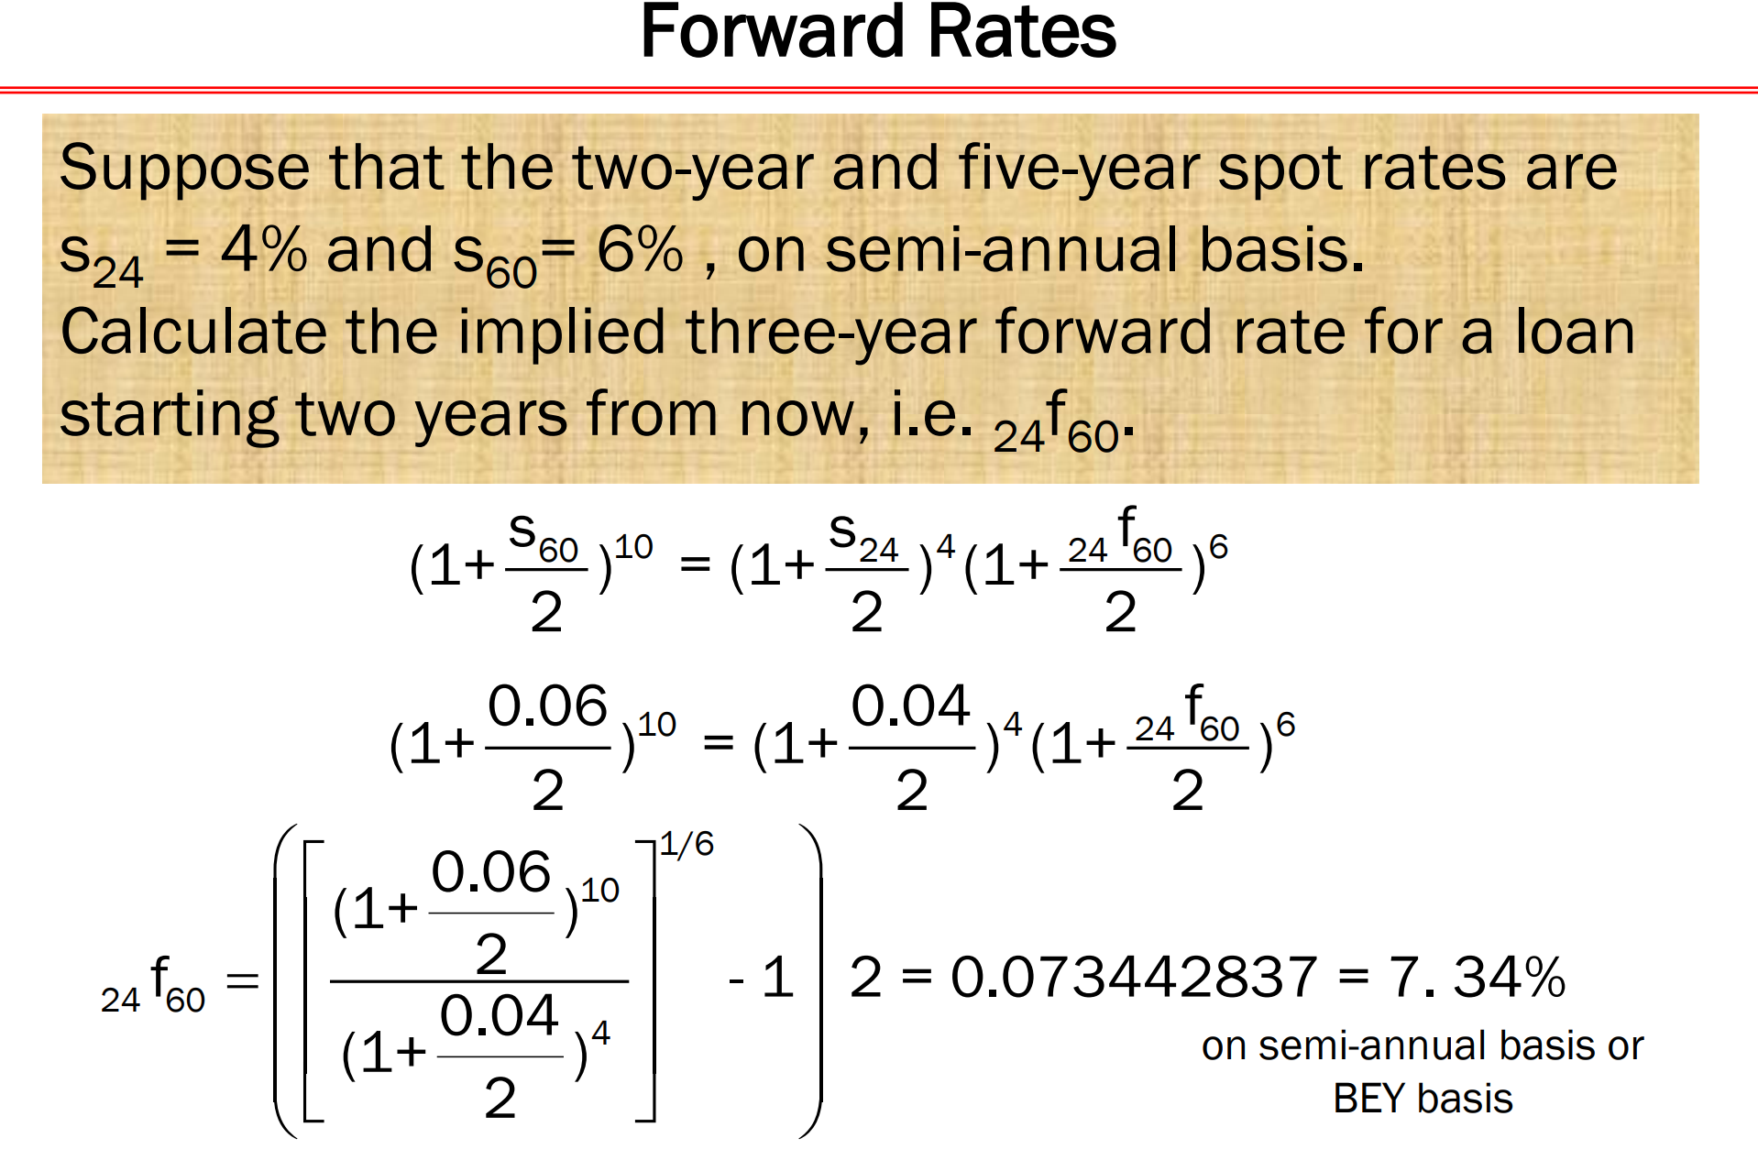

Slide 85
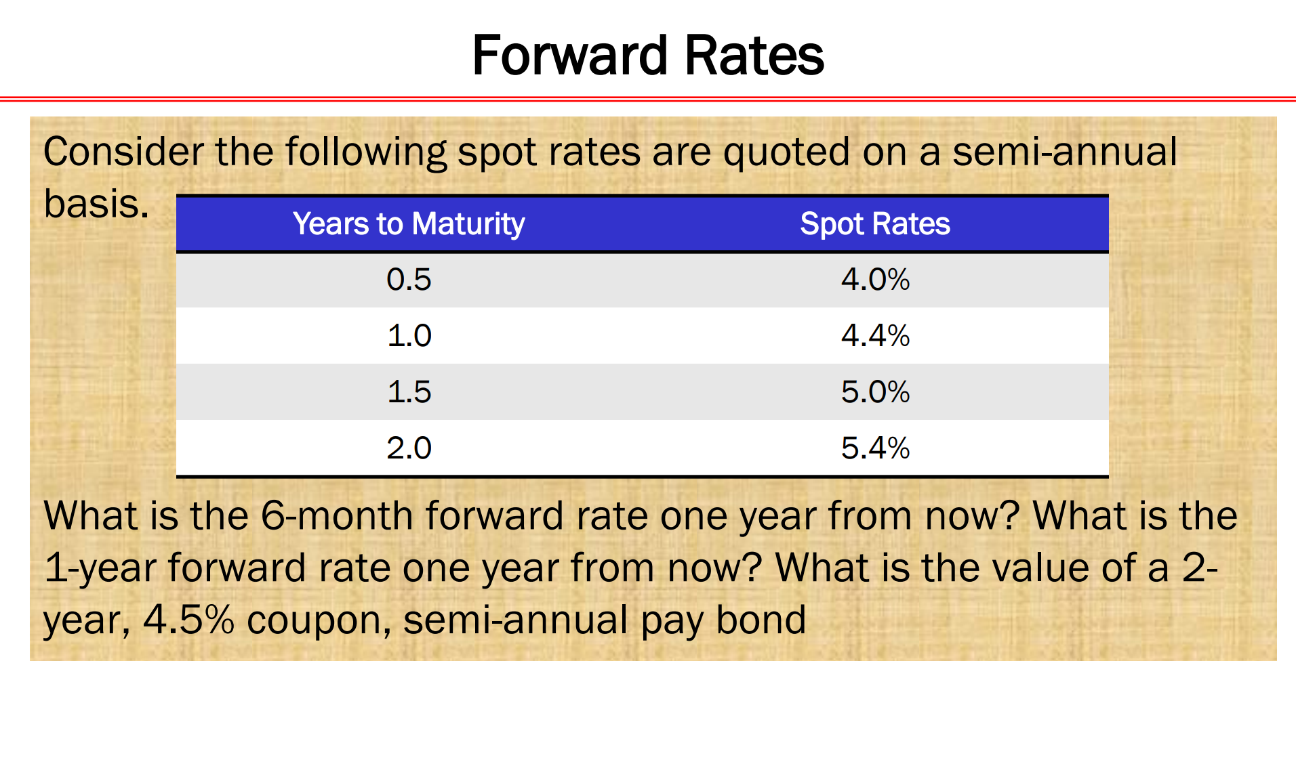

Slide 86
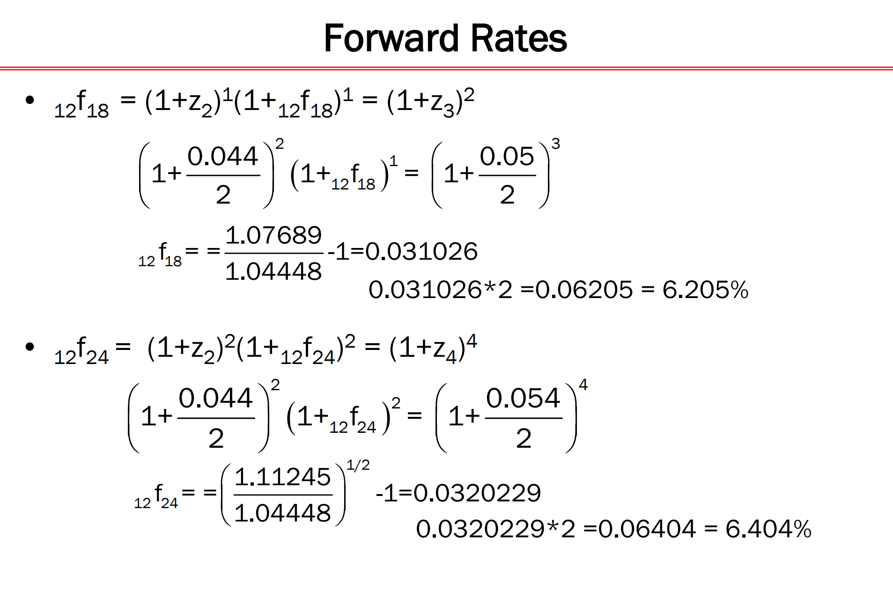

Slide 87
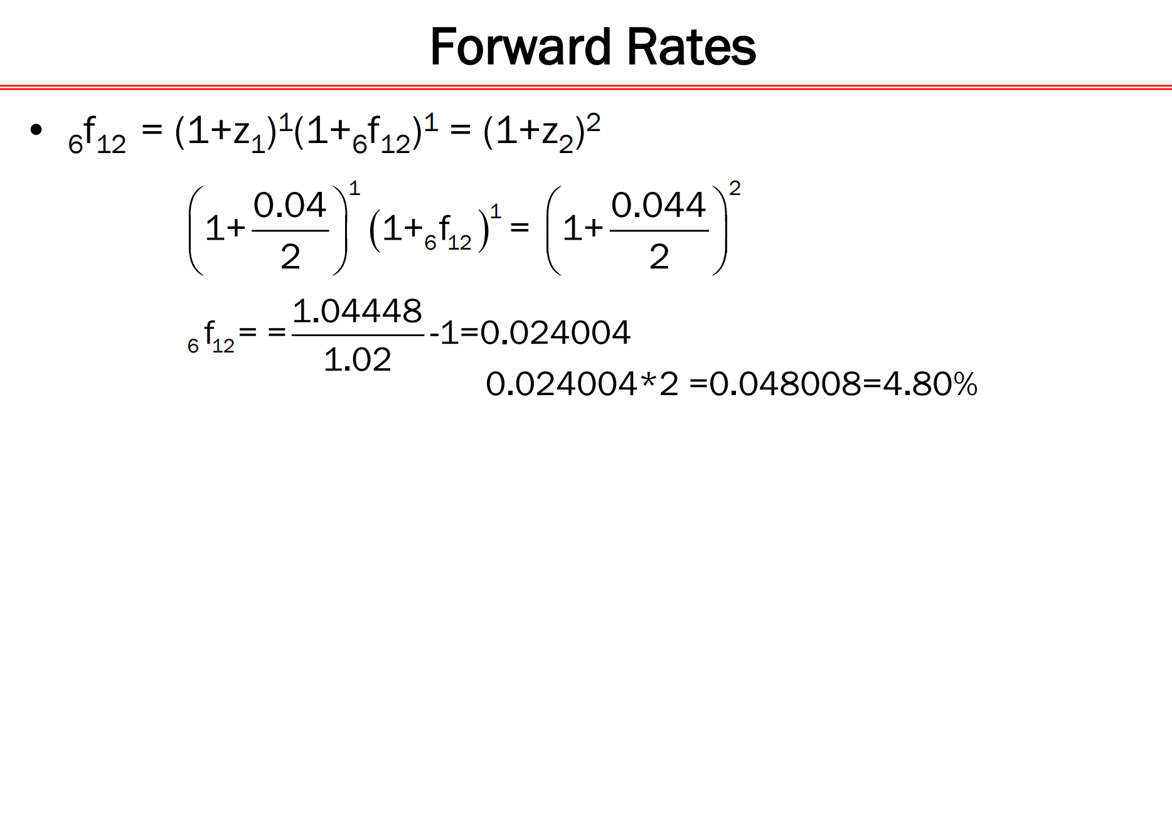

Slide 88
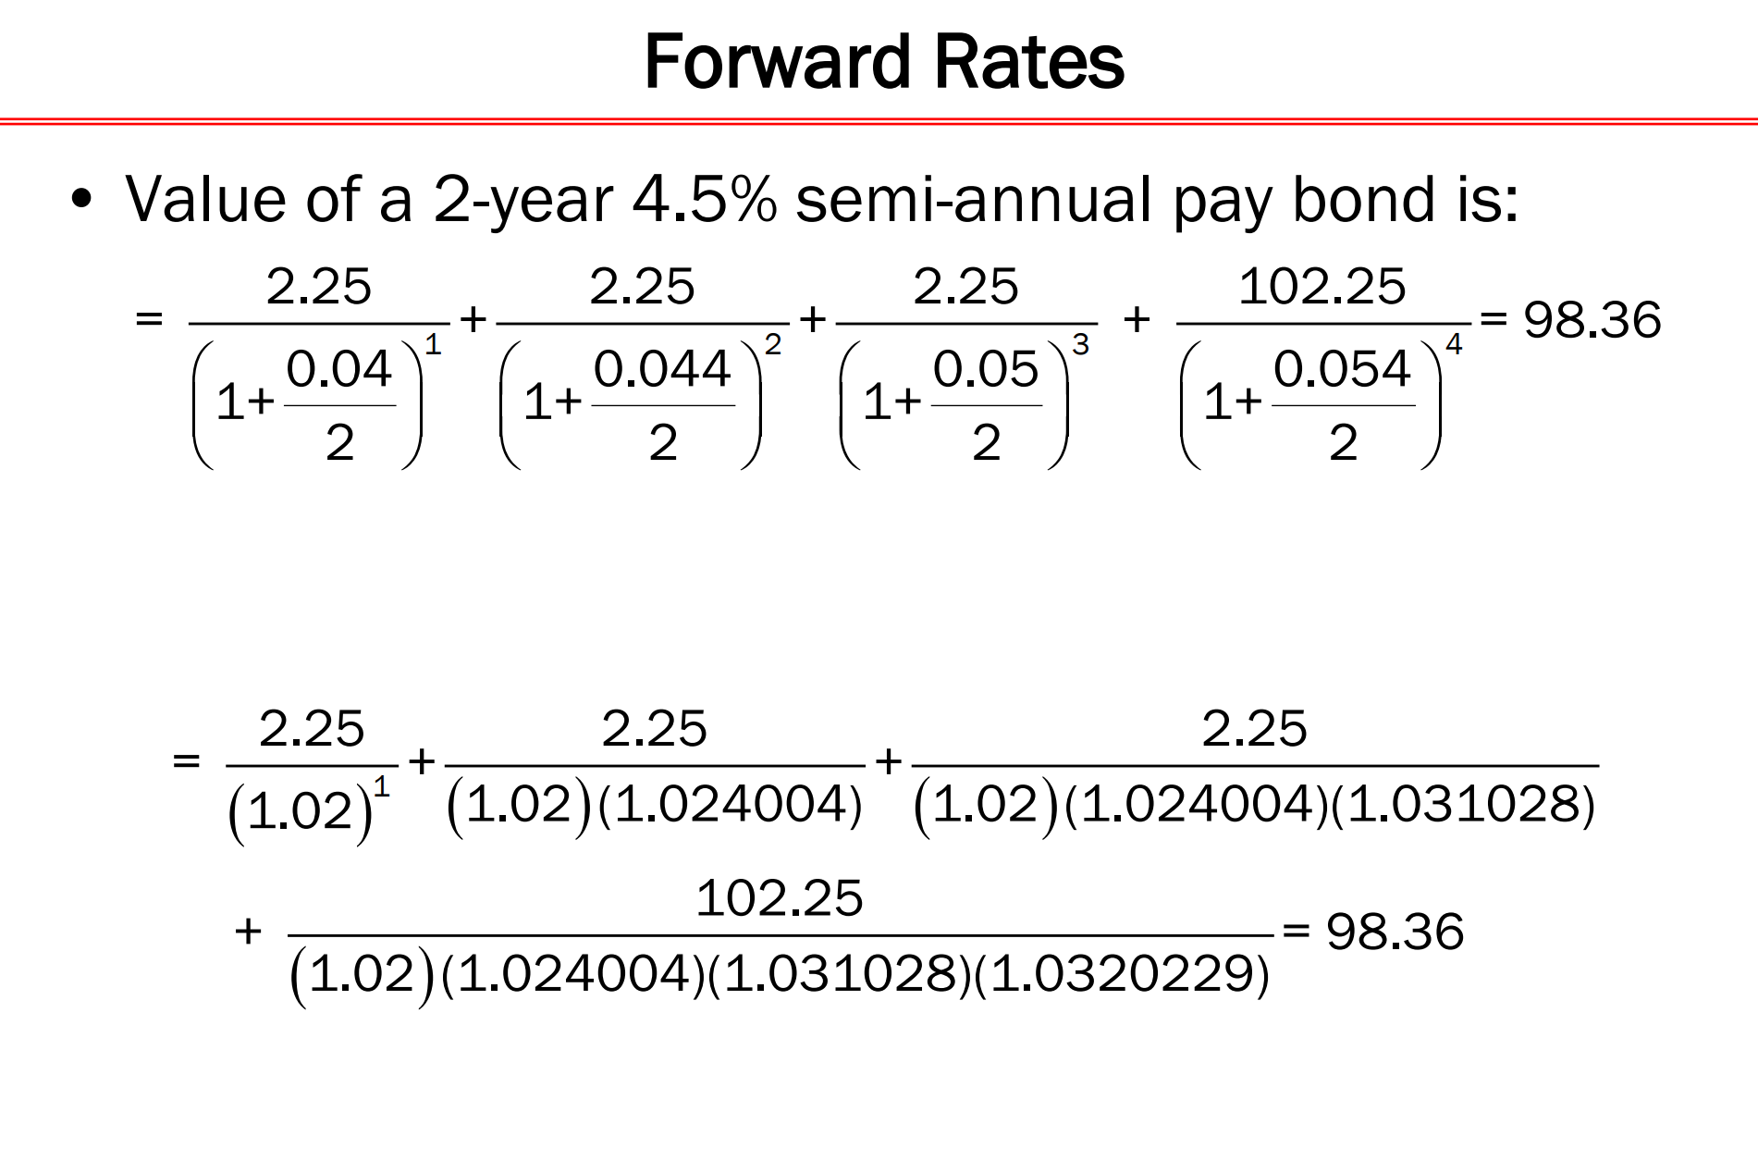

Slide 89
Additional information … Credit Rating Agencies in India
1. CRISIL Limited
CRISIL House
Central Avenue, Hiranandani Business Park, Powai, Mumbai 400 076
2. India Ratings and Research Pvt. Ltd.
(formerly Fitch Ratings India Pvt. Ltd.)
Wockhardt Towers, 4th Floor, West Wing
Bandra Kurla Complex, Bandra East
Mumbai 400 051
3. ICRA Limited
1105, Kailash Building, 11th Floor
26, Kasturba Gandhi Marg
New Delhi 110 001
4. Credit Analysis & Research Ltd.(CARE)
4th Floor, Godrej Coliseum, Somaiya Hospital Road, Behind Everard Nagar
Off Eastern Express Highway, Sion (E)
Mumbai 400 022
5. Brickwork Ratings India Pvt. Ltd.
3rd Floor, Raj Alkaa Park
29/3 & 32/2, Kalena Agrahara
Bannerghatta Road,
Bangalore – 560 076
6. SMERA Ratings Limited
Unit No.102, 1st Floor, Sumer Plaza
Marol Maroshi Road, Marol
Andheri (East)
Mumbai 400 059
7. Infomerics Valuation and Rating Pvt. Ltd.
Flat No. 104/108, 1st Floor
Golf Apartments
Sujan Singh Park
New Delhi – 110003.

Slide 90
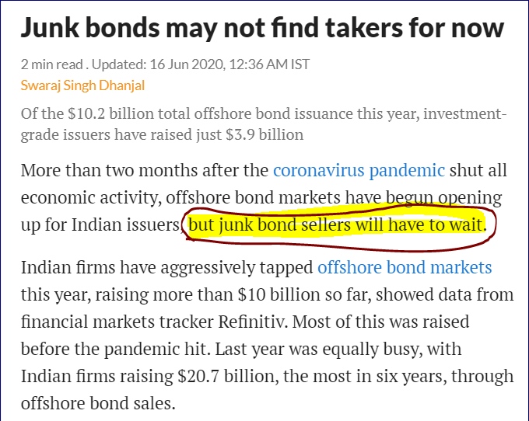
Impact of COVID-19 on Junk Bonds
Source: MINT

Slide 91
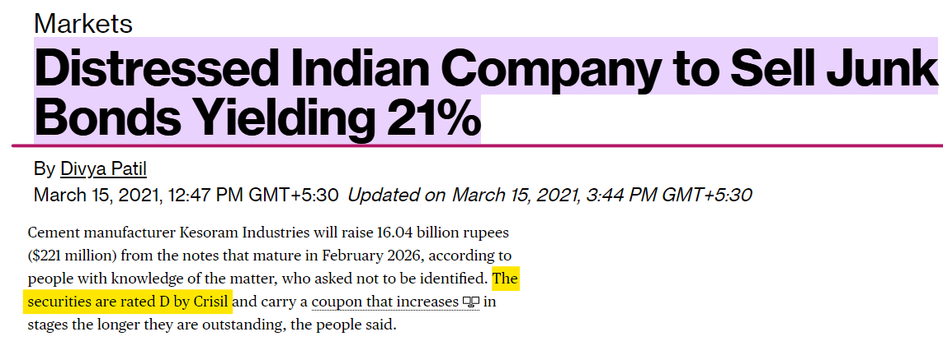
There are people who buys junk bonds!

Slide 92

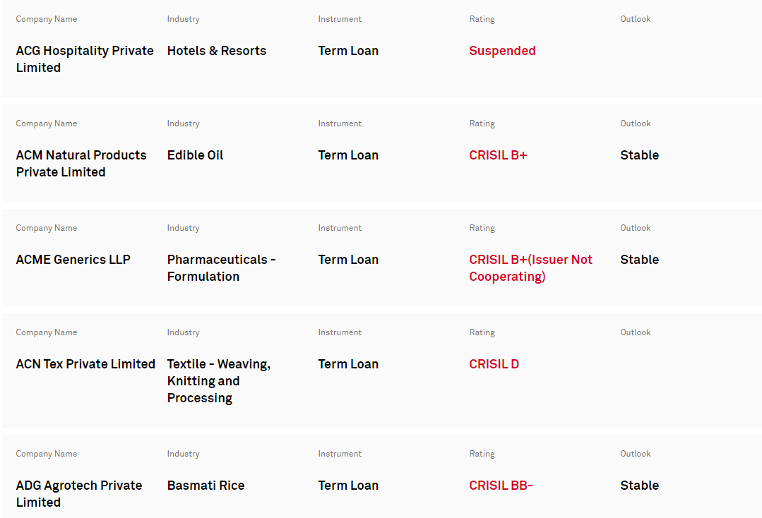

Slide 93
Please remember …
Junk Bonds are a game of HIGH RISK and HIGH RETURN!
Be careful with them!

Slide 94
Can you wonder that the companies are coming out with MASALA BONDS?

Slide 95
We have
MASALA BONDS

Slide 96
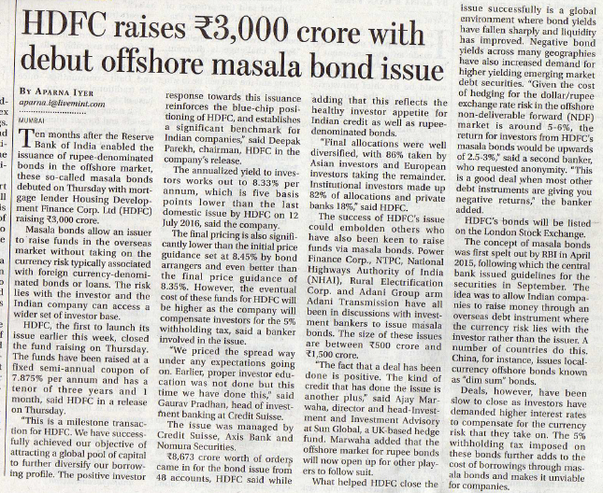
Mint July 15, 2016

Slide 97
Some companies wants to have GREEN MASALA BONDS!

Slide 98

Mint July 21, 2016

Slide 99
Many times …
Green Bonds are called Climate Bonds.

Slide 100
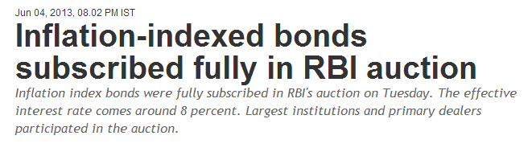
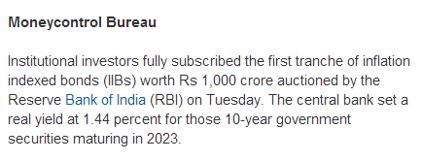
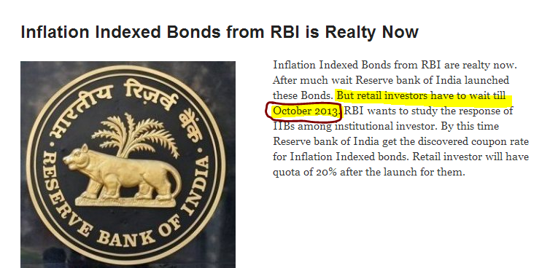
Government has allowed issuance of Indexed Bonds!!!

Slide 101
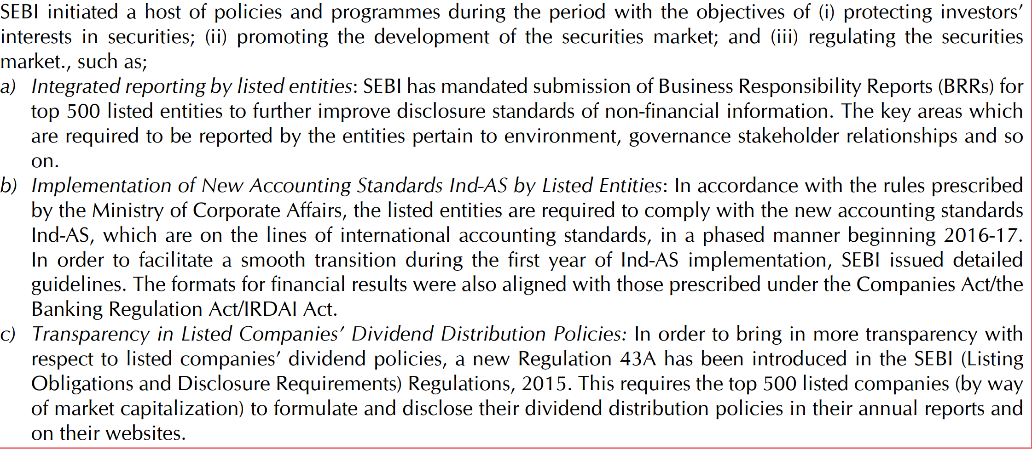
Some reform initiatives introduced in the securities market during March 2016 - December 2017

Slide 102
Some reform initiatives introduced in the securities market during March 2016 - December 2017
Enhancing Corporate Governance Standards
Guidance on Board Evaluation:
Guidelines for Functioning of Stock Exchanges and Clearing Corporations in the International Financial Services Centre (IFSC)
Guidelines, 2015, with regard to market structure, trading hours and settlement, product category, position limits, trading in rupee denominated bonds issued overseas (Masala bonds), the risk management framework, the dispute resolution mechanism and business continuity plan & disaster recovery

