Slide 1
Financial Risk Management

Slide 2

Why are we reading this paper
???????????

Slide 3

Why are we reading this paper of FRM?

Slide 4
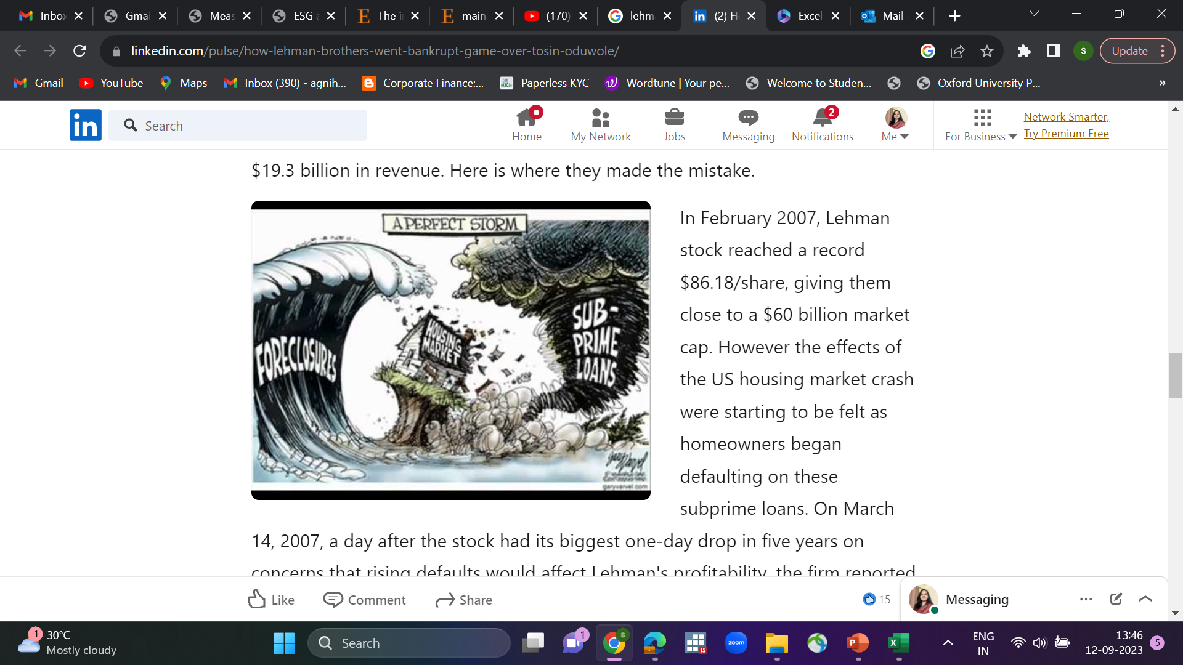
Case of Lehman Brothers

Slide 5
The saga of Lehman Brothers
Lehman Brothers-case.docx

Slide 6
Key Driver of Development in Financial Risk Management
It is because of occurrence of large number of financial disasters.
Allied Irish Bank case
Barring Bank case
Enron
Proctor and Gamble 1994 Case
Drysdale Securities
Hammersmith And Fullham

Slide 7
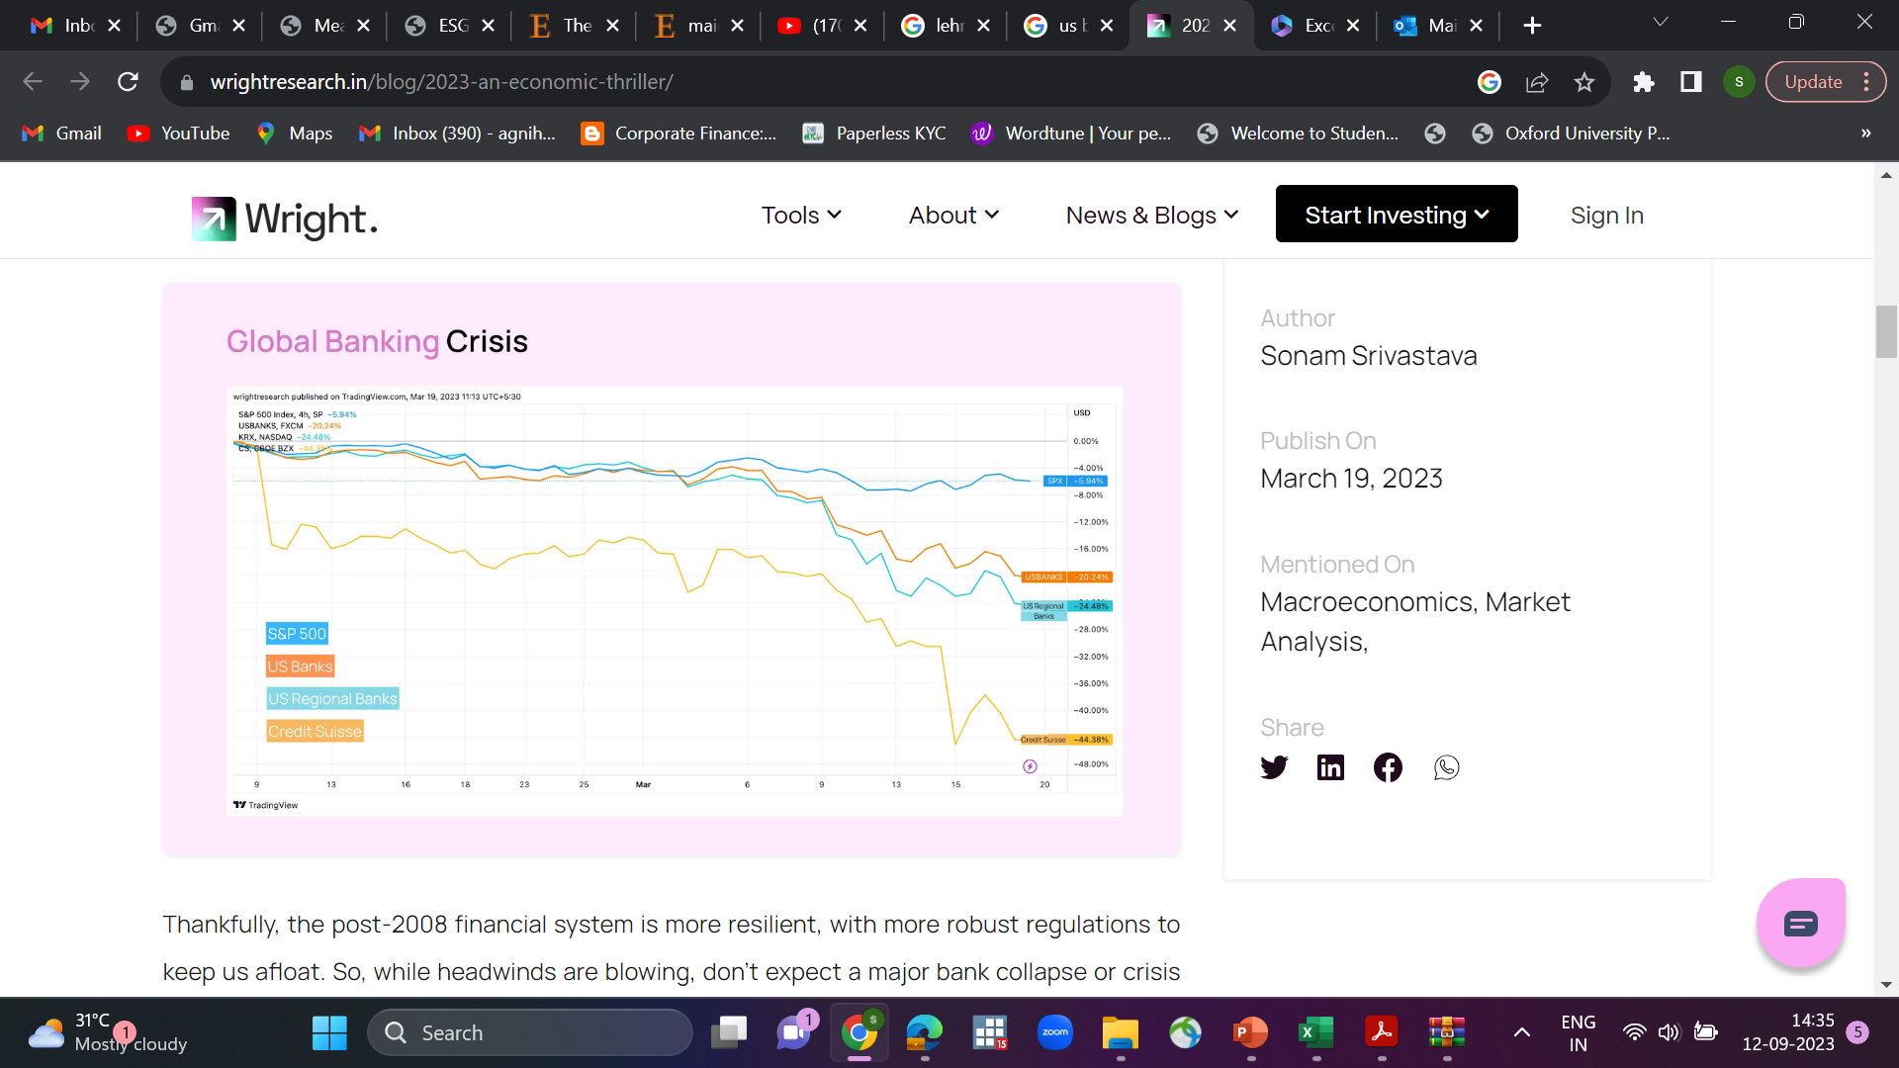

US Banking Crisis 2023

Slide 8
Allied Irish Bank case
John Rusnak (Rusnak), a trader at Allfirst Financial Inc. (Allfirst), the US subsidiary of Ireland's leading bank - Allied Irish Banks (AIB), lost $750 mn in foreign exchange trading operations.
Fraudulent trading activities and manipulation of records by Rusnak resulted in major losses.

Slide 9
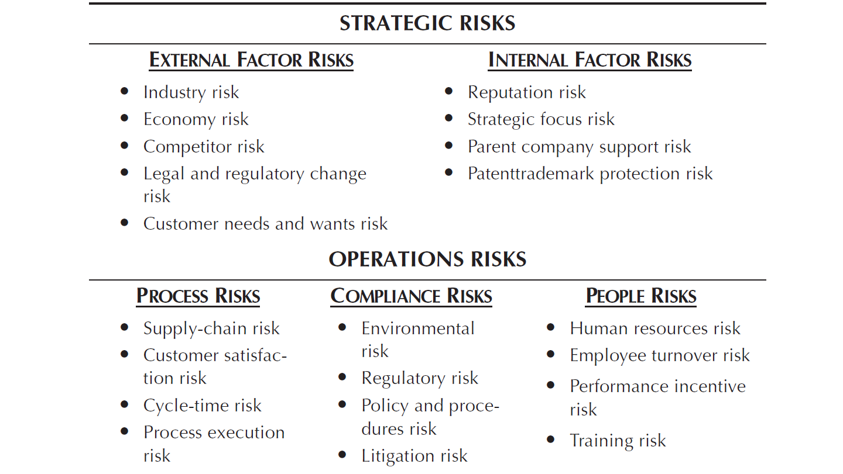

Slide 10
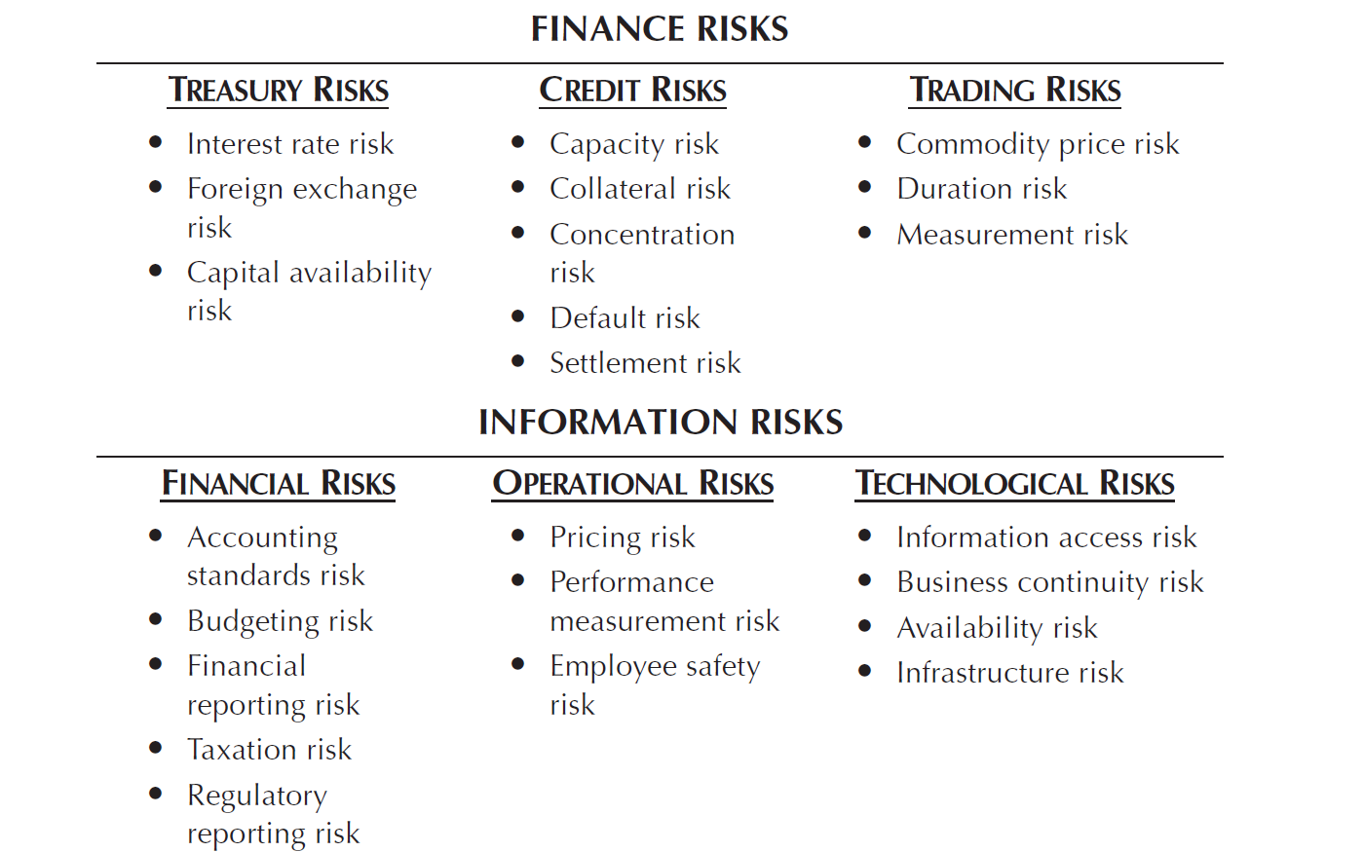

Slide 11
Key Risk Assessment
What is the likelihood of this risk’s occurring over the next one-year period? Using a score of 1 to 9, assign a best-guess single-digit score as follows:
What is the significance of the risk, in terms of cost to the organization? again using a 1-to-9 scale.
These scores are then averaged by both factors and are plotted on a risk assessment analysis.

Slide 12
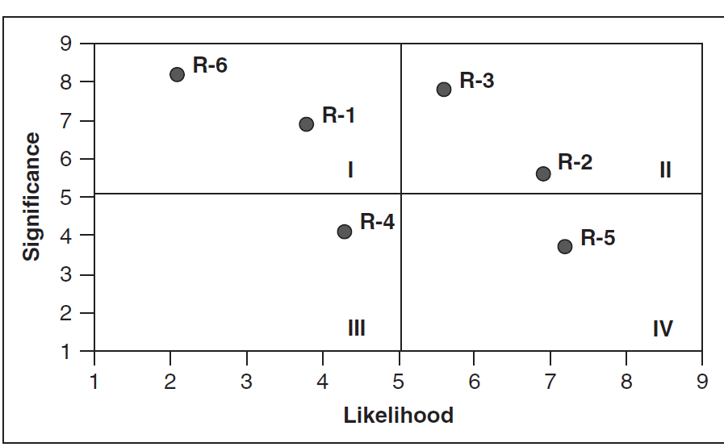
Key Risk Assessment

Slide 13

Key Risk Assessment

Slide 14
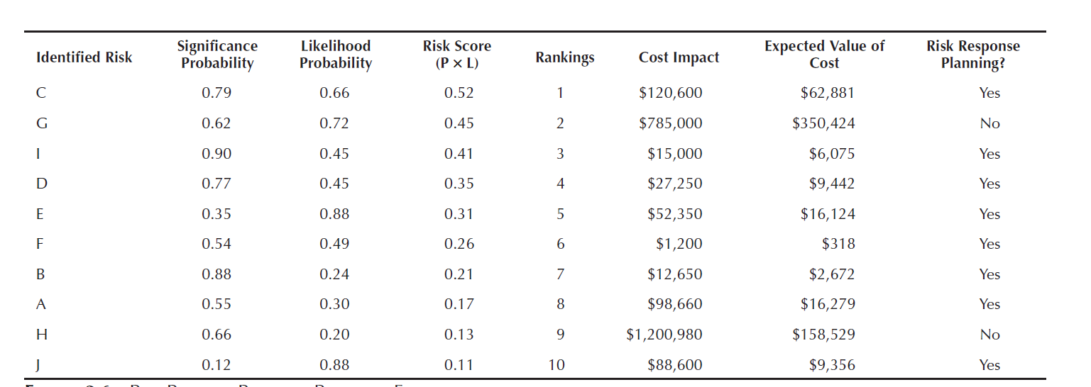
Key Risk Assessment

Slide 15
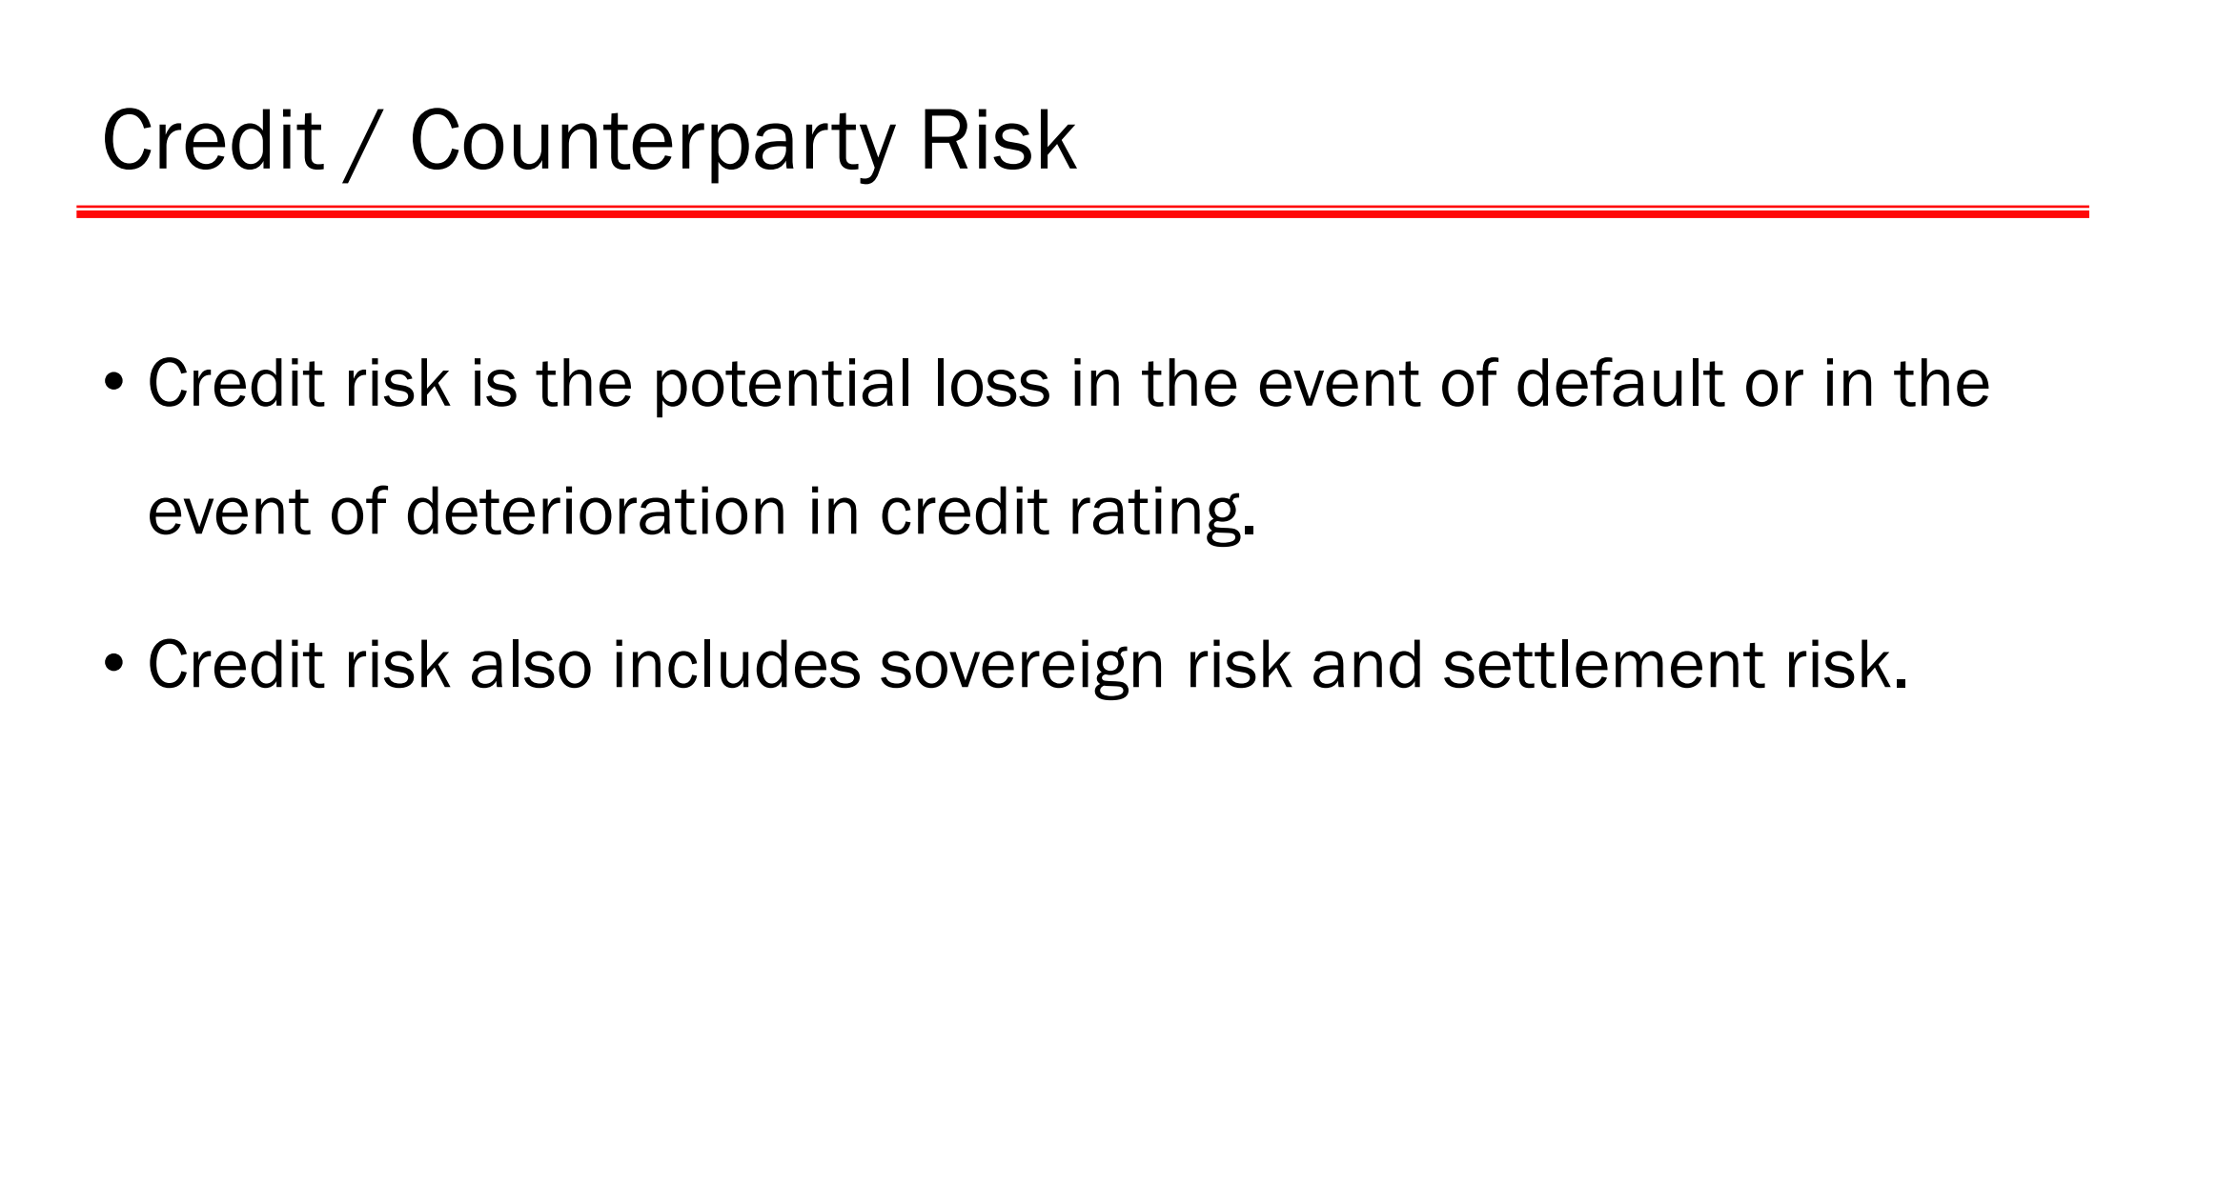

Slide 16
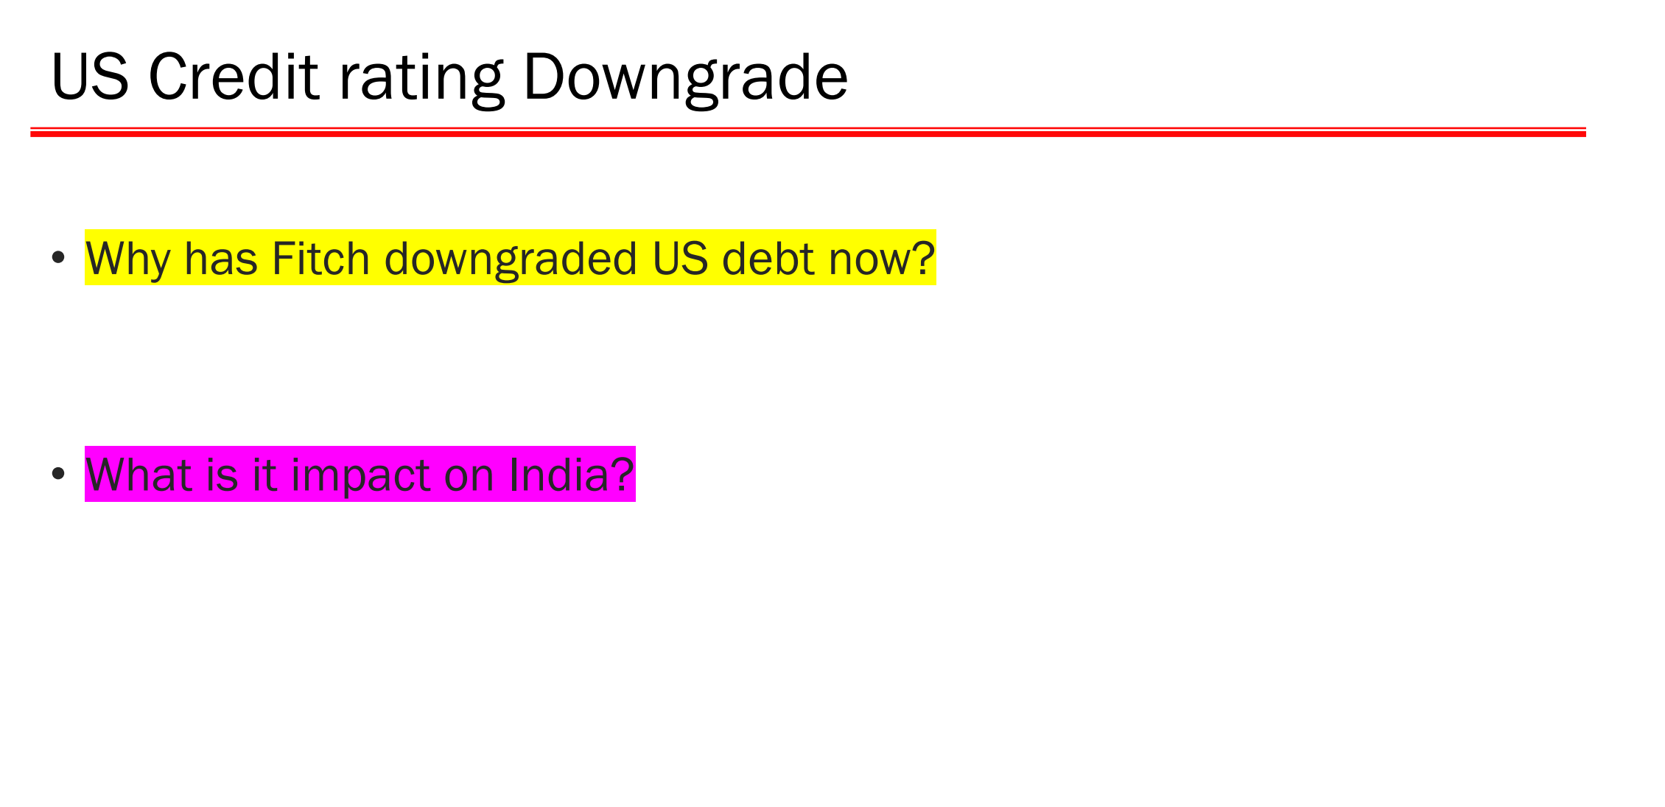

Slide 17
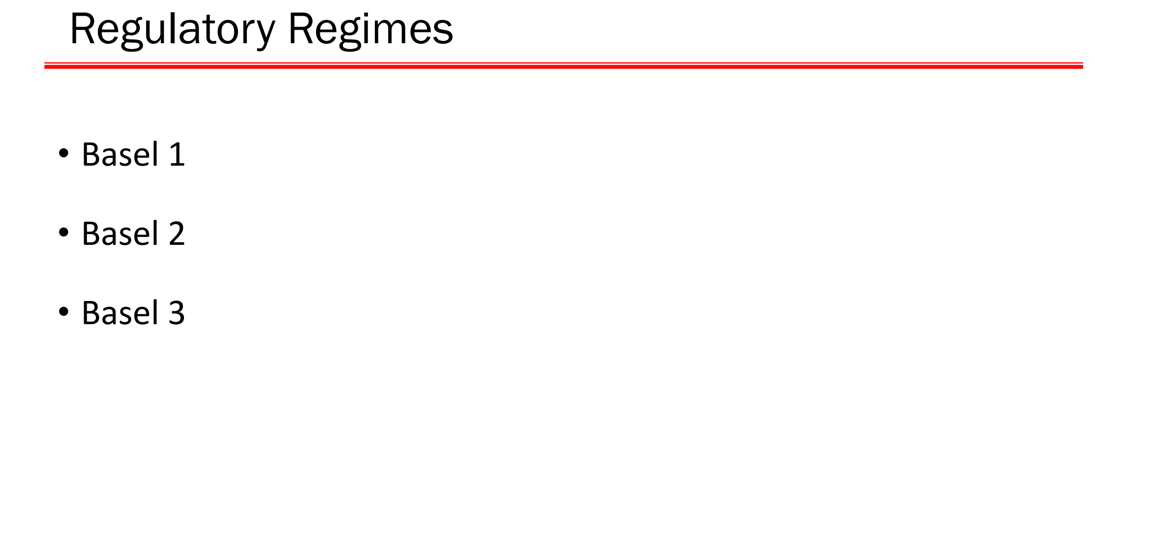

Slide 18
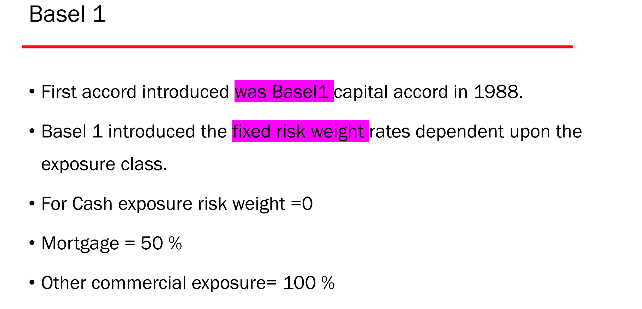

Slide 19
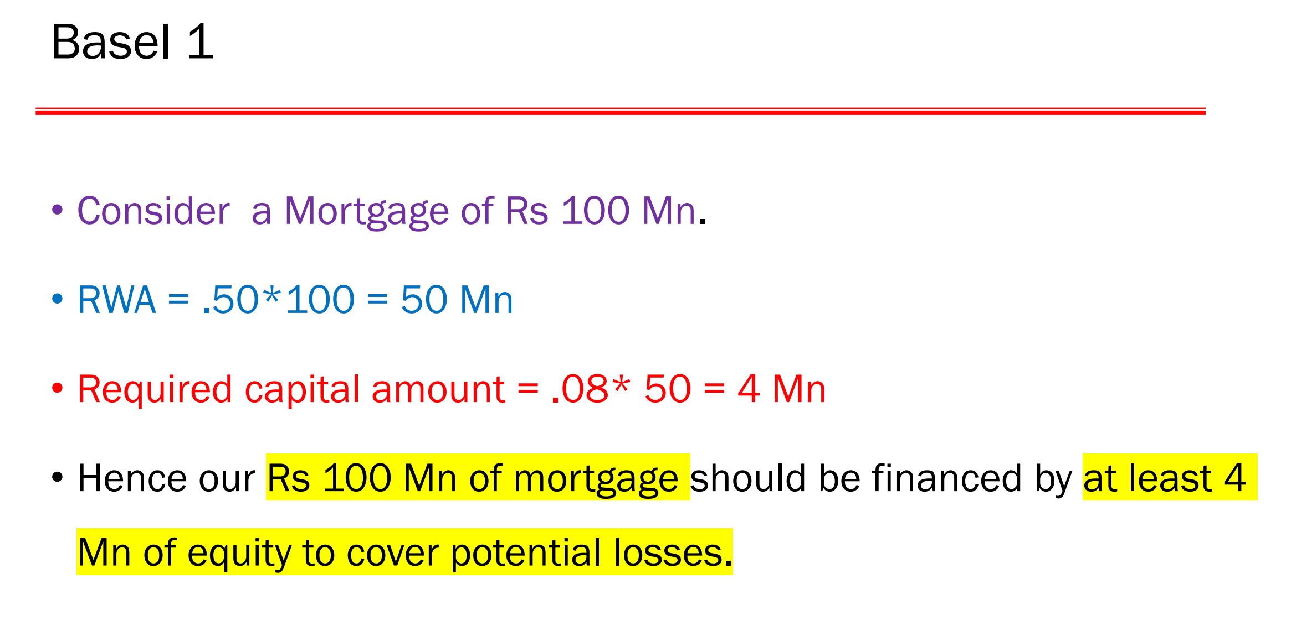

Slide 20
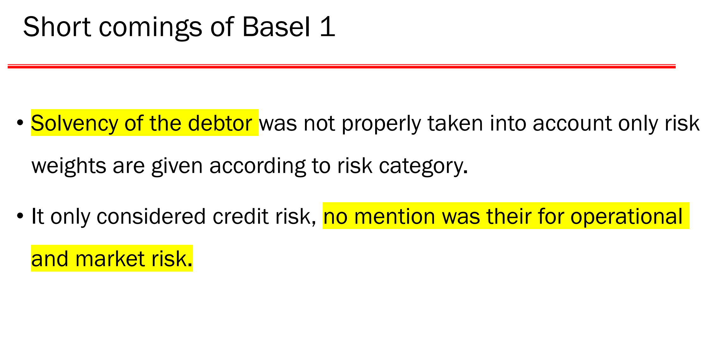

Slide 21
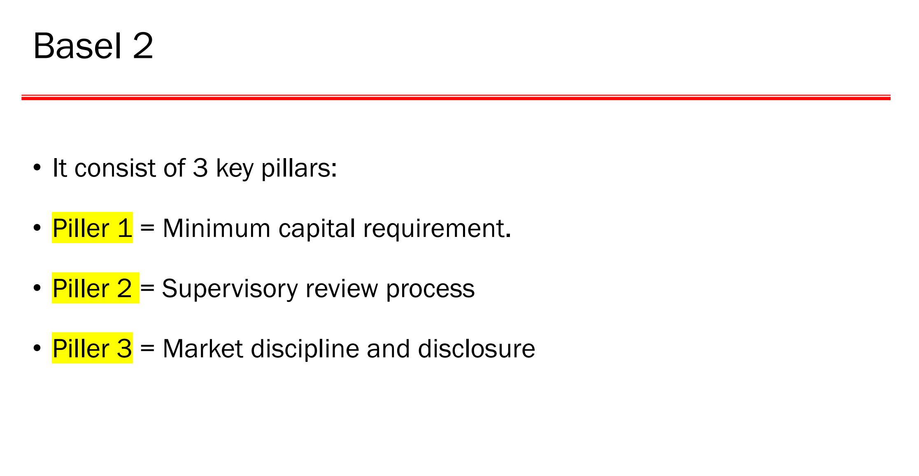

Slide 22
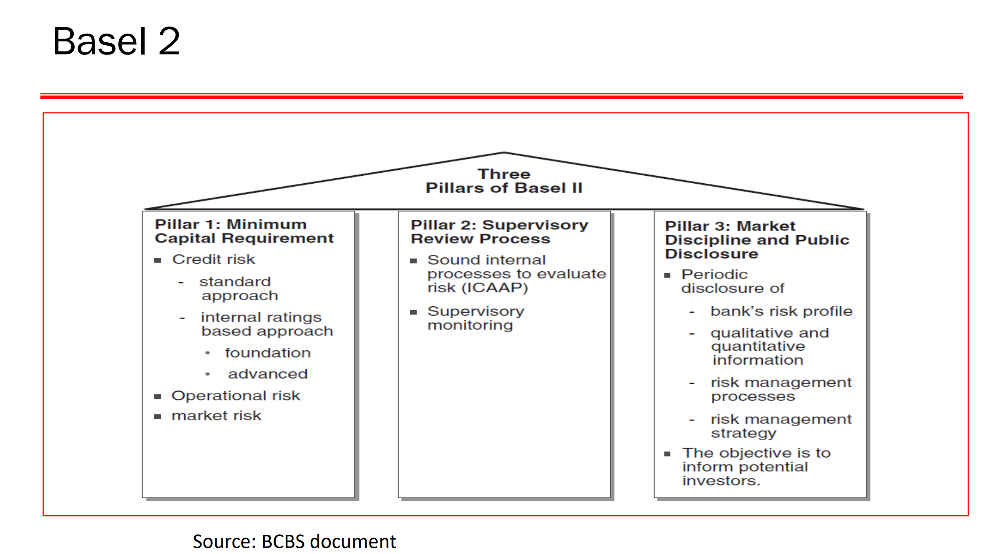

Slide 23
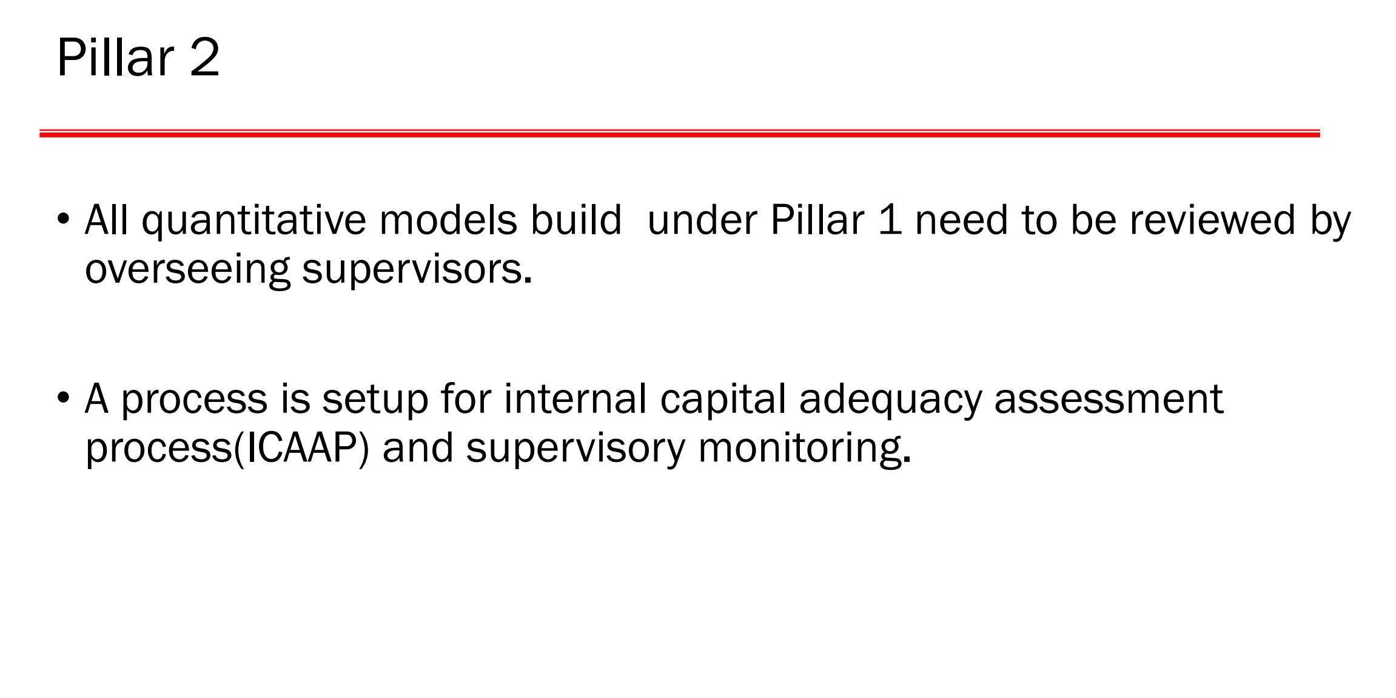

Slide 24
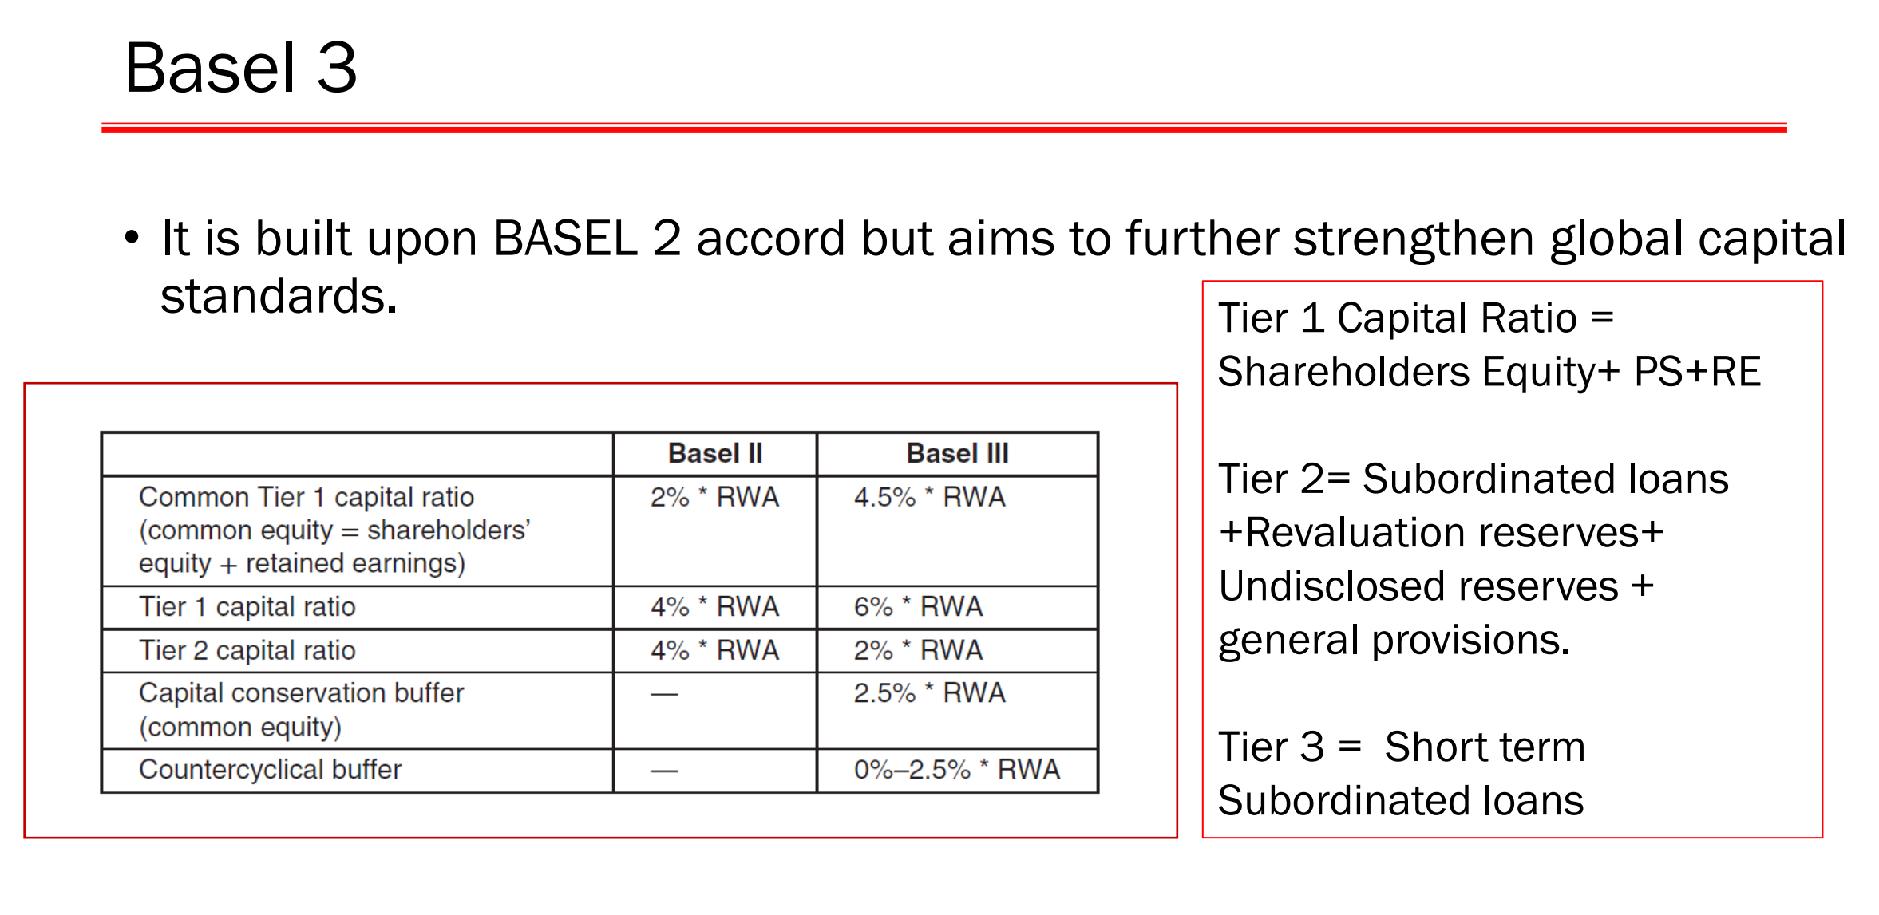

Slide 25
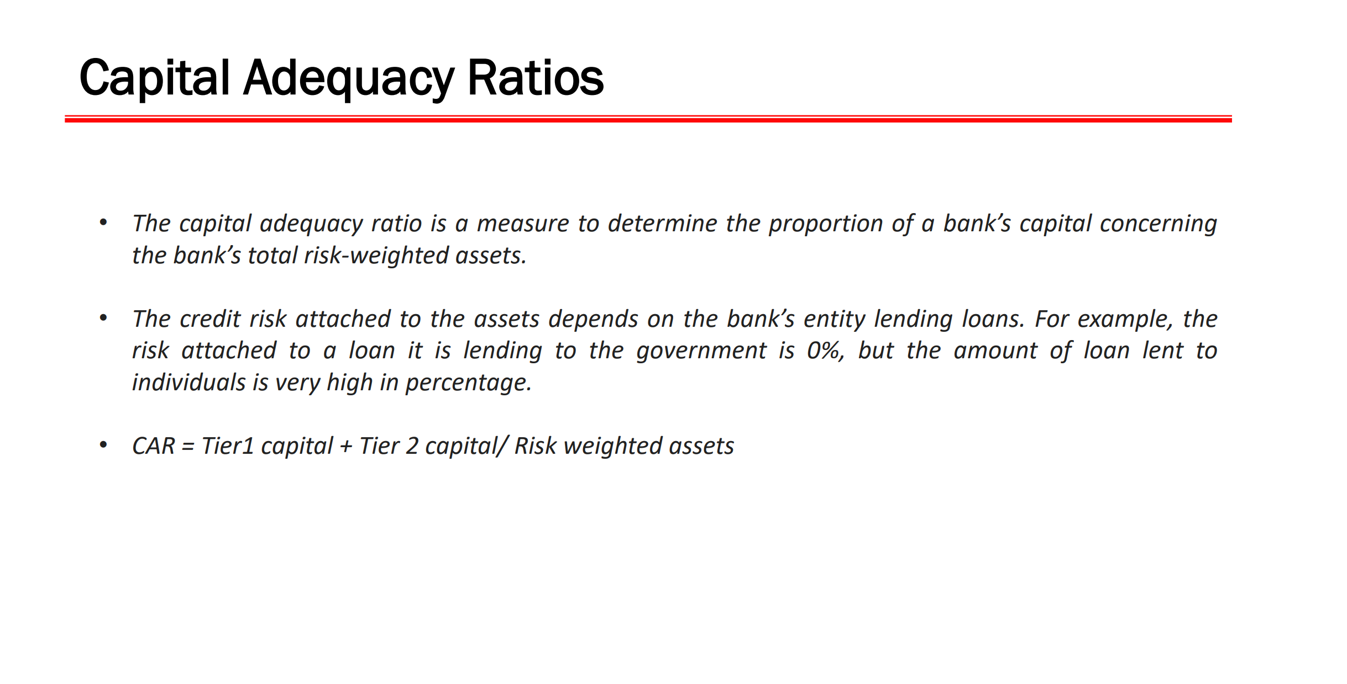

Slide 26
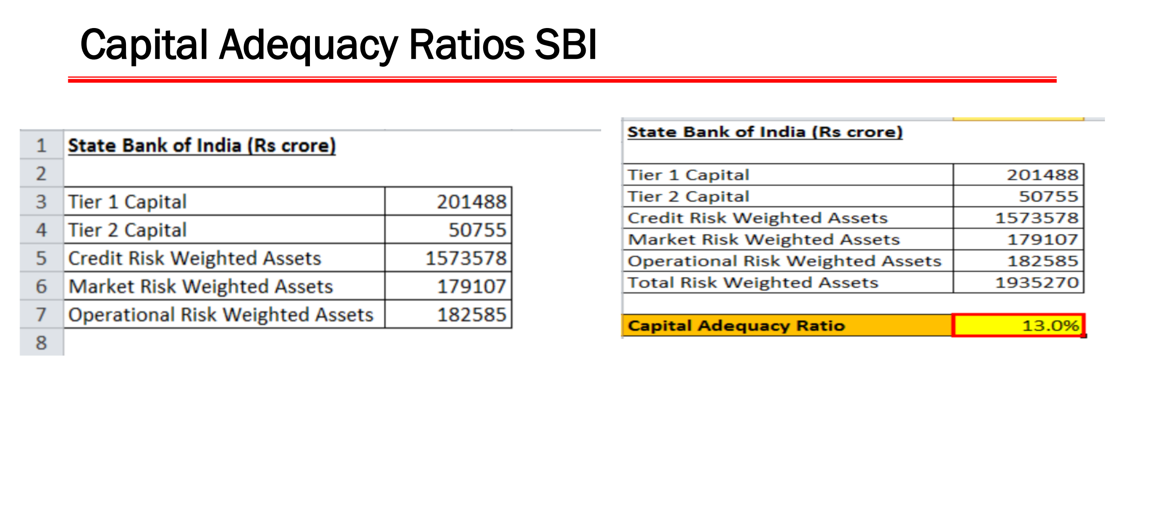

Slide 27
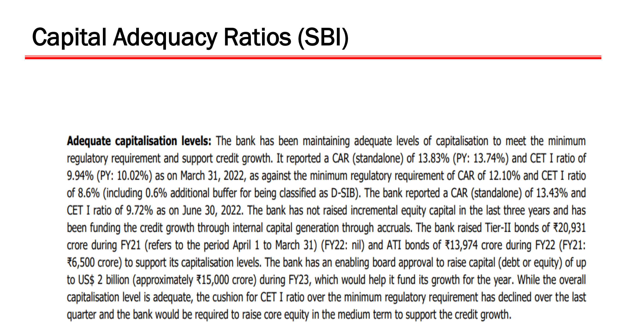

Slide 28
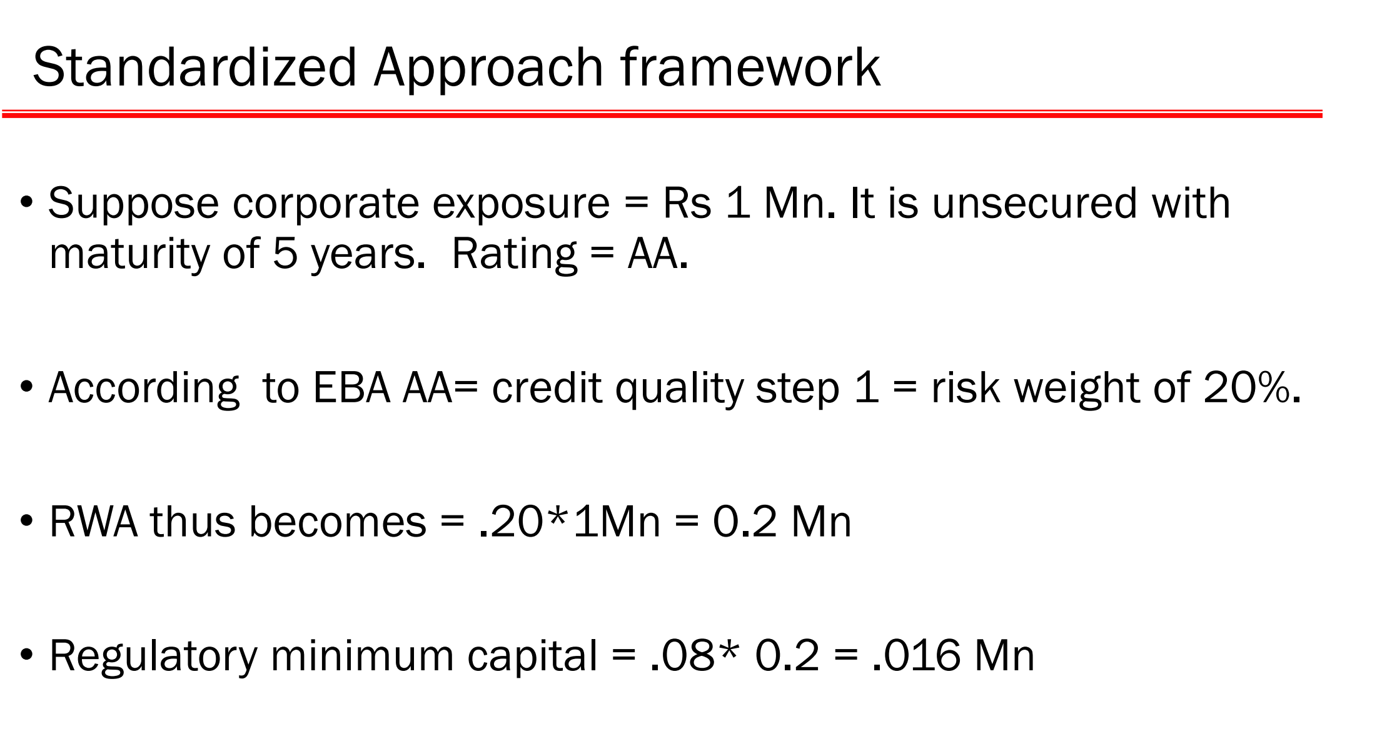

Slide 29
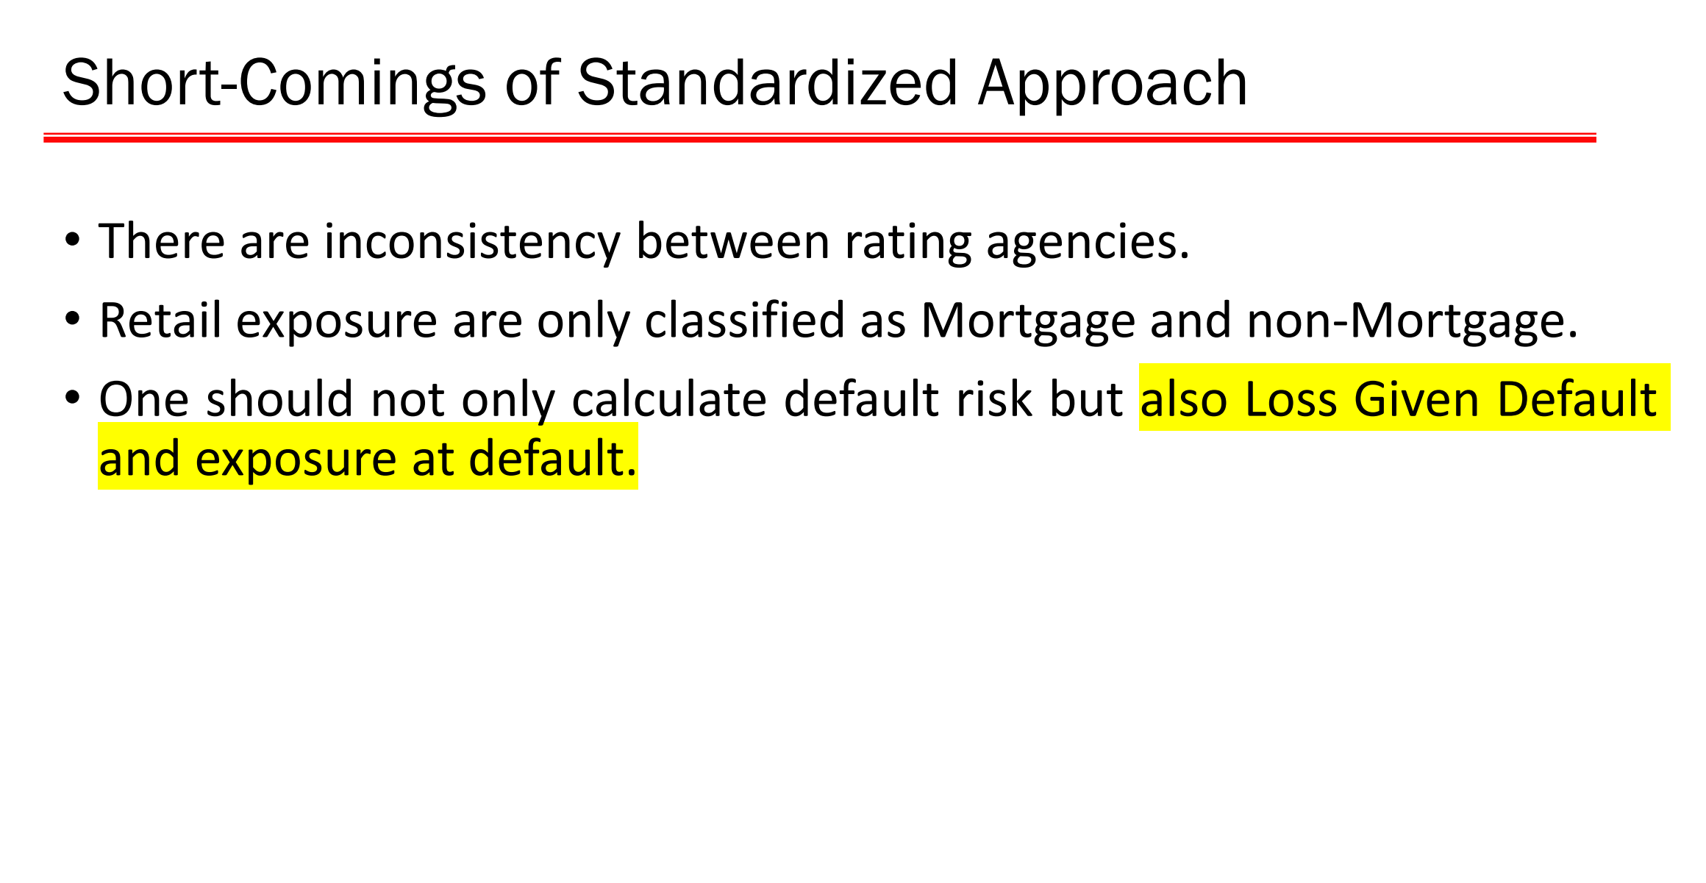

Slide 30
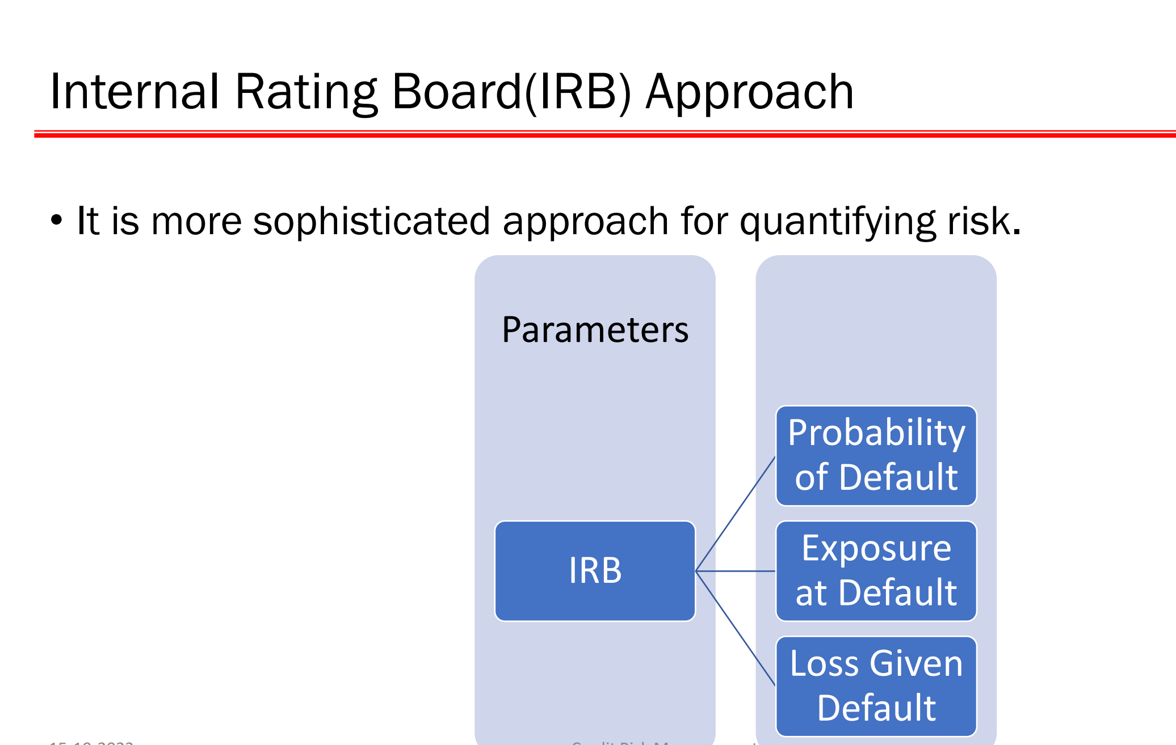

Slide 31
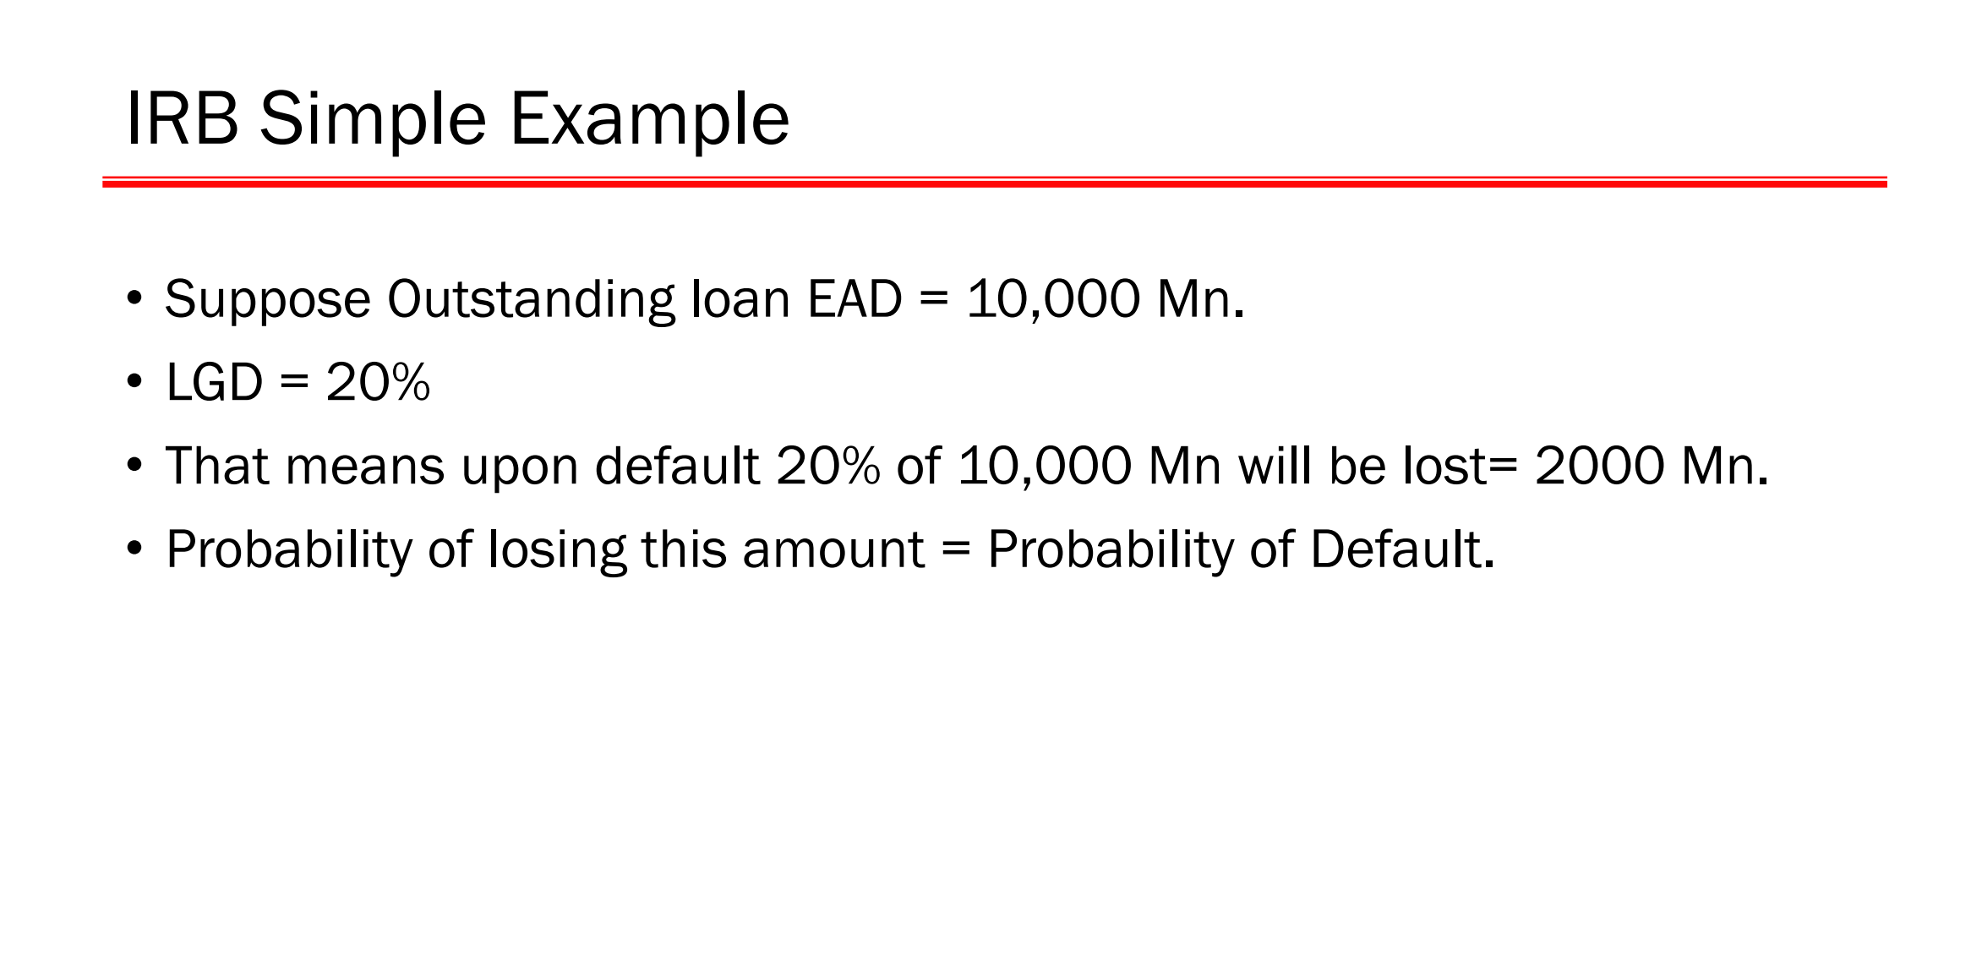

Slide 32
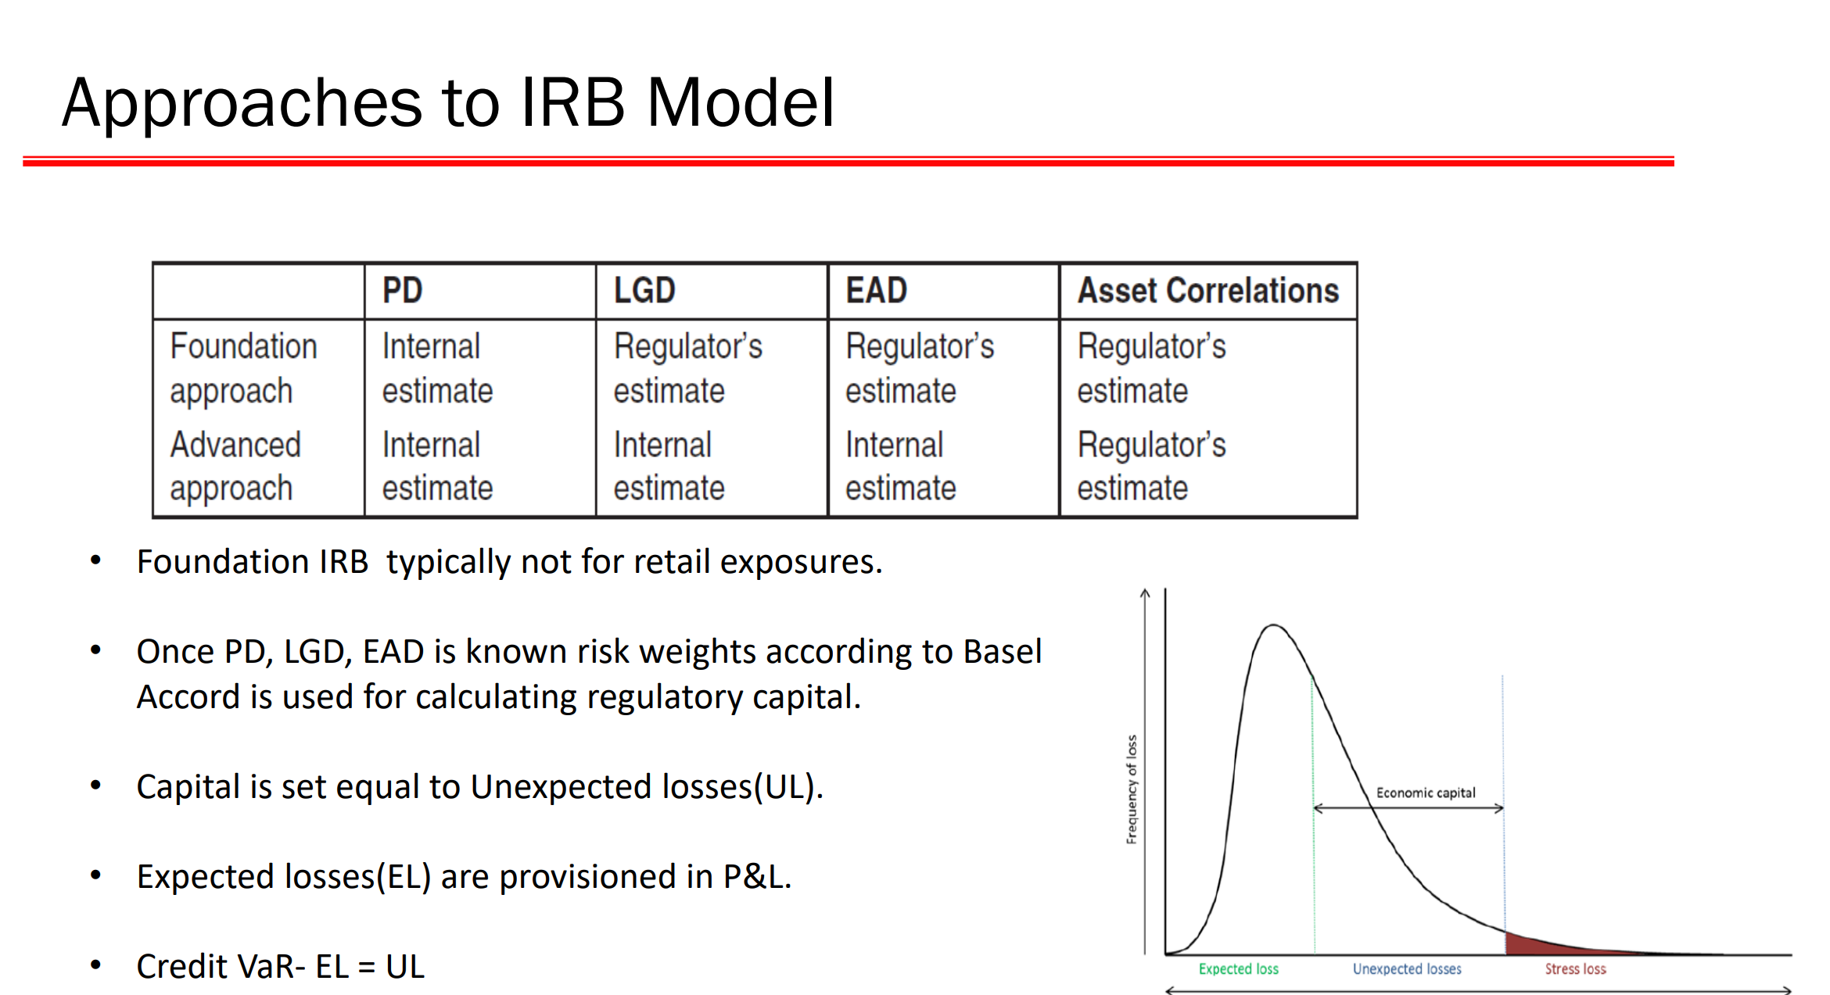

Slide 33
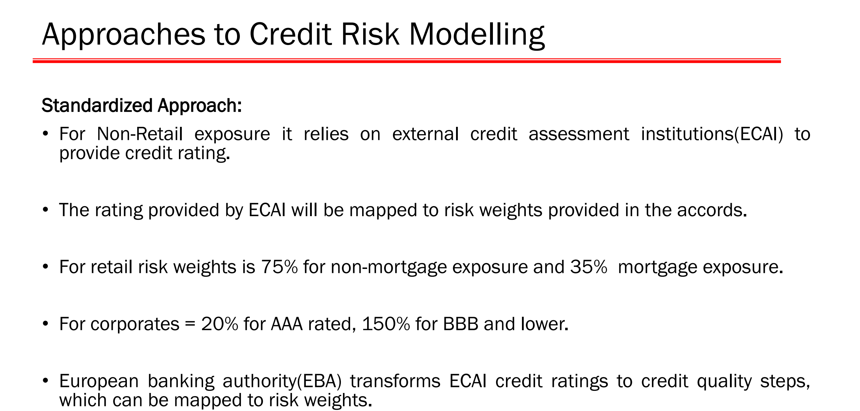

Slide 34
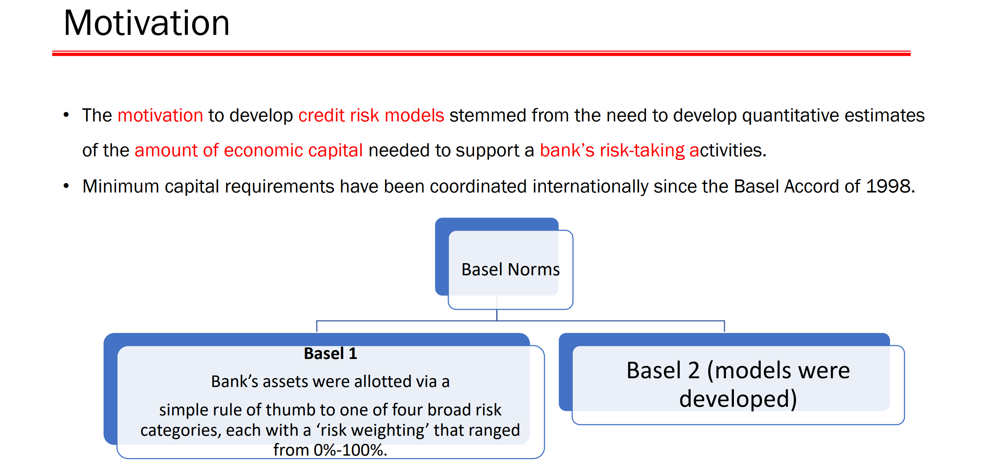

Slide 35
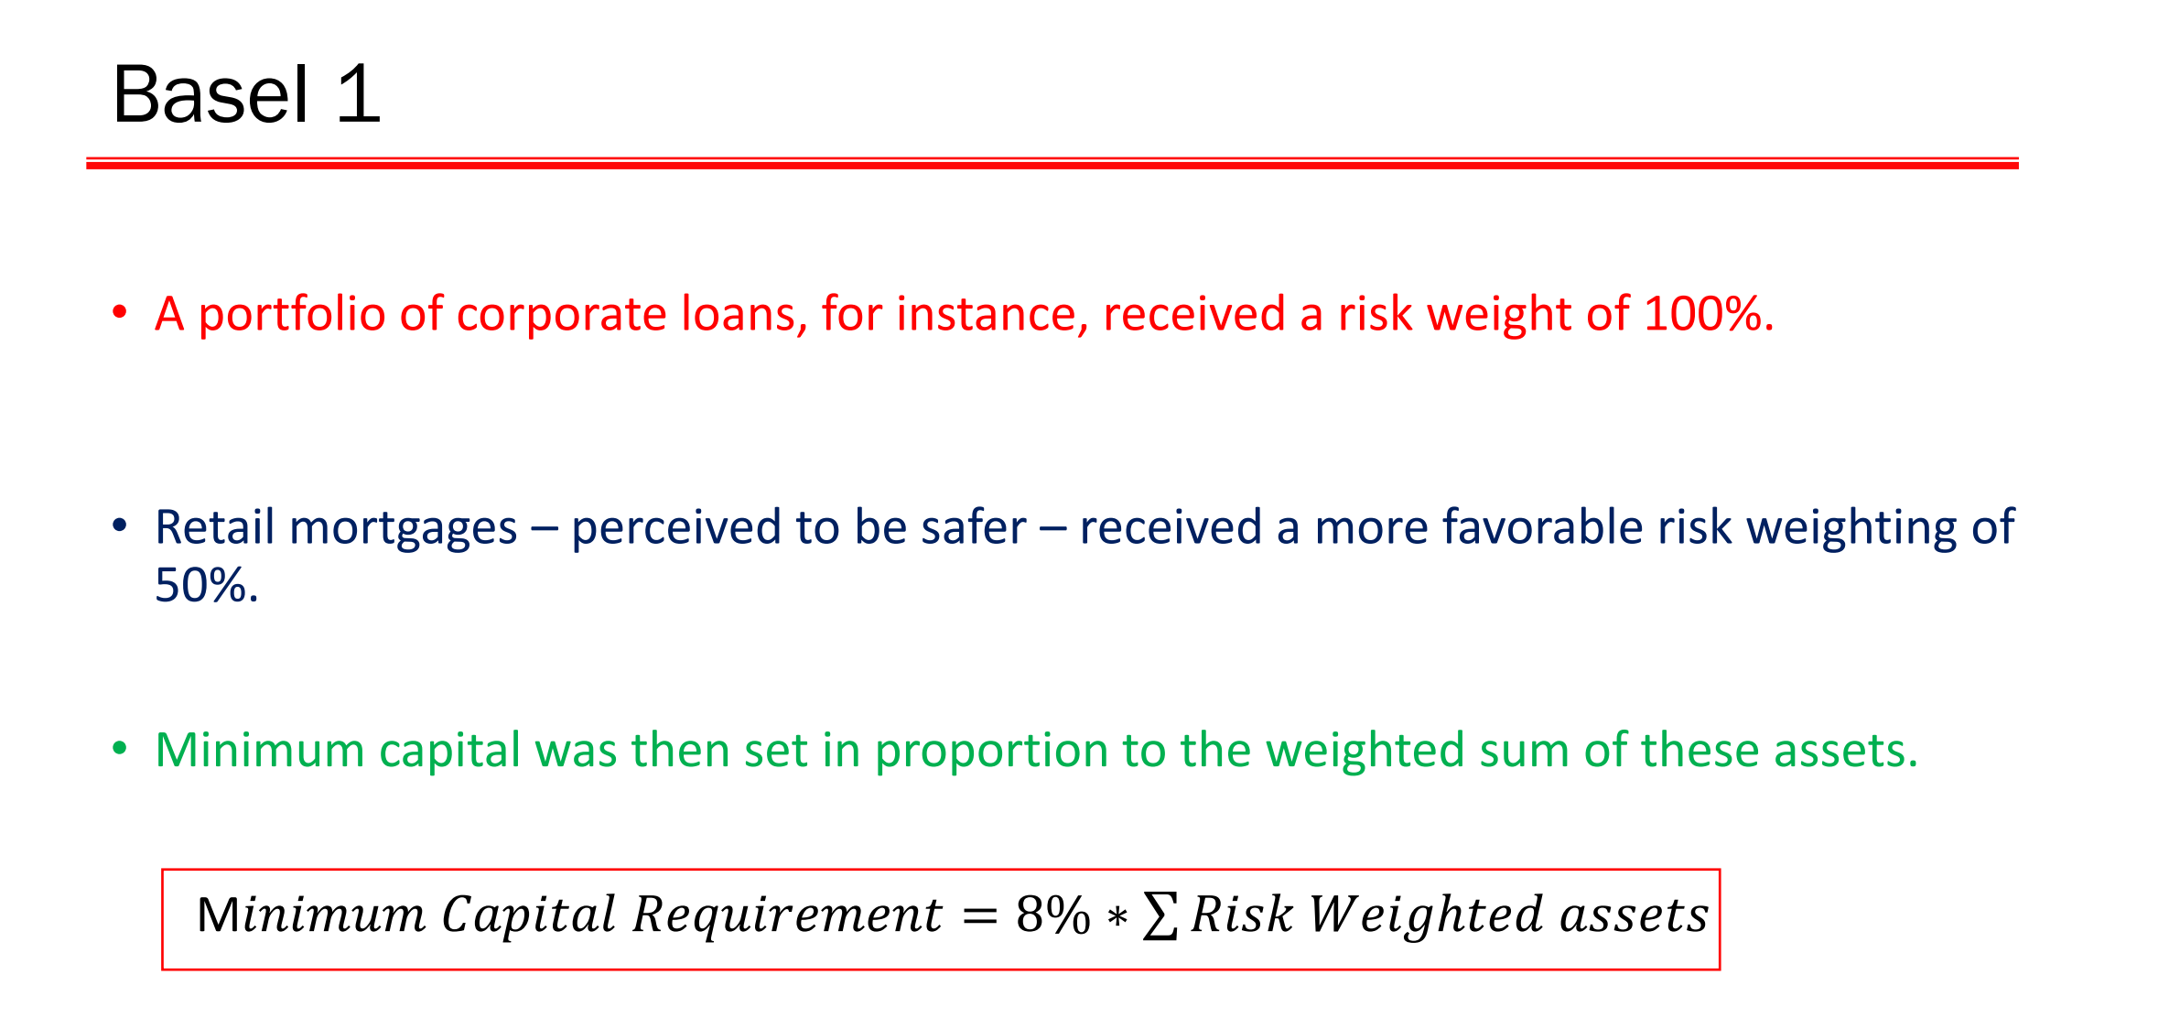

Slide 36
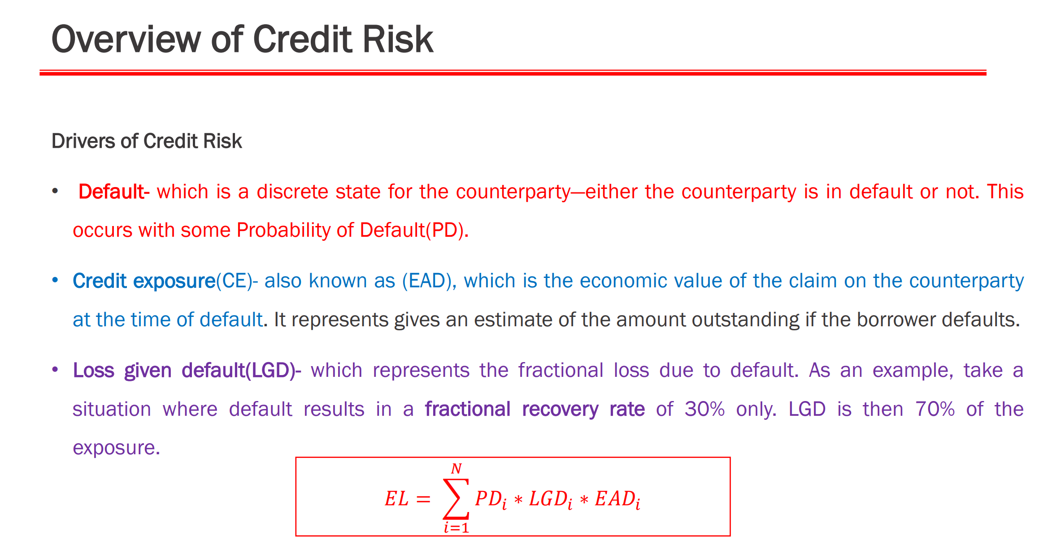

Slide 37
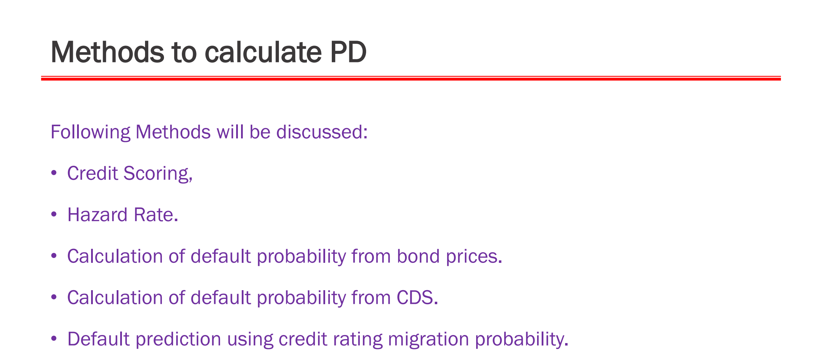

Slide 38
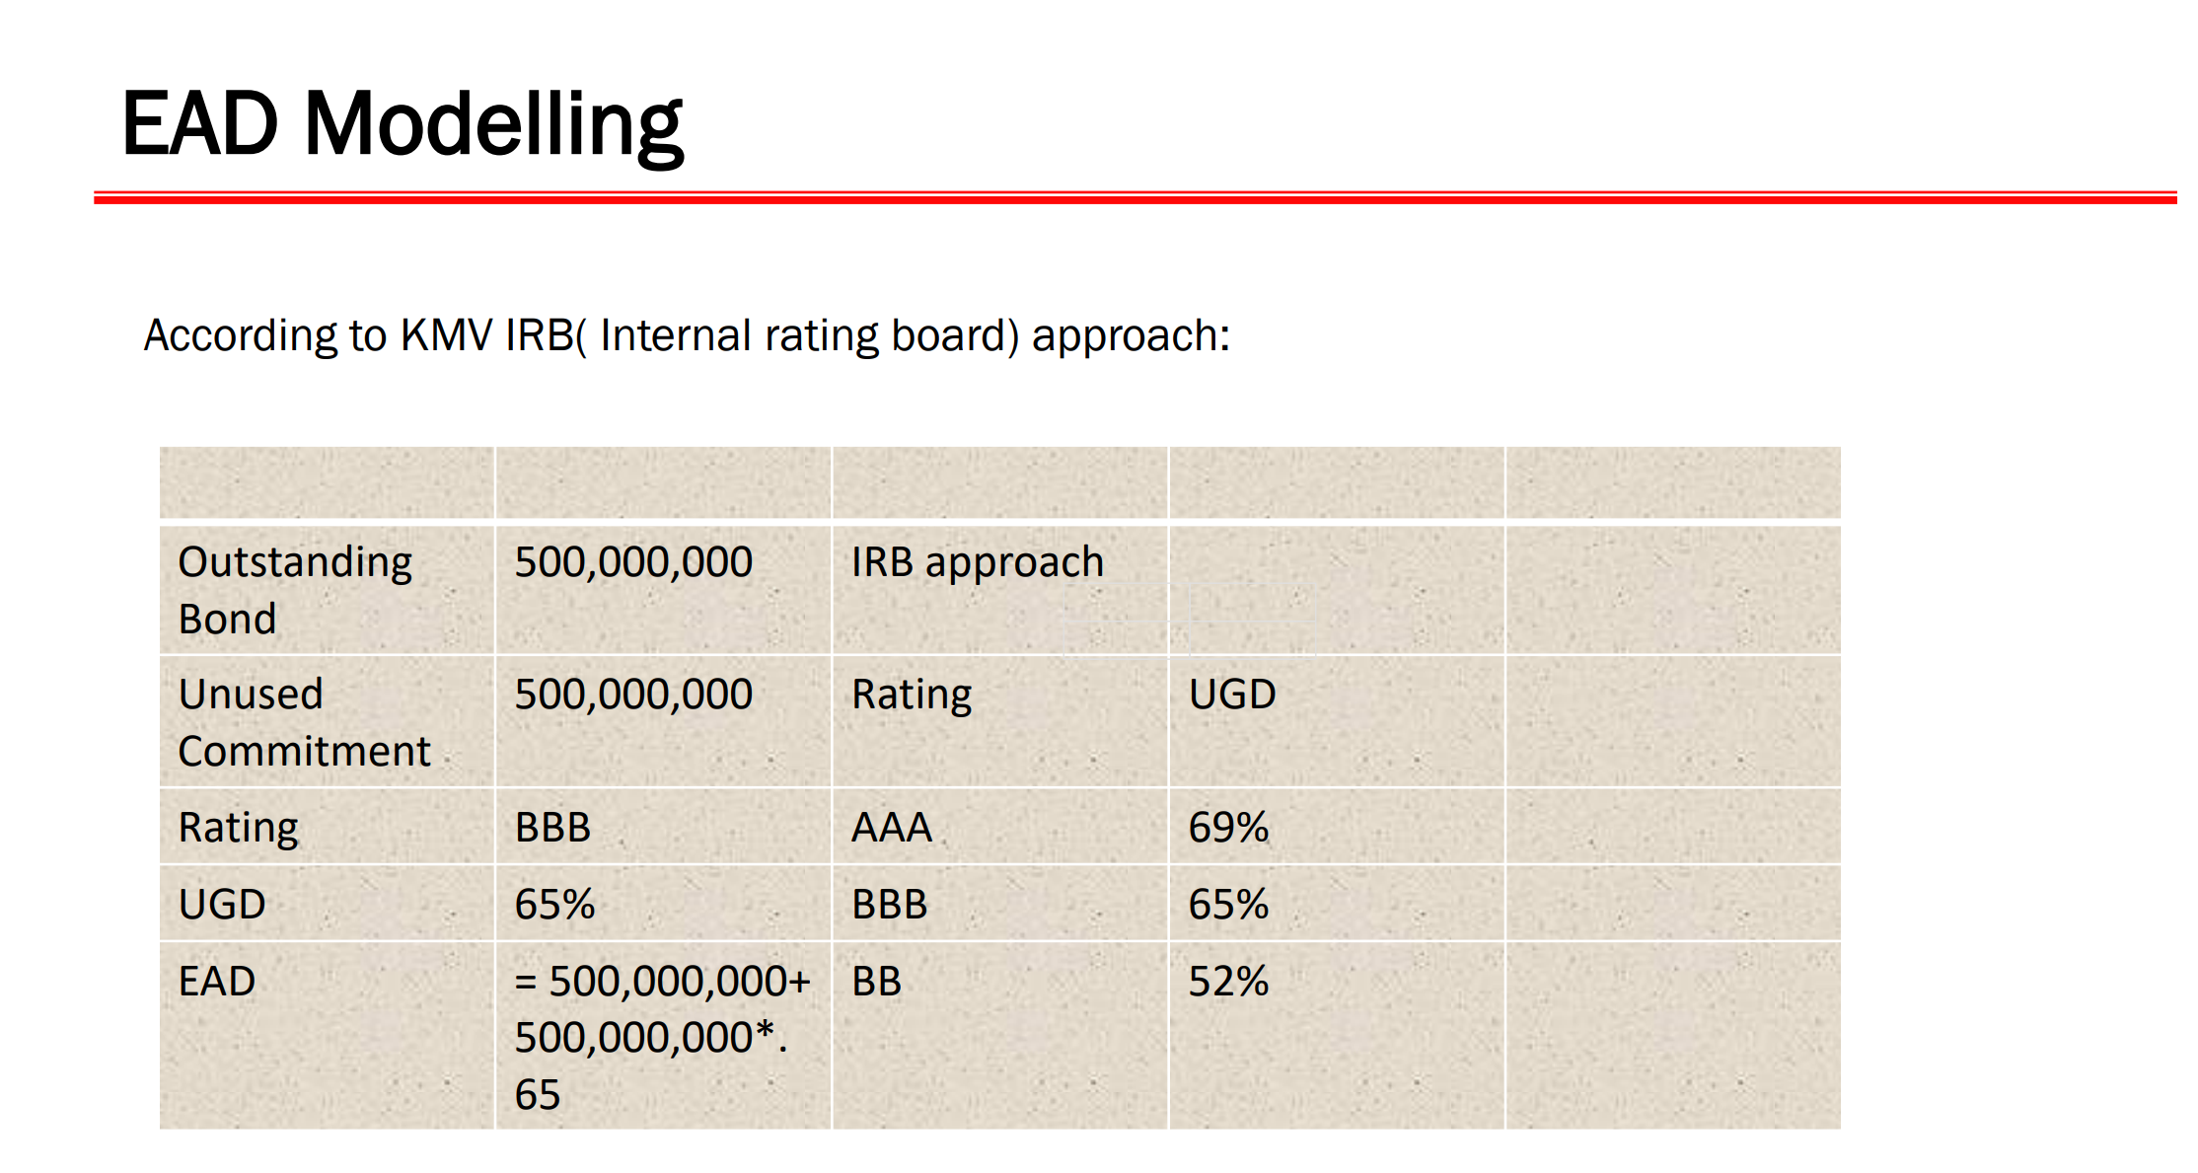

Slide 39
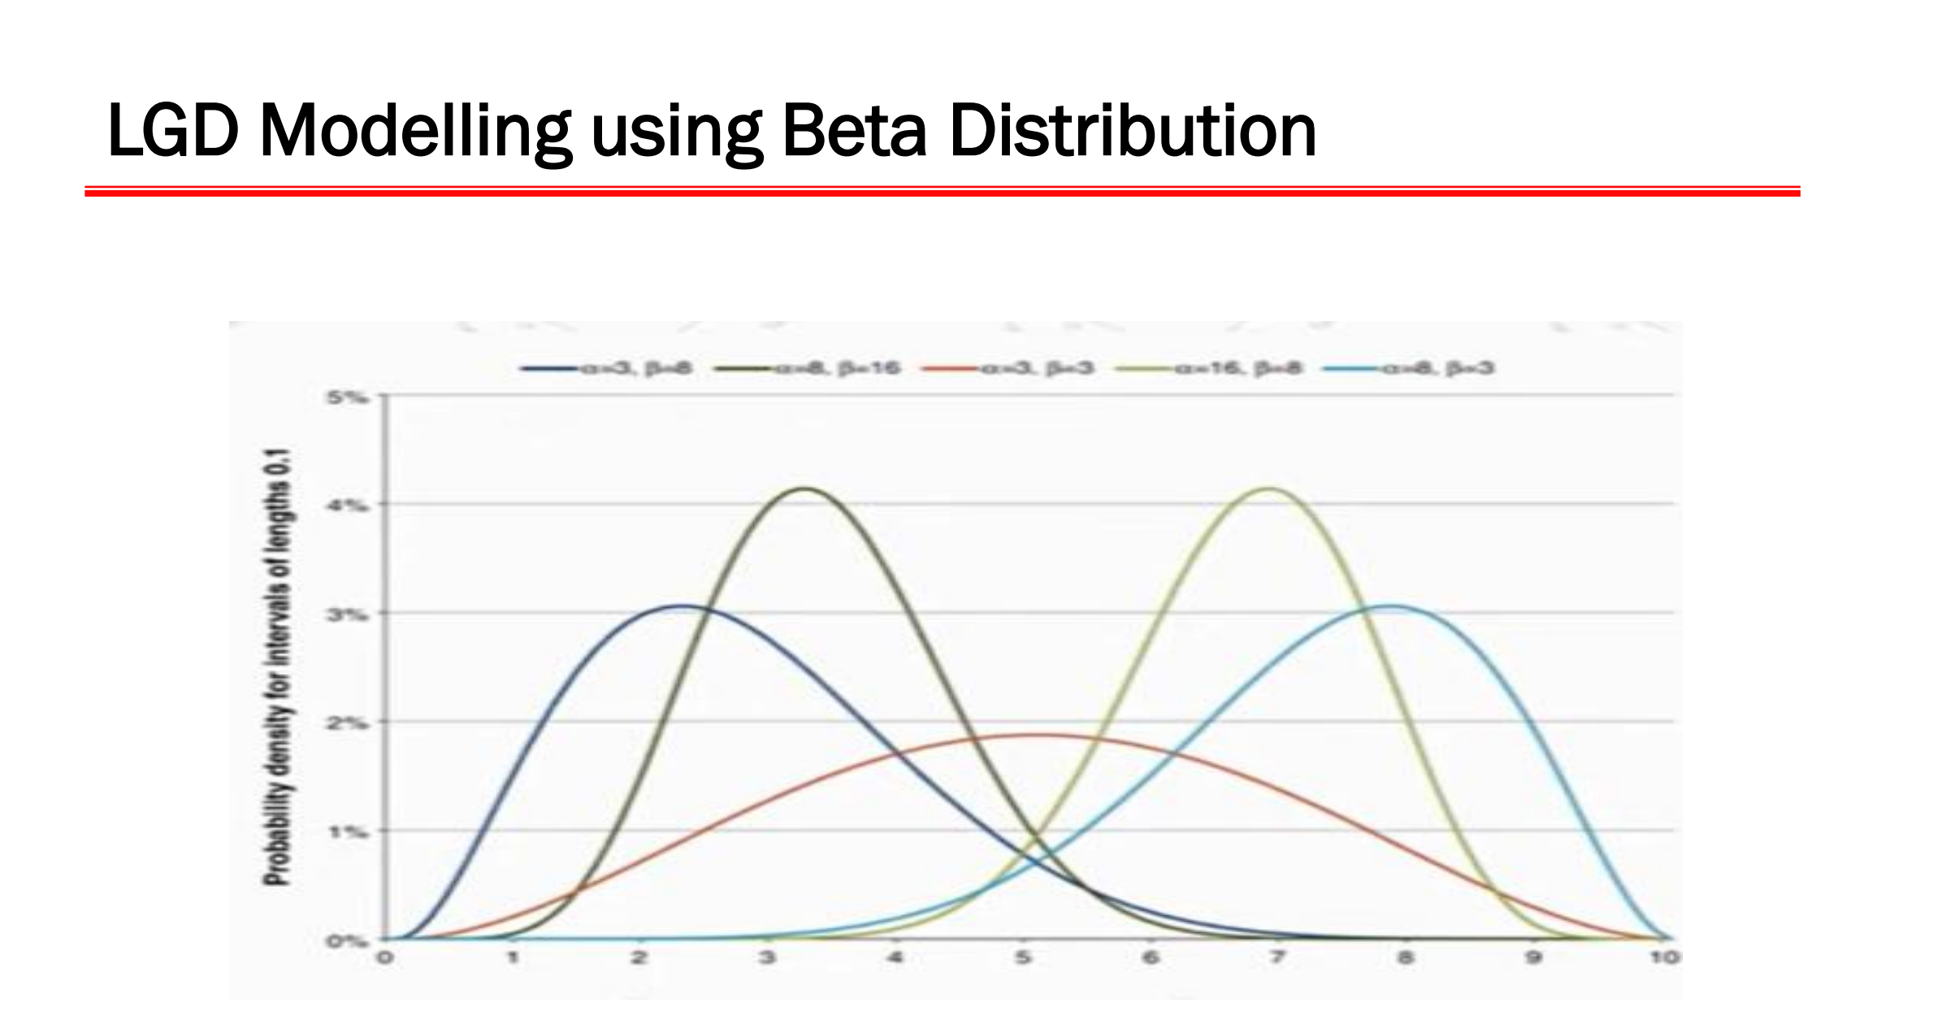

Slide 40
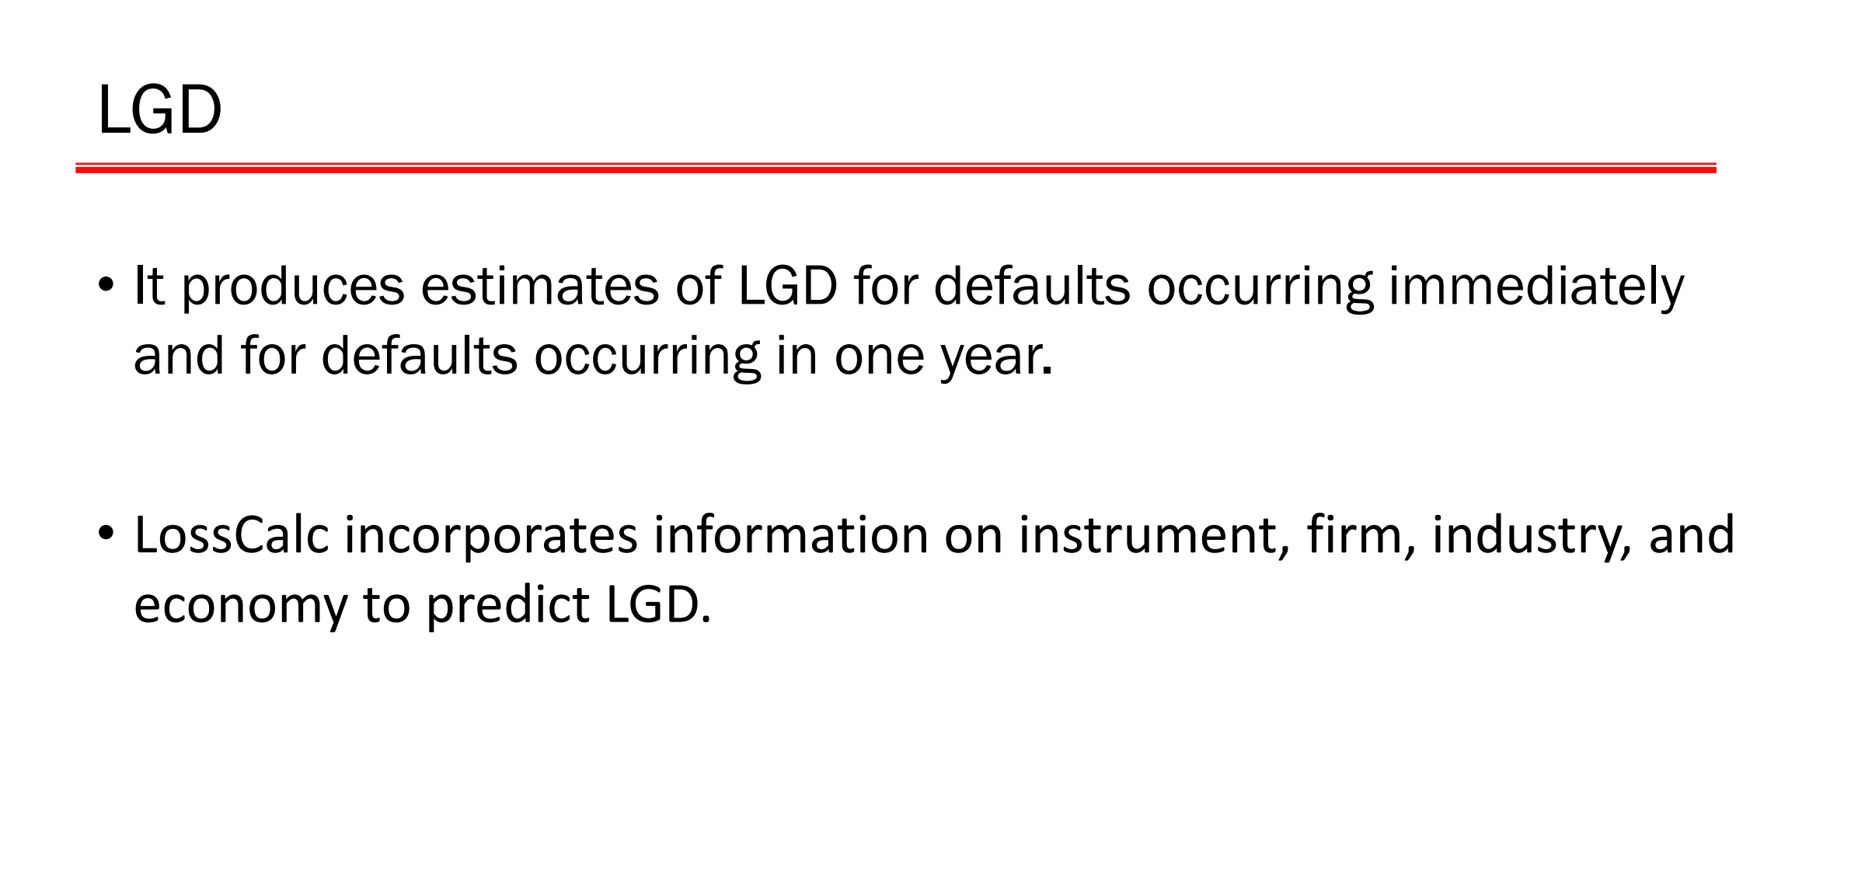

Slide 41
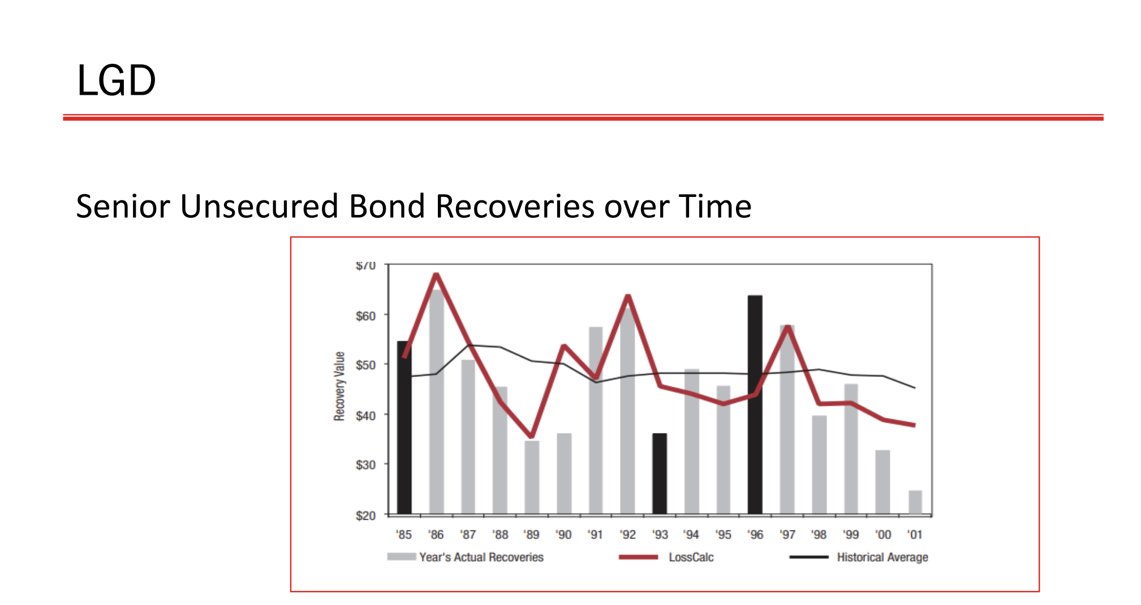

Slide 42
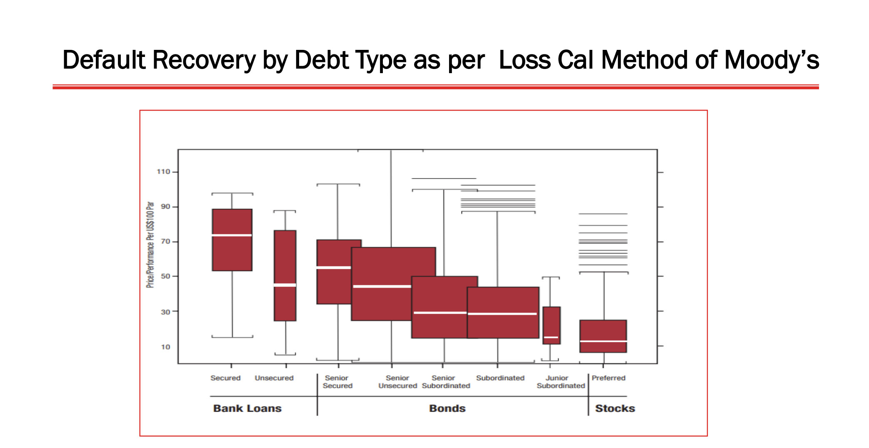

Slide 43
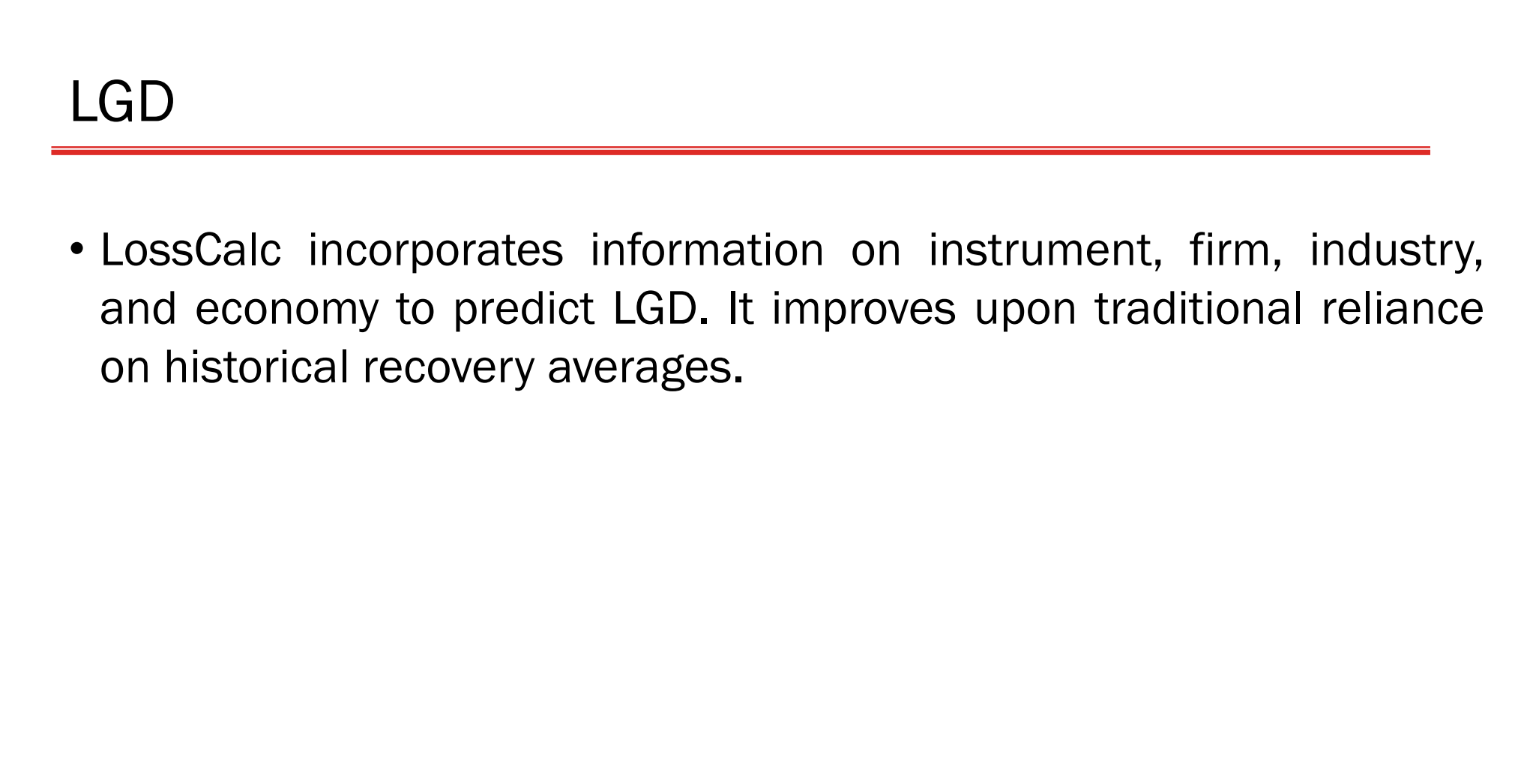

Slide 44
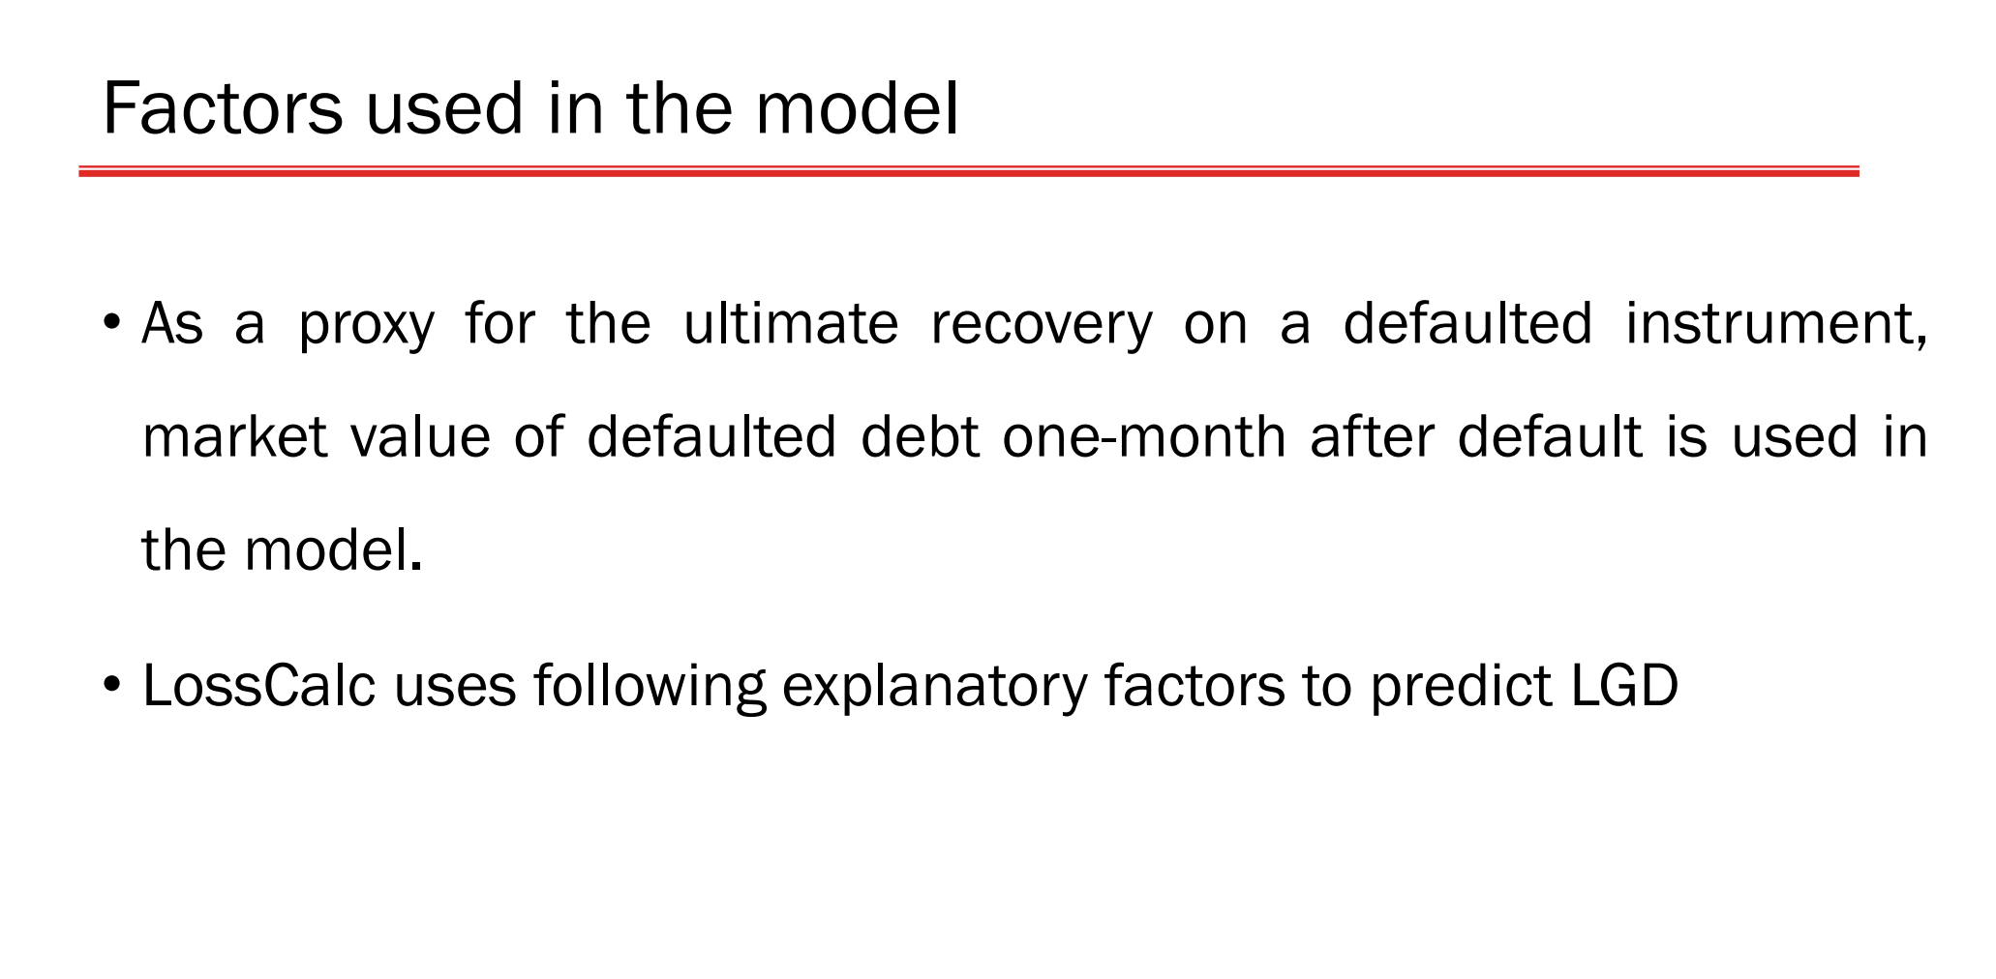

Slide 45
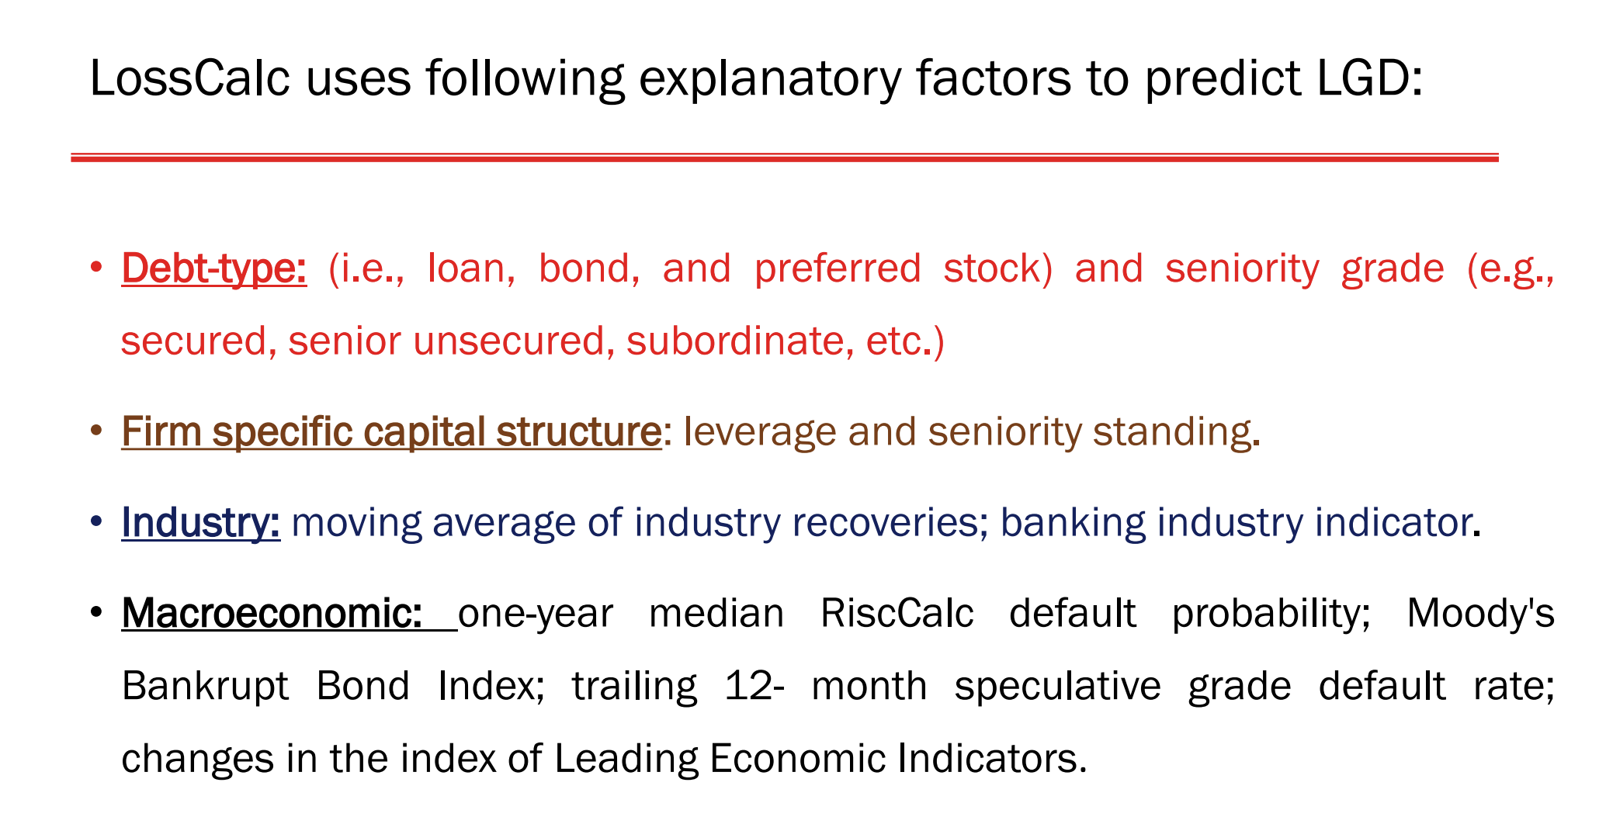

Slide 46
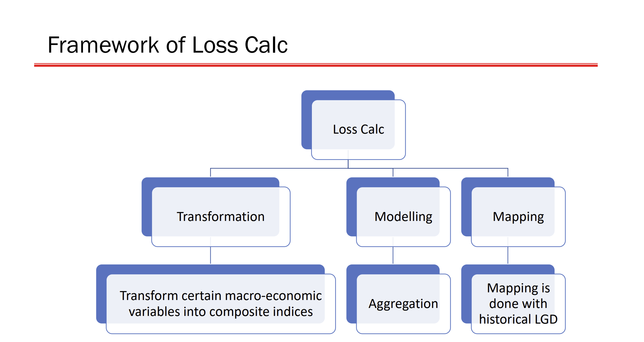

Slide 47
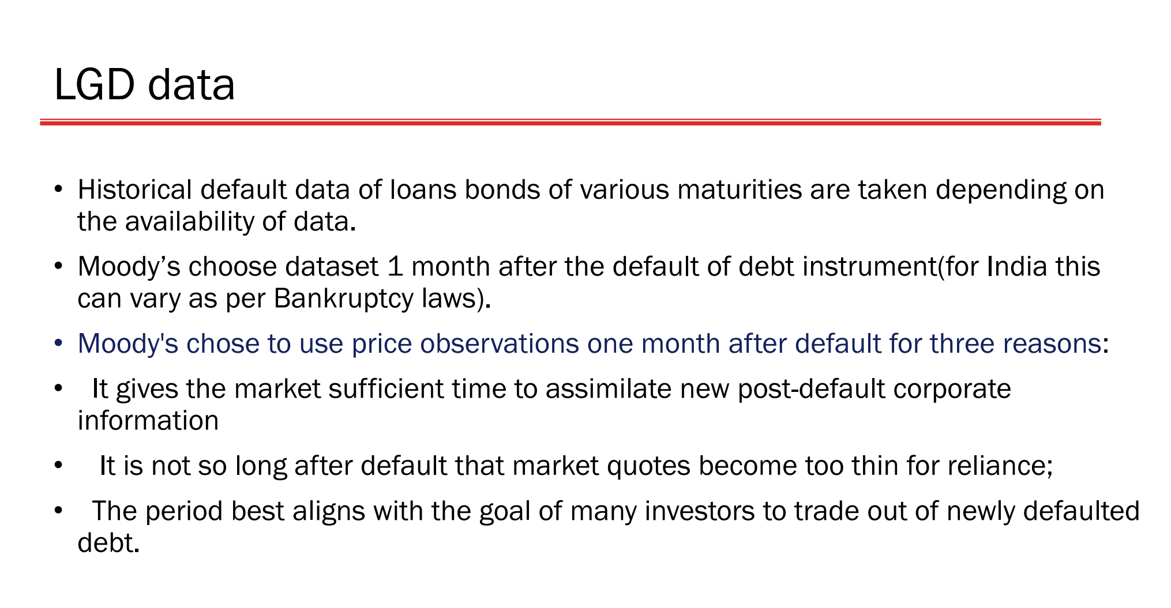

Slide 48
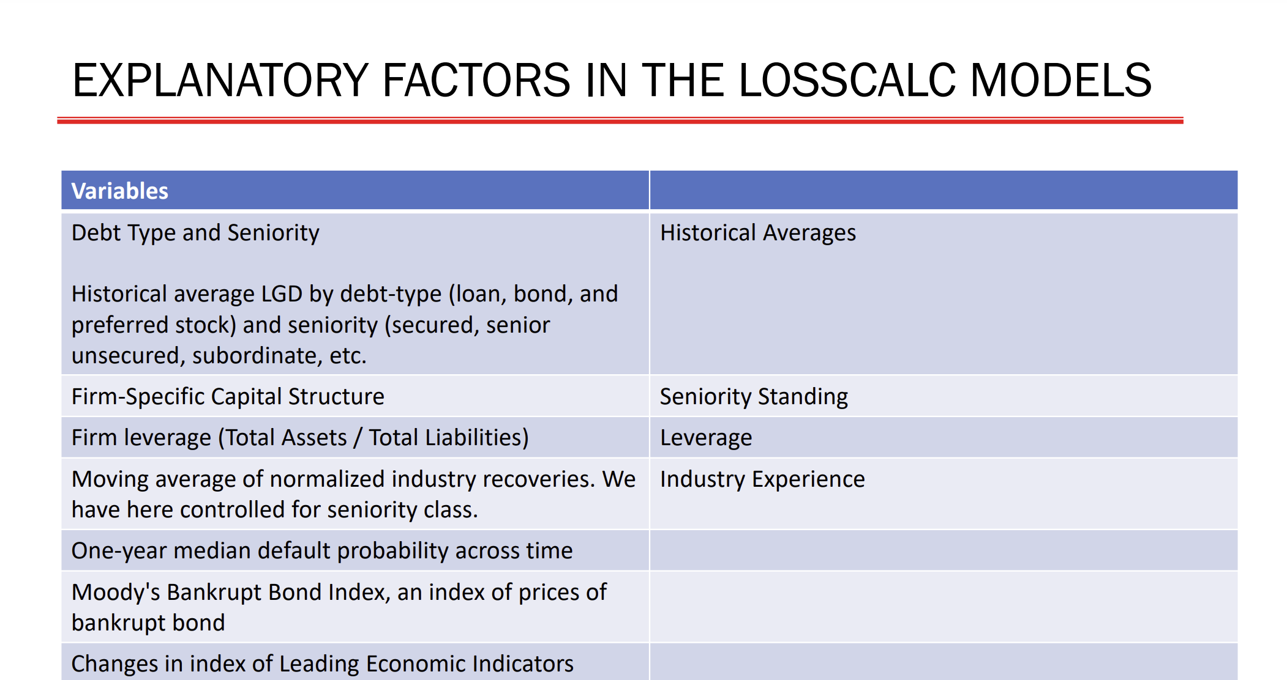

Slide 49
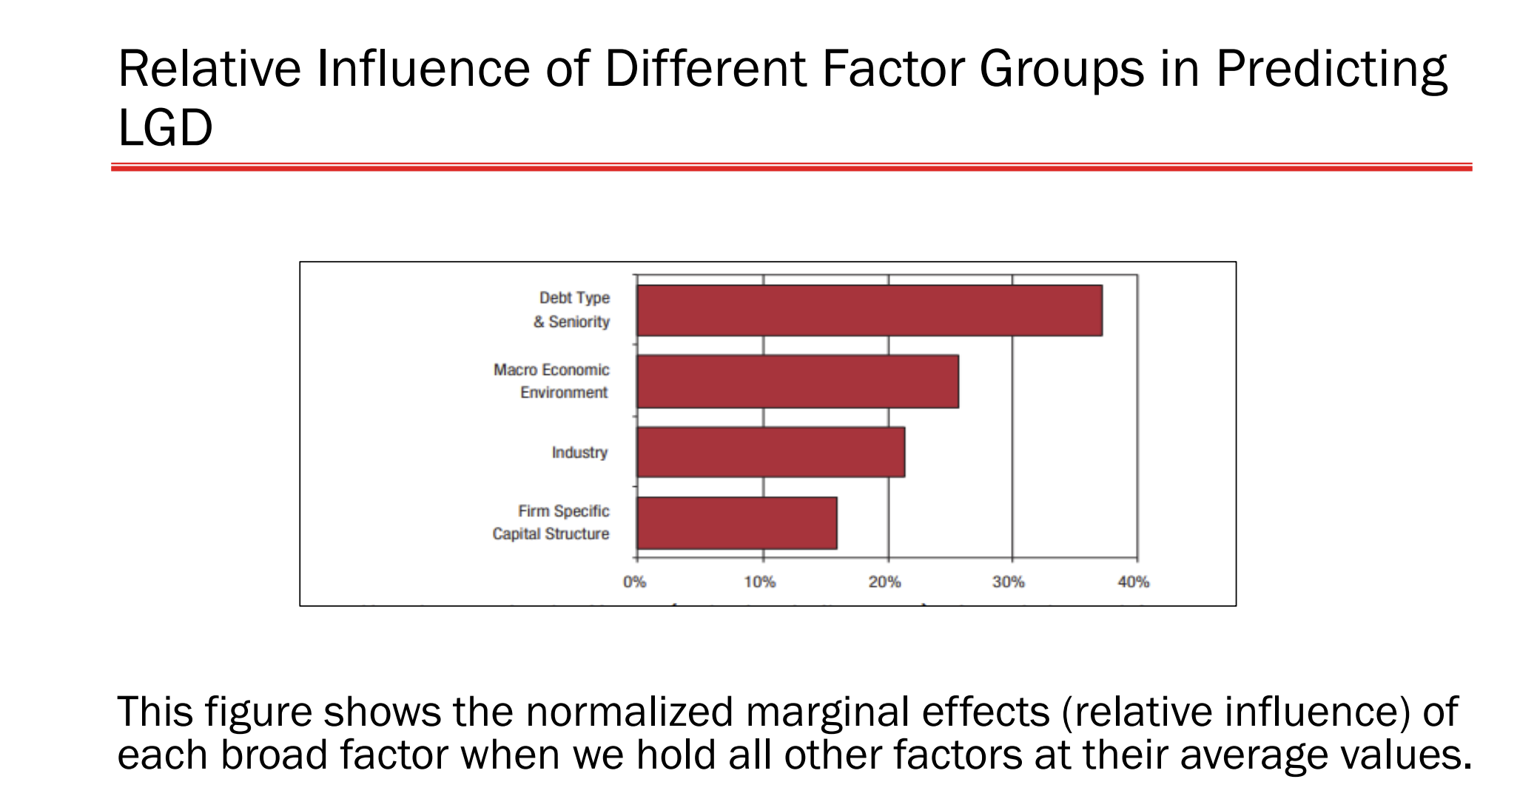

Slide 50
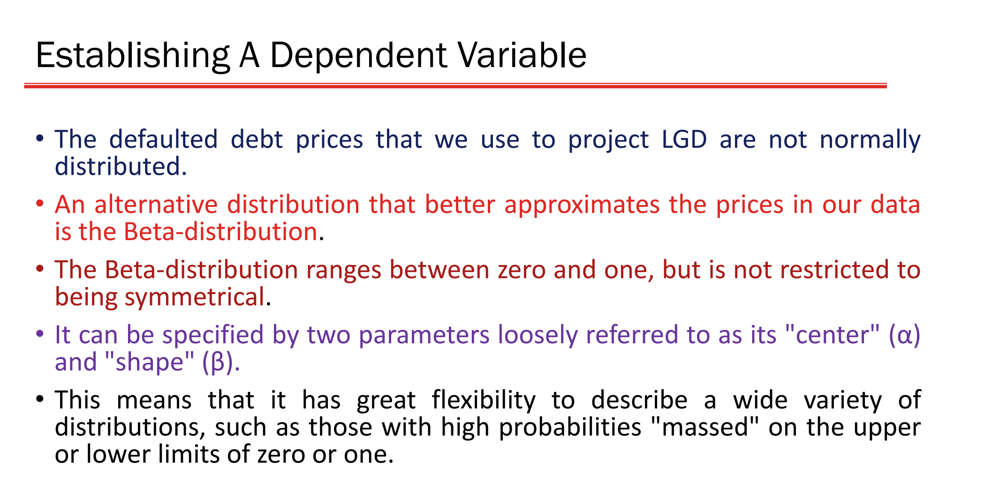

Slide 51
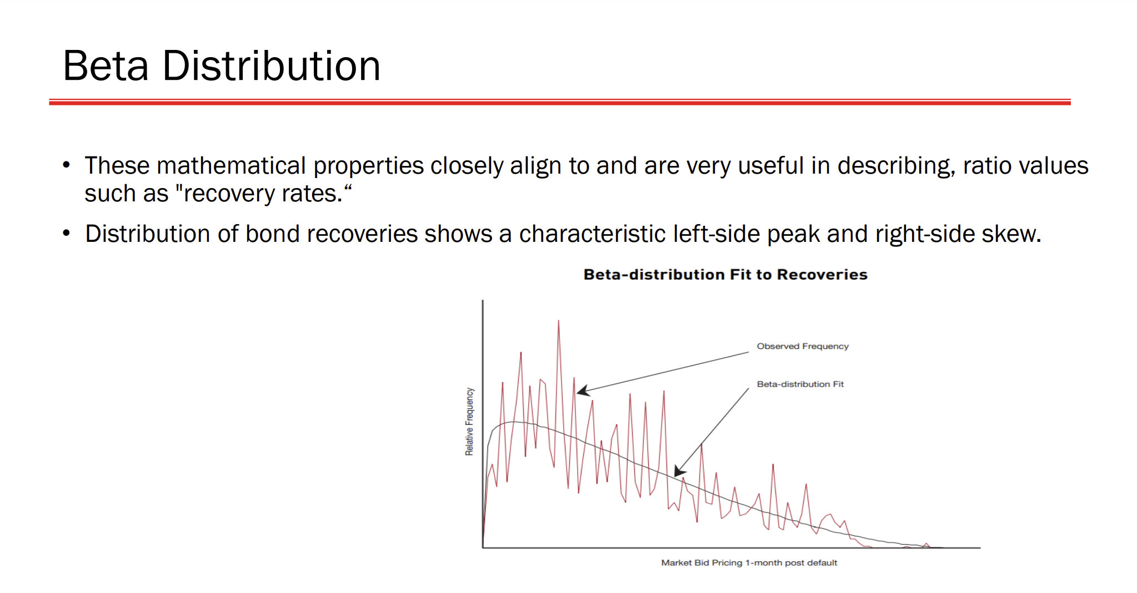

Slide 52
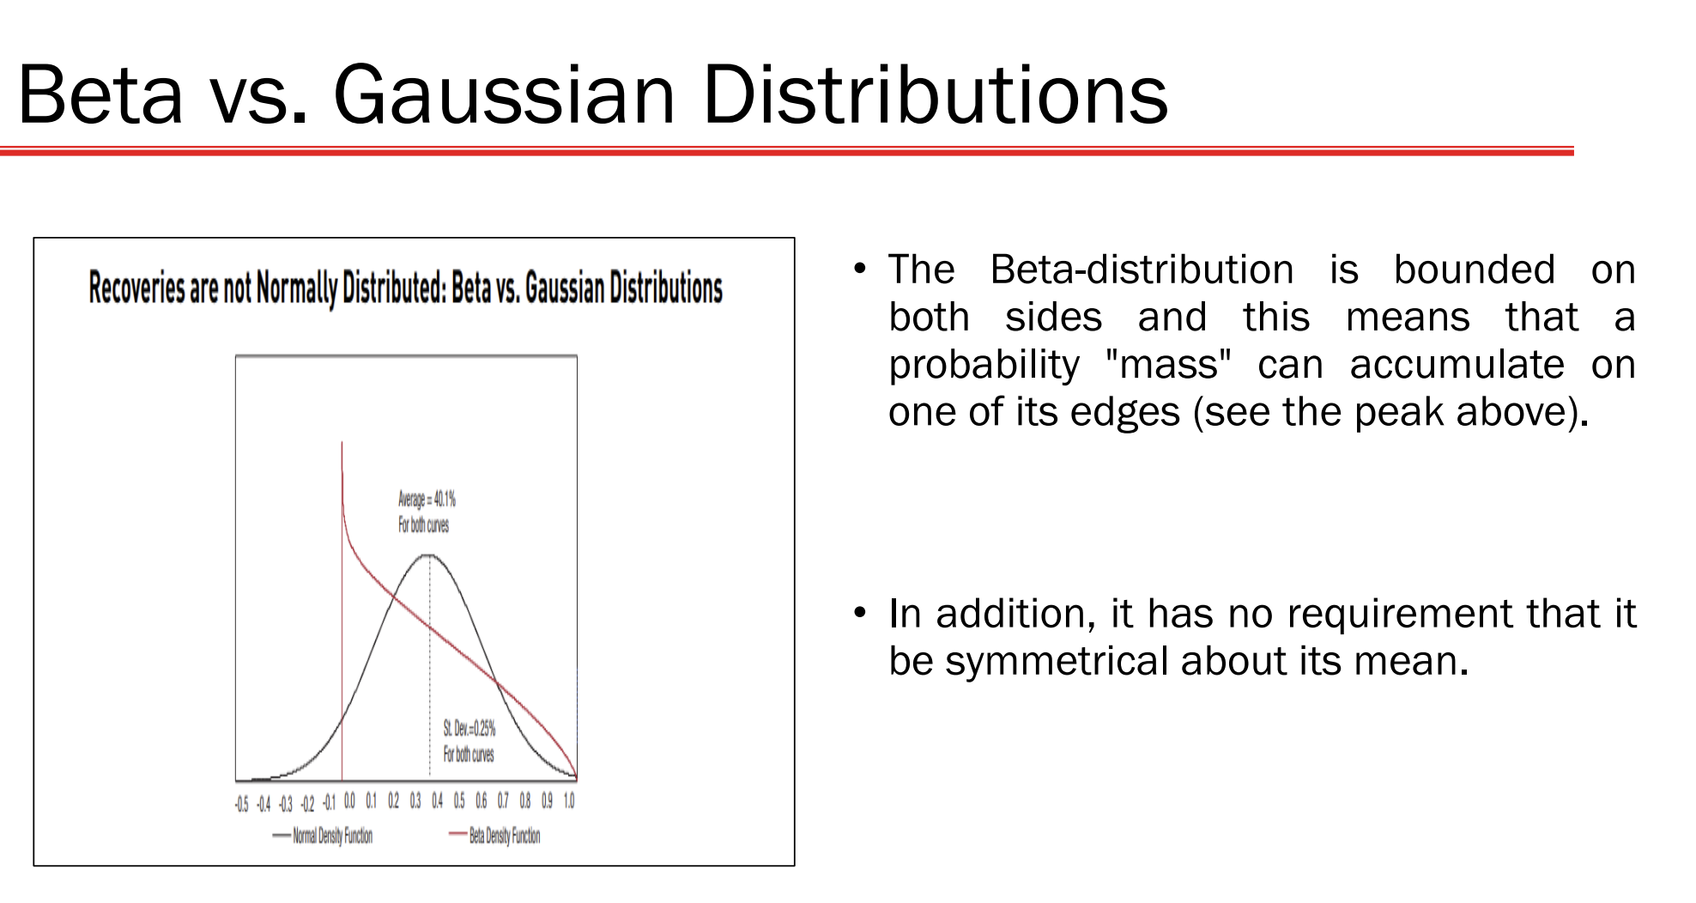

Slide 53
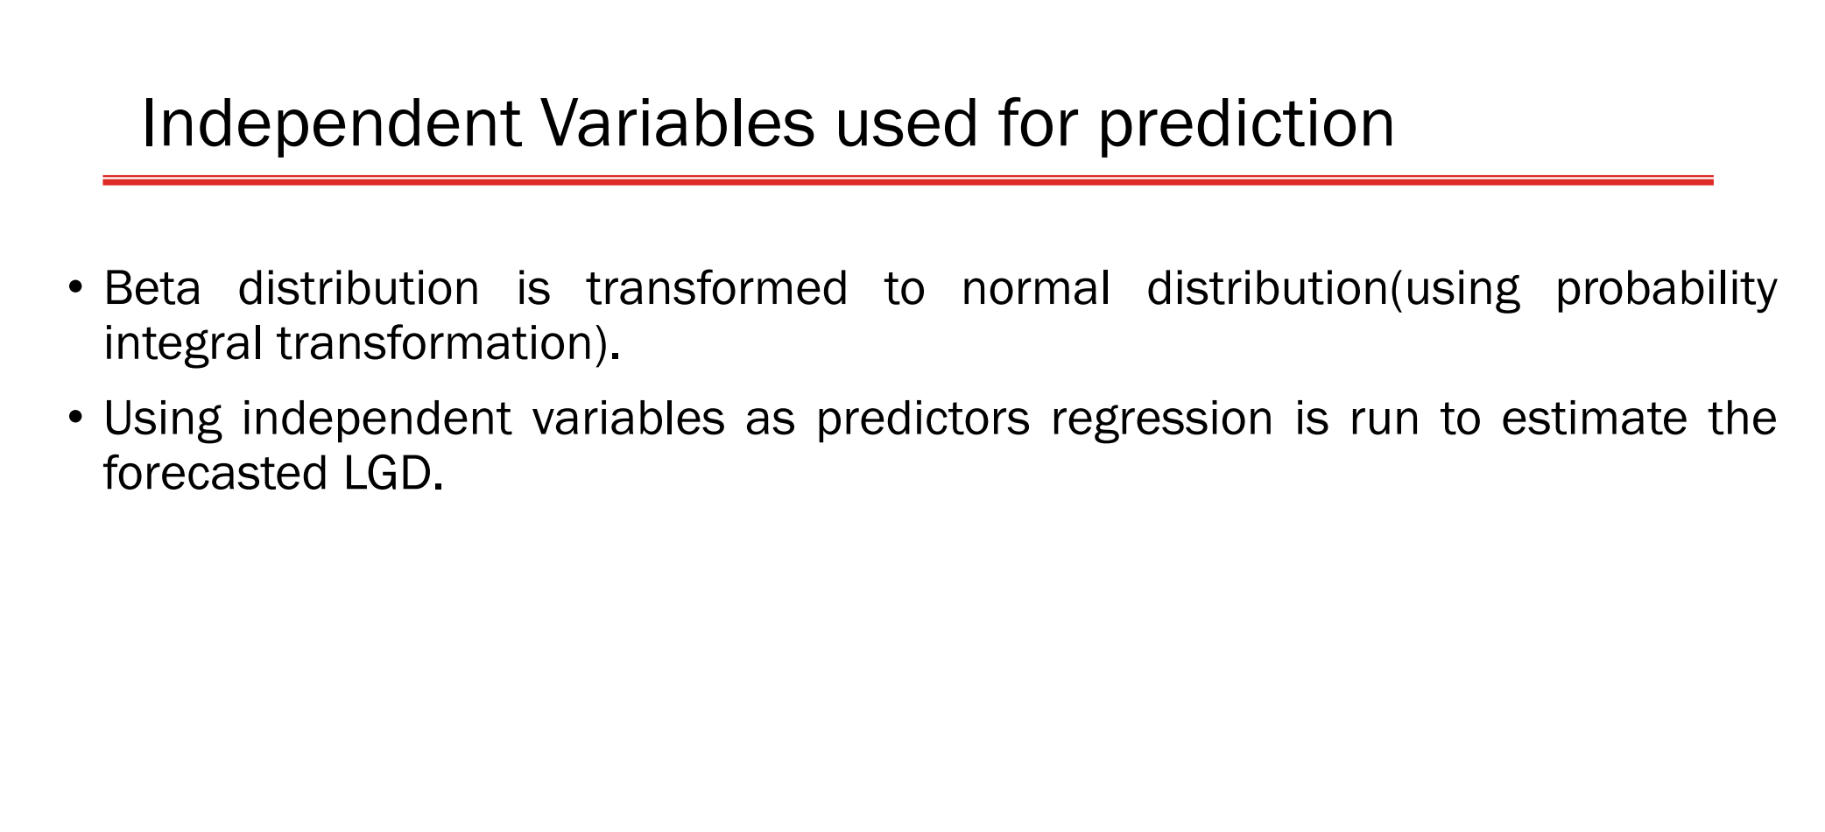

Slide 54
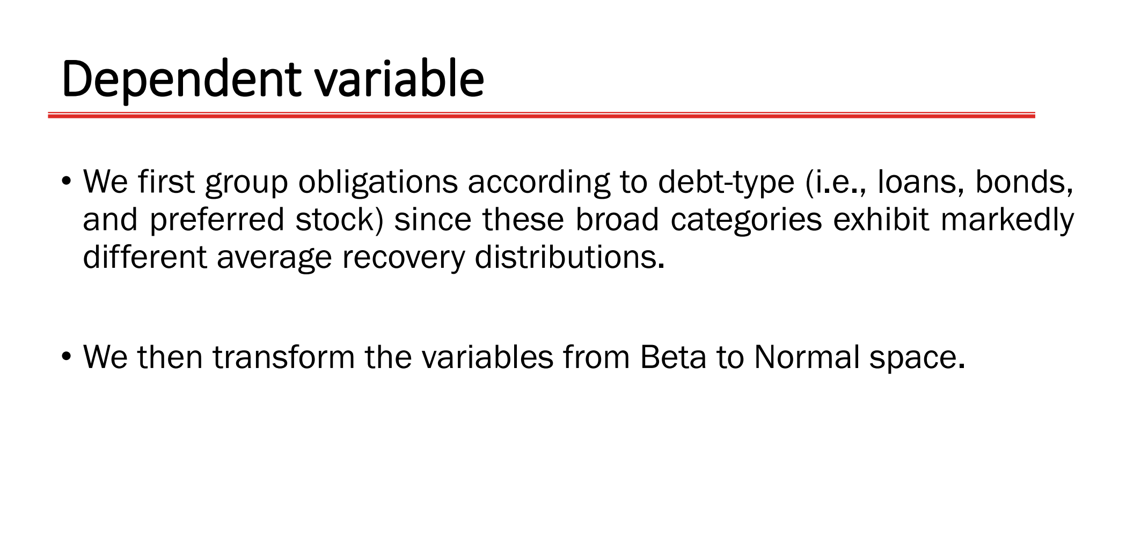

Slide 55
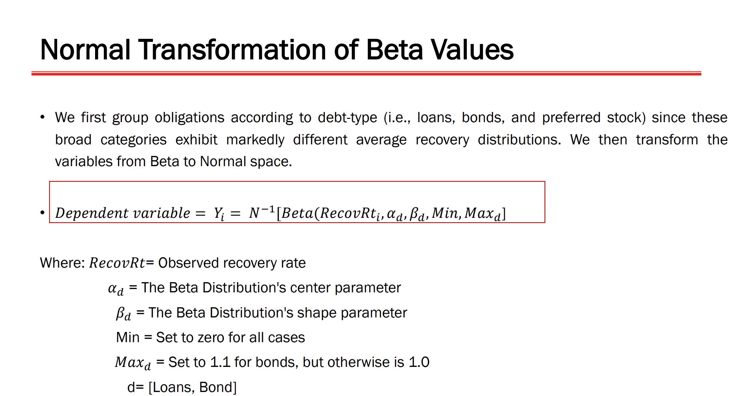

Slide 56
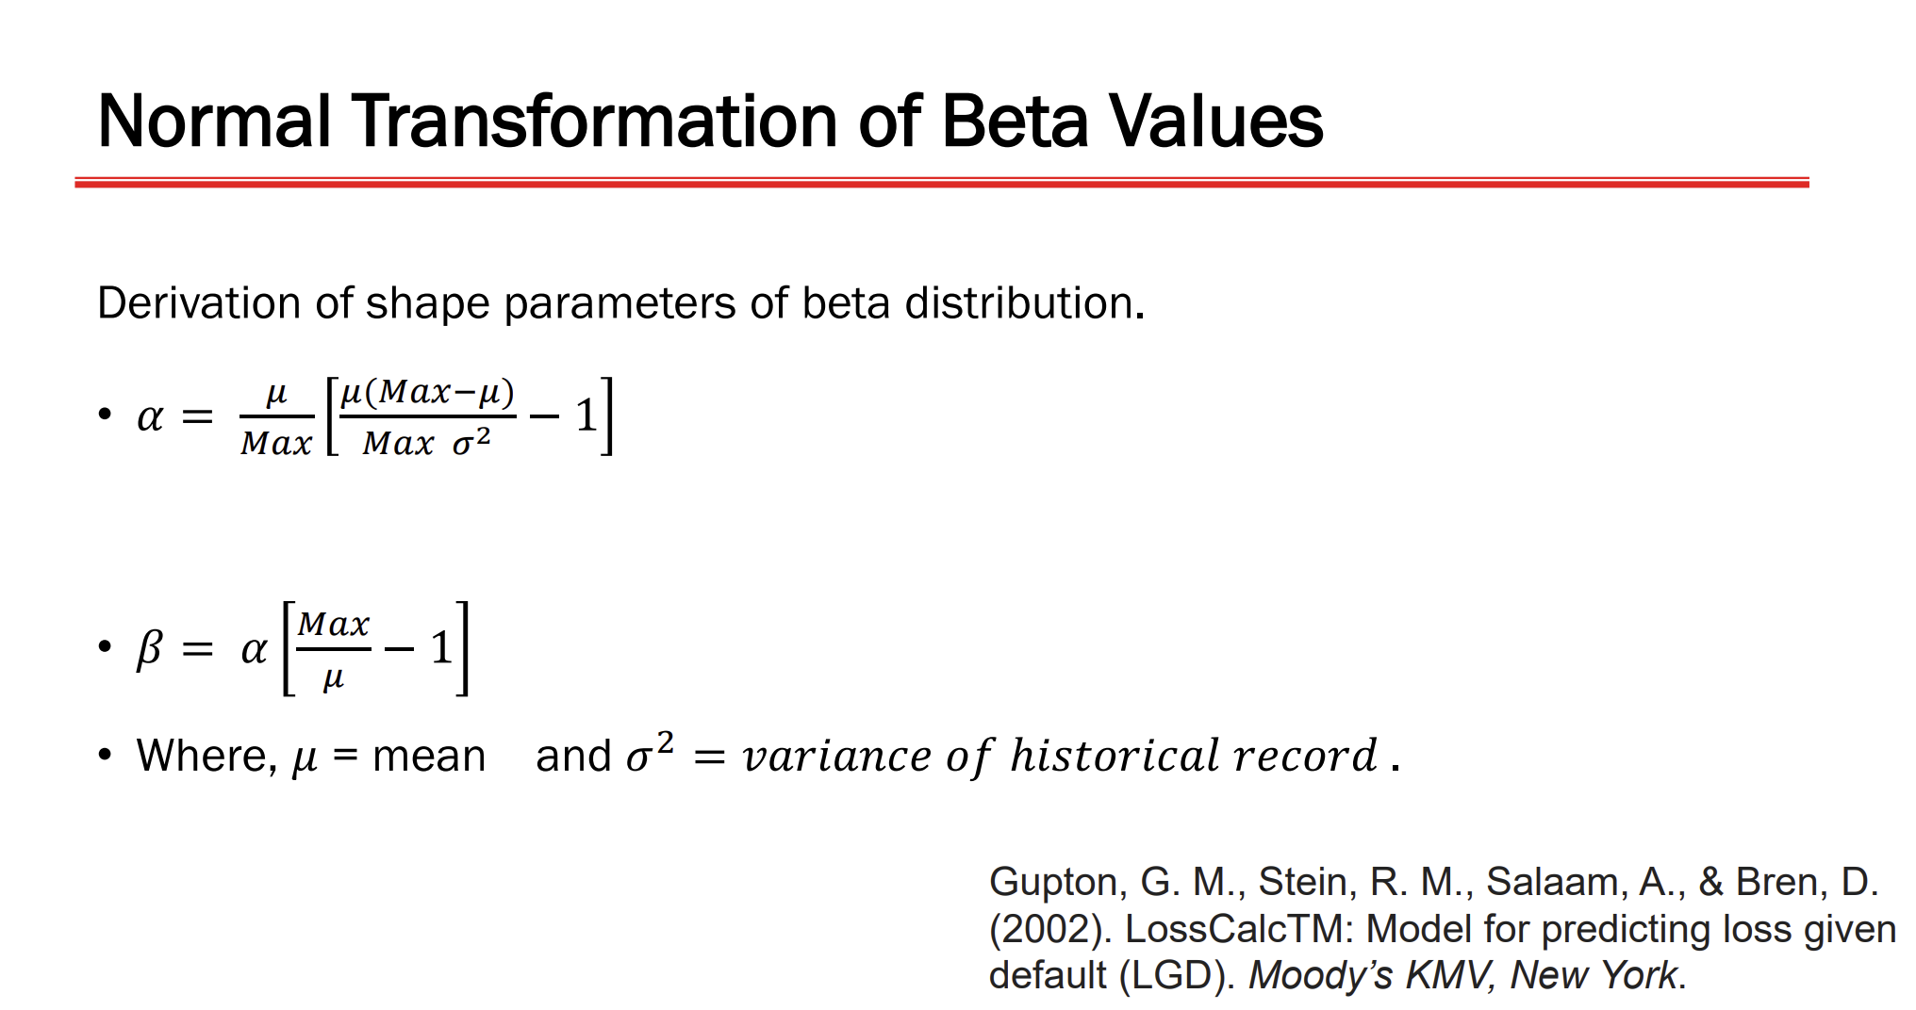

Slide 57
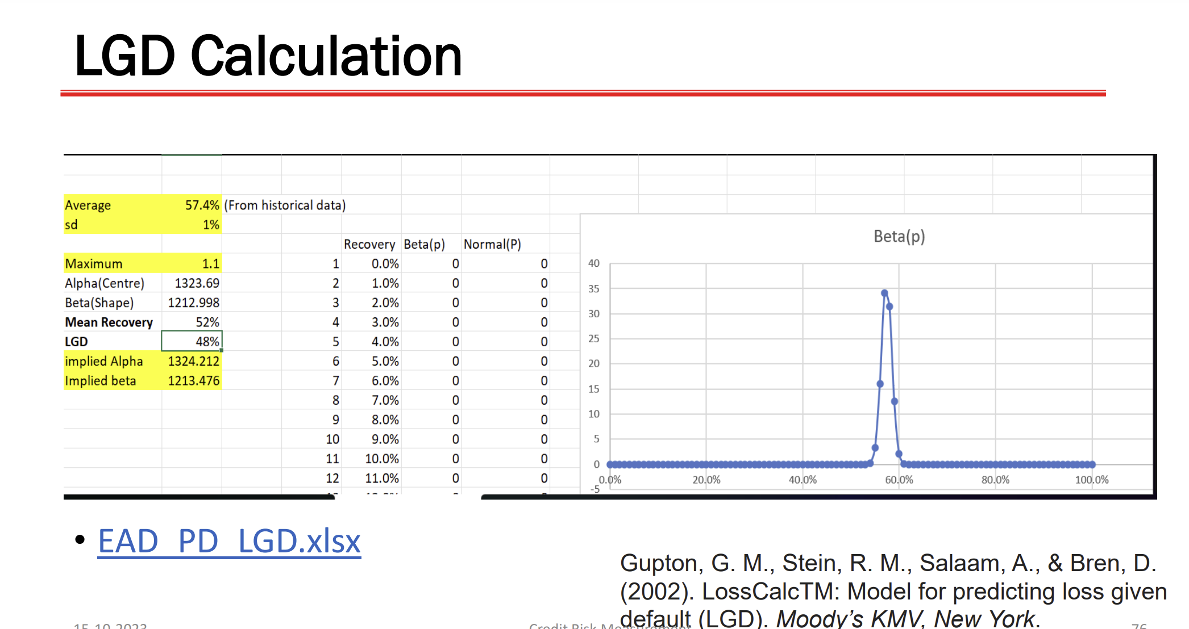

Slide 58
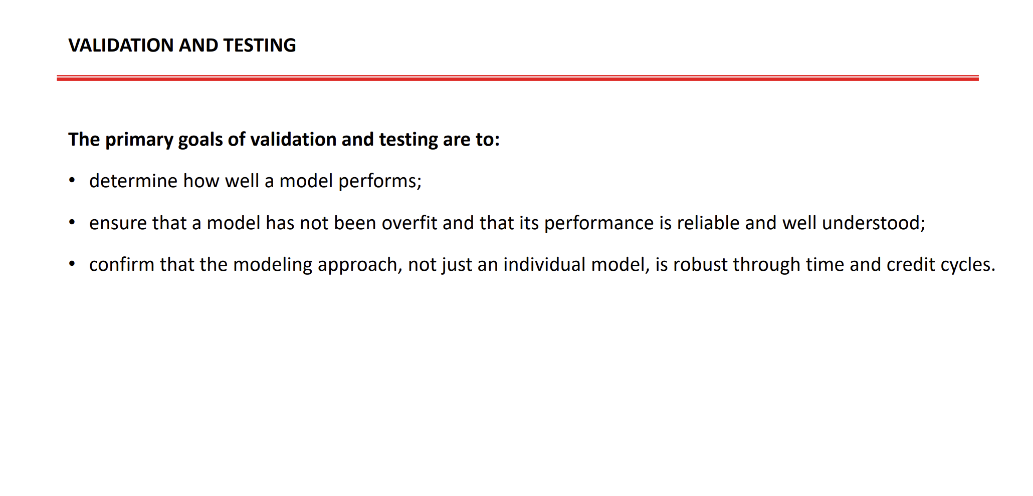

Slide 59


Slide 60
The Liner Probability Model, the Probit Model and the Logit Model
And, this takes us to …

Slide 61
Topic for the day is …
MODELING WITH QUALITATIVE AND LIMITED DEPENDENT VARIABLES

Slide 62
Let’s consider a problem…
A researcher, Mr. Suyra Kant, wants to know what are the factors that determine the ‘bankruptcy’ of a firm. He took a sample of 33 Solvent Firms and 33 Bankrupt Firms; and collected information on the following financial parameters:
    Working Capital to Total Assets (WC_ASSET)
    Retained Earnings to Total Assets (RE_ASSET)
    Return on Assets (ROA)
    Assets Turnover Ratio (ASSET_TURN)
    Market Value to Book Value (MV_BV)

Slide 63
Mr. Suyra Kant has made the following model…
Binary Variable; GROUP=0, the company is bankrupt and GROUP=1, the company is solvent.
What does this equation means? If the estimated value of the dependent variable GROUP is 0.75, how to interpret it?

Slide 64


To appreciate the issues involved in a regression model with binary dependent variable, let’s consider a model with one explanatory variable…
We take a general model as thus:
Assume that OLS is used to estimate the above model, then how to interpret the estimated value of Y_{i}?
E(Y_{i}|X_{i}) is nothing but expected value of Y_{i} given X_{i}.

Slide 65

…continued
Alternatively, the expectation of Yi given Xi can also be calculated as thus:
Let p_{i} be the probability that a Y_{i} takes a value 1 given a particular X_{i} and (1-p_{i}) be the probability that a Y_{i} takes a value 0 given a particular X_{i}. Then, the expected value of Y_{i} given X_{i} can be calculated as thus:

Slide 66

Finally, the LOGIT Model is …

Slide 67
Estimation of LOGIT Model…
The LOGIT Model is not estimated by using OLS but it is estimated by using Maximum Likelihood Method and thus, the estimates we obtain are known as Maximum Likelihood Estimates.

Slide 68

Revisiting our Bankruptcy Example…
Assume that the bankruptcy model is as thus:
As per the model, it assumed that bankruptcy depends upon the Return on Assets; and it is suggested that higher the Return on Assets a company generates, higher the probability that a company will be solvent.

Slide 69

The Result obtained from Eviews…
Z = -0.180031+0.200139 ROA

Slide 70

An Example…(continued)
Interpret the results?

Slide 71
An Example…(continued)
If a firm has ROA = 20%, then its probability of being solvent is 55.25178%

Slide 72

The Complete Example…(continued)
Interpret the results?

Slide 73
Now, let’s take the Complete Example…
The Model as hypothesized by Mr. Surya Kant:
As per the model, it assumed that bankruptcy depends upon the financial ratios - Return on Assets, and Market Value to Book Value. Using the LOGIT Model, we obtain the results as thus:

Slide 74

The Result obtained from Eviews…
Z = -2.042474+0.218424 ROA+0.023347 MV_BV

Slide 75

Does this model create problems for us?
@@@######

Slide 76
The Linear Probability Model – Problem No. 1
As per the Linear Probability Model, the probability increases with the values of X and it could be possible that at times, the values of probabilities are negative (<0) or more than one (>1).
In that case, it is difficult to interpret the results.

Slide 77

The Linear Probability Model – Problem No. 1 (Example)

Slide 78
The Linear Probability Model – Problem No. 2
The Distribution of the Error term is not Normal Probability Distribution but it is Binomial Probability Distribution.

Slide 79
The Linear Probability Model – Problem No. 3
The error term are not homoscedastic but they have a problem of heteroscedasticity.

Slide 80
The Linear Probability Model – Problem No. 4
In the Linear Probability Model, as X increases the probability value continues to increase/decrease at a constant rate. Since the probability values should lie between 0 and 1, that is 0 < p < 1, a constant rate of increase/decrease is impossible.
We need non-linear relation to restrict the probability values between 0 and 1.

Slide 81
How to ensure the choice of p within interval [0,1]?
To limit the value of p within [0,1], usually S-Shaped relationship is used between x and p.
In this regard, two widely used approaches exist –
  one, that makes use of Logistic Function; and
  another, use Standard Normal Probability Distribution.
By using the Logistic Function, we obtain a model which is called LOGIT MODEL; and the one which is obtained by using Standard Normal Probability Distribution is called PROBIT MODEL.

Slide 82
PROBIT AND LOGIT MODELS…
NORMAL PROBABILITY DISTRIBUTION
PROBIT MODEL
LOGISTIC FUNCTION
LOGIT MODEL

Slide 83

Let’s start with PROBIT Model…
Unlike the Linear Probability Model, the PROBIT Model assumes that the underlying distribution is Cumulative Standard Normal Probability Distribution whose shape is as follows:
Note that it is non-linear and its value lies between 0 and 1.

Slide 84



PROBIT Model…
The PROBIT Model expresses the probability p - a dependent variable Y takes the value 1 for given X_{i}.
And, p is –
Where the model is considered is having only one explanatory variable and the Function F represents Cumulative Normal Probability Distribution.
Please note the density function of Standard Normal Probability Distribution -

Slide 85
PROBIT Model…
It is called Normal Equivalent Deviate (n.e.d) or Normit.

Slide 86
Estimation of PROBIT Model…
The PROBIT Model is not estimated by using OLS but it is estimated by using Maximum Likelihood Method and thus, the estimates we obtain are known as Maximum Likelihood Estimates.

Slide 87

Now, let’s start with LOGIT Model…
The LOGIT Model assumes that the underlying distribution is a logistic function or Sigmoid Function whose shape is as follows:
Note that it is non-linear and its value lies between 0 and 1.

Slide 88


LOGIT Model…
The LOGIT Model expresses the probability p that a dependent variable Y takes the value 1 given X_{i}.
For the LOGIT Model, a particular type of logistic function is used which is called SIGMOID FUNCTION given below –
Using the above function form, we may express the probability p that a dependent variable Y takes the value 1 given X_{i} assuming that there is only one explanatory variable.

Slide 89

LOGIT Model…(continued…)
This term is called LOGIT and the Model is known a LOGIT Model.

Slide 90
Finally, the LOGIT Model is …

Slide 91

Option #1: Use Log-likelihood
Log-likelihood Statistic can be used to gauge Goodness of Fit of Logit/Probit Models. It is defined as –
Some software provide an estimate of this as (-2Log-likelihood) or -2LL to get a positive number. Lower -2LL, better is the fit.

Slide 92

Option #2: Use Log-likelihood Ratio
A -2Log-likelihood Ratio (-2LLR) can also be used to gauge Goodness of Fit of Logit/Probit Models. It is defined as –
Where LL_{R} the value of Log-likelihood from the restricted model (with only intercept) and LL_{U} the value of Log-likelihood from the unrestricted model (one with all explanatory variables).
Notes:
Note that -2LLR follows Chi-Square Distribution.

Slide 93
If you can not use R-Square then
USE Pseudo R-Square.
There are several measures which are intended to mimic the R-Squared, but none of them are an R-Squared. Hence, such measures are called Pseudo R-Square.

Slide 94

Option #3: Use Pseudo R-Square
McFadden’s R-Square is one of the Pseudo R-Square measures. It is defined as
Its values lying between 0.2 to 0.4 are considered highly satisfactory.
Notes:
Note that -2LLR follows Chi-Square Distribution.

Slide 95

Option #4: Use Pseudo R-Square
Another measure of Pseudo R-Square is Cox and Snell. It is also based on log-likelihood but it takes the sample size into account.
It is defined as
Notes:
Note that -2LLR follows Chi-Square Distribution.

Slide 96

Option #5: Use Pseudo R-Square
Another measure of Pseudo R-Square is Nagelkerke measure. It adjusts the Cox and Snell measure for the maximum value so that 1 can be achieved.
It is defined as -
Notes:
Note that -2LLR follows Chi-Square Distribution.

Slide 97
Let’s take one more EXAMPLE…
A company is selling R. O. System for home under the brand of Puredews. Their marketing head was interested in predicting what is chance that a person is likely to use their products. For this purpose, a sample of 231 users of their R. O. System and 519 non-users of their R. O. System was taken with their monthly income (in thousands), Age, Gender, Family Size and Prices of R. O. System believing that these determines the uses and non-users.

Slide 98

We obtain the following PROBIT Results

Slide 99

We obtain the following LOGIT Results

Slide 100


Slide 101
Which one should we use?
PROBIT MODEL OR LOGIT MODEL?

Slide 102
LOGIT vs PROBIT
The main difference is that the logistic distribution has comparatively slightly fatter tails as compared to that of Probit Model.
In majority of applications, both give the similar results. However, researchers and practitioners prefer to use LOGIT because of its comparative mathematical simplicity.

Slide 103
Now, the question is what is the relation between the Age, Size and Income and the Probability that a person selected is user of the Company’s R. O. System?

Slide 104
First challenge in the issues is - relationship between the probability values and independent variables…
Though there is a non-linear relation between the probability and an independent variable, yet the sign of coefficient shows the direction of relation between the probability and the independent variable.

Slide 105
Another Example…
A survey is conducted among the users and non-users of micro-wave oven. The following information is being collected about them on the following parameters:
    Users/Non-Users (Users-1 and non-users-0)
    Monthly Income (Rs. in ‘000)
    Monthly Consumption of Food Items (in Kgs.)

Slide 106

Data Collected is …

Slide 107


Slide 108


Slide 109


Slide 110
Second challenge in the issues is – What is the interpretation of β?
Recall ...
β is interpreted as the effect of a unit of X on the predicted value of Logit or log of odd ratio.
This term is called LOGIT.

Slide 111

Third challenge in the issues is – What is the rate of change of probability due to change in independent variable?
The rate of change is given as thus...

Slide 112
Think…???
What should be the
LOGIT MODEL?

Slide 113

The Result of the Estimated LOGIT Model…

Slide 114

The Result of the Estimated LOGIT Model…

Slide 115
Using LOGIT and PROBIT models…
…can we predict who is going to the OWNER of Microwave?
Yes, for that one has to take a threshold limit of the probability!
Normally, such a threshold is taken as p = 50%. If Probability is more than 50%, he is going to be the owner; otherwise he is not!

