Slide 1
Financial Risk Management

Slide 2

Why are we reading this paper
???????????

Slide 3
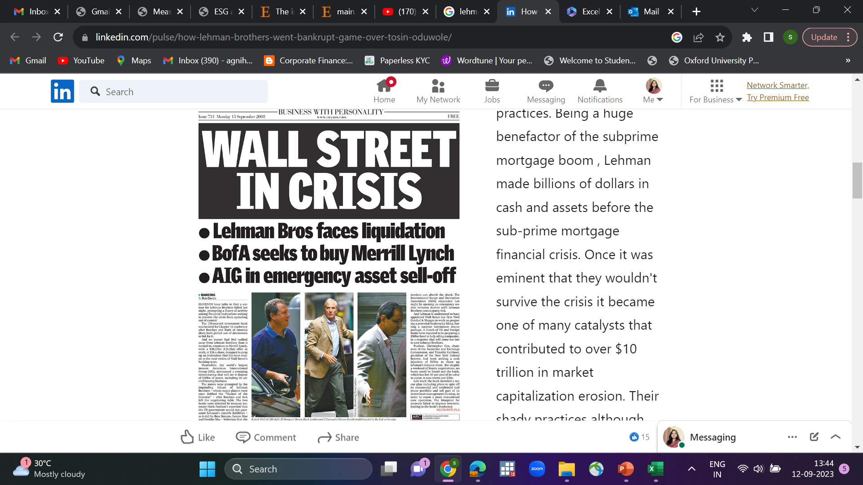
Why are we reading this paper of FRM?

Slide 4
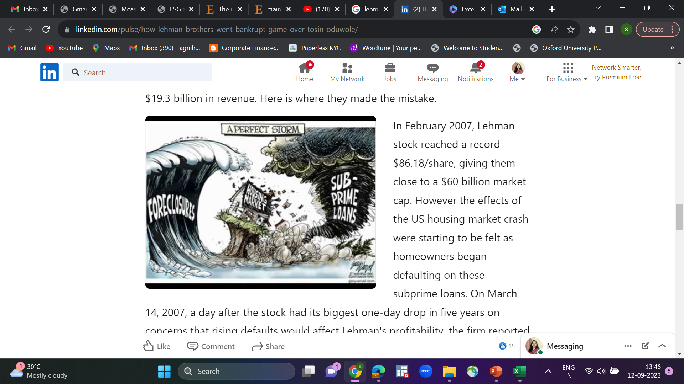
Case of Lehman Brothers

Slide 5
The saga of Lehman Brothers
Lehman Brothers-case.docx

Slide 6
Key Driver of Development in Financial Risk Management
It is because of occurrence of large number of financial disasters.
Allied Irish Bank case
Barring Bank case
Enron
Proctor and Gamble 1994 Case
Drysdale Securities
Hammersmith And Fullham

Slide 7
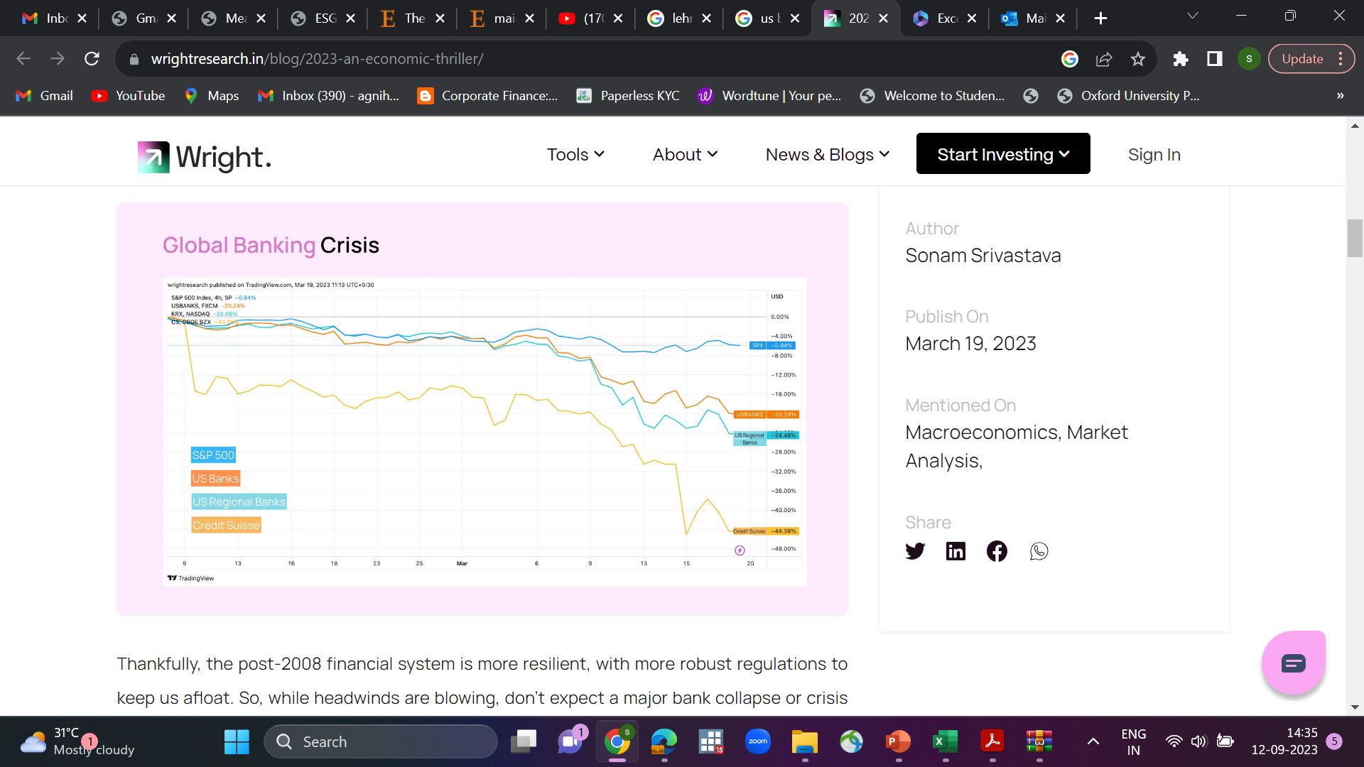
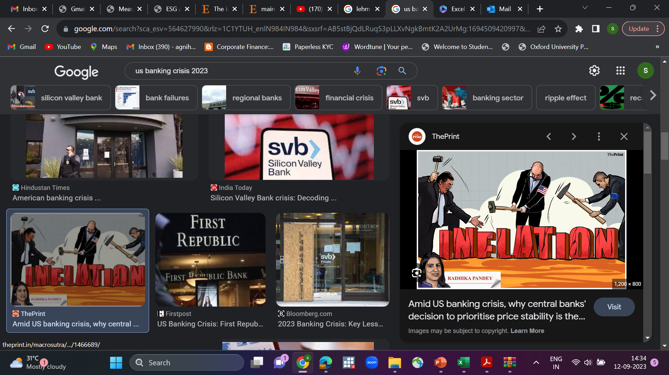
US Banking Crisis 2023

Slide 8
Allied Irish Bank case
John Rusnak (Rusnak), a trader at Allfirst Financial Inc. (Allfirst), the US subsidiary of Ireland's leading bank - Allied Irish Banks (AIB), lost $750 mn in foreign exchange trading operations.
Fraudulent trading activities and manipulation of records by Rusnak resulted in major losses.

Slide 9
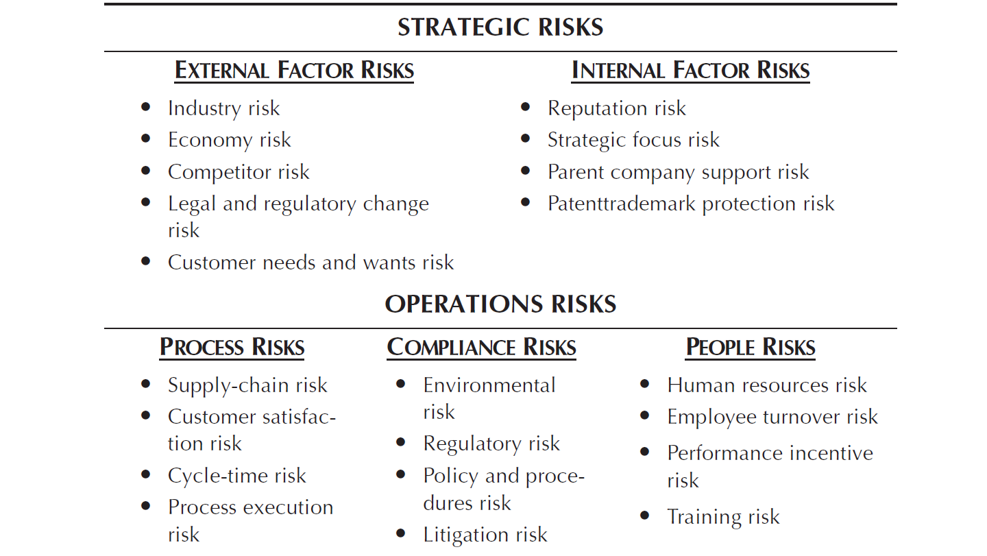

Slide 10
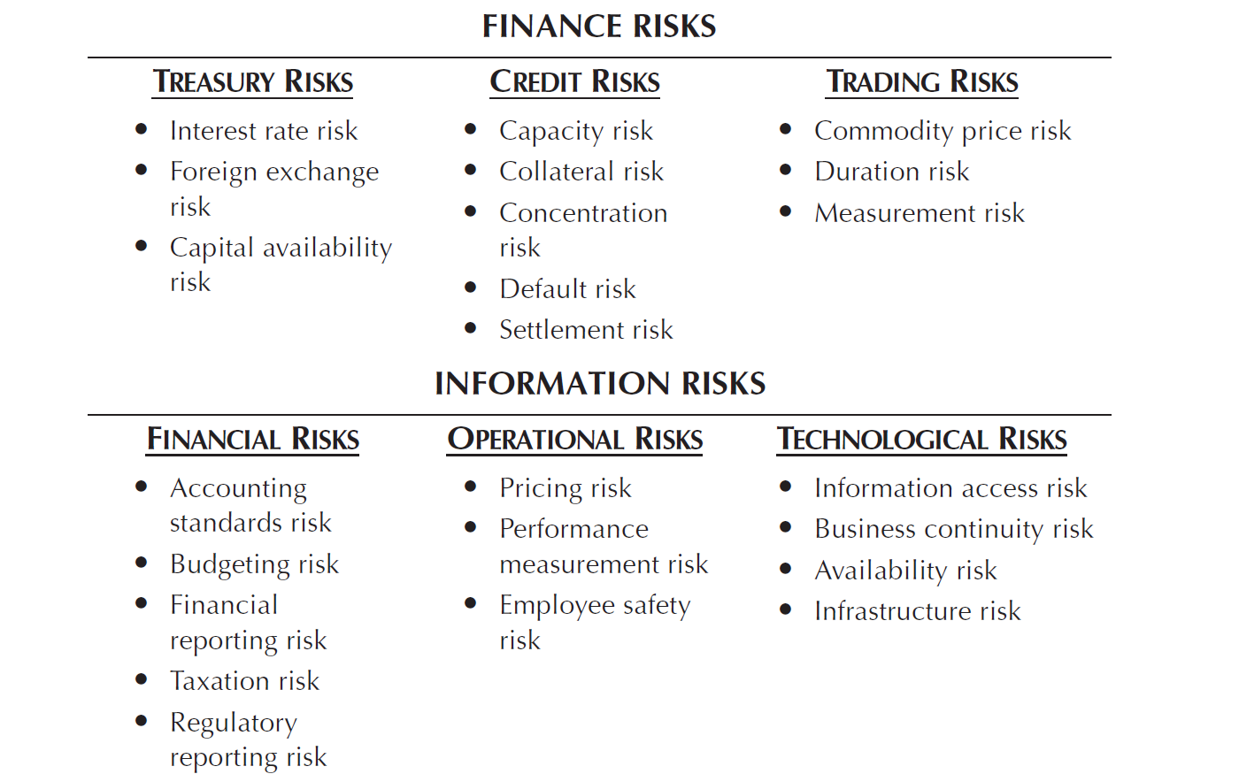

Slide 11
Key Risk Assessment
What is the likelihood of this risk’s occurring over the next one-year period? Using a score of 1 to 9, assign a best-guess single-digit score as follows:
What is the significance of the risk, in terms of cost to the organization? again using a 1-to-9 scale.
These scores are then averaged by both factors and are plotted on a risk assessment analysis.

Slide 12
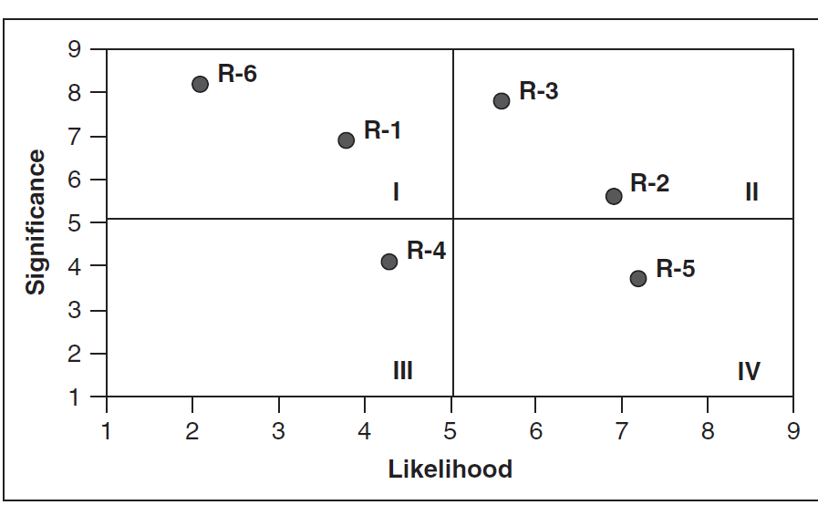
Key Risk Assessment

Slide 13

Key Risk Assessment

Slide 14
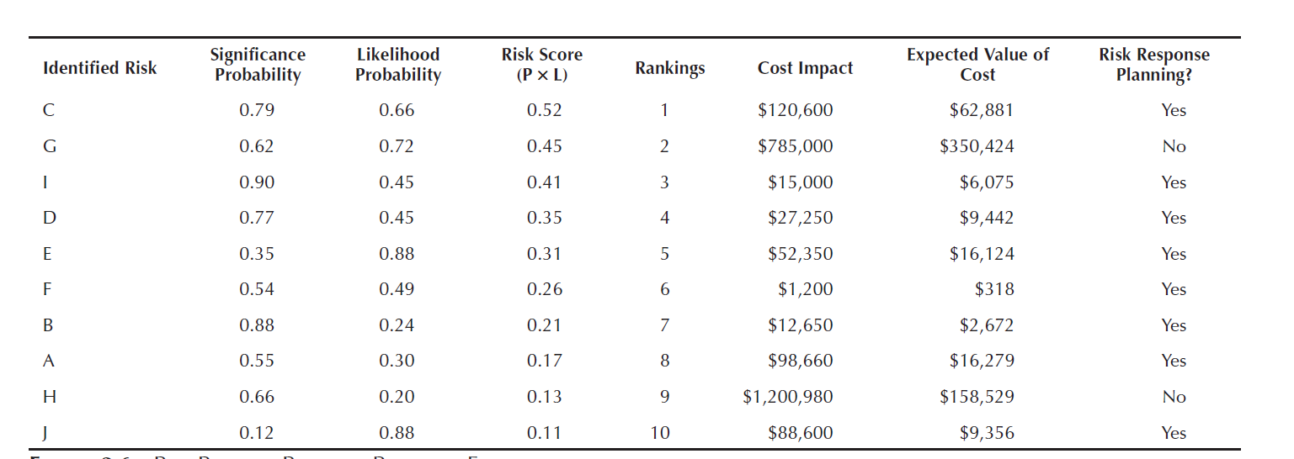
Key Risk Assessment

Slide 15
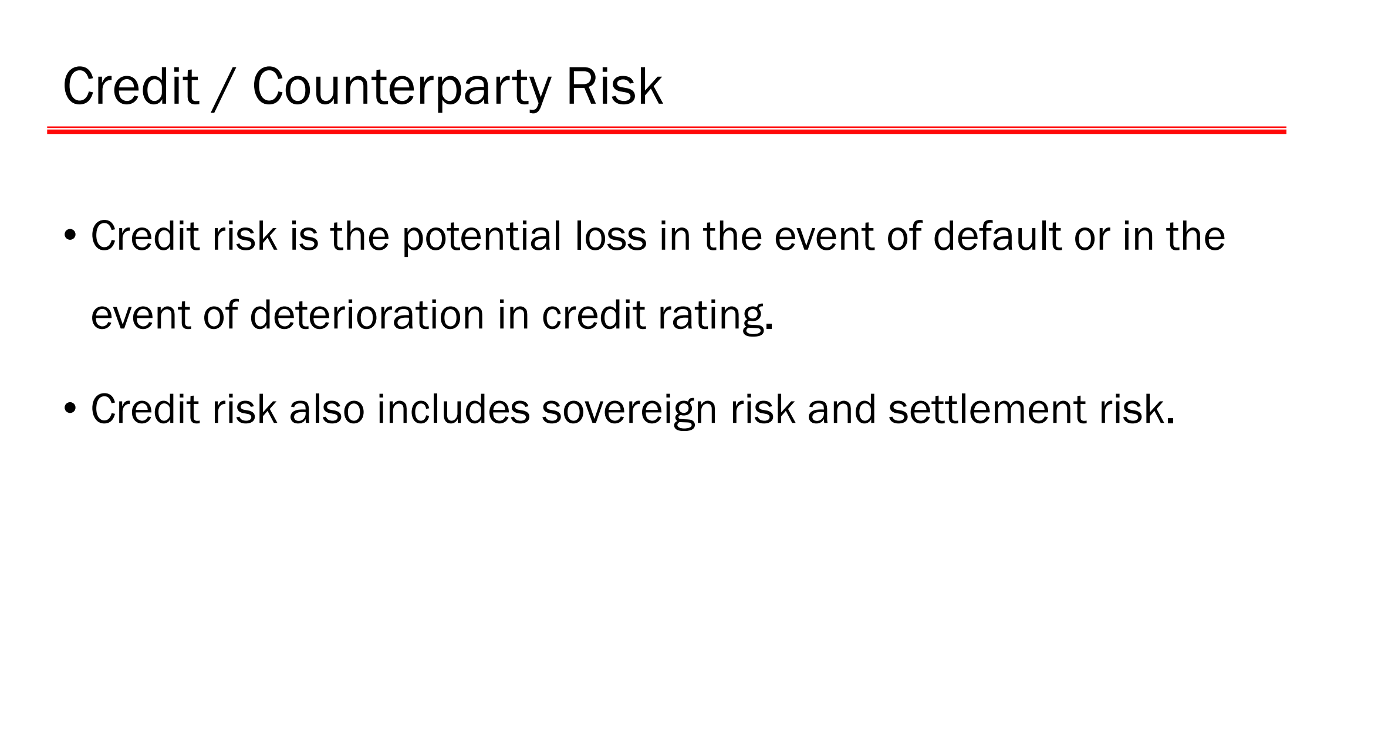

Slide 16
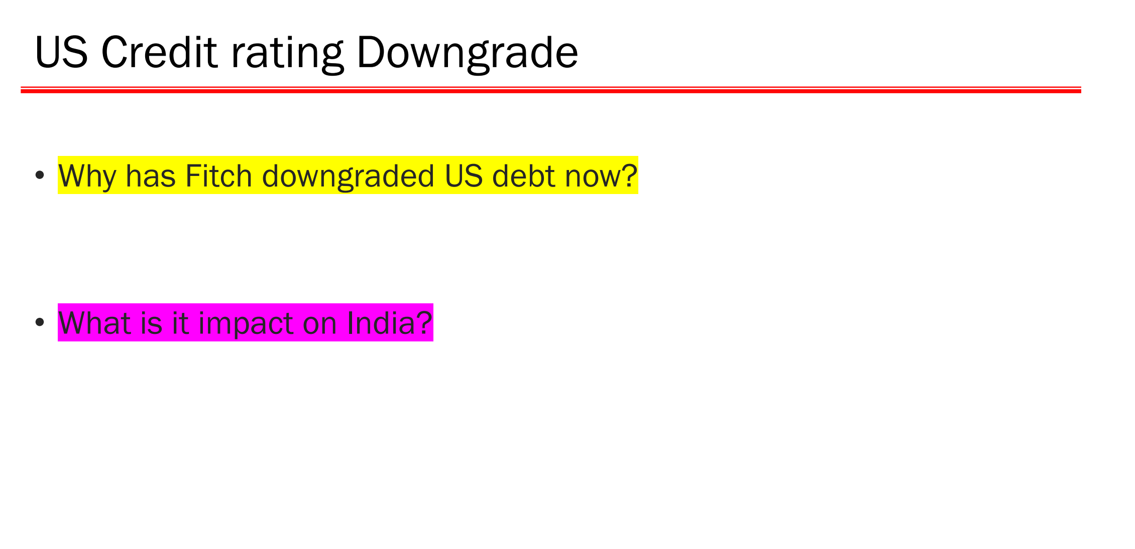

Slide 17
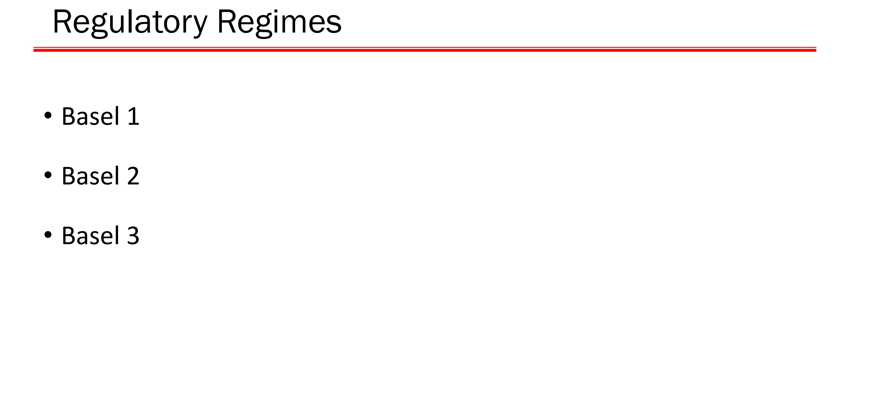

Slide 18
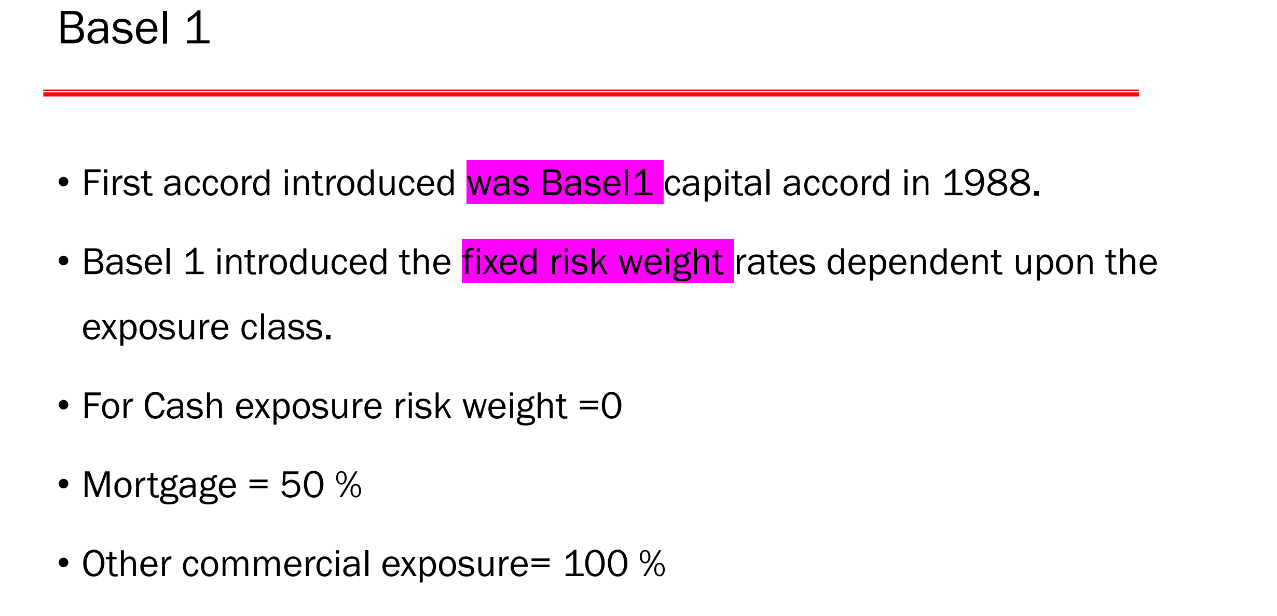

Slide 19
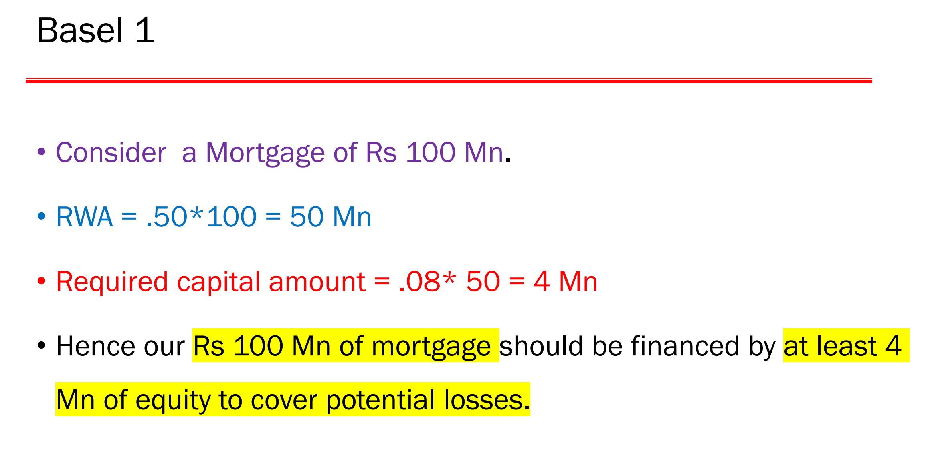

Slide 20
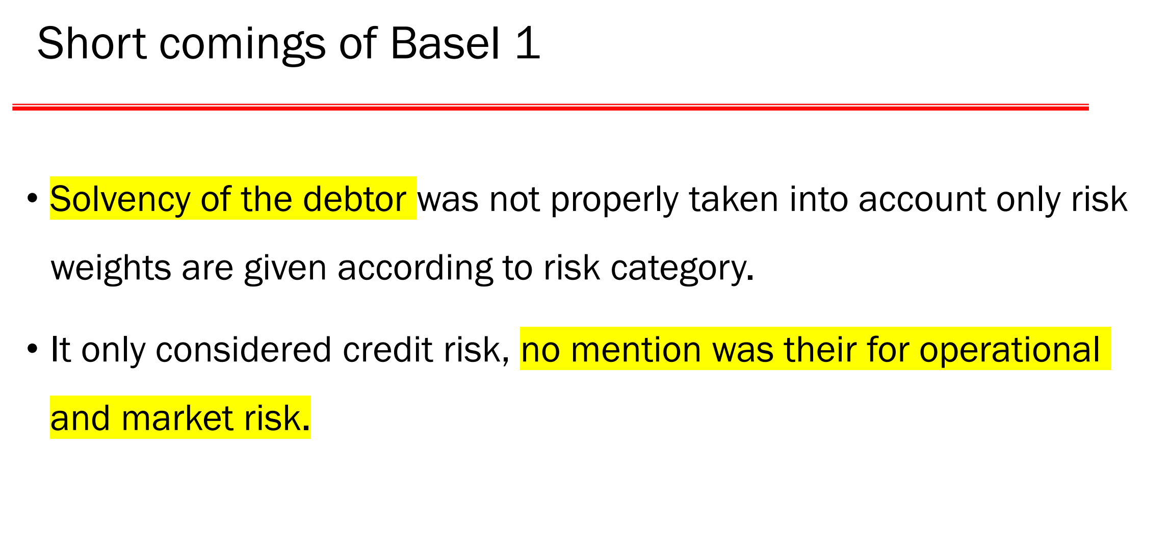

Slide 21
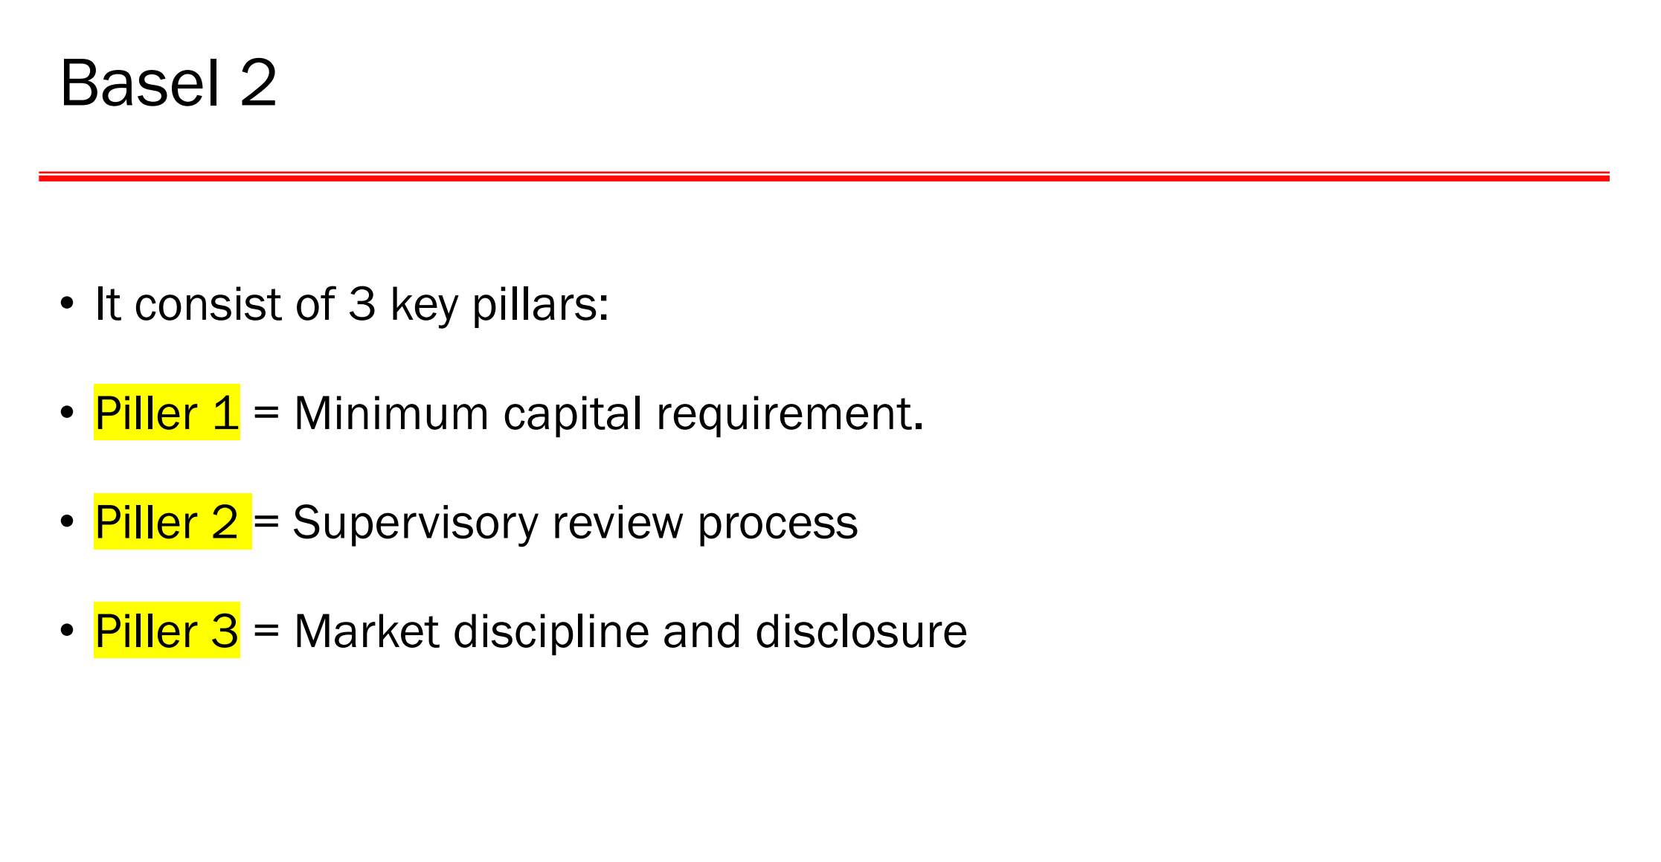

Slide 22
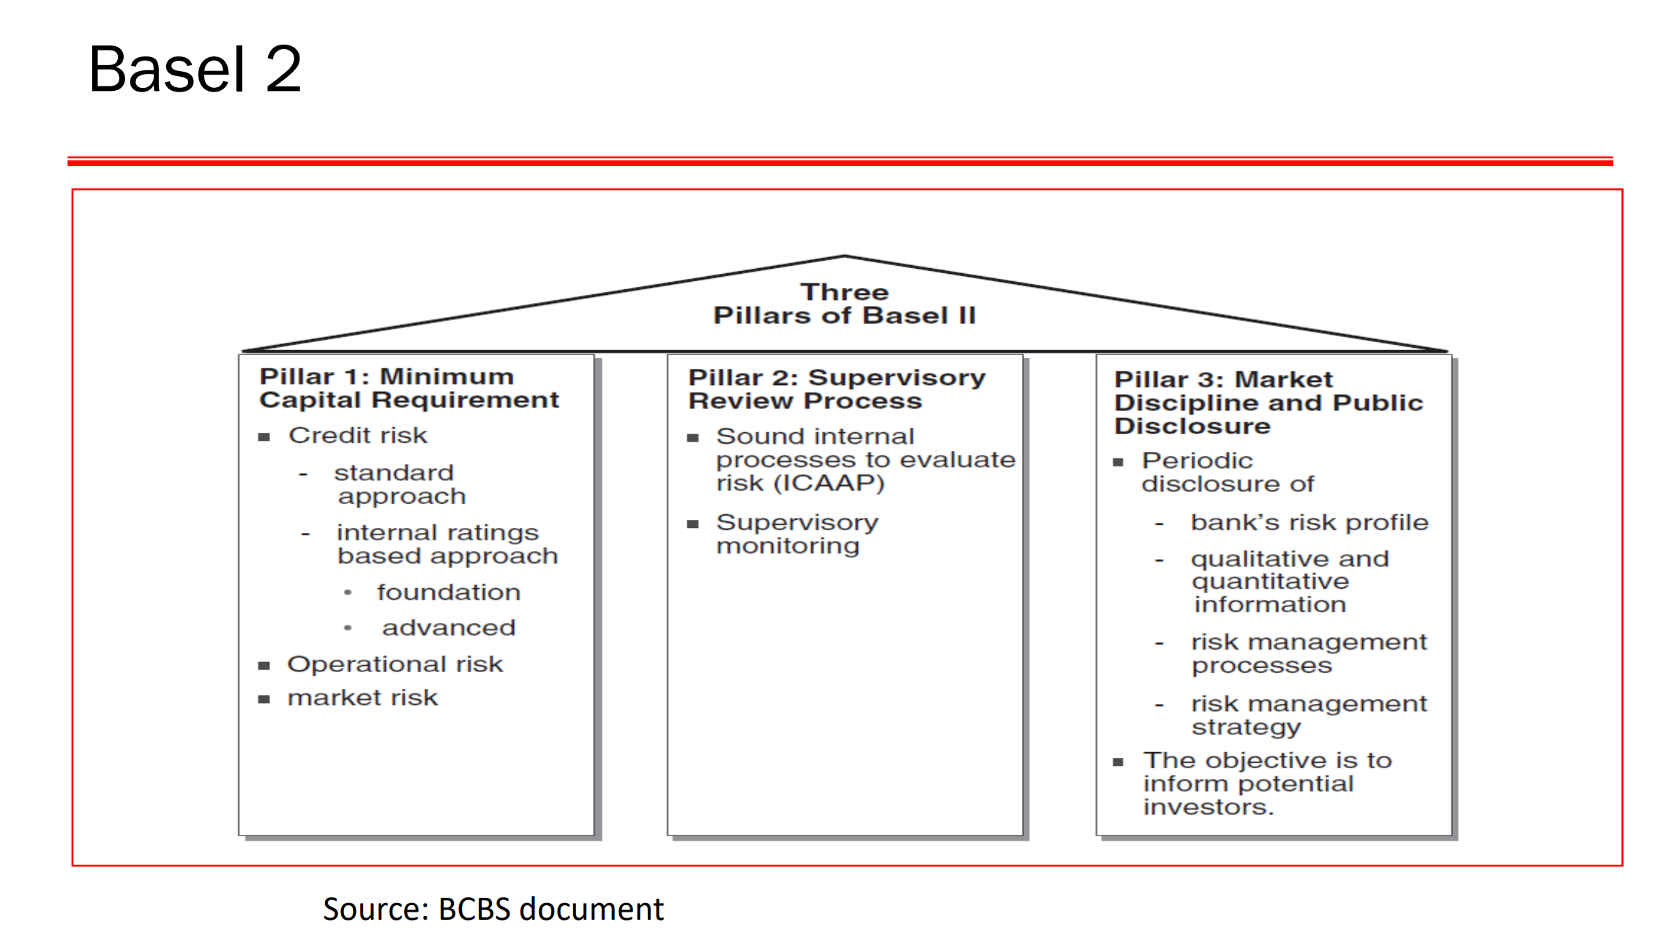

Slide 23
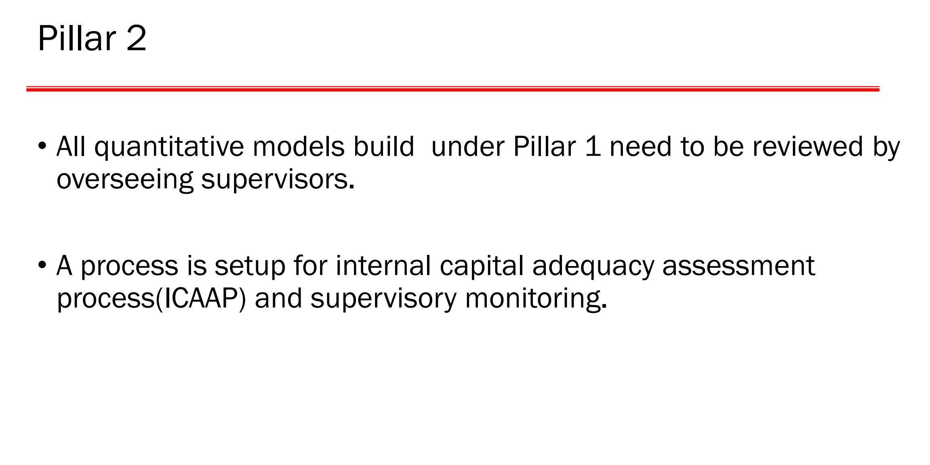

Slide 24
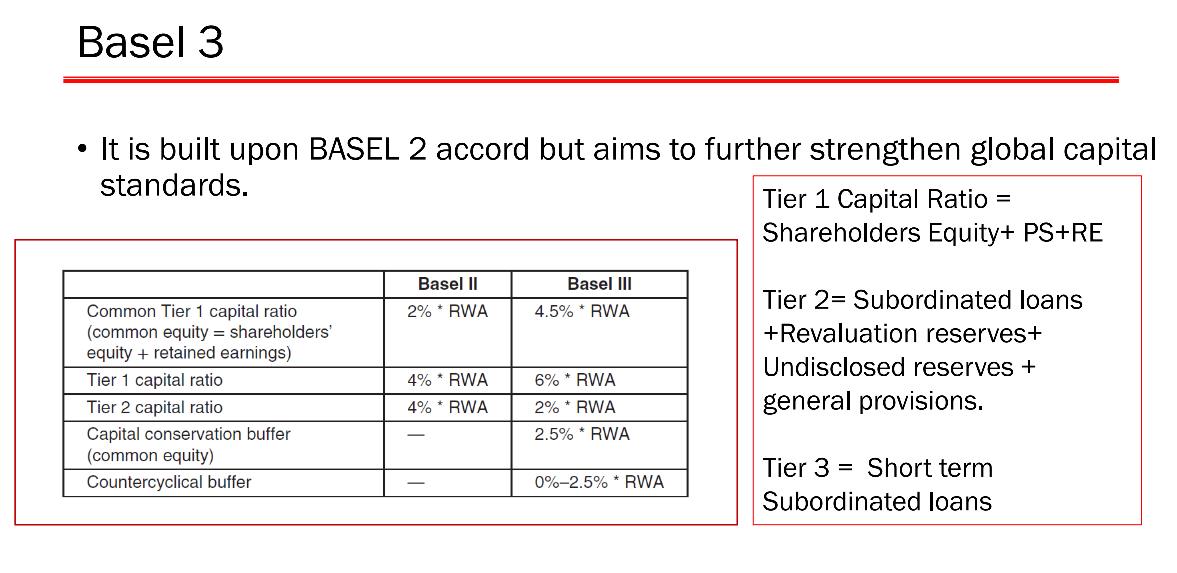

Slide 25
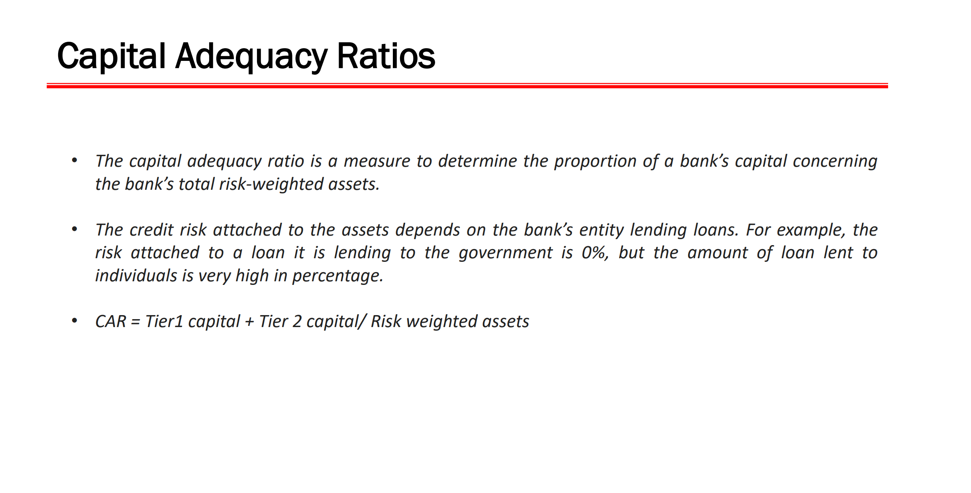

Slide 26
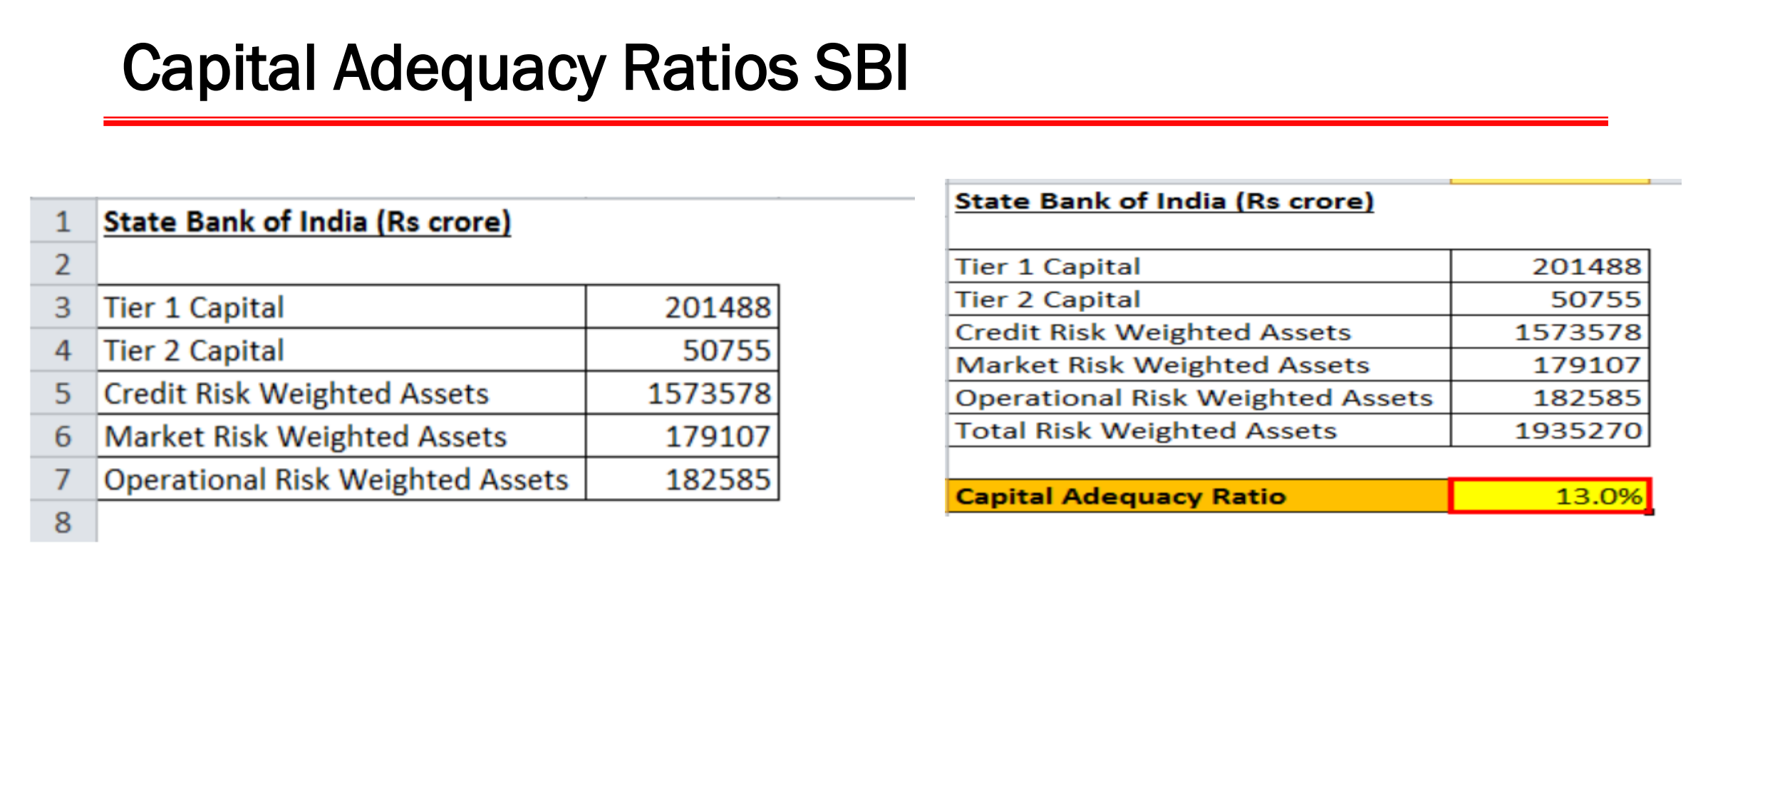

Slide 27
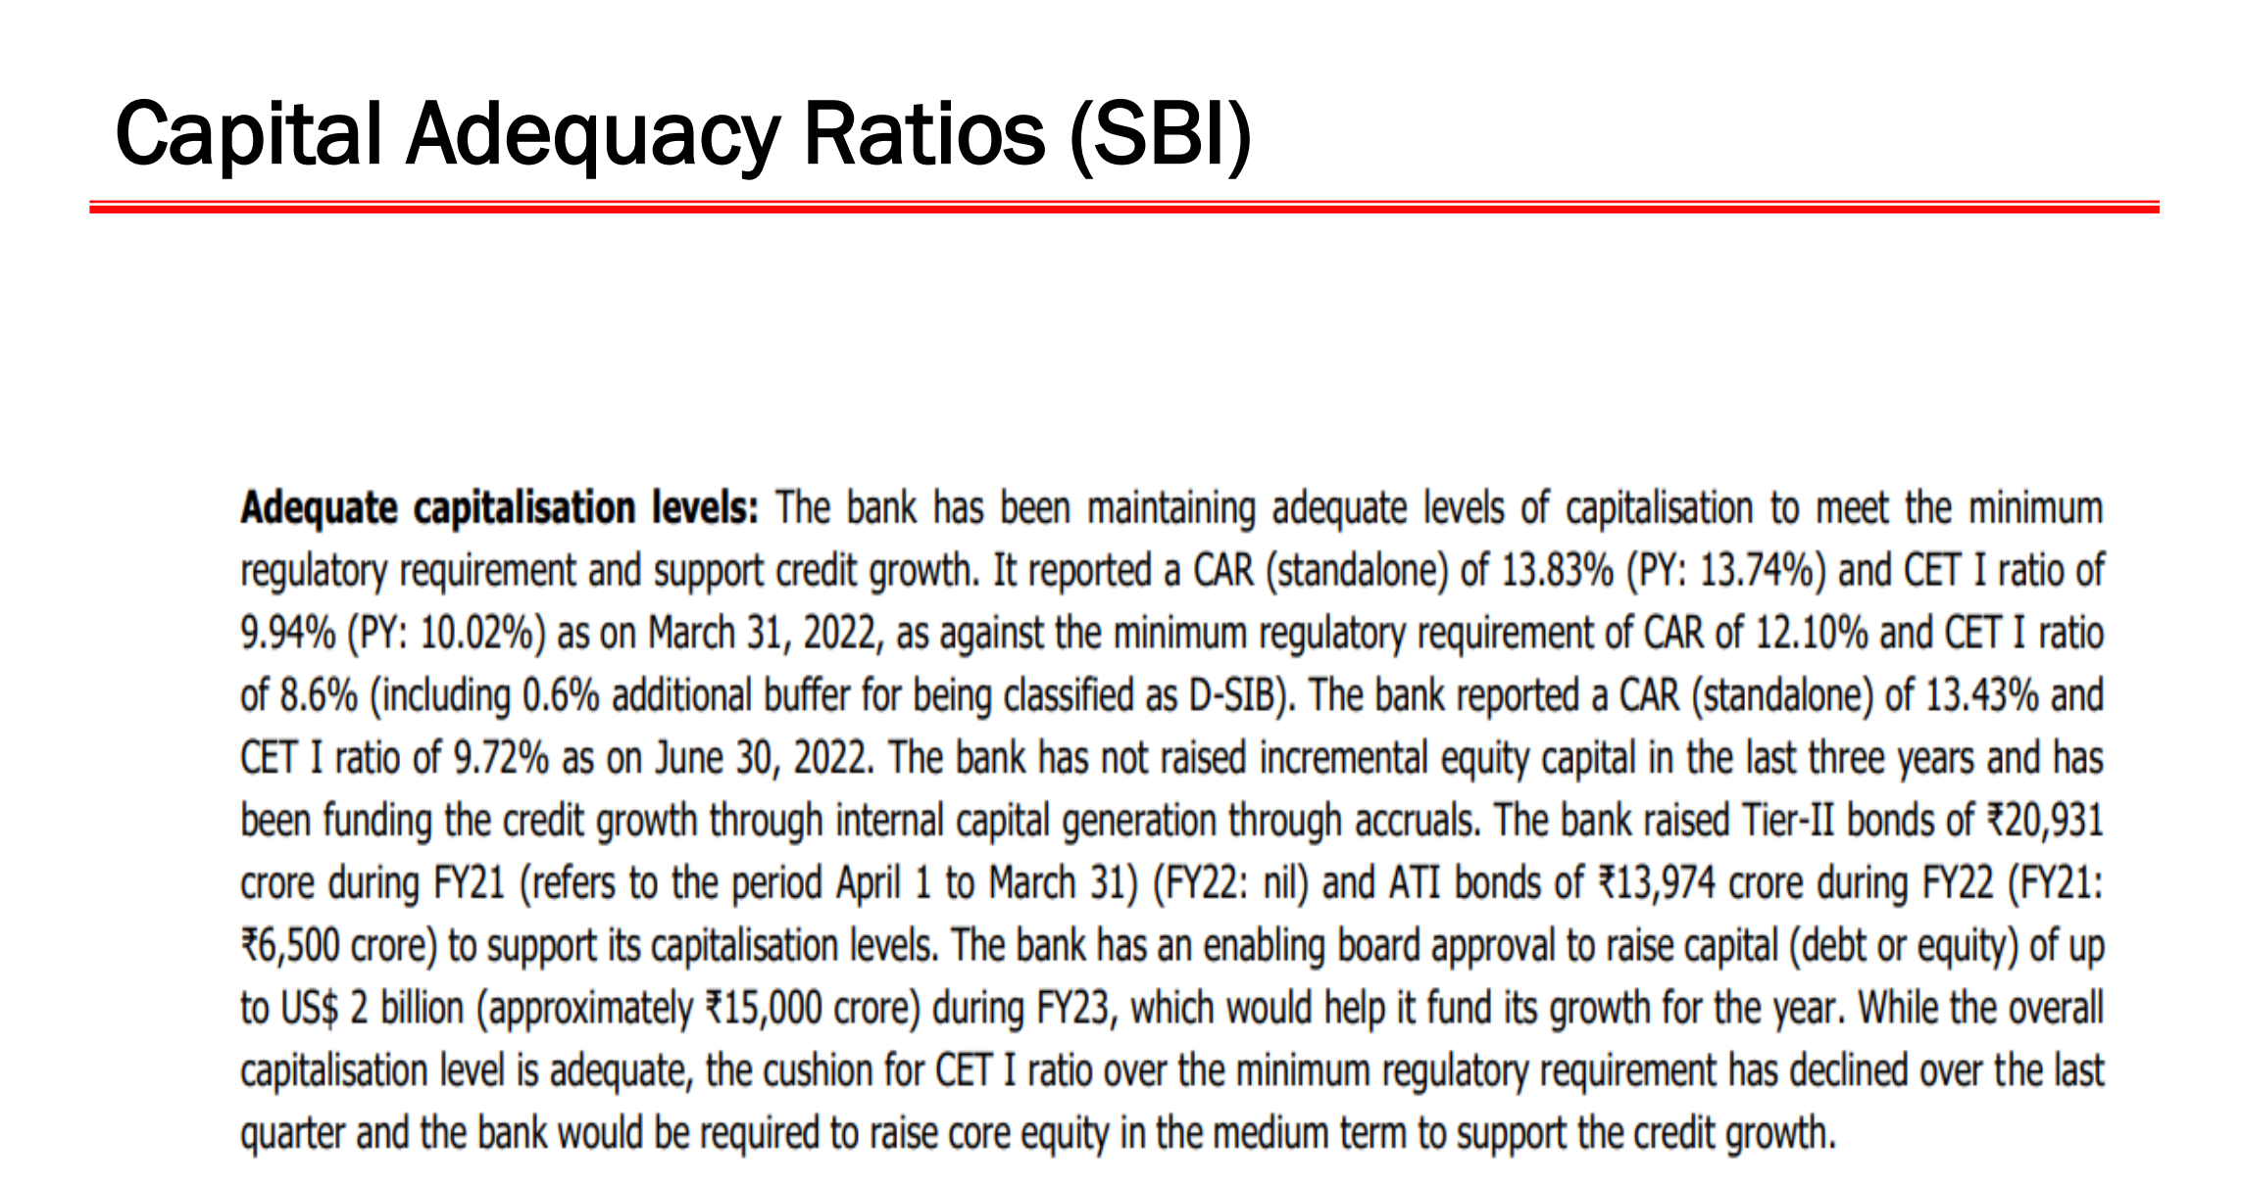

Slide 28
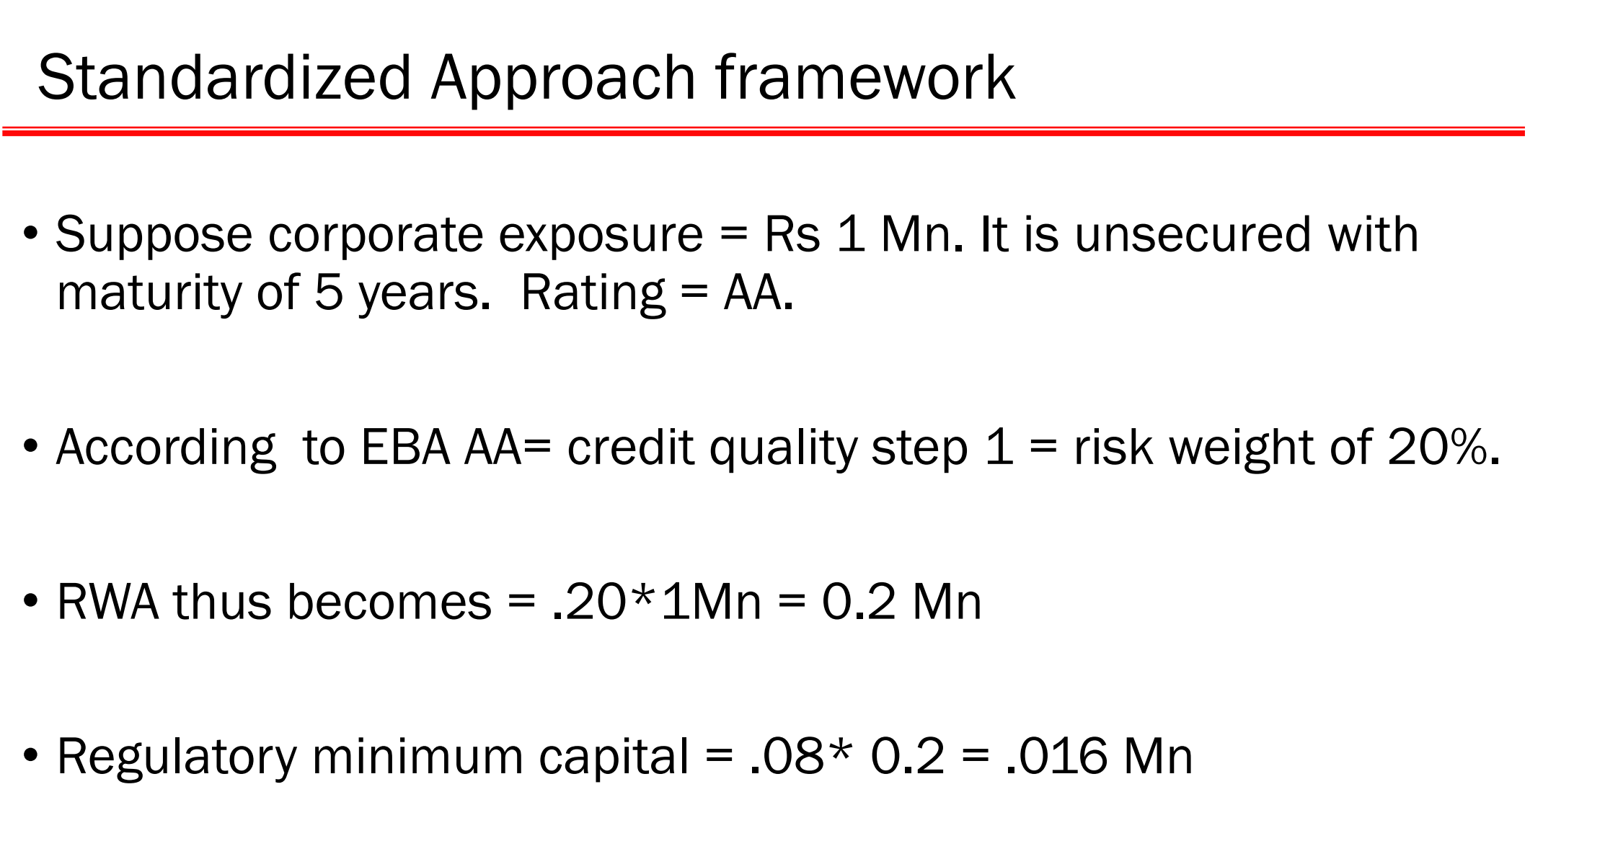

Slide 29
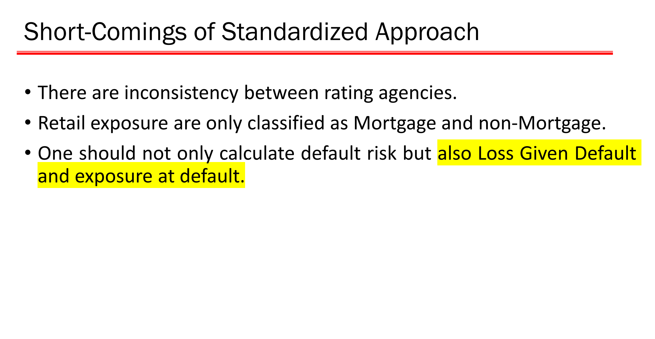

Slide 30
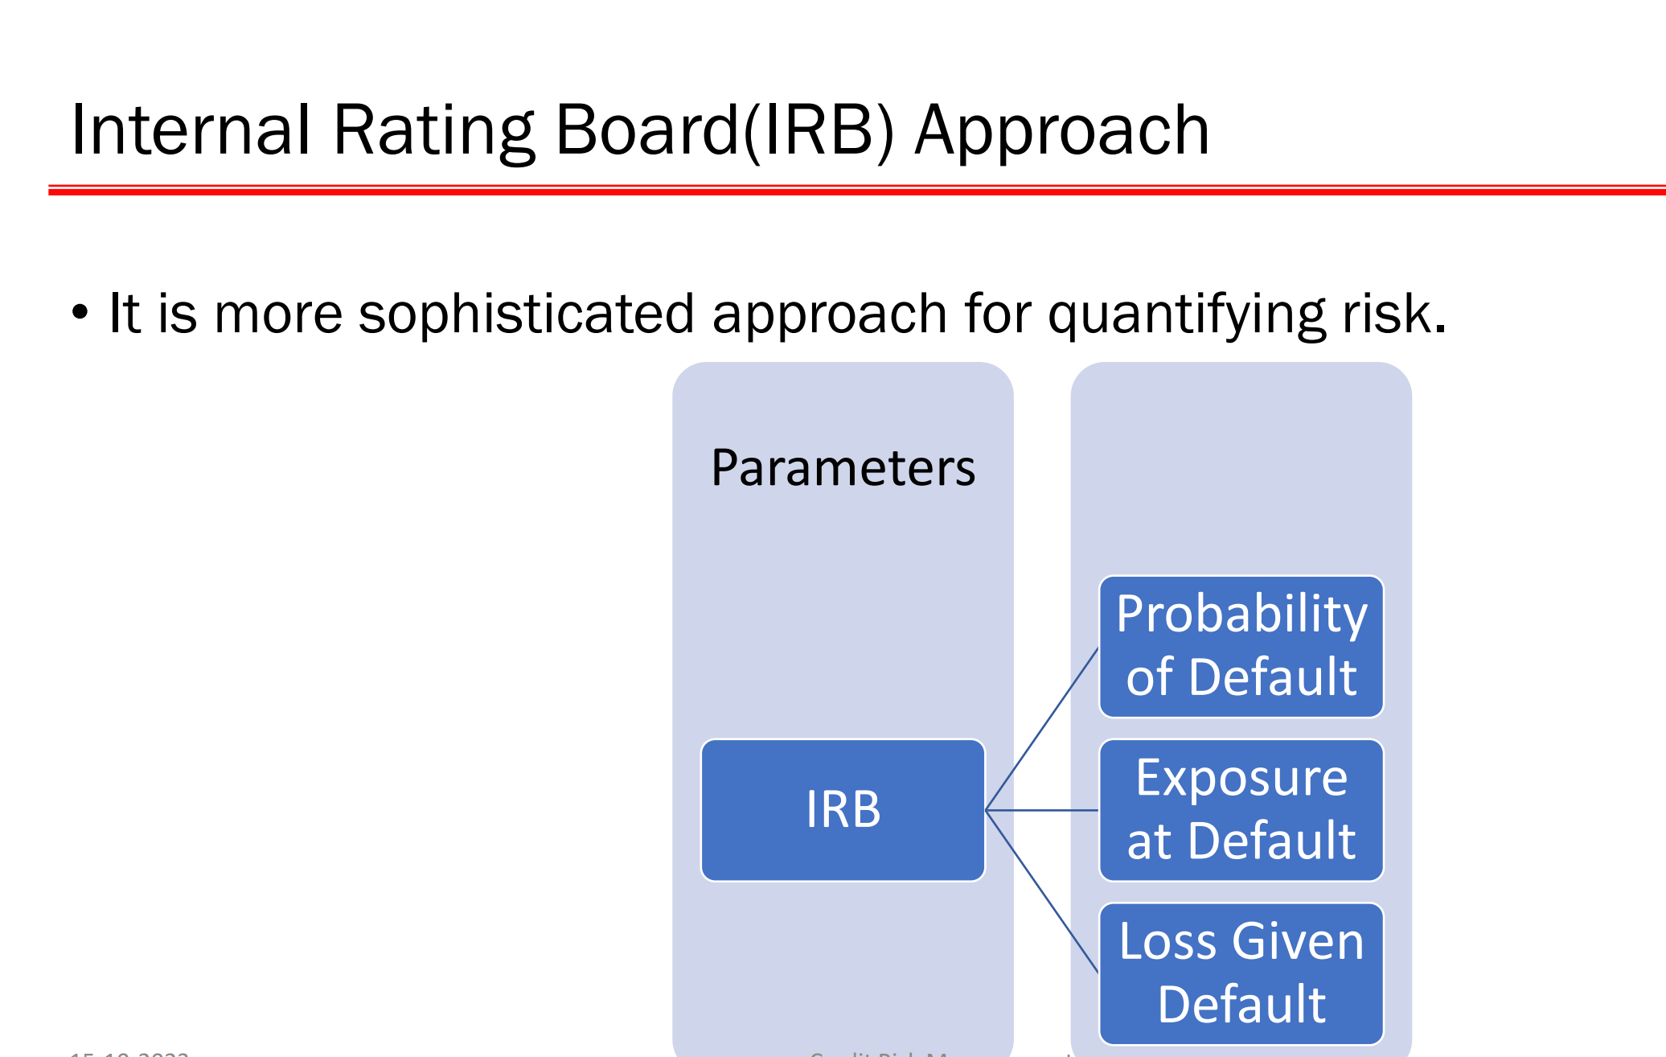

Slide 31
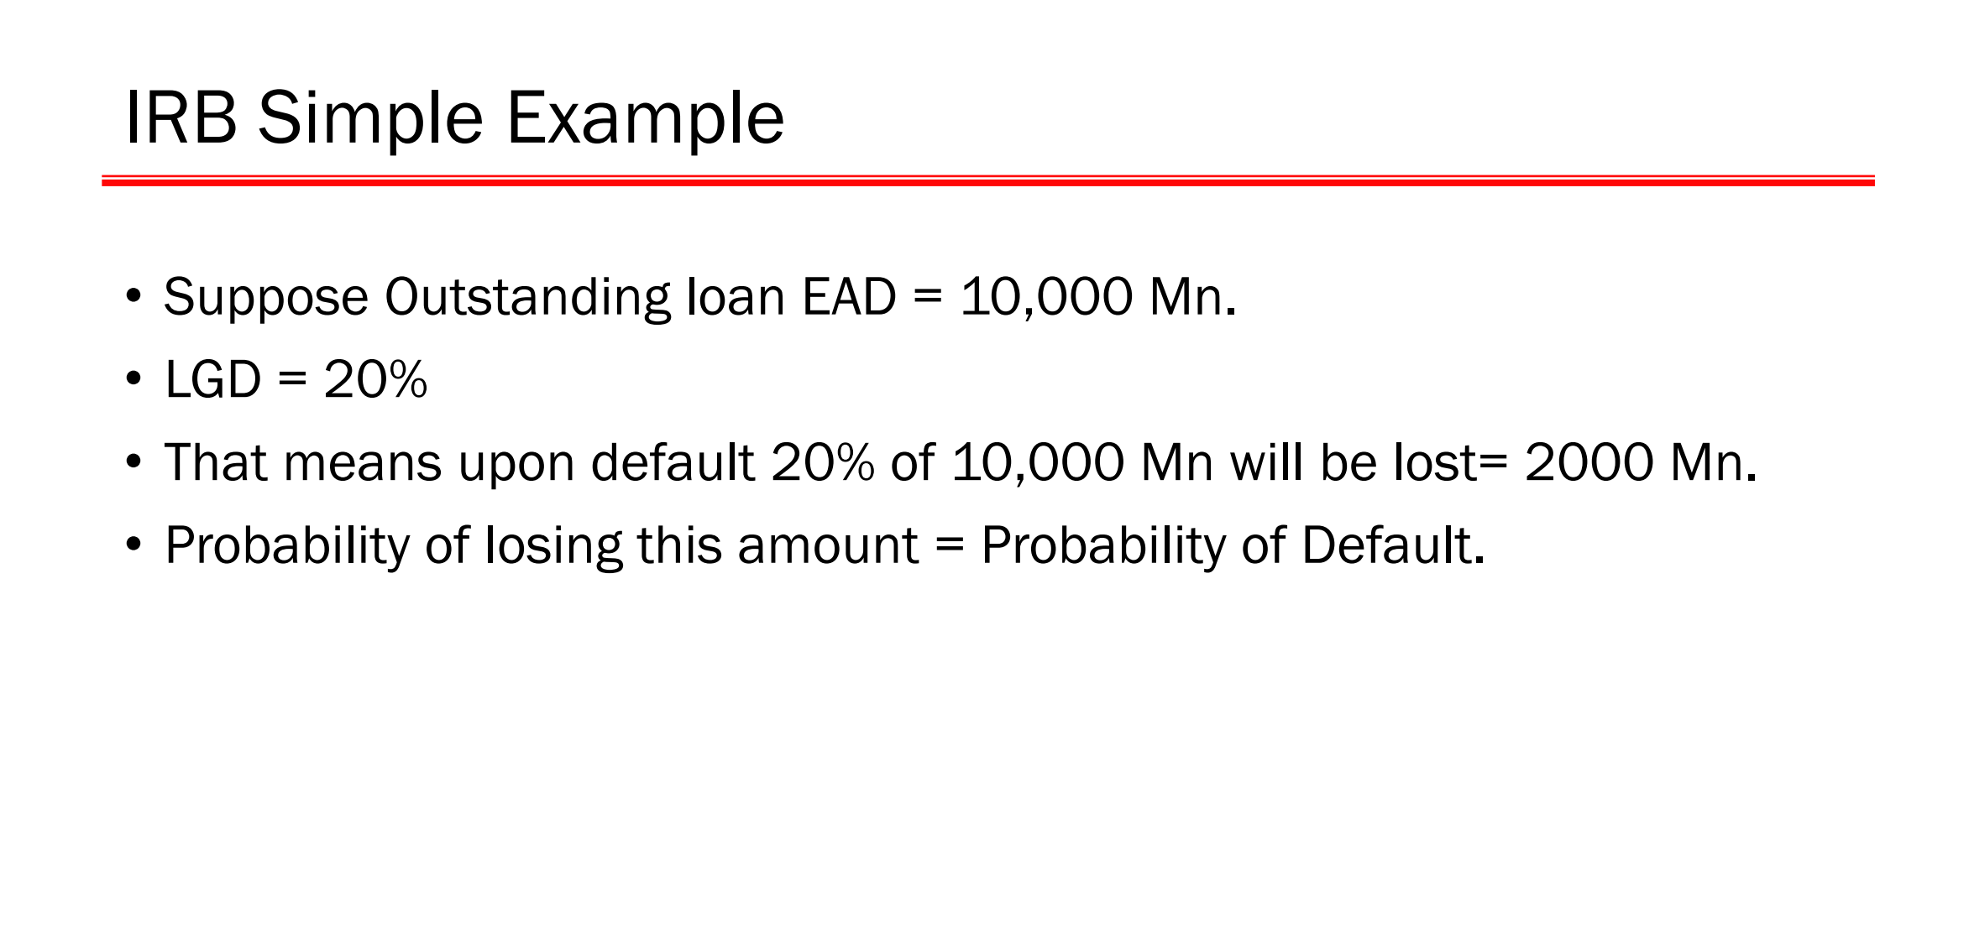

Slide 32
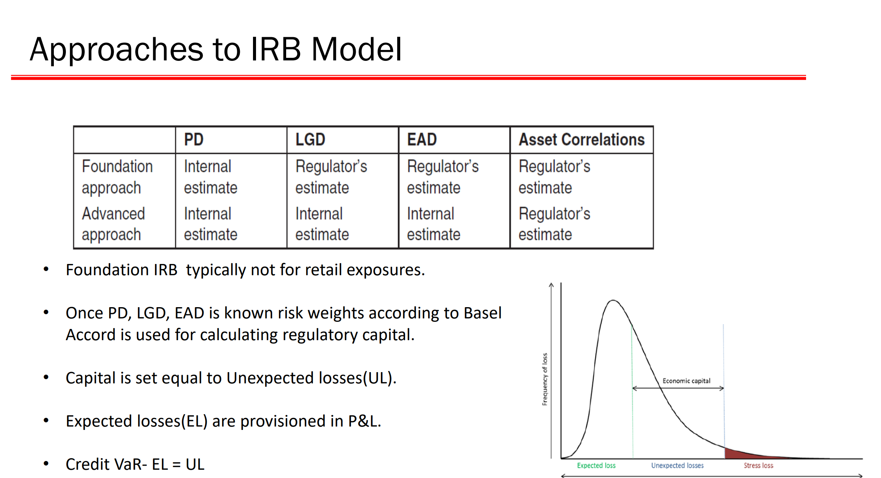

Slide 33
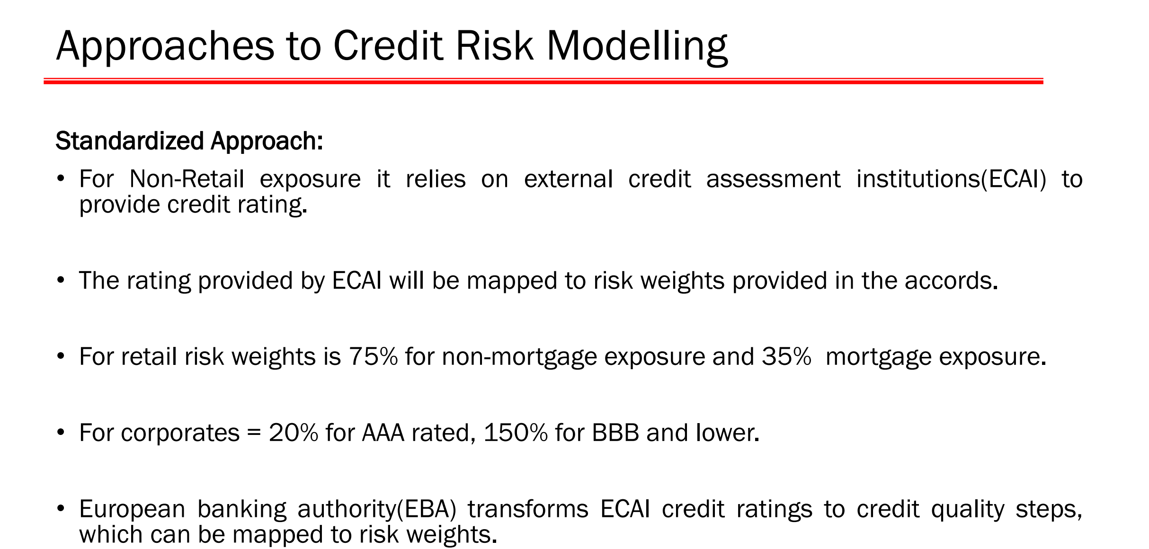

Slide 34
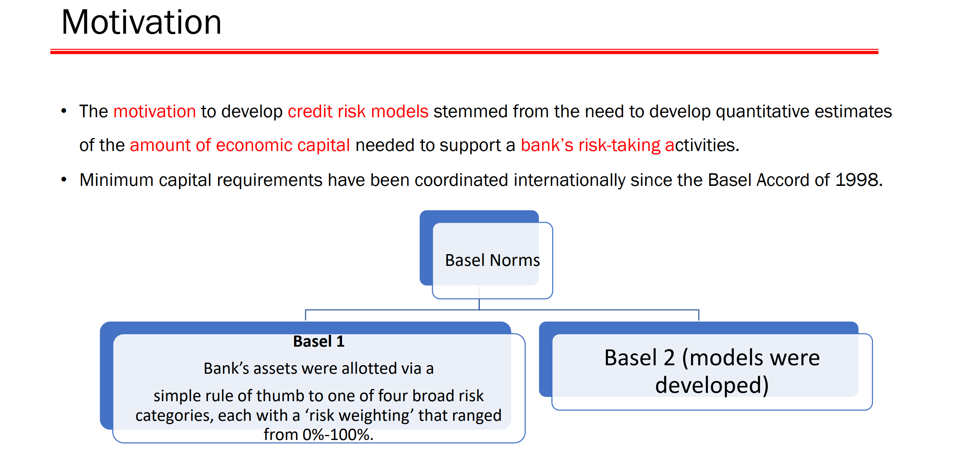

Slide 35
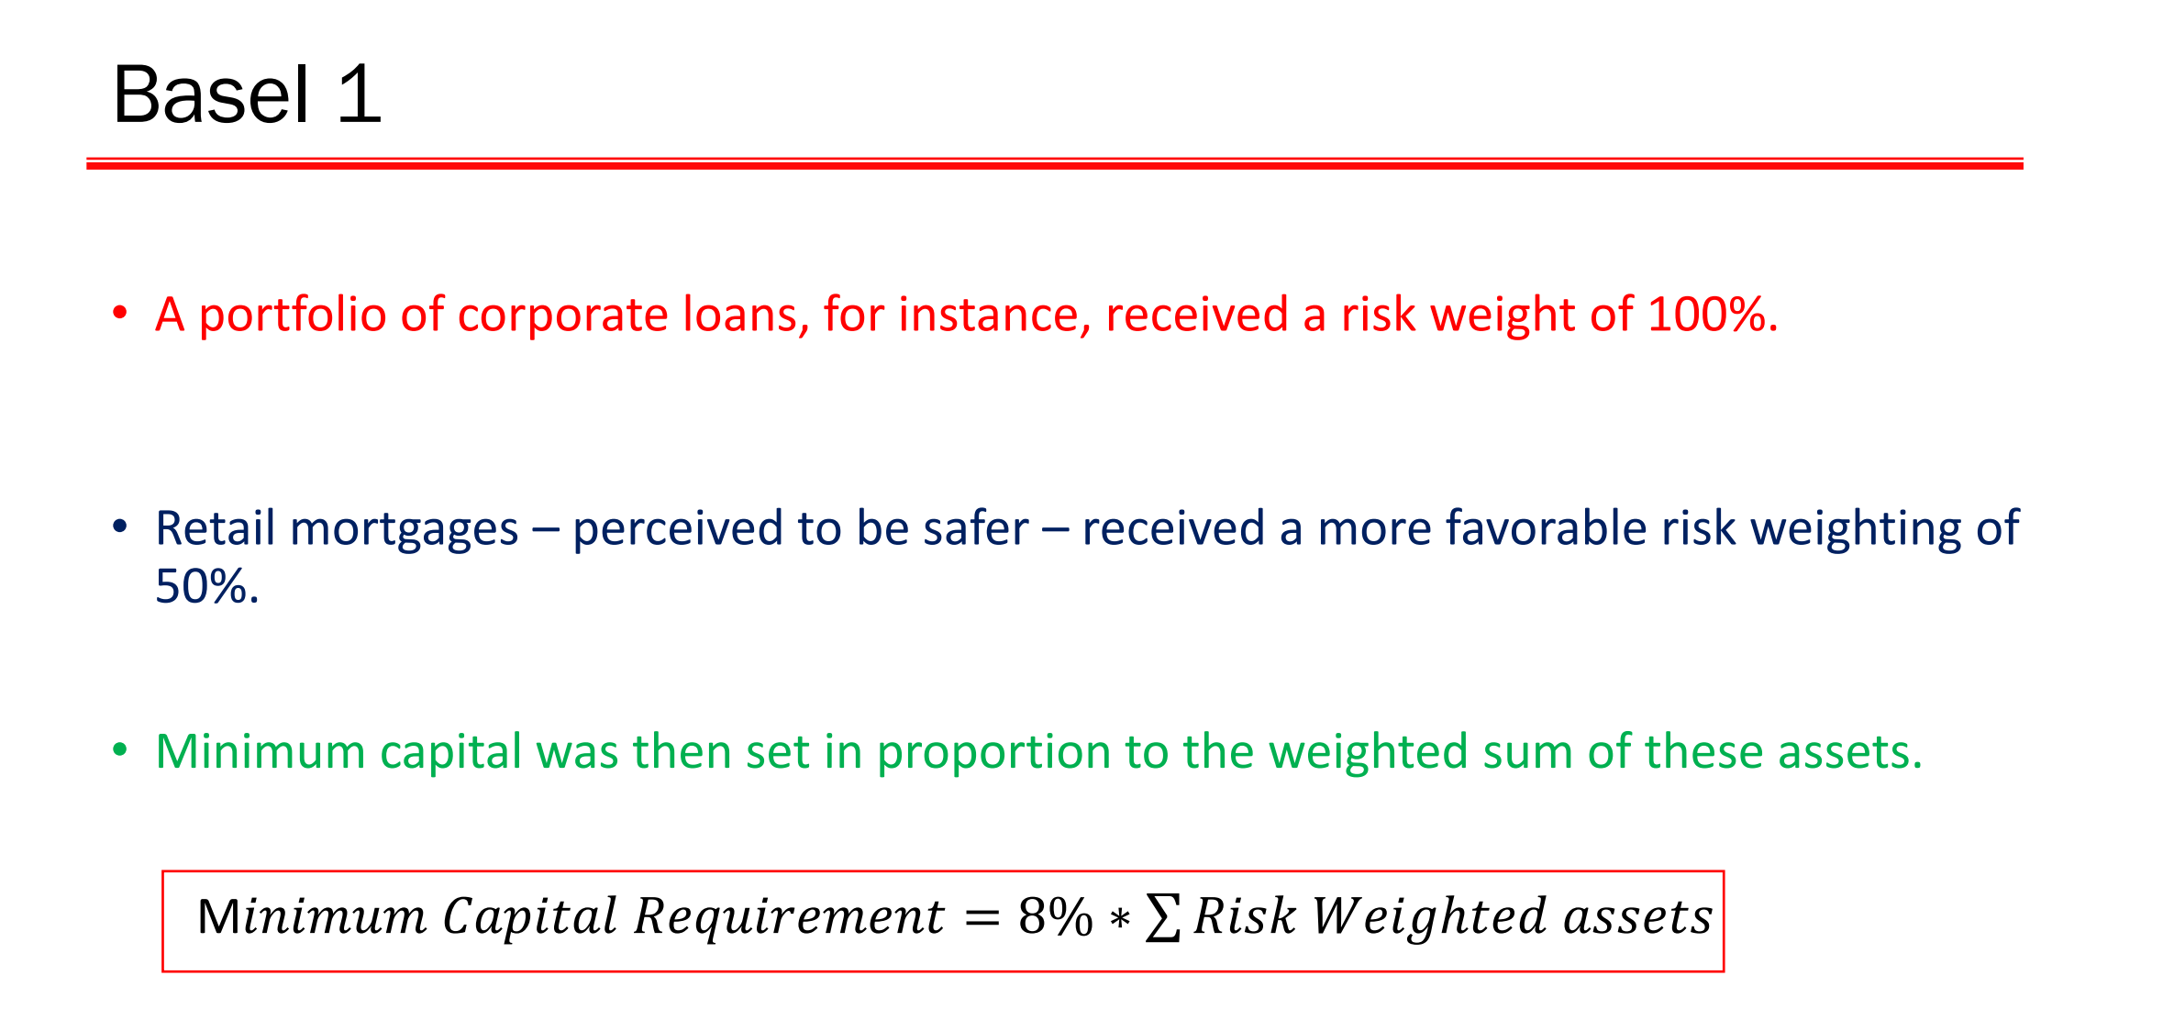

Slide 36
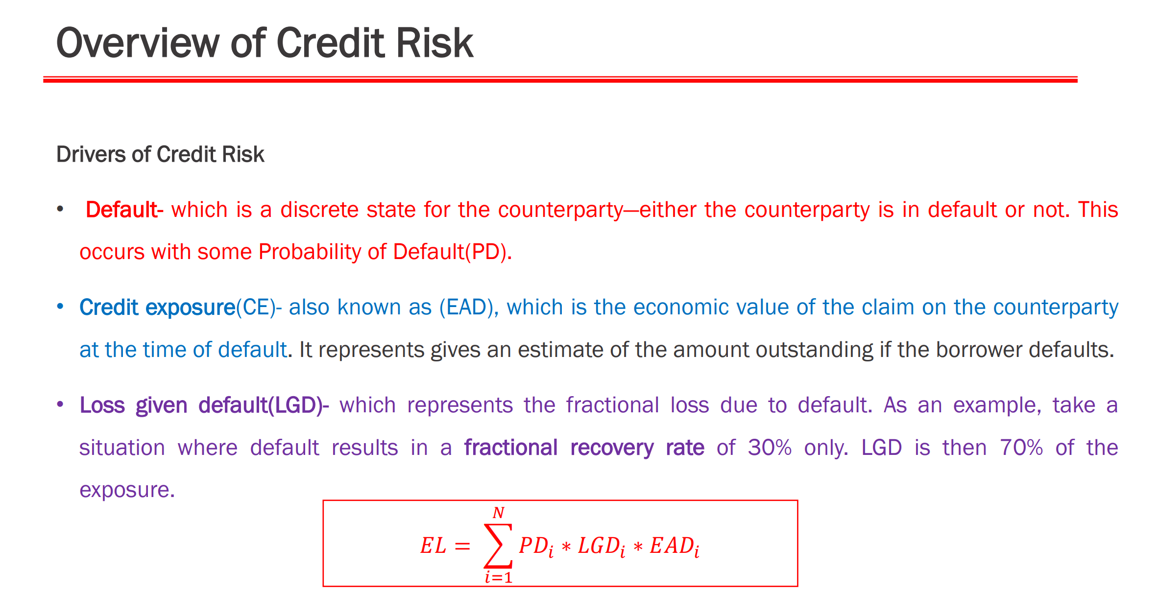

Slide 37
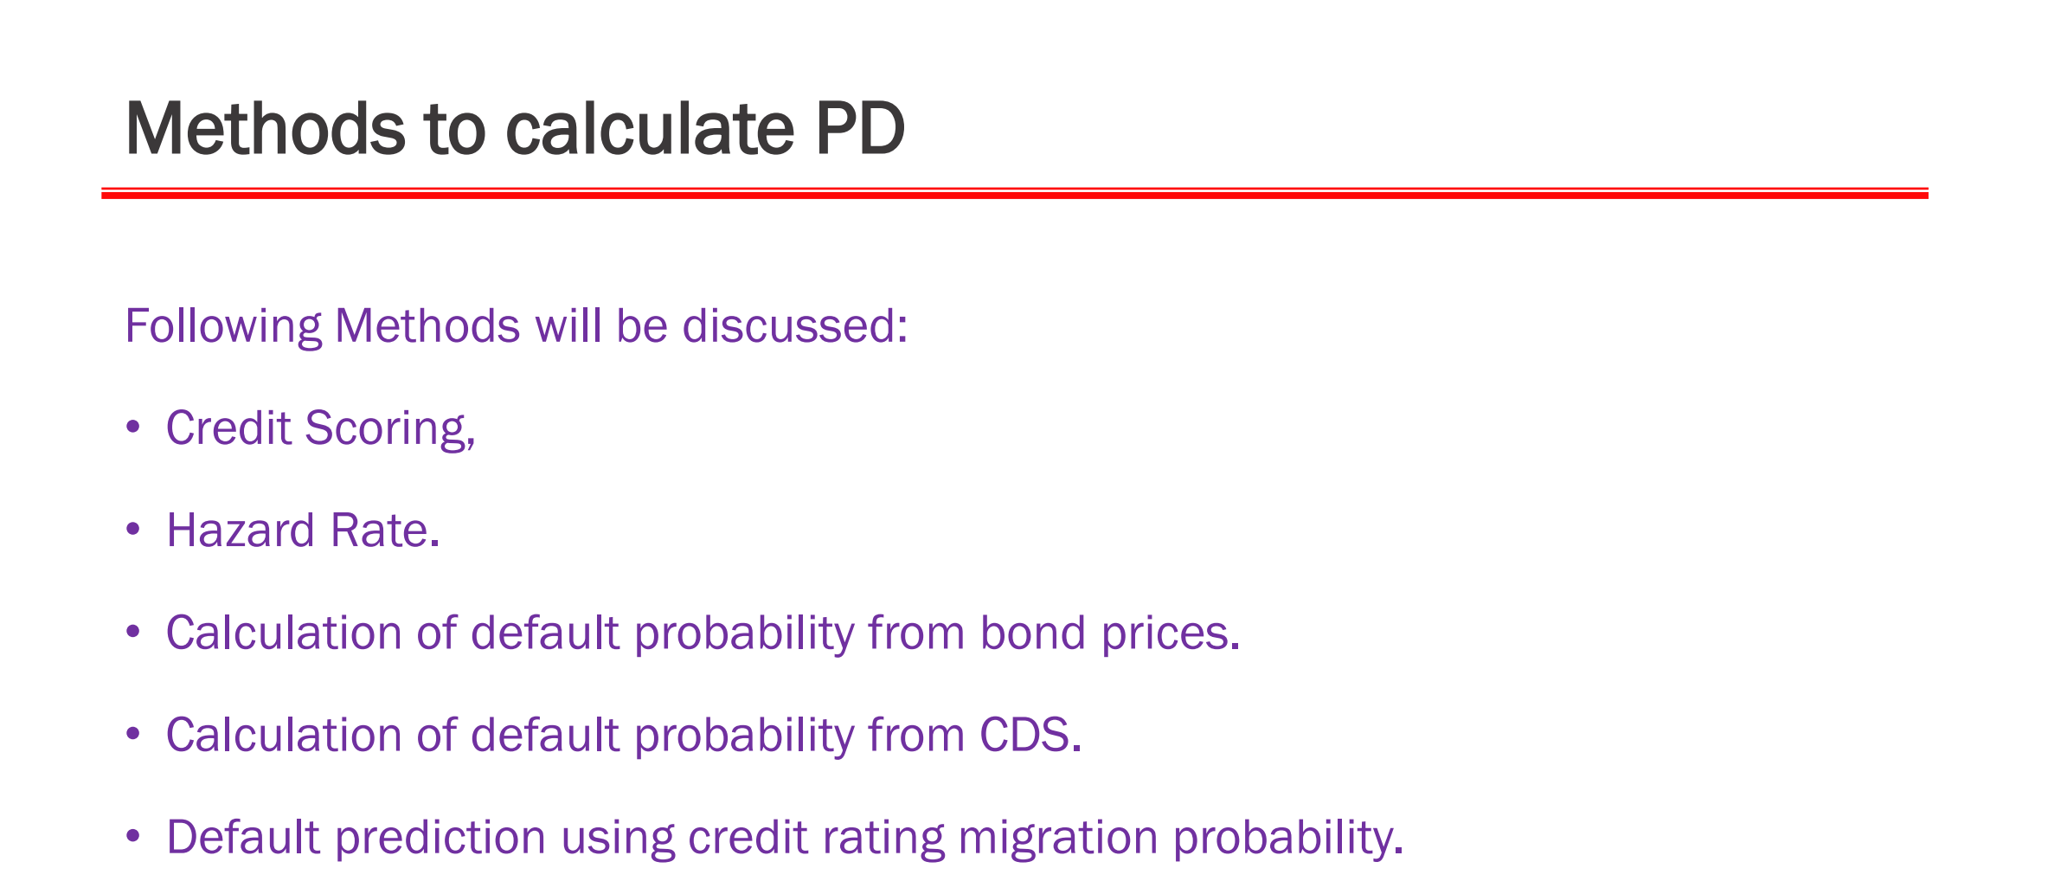

Slide 38
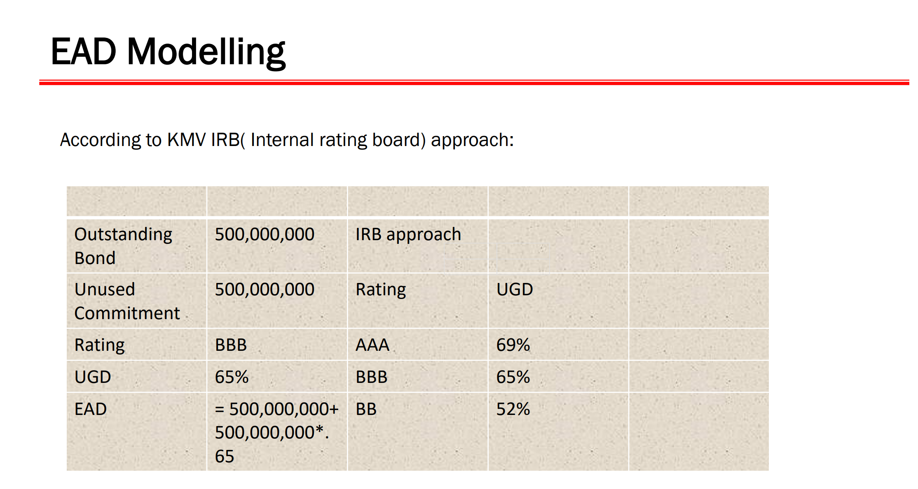

Slide 39
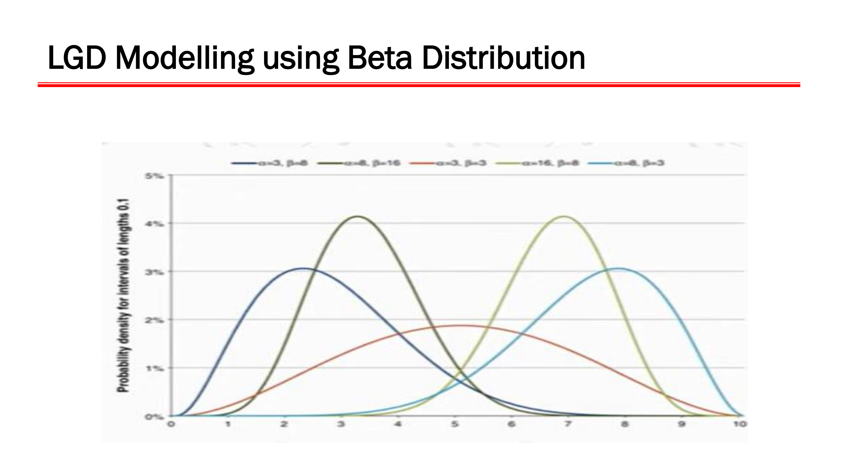

Slide 40
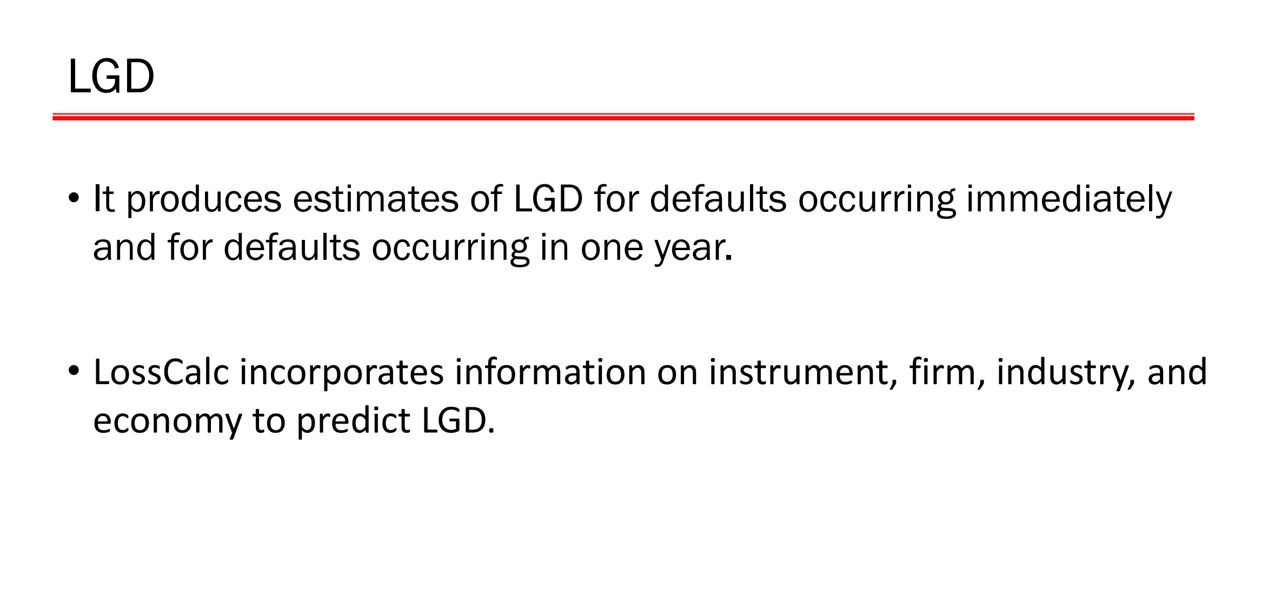

Slide 41
The Liner Probability Model, the Probit Model and the Logit Model
And, this takes us to …

Slide 42
Topic for the day is …
MODELING WITH QUALITATIVE AND LIMITED DEPENDENT VARIABLES

Slide 43
Let’s consider a problem…
A researcher, Mr. Suyra Kant, wants to know what are the factors that determine the ‘bankruptcy’ of a firm. He took a sample of 33 Solvent Firms and 33 Bankrupt Firms; and collected information on the following financial parameters:
    Working Capital to Total Assets (WC_ASSET)
    Retained Earnings to Total Assets (RE_ASSET)
    Return on Assets (ROA)
    Assets Turnover Ratio (ASSET_TURN)
    Market Value to Book Value (MV_BV)

Slide 44
Mr. Suyra Kant has made the following model…
Binary Variable; GROUP=0, the company is bankrupt and GROUP=1, the company is solvent.
What does this equation means? If the estimated value of the dependent variable GROUP is 0.75, how to interpret it?

Slide 45
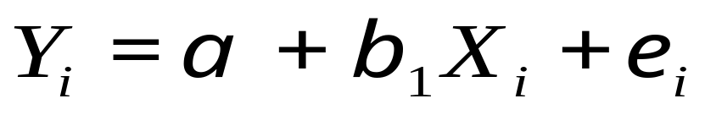
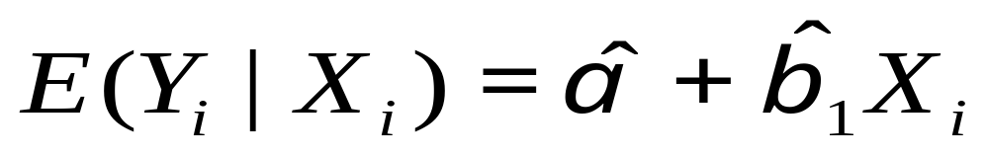
To appreciate the issues involved in a regression model with binary dependent variable, let’s consider a model with one explanatory variable…
We take a general model as thus:
Assume that OLS is used to estimate the above model, then how to interpret the estimated value of Y_{i}?
E(Y_{i}|X_{i}) is nothing but expected value of Y_{i} given X_{i}.

Slide 46
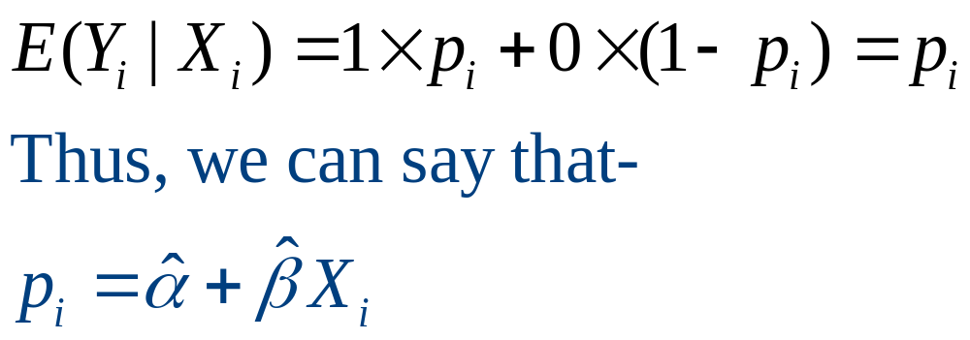
…continued
Alternatively, the expectation of Yi given Xi can also be calculated as thus:
Let p_{i} be the probability that a Y_{i} takes a value 1 given a particular X_{i} and (1-p_{i}) be the probability that a Y_{i} takes a value 0 given a particular X_{i}. Then, the expected value of Y_{i} given X_{i} can be calculated as thus:

Slide 47
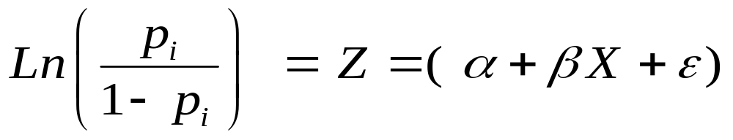
Finally, the LOGIT Model is …

Slide 48
Estimation of LOGIT Model…
The LOGIT Model is not estimated by using OLS but it is estimated by using Maximum Likelihood Method and thus, the estimates we obtain are known as Maximum Likelihood Estimates.

Slide 49
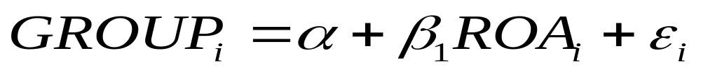
Revisiting our Bankruptcy Example…
Assume that the bankruptcy model is as thus:
As per the model, it assumed that bankruptcy depends upon the Return on Assets; and it is suggested that higher the Return on Assets a company generates, higher the probability that a company will be solvent.

Slide 50
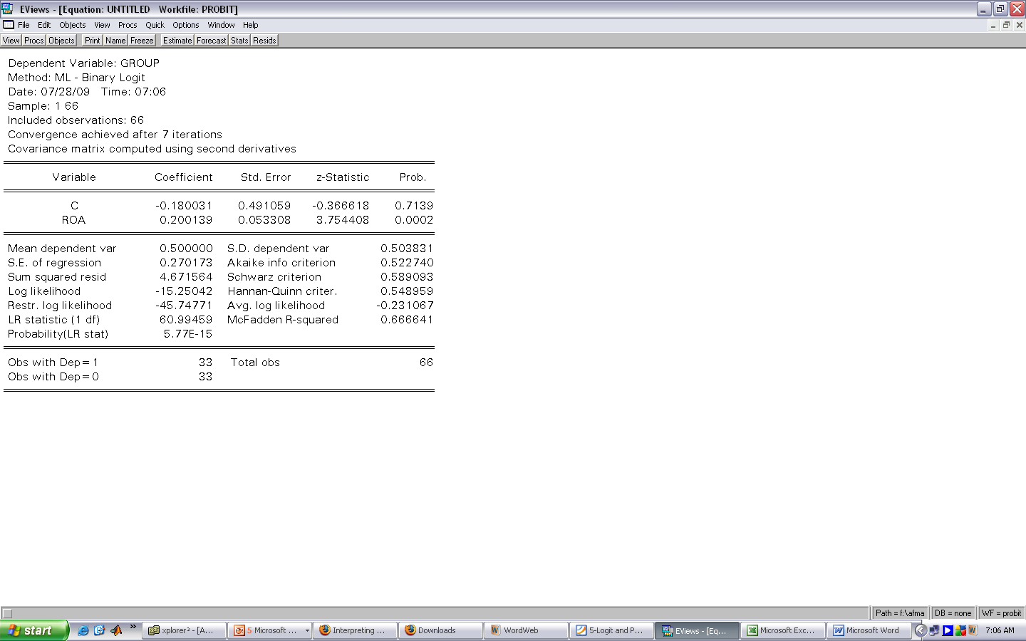
The Result obtained from Eviews…
Z = -0.180031+0.200139 ROA

Slide 51
Now, let’s take the Complete Example…
The Model as hypothesized by Mr. Surya Kant:
As per the model, it assumed that bankruptcy depends upon the financial ratios - Return on Assets, and Market Value to Book Value. Using the LOGIT Model, we obtain the results as thus:

Slide 52
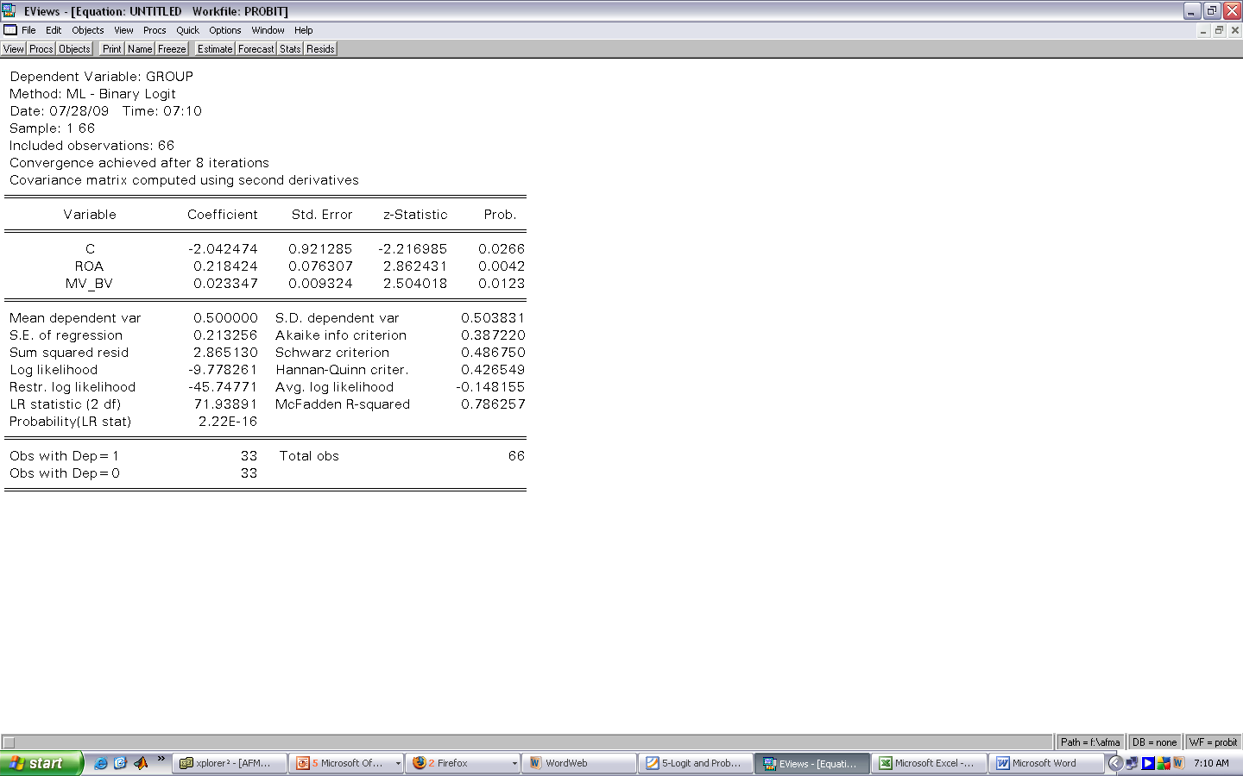
The Result obtained from Eviews…
Z = -2.042474+0.218424 ROA+0.023347 MV_BV

Slide 53
Another Example…
A survey is conducted among the users and non-users of micro-wave oven. The following information is being collected about them on the following parameters:
    Users/Non-Users (Users-1 and non-users-0)
    Monthly Income (Rs. in ‘000)
    Monthly Consumption of Food Items (in Kgs.)

Slide 54
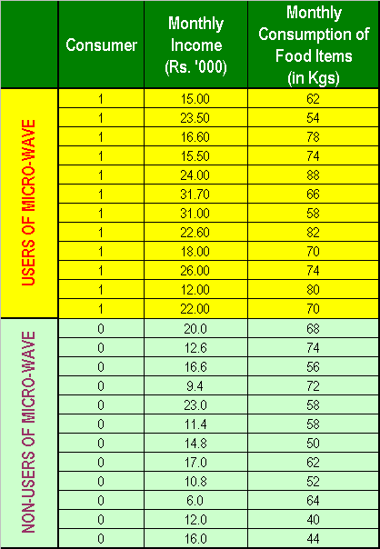
Data Collected is …

Slide 55
Think…???
What should be the
LOGIT MODEL?

Slide 56
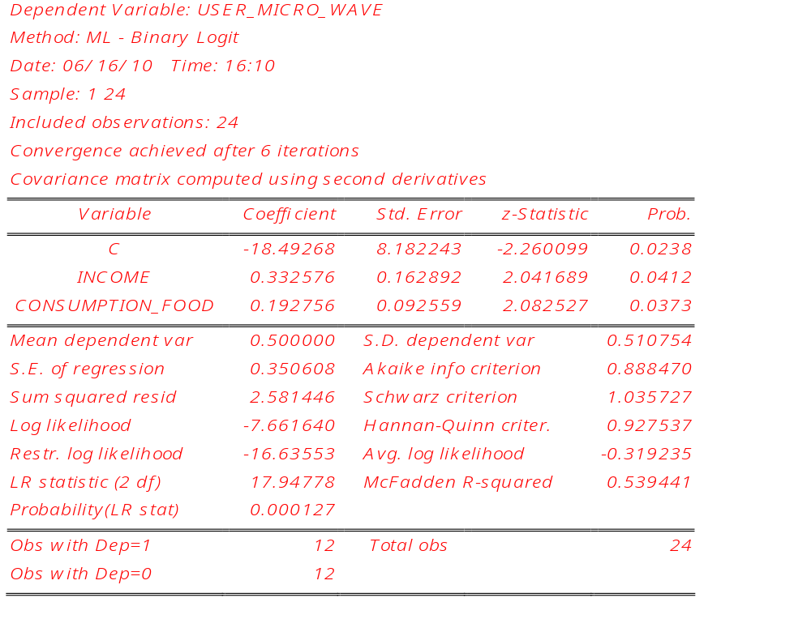
The Result of the Estimated LOGIT Model…

Slide 57
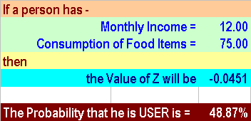
The Result of the Estimated LOGIT Model…

Slide 58
Using LOGIT and PROBIT models…
…can we predict who is going to the OWNER of Microwave?
Yes, for that one has to take a threshold limit of the probability!
Normally, such a threshold is taken as p = 50%. If Probability is more than 50%, he is going to be the owner; otherwise he is not!

