Slide 1
Advanced Leadership and Change Management
Module-3, Session-1&2
Theories and Leadership Styles
02/06/2024
Prof. Anupama Sharma

Slide 2
Learning Objectives
Introduce and critically discuss traditional approaches to leadership that look at the traits, characteristics and personality of leaders
Introduce and critically discuss the notion of leadership style
Introduce and critically discuss the notion of intelligence or intelligences and the link to leadership
Explore the difference between traits, skills, styles and intelligences of leadership

Slide 3


Introduction
Leadership is the ability to develop a vision that motivates others to move with a passion toward a common goal. So leadership is a process by which a person influences others to accomplish an objective and directs the organization in a way that makes it more cohesive and coherent.

Slide 4

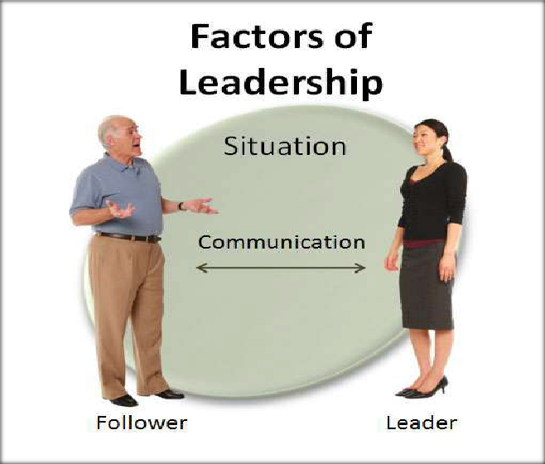
Four factors of leadership

Slide 5
Organizational Leadership: Towards a General Model
Five ‘Intelligences’ Underlying Leadership
Cognitive intelligence
Spiritual intelligence
Emotional intelligence
Moral intelligence
Behavioural skills (Gill, 2006)

Slide 6
Cognitive Intelligence
The ability to perceive and understand information, reason with it, imagine possibilities, use intuition and imagination, make judgements, solve problems and make decisions.
Spiritual Intelligence
The ability to understand that human beings have an animating need for meaning, value and a sense of worth in what they seek and do and to respond to that need. (Gill, 2006)

Slide 7
Emotional Intelligence
The ability to understand oneself and the feelings and needs of other people, exercise self-control, and respond to other people in appropriate ways in order to influence, motivate and inspire them. It includes:
Knowing one’s emotions
Managing emotions
Motivating oneself
Recognising emotions in others
Handling relationships

Slide 8
Moral Intelligence
The ability to differentiate right from wrong according to universal moral principles.
Behavioural Skills
Using and responding to emotion (e.g. body language), communicating in other ways (writing, speaking and active listening), using personal power, and using different leadership styles according to the situation.

Slide 9
Skills Approaches
Three-Skill Approach (Katz, 1955):
  Technical Skills: functional and problem-solving skills
  Human: ability to work effectively as a group member and to build co-operative effort within a team
  Conceptual Skill: ability to see the enterprise as a whole
Different skills needed at different managerial levels
  Technical Skills decrease in importance at higher levels
  Human Skills are important at all levels
  Conceptual Skills increase in importance at higher levels

Slide 10
Leadership Styles
Considers behavioural patterns as the determinant of effective leadership
Principal dichotomy between:
  Task behaviours
    Concern for task - the extent to which the leader emphasises the task objectives
    Directive leadership - the extent to which the leader makes all the decisions regarding group activity
  Relationship behaviours
    Concern for people - the extent to which the leader emphasises the needs, interests etc. of the group
    Participative leadership - the extent to which the leader shares decision-making concerning group activity

Slide 11

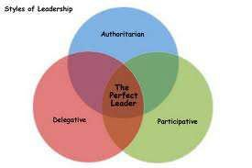
Styles of leadership
The three major styles of leadership are (U.S. Army Handbook, 1973) :
➢Authoritarian or autocratic
➢Participative or democratic
➢Delegative or Free Reign

Slide 12
Main Types of Leadership Styles
The Autocratic or Authoritarian Leader
The Democratic or Participative Leader
The Laissez-faire or Delegative Leader
The Charismatic Leader
The Servant Leader

Slide 13
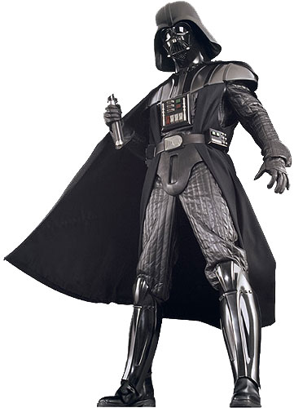
The Autocratic or Authoritarian Leader
Given the power to make decisions alone, having total authority.
Closely supervises and controls people when they perform certain tasks.

Slide 14



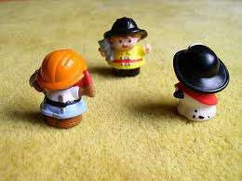
Autocratic – The authoritarian leader makes decisions alone as power is centralized in one person. Decisions are enforced using rewards and the fear of punishment. it is an abusive, unprofessional style called “bossing people around.
”

Slide 15
The Democratic or Participative Leader
Includes one or more people in the decision making process of determining what to do and how to do it.
Maintains the final decision making authority.

Slide 16
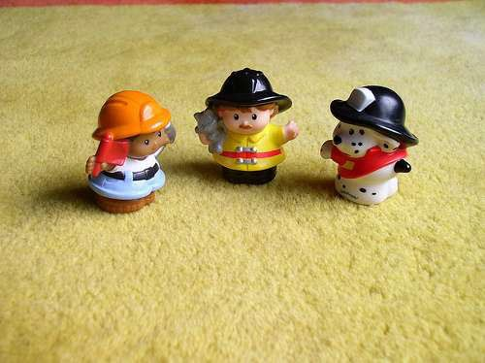
Democratic- The participative leader include one or more employees in the decision making process. Communication flow freely; suggestions are made in both directions. The participation encourages member commitment to the final decisi
on.

Slide 17
The Laissez-faire or Delegative Leader
Allows people to make their own decisions.
Leader is still responsible for the decisions that are made.
This style allows greater freedom and responsibility for people.
However, you need competent people around you or nothing will get done.
Laissez-faire is a French phrase meaning “let do”

Slide 18
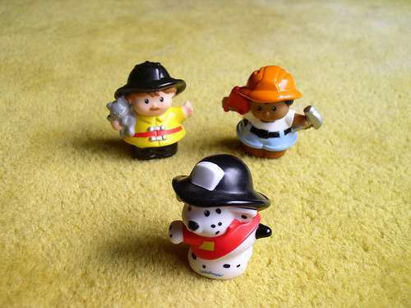
Laissez-faire- The free-rein leader gives power to subordinates to make the decisions. However, the leader is still responsible for the decisions that are made. This is used when employees are able to analyze the situation. Deligative style is generally not useful.

Slide 19
The Charismatic Leader
Leads by creating energy and eagerness in people.
Leader is well liked and inspires people.
Appeals to people’s emotional side.

Slide 20
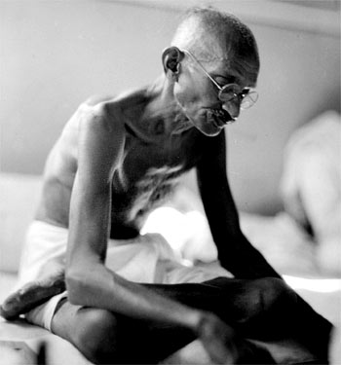
The Servant Leader
The highest priority of this leader is to encourage, support and enable people to fulfill their full potential and abilities.
Helps people achieve their goals.
Works for the people.

Slide 21
Characteristics of the
Servant-Leader
1. Listening Servant-leaders focus on listening to
identify and clarify the needs and desires of
a group.
2. Empathy Servant-leaders try to empathize with
others’ feelings and emotion. An individual’s
good intentions are assumed even when he
or she performs poorly.
3. Healing Servant-leaders strive to make themselves
and others whole in the face of failure or
suffering.
4. Awareness Servant-leaders are very self-aware or their
strengths and limitations.

Slide 22
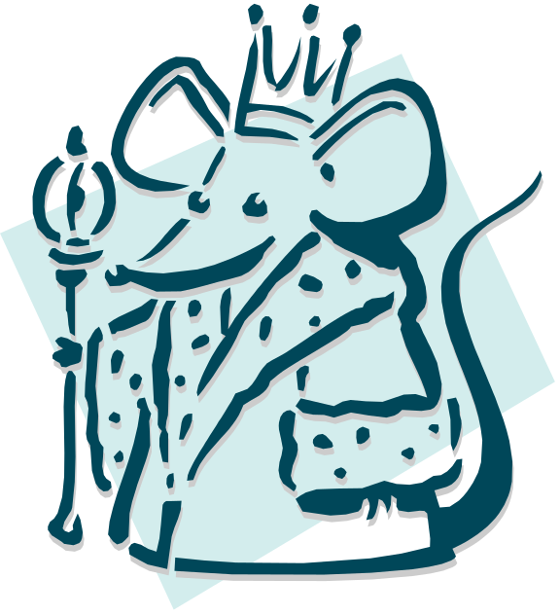
Transactional versus Transformational Leadership
Transactional Leadership: focuses on the interpersonal interactions between managers and employees
Transactional Leaders
- use contingent rewards to motivate employees
- exert corrective action only when employees
fail to obtain performance goals

Slide 23
Transactional and Transformational Leadership
Transactional Leaders
Leaders who guide or motivate their followers in the direction of established goals by clarifying role and task requirements
Contingent Reward
Management by Exception (active)
Management by Exception (passive)
Laissez-Faire
Transformational Leaders
Leaders who provide the four “I’s” (individualized consideration, inspirational motivation, idealized influence, and intellectual stimulation)
Idealized Influence
Inspirational Motivation
Intellectual Stimulation
Individual Consideration

Slide 24
Characteristics of Transactional Leaders
Contingent Reward: Contracts exchange of rewards for effort, promises rewards for good performance, recognizes accomplishments
Management by Exception (active): Watches and searches for deviations from rules and standards, takes corrective action
Management by Exception (passive): Intervenes only if standards are not met
Laissez-Faire: Abdicates responsibilities, avoids making decisions
Bill Gates“If you think your teacher is tough, wait until you get a boss. He doesn’t have tenure.”
Source: B. M. Bass, “From Transactional to Transformational Leadership: Learning to Share the Vision,” Organizational Dynamics, Winter 1990, p. 22. Reprinted by permission of the publisher. American Management Association, New York. All rights reserved.
E X H I B I T 13–2

Slide 25
Characteristics of Transformational Leaders
Idealized Influence: Provides vision and sense of mission, instills pride, gains respect and trust
Inspiration: Communicates high expectations, uses symbols to focus efforts, expresses important purposes in simple ways
Intellectual Stimulation: Promotes intelligence, rationality, and careful problem solving
Individualized Consideration: Gives personal attention, treats each employee individually, coaches, advises
E X H I B I T 13–2 (cont’d)

Slide 26

Transactional versus Transformational Leadership (continued)
Charismatic Leadership: emphasizes symbolic leader behavior that transforms employees to pursue organizational goals over self-interests
Charismatic Leaders
- use visionary and inspirational messages
- rely on non-verbal communication
- appeal to ideological values
- attempt to intellectually stimulate employees
- display confidence in self and followers
- set high performance expectations
For class discussion and Exercise: Should a leader be both transactional and charismatic? In what situations would it be important that transactional leadership dominate? Charismatic?

Slide 27
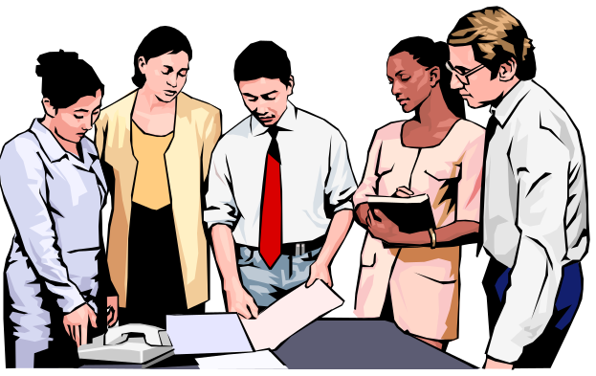
Beyond Charismatic Leadership
Level 5 Leaders
  Possess a fifth dimension—a paradoxical blend of personal humility and professional will—in addition to the four basic leadership qualities of individual capability, team skills, managerial competence, and the ability to stimulate others to high performance
  Channel their ego needs away from themselves and into the goal of building a great company

Slide 28
Questions
Which leadership style do you think is the most effective? Why?
Which leadership style do you think is the least effective? Why?
Which style do you like leaders to use when they are in charge of you? Why?
What leadership style best describes you?

Slide 29
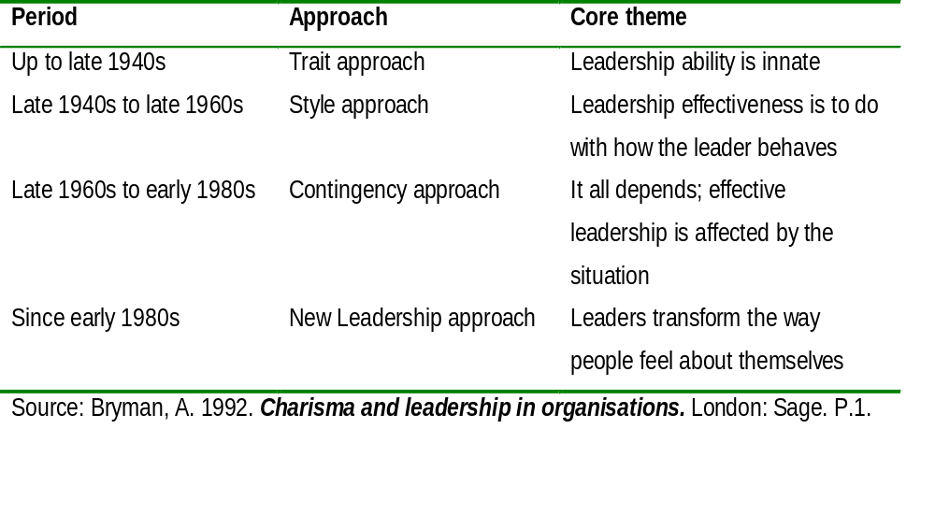
The Early Development of Leadership Theory

Slide 30
Leadership Theories
Trait and Behavioral Theories of Leadership
  Trait Theory
  Behavioral Styles Theory
Situational Theories
  Fiedler’s Contingency Model
  Path-Goal Theory
  Hersey and Blanchard’s Situational Leadership Theory

Slide 31









Theories of leadership
TRAIT THEORY
BEHAVIRAL THEORY
CONTINGENCY
THEORY
SITUATIONAL THEORY

Slide 32
Trait, Personality, Skill, Style or Intelligence?
Trait – a distinguishing feature in character, appearance, habit or portrayal
Personality – a distinctive character or qualities of a person, personal existence or identity, being a person
Skill – expertness, a practised ability, facility in an action
Style – a kind or sort, a manner of writing, speaking or doing, a distinctive manner of a person
Intelligence – understanding, a quickness of understanding

Slide 33
Traits
‘Leaders are born, not made’ and effective leaders have certain qualities in common, such as:
    Intelligence, dependability, sense of responsibility, energy, sociability (e.g. Stogdill - Ohio State studies)

Slide 34

Trait Theory
Leadership Traits: represent the personal characteristics that differentiate leaders from followers.
Historic findings reveal that leaders and followers
vary by
- intelligence
- dominance
- self-confidence
- level of energy and activity
- task-relevant knowledge
Contemporary findings show that
- People tend to perceive that someone is a leader when he or she exhibits traits associated with intelligence, masculinity, and dominance
- Credible leaders are honest, forward-looking, inspiring, and
competent

Slide 35
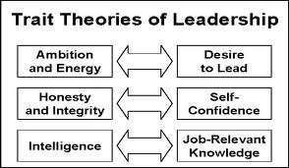
Trait theory-
The Trait Approach arose from the “Great Man” theory as a way of identifying the key characteristics of successful leaders. It was believed that through this theory critical leadership traits could be isolated and that people with such traits could then be recruited, selected, and installed into leadership positions. This theory was common in the military and is still used as a set of criteria to select candidates for commissions.

Slide 36
Advantages of Trait Theory -
It is naturally pleasing theory.
It serves as a yardstick against which the leadership traits of an individual can be assessed.
It gives a detailed knowledge and understanding of the leader element in the leadership process.

Slide 37
Limitations of The Trait Theory –
There is bound to be some subjective judgment
in determining who is regarded as a “good‟ or
“successful‟ leader.
There is also a disagreement over which traits
are the most important for an effective leader

Slide 38
Trait Theory and Gender
Gender and leadership
Men and women were seen as displaying more task and social leadership, respectively
Women used a more democratic or participative style than men, and men used a more autocratic and directive style than women
Men and women were equally assertive
Women executives, when rated by their peers, managers and direct reports, scored higher than their male counterparts on a variety of effectiveness criteria

Slide 39
Behavioral Styles Theory
Ohio State Studies identified two critical dimensions of leader behavior.
1. Consideration: creating mutual respect and trust with followers
2. Initiating Structure: organizing and defining what group
members should be doing
University of Michigan Studies identified two leadership styles that were similar to the Ohio State studies
- one style was employee centered and the other was job centered
Blake and Mouton’s Managerial Grid represents four leadership styles found by crossing concern for production and concern for people
Research shows that there is not one best style of leadership. The effectiveness of a particular leadership style depends on the situation at hand.

Slide 40


Behavioral Theory-
These theories of leadership are based upon the belief that great leaders are made, not born.
Rooted in behaviorism, this leadership theory focuses on the actions of leaders not on mental qualities or internal states.
According to this theory, people can learn to become leaders through teaching and observation.
The behavior approach says that anyone who adopts the appropriate behavior can be a good leader.

Slide 41



Studies of Behvioral theory
Ohio state leadership university studies.
Managerial Grid
University of Michigan studies

Slide 42

Contingency theory-
In Contingency theory of leadership, the success of the leader is a function of various contingencies in the form of subordinate, task, and/or group variables. The Leaders who are very effective at one place and time may become unsuccessful either when transplanted to another situation or when the factors around them change.
This helps to explain how some leaders who seem for a while to have the 'Midas touch' suddenly appear to go off the boil and make very unsuccessful decisions.

Slide 43
Different Sets/theories of contingency theory :
➢FIEDLER‟S CONTIINGENCY MODEL
➢HARSEY & BLANCHARD‟S SITUATIONAL THEORY
➢PATH GOAL THEORY
➢VROOM-JAGO CONTINGENCY MODEL

Slide 44

FIEDLER’S CONTINGENCY MODEL
Fiedler's model assumes that group performance depends on:
Leadership style, described in terms of task motivation and relationship motivation.
➢Situational favourableness, determined by three factors:
Leader-member relations - Degree to which a leader is accepted and supported by the group members.
Task structure - Extent to which the task is structured and defined, with clear goals and procedures.
c)Position power - The ability of a leader to control subordinates through reward and punishment.

Slide 45


Blanchard's situational theory-
The Hersey-Blanchard Situational Leadership Theory was created by Dr Paul Hersey and Ken Blanchard. The theory states that instead of using just one style, successful leaders should change their leadership styles based on the maturity of the people they're leading and the details of the task. Using this theory, leaders should be able to place more or less emphasis on the task.

Slide 46
According to Hersey and Blanchard, there are four main leadership styles:
Telling (S1) – Leaders tell their people exactly what
to do, and how to do it.
Selling (S2) – Leaders still provide information and direction, but there's more communication with followers. Leaders "sell" their message to get the team on board.
Participating (S3) – Leaders focus more on the relationship and less on direction. The leader works with the team, and shares decision-making responsibilities.
Delegating (S4) – Leaders pass most of the responsibility onto the follower or group. The leaders

Slide 47



Path-Goal theory-
According to path-goal theory, the leader‟s responsibility is to increase subordinates‟ motivation to attain personal and organizational goal. A person may do these by adopting a certain leadership style, according to the situation:
➢Directive leadership – it tells subordinates exactly what they are supposed to do, which includes planning, making schedules, setting performance goals and behaviour standards.
➢Supportive leadership - it shows concern for
subordinates‟ well being and personal needs.

Slide 48
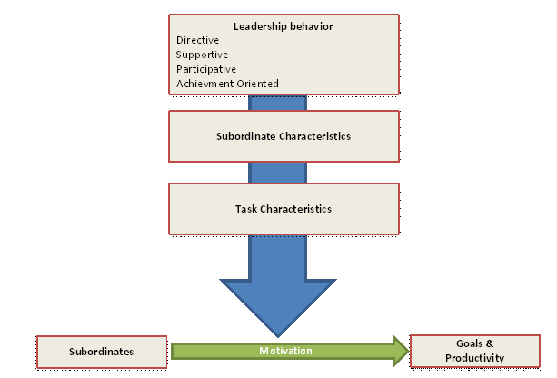
Participative leadership - Decision making is based on group consultation and information is shared with the group.
Achievement-oriented leadership - Challenging goals are set and high performance is encouraged while showing confidence in the groups' ability.

Slide 49

Managerial grid
It describes the relationship between the leader's
concern for task and concern for people, but this theory differs in its perspective. The managerial grid Considers leadership style based on their focus on task and people.
The Managerial Grid is based on two behavioral dimensions:
Concern for People – This is the degree to which a leader considers the needs of team members, their interests, and areas of personal development when deciding how best to accomplish a task.
Concern for Production – This is the degree to which a leader emphasizes concrete objectives, organizational efficiency and high productivity when deciding how best to accomplish a task.

Slide 50
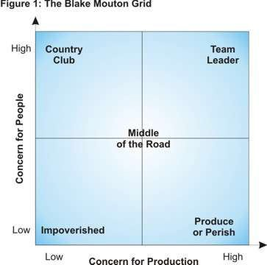
Using the axis to plot leadership „concerns for production‟ versus „concerns for people‟, Blake and Mouton defined the following five leadership styles:

Slide 51

Likert‟s school of leadership
Dr Rensis Likert (1903 - 1981) was a management theorist. According to Likert, the efficiency of an organisation or its departments is influenced by
their system of management. Likert categorised his four management systems as follows:
Exploitive authoritative system
Benevolent authoritative system
Consultative system
Participative (group) system

Slide 52
Exploitative Authoritative: Responsibility lies in the hands of the people at the upper echelons of the hierarchy.
Benevolent Authoritative: The responsibility lies at the managerial levels but not at the lower levels of the organizational hierarchy.
Participative: Responsibility for achieving the organizational goals is widespread throughout the organizational hierarchy.

Slide 53
Extra

Slide 54
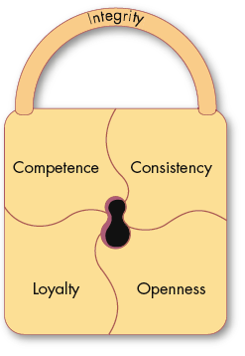
Trust: The Foundation of Leadership
Trust
A positive expectation that another will not—through words, actions, or decisions—act opportunistically
Trust is a history-dependent process (familiarity) based on relevant but limited samples of experience (risk)
E X H I B I T 13–4

Slide 55

Dimensions of Trust
Integrity
  Honesty and truthfulness
Competence
  An individual’s technical and interpersonal knowledge and skills
Consistency
  An individual’s reliability, predictability, and good judgment in handling situations
Loyalty
  The willingness to protect and save face for another person
Openness
  Reliance on the person to give you the full truth

Slide 56
Three Types of Trust
Deterrence-based Trust
Trust based on fear of retaliationl if the trust is violated
Knowledge-based Trust
Trust based on behavioral predictability that comes from a history of interaction
Identification-based Trust
Trust based on a mutual understanding of one another’s intentions and appreciation of the other’s wants and desires

