Slide 1
Advanced Leadership and Change Management
Module-3, Session-3
Leading (Across) Teams
09/06/2024
Prof. Anupama Sharma

Slide 2
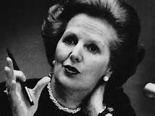
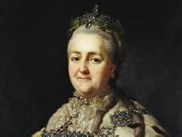
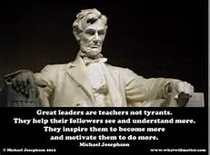
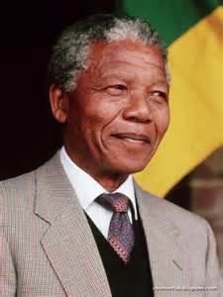
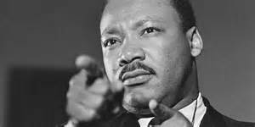

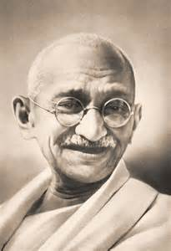
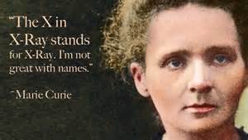

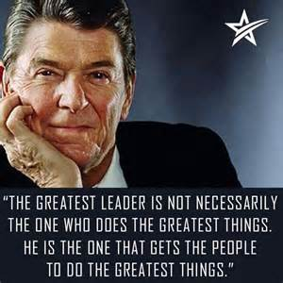
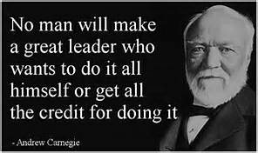
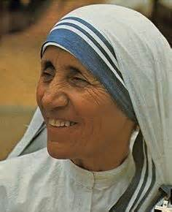
Leadership
Definition
  “If your actions inspire others to dream more, learn more, do more and become more, you are a leader” John Quincy Adams
Notes:
There are as many definitions of leadership as there leaders, but this one by John Quincy Adams incorporates many of the aspects of most definitions of leadership exemplified by all the well-known figures represented on this slide. One image which may not be recognized to the top right of center is Catherine the Great, who rose to power after her husband, Peter III, was assassinated. Under her rule, Russia grew and emerged larger and stronger and became one of the great powers of Europe in the 18th century. Leadership is more about leading people than it is about leading projects.

Slide 3
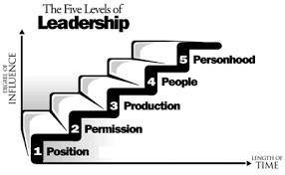
The Ultimate Leader
The best leaders are also good managers, although it is rare to find the best traits of both in one person
“Everything rises and falls on leadership”
John C. Maxwell
Notes:
John Maxwell belongs to the school of leadership gurus who support the position that leadership is a skill that can be taught, rather than people can only be born as leaders. His five levels of leadership promote that one’s skill as a leader grows with increasing influence over time. The first level he refers to as ‘Position’.
‘Position’ leadership: At this level, people follow you because you have the title or “rank”. Because you are the boss they will do as you say, but they will do the bare minimum. They will not go the extra mile for you.
At ‘Permission’ leadership level, people want to follow you because they trust you. This level of leadership is based on “relationship”.
At the level of ‘Production’, people follow you because you achieve “results”. Accomplishments are clear at this stage and people want to be associated with success.
‘People’ leadership is Firestone’s “highest calling of leadership”. People follow you because of what’s in it for them! You poor your life into developing them. You “reproduce” leaders. At this level you achieve much for people as well as organizations.
The top level of ‘Personhood’ has also been named ‘Pinnacle’ leadership. People follow you because of who you are … your values and what you represent and they “respect” you. Few leaders are at this level of influence and it is not easy to get here according to Maxwell. It takes considerable time and consistent effort in the small and big decisions in life. This is where you want to be; strive for this level of leadership.

Slide 4
Six Management Styles
Based on Daniel Goleman’s classic study (Harvard Business Review, 2000) of more than 3000 mid-level managers
  Directive - The “do it the way I tell you” manager
  Authoritative - The “firm but fair” manager
  Affiliative - The “people first, task second” manager
  Participative - The “everyone has input” manager
  Pacesetting - The “do it myself” manager
  Coaching - The “developmental” manager
6 Management Styles and When Best To Use Them –
The Leaders13 Tool Kit, The Huffington Post, April 16, 2013
Rosalind Cardinal
Notes:
In 2000, Daniel Goleman published his 3-year study of more than 3000 mid-level executive managers about their management styles, their impact on the corporate world including profitability. The research showed that management style accounted for 30% of the company’s bottom line! These are the 6 management styles he uncovered as communicated by Rosalind Cardinal in an article published in the Huffington Post in 2013 and updated in 2015. [Review the bullets and add the following applications for each bullet]
Directive management – Effective when there is a crisis and when deviations are risky. Avoid when employees are underdeveloped or highly skilled as they become frustrated and resentful at the micromanaging.
Authoritative management – Is effective when clear directions and standards are needed and the manager is credible. Avoid it when employees need guidance on what to do and/or the leader is not credible as the people won’t follow your vision if they don’t believe in it
Affiliative management – Is effective when tasks are routine, performance adequate, when counseling, helping, or managing conflict. Avoid it when performance is inadequate as affiliation does not emphasise performance or if there is a crisis situation that requires direction
Participative management – Is effective when employees are working together and have experience and credibility. Avoid it when employees must be coordinated or there is a crisis and no time for meetings or if there is a lack of competency & close supervision is required
Pacesetting management – Is effective when people are highly motivated, competent and require little direction e.g., with experts. Avoid it when workload requires assistance from others or when development, coaching & coordination required
Coaching management is effective when skills needs to be developed and employees are motivated and wanting development. Avoid it when the manager lacks expertise or the performance discrepancy is too great or there is a crisis. Coaching managers may help rather than release a poor performer.

Slide 5

Management Characteristics of Great Managers
  Stellar managers create superior dynamics where teams:
    achieve great results because team members trust one another
    work seamlessly with one another
    are excellent at making decisions
    hold one another accountable for making things happen

Slide 6
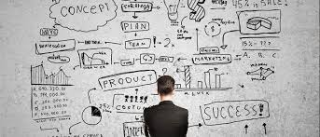
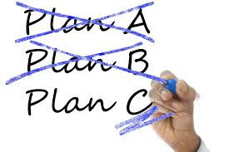
Basic management skills (1/2)
Plan
  What is the “SMART” goal?
    Specific – Clear and detailed objectives which is significant if achieved
    Measurable – Can be achieved, quantified and meaningful, even motivational to the team
    Agreed – The team involved needs to agree to it. It needs to be attainable and action-oriented
    Realistic – The goal needs to be relevant, reasonable, rewarding and results-oriented
    Timely – The goal should be tangible and able to be tracked using deadlines
  What is the desired result?
  What is the complexity and what are the options?
  What will it take to achieve success?
Organize
  This is where the rubber hits the road and all the plans in the world are ineffective without organized and synchronized execution
    Are the right people involved and do they understand their roles?
    Are the right tools and processes in place?
    It timing coordinated?
    What happens when the task is accomplished? Is there a hand-off?
Notes:
1. Planning is the most critical skill of managers. Success is difficult at best, and impossible at worst, without planning. As the saying goes, “If you fail to plan, plan to fail.” Plan for the best case scenario, plan for the worst case scenario and plan a couple other options whilst you’re at it. Use SMART goals. [Review the questions then the bullets]
2. Organizing [Review the bullets]

Slide 7
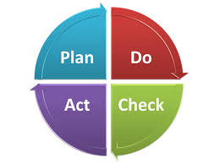
Basic management skills (2/2)
3. Direct
  Once the planning and organization is completed and the project begins, the role of the manager turns to orchestrating flawless execution by and of:
    People
    Systems
    Timing
4. Monitor
  Checking on the project on a regular basis via systematic review of each step is important because issues arise. This is where you are able to determine whether you could operate on your optimal plan to over-deliver or engage alternative options when problems arise.
    Tracking
    Trouble-shooting
    Tweaking
    Motivating
    Encouraging
Notes:
3. Directing [Review the bullets] Directing people can be done in various ways as addressed on the slide on the 6 different management styles. Make sure to use the right approach for the team and circumstances. Managing systems, tools, and processes in today’s world is similar to what we do with various techniques and equipment that are used in academic experimentation and is about optimum efficiency and automation to improve productivity. Today much can also be maximized through the use of network management using telecommunications technologies. Timing can be important to the success or failure of the project, especially if changes are occurring. Make sure to get this right. The right decision or process made, or in place at the wrong time, is a poor decision or process.
4. Monitoring [Review the bullets] Tracking, trouble-shooting, tweaking, motivating and encouraging are all important aspects of managing processes and people. They are needed to ensure that the team delivers results on budget and on time.

Slide 8
Leadership versus Management
Leaders | Managers
Create the vision (What) Transformational Long-term Innovate – breaks rules Inspire people Challenge the status quo Accept failure Heart – Passion – People Seeing & Selling | Execute the vision (How) Transactional Short-term Maintain – make rules Inform people Clarify the status quo Resist failure Head – Control – Processes Doing & Telling
“Management is doing things right; leadership is doing the right things”
Peter F. Drucker
Notes:
Leadership and management are sometimes used interchangeably, but they are in fact different activities as illustrated here. [Review table and summarize with the quote by Drucker]

Slide 9
Session Objective
Understanding groups and team
Difference between groups and teams
Science of building and leading great teams
Stages of group development
  The punctuated-equilibrium model
  Tuckman’s five-stage theory
Ways to build collaborative teams

Slide 10
Individuals versus Groups versus Teams
Team members usually have a stronger sense of identification among themselves than group members do
Teams have common goals or tasks, whereas group members may not have the same degree of consensus about goals that team members do
Task independence is greater with teams than with groups
Team members have more differentiated and specialized roles than group members

Slide 11
Implications of Group Size
Leader emergence is partly a function of group size
As size increases, cliques are more likely to develop
Cliques: Subgroups of individuals who often share the same goals, values, and expectations
Affects a leader’s behavioral style
Leaders with a large span of control tend to be more directive, spend less time with individual subordinates, and use impersonal approaches when influencing followers
Leaders with a small span of control tend to show more consideration and use personal approaches when influencing followers
Affects group effectiveness

Slide 12
Limitations to the Benefits of Size
There may be decreasing returns, on a per-capita basis, as group size increases
May occur in additive tasks due to process losses
  Additive task: A task where the group’s output simply involves the combination of individual outputs
  Process losses: Inefficiencies created by more and more people working together
Social loafing: Phenomenon of reduced effort by people when they are not individually accountable for their work
Social facilitation: People increasing their level of work due to the presence of others

Slide 13
Tuckman’s Stages of Group Development
Forming: Characterized by polite conversation, the gathering of superficial information about fellow members, and low trust
Storming: Marked by intragroup conflict and status differentiation as remaining contenders struggle to build alliances and fulfill the group’s leadership role
Norming: Characterized by the clear emergence of a leader and the development of group norms and cohesiveness
Performing: In this stage, group members play functional, interdependent roles that are focused on the performance of group tasks

Slide 15
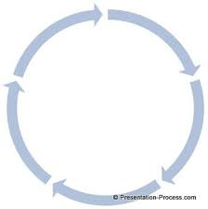
In Nutshell Team Building Stages
  Forming
    Defining the team, charter, roles, tasks, strategy
    Developing trust and communication
  Storming
    Working through the challenges related to the tasks, processes and persons
  Norming
    Acknowledgment of the team strengths and weaknesses
    Acceptance of members
    Harmonize working
  Performing
    Harmonized working and achieving results together
"Developmental sequence in small groups".
Psychological Bulletin. (1965) 63 (6): 384–399.
Bruce W. Tuckman
Notes:
Bruce Tuckman’s classic stages of how teams develop was published in 1965. If you have been part of a team you probably recognize these stages from your own experience.
In Stage 1 - FORMING The teams asks “Why are we here? “ Whilst the team is being defined, people assess each other. There can be feelings of anxiety & confusion and sometimes little work is actually accomplished. Conflicts can emerge, and leadership, value, strategy & feasibility of task(s) can be challenged. Team members typically feel included & expect that their opinions will be valued & respected as trust and communication is established. At this early stage, the team should be establishing its team charter, strategy, roles, tasks and goals. These need to be defined to be an effective team which will learn how to work together.
In Stage 2 – STORMING, the team asks, “Can we work together? “ More conflicts emerge as members work through the challenges related to the work at hand. Power plays may occur, i.e., who’s in charge & what actions need to be taken toward goals. Instability & polarization could bring conflict out in open. At this stage it is important to encourage transparent and fair communication & affirm that disagreement is healthy & resolvable.
In Stage 3- NORMING, the team asks, “How will we work together? . Rules get created and team members learn to work together productively. Team pride develops and norms are established for how people treat each other, meetings are conducted, who will do what work & how it the goals will be achieved based on the strengths and weaknesses of the team. Team member accept each other and working becomes harmonized. Skills & understanding are deepened and productivity is increased. The environment has become safe to share opinions & skills which are evaluated critically & constructively.
In the final Stage 4 – PERFORMING – The team asks, “How can we work smarter? “ The team becomes fully engaged and functional. It is harmonized and achieves results by working seamlessly together as they diagnose, solve problems & make decisions. This is the highest stage of creativity and productivity and the team can handle new tasks working together or delegating work. Team members share leadership, responsibility and accountability.
Typically, the process is linear as the team goes from one stage to the next, however, as new challenges arise the team can move in an out of stages 2 (STORMING) to 4 (PERFORMING) more easily because of the trust that has been built over time. Teams that achieve this level are high-performing teams.

Slide 16
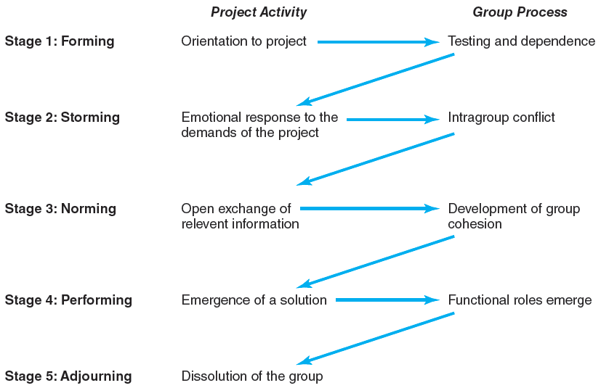
The Five-Stage Team Development Model
FIGURE 11.1

Slide 17

High-Performing Teams
Definition
  “A team is a small number of people with complementary skills who are committed to a common purpose, set of performance goals, and approach for which they hold themselves mutually accountable.”
  The Discipline of Teams, Jon R. Katsenbach and Douglas K. Smith (Harvard Business Review, July-August, 2005)
  Team effectiveness can be influenced by the personality types and traits of its individual members. Personality “types” are sometimes thought to involve qualitative, whereas personality “traits” maybe classified as quantitative differences between individuals. There are several models of assessment for both indices, e.g., MBTI, Five-Factor Model
  A high-performing team (HPT) is committed, coordinated, focused, adaptable and has diverse skills and talents
    communicates optimally
    aligns itself around key initiatives
    creates short-term/long-term plans
    takes ownership of key accountabilities
    holds itself accountable to deliver the required results
  “None of us are as smart as all of us”
  The New Science of Building Great Teams, Alex “Sandy” Pentland (Harvard Business Review, April, 2012)
Notes:
[Review bullets on slide]

Slide 18
High-Performing Teams
Synergy
Positive synergy 1 + 1 + 1 + 1 + 1 = 10
Negative synergy 1 + 1 + 1 + 1 + 1 = 2
Characteristics of High-Performing Teams
Share a sense of common purpose
Make effective use of individual talents and expertise
Balance role and share tasks
Exert energy toward problem solving
Accept differences of opinion and expression
Encourage risk taking and creativity
Set high personal performance standards
Identify source of both professional and personal growth

Slide 19
Situational Factors Affecting Team Development
Conditions Favoring Development of High-Performing Project Teams
There are 10 or fewer members per team.
Members volunteer to serve on the project team.
Members serve on the project from beginning to end.
Members are assigned to the project full time.
Members are part of an organization culture that fosters cooperation and trust.
Members report solely to the project manager.
All relevant functional areas are represented on the team.
The project involves a compelling objective.
Members are located within conversational distance of each other.

Slide 20
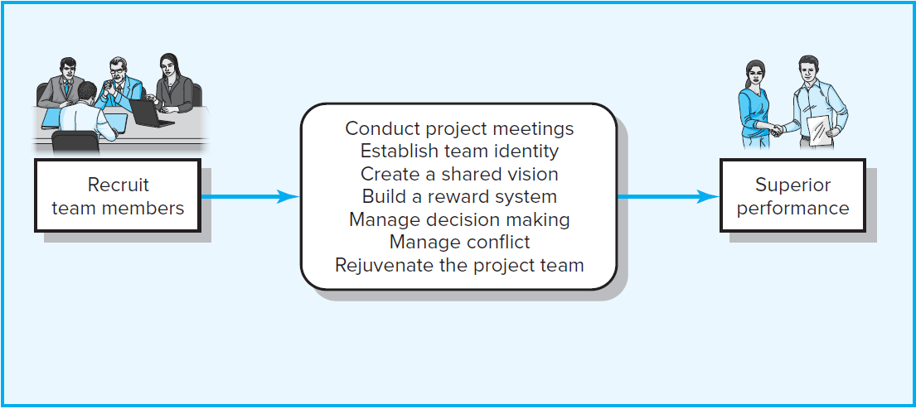
Building High-Performance Project Teams
FIGURE 11.3

Slide 21
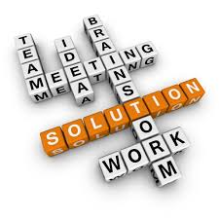
High-Performing Teams
Group Dynamics
  “The best teams invest a tremendous amount of time and effort exploring, shaping and agreeing on a purpose that belongs to them both collectively and individually. This ‘purposing’ activity continues throughout the life of the team.”
  The Discipline of Teams, Jon R. Katsenbach and Douglas K. Smith (Harvard Business Review, July-August, 2005)
  Group dynamics of HPTs centers on how teams communicate and operate:-
    - Energy
      How team members contribute to the team
        Everyone on the team talks and listens in roughly equal measure
        Keep contributions “short and sweet”
        Take ownership
    - Engagement
      How team members communicate with one another
        Connect directly with one another, not just the team leader
        Side-conversations within the team
    - Exploration
      How team members educate each other
        Seek fresh perspectives from other groups
        Bring information back to the team
Notes:
[Review bullets on slide]

Slide 22
5 Dysfunctions of a Team
Absence of trust The fear of being vulnerable with team members prevents the building of trust within the team
Fear of conflict The desire to preserve artificial harmony stifles the occurrence of productive ideological conflict
Lack of commitment The lack of clarity or buy-in prevents team members from making decisions to which they will stick
Avoidance of accountability The need to avoid personal discomfort prevents team members from holding one another accountable
Inattention to results The pursuit of individual goals and personal status erodes the focus of collective success
Dysfunctional teams may not prevent achieving team goals, but they are likely to be ineffective teams
  “The Five Dysfunctions of a Teams”, Patrick Lencione,
  Jossey-Bass, a Wiley imprint, 2002
Notes:
Teams don’t always work well together and in Patrick Lencione’s much read book, he tells a compelling story in which he covers the 5 dysfunctions of a team. This slide outlines these dysfunctions and how they can prevent the team from working optimally. [Review the slide]

Slide 23
Team Building
Key take-away messages
  Building effective teams takes time and effort as they evolve through different stages of development
  High performing teams consists of individuals
    with diverse personalities
    aligned and committed around a unified goal
    accountable, individually and as a team
    who have open communication & use conflict to their advantage
    who seek expertise outside of themselves
    who trust each other
    who are results-oriented

Slide 24
Delegating
Gives the responsibility for decisions to those individuals most likely to be affected by or to implement the decision
Concerned with autonomy, responsibility, and follower development than with participation
Research has shown that:
Leaders who delegate authority more frequently often have higher-performing businesses
Followers are not necessarily happier when their leaders frequently delegate tasks

Slide 25
Why Delegating Is Important
Frees time for the leader to perform other activities
Develops followers by providing them with practical experience in a controlled fashion
Strengthens the organization by signaling that subordinates are trusted and their development is important, which increases job satisfaction levels

Slide 26
Common Reasons for Avoiding Delegation
Takes leaders too much time in the short run, although it saves time in the long run
Risky because it reduces the leader’s direct control over work that would affect his or her reputation
Leaders fear the job will not be done properly
Leaders may resist delegating tasks that are a source of power or prestige
Leaders may feel guilty about delegating because people are already too busy

Slide 27
Principles of Effective Delegation
Decide what to delegate
Decide whom to delegate to
Make the assignment clear and specific
Assign an objective, not a procedure
Allow for autonomy while monitoring performance
Give credit, but do not blame

Slide 28
Gersick’s Punctuated Equilibrium Model
Teams do not necessarily jump right in and get to work
Spend the initial months trying out various ideas and strategies
Experience the equivalent of a midlife crisis midway into the project
  There is a flurry of activity and a reexamination of the strategy to see if it will allow them to complete their work

Slide 30
Group Roles
Sets of expected behaviors associated with particular jobs or positions
Can be categorized in terms of task and relationship functions
Task role: Deals with getting a task done
Relationship role: Deals with supporting relationships within a work group
Problems that can impede group performance
Dysfunctional roles
Role conflict
Role ambiguity

Slide 31
Role Conflict
Receiving contradictory messages about expected behavior.
Ways in which role conflict can occur
Intrasender role conflict: Same person sends mixed signals
Intersender role conflict: Receiving inconsistent signals from several others about expected behavior
Interrole conflict: Inability to perform one’s roles as well as one would like
Person-role conflict: Violation of a person’s values by role expectations

Slide 32
Group Cohesion
Sum of the forces that attract members to a group, provide resistance to leaving it, and motivate them to be active in it
Highly cohesive groups interact with and influence each other more than less cohesive groups do
  Have lower absenteeism and lower turnover, which can contribute to higher group performance
  Greater cohesiveness does not always lead to higher performance
  May sometimes develop goals contrary to the larger organization’s goals

Slide 33
Group Cohesion Continued..
Disadvantages of highly cohesive groups
Overbounding: Tendency to erect boundaries between themselves and others
Groupthink: People in highly cohesive groups often become more concerned with striving for unanimity than objectively appraising different courses of action
Ollieism: Occurs when illegal actions are taken by overly zealous and loyal subordinates who believe that what they are doing will please their leaders

Slide 34
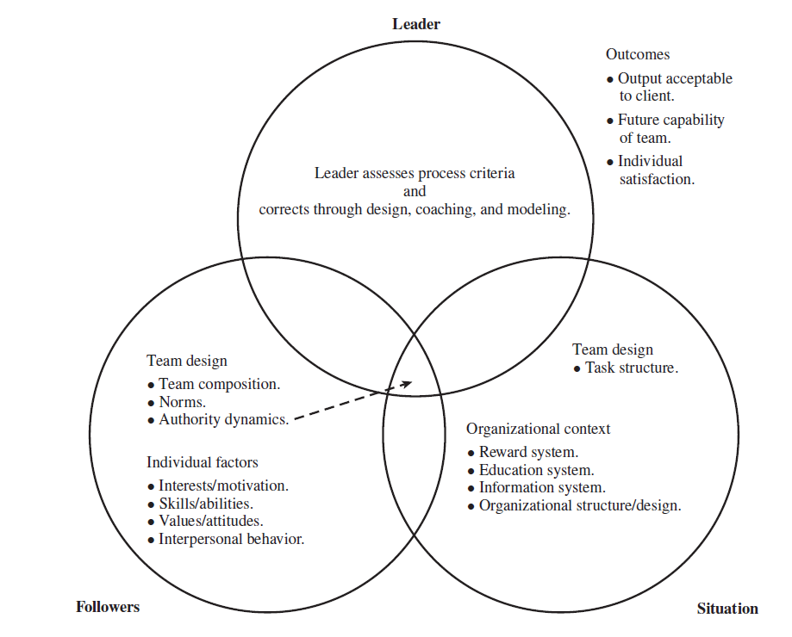
Factors from the Team Leadership
Model and the Interactional Framework

Slide 35
Thank You

