Slide 1
MLOps/AIOps
Dr. Bipul Kumar

Slide 2


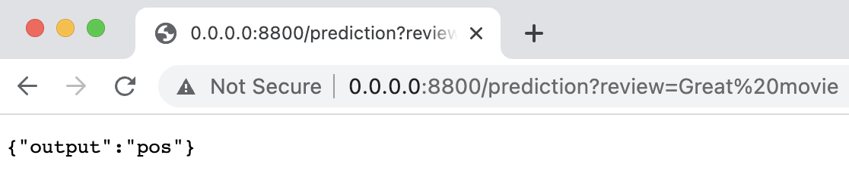
ML Model
Alice:
X
Y = f(X)
Bob:
Y = f(X)
Let’s share our model with users aka let’s put it into production!

Slide 3
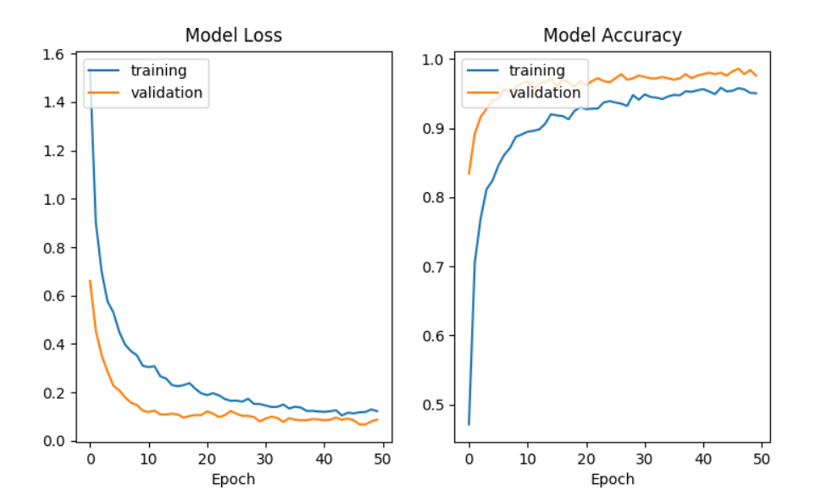
What Has to Go Right?
What is needed for an ML model to perform well in production?

Slide 4
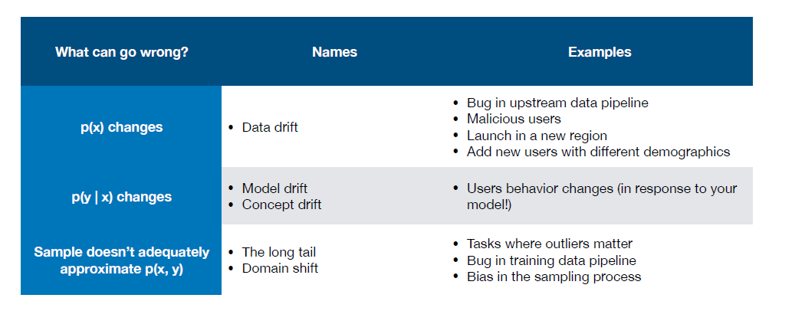
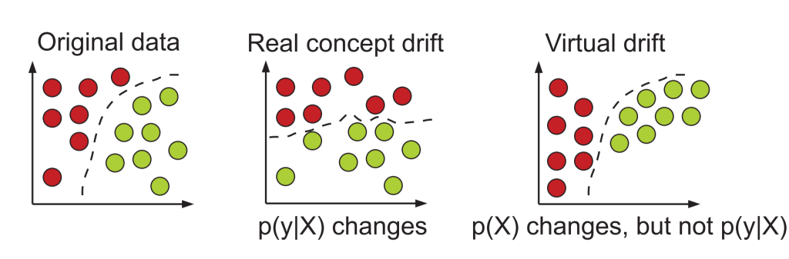
Concept/model and data/virtual drifts are one of the main challenges of production ML systems!

Slide 5
MLOps is about maintaining the trained model performance* in production.
The performance may degrade due to factors outside of our control so we ought to monitor the performance and if needed, roll out a new model to users.
*model performance = accuracy, latency, jitter, etc.

Slide 6
ML Model = Data + Code
MLOps = ML Model + Software
+ Algorithm
+ Weights
+ Hyperparameters
+ Scripts
+ Libraries
+ Infrastructure
+ DevOps

Slide 7
MLOps = ML Model + Software
Configuration
Feature Extraction
Machine Resource Management
Serving Infrastructure
Monitoring
Data Collection
ML Model
Analysis Tools
Data Verification
Process Management Tools
ML Framework
Your code
Good news: most of these components come as ready-to-use frameworks
D. Sculley et. al. Hidden Technical Debt in Machine Learning Systems, NIPS 2015

Slide 8
MLOps Pipeline
Data Engineering
Modelling
Deployment
Monitoring
MLOps is a multi-stage, iterative process.

Slide 9
Data Engineering
Explore
Reproducibility
Model-driven to Data-driven ML
Data Engineering
Modelling
Deployment
Monitoring

Slide 10
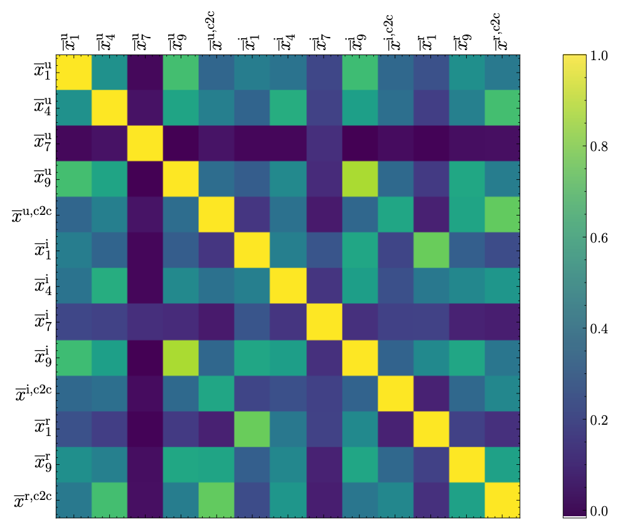
Exploratory Data Analysis
For structured data:
schema as required tables, columns and datatypes
For unstructured data:
resolution, image extension
frequency, duration, audio codec
Initial exploration allows indetifying requirements for input data in produciton.

Slide 11
Data Processing Pipeline
Data
Ingestion
Data Validation
Data Cleaning
Feature Engineering
Load from file
Load from db
Schema check
Audio/video file
check
Filling NaNs
Filtering
Normalization
Standardization
Feature selection
Feature crossover
We need to reproduce some of those steps (e.g. subtracting mean) in production!

Slide 12


Reproducibility
Dataset
Excel spreadsheets
Notebooks
Various scripts
Curated dataset
https://sites.google.com/princeton.edu/rep-workshop/

Slide 13
Keeping Track of Data Processing
Version Input Data – DVC framework
Version Processing Script - Github/GitLab
Version Computing Environment - Docker
Data Provenance – where does data come from?
Data Lineage – how data is manipulated?

Slide 14
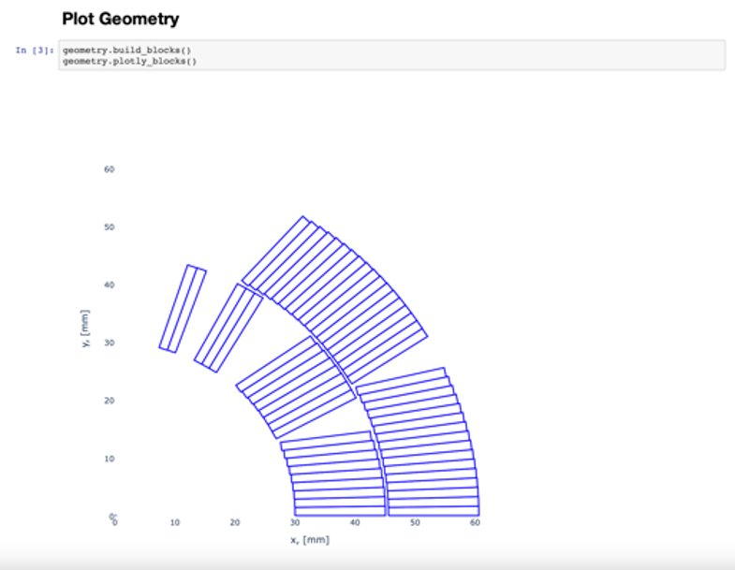
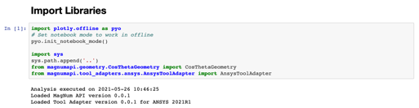
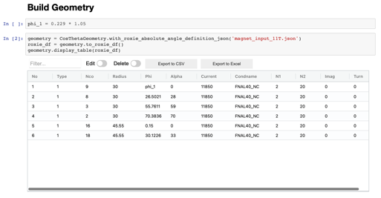
Notebook Good Practices
Linear flow of execution
Little amount of code
Extract reusable code into a package
Pre-commit for cleaning notebook before committing to a repository
Set parameters on top so that notebook can be treated as a function (papermill and scrapbook packages)
It is OK, to do exploratory quick&dirty model development.
Once we start communicating the model outside, we need to clean it!

Slide 15
From Model-driven to Data-driven ML
 | Model-driven ML | Data-driven ML
Fixed component | Dataset | Model Architecture
Variable component | Model Architecture | Dataset
Objective | High accuracy | Fairness, low bias
Explainability | Limited | Possible
https://datacentricai.org
https://spectrum.ieee.org/andrew-ng-data-centric-ai

Slide 16
Modelling
Training challenges
Rare events
Analyzing results
Data Engineering
Modelling
Deployment
Monitoring

Slide 17
Selecting Data for Training
Dataset
Training
80%
Validation
20%
train
Hyperparameter
tuning
validate
With this approach, the model eventually sees the entire dataset.

Slide 18
Selecting Data for Training
Dataset
Training
75%
Validation
15%
Test
10%
Final
check
train
Hyperparameter
tuning
validate
test
Splitting dataset in three allows to perform a final check with unseen data.

Slide 19
Balancing Datasets
Consider a binary classification problem with a dataset composed of 200 entries.
There are 160 negative examples (no failure) and 40 positive ones (failure).
Training
75%
(120 + 30)
Validation
15%
(24+6)
Test
10%
(16+4)
Expected:
Training
75%
(131 + 19)
Validation
15%
(19+11)
Test
10%
(10+10)
Random:
For continuous values it is important to preserve statistical distribution.
Although for big datasets it is not an issue, it is still a low-hanging-fruit.

Slide 20
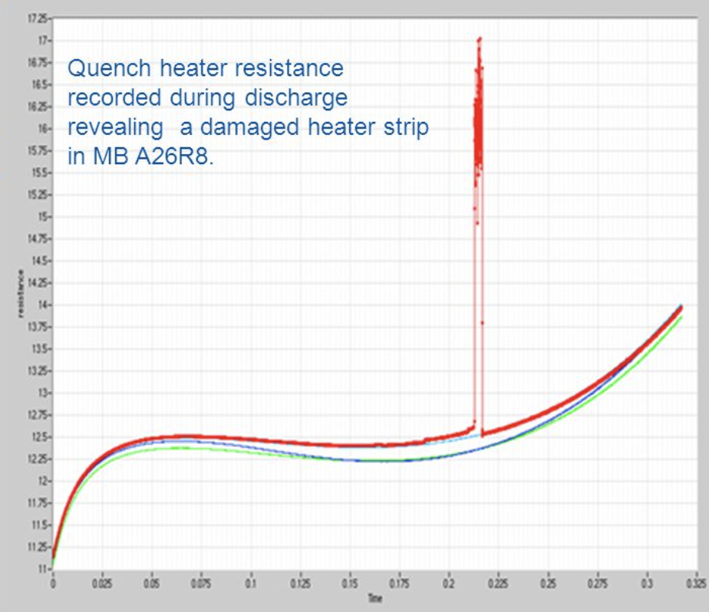
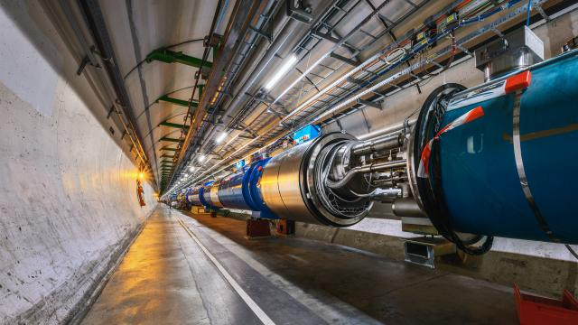
Rare Events
There were 3130 healthy signals (Y=False) and 112 faulty ones (Y=True)
C. Obermair, Extension of Signal Monitoring Applications with Machine Learning, Master Thesis, TU Graz
M. Brice, LHC tunnel Pictures during LS2, https://cds.cern.ch/images/CERN-PHOTO-201904-108-15

Slide 21
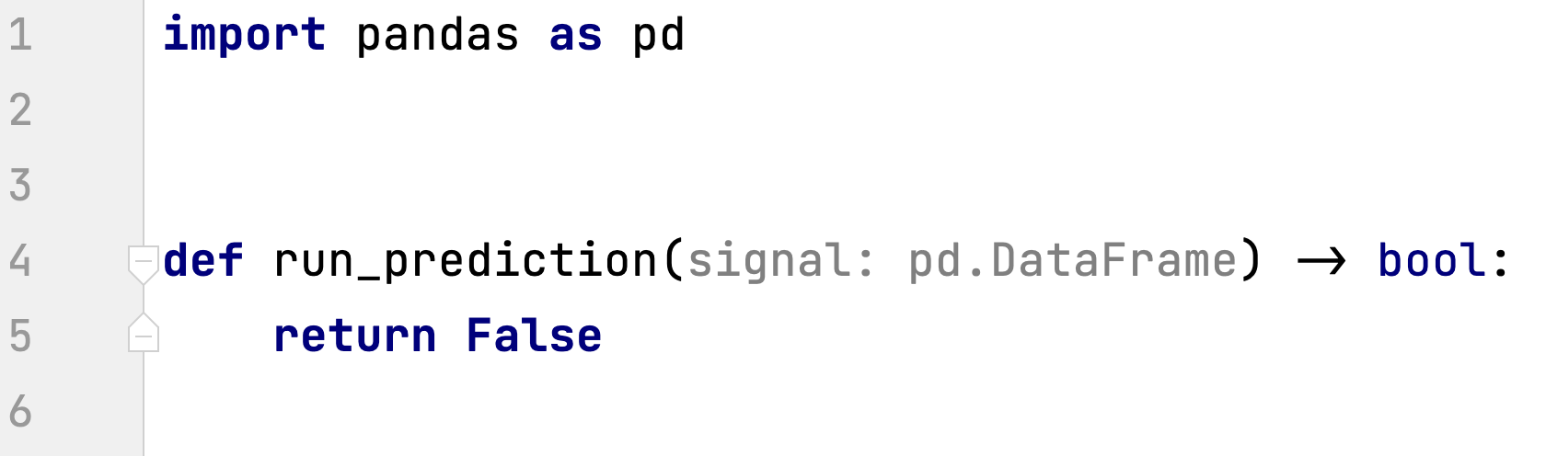
Rare Events
This naive model is guaranteed to achieve 97% average dataset accuracy?!

Slide 22
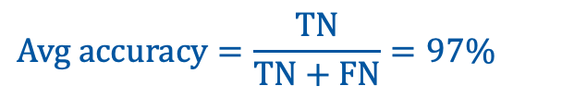
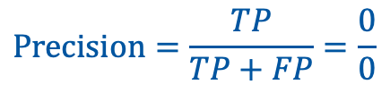
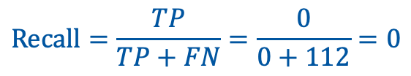
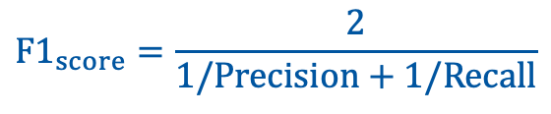
Rare Events
 |  | Ground truth
 |  | Y = True | Y = False
Model | Y = True | 0 true positive | 0 false positive
 | Y = False | 112 false negative | 3130 true negative
It is a valuable conversation to decide if precision or recall (or both) is more important.
Notes:
When one of the values of Y is rare in the population, considerable resources in datacollection can be saved by randomly selecting within categories of Y. This is known in
econometrics as choice-based or endogenous stratified sampling and in epidemiology as a
case-control design (Breslow 1996); it is also useful for choosing qualitative case studies
(King et al. 1994, Sect. 4.4.2). The strategy is to select on Y
by collecting observations
(randomly or all those available) for which Y
= 1 (the "cases") and a random selection of
observations for which Y = 0 (the "controls").

Slide 23
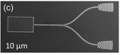
Data Augmentation
New examples obtained by
shifting the region left and right
New examples obtained by
rotating/shifting/hiding
JH. Kim et al. Hybrid Integration of Solid-State Quantum Emitters on a Silicon Photonic Chip, Nano Letters 2017

Slide 24

What else can we do?
When one of the values of Y is rare in the population, considerable resources in data collection can be saved by randomly selecting within categories of Y. […]
The strategy is to select on Y by collecting observations (randomly or all those available) for which Y = 1 (the "cases") and a random selection of observations for which Y = 0 (the "controls").
We can also collect more data of particular class (if even possible).
G. King and L. Zeng, “Logistic Regression in Rare Events Data,” Political Analysis, p. 28, 2001.
https://en.wikipedia.org/wiki/Cross-validation_(statistics)

Slide 25




Training Tracking
Pen & Paper
Spreadsheet
Dedicated framework
  Weights and Biases
  Neptune.ai
  Tensorflow
  …

Slide 26
Deployment
Optimization
Degrees of automation
Modes of deployment
Reproducible environments
Data Engineering
Modelling
Deployment
Monitoring

Slide 27
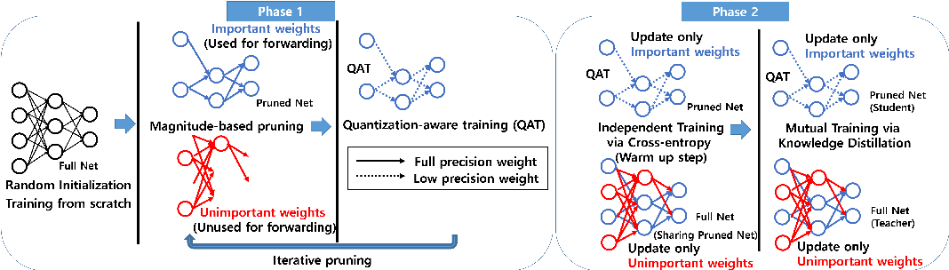
Performance Optimization
https://www.semanticscholar.org/paper/PQK%3A-Model-Compression-via-Pruning%2C-Quantization%2C-Kim-Chang/fd504f20b3ce6cb4e09633941cefa388311d30ce#citing-papers

Slide 28
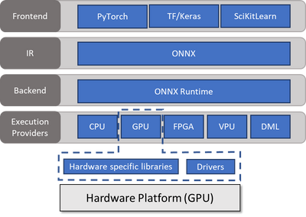
Performance Optimization
https://techcommunity.microsoft.com/t5/ai-machine-learning-blog/onnx-runtime-training-technical-deep-dive/ba-p/1398310

Slide 29
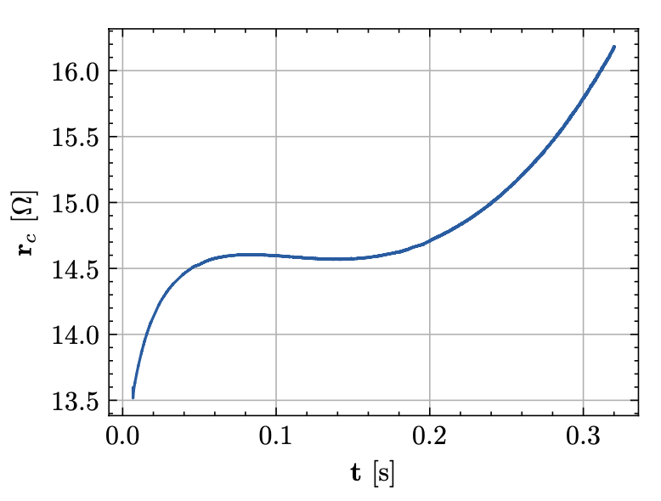
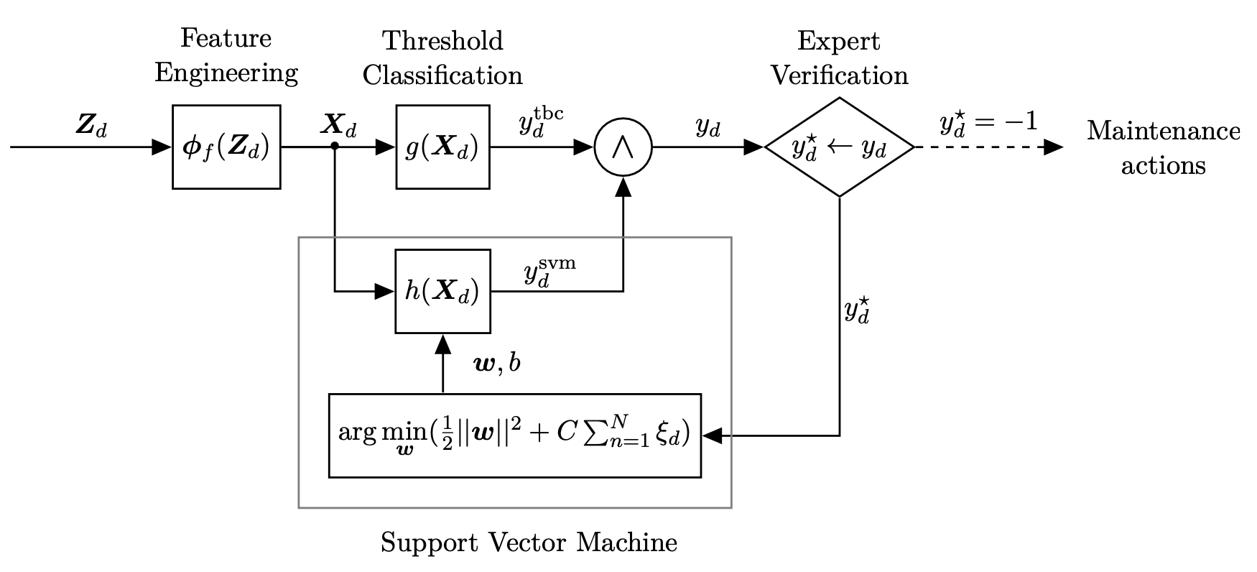
Degrees of Automation
Human inspection
Shadow mode
Human in
the loop
Full Automation
Starting from Shadow mode we can collect more training data in production!
C. Obermair, Extension of Signal Monitoring Applications with Machine Learning, Master Thesis, TU Graz

Slide 30
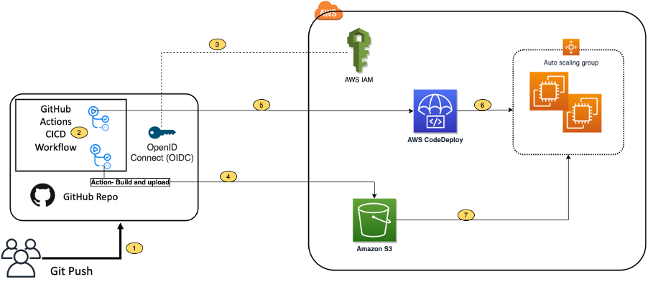
Github actions ci/cd pipeline
https://aws.amazon.com/blogs/devops/integrating-with-github-actions-ci-cd-pipeline-to-deploy-a-web-app-to-amazon-ec2/

Slide 31
Modes of Deployment
Old version
100-X%
Router
X%
New version
In Canary deployment there is a gradual switch between versions
In Blue/green deployment there is an on/off switch between versions
https://hbr.org/2017/09/the-surprising-power-of-online-experiments

Slide 32

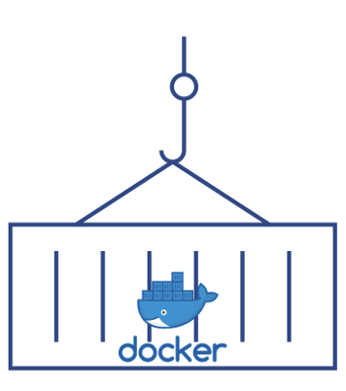



Reproducible Environments
Request
Response
Request
Response
Computing environment
(OS, Python, packages)
HTTP Server
KServe
REST API
Data Pipeline
Config
file
Pool of
models
Computing infrastructure
ML Model
Docker Containers
Serverless compute

Slide 33
Horizontal Scaling
What?
  If you have too much traffic for a single machine, split traffic among multiple machines
How?
  Spin up multiple copies of your service and split traffic using a load balancer
  In practice, two common methods
  Container orchestration (i.e., Kubernetes)
  Serverless (e.g., AWS Lambda)

Slide 34
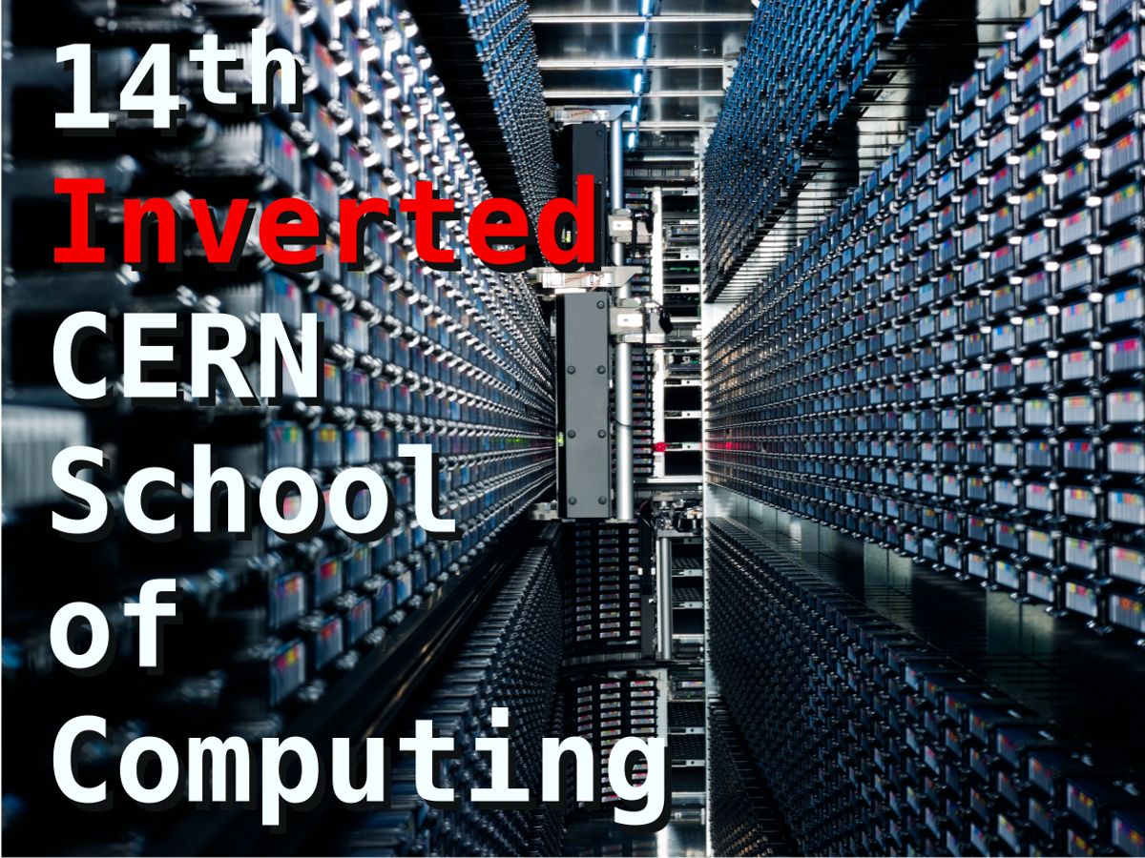
Monitoring
Useful metrics
Relevant frameworks
Data Engineering
Modelling
Deployment
Monitoring

Slide 35
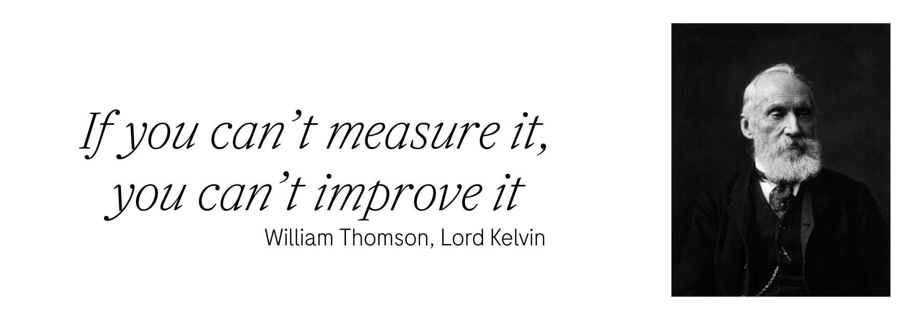

Slide 36
Relevant Metrics
Model metrics
  Distribution of input features – data/concept drift
  Missing/malformed values in the input
  Average output accuracy/classification distribution – concept drift
Infrastructure metrics
  Logging errors
  Memory, CPU resources utilization
  Latency and jitter
For each of the relevant metrics one should define warning/error thresholds.

Slide 37
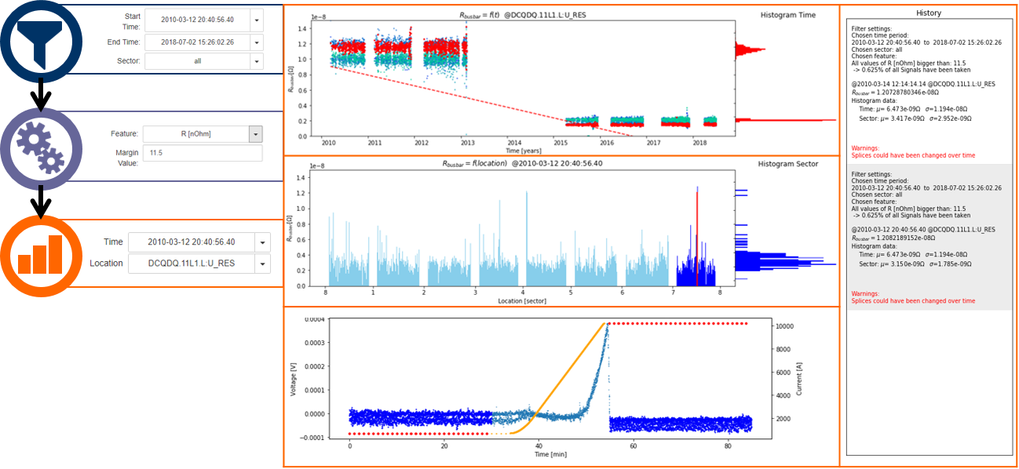
Monitoring Matters
C. Obermair, Extension of Signal Monitoring Applications with Machine Learning, Master Thesis, TU Graz

Slide 38

Data Engineering
Modelling
Deployment
Monitoring

Slide 39
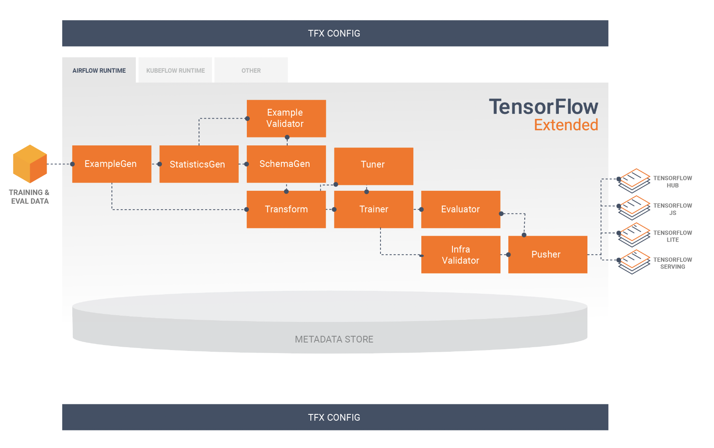
MLOps Pipeline with Tensorflow
Pipeline represented as DAG
directed acyclic graph
Data Engineering
Modelling
Deployment
https://www.tensorflow.org/tfx/guide

Slide 40
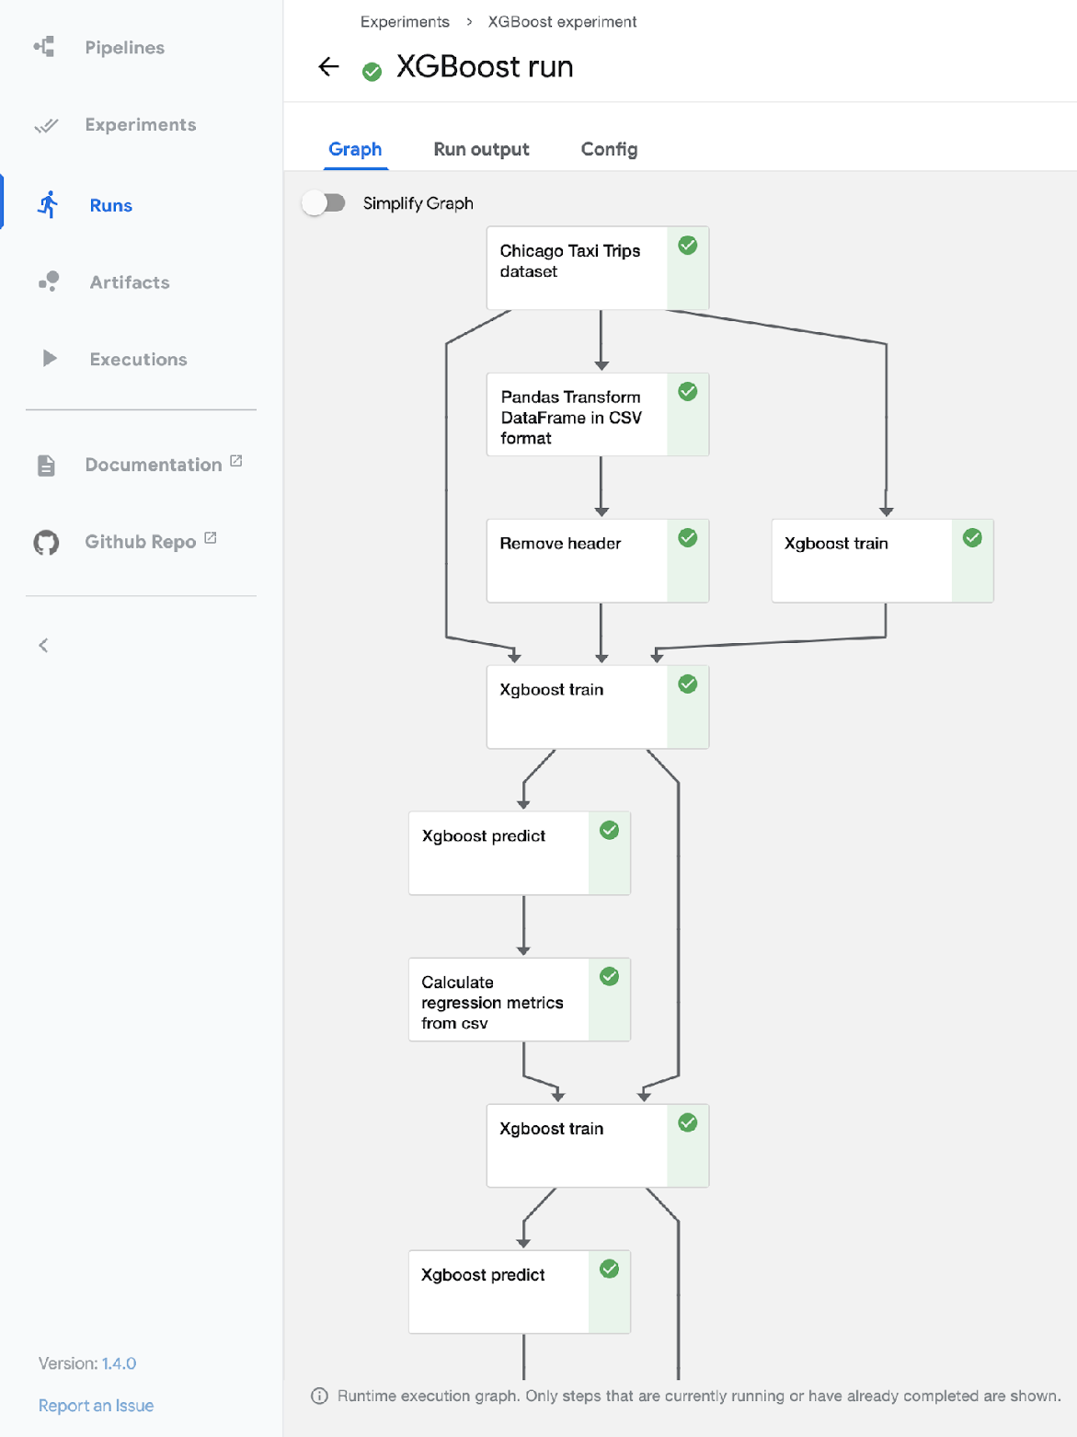
MLOps Pipeline with Kubeflow
Data Engineering
Modelling
https://ml.cern.ch
https://www.kubeflow.org/docs/started/
Deployment
Notes:
Load balancer for computation

Slide 41
Conclusion
 | Development ML | Production ML
Objective | High-accuracy model | Efficiency of the overall system
Dataset | Fixed | Evolving
Code quality | Secondary importance | Critical
Model training | Optimal tuning | Fast turn-arounds
Reproducibility | Secondary importance | Critical
Traceability | Secondary importance | Critical

Slide 42

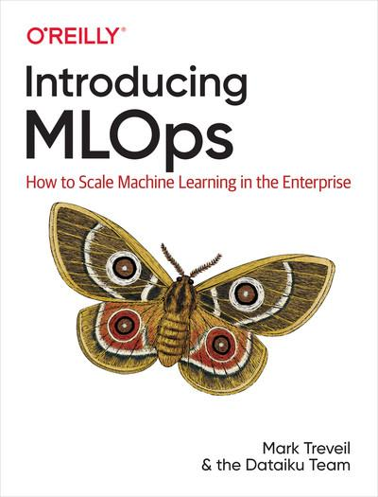

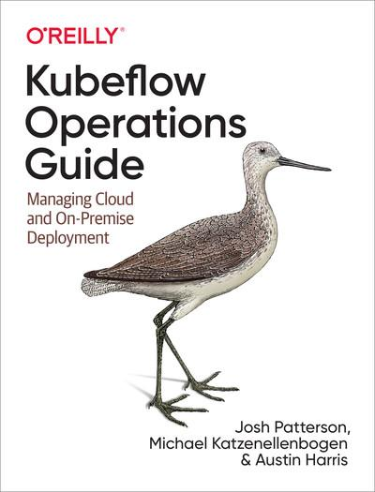

Resources
Machine Learning Engineering for Production (MLOps) Specialization

Slide 44
Introduction to Building Model as a Service
REST APIs:
  Standard for communication between clients and servers.
  Enables seamless interaction with your model service.
Dependency Management:
  Organize and manage external libraries.
  Ensure smooth integration and updates for your service.

Slide 45
Performance Optimization

Slide 46
Scaling & Deployment
Deployment:
  Roll out your service to production.
  Choose appropriate deployment strategies (e.g., blue-green, canary).
Managed Options:
  Consider cloud platforms (AWS, GCP, Azure).
  Benefit from managed services for scalability and maintenance.

Slide 47
Monitoring

Slide 48
Monitoring
Model Performance degrades post deployment

Slide 49
What should I monitor?
Ground truth performance metrics
  Model Metrics
  Business metrics
Approximate performance metrics
  Business Metrics
  Model inputs & predictions
System health Metrics
  Model inputs & predictions
  System performance

Slide 50
How to measure if it’s changed?
Metrics: Accuracy, Precision, Recall, F1 Score
Confusion Matrix: True Positive, True Negative, False Positive, False Negative
ROC Curve and AUC: Evaluating Class Separation
Cross-Validation: Robustness Across Data Splits
Baseline Comparison: Model Effectiveness Benchmark
Time-Series Analysis: Predictions vs. Actuals Over Time
Monitoring Data Drift: Detecting Input Distribution Shifts
A/B Testing: Real-World Performance Comparison
Controlled Deployment: Sandbox Performance Testing
Feedback Loop: User and Domain Expert Insights
Note: Choose metrics aligned with goals, consider business context, and use techniques judiciously for comprehensive performance assessment.

Slide 51
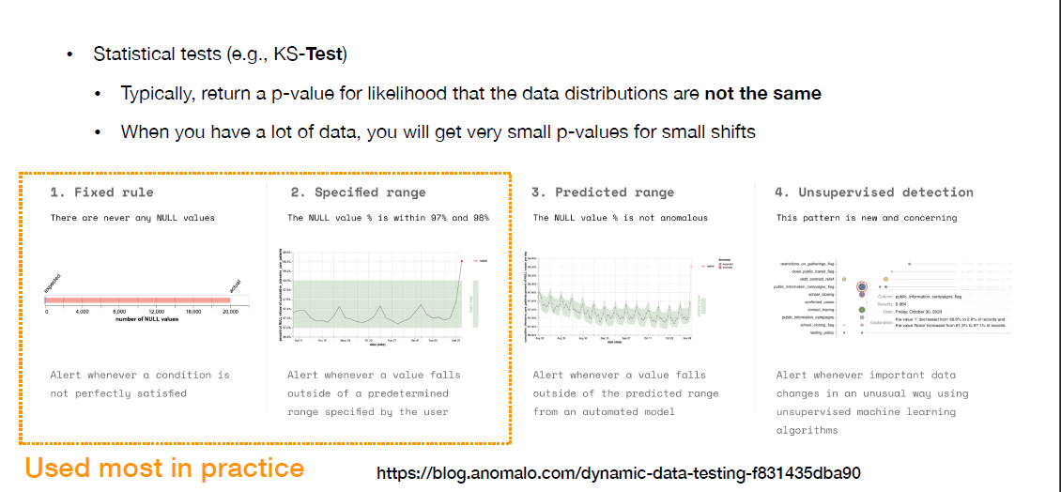
How to tell if the change is Bad?

Slide 52
Tools for Monitoring
System monitoring tools:
  Datadog
  New Relic
  Amazon cloudwatch
  Honeycomb.io
Data Quality Tools
  Greatexpectations
  Monte Carlo
  Anomalo
ML monitoring
  Arize
  Arthur
  Fiddler
  dvc

Slide 53
Performance Optimization:
Model Quantization: Convert model weights from floating-point to lower-precision fixed-point representation, reducing memory usage and speeding up computations.
Pruning: Remove unimportant weights and connections from the model, reducing the model's size and accelerating inference.
Model Slicing: Divide a larger model into smaller components to parallelize inference across multiple cores or threads.
Batch Inference: Process multiple inputs as a batch rather than one at a time, taking advantage of optimized parallelism on modern hardware.
Model Caching: Cache intermediate results of computations to avoid redundant calculations for similar inputs.

Slide 54
Performance Optimization
GPU Utilization: If using a GPU, ensure that your model and framework are optimized to fully utilize the GPU's parallel processing capabilities.
Multi-Threading: Utilize multi-threading to process multiple inference requests concurrently.
Model Loading and Warm-Up: Load the model and perform initial inference with dummy data to pre-allocate resources and reduce subsequent inference times.
Model Format: Choose efficient model formats like ONNX or TensorFlow Lite that are optimized for inference on specific hardware.
Runtime Libraries: Utilize optimized runtime libraries like NVIDIA CUDA, cuDNN, or Intel's Math Kernel Library (MKL) to speed up computations.

Slide 55
Performance Optimization
Caching and Memorization: Store the results of expensive calculations and reuse them for similar inputs.
Profile and Tune: Use profiling tools to identify performance bottlenecks and then optimize the critical parts of your inference pipeline.
Reduce I/O Overhead: Minimize unnecessary data transfers between CPU and GPU, and optimize data loading processes.
Data Preprocessing: Optimize data preprocessing steps to minimize computation time before feeding data to the model.
Compiled Inference: Some frameworks allow you to compile your model for specific hardware, which can significantly improve performance.
Asynchronous Inference: Utilize asynchronous processing to start processing the next request while waiting for the previous one to complete.

