Slide 1

MoSCoW Prioritization
Instructor:
Dr. Sushil Kumar
Assistant Professor
Entrepreneurship , IIM Visakhapatnam

Slide 2

MoSCoW Prioritization
What is MoSCoW Prioritization?
MoSCoW prioritization, also known as the MoSCoW method or MoSCoW analysis, is a popular prioritization technique for managing requirements.
The acronym MoSCoW represents four categories of initiatives: must-have, should-have, could-have, and won’t-have, or will not have right now. Some companies also use the “W” in MoSCoW to mean “wish.”
What is the History of the MoSCoW Method?
Software development expert Dai Clegg created the MoSCoW method while working at Oracle. He designed the framework to help his team prioritize tasks during development work on product releases.
You can find a detailed account of using MoSCoW prioritization in the Dynamic System Development Method (DSDM) handbook. But because MoSCoW can prioritize tasks within any time-boxed project, teams have adapted the method for a broad range of uses.

Slide 3
How Does MoSCoW Prioritization Work?
Before running a MoSCoW analysis, a few things need to happen. First, key stakeholders and the product team need to get aligned on objectives and prioritization factors. Then, all participants must agree on which initiatives to prioritize.
At this point, your team should also discuss how they will settle any disagreements in prioritization. If you can establish how to resolve disputes before they come up, you can help prevent those disagreements from holding up progress.
Finally, you’ll also want to reach a consensus on what percentage of resources you’d like to allocate to each category.
With the groundwork complete, you may begin determining which category is most appropriate for each initiative. But, first, let’s further break down each category in the MoSCoW method.
Start prioritizing your roadmap

Slide 4
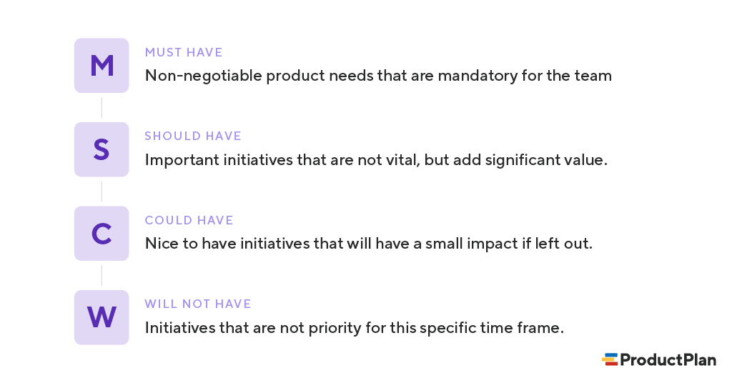

Slide 5
Must-have initiatives
As the name suggests, this category consists of initiatives that are “musts” for your team. They represent non-negotiable needs for the project, product, or release in question. For example, if you’re releasing a healthcare application, a must-have initiative may be security functionalities that help maintain compliance.
The “must-have” category requires the team to complete a mandatory task. If you’re unsure about whether something belongs in this category
If the product won’t work without an initiative, or the release becomes useless without it, the initiative is most likely a “must-have.”

Slide 6
Should-have initiatives
Should-have initiatives are just a step below must-haves. They are essential to the product, project, or release, but they are not vital. If left out, the product or project still functions. However, the initiatives may add significant value.
“Should-have” initiatives are different from “must-have” initiatives in that they can get scheduled for a future release without impacting the current one. For example, performance improvements, minor bug fixes, or new functionality may be “should-have” initiatives. Without them, the product still works.
Could-have initiatives
Another way of describing “could-have” initiatives is nice-to-haves. “Could-have” initiatives are not necessary to the core function of the product. However, compared with “should-have” initiatives, they have a much smaller impact on the outcome if left out.
So, initiatives placed in the “could-have” category are often the first to be deprioritized if a project in the “should-have” or “must-have” category ends up larger than expected.

Slide 7
Will not have (this time)
One benefit of the MoSCoW method is that it places several initiatives in the “will-not-have” category. The category can manage expectations about what the team will not include in a specific release (or another timeframe you’re prioritizing).
Placing initiatives in the “will-not-have” category is one way to help prevent scope creep. If initiatives are in this category, the team knows they are not a priority for this specific time frame.
Some initiatives in the “will-not-have” group will be prioritized in the future, while others are not likely to happen. Some teams decide to differentiate between those by creating a subcategory within this group.

Slide 8
What Are the Drawbacks of MoSCoW Prioritization?
Although many product and development teams have prioritized MoSCoW, the approach has potential pitfalls. Here are a few examples.
1. An inconsistent scoring process can lead to tasks placed in the wrong categories.
One common criticism against MoSCoW is that it does not include an objective methodology for ranking initiatives against each other. Your team will need to bring this methodology to your analysis. The MoSCoW approach works only to ensure that your team applies a consistent scoring system for all initiatives.
Pro tip: One proven method is weighted scoring, where your team measures each initiative on your backlog against a standard set of cost and benefit criteria. You can use the weighted scoring approach in ProductPlan’s roadmap app.

Slide 9
2. Not including all relevant stakeholders can lead to items placed in the wrong categories.
To know which of your team’s initiatives represent must-haves for your product and which are merely should-haves, you will need as much context as possible.
For example, you might need someone from your sales team to let you know how important (or unimportant) prospective buyers view a proposed new feature.
One pitfall of the MoSCoW method is that you could make poor decisions about where to slot each initiative unless your team receives input from all relevant stakeholders.

Slide 10
3. Team bias for (or against) initiatives can undermine MoSCoW’s effectiveness.
Because MoSCoW does not include an objective scoring method, your team members can fall victim to their own opinions about certain initiatives.
One risk of using MoSCoW prioritization is that a team can mistakenly think MoSCoW itself represents an objective way of measuring the items on their list. They discuss an initiative, agree that it is a “should have,” and move on to the next.
But your team will also need an objective and consistent framework for ranking all initiatives. That is the only way to minimize your team’s biases in favor of items or against them.
When Do You Use the MoSCoW Method for Prioritization?
MoSCoW prioritization is effective for teams that want to include representatives from the whole organization in their process. You can capture a broader perspective by involving participants from various functional departments.
Another reason you may want to use MoSCoW prioritization is it allows your team to determine how much effort goes into each category. Therefore, you can ensure you’re delivering a good variety of initiatives in each release.

Slide 11
What is the MoSCoW prioritization technique?
The MoSCoW method is a prioritization matrix widely used in project management and software development. The term MoSCoW is an acronym that stands for Must have, Should have, Could have, and Won’t have, each denoting a level of priority.
Here is the breakdown of the MoSCoW method:
Must have: These are critical requirements that the project cannot be completed without them. If these are not fulfilled, the project is considered a failure.
Should have: These are important but not critical features of a project, and these are high-priority items that are not as time-sensitive as the Must-haves.
Could have: These are desirable features that do not affect the overall project’s success. Therefore, they can be included if time and resources permit.
Won’t have: These features are the lowest priority or are not necessary for the current delivery cycle. They are agreed upon and recognized but are dropped for the project’s current timeline.

