Slide 1
MLOPs 101

Slide 2
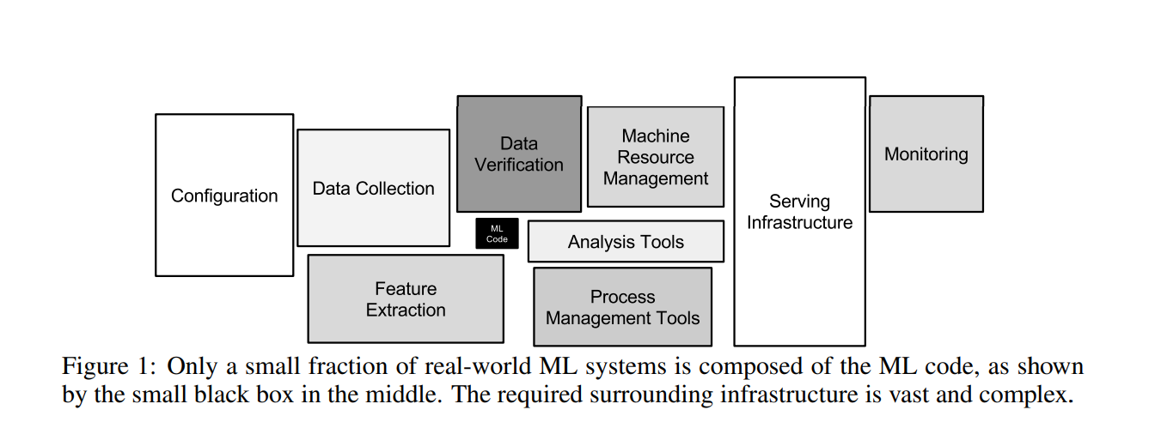

Slide 3
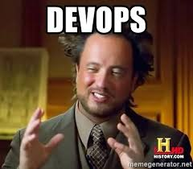

Slide 4
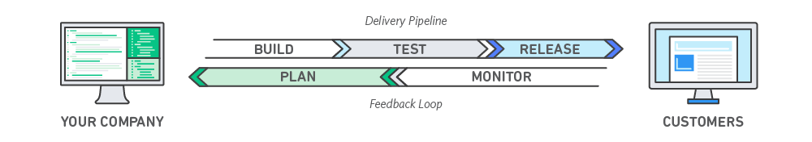
DevOps
is a set of technical and management practices that aim to increase an organization’s velocity in releasing high-quality software.
speed, reliability, scale, and security

Slide 5
DevOps Practices
Continuous Integration & Continuous Delivery (CI/CD) - Developers regularly merge their code changes into a central repository, after which automated builds and tests are run and code is deployed.
Microservices - design approach to build a single application as a set of small services. Each service runs in its own process and communicates with other services through a well-defined interface using a lightweight mechanism, typically an HTTP-based application programming interface (API).
Monitoring and Logging

Slide 6
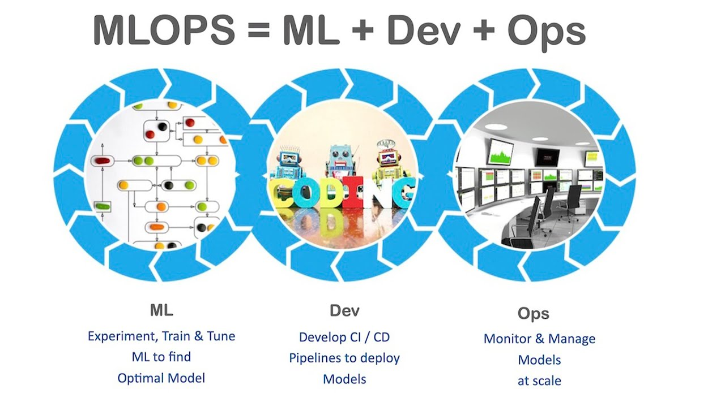

Slide 7
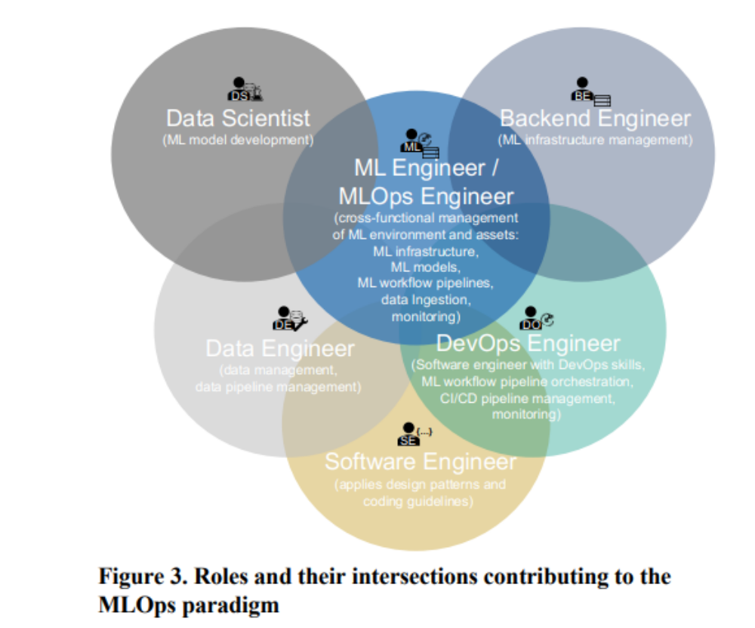

Slide 8
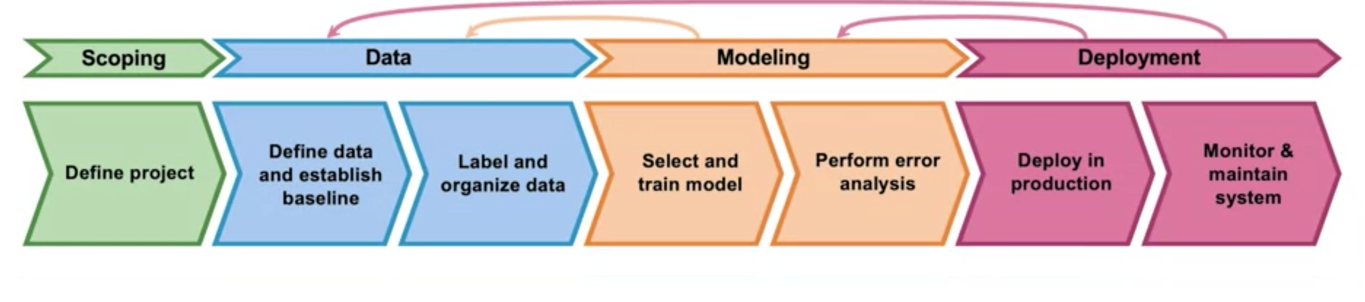
ML project lifecycle

Slide 9
Why do we need to retrain models ?

Slide 10
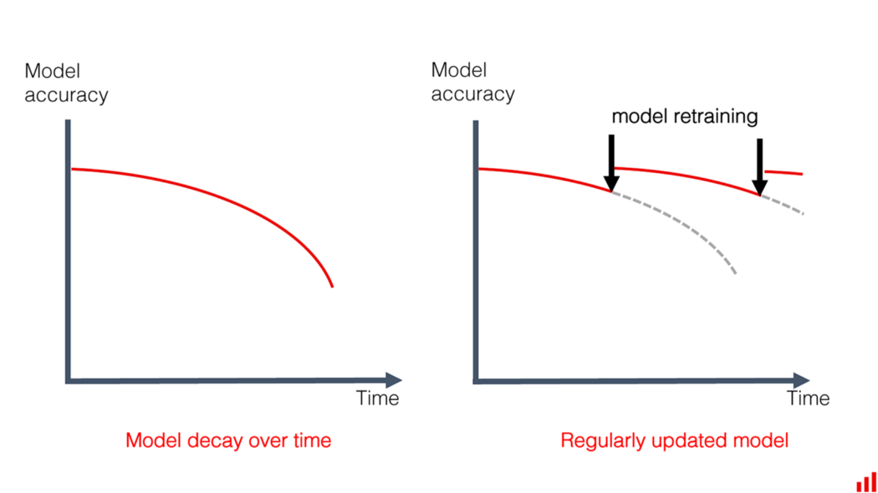

Slide 11
Deployment patterns

Slide 12
Shadow Mode Deployment – Existing workflow ( human/older model) continues to take decision, apart from the model . Model is updated till threshold accuracy is reached.

Slide 13
Blue-green deployment - utilizes two identical environments, a “blue” and a “green” environment with different versions of an application or service. Can easily be interchanged .

Slide 14
Canary deployment - Releases the model incrementally to a subset of users. All infrastructure in a target environment is updated in small phases (e.g: 2%, 25%, 75%, 100%).

Slide 15
Some Tools

Slide 16
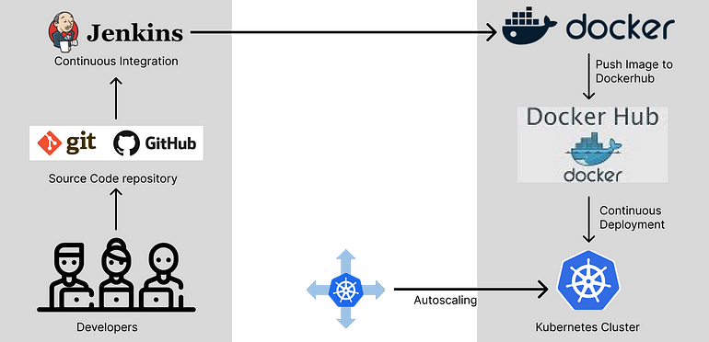

Slide 17


Slide 18
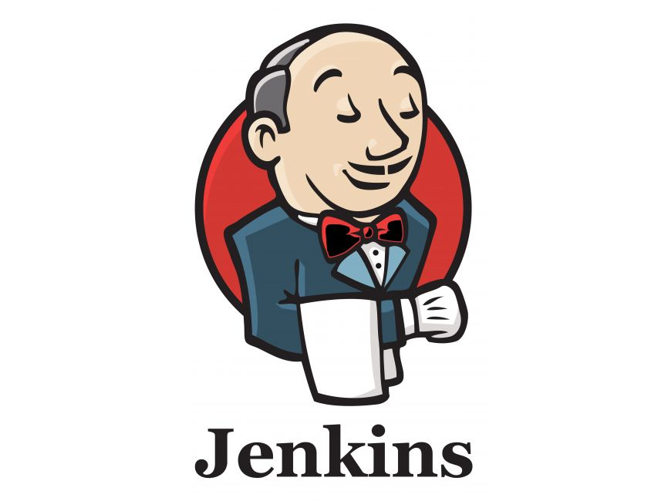
Jenkins
Jenkins is an open source continuous integration/continuous delivery and deployment (CI/CD) automation software DevOps tool written in the Java programming language. It is used to implement CI/CD workflows, called pipelines.

Slide 19

Docker
They are basically containers that allows you to ship, test, and deploy your applications in any environment without worrying about incompatible issues regardless of the machine's configuration settings.
It enables you to separate your applications from your infrastructure so you can deliver software quickly.

Slide 20

Kubernetes (K8S)
automates operational tasks of container management and includes built-in commands for deploying applications, rolling out changes to your applications, scaling your applications up and down to fit changing needs, monitoring your applications, and more—making it easier to manage applications.

Slide 21
Tools for Monitoring
System monitoring tools:
  Datadog
  New Relic
  Amazon cloudwatch
  Honeycomb.io
Data Quality Tools
  Greatexpectations
  Monte Carlo
  Anomalo
ML monitoring
  Arize
  Arthur
  Fiddler
  dvc

Slide 22
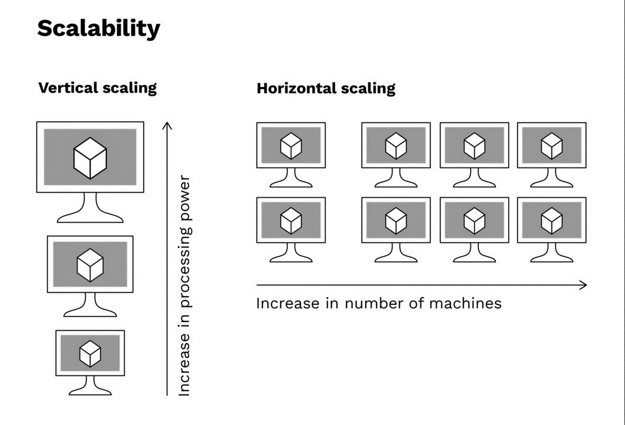

Slide 23
Performance Optimization:
Model Quantization: Convert model weights from floating-point to lower-precision fixed-point representation, reducing memory usage and speeding up computations.
Pruning: Remove unimportant weights and connections from the model, reducing the model's size and accelerating inference.
Model Slicing: Divide a larger model into smaller components to parallelize inference across multiple cores or threads.
Batch Inference: Process multiple inputs as a batch rather than one at a time, taking advantage of optimized parallelism on modern hardware.
Model Caching: Cache intermediate results of computations to avoid redundant calculations for similar inputs.

Slide 24
Performance Optimization
GPU Utilization: If using a GPU, ensure that your model and framework are optimized to fully utilize the GPU's parallel processing capabilities.
Multi-Threading: Utilize multi-threading to process multiple inference requests concurrently.
Model Loading and Warm-Up: Load the model and perform initial inference with dummy data to pre-allocate resources and reduce subsequent inference times.
Model Format: Choose efficient model formats like ONNX or TensorFlow Lite that are optimized for inference on specific hardware.
Runtime Libraries: Utilize optimized runtime libraries like NVIDIA CUDA, cuDNN, or Intel's Math Kernel Library (MKL) to speed up computations.

Slide 25
Performance Optimization
Caching and Memorization: Store the results of expensive calculations and reuse them for similar inputs.
Profile and Tune: Use profiling tools to identify performance bottlenecks and then optimize the critical parts of your inference pipeline.
Reduce I/O Overhead: Minimize unnecessary data transfers between CPU and GPU, and optimize data loading processes.
Data Preprocessing: Optimize data preprocessing steps to minimize computation time before feeding data to the model.
Compiled Inference: Some frameworks allow you to compile your model for specific hardware, which can significantly improve performance.
Asynchronous Inference: Utilize asynchronous processing to start processing the next request while waiting for the previous one to complete.

Slide 26
Summary
 | Development ML | Production ML
Objective | High-accuracy model | Efficiency of the overall system
Dataset | Fixed | Evolving
Code quality | Secondary importance | Critical
Model training | Optimal tuning | Fast turn-arounds
Reproducibility | Secondary importance | Critical
Traceability | Secondary importance | Critical

Slide 27
Beware of Technical Debt

Slide 28
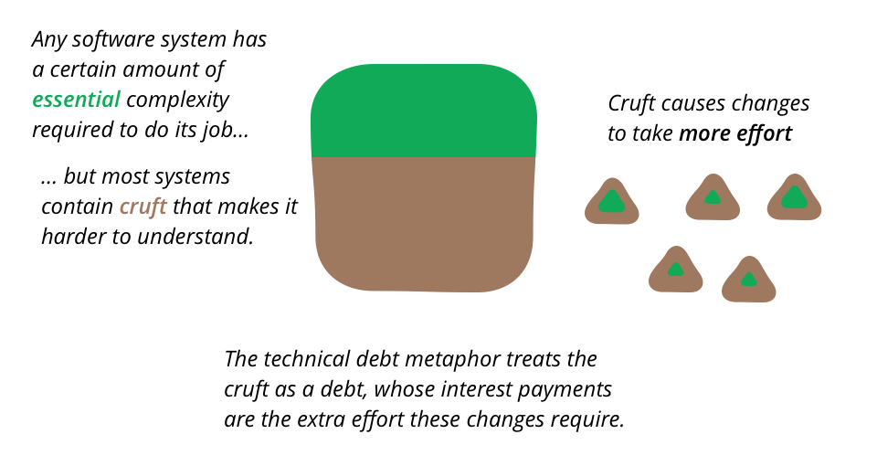
Technical Debt

