Slide 2
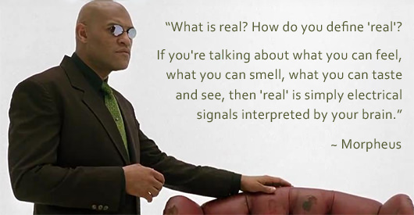
What is Reality ?

Slide 3


Slide 4
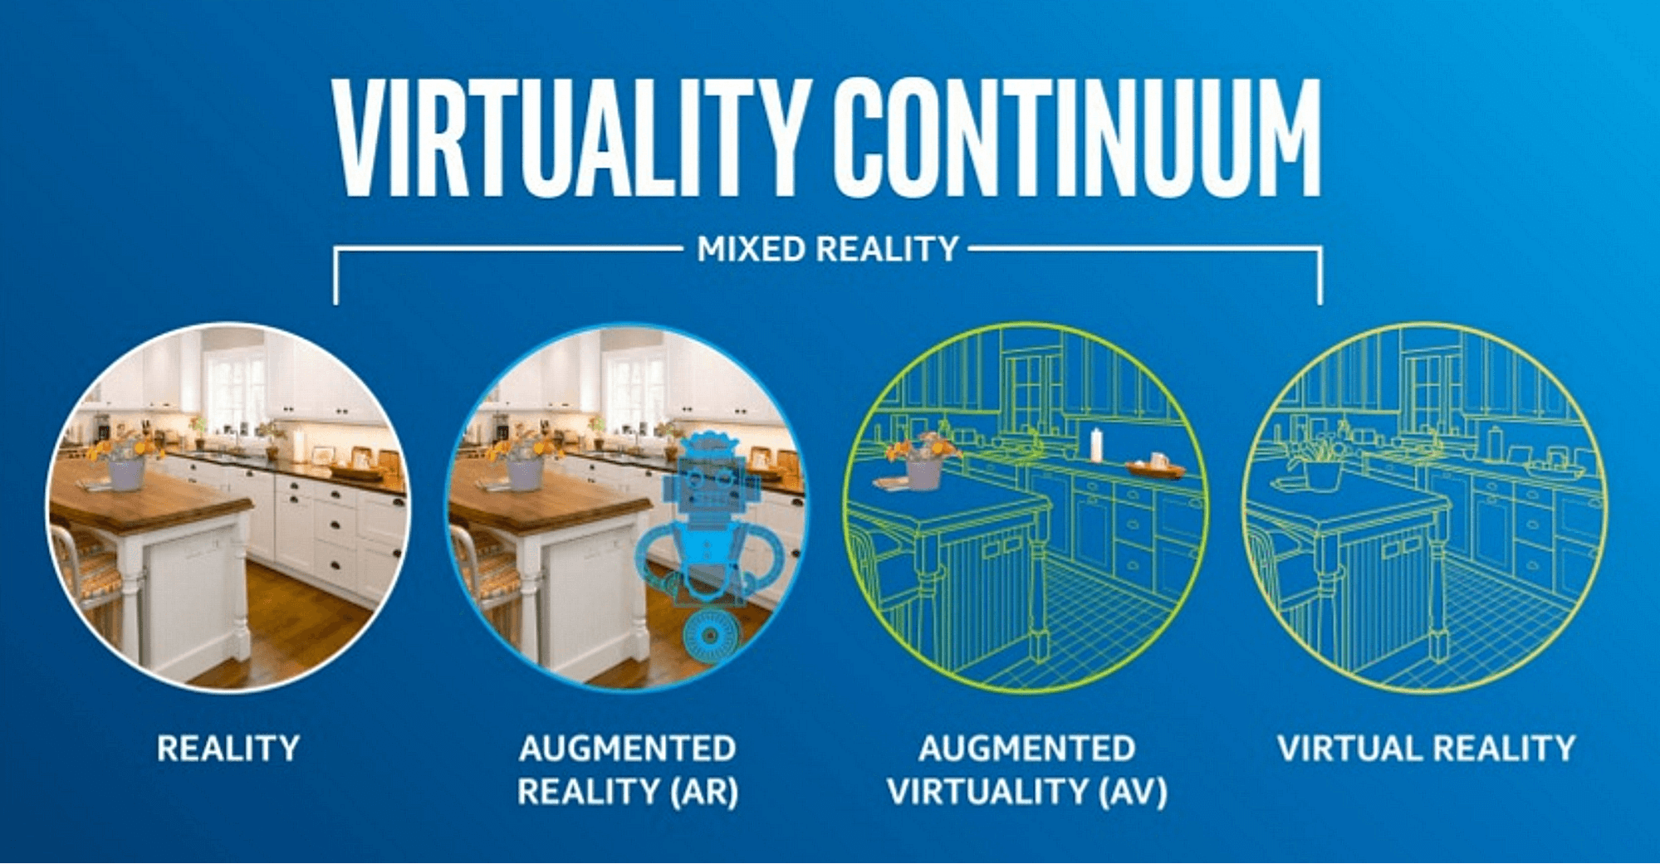
https://www.linkedin.com/pulse/4rs-get-your-head-around-virtuality-continuum-maria-loktionova/

Slide 5
AR in action
VR in action

Slide 8
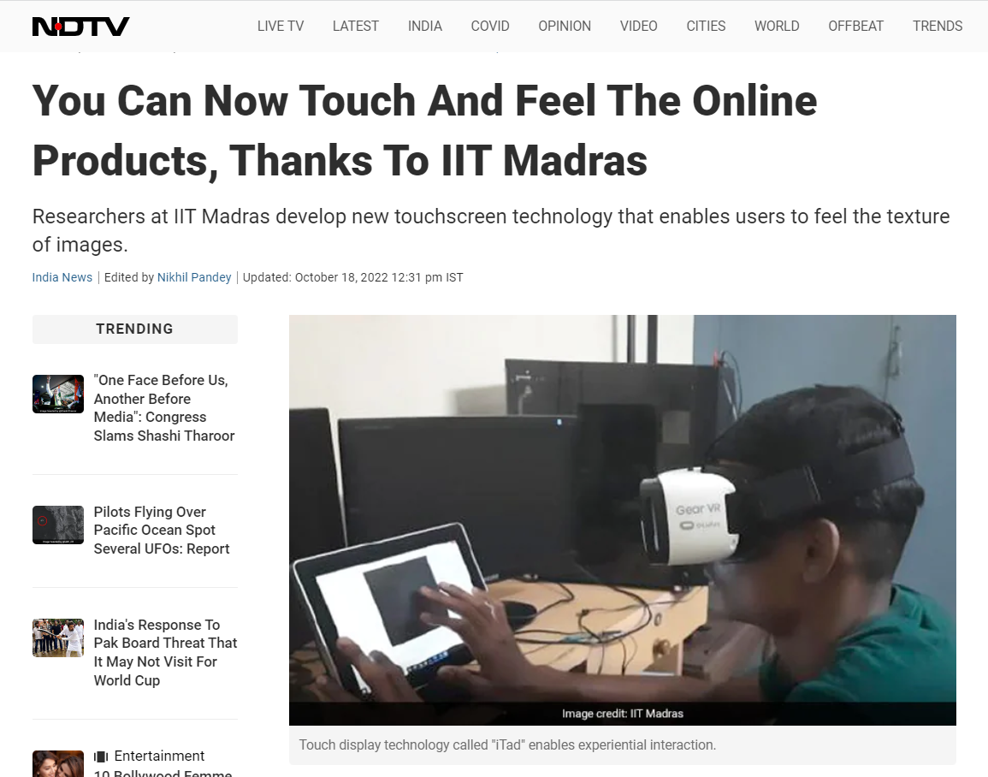

Slide 9
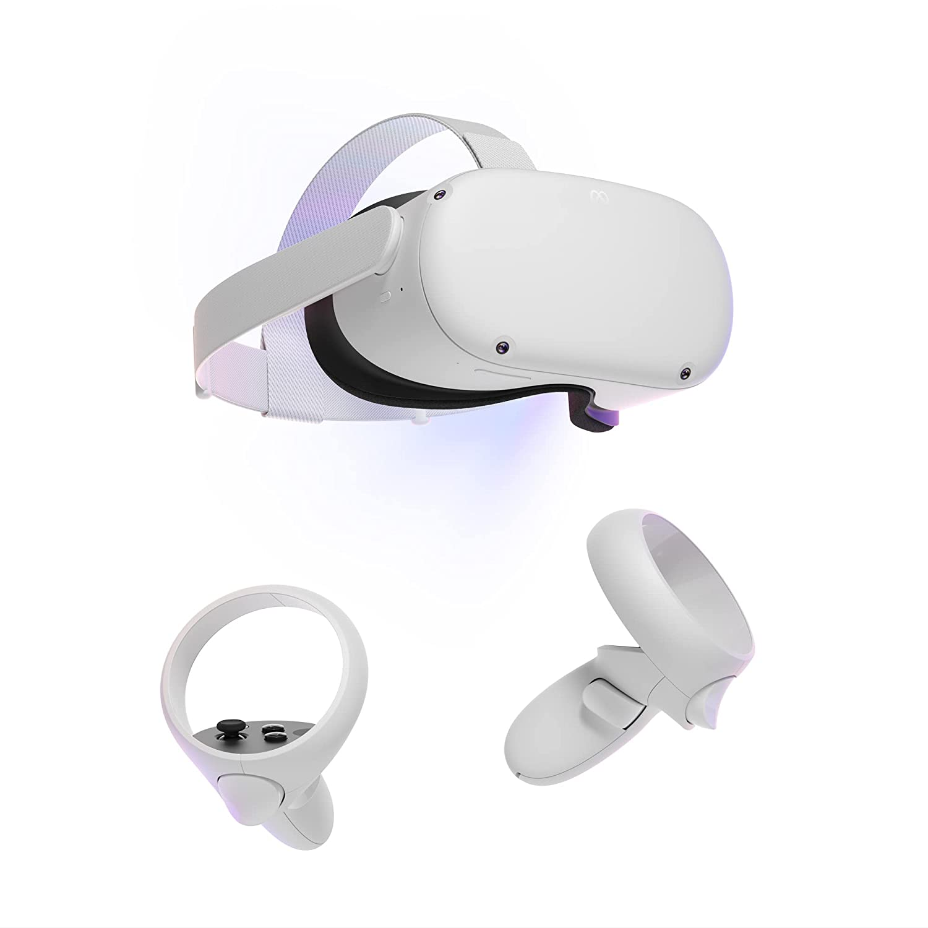
Headsets
Haptic (touch gloves)

Slide 10
Haptic Suits

Slide 11
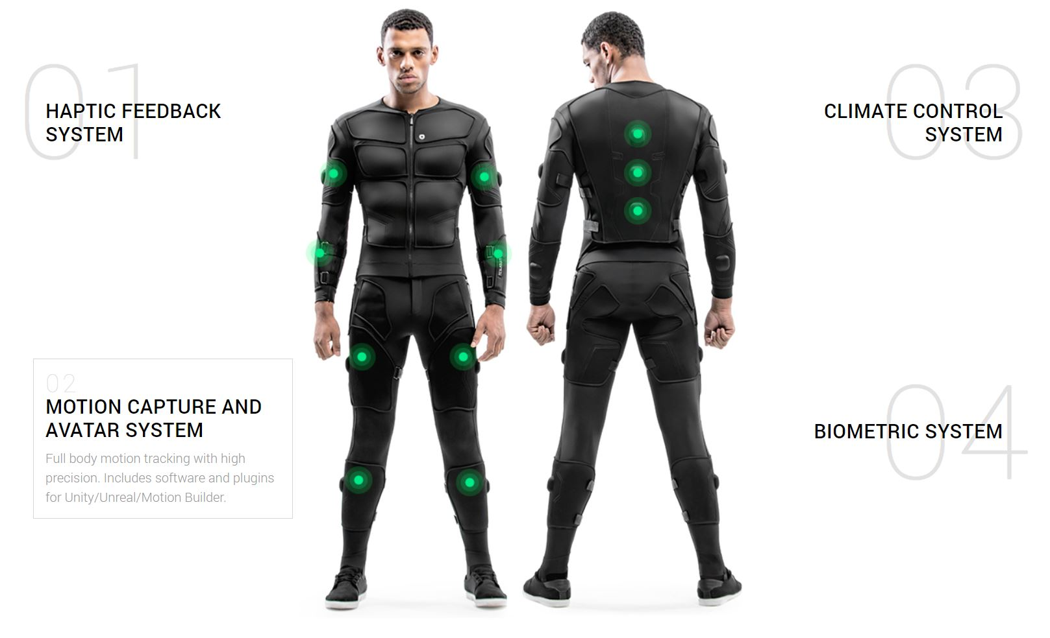

Slide 13
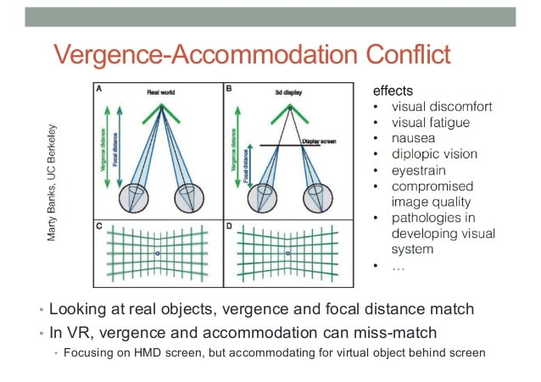

Slide 14
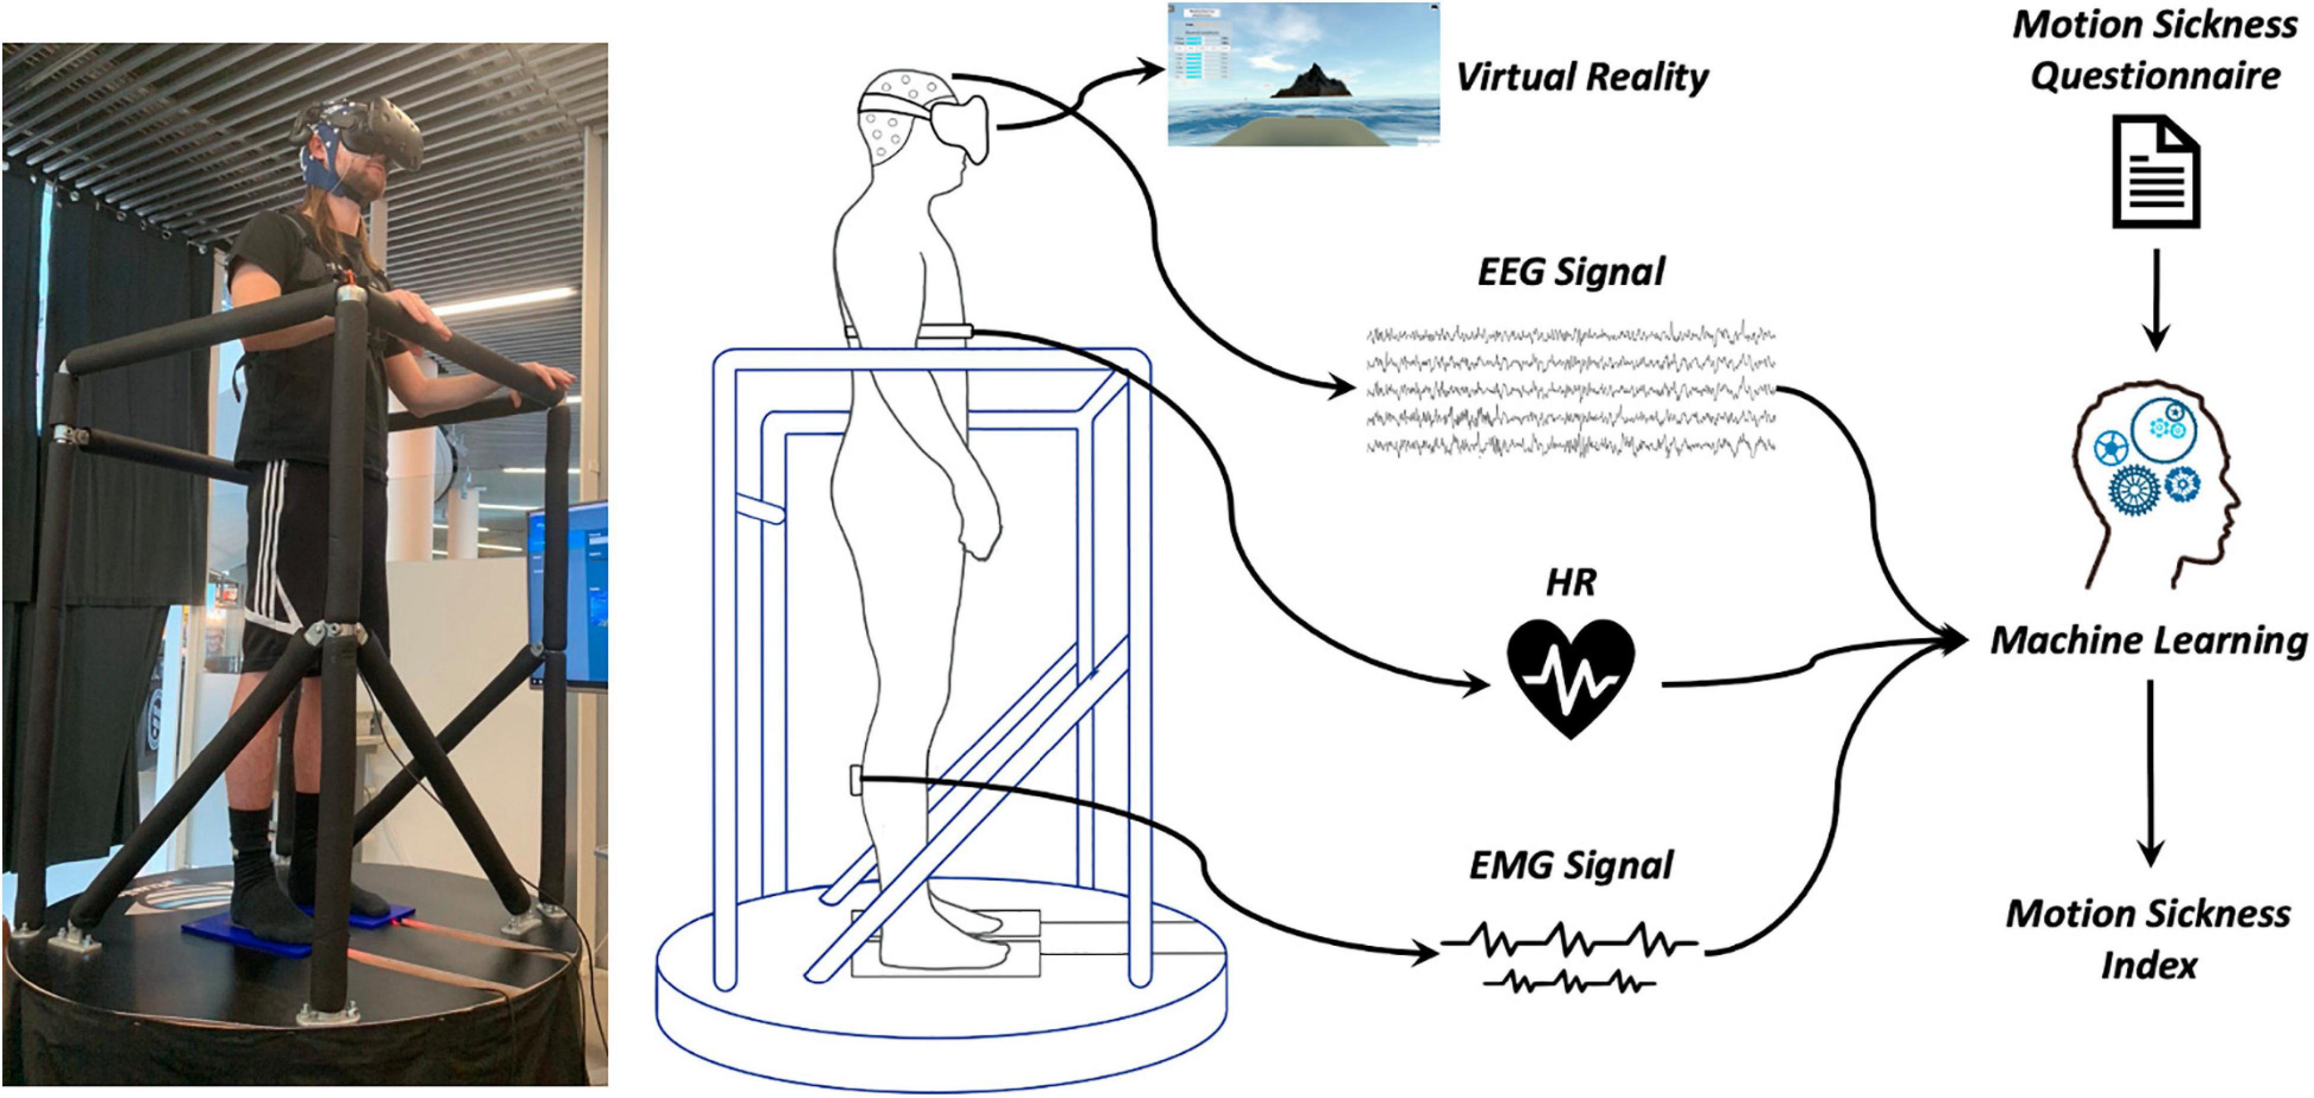
Locomotion Sickness
https://www.frontiersin.org/articles/10.3389/fbioe.2021.635661/full

Slide 15
Metaverse
A network of 3-D virtual worlds where people can interact, do business, and forge social connections through their virtual “avatars.”
Think about it as a virtual reality version of today’s internet.

Slide 16
“Any sufficiently advanced technology is indistinguishable from magic.” ~ Arthur C Clarke

Slide 17
Meta’s vision on Meta

Slide 19
General use cases

Slide 20
• Education: Enhanced Learning Experiences: Global Access
• Healthcare: Remote Consultations , Training Simulations:
• Real Estate: Virtual Property Tours , Architectural Visualization
• Entertainment and Gaming: Immersive Gaming , Interactive Storytelling:
• Finance: Virtual Banking Services , Digital Currency Transactions:

Slide 21
Manufacturing and Design: Collaborative Design , Training Simulations
•Communication and Collaboration: Virtual Meetings Team Collaboration
• Travel and Hospitality: Virtual Travel Experiences: Virtual Events.
• Marketing and Advertising: Immersive Campaigns , Virtual Product Launches:
• Retail: Virtual Shopping , Personalized Experiences:

Slide 22
Do you think metaverse will have similar impact on human civilization , as internet has had ?
What will be the role of Product Managers in shaping up Metaverse

Slide 23
Avatar Customization options to create unique virtual identities.
Cross-Platform Integration

Slide 24
Explore - Facebook Horizon world,
Unity

Slide 25
