Slide 1
Measuring Campaign Effectiveness
Google Analytics (GA)

Slide 2
Three Important Steps to Measure Campaign Success on GA
Placing Google Analytics Code on All Pages
Using UTM Parameters across campaign pages
Setting Up Conversion Tracking (Goals/Revenue)
1
2
3
Notes:
https://marketlytics.com/blog/measure-success-of-your-marketing-campaigns/

Slide 3
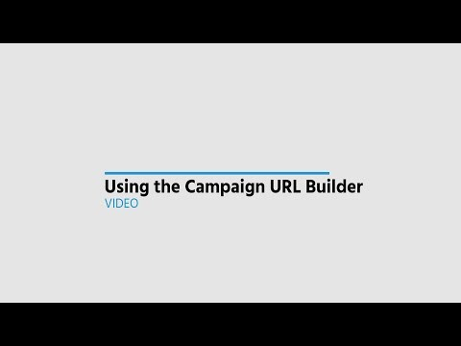
What is a UTM Parameter?
UTM(Urchin Tracking Module) is a simple code/parameters you can add to the end of your custom URL in order to track the source of traffic. It is also known as UTM parameters which send data to your analytics account
Notes:
https://ga-dev-tools.appspot.com/campaign-url-builder/

Slide 4
https://termlife.policybazaar.com/prequotes?
pb_source=google&
pb_medium=cpc&
pb_term=Term_insurance_plan&
pb_campaign=Core_Search_Partners_Exp00Term_Insurance_Plans&

Slide 5
https://www.ericsson.com/en/about-us/new-world-of-possibilities/imagine-possible-india?
utm_medium=advertorial
utm_source=ET
utm_campaign=moai_imaginepossibleind_5g_20220617&
utm_content=125x600&dclid=CjgKEAjw2f-VBhCco53S_f3qmQYSJAALuEub40HcnTBWI8lbKSrmRdIsQNt6C-NyyrGhj0hPgm-T8vD_BwE#education

Slide 6
https://trialclass.cuemath.com/ind/minimal-form-new/?
utm_source=d_fb_m&
utm_medium=ind_sok_FB_conv_Pan_UB_LA_math_LowestCost
utm_campaign=ind_sok_fb_conv_PanIndia_ub_LowestCost_math_0to5AllGeosHVLDD%2BEnrolledGradeKG-8_all&
utm_content=ind_sok_fb_conv_PanIndia_ub_LowestCost_math_0to5AllGeosHVLDD%2BEnrolledGradeKG-8_all_static_freeclassnew_1f_Instagram_Feed_ig&fbclid=PAAaaSo2ZlalGlxn2f0HtOckIdJlxLT-SWA2anEYddl4RqrTFABx0OFHRlB_g_aem_AWItE9fzCpCb_juMfUMNM_Mlluefkz6Nmzdvk8Oymte4F8iA2b3oqd121bsN5D9HT57fAwqYEjbzE-R8X2-1S7DzW1_DoTYP1tWvizEm_xXr8GzfAS7tOkunRoFyUg2abcI

Slide 7
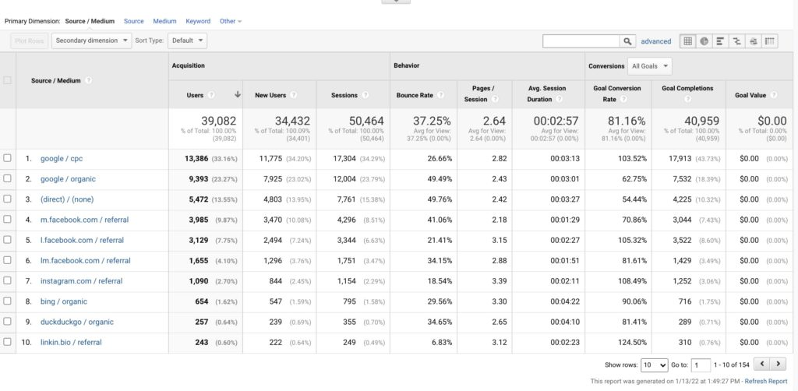
How Does a Campaign Source Report Look Like on GA?

Slide 8
Insights You Can Get from Campaign Source Report
Acquisition
The number of users who click on the link with the UTM code, including new and returning visitors.
Behaviour
How long users stay on the page you are tracking, the number of additional pages they access, and how frequently they leave from the page they first land on.
Conversions
The number of users who complete an action that aligns with your business goals

Slide 9
Three Important Steps to Measure Campaign Success on GA
Placing Google Analytics Code on All Pages
Using UTM Parameters across campaign pages
Setting Up Conversion Tracking (Goals/Revenue)
1
2
3
Notes:
https://marketlytics.com/blog/measure-success-of-your-marketing-campaigns/

Slide 10
Types of Goals in GA
Destination
You can specify a specific URL for this type of goal. For example, when a user reaches your contactus.html page a goal will be recorded.
Duration
A goal will be recorded when a user spends a specific amount of time on your site. For example, you can set up a goal when a user spends 2 minutes on your site.
Page/Screens per visit
A single goal will be recorded if a user visits a specific number of pages within a single session. You can record a goal when a user visits 3 pages/session.
Event
Event type goals are recorded on completion of certain events on your site. Such as a goal will be recorded when a user sign ups for a form or a goal will be recorded when a user shares your content on social media.

Slide 11
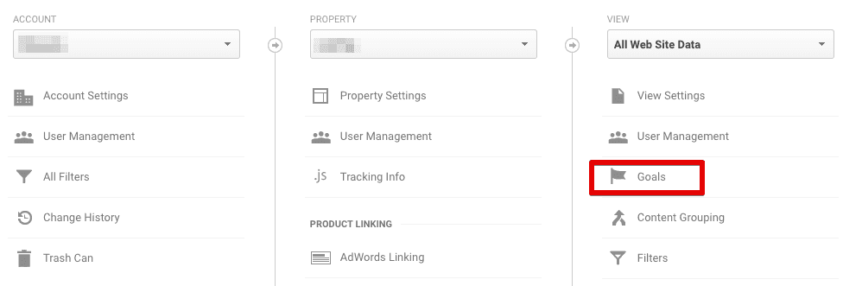
Setting Up Goals on GA

Slide 12
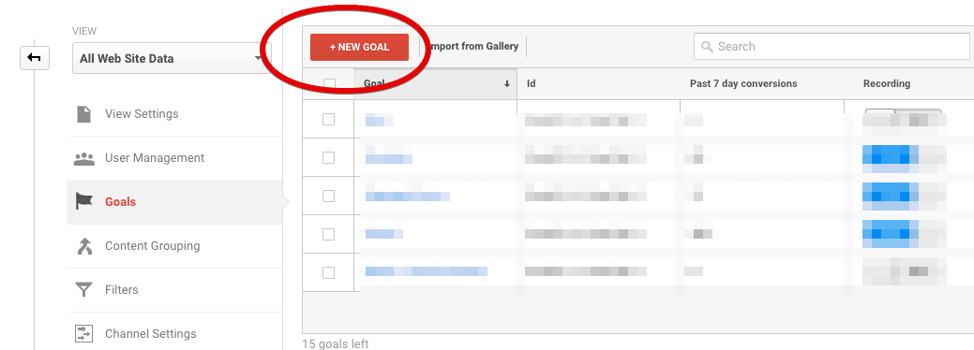
Setting Up Goals on GA

Slide 13
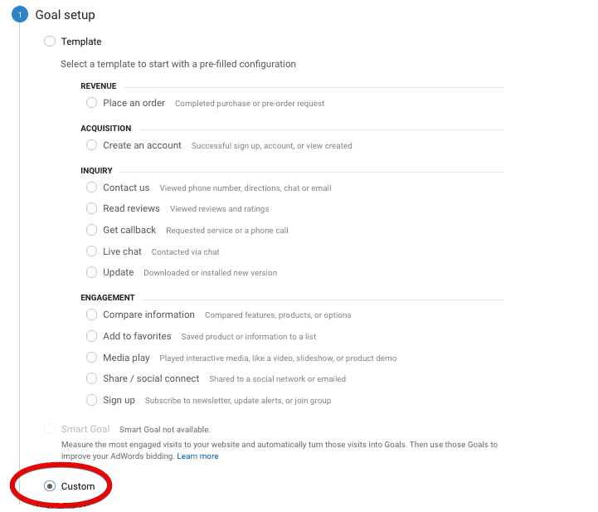
Setting Up Goals on GA

Slide 14
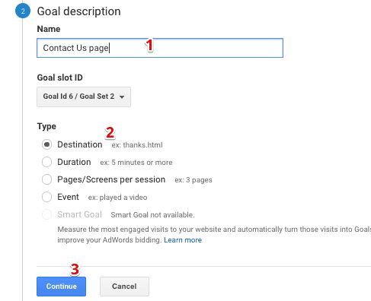
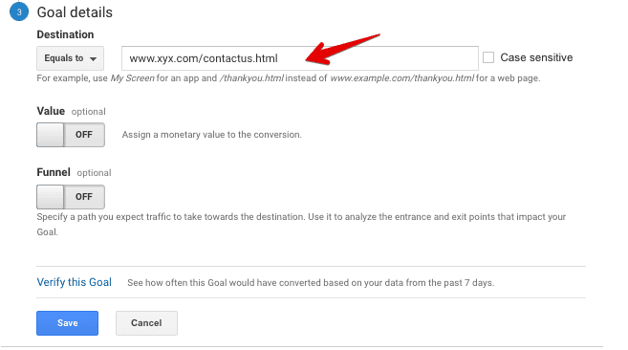
Setting Up Goals on GA

Slide 15
Top GA Metrics

Slide 16
Top Metrics to Track on GA
Sessions
Users
Pages Per Session
Returning Users
Avg. Time on Page
Average Session Duration
Conversions
Bounce Rate
Exit Rate
Page Load Time

Slide 17
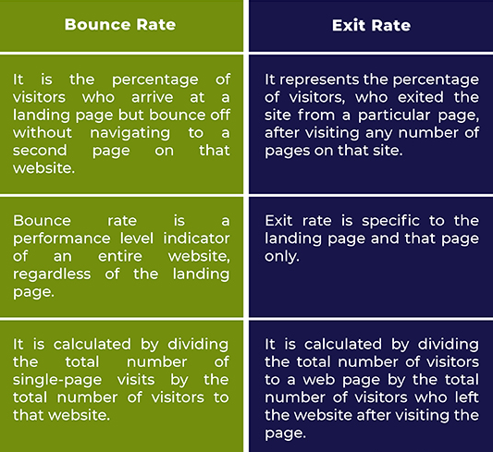
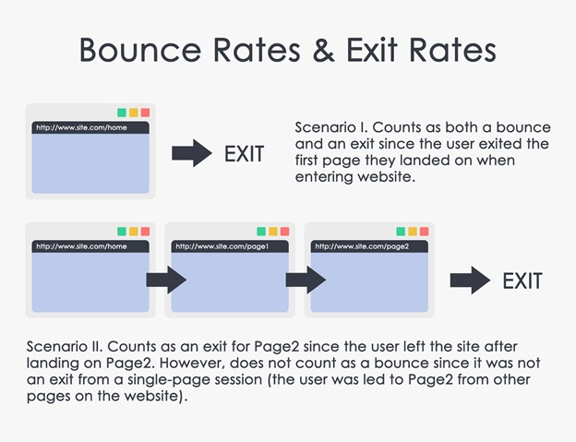
Bounce Rate Vs Exit Rate

Slide 18
Other Audience & Behavior Reports

Slide 19
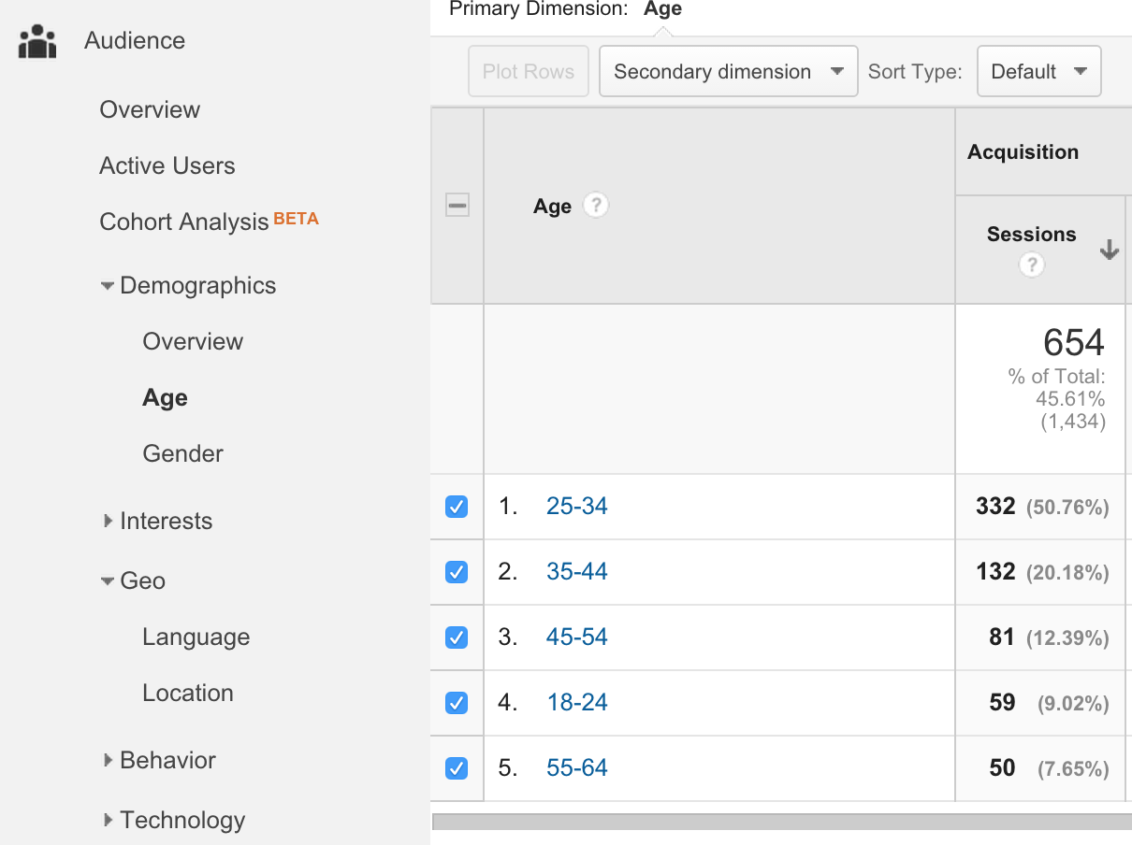

Slide 20
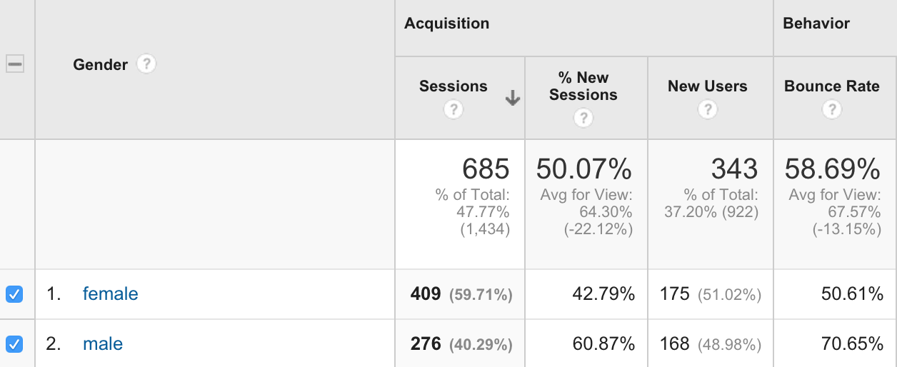

Slide 21
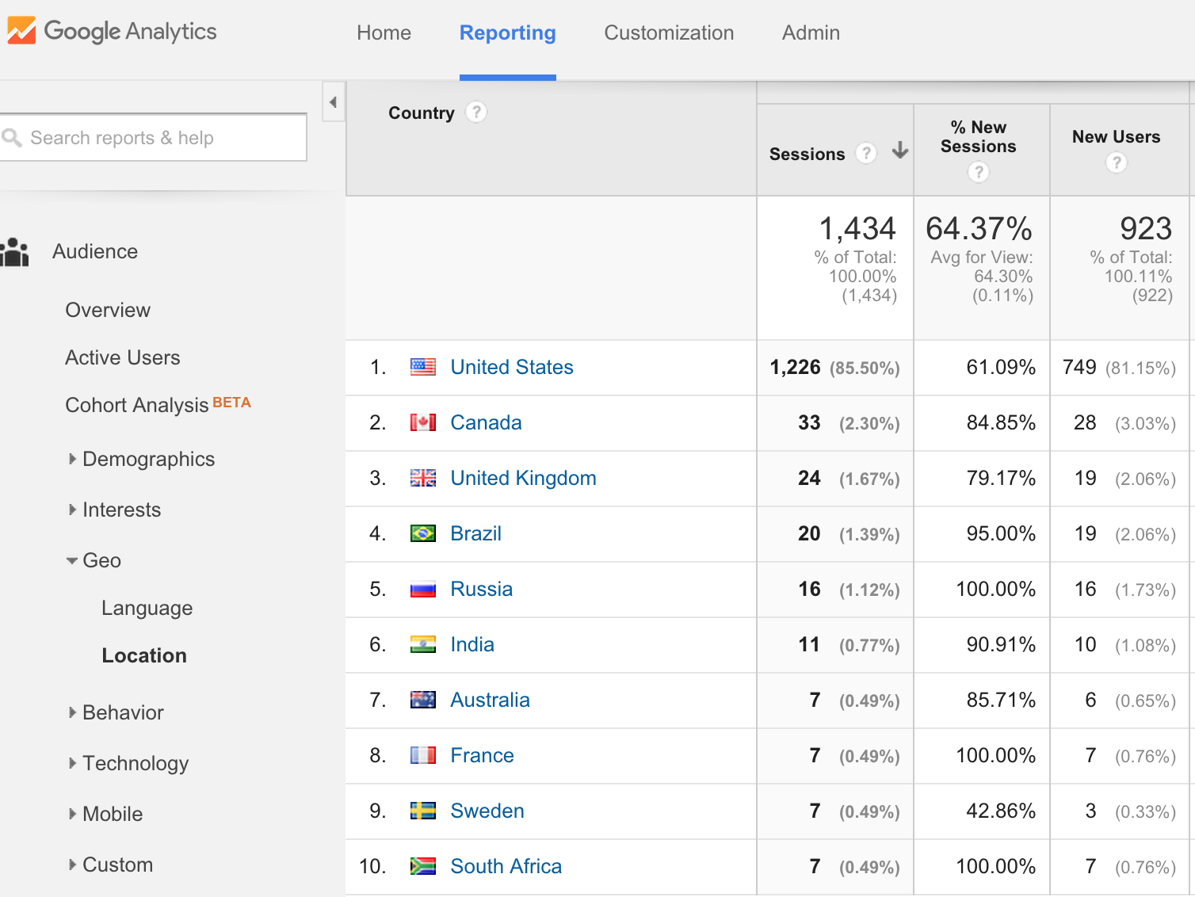

Slide 22
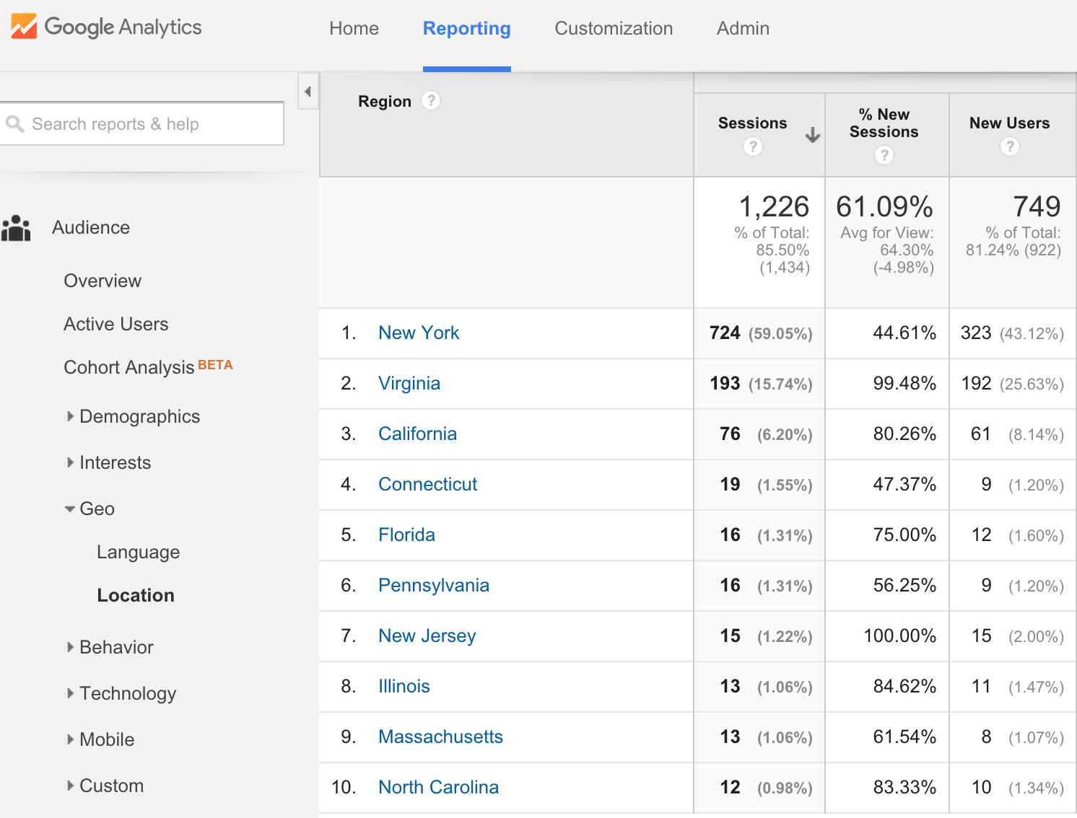

Slide 23
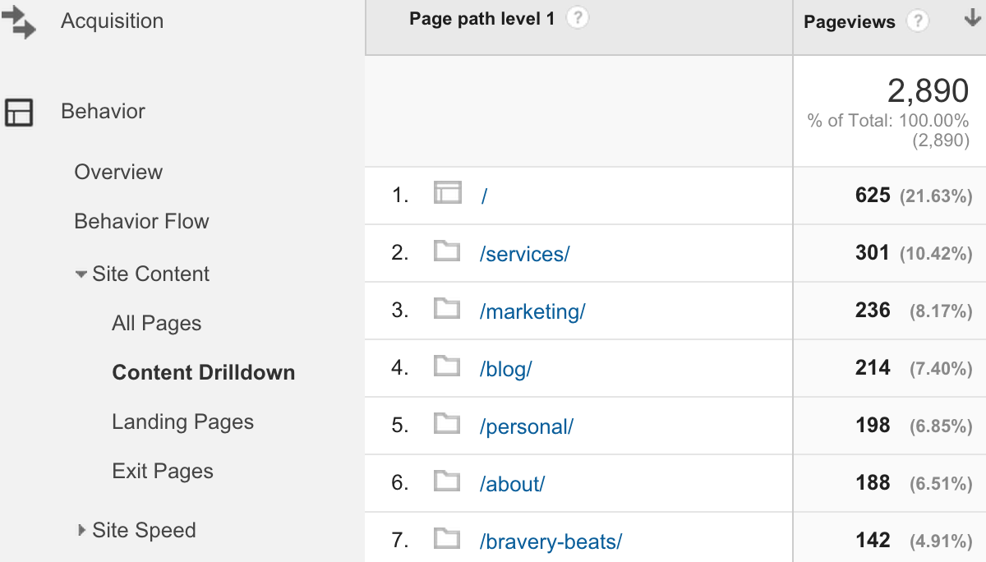

Slide 24
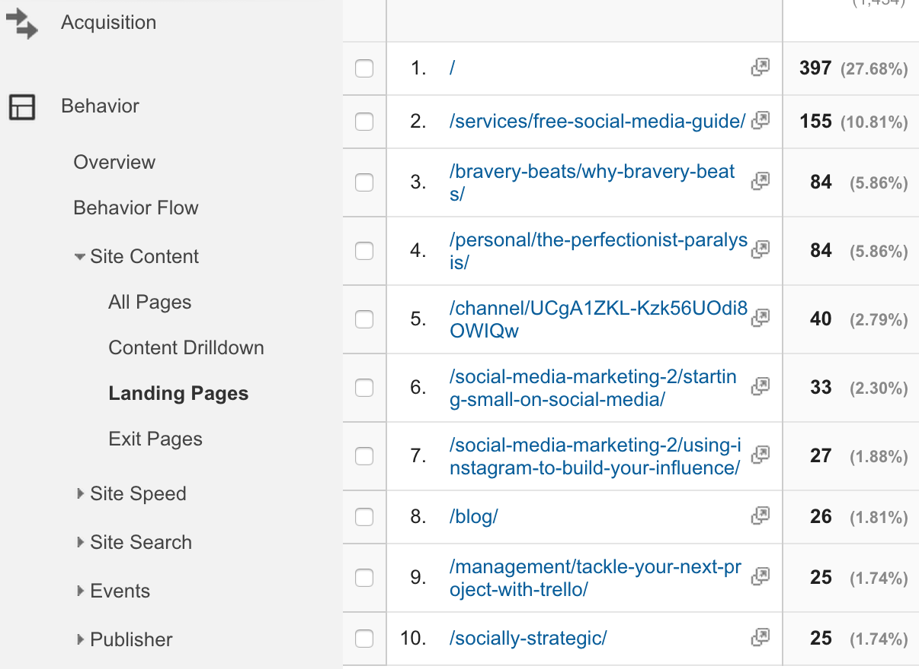

Slide 25
