Slide 1
MEASUREMENT AND ANALYSIS - I
SPHRi

Slide 2
Subjective attitudinal measures
Statistical measures
Human resource accounting
Economic cost accounting measures
Key Performance Indicators (KPI)
Key HR Metrics

Slide 3
Subjective attitudinal measures
The value of an HR activity or the performance of the entire HR department can be assessed with subjective behavioral measures. This assessment is sometimes called an HR audit
A human resource audit evaluates the effectiveness of the human resource department
How well do the policies and programs sponsored by the human resource department meet the needs of the employees and the company
Most HR audits rely on the subjective judgments and candid feedback of line managers or the professional opinions of external experts

Slide 4
HR AUDITS
A compliance audit focuses on risk mitigation issues, such as the firm’s diversity measures, pension plan participation, payroll accuracy, and other aspects of compensation and benefits. Compliance audits are often performed after an alleged violation to ensure that the current policies are appropriate and if they are being followed.
A value- creation audit focuses broadly on how well the HR policies and programs correlate with the business priorities and whether the HR activities can be performed more efficiently. A full audit would examine all HR functional areas, including staffing and recruitment, job analysis and descriptions, compensation and benefits programs, performance management, training and development, employee relations and policies, and HR metrics.

Slide 5
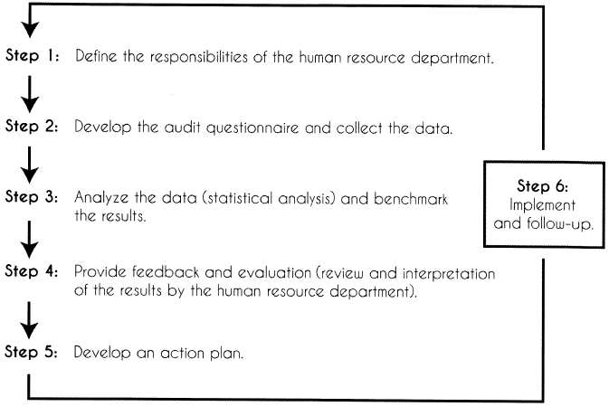
HUMAN RESOURCE AUDIT PROCESS

Slide 6
Subjective attitudinal measures
Statistical measures
Human resource accounting
Economic cost accounting measures
Key Performance Indicators (KPI)
Key HR Metrics

Slide 7
Research Methods
Qualitative data: It is the non-numerical data. For eg., texture of the skin, colour of eyes, etc.
Quantitative data: Quantitative data is given in numbers. Data in the form of questions such as “how much”, “how many”, gives the quantitative data.

Slide 8

Qualitative and Quantitative Research

Slide 9

Qualitative Methods

Slide 10
Quantitative Research
1. Regression analysis includes any techniques for modeling and analyzing several variables, when the focus is on the relationship between a dependent variable and one or more independent variables. That always is shown on a scatter diagram.
2. Analysis of variance (ANOVA) is a collection of statistical models, and their associated procedures, in which the observed variance in a particular variable is partitioned into components attributable to different sources of variation.
3. Factor analysis is a statistical method used to describe variability among observed variables in terms of a potentially lower number of unobserved variables called factors.
4. Cluster analysis or clustering is the assignment of a set of observations into subsets (called clusters) so that observations in the same cluster are similar in some sense.
5. Structural equation modeling (SEM) is a statistical technique for testing and estimating causal relations using a combination of statistical data and qualitative causal assumptions.
6. Operations research (OR, also referred to as decision science or management science) encompasses a wide range of problem-solving techniques and methods applied in the pursuit of improved decision-making and efficiency.

Slide 11

Comparing Qualitative and Quantitative Research

Slide 12

Types of Measurement

Slide 13
Types of Measurement
Nominal data consist of categories or dimensions and have no numerical meaning by themselves. Examples of nominal data include race, hair colour, and marital status.
Ordinal data are rank orders. Examples of ordinal data include baseball standings (“Who’s in first place?”), seniority lists (“She is third from the top), and budget requests.
Interval data have equal intervals but not necessarily equal ratios. Examples of interval data include performance ratings, the temperature outside, and a score on a personality test.
Ratio data have equal ratios and a true zero point. Examples of ratio data include salary, height, and the number of job applicants.

Slide 14

Mean, Median and Mode

Slide 15
Essentials of Statistics
A measure of central tendency is a single value that attempts to describe a set of data by identifying the central position within that set of data. As such, measures of central tendency are sometimes called measures of central location
Mean : The arithmetic average obtained by adding up all the scores and dividing by the total number of scores.
Median : It is the middle score, or average of middle scores in a distribution
Mode : The category or score with the largest frequency (or percentage) in the distribution.
The mean (average) of a data set is found by adding all numbers in the data set and then dividing by the number of values in the set. The median is the middle value when a data set is ordered from least to greatest. The mode is the number that occurs most often in a data set

Slide 16
Essentials of Statistics
Percentiles : A percentile is a measure at which that percentage of the total values are the same as or below that measure. For example, 90% of the data values lie below the 90th percentile, whereas 10% of the data values lie below the 10th percentile.
Quartiles : Quartiles are values that divide a (part of a) data table into four groups containing an approximately equal number of observations. The total of 100% is split into four equal parts: 25%, 50%, 75% and 100%
Range : The range is a measure of spread: it’s the difference between the highest value and the lowest value in a data set.

Slide 17
Essentials of Statistics
Probability is the measure of the likelihood that an event will occur in a Random Experiment. Probability is quantified as a number between 0 and 1, where, loosely speaking, 0 indicates impossibility and 1 indicates certainty. The higher the probability of an event, the more likely it is that the event will occur.
Standard Deviation (SD) is a measure of variability (it is not a measure of central tendency). Conceptually it is best viewed as the 'average distance that individual data points are from the mean.' Data sets that are highly clustered around the mean have lower standard deviations than data sets that are spread out.
Normal Distribution-also known as a Guasian distribution, the normal distribution follows the shape of a bell curve. That is to say that results cluster around a mean and then fan out into symmetrical tails on either side.

Slide 18

Normal Distribution and Standard Deviation (SD)

Slide 19
Quantitative Methods
Regression analysis, also called least-squares analysis, is the process of deriving the linear equation that describes the relationship between two variables with a nonzero coefficient of correlation. Simple regression is used when there is one independent variable. The simple regression equation is, obviously, the algebraic formula for a straight line: y = a + bx.
Correlation coefficient expresses the degree of linear relationship between two sets of scores. A positive correlation exists when high values on one measure (e.g., a job knowledge test) are associated with high scores on another measure (e.g., overall ratings of job performance). A negative correlation exists when high scores on one measure are associated with low scores on another measure

Slide 20
Subjective attitudinal measures
Statistical measures
Human resource accounting
Economic cost accounting measures
Key Performance Indicators (KPI)
Key HR Metrics

Slide 21
Human resource accounting
Human resource accounting refers to the process of identifying and measuring HR data and communicating this information along with financial data to interested parties, especially investors and managers.
This information is especially valuable for managers of service firms where people are the key assets of the firm, such as public accounting firms, management consulting firms, and sports teams.
The purpose of human resource accounting is to improve the quality of financial decisions affecting human resource activities.

Slide 22
Outlay Cost
The outlay cost is also referred to as the historical acquisition cost. This measure represents the value of “human capital” and includes all of the costs associated with recruiting, selecting, training, and developing employees for a firm. It has been suggested that these costs should be capitalized and treated the same way as costs for capital equipment, which are depreciated over the expected useful life of the assets.

Slide 23
Replacement cost
The replacement cost is an estimate of how much it would cost to replace a firm’s existing human resources. Included in this estimate is the cost of recruiting, hiring, training, and developing capable replacements. The total replacement value includes not only the current replacement costs but also the opportunity costs of lost income that would be incurred while the replacements were developing the same level of proficiency as existing employees.

Slide 24
Human resource value
The human resource value represents the expected contribution to the firm’s net income for individuals at each level in the firm. This value is estimated by calculating the net present value of each person based on the person’s expected future services and probability of staying with the firm.

Slide 25
Subjective attitudinal measures
Statistical measures
Human resource accounting
Economic cost accounting measures
Key Performance Indicators (KPI)
Key HR Metrics

Slide 26
Costing HR Activities
In their book Investing in People: Financial Impact of Human Resource Initiatives, Wayne Cascio and John Boudreau list (among others) these costs.
Fixed and variable cost
Opportunity cost
The value of money over time

Slide 27

HR costing to calculate an ROI
Cost is a key element in the ROI formula.
The top part of the ROI formula is called the net benefit. The net benefit is the total benefit minus the total cost. The net benefit is divided by the total cost.

Slide 28
Fixed vs. variable HR cost
Fixed costs are the costs that remain constant, regardless of the activities in the project. Variable costs change as activities change.
For example, creating a training session involves a certain fixed cost. However, the number of times the session is given is related to variable cost. This is why the cost of training 200 people in 10 workshops is higher than the cost of training for 20 people in 1 workshop. The cost of creating the material is the same, but by giving 10 workshops instead of 1, the variable costs decreases 10-fold

Slide 29
HR opportunity cost and savings
Opportunity cost refers to the potential gains that might have been realized if resources were directed to other ends.
For instance, training your salespeople doesn’t only cost you their salary ( the estimated value of employee time). No, it also has opportunity cost: in the time that they spend in training, they might have also closed a deal. This is your opportunity cost.
To quantify these costs, you should make a list of all the activities that the employee can’t do because of the intervention. Next, you can quantify the opportunity costs for each of these activities. For example, if a salesperson works 5 hours less because he is in training, and it takes him on average 200 hours to create a deal that brings in $40,000, the opportunity cost of the sales training would be $1,000.

Slide 30
Value of money over time
We all know that money doesn’t retain its value because of inflation. However, if money is not invested in an HR intervention but stored on a bank, it will create more money. This means that money in the bank usually has a constant, positive return on investment.
So, the value of money fluctuates over time due to inflation and interest. This is important to keep in mind when you calculate the payback period or the return on investment. The method for doing this is referred to as the (net) present value.

Slide 31
Subjective attitudinal measures
Statistical measures
Human resource accounting
Economic cost accounting measures
Key Performance Indicators (KPI)
Key HR Metrics

Slide 32
Key pedormance indicators (KPI)
To evaluate its performance and make strategic adjustments, organizations need useful human resource metrics that measure both efficiency (time and cost) and effectiveness (return on investment and profitability).
Key performance indicators (KPI) refer to specific measures of human resource activities that contribute importantly to the efficiency and effectiveness of a company.
The purpose of key performance indicators is to provide a company with quantitative measurements that can be used to monitor the events that contribute importantly to its long-term success.

Slide 33
Leading and Lagging Indicators
.A leading indicator is a measure that precedes, anticipates, or predicts future performance. An example of a leading indicator is the amount of time required to fill key vacancies (time to fill) since having qualified employees is essential to a company.
A lagging indicator measures the results of a process or a change, such as sales, profits, and customer service levels. The average number of units produced per employee is an example of a lagging indicator that measures how well a company is increasing employee productivity.

Slide 34
Scorecards and Dashboards
The process of collecting HR metrics and presenting them to managers in a useful format is referred to as an HR Scorecard, or sometimes as an HR Dashboard. Documenting and tracking defined metrics allows managers to justify investments in human capital and other HR expenses. A meaningful scorecard serves as a key management tool to strengthen HR’s strategic influence in an organization. A carefully designed scorecard includes four perspectives:
a strategic perspective that measures progress in achieving major strategic initiatives
an operational perspective that measures the effectiveness of HR processes
a financial perspective measuring the financial contribution of HR activities
a customer perspective measuring how well HR activities serve both internal and external customers.

Slide 35

Balanced Scorecard

Slide 36

HR Measures and BSC

Slide 37

Workforce Scorecard

Slide 38

HR Scorecard

Slide 39
Subjective attitudinal measures
Statistical measures
Human resource accounting
Economic cost accounting measures
Key Performance Indicators (KPI)
Key HR Metrics

Slide 40
Key HR Metrics
Revenue Factor (or Revenue per FTE): Revenue - Total Number of FTE
This metric is often used as the primary measure of effectiveness of a company since it represents how much revenue is generated by the average full-time equivalent (FTE) employee. This metric views employees as a capital investment rather than as an expense. Part-time employees are included in the FTE count proportional to the hours they work.
Revenue per Labor Costs: Revenue * Total Labor Costs
This metric has been recommended as a better measure to track than revenue per FTE since it motivates managers to reduce costs rather than FTEs." When companies focus on revenue per FTE, managers are motivated to use expensive overtime to meet production deadlines rather than less expensive contingency hiring that increases the number of FTEs.

Slide 41
Key HR Metrics
Human Capital ROI: [Revenue - (Operating Expense - (Compensation cost + Benefit Cost))] / (Compensation cost + Benefit cost):
This metric measures the return on investment ratio for employees and is frequently mentioned as the prime measure for analyzing HR practices, such as recruitment, training, and incentives. Changes in this metric are carefully examined with respect to changes in HR practices to test for causal relationships.
Human Capital Value Added: [Revenue - (Operating Expense - (Compensation cost + Benefit Cost))] / Total Number of FTE :
This metric represents how much value is added to the company from the average employee and is interpreted as the value of the workforce’s knowledge, skills, abilities, and performance

Slide 42
Key HR Metrics
HR Expense Factor: HR Expenses * Total Employees :
This popular metric, also called HR cost per employee, represents the average cost of providing human resource services to the employees in a company. This metric can be benchmarked using surveys that show the average for all responding companies, plus the average HR expense for different industries and companies of different sizes. Two other popular HR cost metrics are HR cost as a percent of revenue and HR cost as a percent of total operating costs. A study found that “world-class HR” organizations have a 23 percent lower cost of HR per employee than typical HR organizations.“
Absence Rate: [(Number of days absent in the month) / (Average number of employees during month) x (Number of workdays)] x 100
This metric is the standard measure of absenteeism and can be benchmarked with other absenteeism surveys, which show the rates for different industries and companies of different sizes..

Slide 43
Key HR Metrics
Turnover Rate: [Number of separations during the month / Average number of employees during month] x 100
This metric is the standard measure of turnover; it measures the rate that employees leave a company and is usually divided into voluntary and involuntary reasons before examining potential problems in HR policies.
Cost per Hire: The cost per hire (CPH) metric measures the costs associated with the sourcing, recruiting, and staffing activities borne by an employer to fill an open position. It can be used in all industries in both the public and private sectors.The formula for this metric is (external costs + internal costs) / number of hires.
The external costs include all recruiting costs, such as third-party agency fees, advertising costs, job fair costs, and travel costs. The internal costs include the salary and benefits of the recruiting team plus fixed costs such as the physical infrastructure. The number of hires includes both temporary and full-time employees for a given time period.

Slide 44
Key HR Metrics
Turnover Costs per Employee: (Separation Costs + Replacement Costs + Training Costs+ Lost Performance) / Number of Replacements
This metric measures more than just hiring costs; it includes all of the costs associated with turnover and represents the average cost of replacing an employee who quits or is fired. Separate metrics can be calculated for different divisions, different jobs, and different job levels. These costs provide a significant motivation for examining and improving HR practices that reduce turnover.
Time to fill: Total days elapsed to fill requisitions / Number hired
This metric counts the number of days from which job requisitions are approved to the new hire starting date. It measures the average time required to fill job openings and reflects the efficiency of hiring practices. Other key recruiting effectiveness metrics include time to start, response time, offer acceptance rate, and quality of hire.

Slide 45
Yield Ratios
In planning recruitment activities, an organization needs to know how many applicants must be recruited. Since some applicants may be not be satisfactory and others may not accept job offers, an organization must recruit more applicants than it expects to hire.
Yield ratios help organization decide how many candidates to recruit for each job opening. These ratios express the relationship between the number of people at one step of the recruiting process relative to the number of people who will move to the next step.

Slide 46
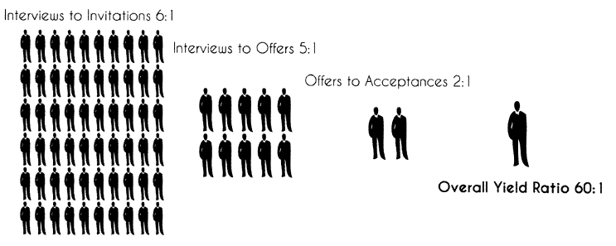
Yield Ratios

Slide 47
Question
In analyzing their selection process, a company finds that they invite one of every 20 applicants to complete a skills test. For every three who complete the skills test, one is offered a job. Half of those offered a job accept. What is the overall yield ratio for this selection process ?
120:1
60:1
20:1
10:1

Slide 48
Answer
Option A

Slide 49
Questions

