Slide 1
MARKET
The word market is derived from the Latin word 'Marcatus' which means trade, commerce, merchandise, a place where business is transacted.
The common usage of market means a place where goods are bought or sold. It is a medium or place to interact and exchange goods and services.
In simple words, the meeting place of buyers and sellers in an area is called Market.

Slide 2
Marketing: Definitions
Marketing refers to the various groups of activities that take place in a market. These activities are either planned or spontaneous. For example, production, assembling, distribution and storage could be planned, consumption is often spontaneous.
The American Marketing association (4) defined marketing as
“Market is an organizational function and a set of process for creating, communicating value to customers and for managing customer relationships in ways that benefit the organization and its stakeholders."
According to Dahl and Hammond (5)
the purpose of production, assembling, storage, and transportation was consumption. All these steps from production to ultimate consumption were included in the term marketing. Hence, marketing is a set of activities without which what is produced cannot reach the ultimate consumer. Hence it might be said that the importance of these activities is the study of marketing.
Kotler (6) says
“Marketing is a societal process by which individuals and groups obtain what they need and want through creating, offering, and freely exchanging products and services of value with others.”

Slide 3

MARKETING ENVIRONMENT
Marketing environment refers to “all those internal and external factors which impact the performance of a product or firm for its decision-making.
The political and economic changes in 1991 resulted in sea changes in the marketing environment through liberalization.
In the field of cellular phone industry, many companies entered India.
Rapid technological changes have taken place in the computer hardware/software industry.
The marketing team has the responsibility to increase sales and profit of the company through effective use of marketing mix.
The demand for the products and profitability of the operations depend upon the marketing environment.
Therefore, marketing environment influences and shapes the marketing strategy.
A marketer has to design his marketing strategies based on the marketing environment

Slide 4
Types of Marketing Environment
A firm is exposed to both external and internal environments. Internal environment consists of a company’s resources such as: Production, Finance, Human Resources, Research and Development, Location, Company Image
External environment has two distinct components:
Micro-environment:
  Consumers
  Marketing intermediaries like Distributors, Wholesalers, Dealers, Suppliers, and Competitors.
Macro-environment:
  Demographic factors
  Economic conditions
  Social and cultural forces
  Political and Legal forces
  Technology and Ecological factors

Slide 5
Importance of Environmental Analysis
Raises general awareness of environmental changes within management.
Assists in government-related matters and compliance.
Aids in market analysis and business forecasting.
Helps in improving diversification and resource allocation.
Enables firms to identify and capitalize on opportunities rather than losing them to competitors.
Provides an objective base for designing business strategies.
Offers continuous broad-based education for executives and strategists.

Slide 6
MICRO-ENVIRONMENT
1. Suppliers: Suppliers can influence the profit of an organization because the price of raw material determines the final price of the product. Organizations need to monitor suppliers on a regular basis to know the supply shortages and change in the price of inputs.
2. Marketing Intermediaries: It helps organizations in establishing a link with customers. They help in promoting, selling, and distributing products.
Marketing intermediaries include the following:
a. Resellers: It purchases the products from the organizations and sell to the customers. Examples of resellers are wholesalers and retailers.
b. Distribution Centers: It helps organizations to store the goods. A warehouse is an example of distribution center.
c. Marketing Agencies: It promotes the organization’s products by making the customers aware about benefits of products. An advertising agency is an example of marketing agency.
d. Financial Intermediaries: It provides finance for the business transactions. Examples of financial intermediaries are banks, credit organizations, and insurance organizations.

Slide 7
3. Customers: Customers buy the product of the organization for final consumption. The organization undertakes the research and development activities to analyze the needs of customers and manufacture products according to those needs.
4. Competitors: Competition refers to a situation where various organizations offer similar products and try to gain market share by adopting different marketing strategies.

Slide 8
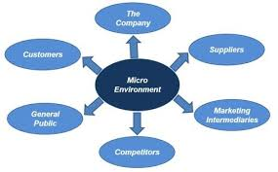

Slide 9
Macro Environment
Macro environment involves a set of environmental factors that is beyond the control of an organization.
These factors influence the organizational activities to a significant extent.
The changes in macro environment bring opportunities and threats in an organization.

Slide 10
Demographic Environment:
Demographic environment is the scientific study of human population in terms of elements, such as age, gender, education, occupation, income, and location.
Provides a consumer profile essential for market segmentation.
Example: Census data helps businesses understand the consumer base.
  Indian has younger population as compared to many countries
    7 out of 10 young consumers prefer to buy less-known brands in FMCG categories
    Millennial and Gen Z audiences lean towards socially and environmentally sustainable choices
    Groceries and snacks witnessed a threefold rise in online deliveries

Slide 11
Economic Environment
The economic environment affects the organization’s cost structure and customers’ purchasing power. The purchasing power of a customer depends on the current income, prices of the product, savings, and credit availability.
The factors of the economic environment are as follows:
  Inflation: It influences the customers’ demand for different products. For example, higher petrol prices lead to a fall in demand for cars.
  Interest Rates: It determines the borrowing activities of the organization. For example, increase in interest rates for loan may lead organizations to cut their important activities.
  Unemployment: It leads to a no income state, which affects the purchasing power of an individual.
  Monetary and Fiscal Policy: It affects all the organizations. The monetary policy stabilizes the economy by controlling the interest rates and money supply in an economy; where as, fiscal policy regulates the government spending in various areas by collecting the revenue from the citizens by taxing their income.

Slide 12
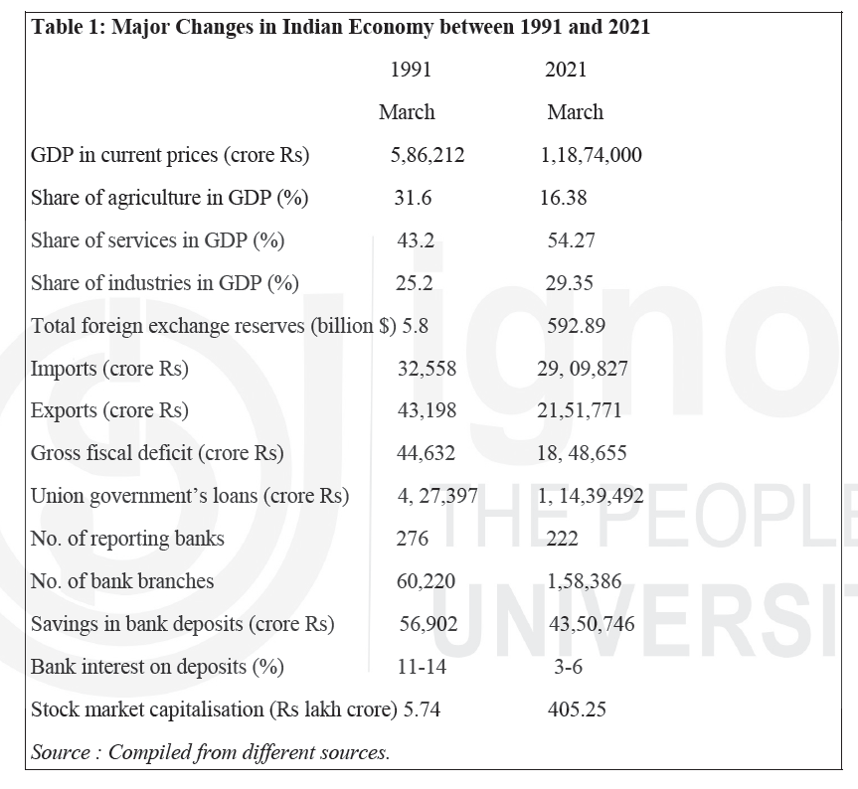

Slide 13
Socio-Cultural Environment
  Socio-cultural environment comprises forces, such as society’s basic values, attitudes, perception, and behavior.
  These forces help in determining that what type of products customers prefer, what influences the purchase attitude or decision, which brand they prefer, and at what time they buy the products
  Trends: changing lifestyles of people, changing role of women, joint to nuclear family
  Examples: Ayurveda-based brands (Himalaya), organic consumer preferences, Urbanization and Western influences shaping modern marketing trends
Natural Environment
  Involves natural resources that are needed as inputs by the marketers or that are affected by the marketing activities
  Trends: shortage of raw materials, increased pollution, increased government intervention, environmentally sustainable strategies

Slide 14
Technological Environment
  Technology revolutionized production, logistics, and digital marketing.
  Emerging trends: AI, IoT, Blockchain, 5G, Cybersecurity, automation, customer engagement, marketing analytics.
  Example: Netflix disrupting traditional media industry.
Political-Legal Environment
  Government policies shape market regulations.
  Examples: Corporate tax cuts, real estate reforms, bank recapitalization.
  Businesses must comply with legal frameworks (consumer protection, taxation).
  Example: Telecom regulatory changes impacting industry competition.

Slide 15
New Indian Consumer in Vibrant Marketing Environment
• Rise of digital economy and mobile-first consumers.
• E-commerce boom: Amazon, Flipkart, JioMart leading the way.
• Shift from sellers' market to buyers' market post-1991 reforms.
• Tech-savvy consumers driving business model changes.

Slide 16
5 C’s Framework

Slide 17
Introduction
It is a tool providing a comprehensive analysis of both internal and external factors affecting an organization.
The framework assists businesses in understanding their position in the market, identifying potential challenges and opportunities, and making informed strategic decisions.
The 5C’s include Company, Customers, Competitors, Collaborators, and Climate (or Context)

Slide 18
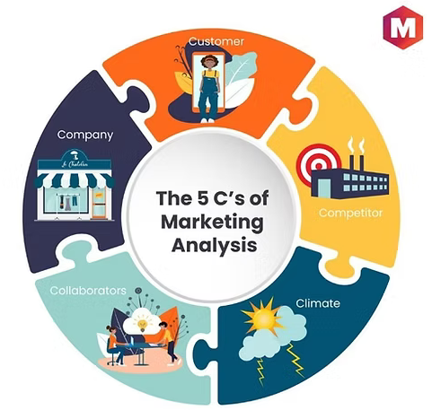
Company
Involves an in-depth review of the organization itself – its strengths, weaknesses, goals, and existing strategies.
This analysis helps firms understand their competitive advantages and areas of vulnerability.
For instance, a company might identify a robust supply chain or a unique product as a strength, while outdated technology or high operational costs might be seen as weaknesses

Slide 19
Customers
  This involves understanding the organization's customer base.
  It delves into their needs, wants, consumption patterns, purchasing behavior, and perceptions about the company's products or services.
  Profound knowledge of customers aids in market segmentation, positioning, and determining marketing communication strategies
Competitors
  This involves identifying and evaluating the company's main competitors.
  Assessing their strategies, strengths, weaknesses, market positions, and products or services.
  Through competitor analysis, a company can understand its relative position within the market, identify potential threats, and uncover opportunities to differentiate itself.

Slide 20
Collaborators
  Collaborators may include suppliers, distributors, shareholders, or any other stakeholders contributing to the company's success.
  A thorough analysis of collaborators can lead to the development of more integrated and efficient strategies that leverage these relationships.
Climate
  It involves macro-environmental factors (also known as PESTEL factors: Political, Economic, Social, Technological, Environmental, and Legal) that influence a company's operations and market potential.
  Understanding these factors can help a company predict market trends, prepare for industry shifts, and mitigate potential risks.

Slide 21
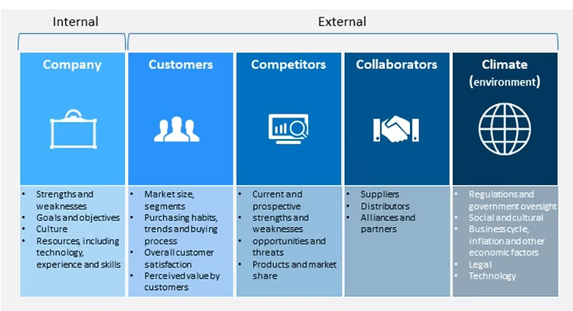

Slide 22
Here’s how the framework is commonly used:
Strategic Planning – Businesses employ the 5C’s framework during the strategic planning process. It helps organizations align their internal strengths with external opportunities and address weaknesses and threats.
Market Analysis – The framework aids in conducting a thorough analysis of the market, identifying key players, understanding customer needs, and evaluating the competitive landscape.
Decision-Making – When faced with strategic decisions, businesses refer to the 5C’s framework to assess the potential impact on the company, customers, competitors, collaborators, and the broader business context.
Risk Management – By considering all five components, businesses can better anticipate and manage risks. Understanding the external climate and potential collaborators, for example, helps mitigate unforeseen challenges.
Resource Allocation -The framework assists in allocating resources effectively by prioritizing areas that align with the company’s internal strengths and market opportunities.

Slide 23
Profit=f(Industry)
Industry
“Groups of Firms producing products which are close substitutes to each other”

Slide 25
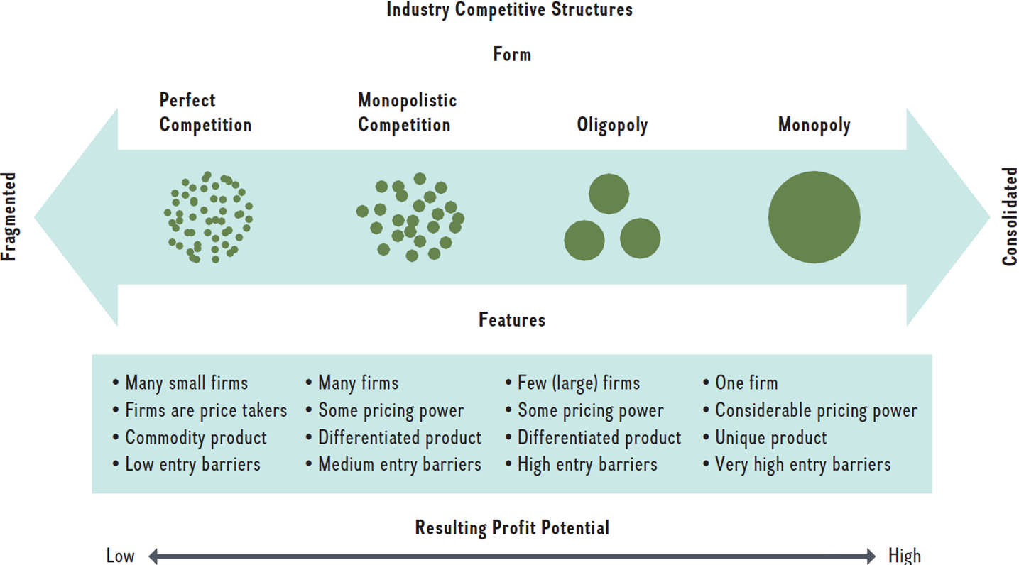
Industry Competitive Structures

Slide 26
Porter’s Five Forces Framework
The intensity with which companies in the same industry compete for market share and profitability

Slide 27
Porter’s Five Forces Framework
Pressure customers put on an industry by demanding:
  A lower price or
  Higher product quality

Slide 28
Porter’s Five Forces Framework
Pressures that industry suppliers can exert on an industry’s profit potential if:
  Suppliers demand higher prices for their inputs
  Suppliers reduce quality

Slide 29
Porter’s Five Forces Framework
Products or services outside an industry meeting the needs of current customers

Slide 30
Porter’s Five Forces Framework
The risk that potential competitors will enter an industry
  Incumbents lower prices

Slide 31
Porter’s Five Forces Framework
Obstacles that determine how easily a firm can leave that industry

Slide 32
Porter’s Five Forces Framework
Complementor:
  A company that provides a good or service that leads customers to value your firm’s offering more when the two are combined

Slide 33
Porter’s Five Forces Framework

Slide 34
“Choose” an industry with a “favorable industry structure”
Where to compete?

Slide 35
Prof. Michael Porter on Five Forces
https://www.youtube.com/watch?v=mYF2_FBCvXw

Slide 36
Case study
Country Delight: Expanding the consumer’s product pantry

Slide 37
Company Background
Founders: Chakradhar Gade and Nitin Kaushal
Business model: D2H delivery of fresh milk
USP: Fresh, high-quality, unadulterated milk and dairy products delivered within 24-36 hrs of milking
Began its operations in NCR and spread across 15 metro cities
Aims to double its current subscriber base (500000) to reach 1 million by 2025

Slide 38
As the company is planning to scale up, the dilemma being faced by Gade (CEO) and Kaushal (COO) are:
“ How to scale further without losing its core identity”

Slide 39
Growth strategies
Expansion to new geographies (moving beyond 15 cities to tier 2 and tier 3 markets)
Adding products to the existing portfolio (ice cream, misti doi, kheer, or entering the plant-based milk segment)
Diversification into agritourism (like the Pune-based vineyard Sula, or farm-fresh meat, poultry, or seafood)

Slide 40
What factors matter most to Indian consumers when buying milk for their family's daily use?
(Please rank as 1 the most important, 2 as the next, and so on.)
Price
Taste
Freshness
Convenience (at-my-doorstep)
Fat Content
Unadulterated
Packaging
Health benefits

Slide 41
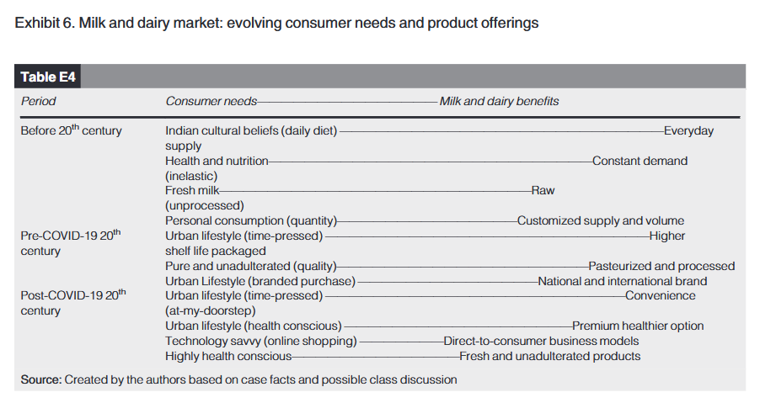

Slide 42
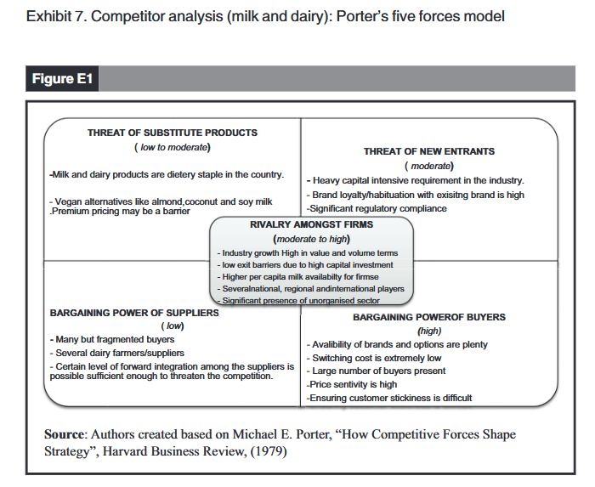

Slide 43
Analyzing the competition (Milk and Dairy Sector)
Opportunities:
  Health-Conscious Consumers – Rising demand for fresh, organic, and unadulterated dairy products.
  Direct-to-Consumer (D2C) Models – Subscription-based and farm-to-home delivery models gaining traction.
  Premiumization – Consumers willing to pay more for high-quality, natural dairy products.
  Government Support – Policies promoting dairy farming and entrepreneurship.
  Technological Advancements – IoT-based supply chain tracking ensures product freshness and quality
  Growing Market Demand – Increasing per capita milk consumption in India.

Slide 44
Analyzing the competition (Milk and Dairy Sector)
Threats:
Regulatory Challenges – Compliance with food safety, labeling, and pricing regulations.
High Competition – Strong competition from established players like Amul, Mother Dairy, and Nestlé.
Supply Chain Risks – Cold chain logistics challenges and dependence on small farmers.
Price Sensitivity – Consumer reluctance to pay a premium for fresh milk versus mass-market brands.
Plant-Based Alternatives – rising popularity of almond, soy, and oat milk alternatives.
Fluctuating Raw Material Costs – Changes in fodder, fuel, and operational costs impact profitability.

Slide 45
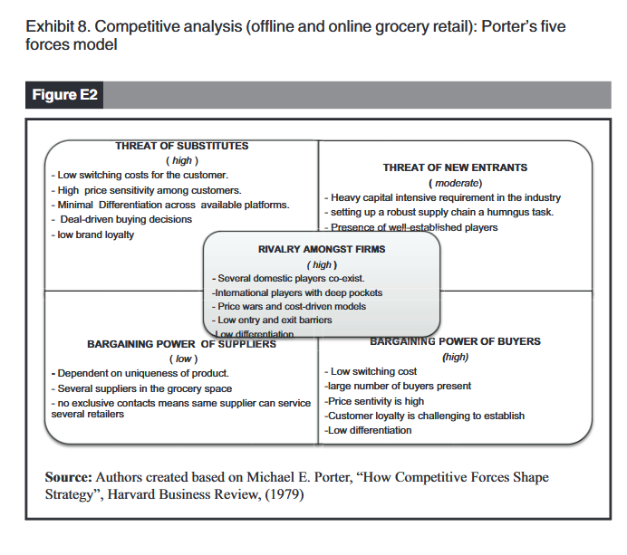

Slide 46
Analyzing the competition (Grocery and Online Marketplace)
Opportunities:
  E-commerce Boom – Increasing consumer adoption of online grocery shopping.
  Urbanization & Lifestyle Changes – Demand for convenient, home-delivered fresh produce and grocery essentials.
  Product Expansion – Addition of fresh meats, bakery, and organic grocery items.
  Strategic Partnerships – Tie-ups with local farmers and suppliers to ensure fresh produce.
  Subscription-Based Models – Steady revenue stream with predictive demand analysis.
  AI & Data Analytics – Personalized shopping experiences and demand forecasting.

Slide 47
Analyzing the competition (Grocery and Online Marketplace)
Threats:
Competition from Aggregators – Players like Big Basket, Blinkit, Zepto, and Amazon Fresh dominate the market
Inventory & Perishability Risks – Fresh products have a short shelf life and require tight supply chain management.
Logistics & Fulfillment Challenges – Efficient last-mile delivery and cold chain management are crucial
Too much variety will dilute the core value of “freshness”, essentially the Country Delight promise.
Pricing Pressure – Competitive pricing from major grocery retailers and discount-driven marketplaces.
Regulatory Hurdles – Compliance with food safety, storage, and packaging norms.

Slide 48
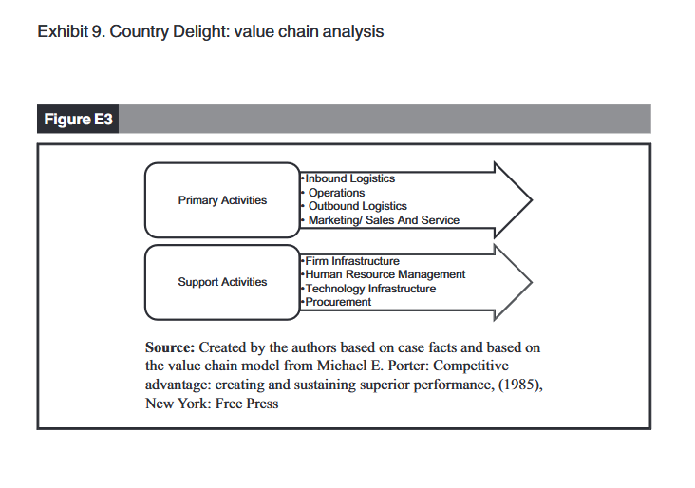

Slide 49
Strengths and Weaknesses
Strengths
  Business professional therefore, structured decision-making
  Large in-company team handling primary activities (marketing, operations, and technology) meant standardized operations
  Well-oiled in terms of funding for every phase of growth
  400,000 subscriber base with decent loyalty
  Has lower attrition amongst suppliers as it pays 10%–15% higher than other players
  Timely payments and pocket-friendly loan schemes for the farmers as they seek to expand their business
  State-of-the-art hardware for quality checks
  In-house technology to facilitate remote monitoring and quality checks
  Simple use of a refrigerated end-to-end supply chain ensures delivery of “fresh milk” to the customer’s doorstep

Slide 50
Strengths and Weaknesses
  Weaknesses:
    The firm did not have a well-defined human resource management structure
    A company that has aspirations for fast growth must delegate and have a professional team with domain-relevant experience
    Needs substantial funding or IPO to fuel its next ambitious growth plan
    Higher production costs due to organic farming methods
    Limited control on the procedures being used by suppliers necessary to generate high-quality products

Slide 51
Core Capabilities
Country Delight has as its biggest strength its nearly wholly owned supply chain, which is the backbone of how it can delight its customers.
Country Delight had at its core milk, which, along with the range of dairy products, was the core product.
The clever use of technology to enable quality monitoring and avoid loss due to spoilage is controlled and largely minimized.
The flipside of the model is that the space has low entry and exit barriers and thus the threat from new entrants who can enter the space will be considerable.
In a price-sensitive market, the pressure to manage costs will increase as the firm expands into new geographies and wants the same tightly controlled supply chain, requiring significant capital investment.
Quality checks into categories like pulses, spices and oils which the firm procures from the local wholesalers and packaging may offer a different value than big brands with a better procurement and packaging and quality monitoring system.

Slide 52
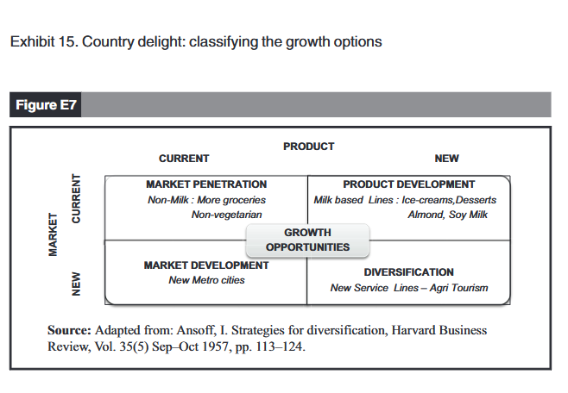
Identifying the best alternative

Slide 53
Thank you

